Slide 1
Introduction to Project Management

Slide 2
Project Management Statistics
The U.S. spends $2.3 trillion on projects every year, an amount equal to one-quarter of the nation’s gross domestic product (GDP).
The world as a whole spends nearly $10 trillion of its $40.7 trillion gross product on projects of all kinds.
More than sixteen million people regard project management as their profession; on average, a project manager earns more than $82,000 per year.*
*PMI, The PMI Project Management Fact Book, Second Edition, 2001
PMI (Project Management Institute )

Slide 3
More Information on Project Management
More than half a million new information technology (IT) application development projects were initiated during 2001, up from 300,000 in 2000.*
Famous business authors and consultants are stressing the importance of project management. As Tom Peters writes in his book, Reinventing Work: the Project 50, “To win today you must master the art of the project!”
*The Standish Group, “CHAOS 2001: A Recipe for Success”

Slide 4
Motivation for Studying Information Technology (IT) Project Management
IT projects have a terrible track record
  A 1995 Standish Group study (CHAOS) found that only 16.2% of IT projects were successful and over 31% were canceled before completion, costing over $81 B in the U.S. alone
The need for IT projects keeps increasing
  In 2000, there were 300,000 new IT projects
  In 2001, over 500,000 new IT projects were started

Slide 5
Advantages of Using Formal Project Management
Better control of financial, physical, and human resources
Improved customer relations
Shorter development times
Lower costs
Higher quality and increased reliability
Higher profit margins
Improved productivity
Better internal coordination
Higher worker morale

Slide 6
What is a project?
Some dictionary definitions:
“A specific plan or design”
“A planned undertaking”
“A large undertaking e.g. a public works scheme”
Longmans dictionary
Key points above are planning and size of task
Notes:
Here are some definitions of ‘project’. No doubt there are other ones: for example
‘Unique process, consisting of a set of coordinated and controlled activities with start and finish dates, undertaken to achieve an objective conforming to specific requirements, including constraints of time, cost and resources’
BSO ISO 10006: 1997

Slide 7
What Is a Project?
A project is “a temporary endeavor undertaken to accomplish a unique product or service” (PMBOK® Guide 2000, p. 4)
Attributes of projects
  unique purpose
  temporary
  require resources, often from various areas
  should have a primary sponsor and/or customer
  involve uncertainty

Slide 8
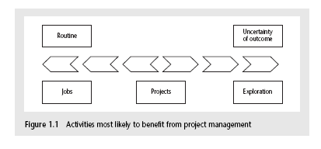
Jobs versus projects
‘Jobs’ – repetition of very well-defined and well understood tasks with very little uncertainty
‘Exploration’ – e.g. finding a cure for cancer: the outcome is very uncertain
‘Projects’ – in the middle!
Notes:
On the one hand there are repetitive jobs a similar task is carried out repeatedly, for example Kwikfit replacing a tyre on a car or a lecturer giving an introductory talk on project management. The task is well-defined and there is very little uncertainty. In some organizations, software development might tend to be like this – in these environments software process management might be more important than software project management
On the other hand some exploratory activities are very uncertain. Some research projects can be like this – we may not be sure what the outcome will be, but we hope that we will learn some things of importance. It may be very difficult to come up with precise plans, although we would probably have some idea of a general approach.
Projects seem to come somewhere between these two extremes. There are usually well-defined hoped-for outcomes but there are risks and uncertainties about achieving those outcomes.

Slide 9
Characteristics of projects
A task is more ‘project-like’ if it is:
Non-routine
Planned
Aiming at a specific target
Work carried out for a customer
Involving several specialisms
Made up of several different phases
Constrained by time and resources
Large and/or complex
Notes:
Exercise 1.1 in the Software Project Management text is a good way of introducing this material if you have time. I have found this exercise to be a good ‘ice-breaker’. Get each student to list the example activities in an order which matches the degree to which they merit the description of ‘project’. You can create a grid on a whiteboard with the projects on the vertical axis and the positions 1st, 2nd, 3rd etc on the horizontal axis. You then go through asking how many put ‘producing a newspaper’ first, second, etc. (Avoid making jokes about this being like the Eurovision song contest). This is time-consuming but it does mean that every student participates in building up a general picture of people’s perceptions, and you can discuss disagreements in perceptions as you go along.

Slide 10
Are software projects really different from other projects?
Not really! …but…
Invisibility
Complexity
Conformity
Flexibility
make software more problematic to build than other engineered artefacts.
Notes:
This is based on Fred Brooks’ paper No Silver Bullet: Essence and Accidents of Software Engineering which appeared in IEEE Computer 20(4) pp10-19 April 1987

Slide 11
Samples of IT Projects
Northwest Airlines developed a new reservation system called ResNet (see case study on companion Web site at www.course.com/mis/schwalbe)
Many organizations upgrade hardware, software, and networks via projects
Organizations develop new software or enhance existing systems to perform many business functions
Note: “IT projects” refers to projects involving hardware, software, and networks

Slide 12
What is Management?
Management can be defined as all activities and tasks undertaken by one or more persons for the purpose of planning and controlling the activities of others in order to achieve objectives or complete an activity that could not be achieved by others acting independently.
  Management functions can be categorized as
    Planning
    Organizing
    Staffing
    Directing
    Controlling

Slide 13
Management Functions
Planning
Predetermining a course of action for accomplishing organizational Objectives
Organizing
Arranging the relationships among work units for accomplishment of objectives and the granting of responsibility and authority to obtain those objectives
Staffing
Selecting and training people for positions in the organization
Directing
Creating an atmosphere that will assist and motivate people to achieve desired end results
Controlling
Establishing, measuring, and evaluating performance of activities toward planned objectives

Slide 14
The Triple Constraint
Every project is constrained in different ways by its
  Scope goals: What is the project trying to accomplish?
  Time goals: How long should it take to complete?
  Cost goals: What should it cost?
It is the project manager’s duty to balance these three often competing goals

Slide 15
What is Project Management (1)
According to *PMI, PMBOK Guide 2003
“The application of knowledge, skills, tools and techniques to project activities in order to meet project requirements”
* The Project management Institute (PMI) is an independent professional society http://www.pmi.org

Slide 16
What is Project Management (2)
Project management is a system of
  management procedures,
  practices,
  technologies,
  skills, and
  experience
that are necessary to successfully manage a project.

Slide 17
Software Project Management
Concerned with activities involved in ensuring
that software is delivered:
  on time
  on schedule
  in accordance with the requirements of the organization developing and procuring the software

Slide 18
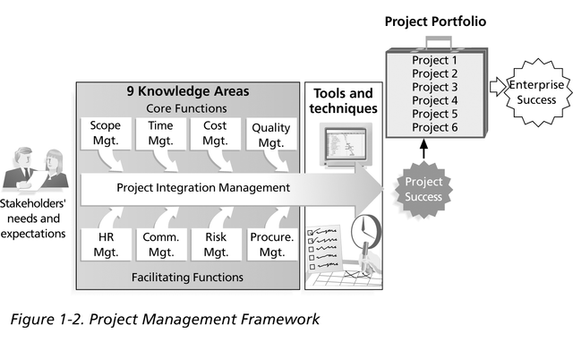
Project Management Framework

Slide 19
Project Stakeholders
Stakeholders are the people involved in or affected by project activities
Stakeholders include
  the project sponsor and project team
  support staff
  customers
  users
  suppliers
  opponents to the project

Slide 20
Project Management Knowledge Areas
Knowledge areas describe the key competencies that project managers must develop
  4 core knowledge areas lead to specific project objectives (scope, time, cost, and quality)
  4 facilitating knowledge areas are the means through which the project objectives are achieved (human resources, communication, risk, and procurement management)
  1 knowledge area (project integration management) affects and is affected by all of the other knowledge areas

Slide 21
Project Management Tools and Techniques
Project management tools and techniques assist project managers and their teams in various aspects of project management
Some specific ones include
  Project Agreement, scope statement, and WBS (work breakdown structure) (scope)
  Gantt charts, network diagrams, critical path analysis, critical chain scheduling (time)
  Cost estimates and earned value management (cost)

Slide 22
How Project Management Relates to Other Disciplines
Much of the knowledge needed to manage projects is unique to the discipline of project management
Project mangers must also have knowledge and experience in
  general management
  the application area of the project

Slide 23
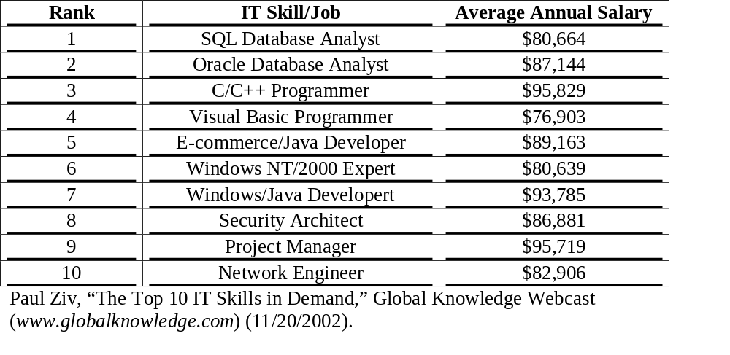
Top Ten Most in Demand IT Skills

Slide 24
SW proj problems
Project Manager -
        poor roles definition,
        lack of estimating & planning skills and
        lack of decision making skills.
        Schedule, budget and quality constraints.
Developers –
        lack of knowledge in the application area,
        lack of knowledge about developing standards,
        lack of up to date documentations
        deadline pressure
        changes of application requirements.
Customers –
        monetary constraints
        receiving products past the due date
        surprises

Slide 25
PM mathematical Tools
PERT – Program Evaluation and Review Techniques
CPM – Critical Path Method

Slide 26
Ethics in Project Management
Ethics is an important part of all professions
Project managers often face ethical dilemmas
In order to earn PMP certification, applicants must agree to the PMP code of professional conduct

