Slide 1
Monitoring and Controlling

Slide 2





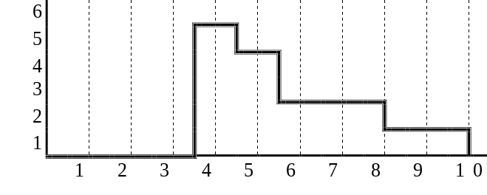
The starting point ...
We have a project plan.
We know the resources to be applied in each moment.
We expect a cash-flow for all the project and it’s accepted by the stakeholders.
Tarea: Diseño Programas
Recursos: …
Duración: 4 semanas
Tarea: Codificación Program.
Recursos: …
Duración: 7 semanas
Tarea: Especifica Necesidades
Recursos: …
Duración: 2 semanas
Tarea: Pruebas
Recursos: …
Duración: 2 semanas
Tarea: Diseño B.D.
Recursos: …
Duración: 2 semanas
Tarea: Realización Esquema
Recursos: …
Duración: 1 semanas
TAREAS
Especificar Necesidades
Diseño Programas
Diseño Base de Datos
Realización Esquema
Codificación Programas
Pruebas
0 2 4 6 8 10 12 14 16
SEMANAS
Notes:
2

Slide 3
Monitoring and Control
Monitoring and control is taking the appropriate actions when:
  we have delays,
  the costs are over planed, or
  some of the previous conditions, accorded before, and that were important in the planning and acceptance, are missed.
Notes:
3

Slide 4
Monitoring and Control
Why?
What?
When?
How?

Slide 5
Monitoring and Control
Why?
  Simply because we know that things don’t always go according to plan (no matter how much we prepare)
  To detect and react appropriately to deviations and changes to plans

Slide 6
Monitoring and Control
What?
Human resources
Machines
Materials
Money
Space
Time
Tasks
Quality/Technical Performance

Slide 7
Monitoring and Control
What?
Inputs
  Time
  Money
  Resources
  Material Usage
  Tasks
  Quality
Outputs
  Progress
  Costs
  Job starts
  Job completion
  Engineering / Design changes
  Variation order (VO)

Slide 8
Monitoring and Control
When?
  End of the project
  Continuously
  Regularly
  Logically
  While there is still time to react
  As soon as possible
  At task completion
  At pre-planned decision points (milestones)

Slide 9
Monitoring and Control
How?
  Through meetings with clients, parties involved in project
  Update: CPM/PERT Charts, Gantt Charts
  Calculate Critical Factors
  Milestones
  Reports
  Tests and inspections
  Delivery

Slide 10


Goals:
Determine if the project is under control.
Identify if the project is out of control.
Notes:
4

Slide 11
Determine if the project is under control.
We arrive to the milestones:
  On time.
  With the expected resources.
  With the quality expected.
  It’s economically acceptable.
Notes:
5

Slide 12
If the project is out of control.
As soon as we observe some deviations, we must:
  Revise the plan.
  Negotiate the new plan with the client.
Notes:
6

Slide 13
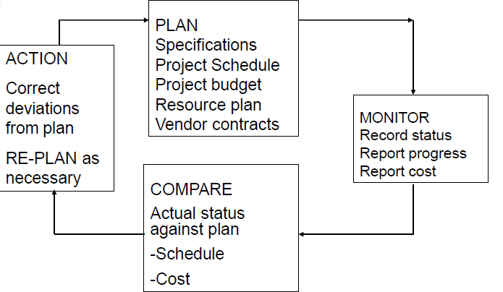
Project Control Cycle

Slide 14
Definition: Controlling a software project...
“... Defined as all the management activities that ensure that the actual work goes according to plan.
  It measures performance against goals and plans,
  reveals when and were deviations exists, and
  by putting in motion actions to correct deviations,
helps ensure accomplishment of plans”
(Thayer 1988)
Notes:
7

Slide 15
Definition: “Control...
... is the process of making things happen in an ordered manner or according to plan.”
(Reifer)
Notes:
8

Slide 16
Why we need control?
Because when we plan, we use “estimations” of:
  Software size.
  Necessary tasks.
  Necessary resources for each task.
  Expected Productivity.
  Usually plan differs from realty.
  Software projects substantially differ from one to the next.
Notes:
9

Slide 17
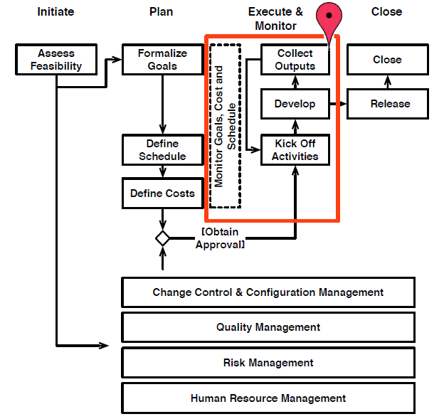
Monitoring and Control

Slide 18
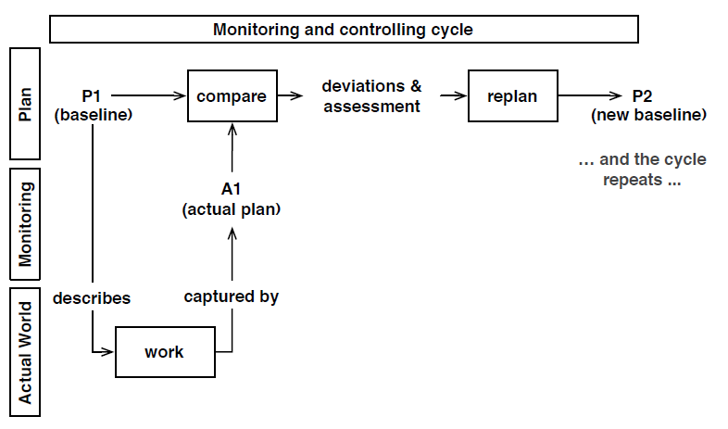
Monitoring and Control

Slide 19

Monitoring and Control
Development start
Gather actual project information
Plan (Expected)
Compare progress with target and standards
Corrective actions
Standards of performance
Satisfactory?
NO
Yes
¿Project finished?
NO
Yes
Development end
Notes:
10

Slide 20
Controlling activities
Develop standards of performance.
  Set conditions or measurements that will exists when tasks are correctly done.
Establish monitoring and reporting systems.
  Determine necessary data, who will receive it, and when they will receive it
Notes:
11

Slide 21
Controlling activities
Measure results
  Determine accomplishment of, or extent of deviation from, goals and standards.
Initiate corrective actions
  Reinforce standards, adjust goals, or re-plan.
Notes:
12

Slide 22
Controlling activities
Reward and discipline
  Praise, remunerate, and discipline applicable personnel.
Document controlling methods.
  Document the standards, methods of reporting and control, bonus plans et al., decisions points, and so on.
Notes:
13

Slide 23
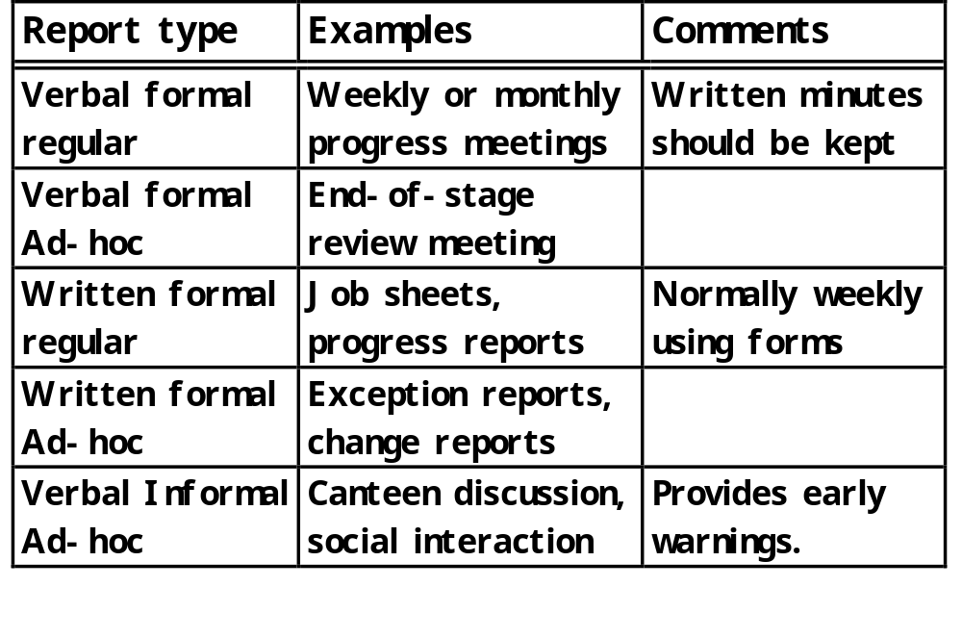
Categories of reporting
Notes:
14

Slide 24
Compare progress against target and standards
What we expects is based on:
  Productivity standards, and
  planning agreements.
The work can be correct from the standards point of view but not according to the plan.
We can be in one of this situations...
Notes:
15

Slide 25
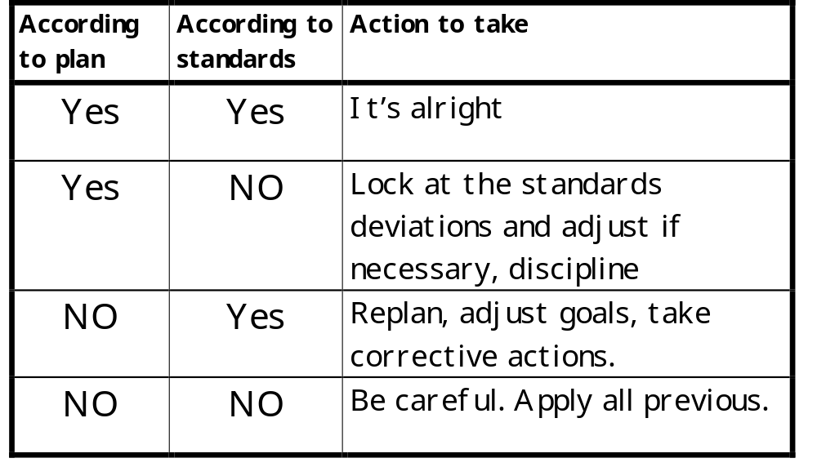
Compare progress with target and standards
Notes:
16

Slide 26
Compare progress with target: the plan
Using a Gantt diagram we draft a line:
  Starting and ending in the top and down of the Gantt diagram on the actual day.
  The vertex of this line cross:
    the non finished tasks at the estimated % done.
    Only the end of tasks that were expected not to be finished yet.
    The start of tasks that we suppose that must be started yet.
Notes:
17

Slide 27
Compare progress with target: Plan
today
Well
Extraordinary
WRONG
Perfect?
Notes:
18

Slide 28
Compare progress with target: plan
There are a lot of authors that don’t agree with the estimation in a percent of the non finished tasks.
  It leads to the 90% eternal syndrome.
DeMarco talks about the binary system. The task is finished or not.
  In this situation the tasks mustn’t have an excessive duration.
Notes:
19

Slide 29
Evaluating the situation.
When we have problems with a project, decisions must be taken at the correct level.
Strategic
Tactic
Operational
Notes:
20

Slide 30
Is the situation satisfactory?
  At operational level: little adjustments, the project manager differs this to technicians.
  At tactical level: plan adjustments such as: one week delay... They are managed by the project manager.
  At strategic level: important delays, and other important incidences.
    The client was bought by other company..
Notes:
21

Slide 31
Re-planning or Correct
Re-planning is done in order to adjust the timetable to reality
  Developers fill less frustrated, they can reach objectives.
  Clients will have a clear idea about what to expect.

Slide 32
Re-planning or Correcting?
Correcting deviations.
  In place of change the plan, we will force the team in order to approximate actual and planed situations.
  We call project crisis the period between the delay and the moment in which the situation is re-established.

Slide 33
Software project crisis management.
Delay detection
Crisis management
Crisis recovery

Slide 34
Crisis management
Announce and generally publicize the problem.
Assign responsibilities and authorities.
Update status frequently.
Relax resource constrains.
Have project personnel operate in burnout mode.
Establish a drop-dead date.
Clear out unessential personnel.

Slide 35
Crisis recovery.
Conduct a crisis postmortem.
Calculate cost to complete the project.

Slide 36
Announce and generally publicize the problem.
Even the best plan have delays, and contingency plan may fail.
All the people who can help, even remotely, must be informed. If not people can think...
  They doesn’t need help.
  They take offense if I sail anything, it’s better to wait.
  the problem isn’t important.

Slide 37

Announce and generally publicize the problem.
The fist step is inform people. All the people in the project.
The objective is:
  Involve all of them in the problem.
  Let them know the project need help.

Slide 38
Assign responsibilities and authorities.
Resources must be reassigned,
  some tasks will be stopped,
    People and other resources assigned to some tasks will work concentrate on the problem.
We must be careful:
  Clarifying the new responsibilities, and
  Who can take decisions and about what.

Slide 39
Update status frequently.
Plan meetings in order to align all the work towards the same solution.
  In this moments is when communication becomes more important
Clarify what is done, tried, and failed, we don’t what to fail twice with the same subject.
Usually Teamwork offer more creative solutions.

Slide 40
Relax resource constrains.
Same limited use of resources can be used know.
Its possible this kind of exceptions:
  Use of powerful hardware from other projects.
  Increase administrative support.
  catering, ...

Slide 41
Have project personnel operate in burnout mode.
Work as many hours as is humanly possible (extra hours)
Ask for use of cell telephones 24 hours at day, is possible that some one need communicate with a coworker.
Suppress enterprise or departmental meetings, postpone courses, etc.

Slide 42
Establish a drop-dead date.
Establish a reasonable date to finish the crisis. Not longer than 30 days.
If the problem isn’t solved then reevaluate the project feasibility.
People can't live with an excessive stress level.

Slide 43
Conduct a crisis postmortem.
Evaluate what was wrong.
Identify any systematic problems.
Document any lessons learned.

Slide 44
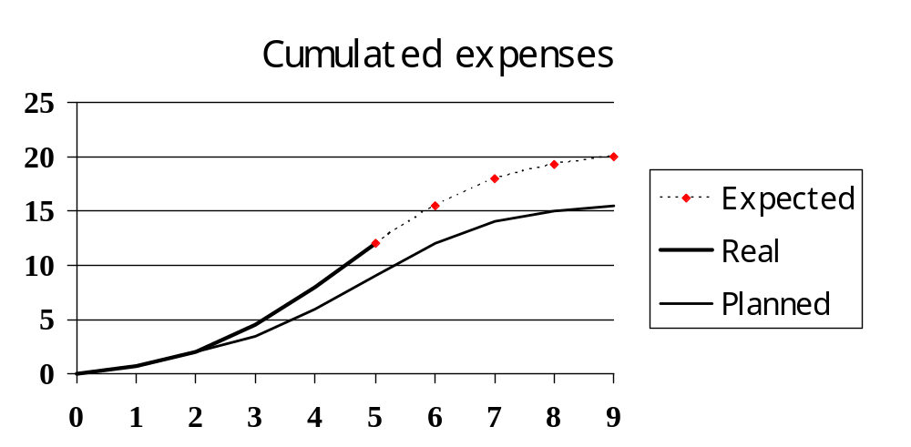
Calculate cost to complete the project.
How the crisis has affected the projects budget and schedule.

Slide 45
Monitoring kinds
Process
  Milestones (Instants along the project)
  Tasks: start, end, resources.
Products
  Deliverables
  Quality (client acceptance)
This points of view aren't independents.

Slide 46
Project postmortem.
All projects have problems.
The idea is to document, analyze and learn from what was wrong.
Document this things that we must do in a different manner next time.

Slide 47
Project postmortem.
We must have same time to all the members in the team in order to reflect on:
  deviations,
  problems, and
  The solutions we take.

Slide 48
postmortem: examples.
  “When we were delayed 10 days in the test we must communicate that to the client!
  “We start the design too early, we need a more complete specs before design”
  “personnel was unmotivated because of firing a high quantity of coworkers.”

