Slide 1
Software Quality Assurance and Testing

Slide 2
What is Quality?
Quality – developed product meets it’s specification
Problems:
• Development organization has requirements exceeding customer's specifications (added cost of product development)
• Certain quality characteristics can not be specified in
unambiguous terms (i.e. maintainability)
• Even if the product conforms to it’s specifications, users may not consider it to be a quality product (because users may not be involved in the development of the requirements)

Slide 3
What is Quality Management?
Quality Management –
• ensuring that required level of product quality is achieved
• Defining procedures and standards
• Applying procedures and standards to the product and process
• Checking that procedures are followed
• Collecting and analyzing various quality data

Slide 4
What are SQA, SQP, SQC, and SQM?
Quality Management includes all 4 elements…
1. Software Quality Assurance – establishment of network of organizational procedures and standards leading to high-quality software
Software Quality Planning – selection of appropriate procedures and standards from this framework and adaptation of these to specific software project
Software Quality Control – definition and enactment of processes that ensure that project quality procedures and standards are being followed by the software development team
Software Quality Metrics – collecting and analyzing quality data to predict and control quality of the software product being developed

Slide 5
Software Quality Assurance

Slide 6
Software Quality Assurance
Goal: to achieve high-quality software product
Quality definition:
“Conformance to explicitly stated functional and performance
requirements, explicitly documented development standards,
and implicit characteristics that expected of al professional
developed software.”
Three import points for quality measurement:
- Use requirements as the foundation
- Use specified standards as the criteria
- Considering implicit requirements

Slide 7
Software Quality Assurance
About quality assurance:
- The first formal quality assurance and control function was introduced at Bell Labs in 1916 in the manufacturing world.
- During the 1950s and 1960s, the programmers controls their product quality.
During the 1970s, quality assurance standards were introduced first in military contract software development.
- In 1987, the extending definition is given in [SCH87].

Slide 8
SQA Group
The SQA group’s tasks:
- Prepare a SQA plan for a project
- Participate in the development of the project’s software process description
- Review engineering activities to verify compliance with the defined process
- Audits designated software work products to verify compliance the defined process
- Ensure the deviations in software work and products according to a documented procedure
- Records any noncompliance and reports to senior management

Slide 9
SQA Group
Who involves quality assurance activities?
Software engineers, project managers, customers, sale people, SQA group
Engineers involved the quality assurance work:
- apply technical methods and measures
- conduct formal technical review
- perform well-planned software testing
The SQA group’s role -> serves as the customer’s in-house representative assist the software engineering team in achieving high-quality
The SQA group’s responsibility:
- quality assurance planning oversight, record keeping, analysis and reporting

Slide 10
The SQA Plan
purpose of plan and its scope
management
  organization structure, SQA tasks, their placement in the process
  roles and responsibilities related to product quality
documentation
  project documents, models, technical documents, user documents.
standards, practices, and conventions
reviews and audits

Slide 11
The SQA Plan
Test
  test plan and procedure
problem reporting, and correction actions
tools
code control
media control
supplier control
records collection, maintenance, and retention
training
risk management

Slide 12
Standards
• Standards provide encapsulation of best, or at least most appropriate, practice
• Standards provide a framework around which the quality assurance process may be implemented
• Standards assist in continuity of work when it’s carried out by different people throughout the software product lifecycle
Standards should not be avoided. If they are too extensive for the task at hand, then they should be tailored.

Slide 13
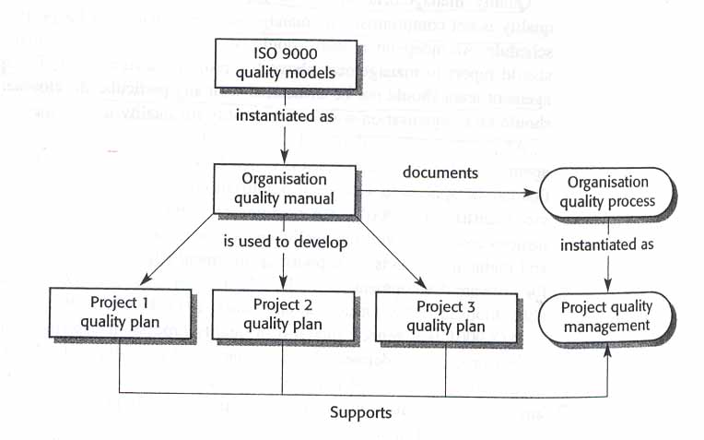
Simplistic approach of Standards
In most mature organizations:
• ISO is not the only source of SDS
• Process and Product standards are derived independently
• Product standards are not created by SQA

Slide 14
Process Standards
Process Standards – standards that define the process
which should be followed during software development
ISO
CMM
CMMI
Organizational
Quality Manual
Organizational
SD Process STD’s
IPDS
Project SQP
Project SD Process STD’s
(SDP, IP, Method Sheets)
Project SCMP

Slide 15
Product Standards
Product Standards – standards that apply to software
product being developed
ISO
Industry
STDs
Organizational
Product STD
COTS
STD
Project Product STD

Slide 16
Quality Models

Slide 17
ISO - 9001 Elements
Quality System Requirements
Management Responsibility
Quality system
Contract review
Design Control
Document control
Purchasing
Purchaser supplied product
Product identification and traceability
Process control
Inspection and testing
Inspection, measuring and test equipment
Inspection and test status
Control of non-conforming product
Corrective action
Handling, storage, preservation, packaging and shipping
Quality records
Internal quality audits
Training
Servicing
Statistical techniques
Software Quality Responsibilities
Management Responsibility
Quality system
Contract review
Design Control
Document control
Purchasing
-
Product identification and traceability
Process control
Inspection and testing
-
Inspection and test status
-
Corrective action
-
Quality records
Internal quality audits
Training
-
Statistical techniques

Slide 18
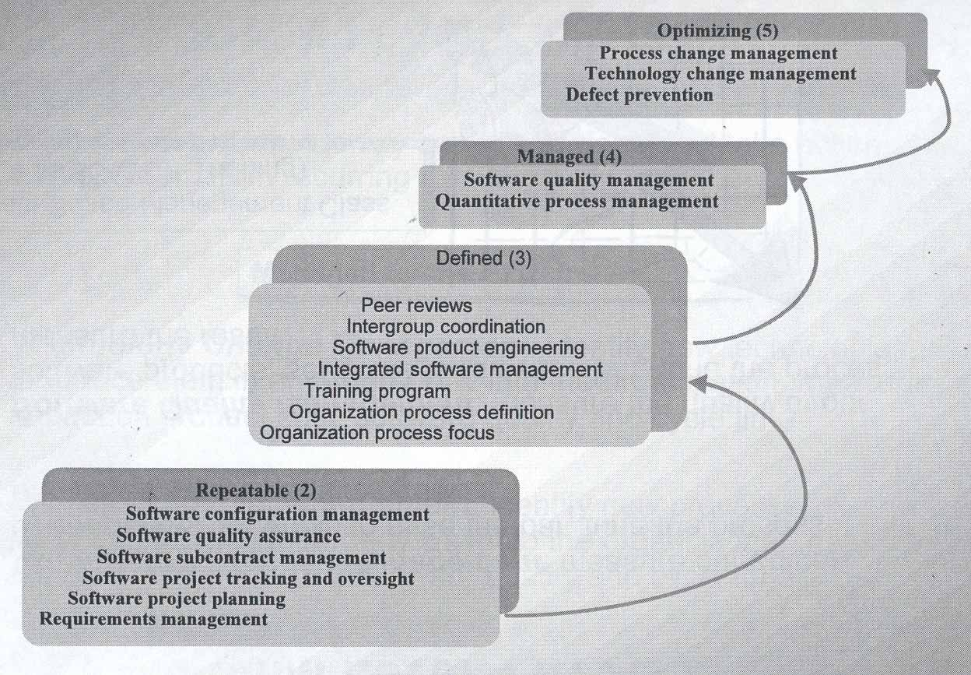
Capability Maturity Model

Slide 19
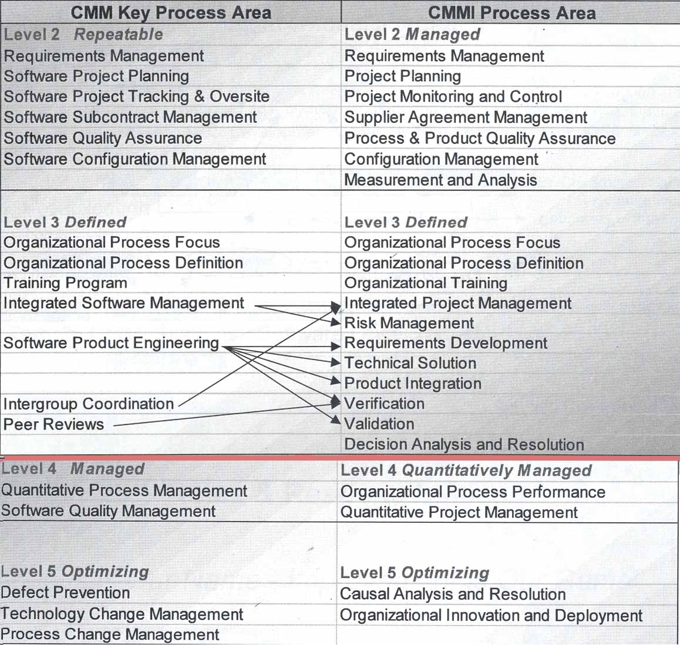
CMM to CMMI Mapping

Slide 20
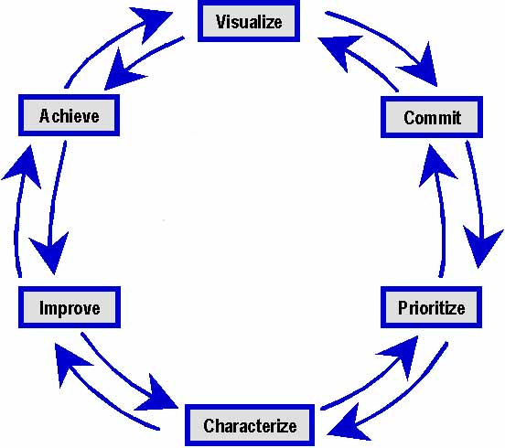
Quality Improvement – The Wheel of 6Sigma
Six Sigma

Slide 21
Quality Improvement – Six Sigma Process
• Visualize – Understand how it works now and imagine how it will work in the future
• Commit – Obtain commitment to change from the stakeholders
• Prioritize – Define priorities for incremental improvements
• Characterize – Define existing process and define the time progression for incremental improvements
• Improve – Design and implement identified improvements
• Achieve – Realize the results of the change

Slide 22
Continuity and Independence of SQA
• Software Quality Assurance team must be independent in order to
take an objective view of the process and report problems to senior
management directly
• If prescribed process is inappropriate for the type of software
product which is being developed, then it should be tailored
• The standards must be upheld no matter how small the task.
Prototyping doesn’t mean no standards. It means tailored standards.

Slide 23
Software Quality Planning

Slide 24
Software Quality Plan
Tailoring - SQP should select those organizational standards that are appropriate to a particular product
Standardization - SQP should use (call out) only approved organizational process and product standards
If new standards are required a quality improvement should be initiated
Elements - SQP elements are usually based on the ISO-9001 model elements
SQP is not written for software developers. It’s written for SQE’s as a guide for SQC and for the customer to monitor development activities
Things like software production, software product plans and risk management should be defined in SDP, IP
Quality Factor’s shouldn’t be sacrificed to achieve efficiency. Don’t take the job if quality process can’t be upheld

Slide 25
Software Quality Control

Slide 26
Methods of Software Quality Control
SQC involves overseeing the software development process to ensure that the
procedures and STD’s are being followed
The following activities constitute SQC:
• Quality Reviews - in-process reviews of processes and products
Reviews are the most widely used method of validating the quality of processes and products. Reviews make quality everyone's responsibility. Quality must be built-in. SQE is responsible for writing Quality Engineering Records (QERs) documenting their participation in these reviews.
• Tests - end-result verifications of products. These verifications are conducted after the software has been developed. Test procedures are followed during conduct of these activities. SQE is responsible for keeping the logs and some times for writing the test report.
• Quality Audits - in-process verifications of processes. These audits are conducted periodically (twice a month) to assess compliance to the process STD’s.

Slide 27
Quality Reviews
• Peer reviews - reviews of processes and products by groups of people. These reviews require pre-review preparation by all participants. If a participant is not prepared, then the review is not effective. This type of review requires participation of the SQE, moderator, recorder, author(s), and one or more critical reviewers. All issues found during these reviews are documented on AR forms.
• Walkthroughs - reviews of products by groups of people mostly without preparation. For example a requirements traceability review is a walkthrough. It involves tracing a requirement from customer requirements to the test procedures. All issues found during these reviews are documented on CAR forms.
• Desk inspections - reviews of products by individuals. These reviews involve people reviewing products by themselves (not in a group) and then submitting their comments to the author(s). The issues found during these reviews are treated in informal manner.

Slide 28
Tests
• Dry-run - test conducted by engineering without SQE. These tests include Unit Tests and engineering dry-runs of the formal tests. These engineering dry-runs are used to verify correctness and completeness of the test procedures. Also, these is the final engineering verification of the end-product before sell-off to SQE. All issues found during these tests are documented.
• SQE Dry-run - test conducted by SQE. These tests are used to verify the end-product before the formal test with the customer. An SQE is sometimes responsible for writing the test report. However, if a separate test group is available, then SQE is relived of this obligation. All issues found during these tests are documented on STR forms.
• TFR - test conducted as “RFR - run-for-record” with the SQE and the customer. These tests are conducted to sell the end-product off to the customer. SQE is present at all such tests. All issues found during these tests are documented.

Slide 29
Quality Audits
• SQE Audits - audits conducted by SQE to verify that the process STDs are being followed. All findings for these audits are documented. The results of the audits are distributed to the next level of management (above project level). If the issue(s) are not fixed then the findings are elevated to upper management.
• Independent Audits - audits conducted by ISO generalists or other independent entities to verify that the process STDs are being followed. The results of these audits are distributed to upper management.

Slide 30
Software Configuration Management
SCM – activities assuring that software products are properly identified and their transition is tracked. In many mature organizations SCM is not part of SQA responsibilities.
• Baseline Identification – identification of initial state of the product
• Change Identification – identification of changes made to the baseline
• Change Control – documentation of changes via revision history, change summary, or using automated development tools (ClearCase or Apex)
• Status Accounting – reporting changes to others and monitoring completeness of the project archives
• Preservation – keeper of the software products

Slide 31
Software Quality Metrics

Slide 32
Metrics Collection
• Software measurement - the process of deriving a numeric value
for some attribute of a software product or a software process. Comparison of these values to each other and to STD’s allows drawing conclusions about the quality of software products or the process.
• The focus of the metrics collecting programs is usually on collecting metrics on program defects and the V&V process.
• Metrics can be either Control Metrics or Predictor Metrics
• Most of the “Ilities” can not be measured directly unless there’s historical data. Instead tangible software product attributes are measured and the “Ility” factors are derived using predefined relationships between measurable and synthetic attributes.
• The boundary conditions for all measurements should be established in advance and then revised once a large databank of historical data has been established

Slide 33
The end

