Slide 1
Managing Contracts and People

Slide 2
Acquiring software from external supplier
This could be:
a tailored system - created specially for the customer
off-the-shelf - bought ‘as is’
customised off-the-shelf (COTS) - a core system is customised to meet needs of a particular customer
Notes:
Section 10.2 page 237

Slide 3
Types of contract
fixed price contracts
time and materials contracts
fixed price per delivered unit
Note difference between goods and services
Often licence to use software is bought rather than the software itself

Slide 4
Fixed price contracts
Advantages to customer
known expenditure
supplier motivated to be cost-effective

Slide 5
Fixed price contracts
Disadvantages
supplier will increase price to meet contingencies
difficult to modify requirements
cost of changes likely to be higher
threat to system quality
Notes:
Even though the supplier will have to add a margin to the price to deal with contingencies, the cost could still be less than doing the work in-house as the supplier may be able to exploit economies of scale and the expertise that the have from having done similar projects in the past.
When competing for work, there will be pressure on the suppliers to reduce prices. Once a contract has been won and signed, the contractor is in a stronger negotiating position when it come to negotiating the price of additional work as the customer is now locked in.

Slide 6
Time and materials
Advantages to customer
easy to change requirements
lack of price pressure can assist product quality

Slide 7
Time and materials
Disadvantages
Customer liability - the customer absorbs all the risk associated with poorly defined or changing requirements
Lack of incentive for supplier to be cost-effective
Notes:
Because suppliers appear to be given a blank cheque, this approach does not normally find favour with customers. However, the employment of contract developers may involve this type of contract.

Slide 8
Fixed price/unit
Advantages for customer
customer understanding of how price is calculated
comparability between different pricing schedules
emerging functionality can be accounted for
supplier incentive to be cost-effective

Slide 9
Fixed price/unit
Disadvantages
difficulties with software size measurement - may need independent FP counter
changing (as opposed to new) requirements: how do you charge?

Slide 10
The tendering process
Open tendering
any supplier can bid in response to the invitation to tender
all tenders must be evaluated in the same way
government bodies may have to do this by local/international law (including EU and WTO, World Trade Organization, requirements
Notes:
See page 242

Slide 11
The tendering process
Restricted tendering process
bids only from those specifically invited
can reduce suppliers being considered at any stage
Negotiated procedure
negotiate with one supplier e.g. for extensions to software already supplied

Slide 12
Stages in contract placement
requirements
analysis
evaluation
plan
invitation to
tender
evaluation of
proposals

Slide 13
Requirements document: sections
introduction
description of existing system and current environment
future strategy or plans
system requirements -
mandatory/desirable features
deadlines
additional information required from bidders
Notes:
The requirements document is sometimes referred to as the operational requirement or OR.
If a mandatory requirement cannot be met the proposed application would have to be rejected regardless of how good it might be in other ways.
A shortfall in one desirable requirement might be compensated for by other qualities or features.

Slide 14
Requirements
These will include
functions in software, with necessary inputs and outputs
standards to be adhered to
other applications with which software is to be compatible
quality requirements e.g. response times

Slide 15
Evaluation plan
How are proposals to be evaluated?
Methods could include:
reading proposals
interviews
demonstrations
site visits
practical tests
Notes:
Off the shelf software clearly has an advantage here as there is actually product that can be evaluated in existence.

Slide 16
Evaluation plan -contd.
Need to assess value for money (VFM) for each desirable feature
VFM approach an improvement on previous emphasis on accepting lowest bid
Notes:
£(4 x 10 x 12 x 4) would be saved i.e. £3,840. The payback period would be just over a year and so this feature would be worth the additional cost.

Slide 17
Invitation to tender (ITT)
Note that bidder is making an offer in response to ITT
acceptance of offer creates a contract
Customer may need further information
Problem of different technical solutions to the same problem
Notes:
ISO 12207 refers to an ITT as a Request for Proposal or RFP.

Slide 18
Memoranda of agreement (MoA)
Customer asks for technical proposals
Technical proposals are examined and discussed
Agreed technical solution in MoA
Tenders are then requested from suppliers based in MoA
Tenders judged on price
Fee could be paid for technical proposals by customer

Slide 19
Contracts
A project manager cannot be expected to be a legal expert – needs advice
BUT must ensure contract reflect true requirements and expectations of supplier and client

Slide 20
Contract checklist
Definitions – what words mean precisely e.g. ‘supplier’, ‘user’, ‘application’
Form of agreement. For example, is this a contract for a sale or a lease, or a license to use a software application? Can the license be transferred?
Goods and services to be supplied – this could include lengthy specifications
Timetable of activities
Payment arrangements – payments may be tied to completion of specific tasks

Slide 21
Contract checklist - continued
Ownership of software
Can client sell software to others?
Can supplier sell software to others? Could specify that customer has ‘exclusive use’
Does supplier retain the copyright?
Where supplier retains source code, may be a problem if supplier goes out of business; to circumvent a copy of code could be deposited with an escrow service

Slide 22
Contract checklist - continued
Environment – for example, where equipment is to be installed, who is responsible for various aspects of site preparation e.g. electricity supply?
Customer commitments – for example providing access, supplying information
Standards to be met

Slide 23
Contract management
Some terms of contract will relate to management of contract, for example,
Progress reporting
Decision points – could be linked to release of payments to the contractor
Variations to the contract, i.e. how are changes to requirements dealt with?
Acceptance criteria

Slide 24
Contract management
Contracts should include agreement about how customer/supplier relationship is to be managed e.g.
decision points - could be linked to payment
quality reviews
changes to requirements

Slide 25
Managing people
Managing people working as individuals and in groups
People are an organisation’s most important assets

Slide 26
Management activities
Problem solving (using available people)
Motivating (people who work on a project)
Planning (what people are going to do)
Estimating (how fast people will work)
Controlling (people's activities)
Organizing (the way in which people work)

Slide 27
Problem solving
Requires the integration of different types of knowledge (computer, task, domain, organisation)
Development of a model of the solution and testing of this model against the problem
Representation of this model in an appropriate notation or programming language

Slide 28
Motivation
An important role of a manager is to motivate the people working on a project
Motivation is a complex issue but it appears that their are different types of motivation based on
Basic needs (e.g. food, sleep, etc.)
Personal needs (e.g. respect, self-esteem)
Social needs (e.g. to be accepted as part of a group)

Slide 29
Human needs hierarchy

Slide 30
Personality types
The needs hierarchy is almost certainly an over-simplification
Motivation should also take into account different personality types:
Task-oriented
Self-oriented
Interaction-oriented

Slide 31
Personality types
Task-oriented.
The motivation for doing the work is the work itself
Self-oriented.
The work is a means to an end which is the achievement of individual goals - e.g. to get rich, to play tennis, to travel etc.
Interaction-oriented
The principal motivation is the presence and actions of co-workers. People go to work because they like to go to work

Slide 32
Group working
Most software engineering is a group activity
The development schedule for most non-trivial software projects is such that they cannot be completed by one person working alone
Group interaction is a key determinant of group performance
Flexibility in group composition is limited
Managers must do the best they can with available people

Slide 33
Group composition
Group composed of members who share the same motivation can be problematic
Task-oriented - everyone wants to do their own thing
Self-oriented - everyone wants to be the boss
Interaction-oriented - too much chatting, not enough work
An effective group has a balance of all types
Can be difficult to achieve because most engineers are task-oriented
Need for all members to be involved in decisions which affect the group

Slide 34
Group leadership
Leadership depends on respect not title or status
There should be both a technical and a managerial leader
A career path based on technical competence should be supported

Slide 35
Group cohesiveness
In a cohesive group, members consider the group to be more important than any individual in it
Advantages of a cohesive group are:
Group quality standards can be developed
Group members work closely together so inhibitions caused by ignorance are reduced
Team members learn from each other and get to know each other’s work
Egoless programming where members strive to improve each other’s programs can be practised

Slide 36
Group communications
Good communications are essential for effective group working
Information must be exchanged on the status of work, design decisions and changes to previous decisions
Good communications also strengthens group cohesion as it promotes understanding

Slide 37
Group communications
Status of group members
Higher status members tend to dominate conversations
Personalities in groups
Too many people of the same personality type can be a problem
Sexual composition of group
Mixed-sex groups tend to communicate better
Communication channels
Communications channelled though a central coordinator tend to be ineffective

Slide 38
Group organisation
Software engineering group sizes should be relatively small (< 8 members)
Break big projects down into multiple smaller projects
Small teams may be organized in an informal, democratic way
Chief programmer teams try to make the most effective use of skills and experience

Slide 39
Choosing and keeping people
Choosing people to work on a project is a major managerial responsibility
Appointment decisions are usually based on
information provided by the candidate (their resume)
information gained at an interview
recommendations from other people who know the candidate
Some companies use psychological or aptitude tests
There is no agreement on whether or not these tests are actually useful

Slide 40
Staff selection factors

Slide 41
Working environments
Physical workplace provision has an important effect on individual productivity and satisfaction
Comfort
Privacy
Facilities
Health and safety considerations must be taken into account
Lighting
Heating
Furniture

Slide 42
The People Capability Maturity Model
Five stage model
Initial. Ad-hoc people management
Repeatable. Policies developed for capability improvement
Defined. Standardized people management across the organization
Managed. Quantitative goals for people management in place
Optimising. Continuous focus on improving individual competence and workforce motivation

Slide 43
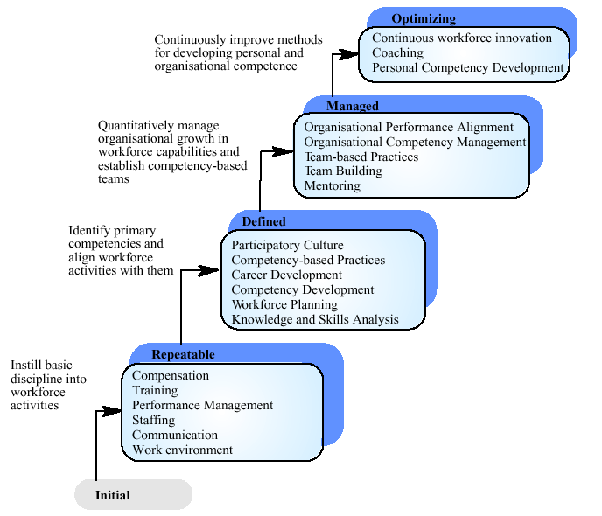
The People Capability Maturity Model

