Slide 1
Invisible People
The story of those who work hard, pay their bills on time, save for years –
and still get told “NO”

Slide 2
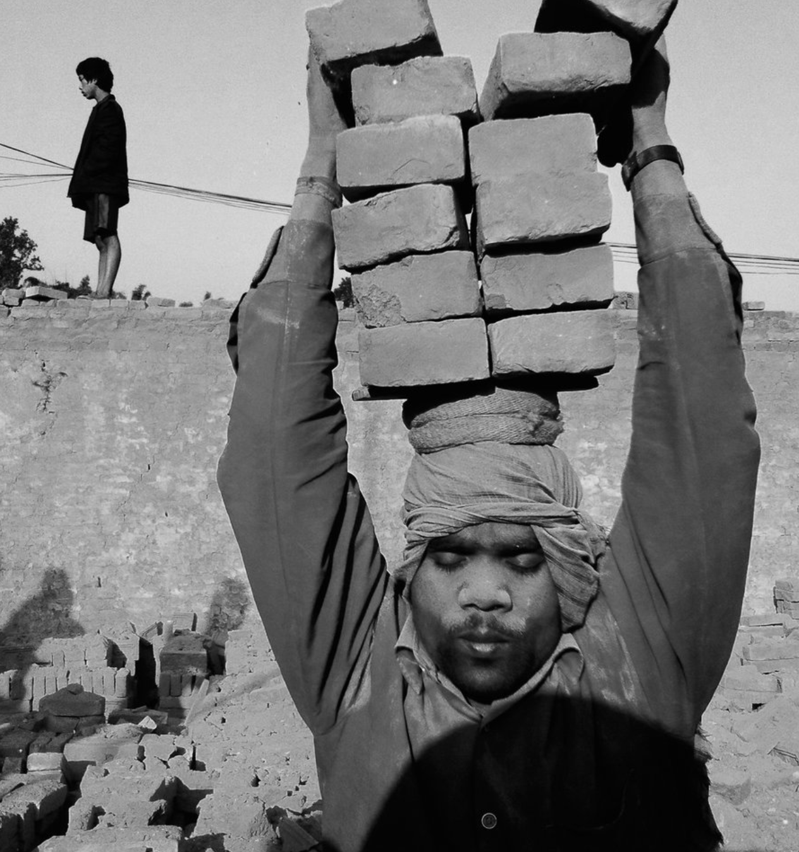
NEPAL · 2026
The Problem
"Ram Bahadur pays his bills on time, saves his money, and works hard every day."
But when he walks into a bank, they tell him he's too risky because he lacks a formal credit score.
He isn't a risk—he's just invisible to the current system.

Slide 3
72%
100,000 Real People
Because banks don't look at their actual history, they are forced to use expensive informal lenders.
Have no official score.
They end up paying 36% to 60% interest, not because they are bad borrowers, but because they have no other choice.

Slide 4
OUR SOLUTION
A system that finally Looks
We look at real habits, not just traditional banking reports.

Slide 5












Not a Bank Statement, A life Statement
We build a complete picture of reliability.
Savings History
Remittance
Land Title
Years of Savings History
Regular Overseas Income
Lalpurja Collateral Value
Utility Bills
Digital Wallets
On time payment rate
Monthly Income Pattern

Slide 6




5 Intelligence Agents - 1 Decision
Document Agent
Income Agent
Scoring Agent
Compliance Agent
Decision Agent
We collect and check your documents quickly.
We look at total income from all reliable sources.
You get a clear, fair score based on real data.
We follow all rules automatically.
You get an answer immediately.

Slide 7


Ram Bahadur's result
Approved amount
720
NPR 3,00,000
Interest rate
10.5% annual
credit score
Very good
Monthly EMI
NPR 27,500
Electricity on-time rate: 88%
Utility payment reliability · +42 pts
Cooperative member: 3 years
Savings history signal · +31 pts
No CIB bureau score
Standard for 72% of Nepali applicants · -15 pts

Slide 8



Every hackathon target — exceeded.
83.6%
0.95
Decision accuracy
Macro F1 score
✓ Target > 78%
✓ Target > 0.72
0.93
0.86
AUC (one-vs-rest)
Gini coefficient
✓ Target > 0.80
✓ Target > 0.45

Slide 9



The Gap We are Closing
1.3 Cr
36-60%
10.5%
Nepalis economically active with no formal credit access
Moneylender interest rate they pay today
Our base interest rate — what they will pay tomorrow

Slide 10


Mohamed Bouazizi never got his loan.
Ram Bahadur still might not.
We built this so the next one does.
Built with real Nepali lending data · GIBL Hackathon 2026 · Track A
Thank you.

