Slide 1
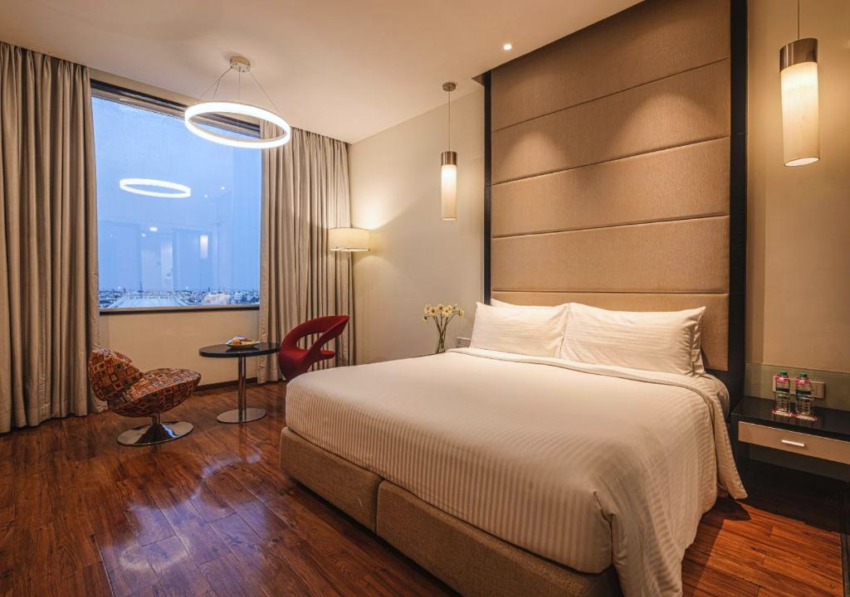
EDA
HOTEL BOOKING ANALYSIS
Presented By:
Sagar Nilange & Aditya Sapkal
Guide By :
Abhishek Wahval

Slide 2
TABLE OF CONTENTS
1. Project Summary 5. variable description
2. Problem Statement 6. Data Visualization And Analysis
3. Columns 7. Conclusion
4. Data Cleaning

Slide 3
Project overview
This project analyses the Hotel performance of City Hotel and Resort Hotel during the period 2015 to 2017.
The study focuses on booking trends, customer Behaviour, cancellation rates, occupancy levels, and revenue performance.
It also studies different booking channels and pricing trends.
By studying key performance indicators and market trends, the project provides useful insights to improve hotel operations, increase revenue, and support long-term business growth for both hotels.

Slide 4
Problem Statement
This dataset contains booking details for a City Hotel and a Resort Hotel.
It includes information like booking date, number of adults, children, and babies, parking availability, and booking agent.
The goal of this project is to analysis the data to find the key factors that influence hotel bookings, cancellations, and occupancy.

Slide 5
Columns
We have 32 columns which are given below:
Hotel, Is Cancelled, Lead Time, arrival Date Year, arrival_ Date Month, arrival Date Week Number, arrival Date_ Day Of Month, Stay In Weekend Nights, Stay In Week Nights, Adults, Children, Babies, Meal, Country, Market Segment, Distribution channel, Is Repeated Guest, Previous Cancellations, Previous Booking Not Cancelled, Reserved room type, Assign Room Type, Booking Change, Deposit type, Agent, Company, Day In Waiting list, Customer Type, ADR, Required Car Parking Space, Total Of Special Request, Reservation Status, Reservation Status Date.

Slide 6
Data Cleaning
1. Removing Errors & Duplicates
The original dataset had 1,19,390 records.
4 error records were identified and removed.
After removing errors, 1,19,386 records remained.
31,994 duplicate records were found in the data.
After removing duplicates, 87,392 clean records remained.
After adding total people column 172 More error records identified and removed.
After removing errors, 87220 clean records remained.

Slide 7
Data Cleaning
2.Handling Nulls &Missing Values
Some columns had missing values, mainly Agent and Country.
Missing values in the Agent column were replaced with “Direct Booking”.
Missing values in the Country column were replaced with “Self Country”.
The Company column had about 93% missing values.
Due to high missing data, the Company column was removed.
These steps improved data quality and accuracy for analysis.

Slide 8
Data Cleaning
3.Adding & Merging column
Total Stay was created by combining Week Nights and Weekend Nights to understand the length of stay.
Total peoples was created using Adults, Children, and Babies to know the group size per booking.
These merged columns reduce data complexity and make analysis easier.
A Booking ID column was added to uniquely identify each booking.
Booking ID acts as a Primary Key, avoiding duplicate records and improving accuracy.
After adding and merging columns, the dataset has 33 columns and is ready for EDA and visualization.

Slide 9
Variable Description
Hotel – Type of hotel (City or Resort)
Is Canceled – Booking canceled or not
Lead Time – Days between booking and arrival
Arrival Date Year / Month / Day – Date of arrival
Stays In Week Nights / Stays In Weekend Nights – Length of stay
Adults / Children / Babies – Number of guests
Meal – Meal plan chosen
Country – Customer’s country

Slide 10
Variable Description
Market Segment – Booking source (Online, Travel Agent, etc.)
Distribution Channel – Booking channels
Repeated Guest – Whether the guest is returning
Previous Cancellations / Previous Bookings Not Canceled – Guest’s booking history
Reserved Room Type / Assigned Room Type – Room category
Booking Changes – Number of changes made to the booking
Deposit Type – Type of deposit paid
Agent / Company – Booking agent or company

Slide 11
Variable Description
Days In Waiting List – Waiting period for booking
Customer Type – Contract, Transient, Group, etc.
ADR (Average Daily Rate) – Price per night
Required_Car_Parking_Spaces – Parking spaces required
Total of Special Requests – Number of special requests
Reservation Status – Final status of the reservation (Canceled, Check-Out, No-Show)
Reservation Status Date – Date when the reservation status was updated

Slide 12
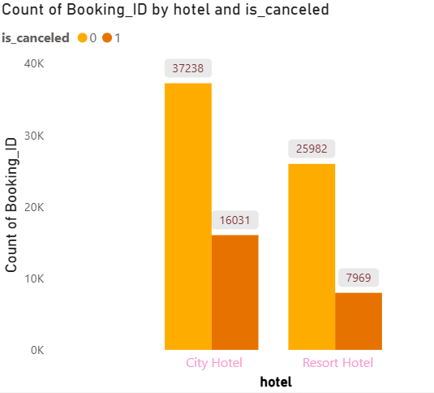
DATA VISUALIZATION AND ANALYSIS
Hotel booking demand and cancellations
We can clearly see that City Hotels have a higher number of bookings compared to Resort Hotels.
City Hotels also show a higher number of cancellations.
Around 37238 bookings in City Hotels were completed, while 16031 were canceled.
Resort Hotels recorded about 25982 completed bookings and 7969 cancellations.
This chart shows that City Hotels attract more bookings but face higher cancellation rates, while Resort Hotels are more stable.

Slide 13
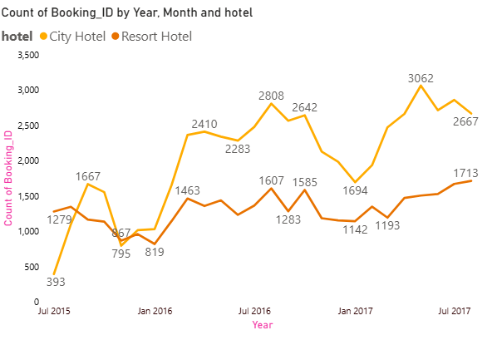
Hotel Booking Pattern over time
Based on this chart we can say that City hotels get more bookings than resort hotels almost every month and year.
Bookings are highest in July and August for both hotel types.
Resort hotel bookings are lower and change more compared to city hotels.
City hotels show steady growth from 2015 to 2017, with consistent demand.
Overall, city hotels are the most preferred by guests, though both follow similar seasonal trends.

Slide 14
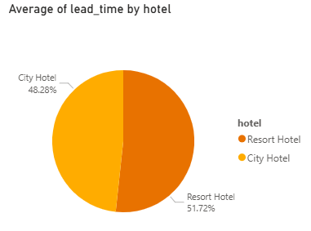
Lead Time Contribution by Hotel Type
he pie chart shows the proportional contribution to the overall average lead time (days between booking and arrival) by hotel type:
Resort Hotel: 51.72%
City Hotel: 48.28%

Slide 15
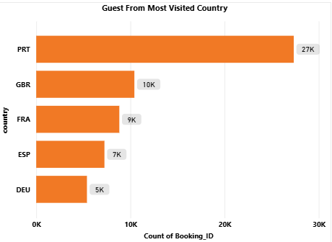
Guest from most visited country
Portugal (PRT) contributes the highest number of guests with 27K bookings, making it the primary source market.
The United Kingdom (GBR) and France (FRA) follow with 10K and 9K bookings respectively.
Spain (ESP) and Germany (DEU) contribute 7K and 5K bookings, showing moderate demand.
The data indicates that European countries dominate the guest distribution for bookings.
This insight can help the business focus marketing and pricing strategies on high-performing source countries.

Slide 16
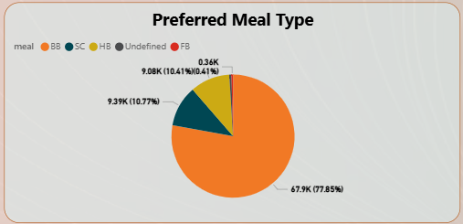
Preferred meal type
The majority of guests prefer Bed & Breakfast (BB) with 67.9K bookings (77.85%), making it the most popular meal plan.
Self-Catering (SC) and Half Board (HB) contribute 9.39K (10.77%) and 9.08K (10.41%) respectively, showing moderate demand.
Full Board (FB) has very low preference with only 0.36K (0.41%) bookings.
This distribution indicates that customers favor flexible and cost-effective meal options.
The insight can help optimize meal plan pricing and focus service improvements on high-demand categories.

Slide 17
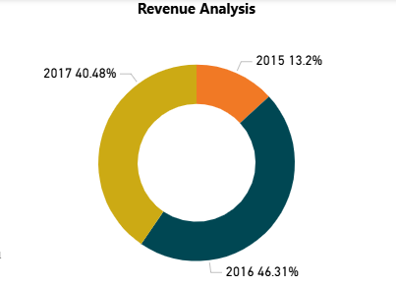
Revenue analysis
The highest revenue contribution is from 2016 with 46.31%, indicating peak business performance during that year.
Year 2017 contributes 40.48%, showing strong continuity in revenue generation.
Year 2015 accounts for only 13.2%, reflecting comparatively lower business volume.
There is a significant revenue growth from 2015 to 2016, followed by stable performance in 2017.
This trend highlights business expansion and improved revenue efficiency over time.

Slide 18
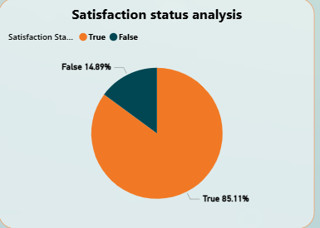
Satisfaction status analysis
Most guests are happy with their stay.
About 85% guests are satisfied with the hotel.
Only a small number of guests are not satisfied.
This shows the hotel provides good service.
High satisfaction can lead to more repeat bookings.

Slide 19
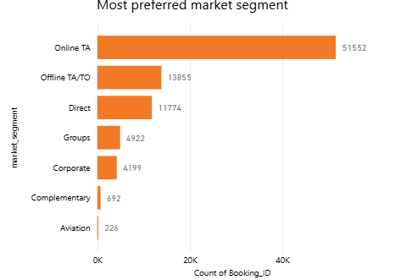
Most preferred market segment
Online TA is the most preferred market segment, with the highest number of bookings (51,552), showing strong customer trust in online platforms.
Online TA/TO ranks second (13,855 bookings), confirming that online channels dominate hotel bookings.
Direct bookings are important but much lower than online sources, indicating limited customer direct engagement.
and Group bookings are moderate, contributing steadily but not as much as online channels.
Aviation and Complimentary bookings are very low, suggesting minimal impact from these segments and scope to improve direct booking strategies through offers or loyalty programs.

Slide 20
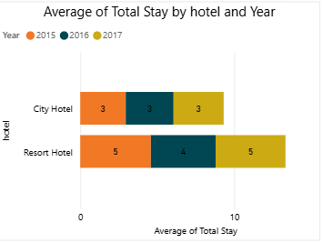
Average Stay Duration by Hotel
This chart shows the average stay duration (number of nights) for City Hotel and Resort Hotel.
It compares the average total stay across different years (2015, 2016, 2017).
City Hotel guests stay for about 3 nights on average every year.
Resort Hotel guests stay longer, around 4–5 nights on average.
Overall, Resort Hotels have longer stay than City Hotels, showing they are preferred for longer vacations.

Slide 21
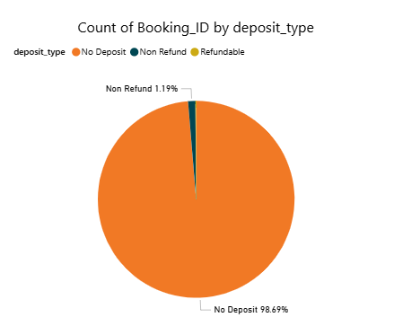
Deposit Type Analysis
Most bookings are made without any deposit (about 98.6%).
Very few bookings are Non-Refundable (about 1.2%).
Refundable bookings are almost zero.
Guests prefer flexible and risk-free booking options

Slide 22
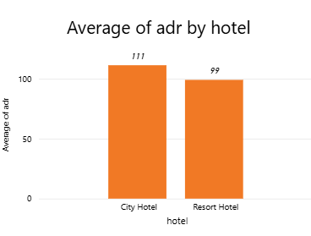
Average Daily Rate (ADR) by hotel type
This chart compares the average room price per night for City Hotels and Resort Hotels.
Based on this chart, we can say that City Hotels have a higher average ADR (111) than Resort Hotels (99).
City hotels generate more revenue per room per night, indicating higher demand or premium pricing.

Slide 23
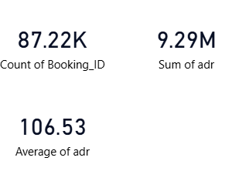
KPIs
Total Bookings
87.22K bookings
Shows the total number of bookings received.
Average ADR (Average Daily Rate)
106.53
shows the average priced charged per room.
Total Revenue (Sum of ADR)
9.29M
Shows the overall revenue generated from bookings.

Slide 24
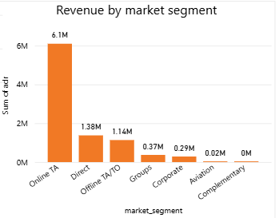
Revenue by Market Segment
This chart compares total revenue (Sum of ADR) from different market segments.
Online TA generates the highest revenue (around 6.1M).
Direct bookings are the second highest revenue source.
Online TA/TO also contributes a good amount but less than Direct.
Groups and Corporate segments generate moderate revenue.
Aviation and Complimentary bookings contribute very little revenue.

Slide 25
WEEKLY AND ANNUAL INSIGHTS
+
DASHBOARD

Slide 26
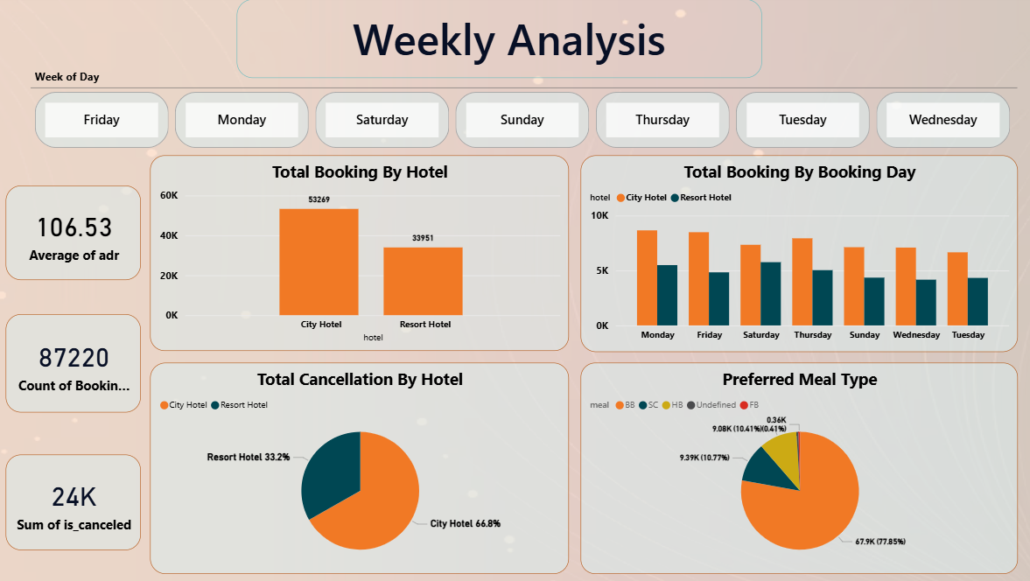

Slide 27
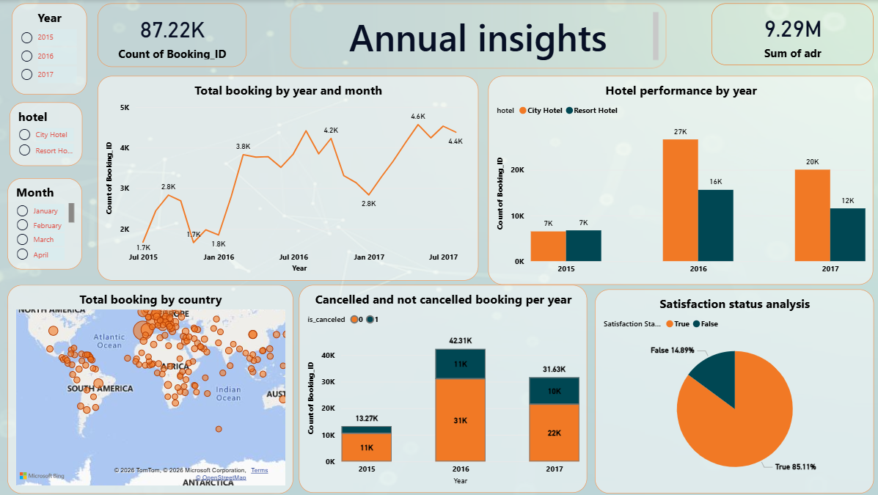

Slide 28
Conclusion
In this project, we found that City Hotels are more popular and had the highest bookings and revenue in 2016. Most guests do not need car parking, so spending more on parking is not necessary. July and August have the highest bookings, mainly because of holidays and more travel.
Most bookings are made through agents, and many guests come from Portugal, the UK, France, and Spain. Room types A and D are the most preferred, and many guests return to the same hotel. Guests mostly choose the BB (Bed & Breakfast) meal plan.
As the number of guests increases, the ADR also increases, which shows that higher occupancy leads to higher revenue and better business growth.

Slide 29
THANK YOU

