Slide 1
Superstore Sales & Profit Dashboard
Sales, Profit & Regional Insights
Sagar NM
Elevate Labs Internship – Day 4
Power BI | Task 4

Slide 2

Objective
01
Interactive Dashboard
Design an interactive dashboard built for business stakeholders
02
Sales & Profit Analysis
Analyze sales and profit performance across categories and regions
03
Trend Identification
Identify key trends and patterns hidden within the data
04
Data-Driven Decisions
Support stakeholders in making informed, data-backed decisions

Slide 3


Tools & Dataset
TO O L S U S E D
DATA S E T
DASHBOARD FEATURES
Power BI
Dashboard & visualizations
Superstore Sales Dataset
Sales
KPI Cards (Sales, Profit, Orders)
Region & Category Filters
Profit
Excel
Dataset preparation
Monthly Sales Trend Chart
Category
Sales by Category (Bar)
Region
Sales by Region (Bar)
Order Date
Profit by Category (Bar)

Slide 4
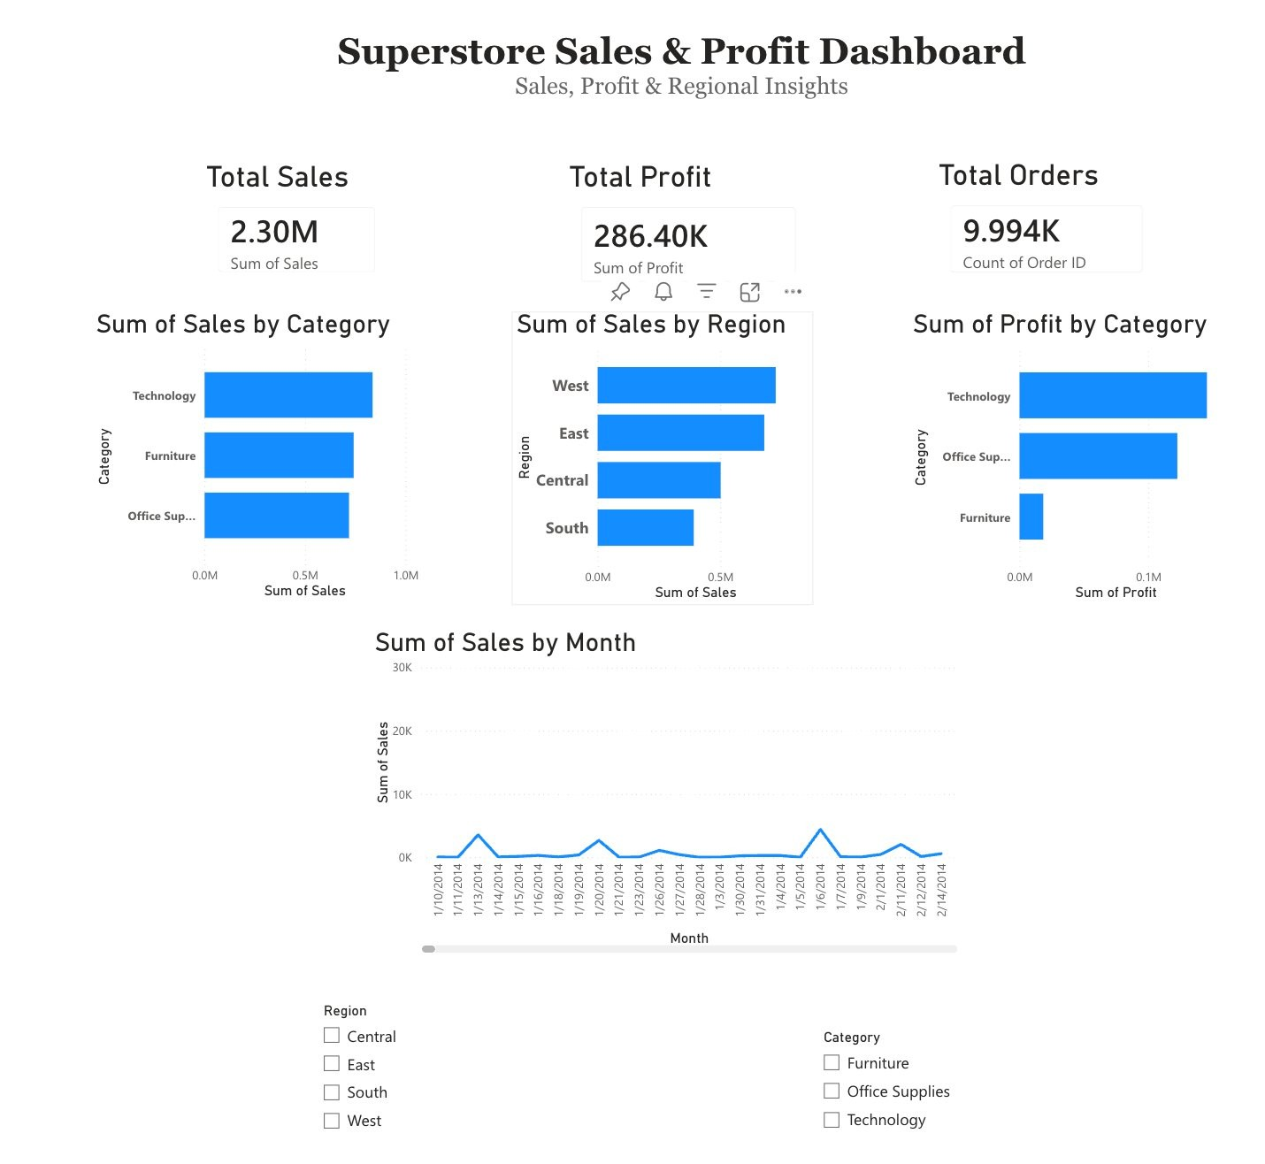


Dashboard Overview
2.30M
Total Sales
286.40K
Total Profit
9,994
Total Orders
Interactive slicers for Region & Category
Bar charts by category, region & profit Time-series monthly sales trend

Slide 5

Key Insights
01
Top Category
Technology generates the highest sales revenue, leading in both volume and profit margins.
02
Top Region
West region contributes the most revenue — a key market for strategic investment.
03
Best Profitability
Technology segment also leads in profit, making it the most valuable category overall.
04
Monthly Trends
Sales fluctuate across months, revealing seasonal patterns and peak demand periods.
Conclusion: The dashboard provides clear, actionable insights — empowering stakeholders to make informed, data-driven business decisions.

