Slide 1
SpateAugur
Group No.: 53
Sagar Palao
Siddhesh Dighe
Abhishek Shahasane
Dhairya Shah
Guided By: Mrs. Anjali Yeole

Slide 2
What’s the current state?
The concept of Smart India, Digital India is currently soaring.
But very less focus is given to: Public Health - in terms of Disease Prediction, Prevention & Control.
In India the punch of ubiquity and pervasive computing in HealthCare is not that hard.

Slide 3
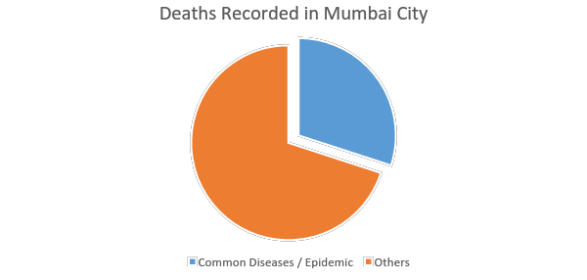
Statistics - Mumbai Health Report 2015
7650 people in Mumbai died because of common diseases in the year 2015.
30% of the total death population in Mumbai die due to common diseases or epidemic hit.
Courtesy: Mumbai Health Report | International Workshop on Climate Change Vulnerability Assessment and Urban Development Planning for Asian Coastal Cities

Slide 4
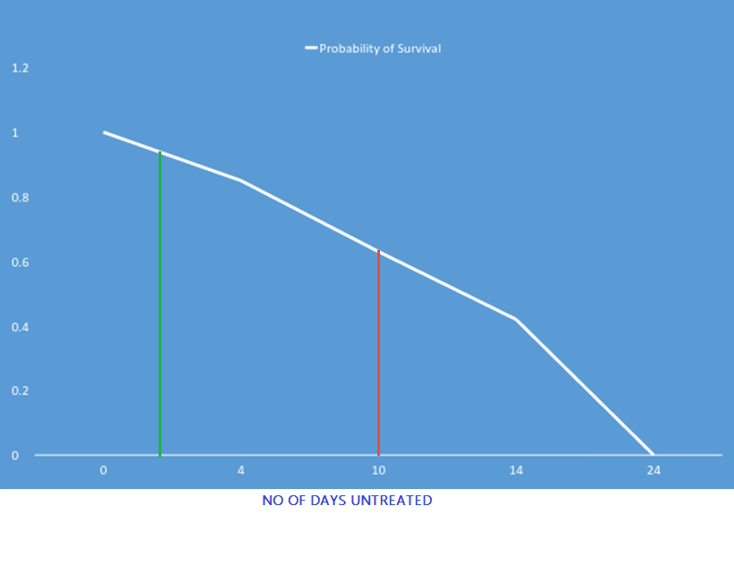
Where do we lack?
Courtesy: Mumbai Health Report | International Workshop on Climate Change Vulnerability Assessment and Urban Development Planning for Asian Coastal Cities

Slide 5


What is SpateAugur ?
SpateAugur is an informative health eco-system which is used for predicting epidemics and diseases.
This eco-system will predict,
What is the probability of a disease/epidemic to outbreak in a region.
What are the numbers of people who will get inflected by the disease.
Such predictions act as an alarm for health control boards to take appropriate decision.

Slide 6

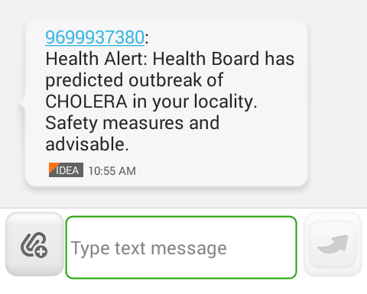


What can it do ?
Public Notification
People are made
aware of spreading of
diseases.
General public will be notified
about precautions.
Sample text
notification.

Slide 7




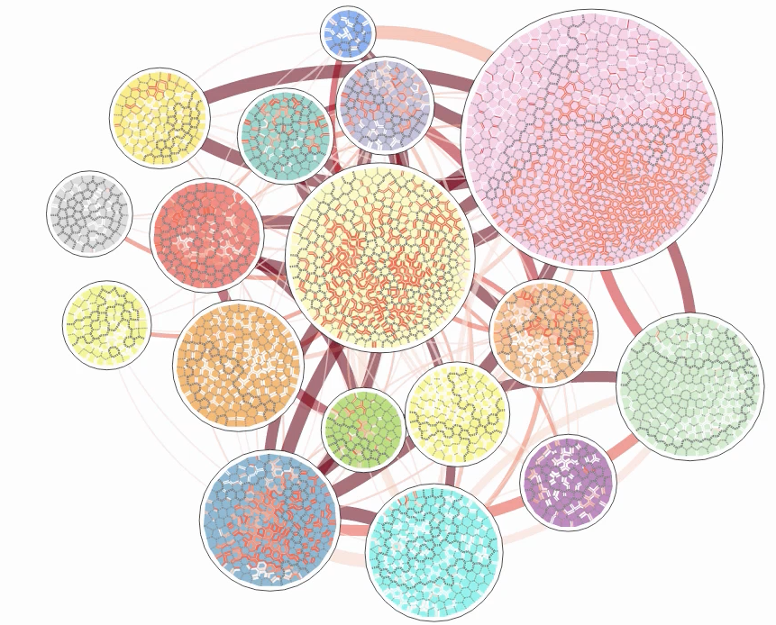
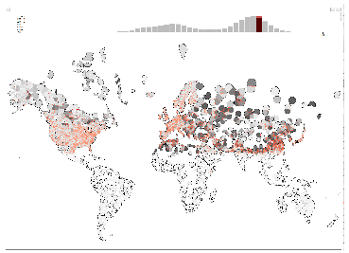

Alike us
IBM’s Vorograph

Slide 8
How to do it ?

Slide 9
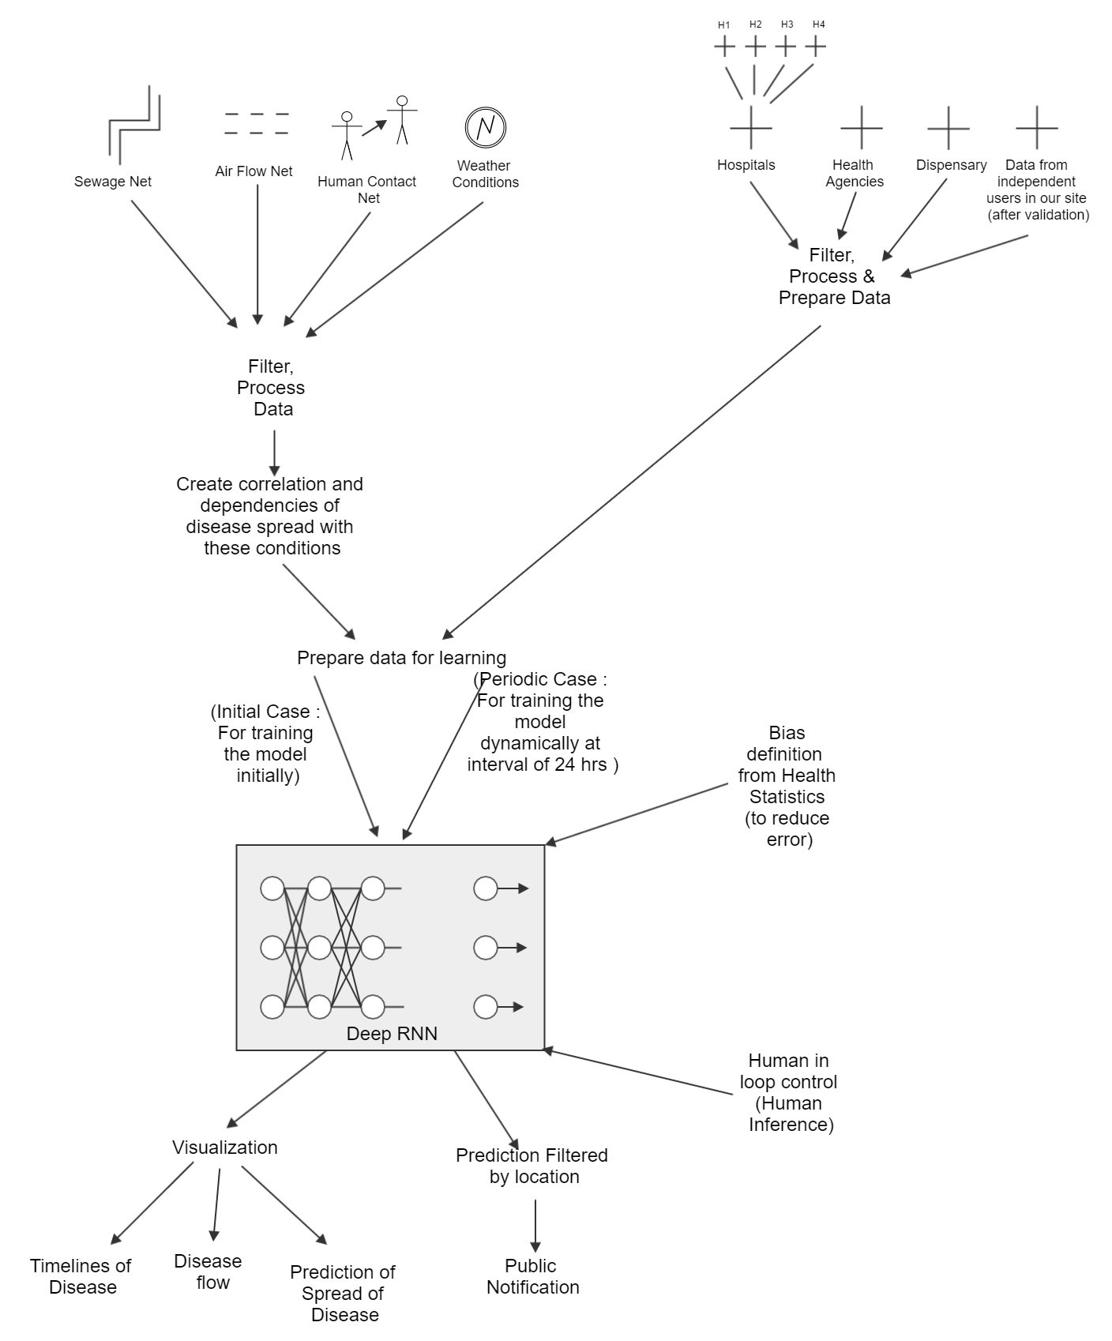

Slide 10
Data….
We need both static and dynamic data.
First we collect data from hospitals.
It includes,
On per day basis
the count of number of patients which are admitted in the hospital for each common disease.
The region to which the patient belongs.

Slide 11
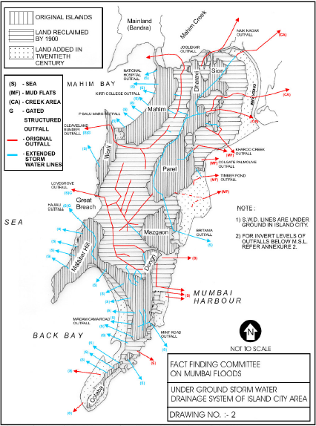
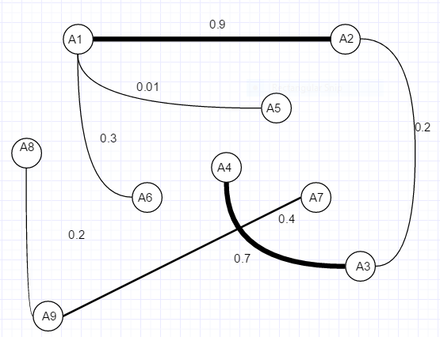
Sewage / Water Network

Slide 12
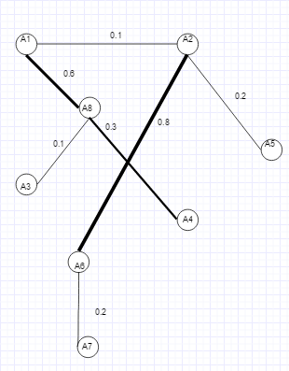



Air Network

Slide 13
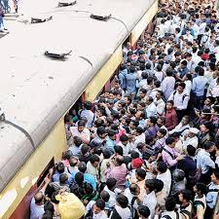
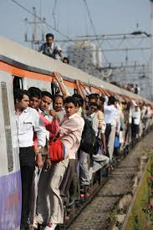
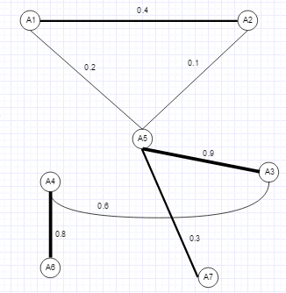
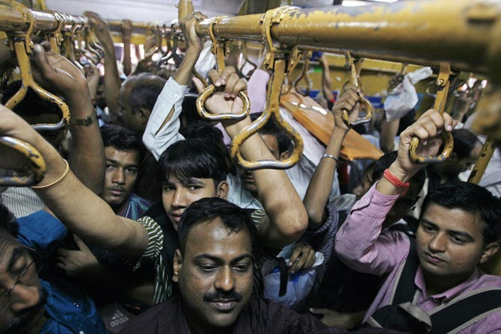
Human Contact Network

Slide 14







Weather Information

Slide 15
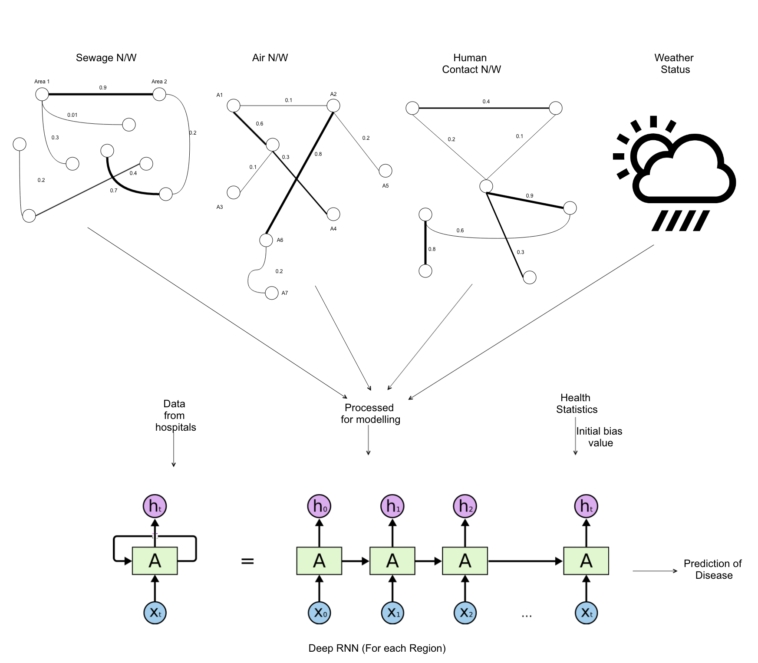

Slide 16
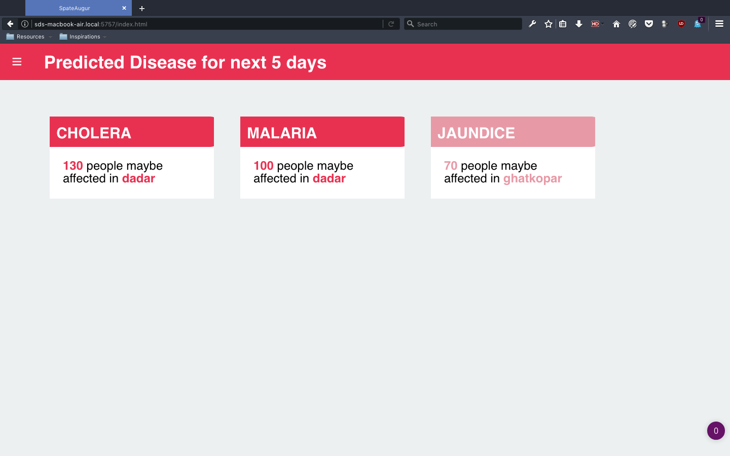
Visualization

Slide 17
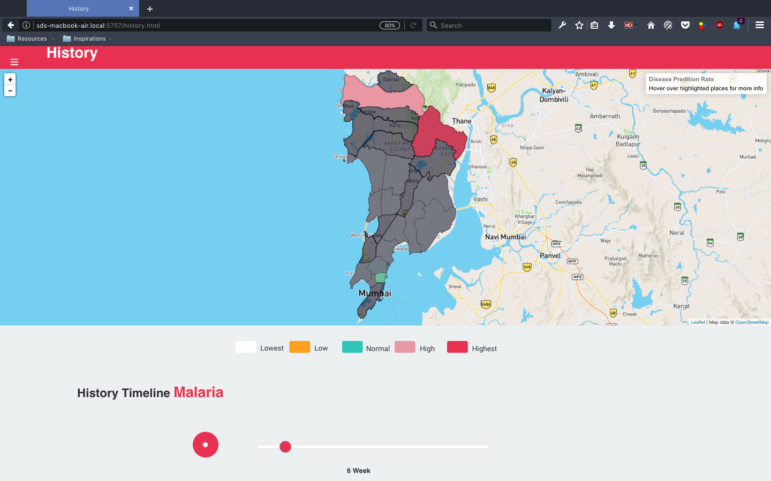

Slide 18
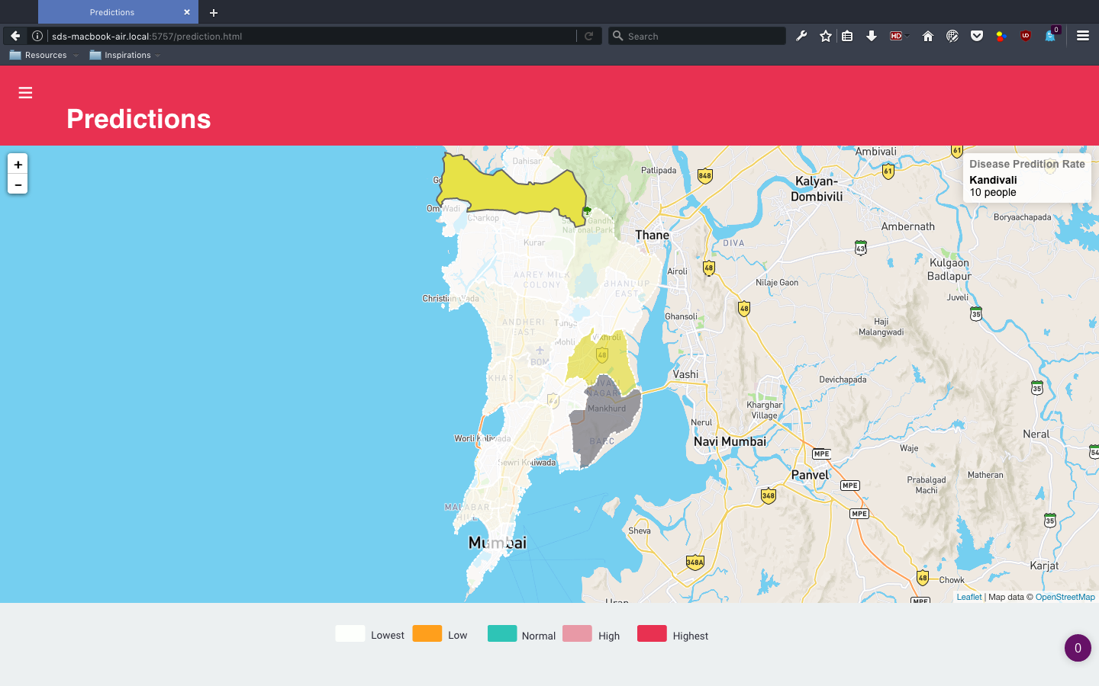

Slide 19
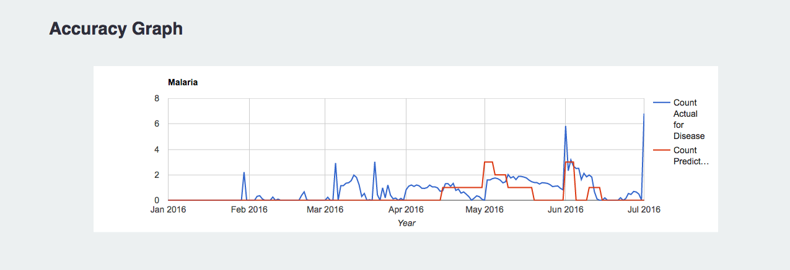

Slide 20
Benefits
General Public
Health Officials
Hospitals
Reduction in Mortality Rate

Slide 21
Summary
Prediction of spread of diseases
Notifications
Visual Summary
Analytics for health officials
Scalable

Slide 22
What we have achieved till now…
Competition Name and Type | Venue | Date | Position/Prize
Avalon : National Level Project Competition | Terna Engg. College | 2 March 2017 | Participant
Innovations : National Level Project Competition | SIES, Nerul | 10 March, 2017 | 1st Prize + Opportunity for giving research talk at IIT Bombay
Nawonmesh : National Level Idea & Innovation Competition | IIT Bombay | 4 March 2017, 5 March 2017 | 2nd Prize + Internship at IIT Bombay
Technomania ‘17 : Project Presentation Competition | IEEE - CRCE in college: Fr. Conceicao Rodrigues College of Engineering | 17 March 2017, 18 March 2017 | 3rd Prize

Slide 23
What we have achieved till now…
Competition Name and Type | Venue | Date | Position/Prize
ReSConAM ‘17 : National Level Research Presentation Competition | IIT Bombay | 18 March 2017, 19 March 2017 | 3rd Prize + Paper published at IIT Network
Prodology : Technical Paper Presentation | VJTI | 19 March 2017 | Participant
IET Karamaveer Expo ‘17 : National Level Working Model Project Competition | IET (Institute of Engineering and Technology) at K.K. Wagh Inst. of Edu. & Research, Nashik | 21 March 2017, 22 March 2017 | 2nd Prize

Slide 24
Thank You
Thanks for bearing with us! We’d love to hear from you
Kindly post your suggestions, feedbacks or simply stay connected with us:
spateaugur@gmail.com

