Slide 1
VULSCAN
Sagar Palao | 73
Siddhesh Dighe | 79
Abhishek Shahasane | 78
Manish Manghwani | 31

Slide 2
What is VulScan
VulScan is a security auxillary tool which helps in scanning vulnerabilities in a server.
It aims at providing security to server at low maintenance cost for Commercial and Enterprise level projects as well as Individual level project.

Slide 3


Working of VulScan
For VulScan to work, needs to be installed on the particular server
VULSCAN

Slide 4

Working of VulScan
For VulScan to work, needs to be installed on the particular server
VULSCAN
VulScan works on monitoring and providing information about the vulnerabilities of the Server.

Slide 5
Working of VulScan
For VulScan to work, needs to be installed on the particular server
VULSCAN
VulScan works on monitoring and providing information about the vulnerabilities of the Server.
2 levels to monitor attacks
Level 1
Level 2

Slide 6



Level 1
VULSCAN
In Level 1, we focus on System tempering.

Slide 7

Level 1
VULSCAN
In Level 1, we focus on System tempering.
In system tempering we look for basic network configuration files in the system. VulScan application tries to look for this tempering based on the template file which has been provided to it by the administrator.

Slide 8
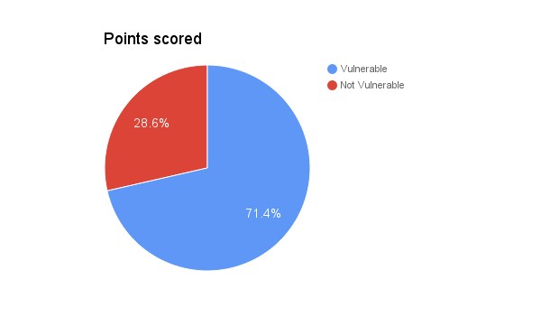
Level 1
VULSCAN
In Level 1, we focus on System tempering.
In system tempering we look for basic network configuration files in the system. VulScan application tries to look for this tempering based on the template file which has been provided to it by the administrator.
Based on this, we measure the level of tempering in the system, based on which thegeneral degree of vulnerability is assigned to the system.

Slide 9

Level 2
Sql Injection
Cross Site Scripting
Monitor Logs
VULSCAN
LDS
In level 2 we have detailed the set of attacks in a generic Web/Database Server.
So when an attack or an attempt for attack is made to the server, server logs the attack in its access log.

Slide 10

Level 2
Sql Injection
Cross Site Scripting
Monitor Logs
Generate Reports
VULSCAN
LDS
In level 2 we have detailed the set of attacks in a generic Web/Database Server.
So when an attack or an attempt for attack is made to the server, server logs the attack in its access log.
We scan the entire log file to discover signature of vulnerability. This log records are compared with the actual signature of attacks.Thus the vulnerability can be scanned and attacks or attempts to attacks can be listed.

Slide 11
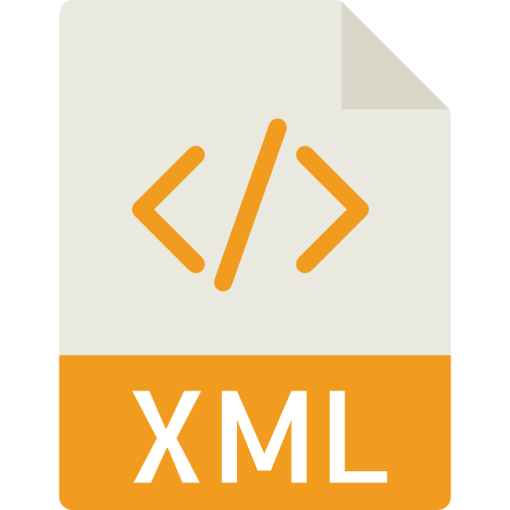


Level 2
Sql Injection
Cross Site Scripting
Monitor Logs
Generate Reports
VULSCAN
LDS
In level 2 we have detailed the set of attacks in a generic Web/Database Server.
So when an attack or an attempt for attack is made to the server, server logs the attack in its access log.
We scan the entire log file to discover signature of vulnerability. This log records are compared with the actual signature of attacks.Thus the vulnerability can be scanned and attacks or attempts to attacks can be listed.
The result of the scanning is brought in three forms
HTML Document
XML Document
TEXT Document

Slide 12
Thank You

