Slide 1
GOOGLE PLAY STORE DATA ANALYSIS
CSE 3020
DATA VISULISATION PROJECT FINAL REVIEW
SUBMITTED TO: PROF. PATTABIRAMAN V
SUBMITTED BY: SAGAR PANDEY
18BCE1002

Slide 2
PROBLEM DEFINITION
With more and more number of apps being launched today developers face a great competition
for the downloads on google play store/app store.
While google play store lets you know the category of the app but doesn't give any analysis how other apps in that category are performing and where you stand in number of installs, downloads and review.
If a developer is aiming for just making money out of apps he needs know that launching what kind of app will give him the maximum Return of Investment (ROI).
If his app is already in the market he will also be able to predict the expected number of installs depending upon the current rating he has.

Slide 3
OBJECTIVE/OUTCOME
Along with the prediction the project also will give basic analysis of the statistics of the data.
For example bar charts, histograms, pie charts, bee swarm charts etc.
The main focus of the project is to felicitate the developer to predict the installs and cluster the given data into categories using various techniques.

Slide 4
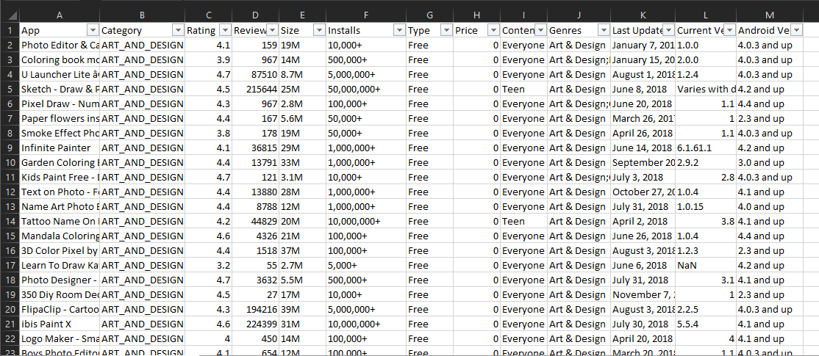
RAW DATA SET

Slide 5
PROBLEMS WITH RAW DATASET
The csv file presented the following problems:
Mismatched value in columns
Wrong data type
Out of bound values
Empty cells in data

Slide 6
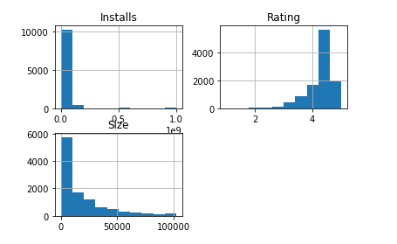
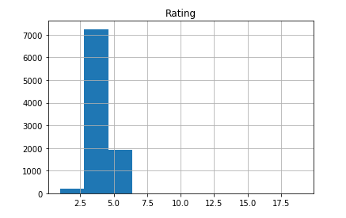
CLEANED DATA SET USING JUPYTER NOTEBOOK
Jupyter Notebook was used to clean the data set and perform the required modifications in the given raw data set.
The complete project is to be developed in the same environment including the training and testing of data.

Slide 7
TECHNIQUES AND METHODS
Following ML techniques are intended to be used for the prediction:
KNeighbor Classifier
Random Tree Classifier
Decision Tree Classifier
For training the model 70% of the data will be utilised and 30% will be used for testing and confusion matrix will be used for checking accuracy.

Slide 8
WORKFLOW

Slide 9
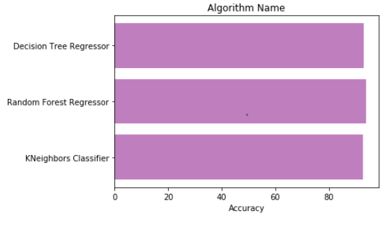
RESULTS
93.54%
93.0%
92.85%

Slide 10
CONCLUSIONS
The algorithms namely KNeighbor, Random Forest Classifier and Decision Tree Regressor were used to fit the dataset and predict the results. The Random Forest Regressor proved to be the best suited algorithm for this dataset with an accuracy of 93.85% followed by Decision Tree Regressor and KNeighbor with accuracies of 93.00% and 92.59% respectively.
• The Random Forest regressor gives the best accuracy but lags behind in training time since around 150 trees were made in this process to achieve this accuracy.
• On the other hand, the Decision Tree Classifier proves to be the fastest with quite acceptable accuracy of 93.0%

