Slide 1

Collective

Slide 2
What is Collective?
Collective is an equity crowdfunding platform.
The platform enables startups and projects to raise funding in return of equity.
Individual can invest a relatively small amount of money inorder to receive stake in a company at an early stage.
Along with funding, Collective also enables startups / companies to find the required talent for their projects.

Slide 3
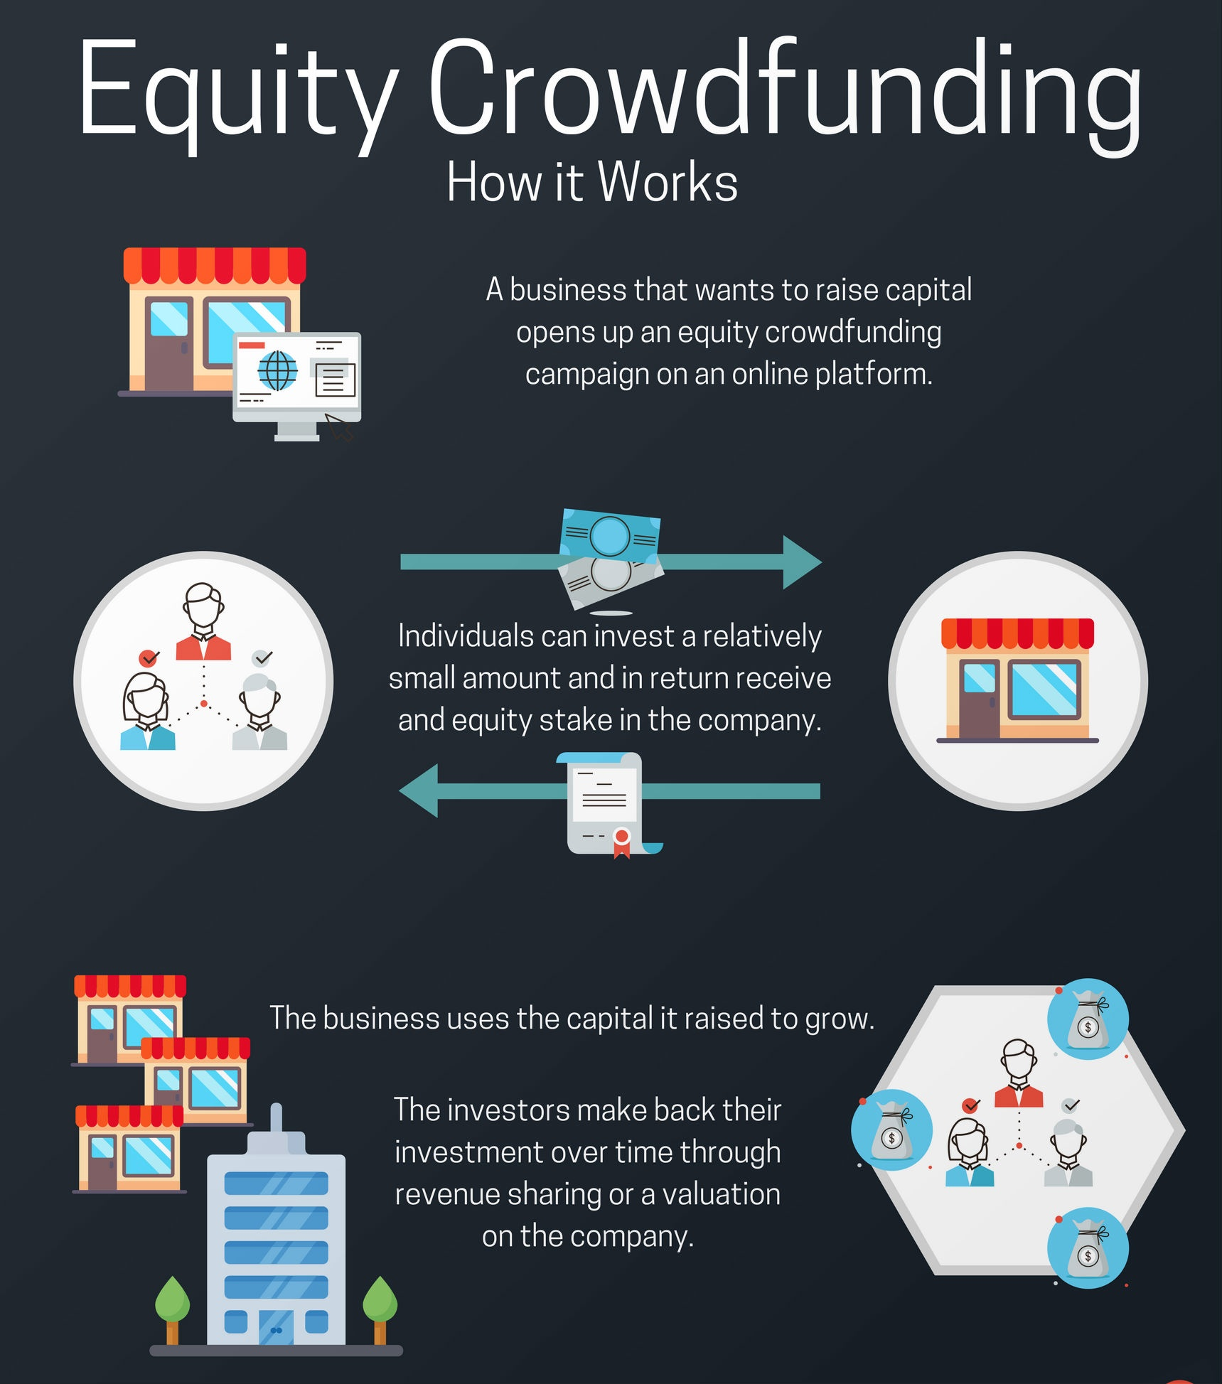

Slide 4
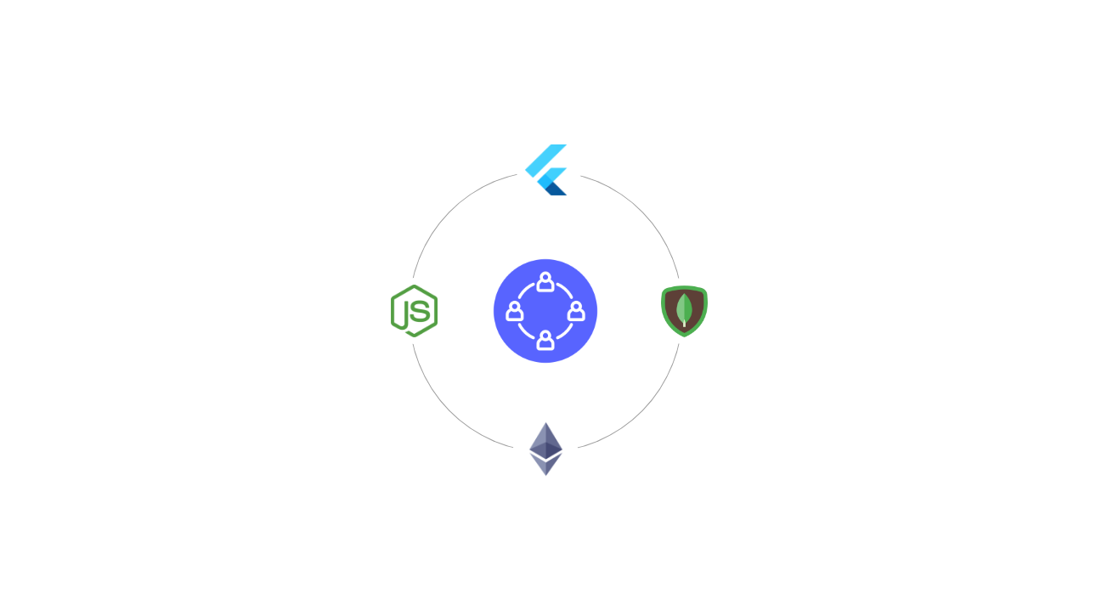
What makes Collective special?
Collective manages crowdfunding with Smart contracts that are deployed on blockchain and provides its users a cross-platform mobile app made with flutter which makes its approach towards crowdfunding truly unique.

Slide 5
Technologies used
Flutter - Android / IOS mobile application
Node.js - Backend Server
Ethereum - Blockchain
ERC20 standard - Token
MongoDB - Database

Slide 6
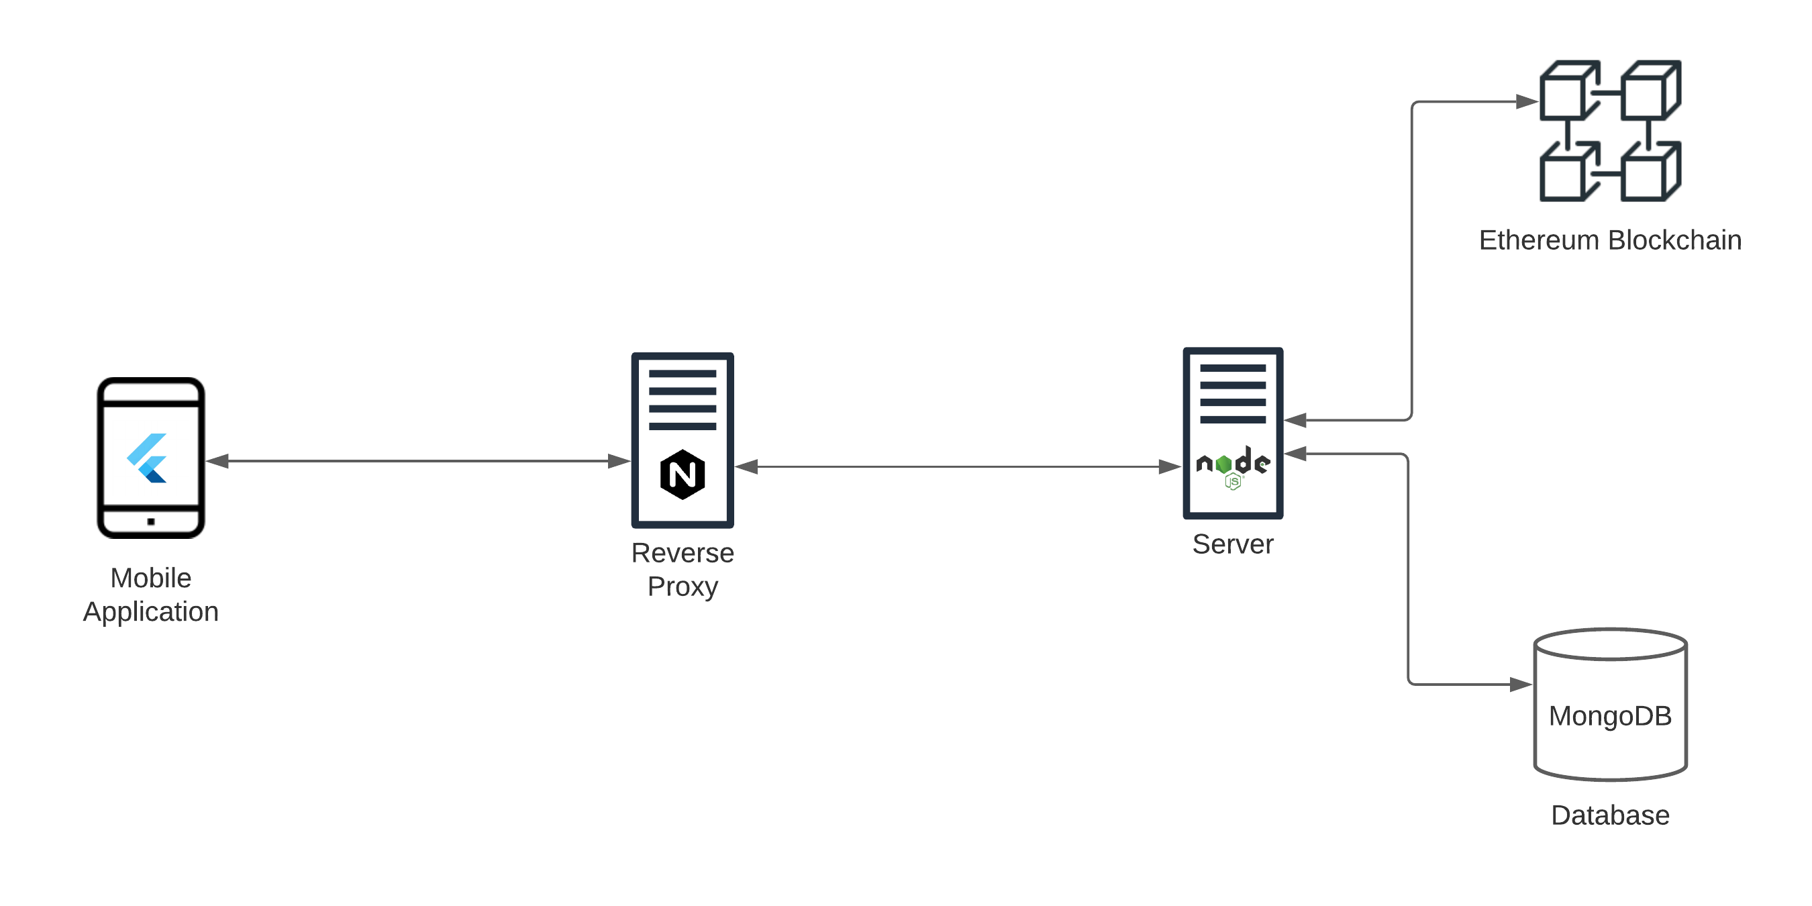
System design

Slide 7
Thank you !

