Slide 1

CouchDB
NoSQL Database
643 - Sagar Ajay Parker

Slide 2
What is CouchDB?
CouchDB is an document based open source NoSQL database developed by Apache.
CouchDB uses JSON to store data.
It uses JavaScript as its query language to transform the documents, using MapReduce function.
HTTP is used for accessing the database through an API.
In CouchDB, data is stored in the flexible document-based structure.

Slide 3
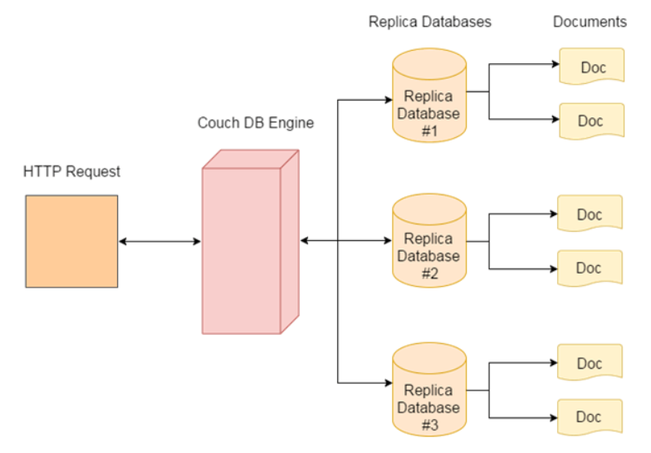
CouchDB Architecture

Slide 4
Features of CouchDB
Document Storage : CouchDB is a NoSQL database which follows document storage.Documents don't have a set limit to text size or element count.
Browser Based GUI : CouchDB provides an interface Futon which facilitates a browser based GUI to handle your data, permission and configuration.
Replication : CouchDB provides the simplest form of replication.
Security: CouchDB also provides database-level security. The permissions per database are separated into readers and admins.
Map/Reduce List and Show : The main reason behind the popularity of MongoDB and CouchDB is map/reduce system.

Slide 5
Create a new database in CouchDB
couch.createDatabase('mydb').then(() => {
console.log('Database created')
}, err => {
// request error occured
console.log(err);
});

Slide 6
Get a list of all the databases
couch.listDatabases()
.then((dbs)=>{
res.status(200).json({
msg:"Databases retireved.",
result:true,
data:dbs
})
},err=>{
res.status(400).json({
msg:"There was a problem fetching the list of all databases.",
result:false
})
});

Slide 7
Insert query with Mango for CouchDB
//Creating a unique ID for the document
couch.uniqid().then((ids) =>{
const newUser = {
_id:ids[0],
"name": req.body.name,
"age": req.body.age,
"phone": req.body.phone,
"fav_sitcom": req.body.fav_sitcom
}
//Saving the document to the database
couch.insert("mydb", newUser).then(({data, headers, status}) => {
res.status(200).json({
msg:"New user saved to the database",
result:true
})
}, err => {
console.log(err);
res.status(400).json({
msg:"There was a problem saving users data to the database.",
result:false
})
});
});

Slide 8
Read query with Mango for CouchDB
couch.mango('mydb',{selector:{}},{}).then(({data, headers, status}) => {
res.status(200).json({
msg:"All User data retireved.",
result:true,
data:data.docs
})
}, err => {
console.log(err);
res.status(400).json({
msg:"There was a problem fetching users data.",
result:false
})
});

Slide 9
Insert query with Mango for CouchDB
couch.update("mydb",userData).then(({data, headers, status}) => {
res.status(200).json({
msg:"User updated in the database",
result:true
})
}, err => {
console.log(err);
res.status(400).json({
msg:"There was a problem updating users data from the database.",
result:false
})
});

Slide 10
Delete query with Mango for CouchDB
couch.del("mydb", id, rev).then(({data, headers, status}) => {
res.status(200).json({
msg:"User deleted from the database",
result:true
})
}, err => {
console.log(err);
res.status(400).json({
msg:"There was a problem deleting users data from the database.",
result:false
})
});

Slide 11
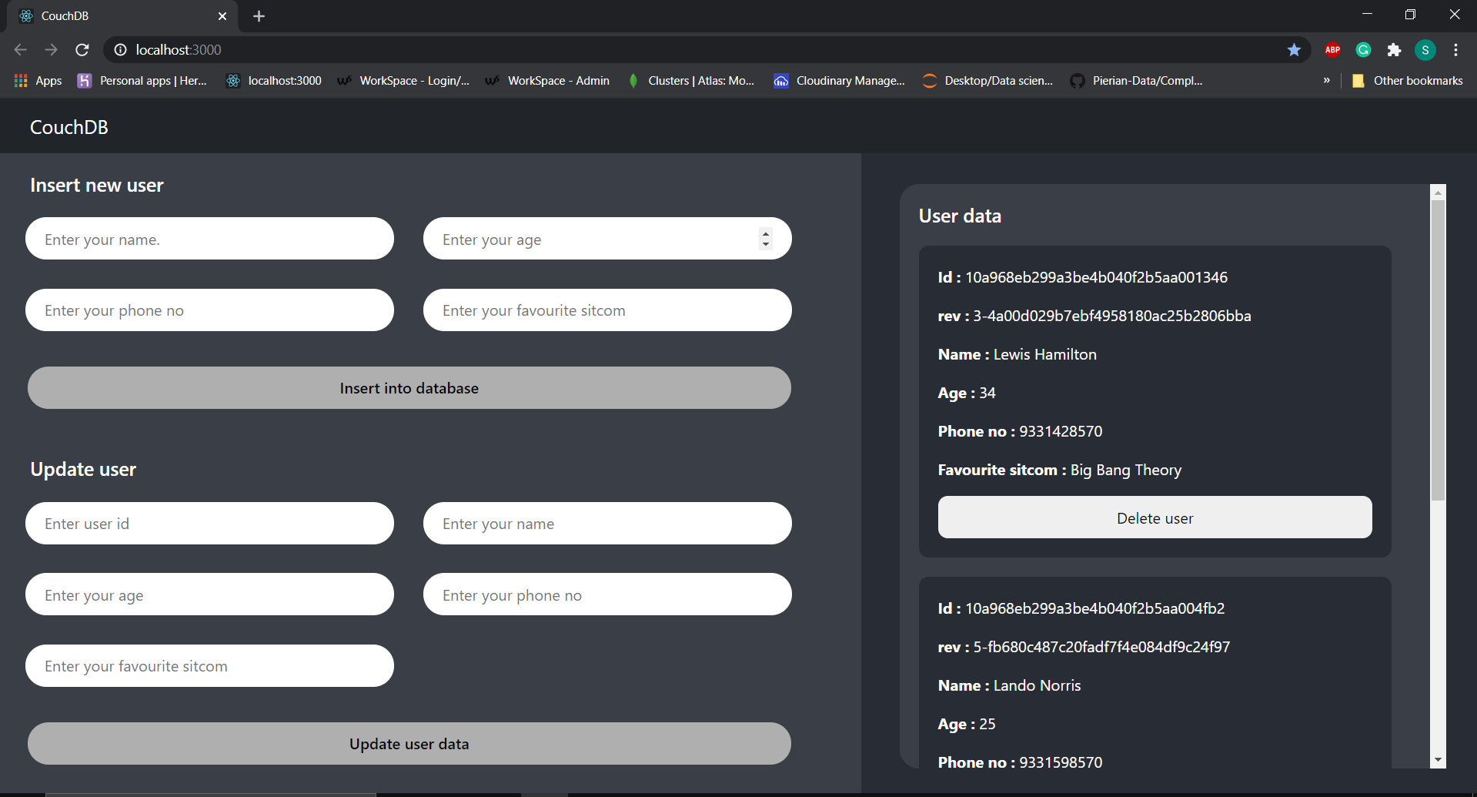
React frontend

Slide 12
Thank you !

