Slide 1
Ethereum price predicition
ML Project - 634
Sagar Ajay Parker

Slide 2
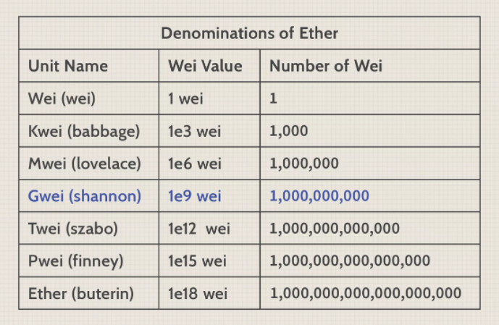
What is Ethereum ?
Ethereum is a decentralized, open-source blockchain with smart contract functionality.
Ether is the native cryptocurrency of the platform.
Ethereum uses PoS (Proof-of-Stake) as a consensus algorithm.

Slide 3
How I am predicting the ETH prices?
Getting real-time ETH data from yahoo finance in csv format.
Prepare data for training and testing. (Spliting data into train-test split).
Predicting the price of crptocurrency using LSTM neural network.
Visualize the prediction results.
Libraries used
sklearn
tensorflow
pandas
matplotlib

Slide 4
The problem with traditional neural networks
Lets start by understanding how a human understands a piece of information, we don’t start thinking from scratch every second.
As we read something, we understand each word based on our understanding of previous words. We don’t throw everything away and start thinking from scratch again. Our thoughts have persistence.
Traditional neural networks can’t do this.
For example, imagine if we want to classify what kind of event is happening at every point in a movie. It’s unclear how a traditional neural network could use its reasoning about previous events in the film to inform later ones.

Slide 5
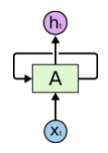
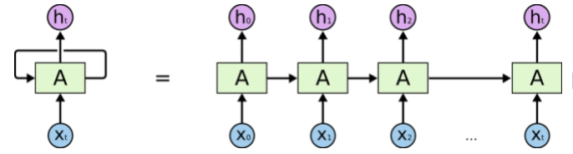
How Recurrent Neural Network help to solve this issue ?
RNN are neural networks with loops in them,allowing for information to persist.
A recurrent neural network can be thought of as multiple copies of the same network, each passing a message to a successor.

Slide 6
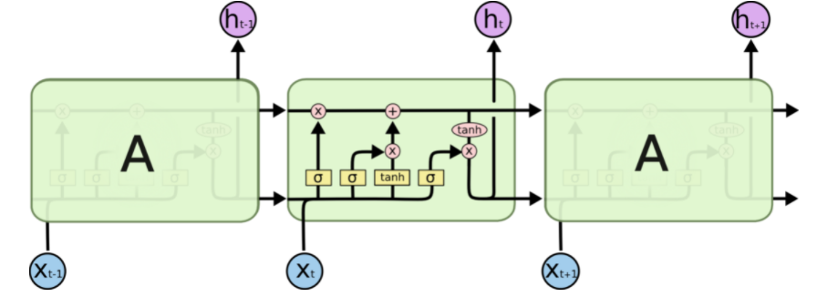
What are LSTM Networks ?
Long Short Term Memory (LSTM) – are a special kind of RNN, capable of learning long-term dependencies.
LSTMs are explicitly designed to avoid the long-term dependency problem. i.e. Remembering information for long periods of time.
LSTM can retain the information for long period of time. It is used for processing, predicting and classifying on the basis of time series data.

Slide 7
Forget, Input and Output gates
LSTM has a chain structure that contains four neural networks and different memory blocks called cells.
Information is retained by the cells and the memory manipulations are done by the gates. There are three gates --
Forget gate: The information that no longer useful in the cell state is removed with the forget gate.
Input gate: Addition of useful information to the cell state is done by input gate.
Output gate: The task of extracting useful information from the current cell state to be presented as an output is done by output gate.

Slide 8
Python code
import numpy as np
import matplotlib.pyplot as plt
import pandas as pd
from sklearn.preprocessing import MinMaxScaler
data = pd.read_csv('ETH-USD.csv', date_parser = True)
data.tail()
data_training = data[data['Date']< '2020-03-01'].copy()
data_training
data_test = data[data['Date']> '2020-03-01'].copy()
data_test
training_data = data_training.drop(['Date', 'Adj Close'], axis = 1)
training_data.head()
scaler = MinMaxScaler()
training_data = scaler.fit_transform(training_data)
training_data
X_train = []
Y_train = []
training_data.shape[0]
for i in range(60, training_data.shape[0]):
X_train.append(training_data[i-60:i])
Y_train.append(training_data[i,0])
X_train, Y_train = np.array(X_train), np.array(Y_train)
X_train.shape
from tensorflow.keras import Sequential
from tensorflow.keras.layers import Dense, LSTM, Dropout
regressor = Sequential()
regressor.add(LSTM(units = 50, activation = 'relu', return_sequences = True, input_shape = (X_train.shape[1], 5)))
regressor.add(Dropout(0.2))

Slide 9
regressor.add(LSTM(units = 60, activation = 'relu', return_sequences = True))
regressor.add(Dropout(0.3))
regressor.add(LSTM(units = 80, activation = 'relu', return_sequences = True))
regressor.add(Dropout(0.4))
regressor.add(LSTM(units = 120, activation = 'relu'))
regressor.add(Dropout(0.5))
regressor.add(Dense(units =1))
regressor.compile(optimizer = 'adam', loss = 'mean_squared_error')
regressor.fit(X_train, Y_train, epochs = 20, batch_size = 50)
past_60_days = data_training.tail(60)
df= past_60_days.append(data_test, ignore_index = True)
df = df.drop(['Date', 'Adj Close'], axis = 1)
df.head()
inputs = scaler.transform(df)
inputs
X_test = []
Y_test = []
for i in range (60, inputs.shape[0]):
X_test.append(inputs[i-60:i])
Y_test.append(inputs[i, 0])
X_test, Y_test = np.array(X_test), np.array(Y_test)
X_test.shape, Y_test.shape
Y_pred = regressor.predict(X_test)
scaler.scale_
scale = 1/7.15794819e-04
scale
Y_test = Y_test*scale
Y_pred = Y_pred*scale
plt.figure(figsize=(15,5))
plt.plot(Y_test, color = 'red', label = 'Real Ethereum Price')
plt.plot(Y_pred, color = 'green', label = 'Predicted Ethereum Price')
plt.title('Ethereum Price Prediction using RNN-LSTM')
plt.xlabel('Time')
plt.ylabel('Price')
plt.legend()
plt.show()

Slide 10
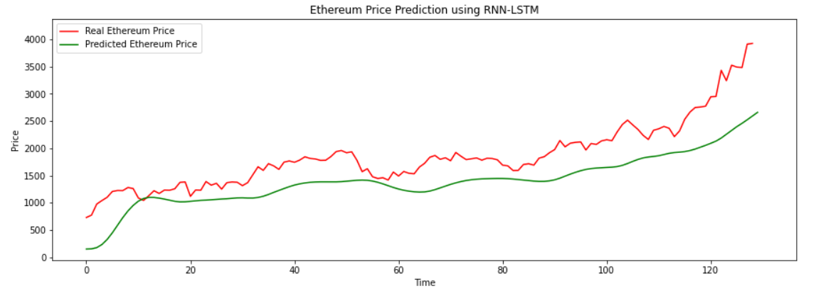
Output

Slide 11
Thank you !

