Slide 1
KrishiGruha
JWT + Bcrypt
634 - Sagar Parker

Slide 2

What is KrishiGruha ?
KrishiGruha is an mobile app made for farmers/customers to sell/buy farm products online.
It allows users to buy/sell their products at a standardised price.

Slide 3
Technologies used for development
JWT - Authentication
Bcrypt - Hashing data
React Native - Mobile APK
Node.js (Heroku) - Backend API server
MongoDB - Database

Slide 4
What is JWT ?
A JSON web token(JWT) is a JSON Object which is used to securely transfer information over the web(between two parties).
It can be used for an authentication system and can also be used for information exchange.
This information can be verified and trusted because it is digitally signed.
JWTs can be signed using a secret (with the HMAC algorithm) or a public/private key pair using RSA or ECDSA.

Slide 5
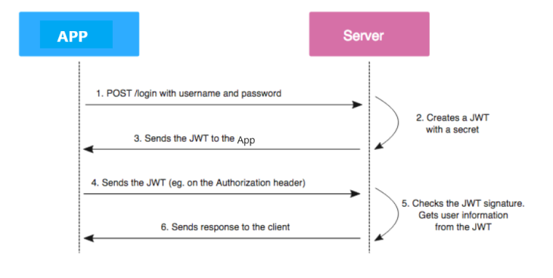
How JWT authentication works

Slide 6
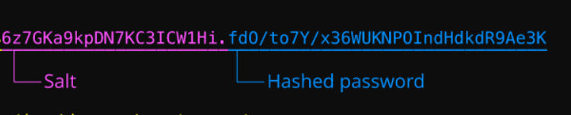
How I have used Bcrypt
Storing users password as salted hash in the MongoDB database
Creating an API key for autheticating the APIs

Slide 7
Code
const jwt = require("jsonwebtoken");
const bcrypt = require("bcryptjs");
require("dotenv").config();
//Generate token
exports.generateToken = (payload) => {
return jwt.sign(payload, process.env.TOKEN_SECRET, {
expiresIn: "90d",
});
};
//Check for authentication
exports.isAuthenticated=(req,res,next)=>{
var authHeader =
req.body.token ||
req.query.token ||
req.headers["authorization"];
if (authHeader) {
let token = authHeader.split(" ");
jwt.verify(token[0], process.env.TOKEN_SECRET, function (err, decoded) {
if (err) {
return res
.status(401)
.send({ success: false, message: "Failed to authenticate token." });
} else {
req.decoded = decoded;
next();
}
});

Slide 8
} else {
return res.status(401).send({
success: false,
message: "No token provided.",
});
}
}
// Generate token with payload
let payload = {
email: data[0].email,
username:data[0].username,
id:data[0]._id
};
const token = generateToken(payload);

Slide 9
router.post('/verifyUser',
isAuthenticated,
async (req,res)=>{
try{
const userData = await UserAuthModel.find({ $or:[ {email:req.decoded.email},{username:req.decoded.username}]});
if(userData.length>0){
res.status(200).json({
msg:"User is a valid registered user",
result:true
})
}
else{
res.status(404).json({
error:"User doesn't exist",
result:false
})
}
}catch(err){
return res.status(500).json({
msg:"Failed to verify user.",
result:false,
err
});
}});

Slide 10
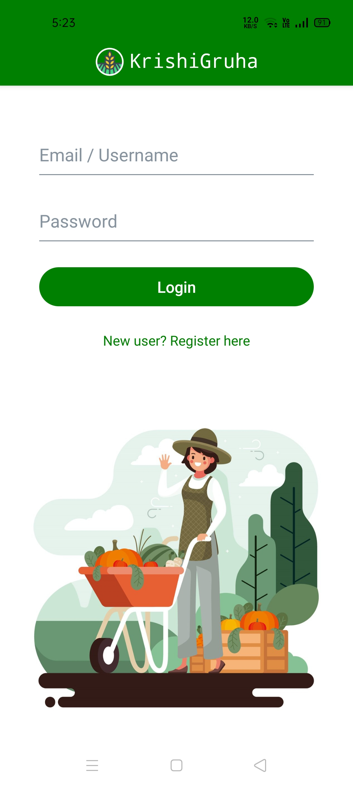
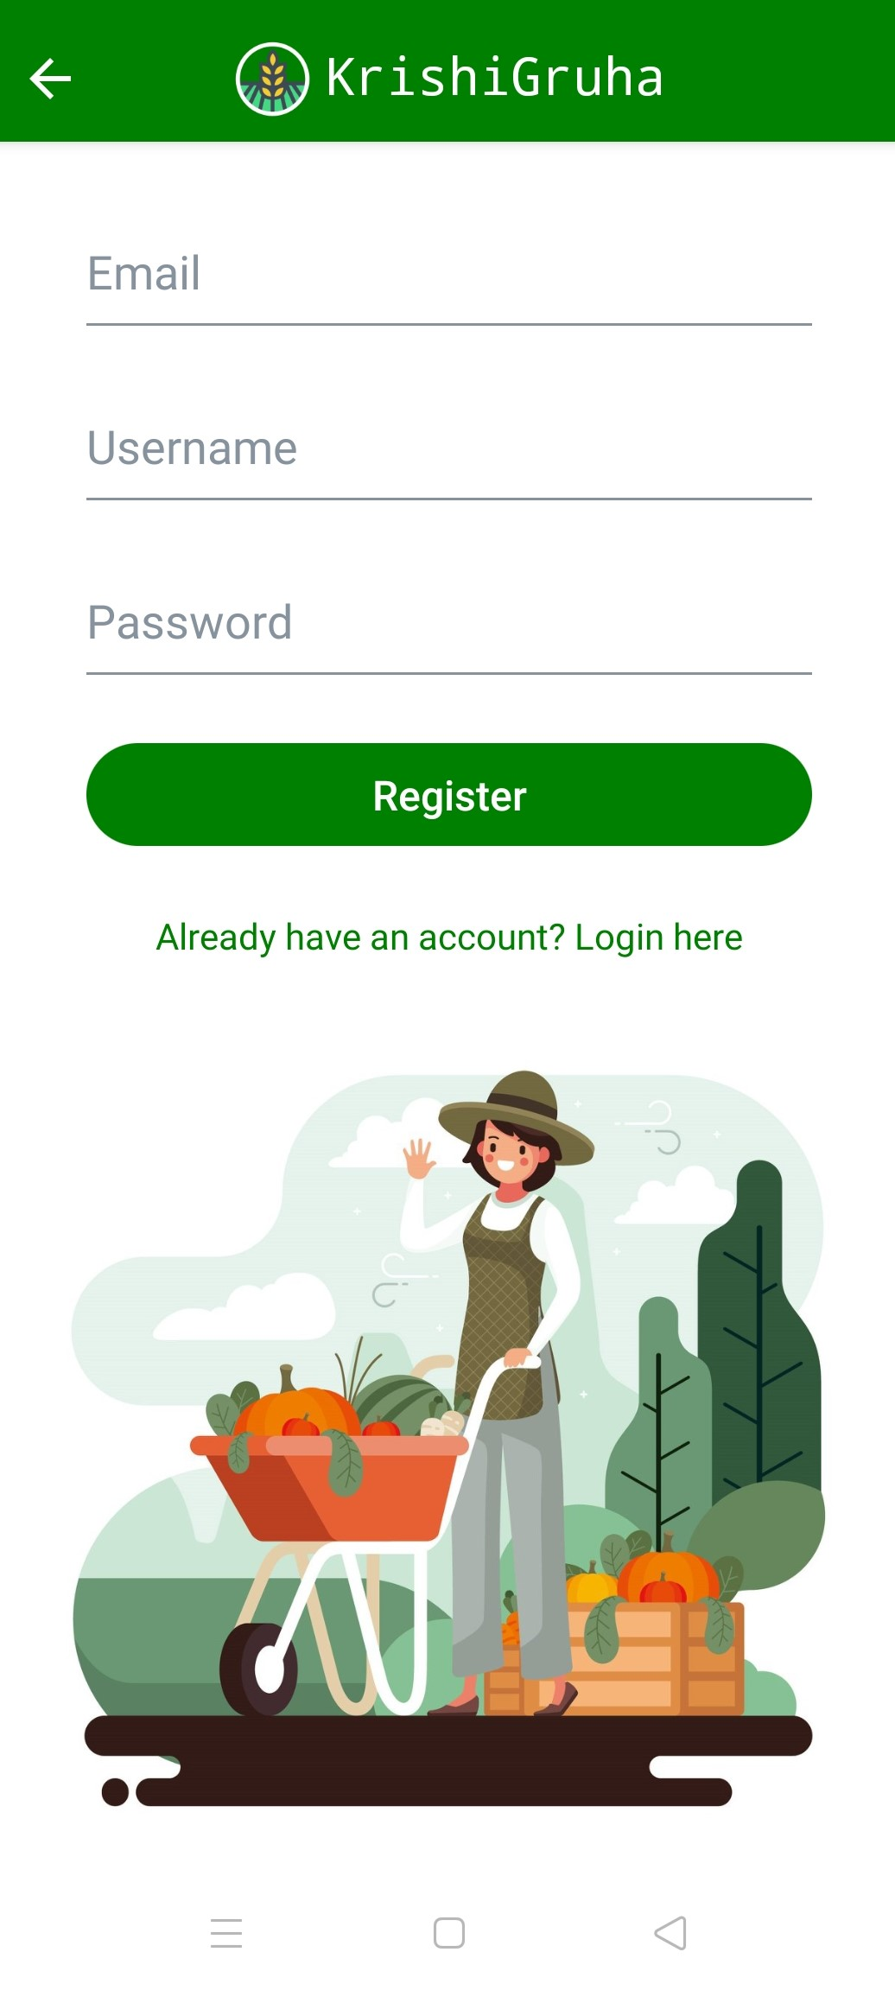
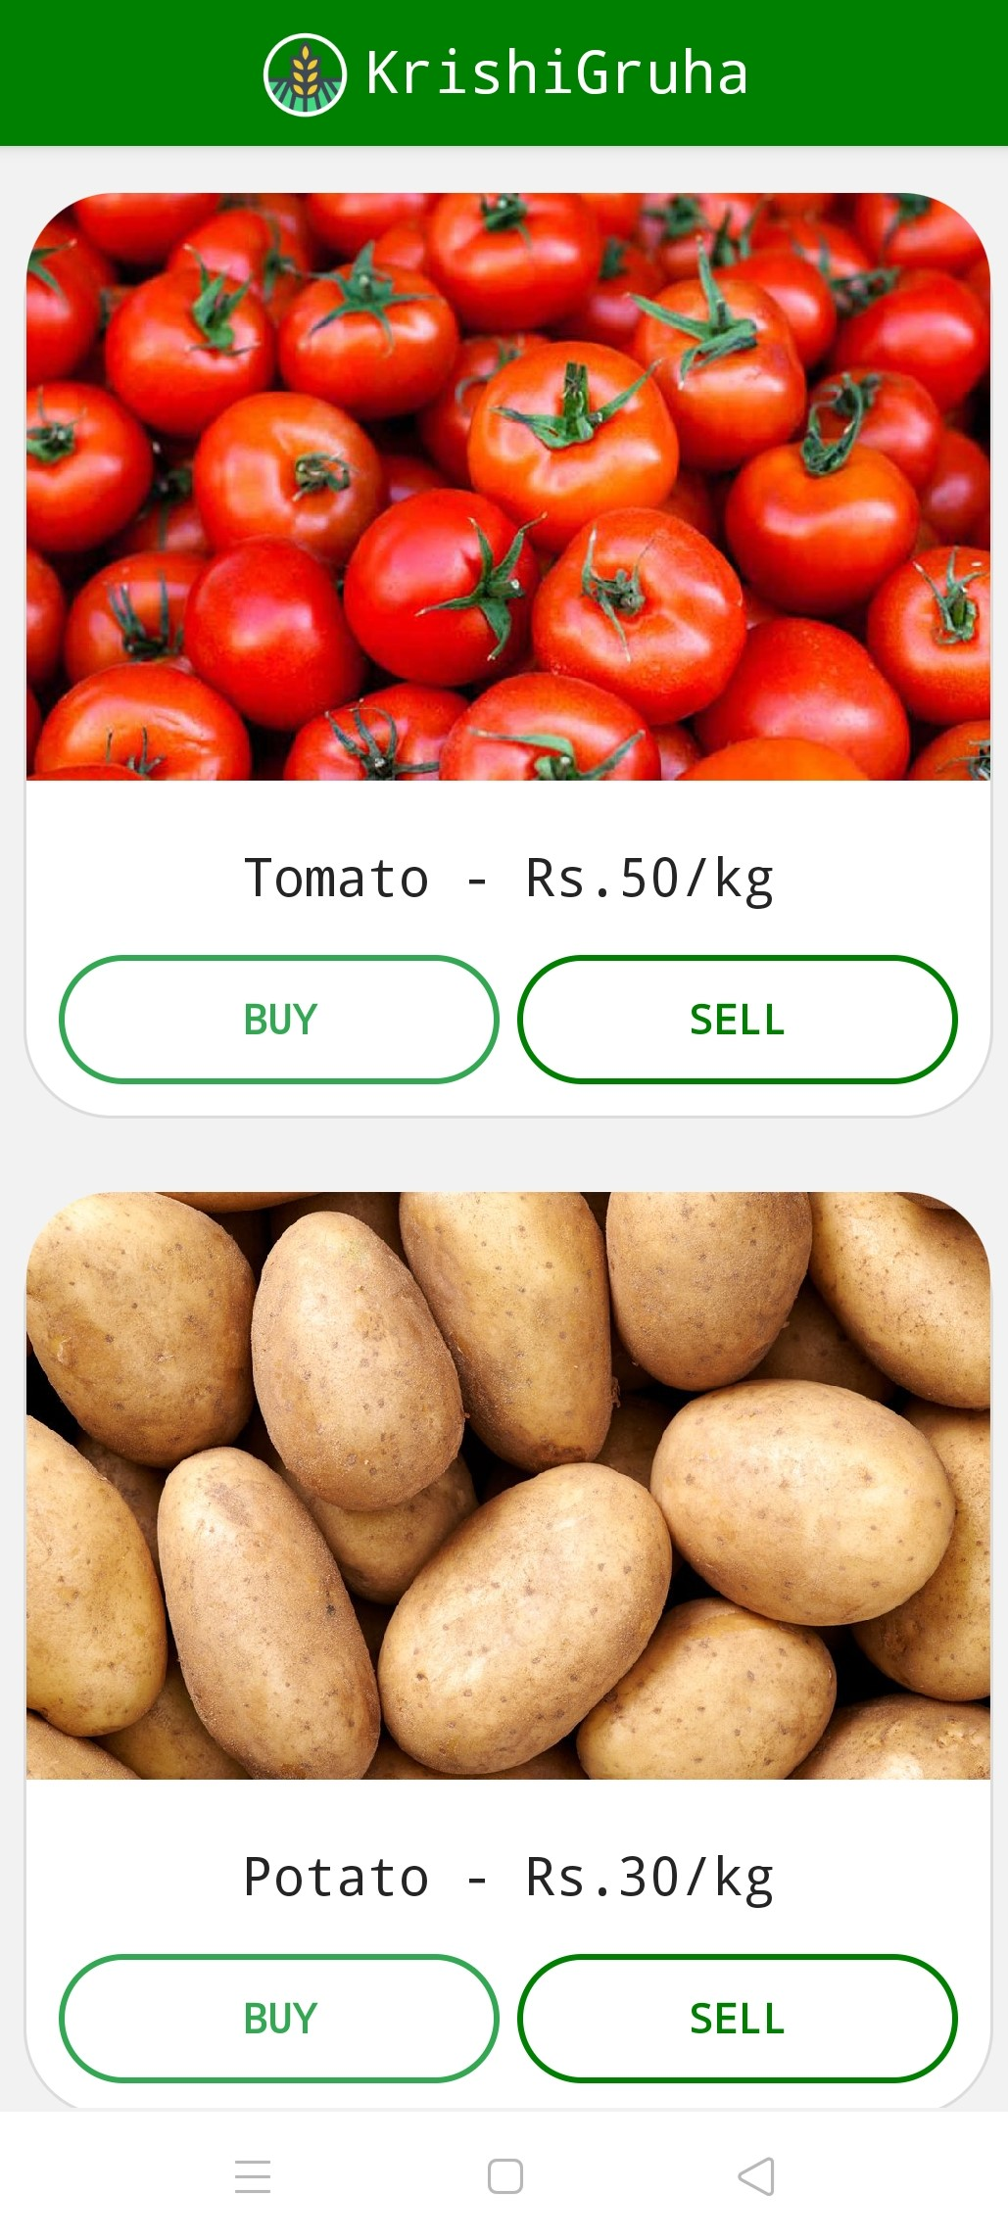
Outputs

Slide 11
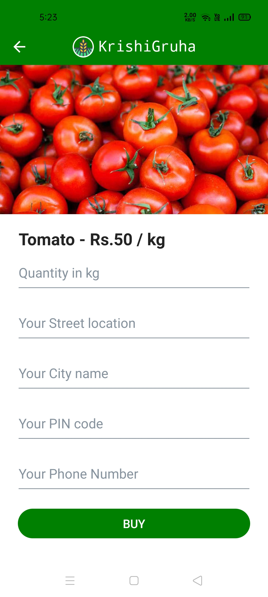

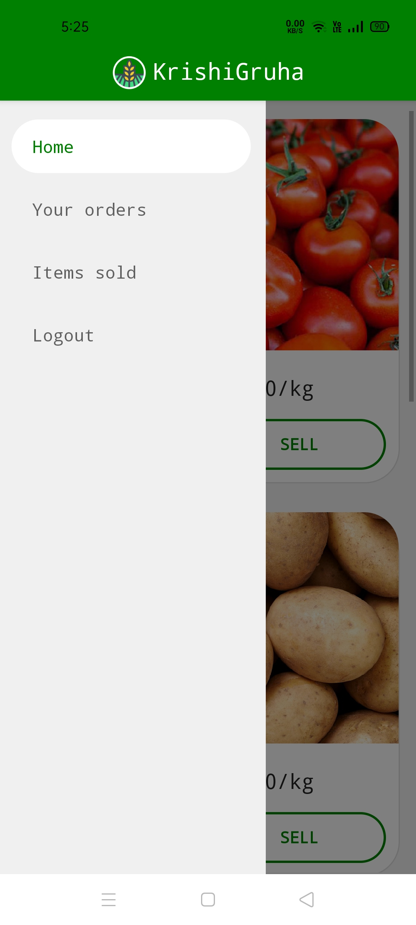
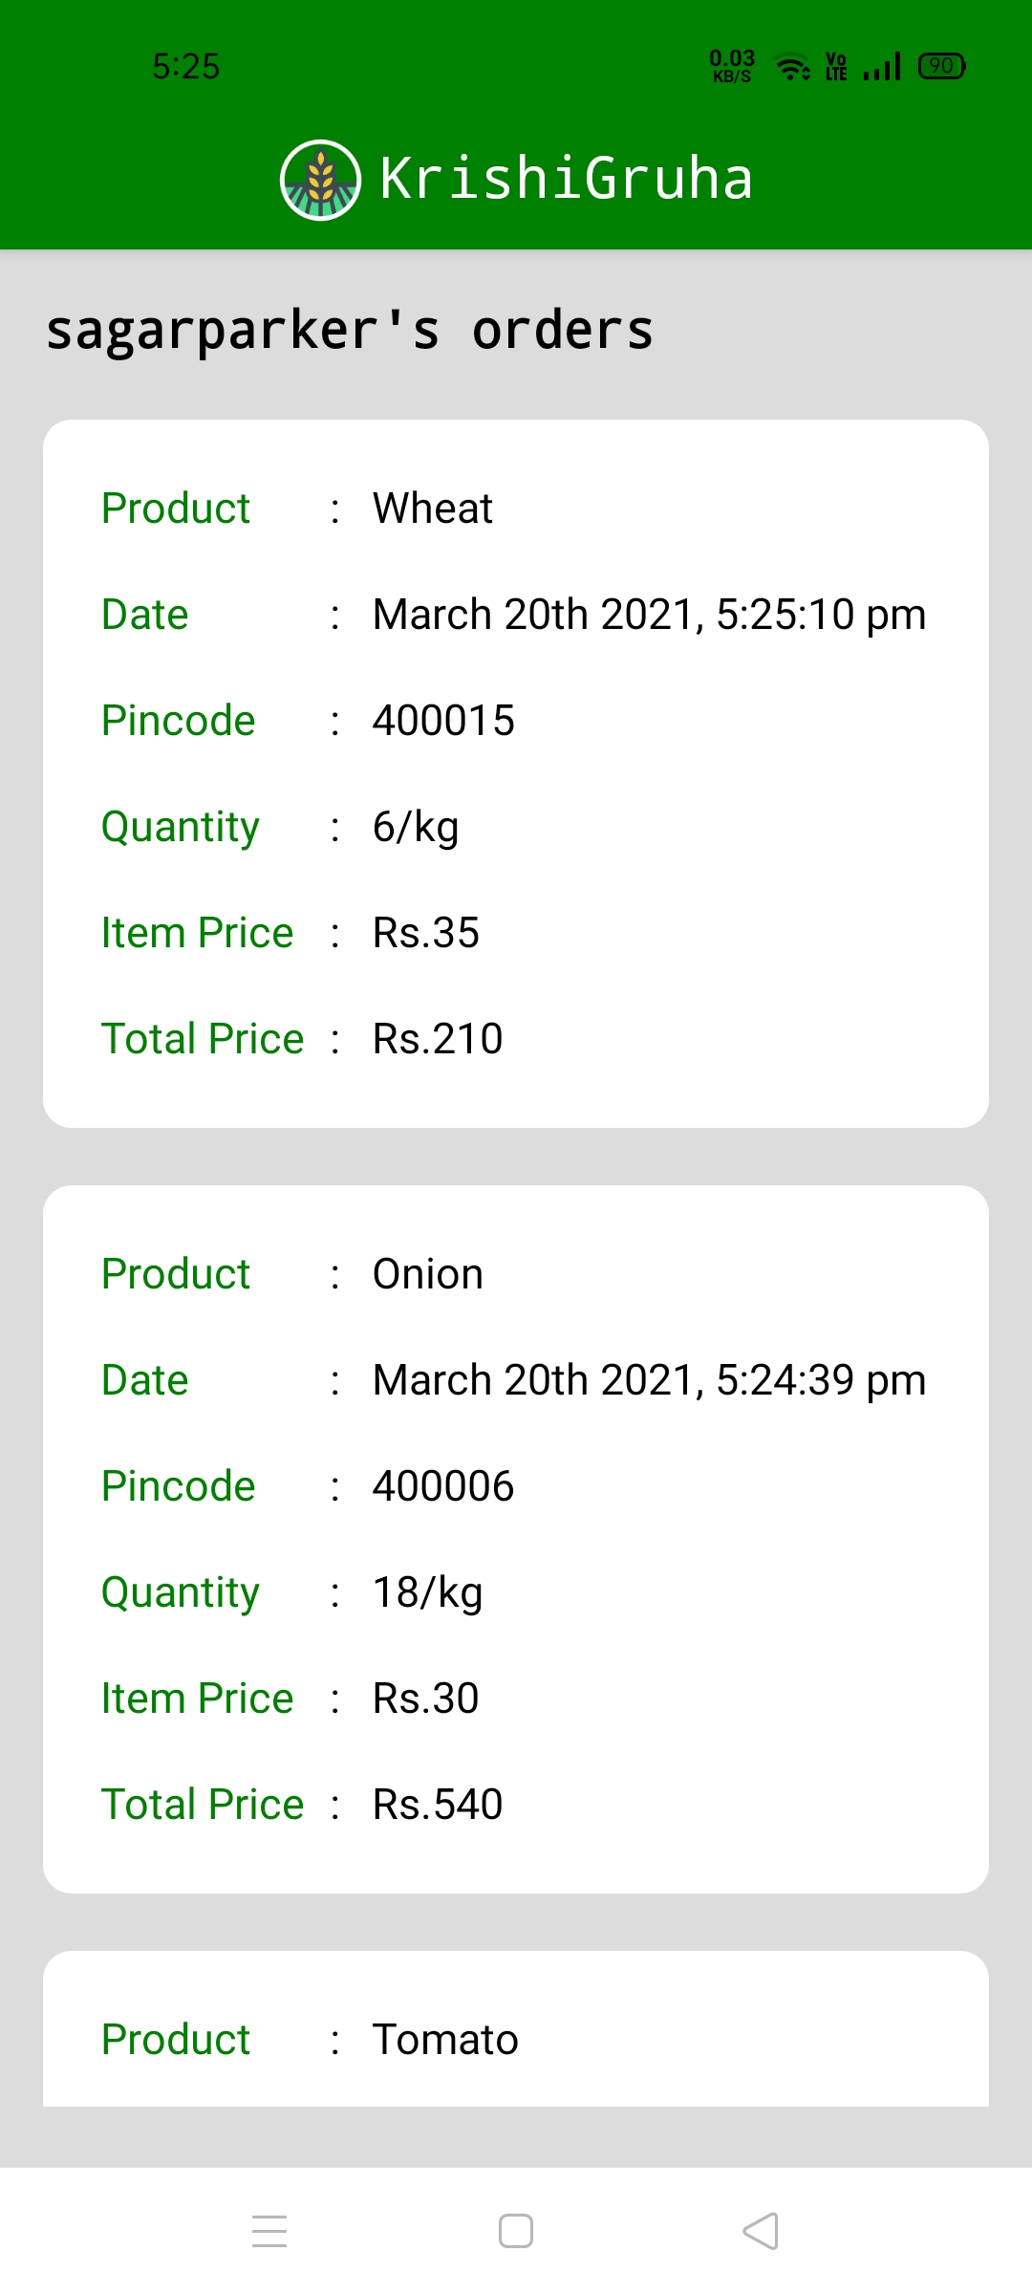
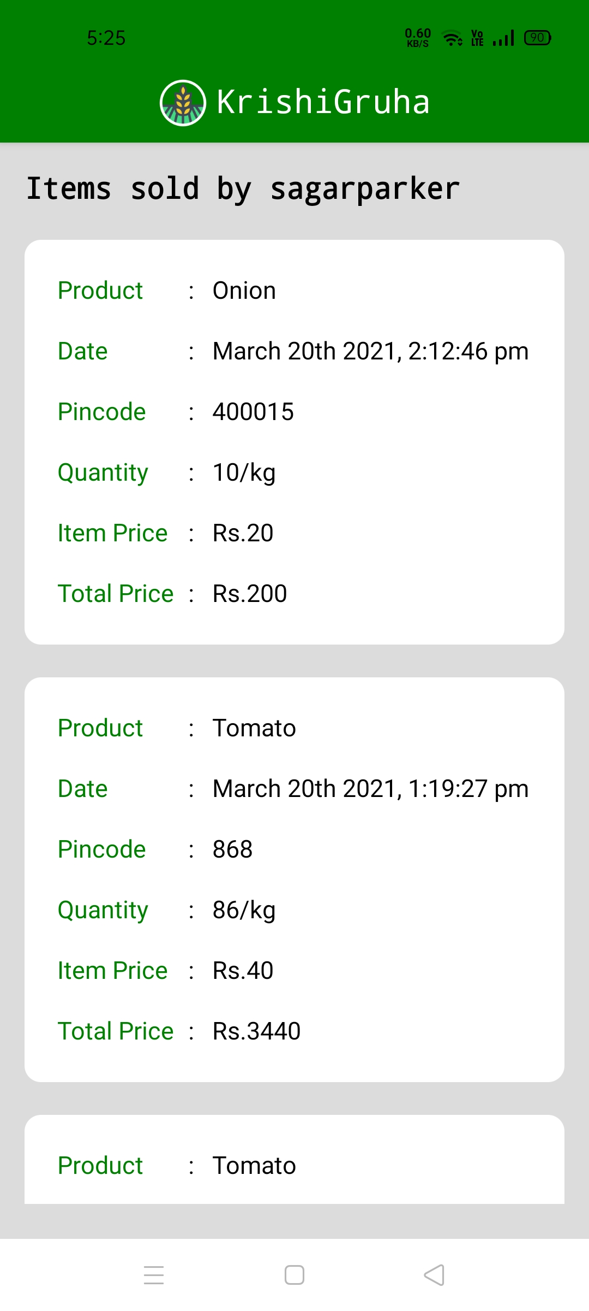

Slide 12
Thank you !

