Slide 1

Reddit posts sentiment analysis
Sagar Ajay Parker

Slide 2
What is sentiment analysis?
Sentiment Analysis is the process of determining whether a piece of writing is positive, negative or neutral.
A sentiment analysis system for text analysis combines natural language processing (NLP) and machine learning techniques to assign scores to the entities, topics, themes and categories within a sentence or phrase.
Sentiment analysis helps data analysts within large enterprises to understand public opinion, conduct nuanced market research, monitor brand and product reputation, and understand customer experiences

Slide 3
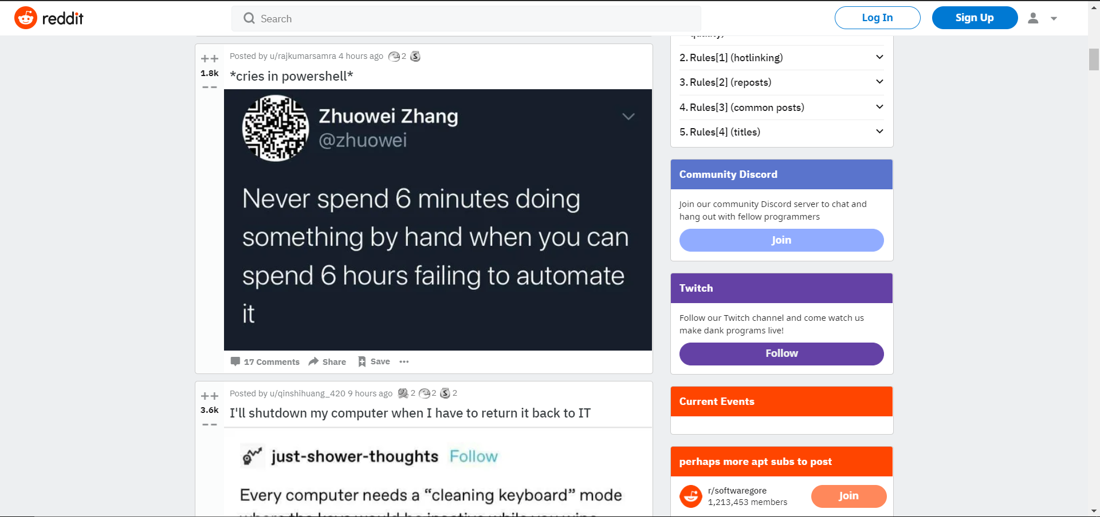
What is reddit?
Reddit is a community-determined aggregator of content. It is a social platform where users submit posts that other users 'upvote' or 'downvote' based on if they like it. If a post gets lots of upvotes it moves up the Reddit rankings so that more people can see it.

Slide 4
Libraries/module used in this project
scikit-learn
pandas
matplotlib
warnings
os
string

Slide 5
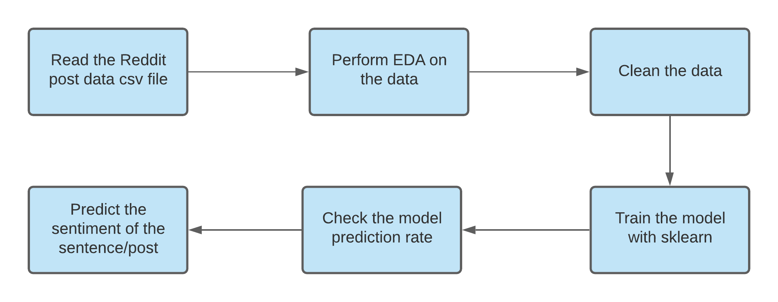
How I used NLP to perform reddit posts sentiment analysis

Slide 6
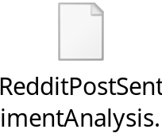
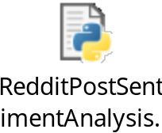
Python Code :

Slide 7
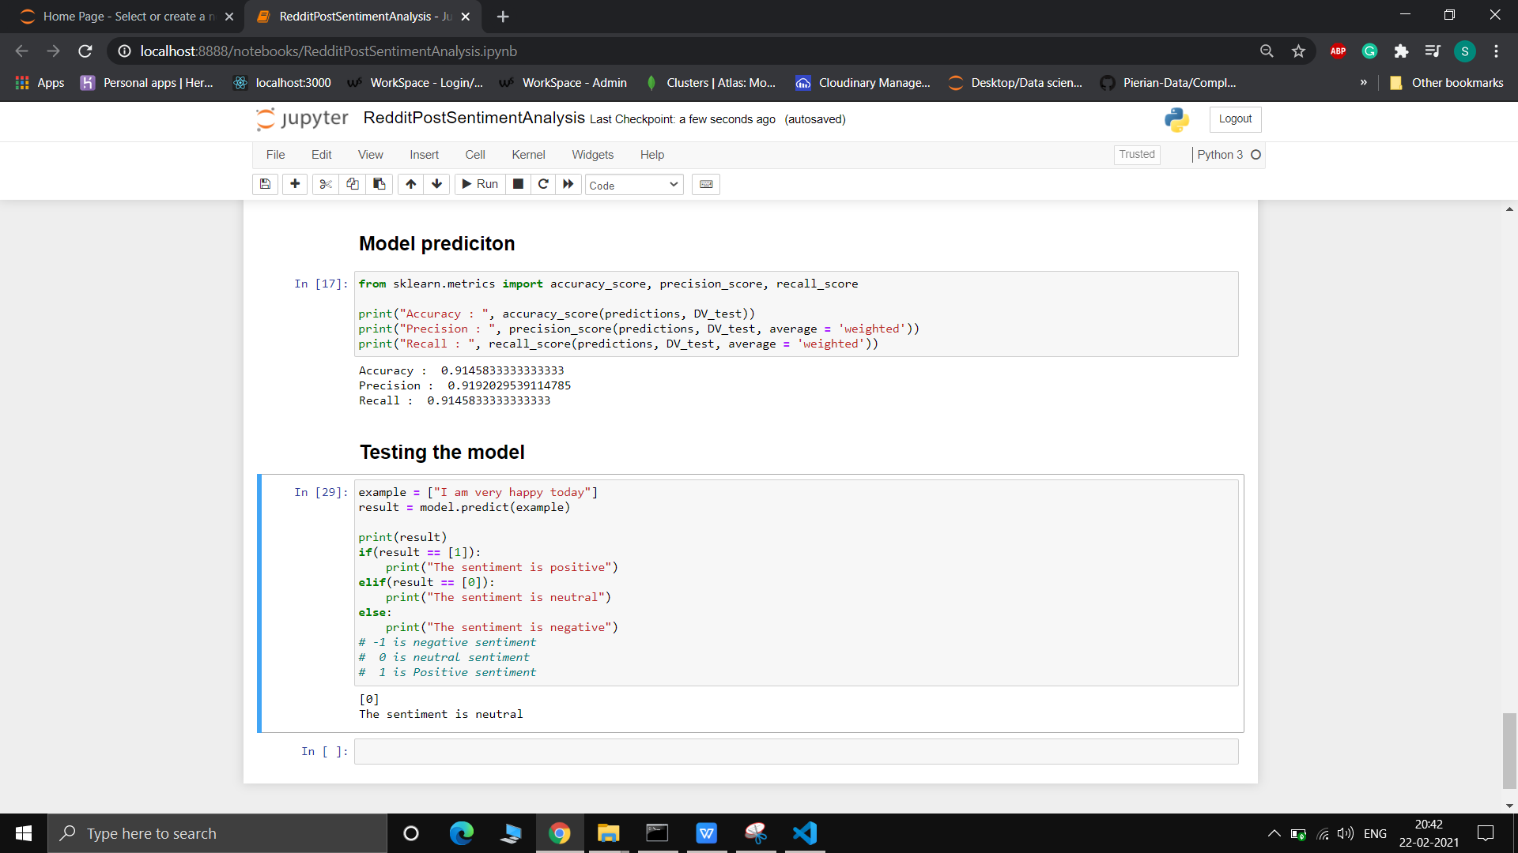
Output

Slide 8
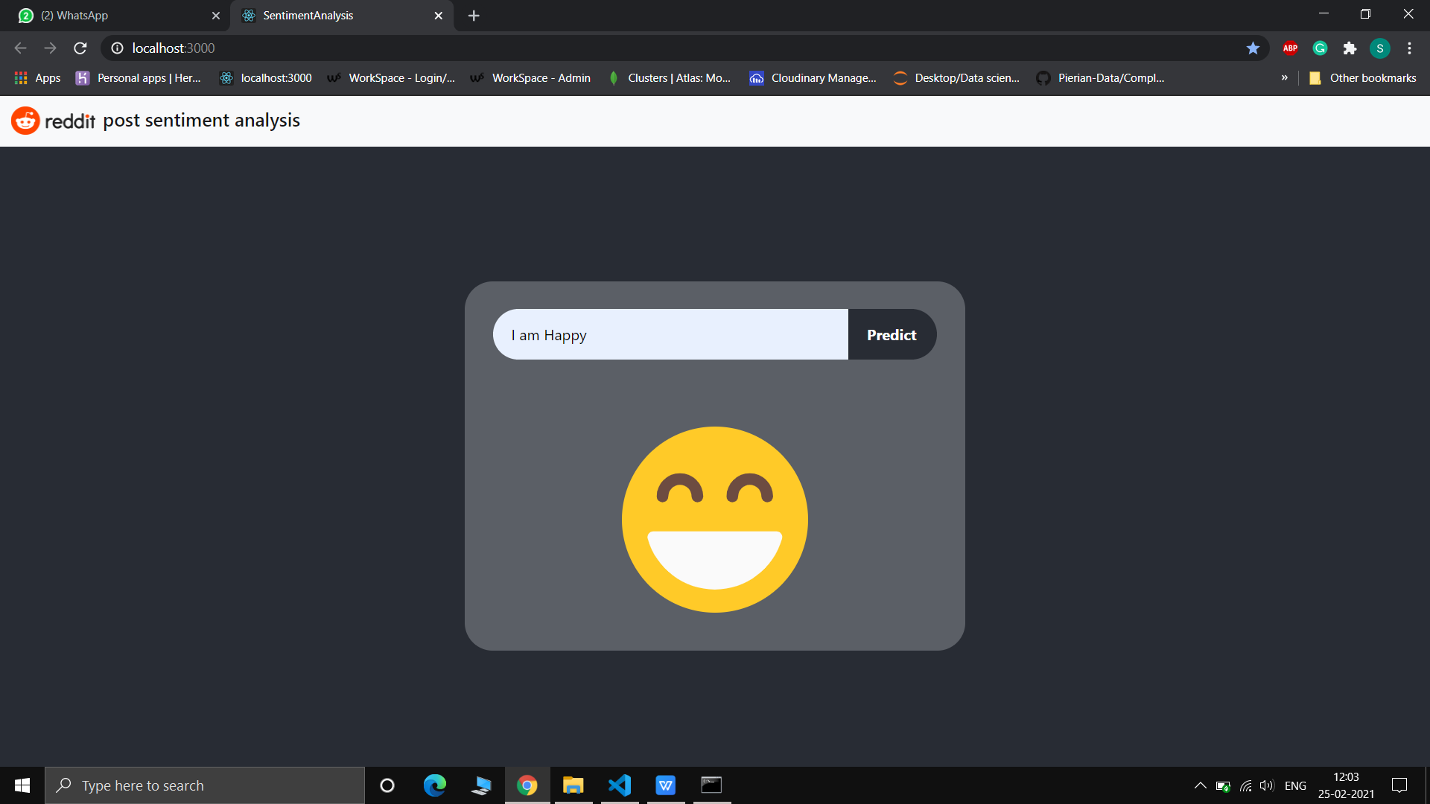
Output : Positive sentiment

Slide 9
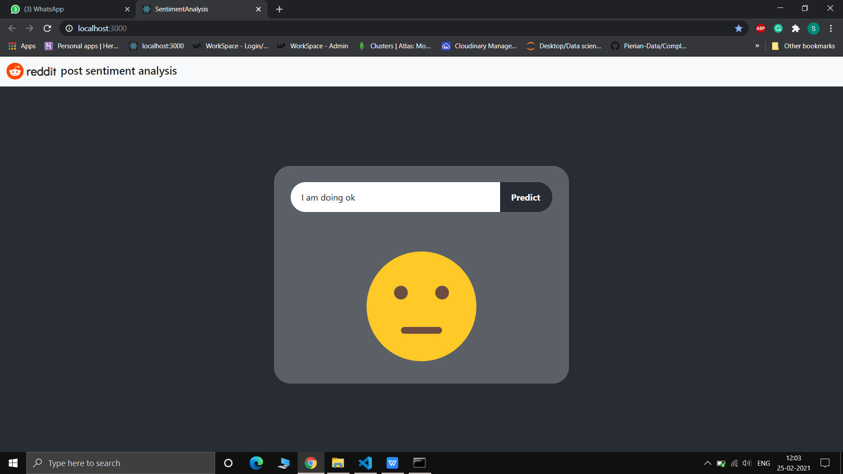
Output : Neutral sentiment

Slide 10

Output : Negative sentiment

Slide 11
Thank you!

