Slide 1

Peer to Peer
communication
634 - Sagar Parker

Slide 2
What is WebRTC ?
Web Real-Time Communications (WebRTC) is an open source project created by Google to enable peer-to-peer communication between mobile applications and web browsers through application programming interfaces ( APIs ).
WebRTC allows us to exchange video,audio and other data with peer-to-peer communication.
WebRTC enables us to create high-quality RTC applications that can be used in Chrome, Firefox, Opera, and Android, as well as natively on iOS and Android.

Slide 3
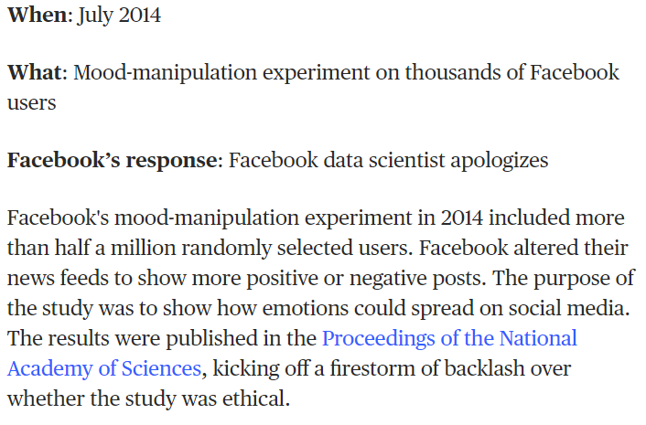
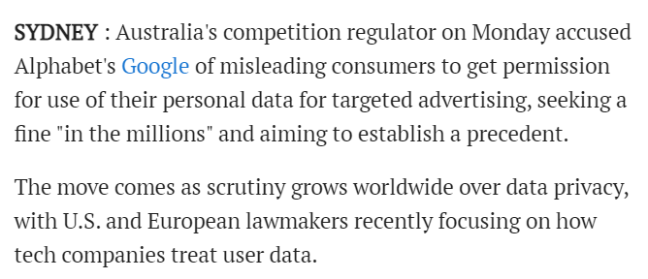
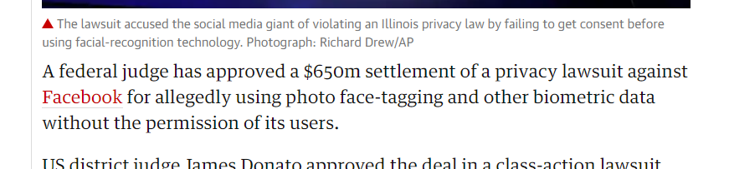
Why is decentralization booming ?

Slide 4
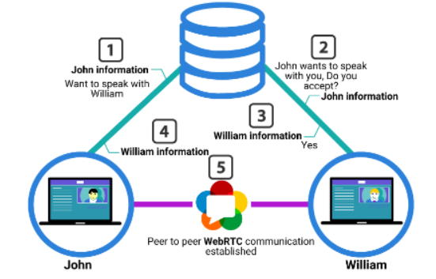
How does WebRTC work ?

Slide 5
APIs provided by WebRTC
getUserMedia() - accesses the audio and video available on our device by accessing the camera and microphone.
MediaRecorder - records audio and video available from our device.
RTCPeerConnection - allows peer-to-peer audio and video communication. This includes the initial connection, monitoring the connection, and closing the connection.
RTCDataChannel - enables bidirectional transfers of data between two peers.

Slide 6
Technologies used to create a WebRTC chat app
Javascript
Node.js
HTML
CSS / Bootstrap
budo
simple-peer

Slide 7
JS Code :
const Peer = require('simple-peer');
const peer = new Peer({
initiator: location.hash === '#init',
trickle: false
})
window.onload = function(){
peer.on('signal', function (data) {
document.getElementById('yourId').value = JSON.stringify(data)
})
document.getElementById('connect').addEventListener('click', function () {
var otherId = JSON.parse(document.getElementById('otherId').value)
peer.signal(otherId)
})
document.getElementById('send').addEventListener('click', function () {
var msgDiv = document.getElementById('msgList');
var newMsg = document.createElement("li");
var yourMessage = document.getElementById('yourMessage').value;
newMsg.innerHTML = yourMessage;
msgDiv.appendChild(newMsg);
peer.send(yourMessage)
})
peer.on('data', function (data) {
var msgDiv = document.getElementById('msgList');
var newMsg = document.createElement("li");
newMsg.innerHTML = data;
msgDiv.appendChild(newMsg);
})
}

Slide 8
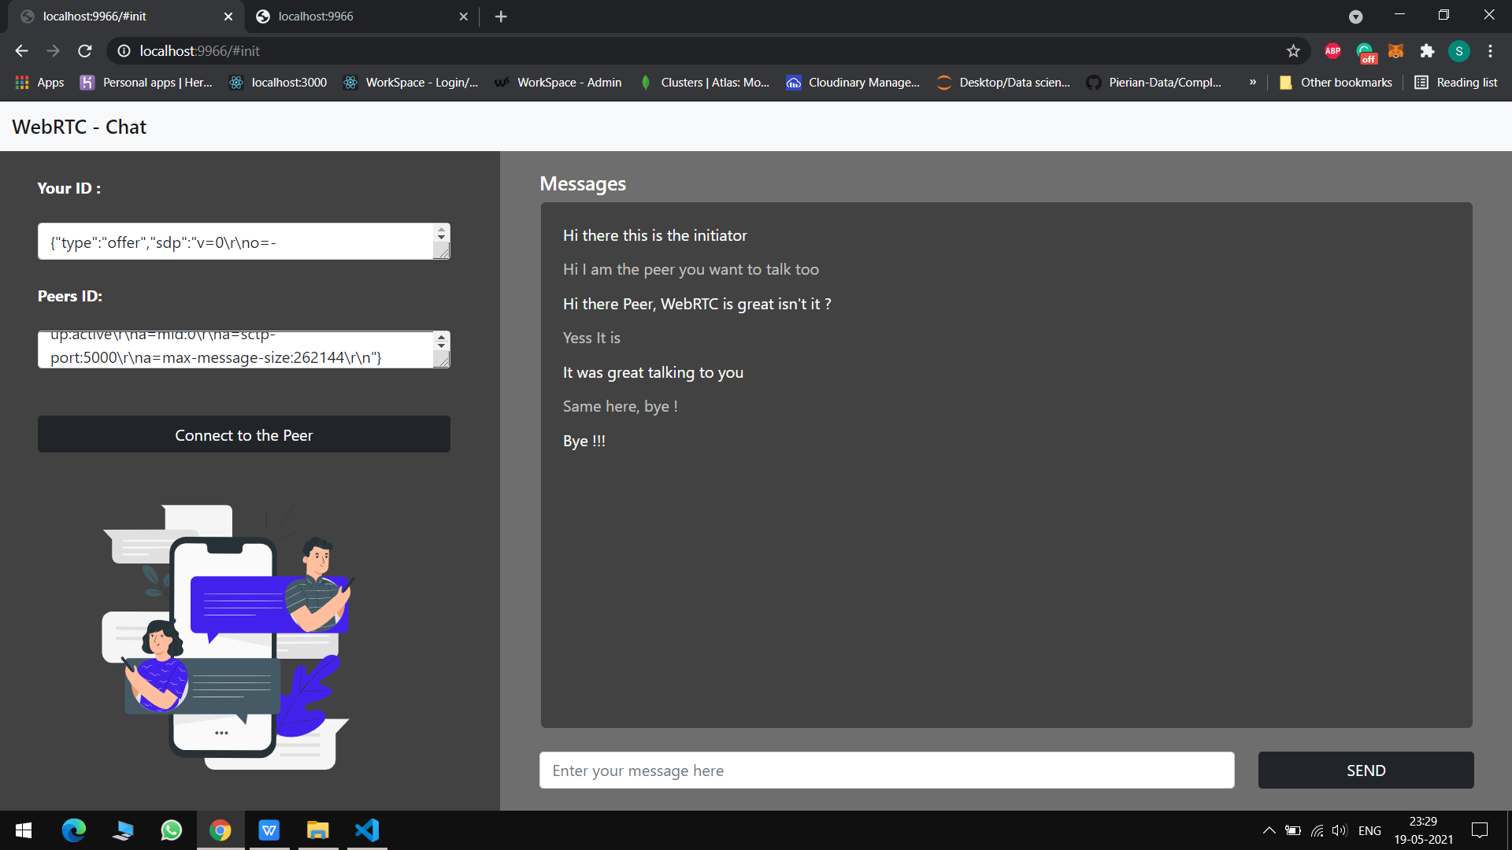
Output : Initiator

Slide 9
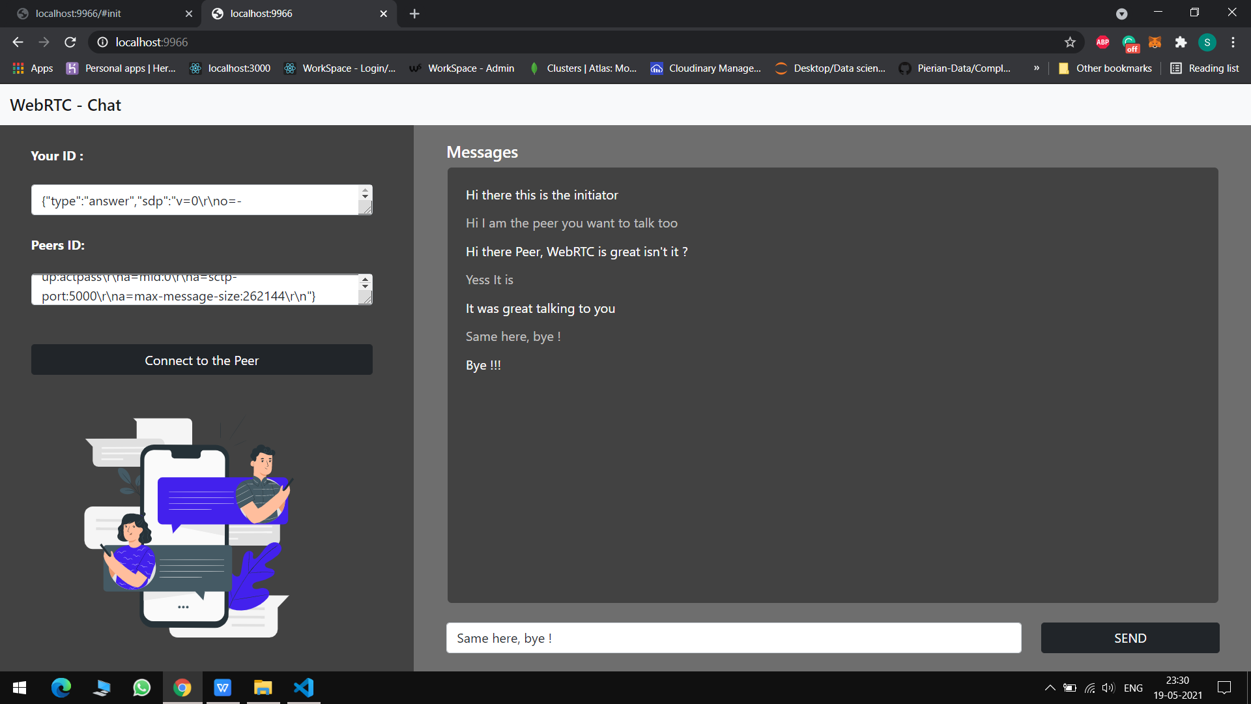
Output : Peer

Slide 10
Thank you !

