Slide 1
FRAUDULENT CLAIM DETECTION

Slide 2
Overview
Summary
Visual Insights from Models
Business Implications
Recommendations
Answers for Problem Statement Questions

Slide 3
Summary
Fraudulent Claim Detection project is about a leading company, Global Insure, which is facing challenge in detecting fraudulent claims resulting in considerable financial losses.
Company is now detecting fraudulent claims by manual inspections, which is time-consuming and inefficient.
These fraudulent claims are detected later at a stage after company has already paid out significant amounts.
Now, Company wants to improve its fraud detection process using data-driven insights to classify claims as fraudulent or legitimate early in the approval process.
This would minimize financial losses and optimize the overall claims handling process.
In this project, using a dataset of historical claims, a machine learning pipeline was developed that includes data cleansing, EDA Analysis, feature engineering and model building.

Slide 4
Summary Contd.
In this, we have built Logistic Regression Model and Random Forest to classify claims as fraudulent or legitimate for getting better insights and to improve accuracy.
These models demonstrated strong performance in identifying fraud patterns, and features that affect fraud patterns.
This will help company to reduce financial losses, and it will be able to predict which claims are likely to be fraudulent before they are approved.
As Model performance is good, we can incorporate feature importance analysis into operational decisions.
By incorporating this process, Global Insure can reduce financial losses, by facing fraud challenges earlier before claim payments and ensuring trust with its clients for legitimate claims.

Slide 5
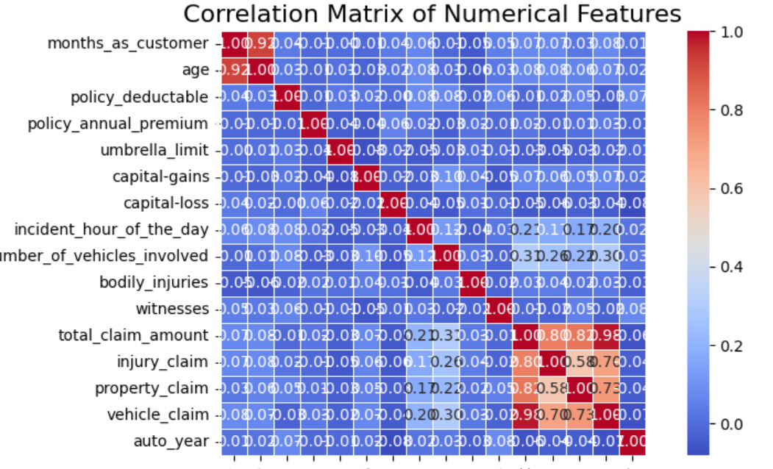
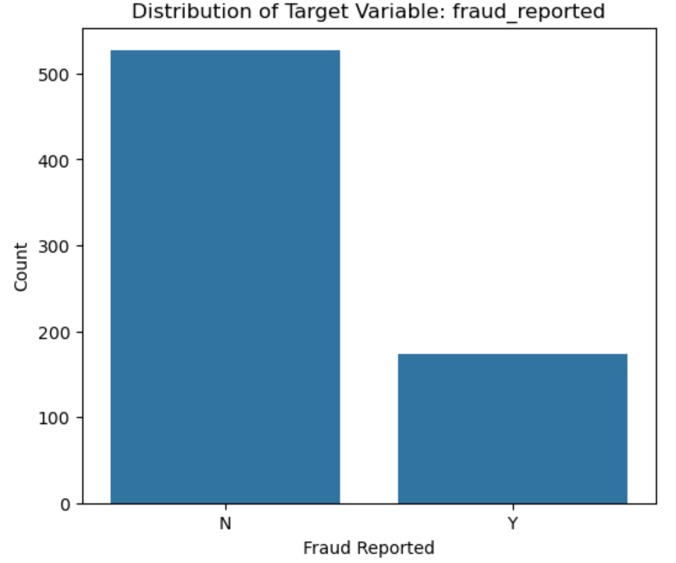
VISUAL INSIGHTS FROM MODEL BUILDING
From this bar representation of historical data, we are able to infer that Fraud reported claims are minor class and thus we did random sampling.
From this heatmap using correlation matrix of Numerical features, there is relation between features which can be treated for model building.

Slide 6
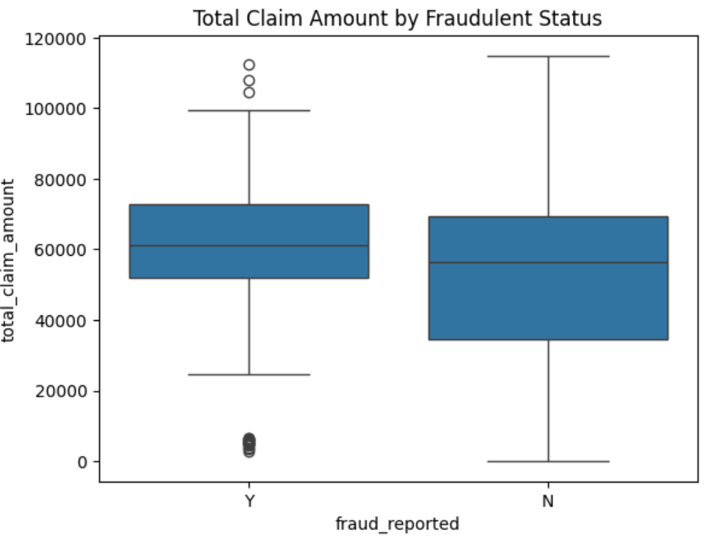
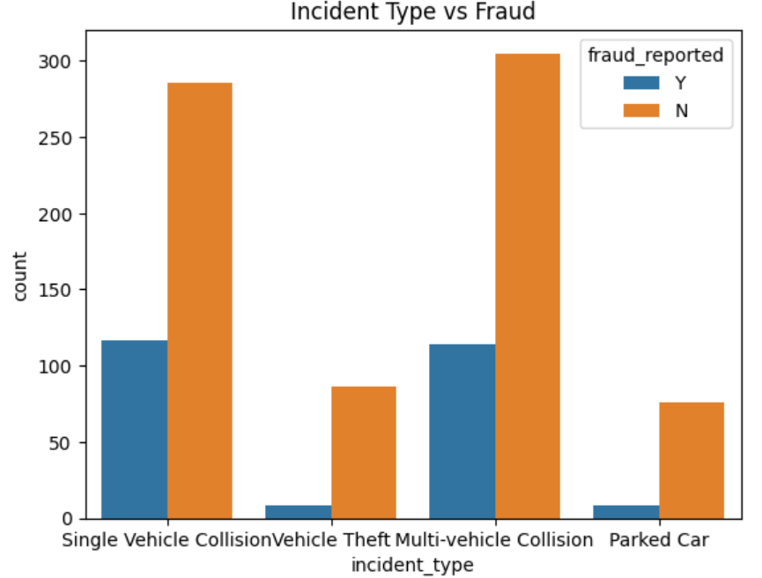
VISUAL INSIGHTS FROM MODEL BUILDING CONTD
This explains us about the Total Claim amount that differs with Fraudulent and Legitimate Claims.
Also, this important feature Incident type, that affects fraud in a way it is showed from this representation which means Single Vehicle Collision and Multi-vehicle collision has more chances of fraud if compared with other Incident types.

Slide 7
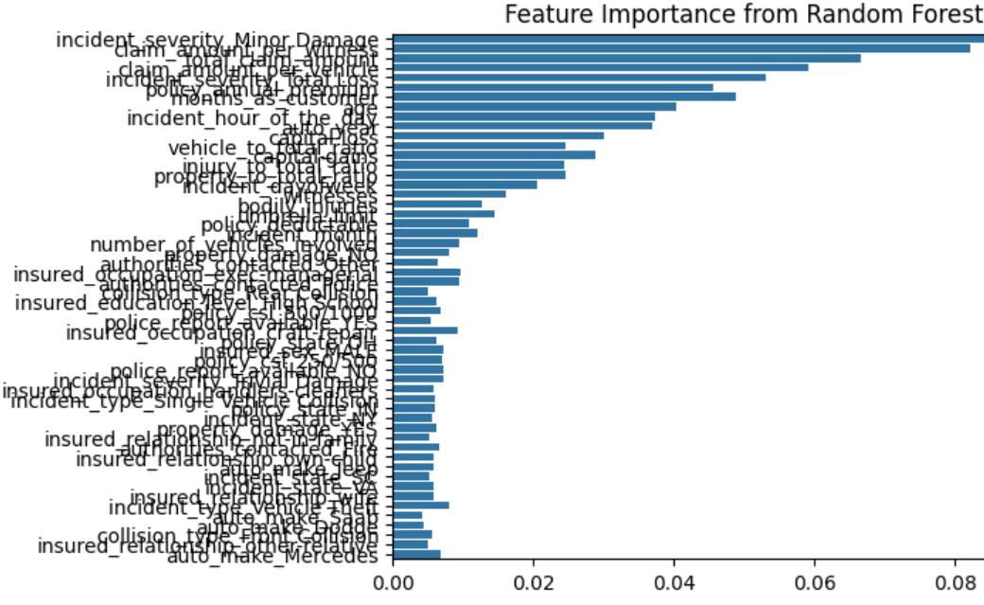
VISUAL INSIGHTS FROM MODEL BUILDING CONTD
From this plot, we can infer which features are important for our analysis and this shows incident_severity, total_claim_amount, Insured_hobbies, Umbrella_limit, Injury_claim, incident_type, insured_occupation etc.

Slide 8
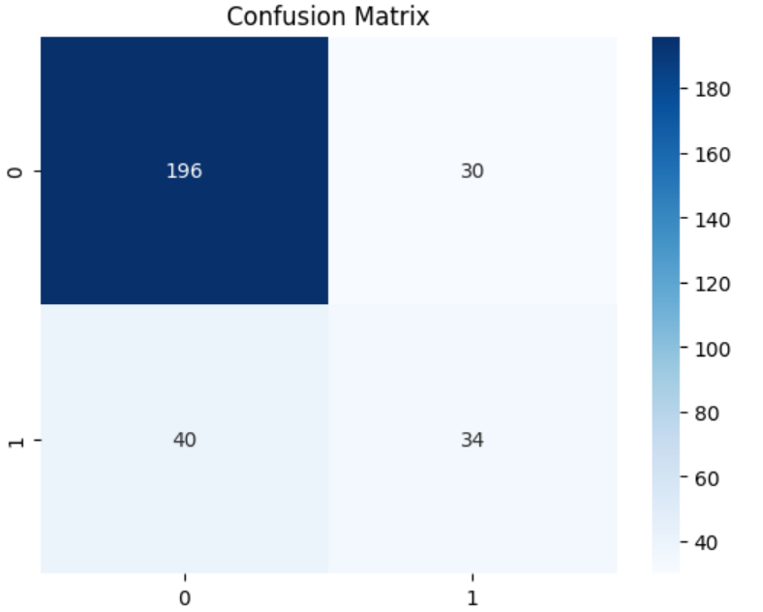
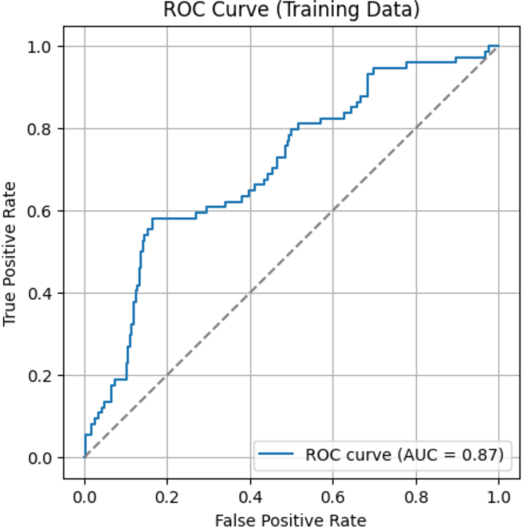
VISUAL INSIGHTS FROM MODEL BUILDING CONTD
CONFUSION MATRIX
ROC CURVE
From the plots above, we can infer about the performance of models over Fraudulent claim detection which provides better insights for predicting likelihood for new claims.

Slide 9
Business Implications Of Models
By finding fraud claims early, the company can avoid paying amounts for illegitimate claims.
By incorporating this analysis into operational decisions, we are able to reduce financial loss for the company.
Also, by this process, we can reduce manual inspection thereby maintaining time effectively and with lesser costs.
With the reduced manpower and resources, claims can be fast-tracked which will improve customer relation with company.
This builds trust and satisfaction in customers which is beneficial for company in long run.
By using historical data, model provides insights on features which contribute to fraudulent claims thereby helping us to focus on business rules and policies for avoiding such claims.
Preventing some fraud claims improves the profitability for company as they will be spending less on claims and on manual inspection.

Slide 10
Recommendations
Based on model performance, with metrics calculated it is safe to infer that incorporating feature importance analysis into operational decisions with more than 80 percent accuracy in finding fraud claims.
These models need to be refined periodically with new data for preventing it become outdated for Fraud detection process.
If we still need higher accuracy, based on business decisions finetuning models is possible using other ensemble models and techniques.

Slide 11
Assignment Q&A
How can we analyse historical claim data to detect patterns that indicate fraudulent claims?
From Machine Learning Model building, we can analyse Historical Claim data to detect patterns for indicating fraudulent claims using following methods.
Exploratory Data Analysis – This explains the characteristics of each feature either individually or in comparison with target variable; by plotting visually we can understand their behaviors.
Another method we can use is Correlation analysis for all numerical variables which gives relation between different features.
Feature Segmentation – Analysing target variable accross categories helps in getting more insights about target variable behaviour.

Slide 12
Assignment Q&A
2. Which features are most predictive of fraudulent behaviour?
From the model building and its evaluation, we have features that are more important for prediction are:
incident_severity – From the plot, high severity claims are more likely to be fraudulent.
Insured_hobbies – Some hobbies of users have more probability for getting fraud claims.
Total_claim_amount – Larger claims have more predicted fraud cases.
Umbrella_limit – This also has some effect of fraudulent claims.
Injury_claim – Unusual injury claims are suspicious to consider.

Slide 13
Assignment Q&A
3. Can we predict the likelihood of fraud for an incoming claim, based on past data?
Using our trained Random Forest model we are able to predict the likelihood of fraud for a new claim based on past data with an accuracy of 0.78.
Using model, we can classify a claim as either Fraud or Legitimate.
This will help Company conduct inspection on suspicious cases early before releasing claim amount for fraud claims.

Slide 14
Assignment Q&A
4. What insights can be drawn from the model that can help in improving the fraud detection process?
The Key insights that we can infer from model for improving fraud detection process are:
Introducing these data driven inferences in operations will help to track suspicious claims more effectively.
Claims that are legitimate as per model can be processed fastly to improve customer experience.
Resources utilized for manual inspection of claims can be reduced and just focus on claims that have high probability for fraud.
We can train the model continuously and by updating it regularly fraud detection process can be more efficient and less time consuming which helps in preventing financial loss.

Slide 15
Conclusion
Fraudulent Claim Detection project successfully explains about how ML models can be used to solve critical issues of a company by using historical data and ML techniques.
For the company, by using Random Forest Model, it can classify a claim as Fraudulent or Legitimate based on data driven approach with time efficiency.
This project provided an approach to solve fraud claim issue and improve company services with increased profitability.
This improves customer relation and trust with the company.

