Slide 1
Machine Learning for Personalising Assistance for Kids with Diabetes
Sagar Patel – CID: 00842688

Slide 2
PAL Project
Imperial Personal Robotics Laboratory is in collaboration with the PAL project
Develop a suite of applications to assist children with diabetes:
Monitoring and Information tools for parents
Authoring and control tools for healthcare providers
Personalised education applications for children
Notes:
This project involves working on the Personal Assistance for Healthy Lifestyle Project, with Imperials Personal Robotics Lab. It is an EU funded project which aims to aide children with the management of diabetes using a suite of applications that provide…

Slide 3
Project Objectives
This project assists the development of an existing task-based learning application within the PAL architecture.
The project was tasked to solve two key problems that exist in the current application:
Providing relevant task recommendation specific to each child
New user bootstrapping
Notes:
This project specifically focuses on the development of an existing task-based learning application within the pal architecture, focusing specifically on
Providing task recommendation to each child that maximises their learning potential.
New User bootstrapping, when a new user arrives to the system, no information is available that describes the user, which makes providing bespoke task recommendation a challenge. The project must be able to solve this problem such that suitable learning tasks are provided in a short amount of time from when the user first uses the system.

Slide 4
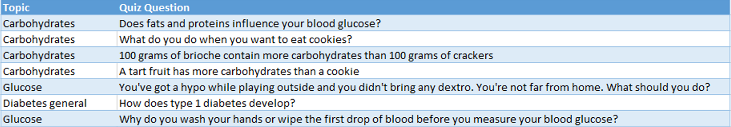

Current PAL Application
Educates a child about their underlying condition through task-based learning
Each task is structured as:
$topic ⊇question$
Notes:
The current PAL application aims to education a child about their underlying condition through task-based learning, for example providing quiz problems and educational games to solve. At present the only activity in the PAL application is a quiz game.
Each quiz problem is a question that belongs to a topic category.
At present the choice for the next quiz problem is chosen at random, it is the goal of this project to provide personalised quiz problem recommendation to each child.

Slide 5
Current PAL application
Student Performance Model
Topic Model
Question Model
Student Profiling Model
Demographic Data
Hobbies
Notes:
The data that is available to us from the current application is:
Student performance model which contains performance data for each child in each topic and individual quiz question, given by the topic model and question model respectively.
Supplementary data is also collected on each child which aims to build a general profile describing each child such as hobbies, age and nationality.

Slide 6
Providing Task Recommendation
Topic and Question Recommendation
Notes:
Now that we understand how the current system works, how do we determine the next quiz problem to recommend
There are two actions that must be completed in order for task recommendation to occur:
Topic Selection
Question Selection

Slide 7
Vygotsky’s - Zone of Proximate Development
States that in an educational environment, when providing students with learning tasks, the difficulty of the task provided should be slightly higher than the students current ability level.
Notes:
A fundamental concept in determining the next task to select.

Slide 8

Topic Selection
Topic selection is determined by a students topic model
The choice for the next topic should have performance score slightly below the average performance of a student across all topics.

Slide 9
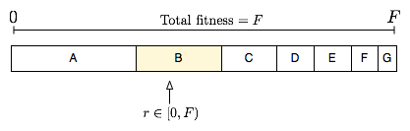
Topic Selection – Fitness Proportionate Selection
Selecting a topic in a deterministic manner could lead to unfavourable effects within the system.
A better solution would allow all topics to be chosen but more appropriate topics have a better chance of selection.
Exploitation vs. Exploration trade off.
Notes:
Unfavourable effect – Does not introduce variability, which may force a student to complete a number of problems within a single topic before being able to move onto another topic
More appropriate solutions are those with performance scores low than users current average performance
Fitness proportionate selection is such an algorithm which assigns weights to topics depending on how much they deviate from the average performance. Topics with greater weight have higher chance of selection
FPS highlights the exploitation – exploration trade-off, while it is possible to make the best decision for topic selection using the data available to us, it is important to realise that by introducing a random factor, it allows the system to learn further about a students ability.

Slide 10
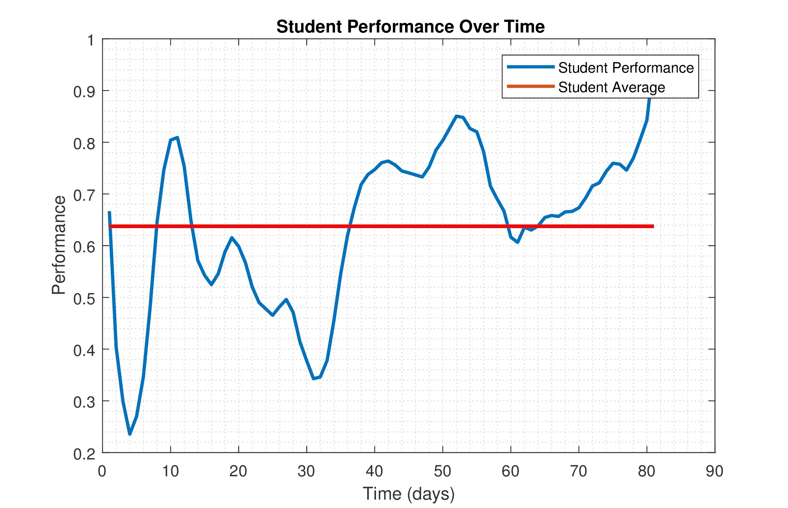
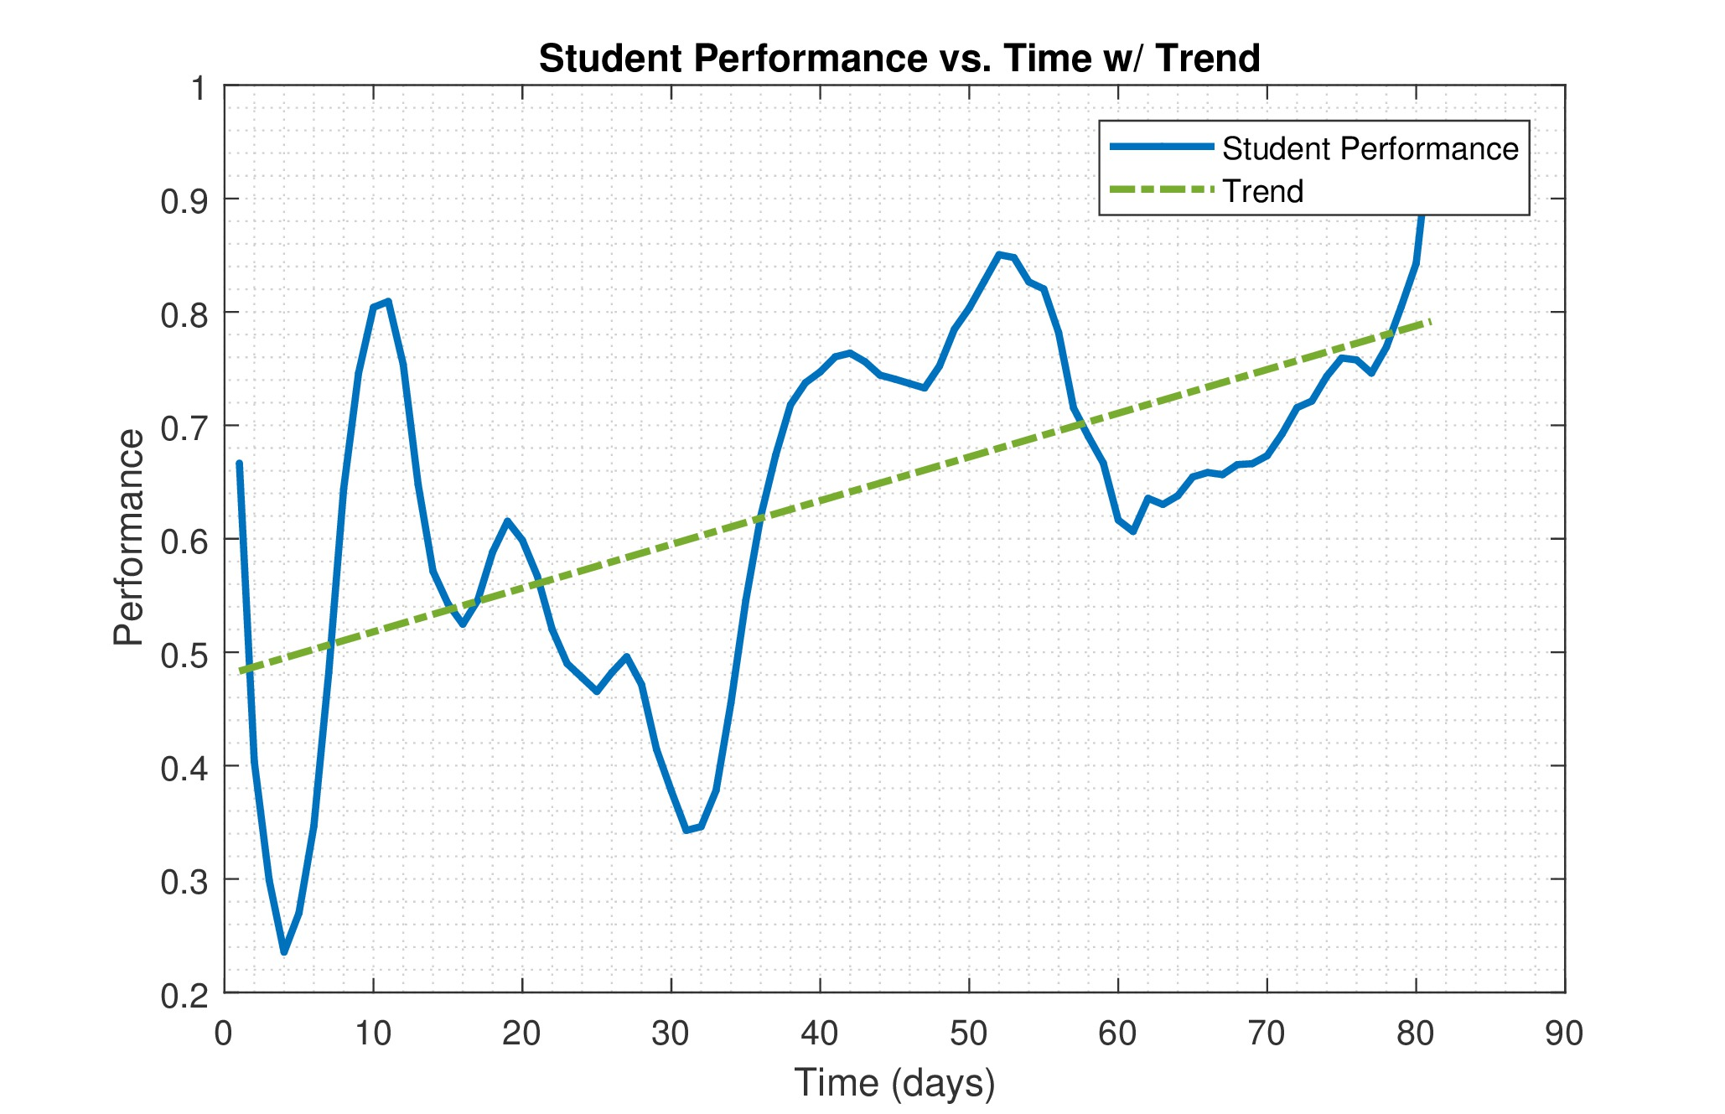
Topic Selection – Accounting for Temporal Effects
Notes:
The problem with using average performance as an indicator for a students current ability at the current can be seen here. Using the average implies that student ability remains constant over time.
However generally this is not the case as the more a student studies a topic the better they get at solving problems. Thus we should account for the trend that exists in student ability.

Slide 11
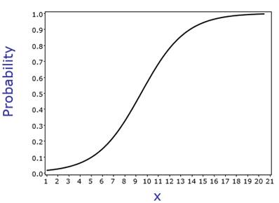
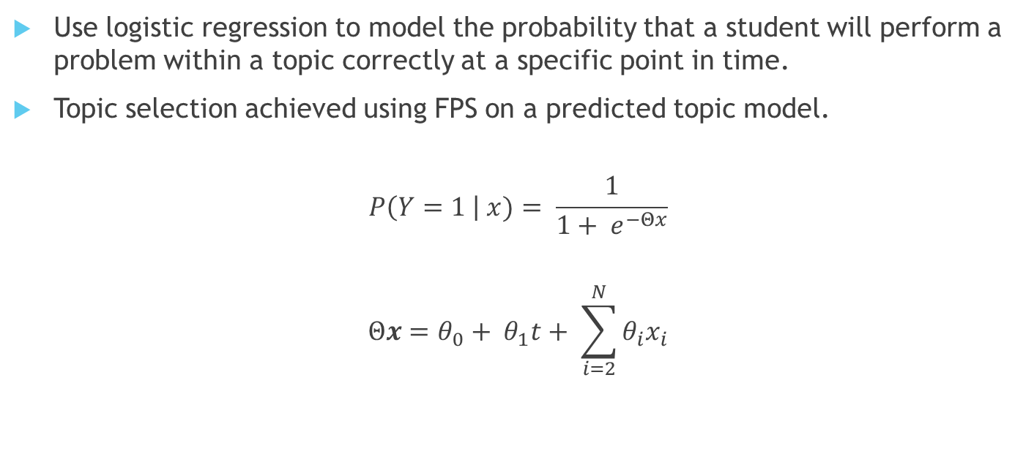
Logistic Regression to Estimate Student Topic Performance
Use logistic regression to model the probability that a student will perform a problem within a topic correctly at a specific point in time.
Topic selection achieved using FPS on a predicted topic model.
$$P\left(Y=1 \right| x)= \frac{1}{1+ e^{−Θx}}$$
$$Θx=θ_{0}+ θ_{1}t+ \sum_{i=2}^{N}{θ_{i}x_{i}}$$
time
Lag terms
Notes:
To do this we use logistic regression to predict the performance in each topic at the current time. Logistic regression provides the probability that the next outcome of a problem is successful given some regressors X. This probability can then be used as an indicator for student performance within a topic.
The logistic regression maps the linear regressor, to a probabilistic outcome using the sigmoid curve. The regressor in this work is dependent on time and N lag terms. The reason for these lag terms are that intuitively the next outcome is more dependent on the N most previous outcomes than older outcomes as student performance is more dependent on what was most recently learnt.
The coefficient theta are determined using stochastic gradient ascent to perform maximum likelihood estimation.

Slide 12
Question Recommendation
Once an appropriate topic has been selected, a question within this topic must be provided.
The problem in PAL is that there is no explicit data indicating the difficulty of each question to a child, nor is there recorded performance for each question by every child.
Use recommendation systems to derive relationships between children and questions.
Notes:
As a result in this project to determine the next question to suggest, we employ the use of recommendation systems, more specifically CF to derive relationships between student and questions. Using these relationships one can predict the performance of each student in every question and then use this information to provide a question that is neither too difficult or easy specific too each student.

Slide 13
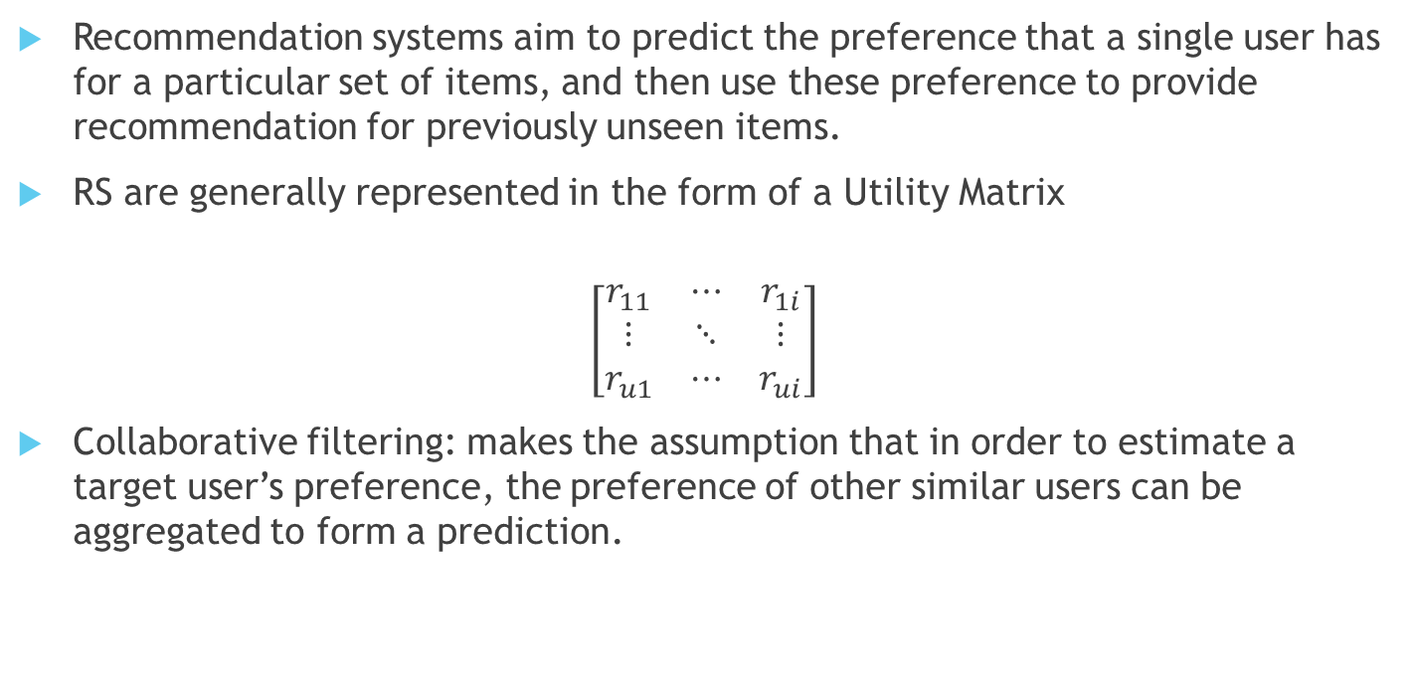
Recommendation Systems
Recommendation systems aim to predict the preference that a single user has for a particular set of items, and then use these preference to provide recommendation for previously unseen items.
RS are generally represented in the form of a Utility Matrix
$$\left[\begin{matrix}r_{11} & ⋯ & r_{1i} \\ ⋮ & ⋱ & ⋮ \\ r_{u1} & ⋯ & r_{ui}\end{matrix}\right]$$
Collaborative filtering: makes the assumption that in order to estimate a target user’s preference, the preference of other similar users can be aggregated to form a prediction.
Notes:
So what is a recommendation system.

Slide 14
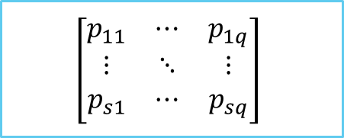
Mapping Recommendation Systems
𝑆𝑡𝑢𝑑𝑒𝑛𝑡 ↦ User
𝑄𝑢𝑒𝑠𝑡𝑖𝑜𝑛 ↦ Item
𝑃𝑒𝑟𝑓𝑜𝑟𝑚𝑎𝑛𝑐𝑒 ↦ Rating
$$\left[\begin{matrix}p_{11} & ⋯ & p_{1q} \\ ⋮ & ⋱ & ⋮ \\ p_{s1} & ⋯ & p_{sq}\end{matrix}\right]$$
By utilizing collaborative filtering techniques to predict student performance we assume that two students that share similar ability (performance) in some problems will share similar ability in others.
Slip & Guess Factors
Notes:
We can map recommendation systems to an educational environment, rather than predicting preference for an item we predict the performance of a student for a given question. As such the next question to be recommended should have a performance score close to 0.5, ie. They will not find the task to easy or too difficult.
Slip factor: The probability that student knows the answer but answer incorrectly by accident
Guess factor: The probability that student guess but answers correctly

Slide 15

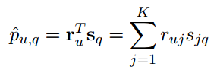





Prediction Using Latent Factor Models
Latent Factor Models operate under the assumption that the state of the utility matrix is influenced by a set of factors (eg. Slip and Guess Factors). Latent factor models aim to infer these factors from the utility matrix.
$$\left[\begin{matrix}p_{11} & ⋯ & p_{1q} \\ ⋮ & ⋱ & ⋮ \\ p_{s1} & ⋯ & p_{sq}\end{matrix}\right]$$
$$\left[\begin{matrix}r_{11} & ⋯ & r_{1k} \\ ⋮ & ⋱ & ⋮ \\ r_{s1} & ⋯ & r_{sk}\end{matrix}\right]$$
$$\left[\begin{matrix}s_{11} & ⋯ & s_{k1} \\ ⋮ & ⋱ & ⋮ \\ s_{1q} & ⋯ & s_{kq}\end{matrix}\right]$$
$$≈$$
$$×$$
Notes:
Advantages of latent factor models
Latent factor matrices can be computed offline, this is beneficial for as the size of the utility matrix increases, the amount of time to generate these factors also increase, as the latent factors can be precomputed, real time recommendation is not affected
More over this model implicitly encodes slip and guess factors into the model.

Slide 16
New User Bootstrapping
Notes:
Now that we understand the potential solutions to providing task recommendation, we move onto providing task recommendation to a new user.

Slide 17
New User Bootstrapping
Topic 1
Topic 2
…
Topic n
q1
q2
…
qn
…
…
q1
q2
…
qn
Bootstrapping is achieved via an adaptive interview process.
Taking concepts from CF the goal of predicting a new user model becomes finding the user neighbourhood that represents the user most.
Notes:
Every user in the PAL application can be represented by a topic model and corresponding question models, for a new user these must be rapidly determined, after which task recommendation can be provided as normal.
Adaptive interview process: new users are given questions to solve, the topic for the next interview question adapts depending on the response given by the user to each question.
In the interest of time we discuss one adaptive interview method used in this work
Adaptive bootstrapping using decision trees.

Slide 18




Adaptive Bootstrapping via Decision Forests
Topic | Performance
1 | 0
2 | 0
3 | 0
4 | 1
Topic | Performance
1 | 0
2 | 1
3 | 0
4 | 1
Topic | Performance
1 | 0
2 | 0
3 | 0
4 | 0
New User
Topic 4
Topic 4
$$U$$
Topic 2
Leaf
Topic 2
A$⊂U$
$$B ⊂U$$
Leaf
Leaf
$$C⊂A$$
Notes:
This method conducts an interview by directing a user from the root of a decision tree to a leaf node that best characterise them.
Each node in the tree represents a group of existing users referred to as a neighbourhood, with the size of the neighbourhood being refined as the depth of the tree increases.
Each node in the tree corresponds to a single topic that a question is based upon, depending on the new users response in that topic they are directed to a subtree.
At the end of the interview process we haven an initial student topic model and a neighborhood of users that best characterize them.

Slide 19
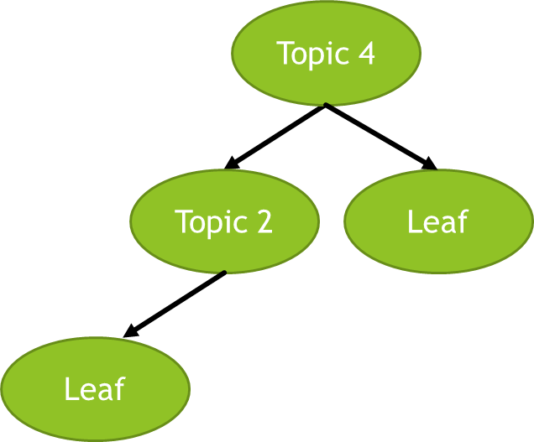
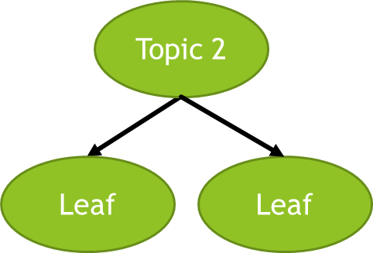
Adaptive Bootstrapping via Decision Forests
Instead of having a single decision tree, decision forests can be used.
Mitigate the problem of high bias in decision trees, resulting in better classification accuracy.
Notes:
Decision forests are regarded as one of the best classification tools, as they are able to classify data with a high degree of accuracy. Instead of creating one decision tree an ensemble of different trees are created, where the choice for the topic at each node is randomised.
The new user would now have to traverse every decision tree in the decision forest, they would then be characterized by a number of leaf nodes.

Slide 20
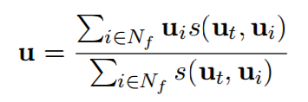
Determining New User Models
The interview method results in an initial user topic model and a neighbourhood of users.
Topic Model
Question Model
Notes:
A more accurate topic model can then be determined by combining the user neighbourhood and initial topic model.
The weighted average of performance score by users in the neighbourhood can be used to determine the new user topic model, with weights being determined by the similarity between the initial user topic model and each user in the neighbourhood.
To the same effect the question model for each topic can be determined in this manner by taking the average of the question models of the users in the user neighbourhood

Slide 21
Evaluation
The project has achieved its initial goals
The recommendation system is able to provide accurate task recommendation
A new user can be bootstrapped in the system requiring to complete on average 15 quiz problems.
While only the best performing algorithms have been discussed in this presentation a number were implemented to solve each problem.
Due to time constraints it was not possible to test the recommendation system in a live environment, as such we are unable to completely validate the effectiveness of task recommendation
Notes:
The reason for implementing many algorithms was because the test data available to us from the PAL application was very minimal. There was a desire to produce a system that made testing and analysis easy once real system data became available
However under the assumption of zygotskys zone of proximate development, we have shown that the proposed system should work in practice, as we are able to predict student performance quite accurately.

Slide 22
Questions

Slide 23
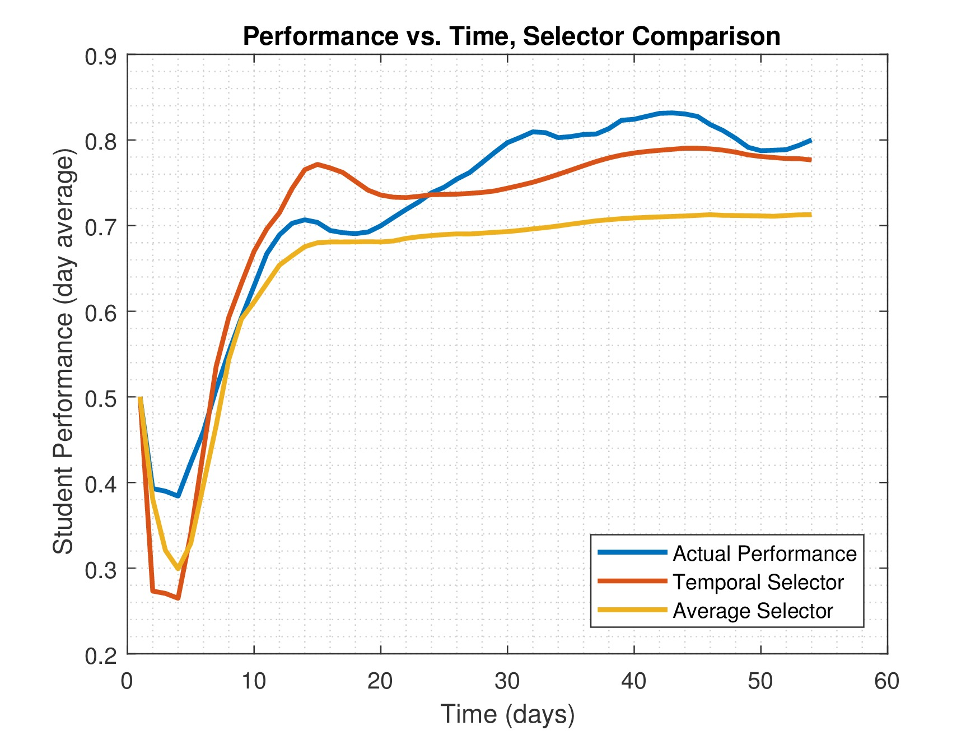
Topic Recommendation - Results
Method | RMSE
Average Performance | 0.2139
Logistic Regression Prediction | 0.1998
Notes:
Under the assumption of the Zone of proximate development having a more accurate measure of student performance allows us to determine the next suitable topic.. To test the topic recommendation we compare the RMSE between the average performance and actual observed performance. And actual observed performance and Logistic Regression predicted performance over time
The graph shows the performance prediction for one student in one topic, at the start average outperforms logistic due to a lack of data to train the logistic regression model accurately

Slide 24
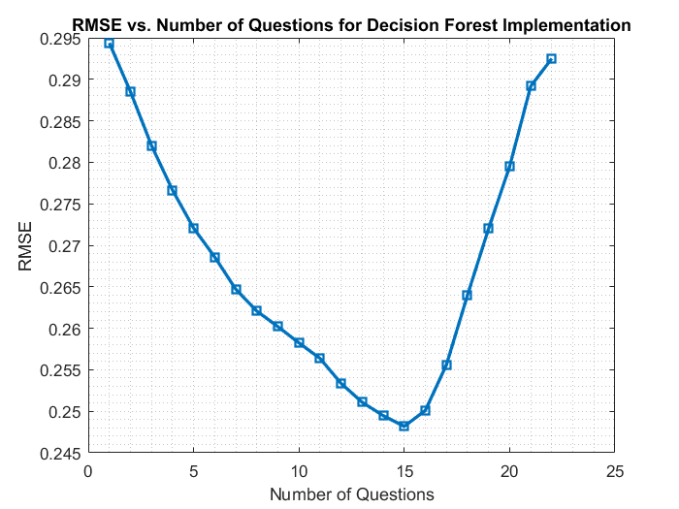
New User Bootstrapping - Results

Slide 25
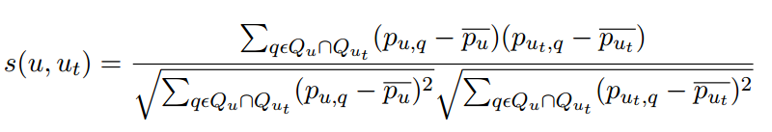
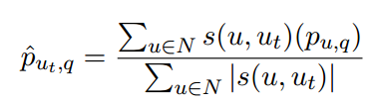
Prediction Using Neighborhood Models
The first stage is to determine a user neighborhood of most similar users to the target user. Similarity is given by Pearson's correlation:
The prediction for an unseen question by the target user can be made by aggregating the performance of the most similar users.

Slide 26
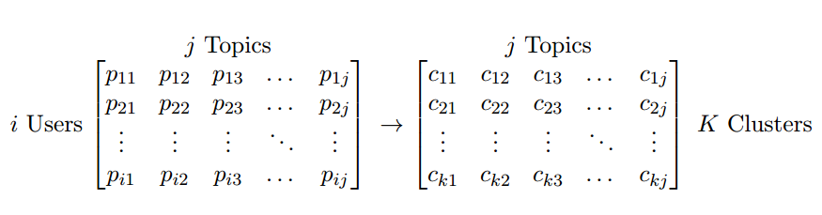



Information Gain via Clustered Neighbours (IGCN)
1) Identify user neighbourhoods
K-means
Smoothing
2) Conduct Interview Process
Notes:
identify user neighbourhoods:
K-means clustering, each cluster is regarded as a neighborhood of users.
The problem is that when applying K-means to a sparse utility matrix, often sub-optimal neighborhoods are identified
Smoothing:
Apply SVD to the resulting matrix
Reduce the factor matrices to dimension d
Smooth the utility matrix

Slide 27
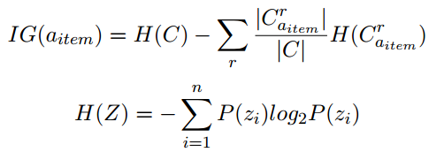
Information Gain via Clustered Neighbours (IGCN)
1) Identify user neighbourhoods
K-means
Smoothing
2) Conduct Interview Process
Topic | Performance
1 | 1
2 | 1
3 | 0
4 | 0
Topic | Performance
1 | 0
2 | 0
3 | 0
4 | 0
Topic | Performance
1 | 1
2 | 0
3 | 0
4 | 0
Topic | Information Gain
1 | 0.3
2 | 0.2
3 | 0.1
4 | 0.1
Topic | Information Gain
2 | 0.4
1 | 0.2
3 | 0.2
4 | 0.1
Find N Similar Cluster Centres
Notes:
IGCN works by repeatedly computing the Information gain of each topic at every question in the interview process
IG essentially expresses the reduction in required information toward the goal of finding the right neighbourhood by rating that item.
At the end of the interview process we haven an initial student topic model and the N most similar cluster centers

