Slide 1

Zomato Expansion Analysis
Sagar Patil

Slide 2
AGENDA
1
2
3
4
5
Introduction
Problem Statement
Analysis
Conclusion
Dashboard

Slide 3
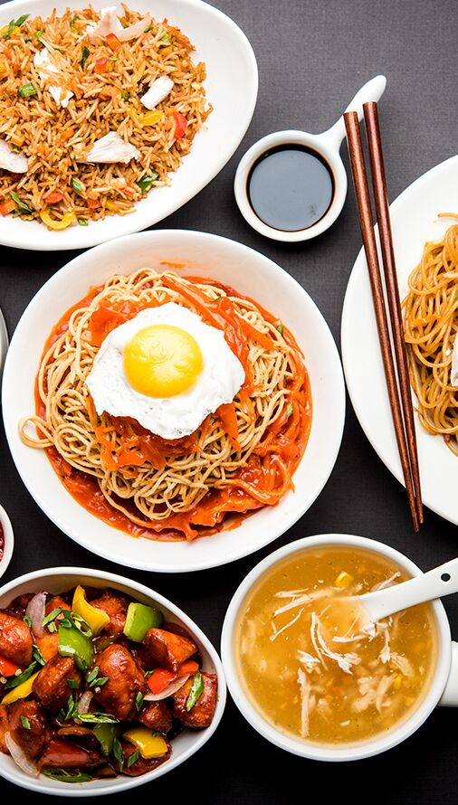
INTRODUCTION
Zomato is an Indian multinational restaurant aggregator and food delivery company founded by Pankaj Chaddah and Deepinder Goyal in 2008. Zomato offers menus, user reviews, and details on restaurants. This project help you to start new restaurants and delivery platforms based on the suggested cities.

Slide 4



Do You know? Zomato is the only food delivery app that operates in 24 countries.
This Photo by Unknown Author is licensed under CC BY-SA

Slide 5
PRIMARY OBJECTIVES
Global Market expansion
Brand Recognition
Restaurant partnerships
Revenue growth
Quality and consistency

Slide 6
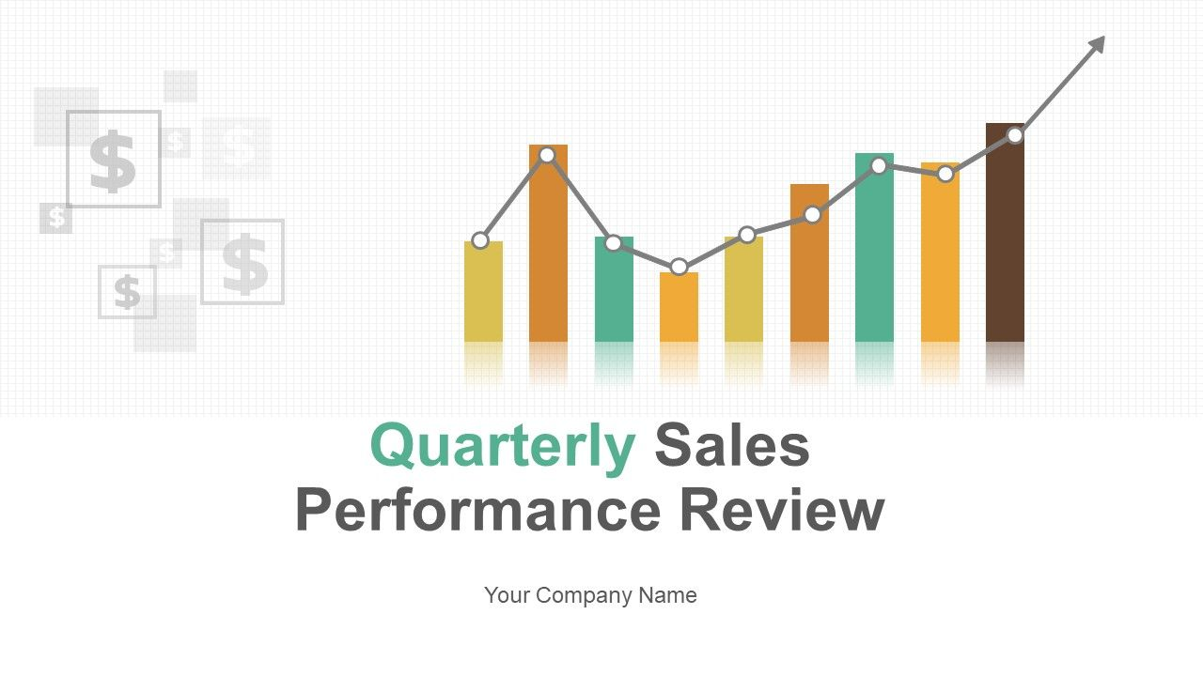
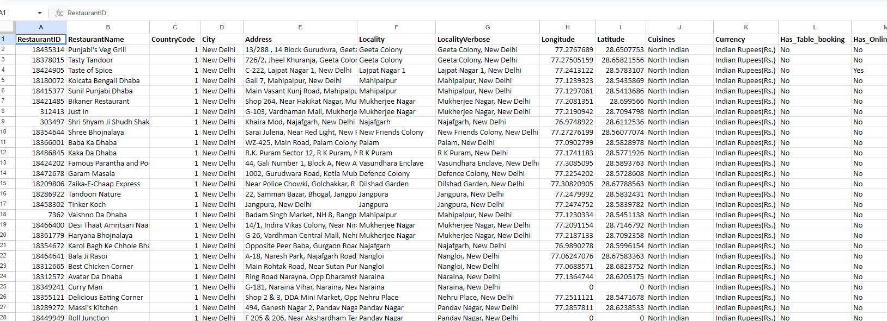
PROBLEM STATEMENT
You are hired as a consultant data analyst by Zomato where the team is looking for expansion and opening more restaurants. Your task is to develop strategies/suggestions for opening newer restaurants.

Slide 7

DATA OVERVIEW
Total Number of Countries: 15
Total Number of Restaurants: 9,543
No. of attributes: 24
Key data points:
Rating
Price range
Average cost for two
Votes

Slide 8

Data Cleaning
Data cleaning plays a major role in data analysis.
Here we can remove duplicates, remove or replace null values , Data formatting, using split function to separate data.
Unstructured data to structured data.
Formatting date key column
Finding Null values
Merge queries to add country column.
Adding attributes to get meaningful insights.
Data is critical for analysis because it forms the foundation upon which insights, decisions, and strategies are built.
Informed decision making
Identifying patterns and trends
Risk management
Predictive Analysis

Slide 9



ANALYTICAL APPROACH
Data cleaning: used find and replace to format the date key column
Data enrichment: used merge query to extract the country names for the given country codes
Descriptive analysis: used pivot tables to find the number of restaurants with the average rating across various regions and to summarize important metrics.
Visual analysis: created different pivot charts such as column chart/ stacked column chart, pie charts, bar charts etc.
Visualization: Designed dashboards to facilitate interactive data exploration and data display.

Slide 10

No. of Restaurants opened in each year
As per the data, a line chart has been created which gives insights such as,
In the year 2011(1096) and 2018 (1102), highest no.of restaurants are opened.
In the year 2012, 2015, 2016 lower no. of restaurants are opened.

Slide 11
Average Votes Vs Country
The bar chart represents the average number of voters for the restaurants in each country according to the data.
Indonesia is having highest average voting compared to other countries
Least average voting is for Brazil

Slide 12
Suggested cities to open new restaurants
Yellow highlighted are the suggested cities that are located in suggested countries with Average rating and least no. of restaurants.
Armidale
Balingup
Chatham-Kent
Yorkton
Doha
Singapore
Colombo

Slide 13
The team can open new restaurants with lesser competition are as follows :
Australia
Canada
Qatar
Singapore
Sri Lanka
Row Labels | Count of RestaurantID
Australia | 24
Canada | 4
Qatar | 20
Singapore | 20
Sri Lanka | 20
Average of Rating
3.66
3.58
4.06
3.58
3.87

Slide 14
Current expenditure on Suggested Countries
Row Labels | Sum of Average cost for two in rupees
Australia | 31292.92
Canada | 8797.15
Qatar | 102567
Singapore | 187865.65
Sri Lanka | 13300
Grand Total | 343822.72
The current expenditure on food in the suggested countries is ₹343822
To keep financial expenditure in control, you could consider evaluating your budget and spending priorities in each country, perhaps allocating more resources to countries with higher costs if necessary.

Slide 15
Table booking Vs Rating
Online Delivery VS Average Rating
When compared, the average rating is higher when table booking is available (Yes) compared to when it's not available (No).
This suggests that table booking may contribute positively to the overall dining experience and perception of the restaurant by customers.
The average rating is higher when online delivery is available (Yes) compared to when it's not available (No).
Therefore, based on this data, it seems that online delivery does have a positive effect on the average rating. Restaurants that offer online delivery tend to receive higher average ratings compared to those that do not offer this service.

Slide 16

Here comes the Dashboard

Slide 18

CONCLUSION
By analysing the data, I suggest that we can open the restaurants in the cities with least no. of restaurants and with moderate Rating. So there will be lesser competition.
we have also done the cuisine analysis, we can choose the top rated cuisines in the new restaurants
Online delivery and table booking should be provided as they are having positive affect on the average rating.

Slide 19

Thank you
Sagar Patil
Sagarpatil.90818@gmail.com

