Slide 1

Logistics Optimization for Delivery Routes – DHL
SQL PROJECT
Video link :- https://www.loom.com/share/023e545fa04c454598214679fcf985f4
Submitted By SAGAR

Slide 2

Project Objectives
Identify the root causes of shipment and delivery delays.
Optimize delivery routes for faster and more cost-effective transportation.
Analyze warehouse performance and operational efficiency.
Evaluate delivery agent performance using SQL analytics.
Generate KPI reports to support data-driven business decisions.
The main objective of this project is to analyze DHL logistics data using SQL, identify operational bottlenecks, evaluate delivery performance, and provide actionable recommendations to improve route efficiency and customer satisfaction.

Slide 3
Dataset Description
Dataset | Records | Description
Orders | 300 | Customer order details
Shipments | 1000 | Shipment tracking information
Routes | 20 | Route and transit details
Warehouses | 10 | Warehouse information
Delivery Agents | 50 | Delivery agent performance
Key Relationships
Orders ↔ Shipments → Order_ID
Shipments ↔ Routes → Route_ID
Shipments ↔ Warehouses → Warehouse_ID
Shipments ↔ Delivery Agents → Agent_ID
Summary - The project uses five interconnected datasets to analyze delivery performance, route efficiency, warehouse operations, and delivery agent performance using SQL queries.

Slide 4



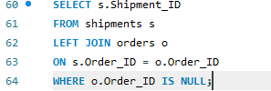

Data Cleaning & Preparation
Task 1
No duplicate Order_ID records found.
No duplicate Shipment_ID records found.
No missing values found in Delay_Hours.
All delivery dates are valid.
Referential integrity maintained across all tables.
Dataset is clean and ready for analysis.

Slide 5
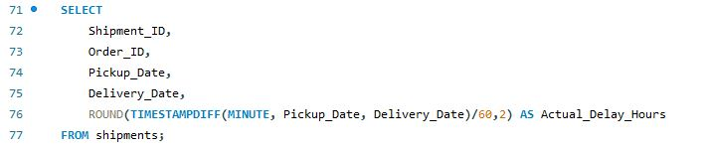
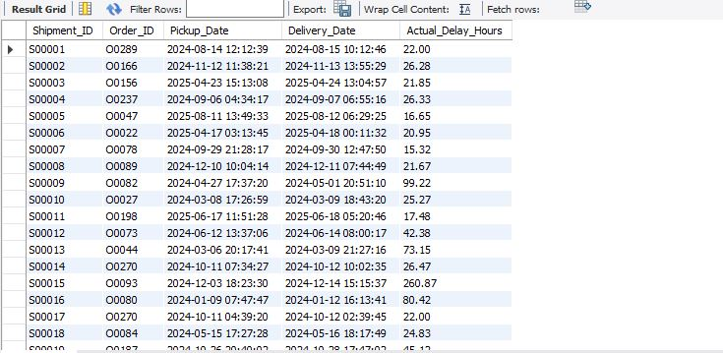
Task 2
Delivery Delay Analysis

Slide 6
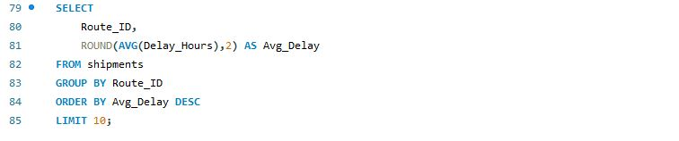
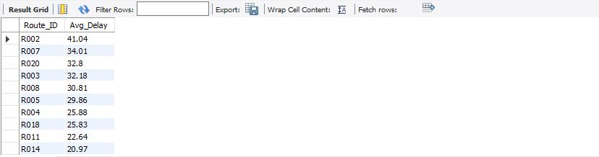
Task 2
Delivery Delay Analysis

Slide 7
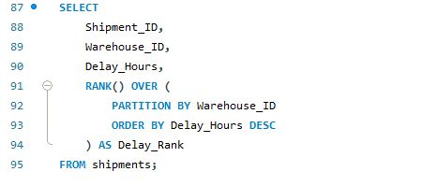
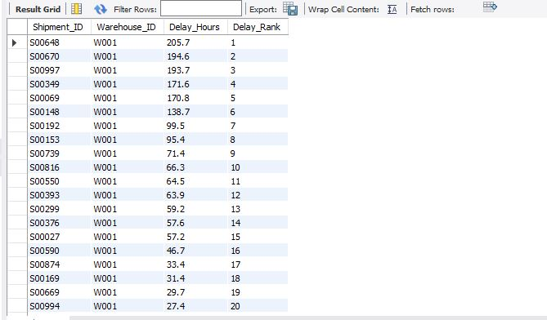
Task 2
Delivery Delay Analysis

Slide 8
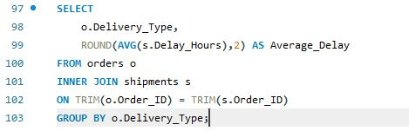

Task 2
Delivery Delay Analysis

Slide 9
Insights
Task 2
Delivery Delay Analysis
Average delivery delay was calculated for every shipment.
Top delayed routes were identified using average delay hours.
Shipments were ranked within each warehouse using SQL window functions.
Express deliveries showed a higher average delay (22.50 hours) than Standard deliveries (20.85 hours).
Delay analysis helps identify operational bottlenecks and improve service quality.

Slide 10
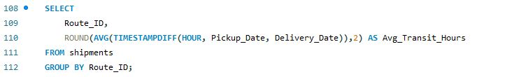
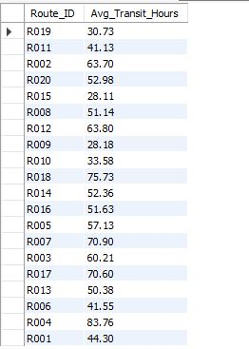
Route Optimization Insights
Task 3

Slide 11
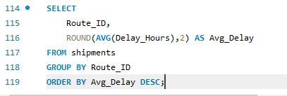
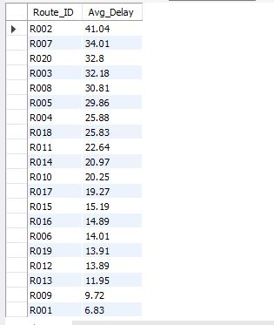
Task 3
Route Optimization Insights

Slide 12
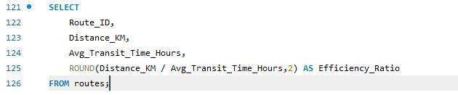
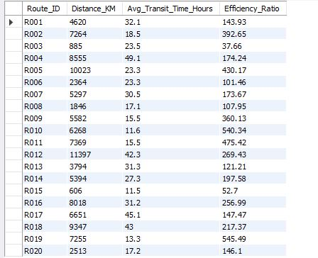
Task 3
Route Optimization Insights

Slide 13
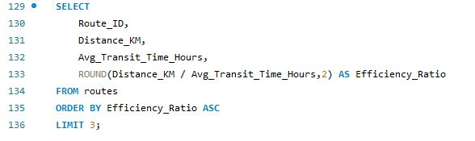
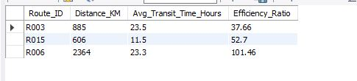
Task 3
Route Optimization Insights

Slide 14
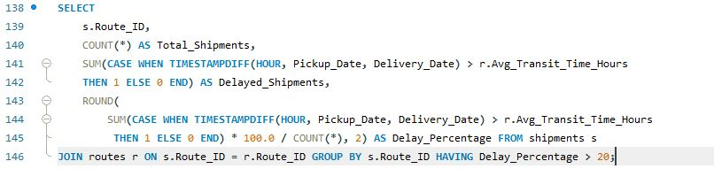
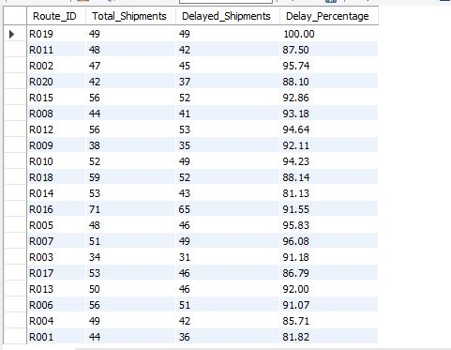
Task 3
Route Optimization Insights

Slide 15
Task 3
Route Optimization Insights
Recommendation on potential routes or hub pairs for optimization.
Routes R019 (Johannesburg -> Dubai), R007 (Shanghai -> Sydney), R005 (London -> Los Angeles) and R002 (Dubai -> Shanghai) where >=85% of shipments are delayed beyond expected time need immediate attention.
An audit must be performed for information that warehouses are doing well or not. In the cites what reason is stopping us to make deliveries faster like traffic, routes are complex.
Routes with worst efficiency ratio should be re-routed to decrease the distance or time like changing flights.

Slide 16
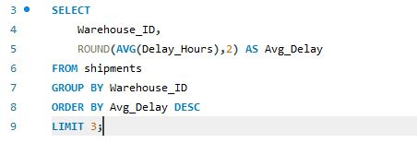

Task 4
WAREHOUSE PERFORMANCE

Slide 17
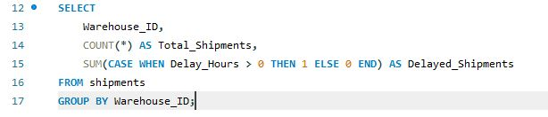
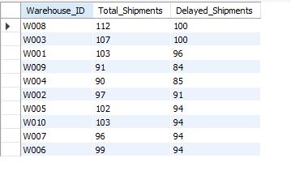
Task 4
WAREHOUSE PERFORMANCE

Slide 18
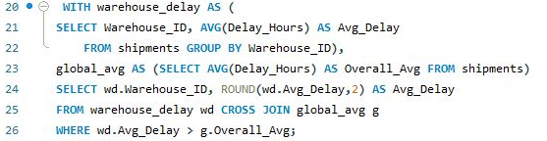
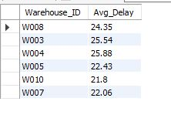
Task 4
WAREHOUSE PERFORMANCE

Slide 19
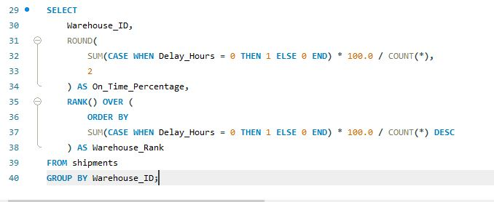
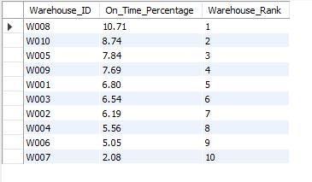
Task 4
WAREHOUSE PERFORMANCE

Slide 20
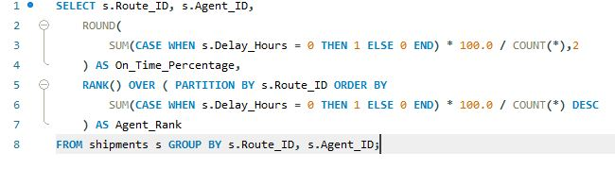
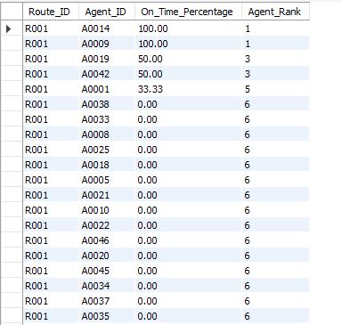
Task 5
Delivery Agent Performance
Rank delivery agents (per route) by on-time delivery percentage

Slide 21
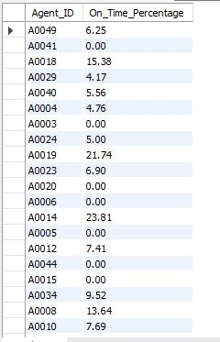
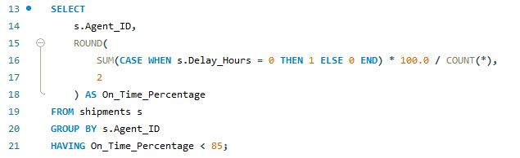
Task 5
Delivery Agent Performance
Find agents whose on-time % is below 85%

Slide 22
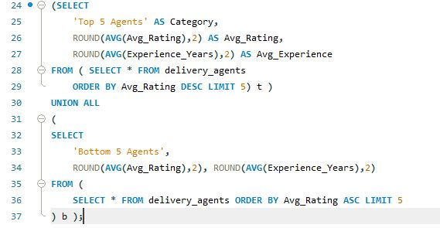

Task 5
Delivery Agent Performance
Compare the average rating and experience (in years) of the top 5 vs bottom 5 agents using subqueries.

Slide 23
Task 5
Delivery Agent Performance

Slide 24
Task 5
Delivery Agent Performance
Suggest training or workload balancing strategies for low-performing agents based on insights.
Provide additional training to agents with on-time delivery below 85%.
Balance workload among delivery agents.
Reward high-performing agents.
Monitor routes assigned to low-performing agents.

Slide 25
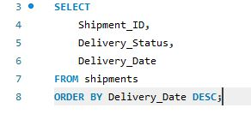
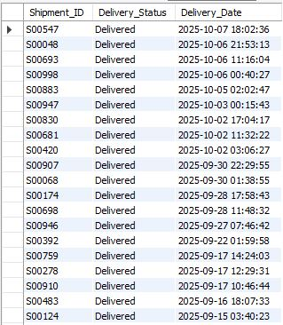
TASK 6
SHIPMENT TRACKING ANALYTICS
For each shipment, display the latest status (Delivered, In Transit, or Returned) along with the latest Delivery_Date

Slide 26
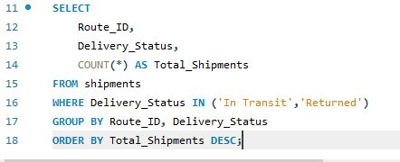
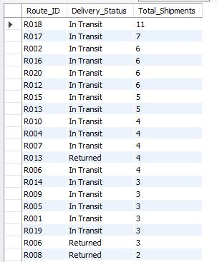
TASK 6
SHIPMENT TRACKING ANALYTICS
Routes with Majority of Shipments In Transit or Returned

Slide 27
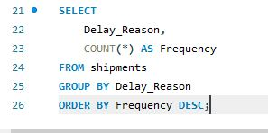
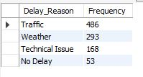
TASK 6
SHIPMENT TRACKING ANALYTICS
Find the most frequent delay reasons (if available in delay-related columns or flag).

Slide 28
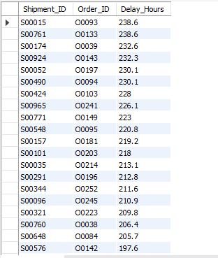
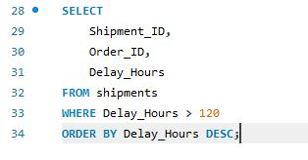
TASK 6
SHIPMENT TRACKING ANALYTICS
Identify orders with exceptionally high delay (>120 hours) to investigate potential bottleneck

Slide 29
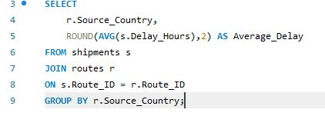
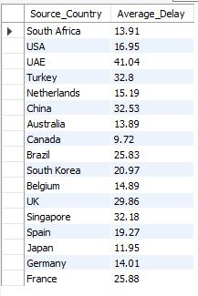
TASK 7
Advanced KPI Reporting
Average Delivery Delay per Source Country

Slide 30
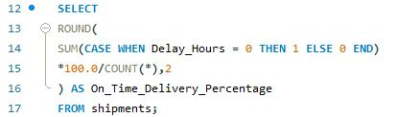

TASK 7
Advanced KPI Reporting
On-Time Delivery % = (Total On-Time Deliveries / Total Deliveries) * 100

Slide 31
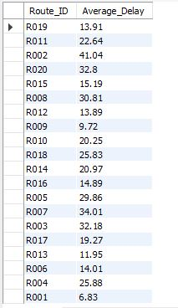
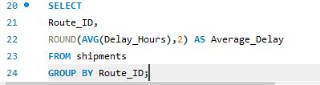
TASK 7
Advanced KPI Reporting
Average Delay (in hours) per Route ID

Slide 32
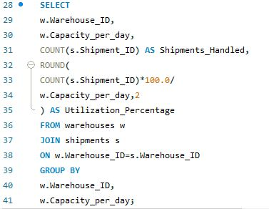
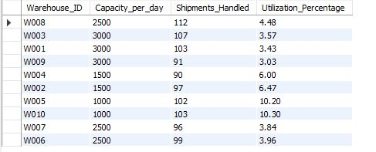
TASK 7
Advanced KPI Reporting
Warehouse Utilization % = (Shipments Handled / Capacity per day) * 100

Slide 33
Conclusion
Key Insights
Traffic is the primary reason for shipment delays on all routes.
Route R015 has the most punctual delivery.
The top five agents are performing poorly, while the bottom five are doing well, based on the average experience years to average rating ratio.
Warehouses 3, 4, and 8 have the most average delivery delays, exceeding the global average.
When it comes to timely delivery, Counter Intuitively 8 comes in second. The majority of on-time deliveries come from Warehouse 10.
The most on-time deliveries are made by agents A0042, 9, and 14.
Less than 85% of agents deliver on time.
R15 Netherlands has a timely height percentage.

Slide 34
Recommendations
Conclusion
To optimize the logistics, a logistics level audit must be carried out.
Low-performing agents ought to be placed with high-performing agents.
If an agent delivers the cargo ahead of schedule, there should be a bonus.
Every warehouse has to have more inventory on hand than the goods we need to deliver.
On routes that are delayed, rerouting is necessary.

