Slide 1


PortfolioBox
Presented By:
Nikunj Katariya (19MCA010)
Sagar Pipaliya (19MCA028)
GUIDED BY:
ASST. PROF. RUSHABH SHAH

Slide 2

Project Profile
Project Definition
Project Requirements
Benefits of using PHP
Benefits of MySQL
System Scope
System Advantages
Functional & non-functional requirement
Database design
Use Case Diagram

Slide 3

Project Definition
The world is growing digitally, and for the job seekers there are more opportunities to seek employment.
This system introduced the way of hiring the employees for the organization that contains all the information of the employees and according to their skill and job requirements, they get selected in the particular post.
The purpose of Portfolio management is the selection, prioritization and control of an organization's programmed and projects, in line with its strategic objectives and capacity to deliver. It is a collection of projects and programmed used to structure and manage investments at an organizational or functional level to optimize strategic benefits or operational efficiency.

Slide 4

Project Requirements
Hardware Specification
Processor : Intel Pentium 4 or above
RAM : 256 MB OR above
Hard Disk : 160GB or above
Software tools:-
Front End :- HTML, CSS, Bootstrap, jQuery.
Back End :- MySQL, PHP.
Front End tool :- VS code, Wamp server.
Portfolio management is an online web based application so the main advantage is that there is no more system compatibility requirement problem.

Slide 5

Benefits of using PHP
Open source
Easy To develop
Easy Manageable
Cost effective
Database Flexibility

Slide 6
Benefits of MySQL
Data security
On demand scalability
High Performance
Workflow control
Reduce overall cost
Open source flexibilitys

Slide 7

Scope of a system
Monitoring the performance of the portfolio by incorporating the latest conditions.
Identifying the objectives, preferences and constraints.
Compare with the latest targets and achievements.
There is no need of keeping a physical resume for the candidate.
Users have their own login ID and password, with which they can secure their documents.
If a wrong password is given three times in succession, that user account will be locked and the user will not be able to use it.
Once provided with internet access, users can take part in the system from everywhere.

Slide 8

System Advantages
Improves Project selection process.
Better View of a big picture.
Focuses on objective business goals.
Collaboration over heavy competition.
More efficient use of resources.
More accurate data.
Helps to make decisions.
Financial stability.

Slide 9

Functional Requirement
Manage Users:- The administrator can manage the user information and admin can mail and send the details to the appropriate user.
Maintain Details:- The administrator maintains entire details of the system including details of the users.
Taking System Backup:- The administrator takes backup of the database in order to prevent loss of the data on system crashes. He takes backup of the entire database in a particular section.
Generate Reports:- Responsible for checking the logs of different system users for auditing and maintaining the whole system.
Use Registration & Login:- The first thing is to register yourself by giving proper mail id and password then move forward to login into the system.
Filtering as per need:- The administrator can filter the candidate & can view the information related to the filtering.

Slide 10

Non-Functional Requirement
User Interactive:- The response of the website should be high and the website should behave as per the user action. Users should be acknowledged in the form of visual changes or feedback on the site to enhance the interaction. Portal should be maintained across all the web pages.
Security:- Secure login option to the users to avoid unauthorized access to the system and the information. Advanced encryption algorithms must be integrated in the site to avoid misuse of the data sets.
Reliability:- Portal should provide the users with valid information at all times.
Business Rules:- This requirement contains all the rules and regulations on behalf of the system.

Slide 11
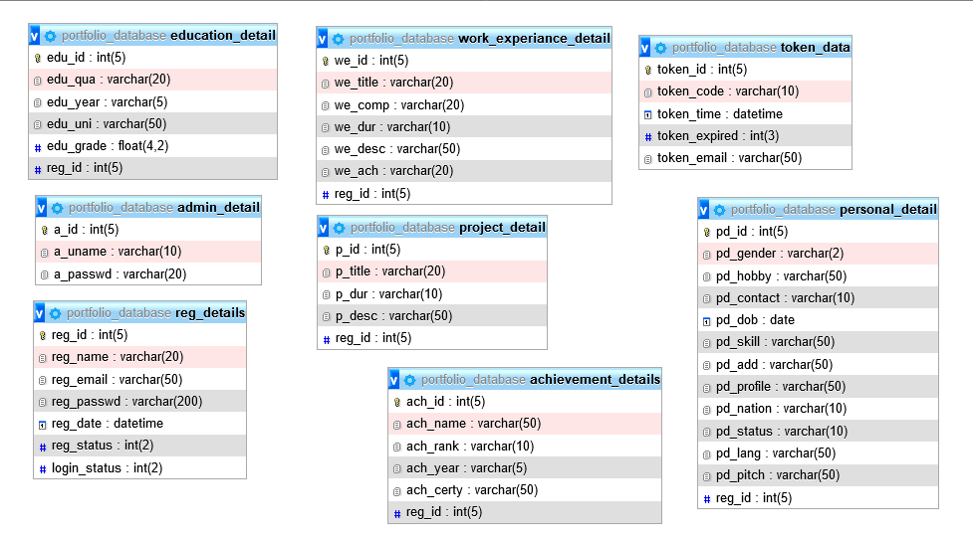

Database Design

Slide 12
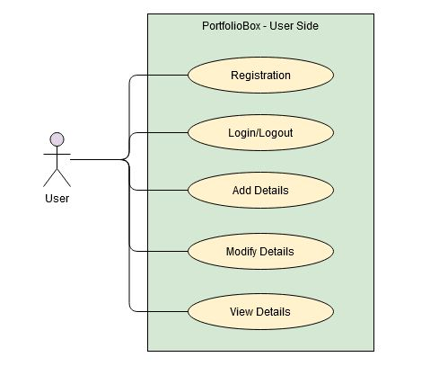

Use Case Diagram – User Side

Slide 13
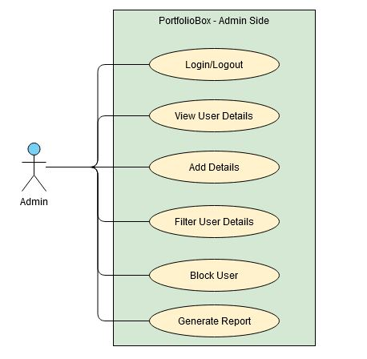

Use Case Diagram – Admin Side

Slide 14


