Slide 1


PortfolioBox
DEVELOPED By:
Nikunj Katariya (19MCA010)
Sagar Pipaliya (19MCA028)
GUIDED BY:
ASST. PROF. RUSHABH SHAH

Slide 2

Project Profile
Project Definition
Project Requirements
Benefits of using PHP
Benefits of MySQL
System Scope
System Advantages
Functional & non-functional requirement
Database design
Use Case Diagram
Activity Diagram
State Chart Diagram
Class diagram
Data Dictionary
Testing Plans

Slide 3

Project Definition
The world is growing digitally, and for the job seekers there are more opportunities to seek employment.
This system introduced the way of hiring the employees for the organization that contains all the information of the employees and according to their skill and job requirements, they get selected in the particular post.
The purpose of Portfolio management is the selection, prioritization and control of an organization's programmed and projects, in line with its strategic objectives and capacity to deliver. It is a collection of projects and programmed used to structure and manage investments at an organizational or functional level to optimize strategic benefits or operational efficiency.

Slide 4

Project Requirements
Hardware Specification
Processor : Intel Pentium 4 or above
RAM : 256 MB OR above
Hard Disk : 160GB or above
Software tools:-
Front End :- HTML, CSS, Bootstrap, jQuery.
Back End :- MySQL, PHP.
Front End tool :- Sublime, Xampp server.
Portfolio management is an online web based application so the main advantage is that there is no more system compatibility requirement problem.

Slide 5

Benefits of using PHP
Open source
Easy To develop
Easy Manageable
Cost effective
Database Flexibility

Slide 6
Benefits of MySQL
Data security
On demand scalability
High Performance
Workflow control
Reduce overall cost
Open source flexibilitys

Slide 7

Scope of a system
Monitoring the performance of the portfolio by incorporating the latest conditions.
Identifying the objectives, preferences and constraints.
Compare with the latest targets and achievements.
There is no need of keeping a physical resume for the candidate.
Users have their own login ID and password, with which they can secure their documents.
If a wrong password is given three times in succession, that user account will be locked and the user will not be able to use it.
Once provided with internet access, users can take part in the system from everywhere.

Slide 8

System Advantages
Improves Project selection process.
Better View of a big picture.
Focuses on objective business goals.
Collaboration over heavy competition.
More efficient use of resources.
More accurate data.
Helps to make decisions.
Financial stability.

Slide 9

Functional Requirement
Manage Users:- The administrator can manage the user information and admin can mail and send the details to the appropriate user.
Maintain Details:- The administrator maintains entire details of the system including details of the users.
Taking System Backup:- The administrator takes backup of the database in order to prevent loss of the data on system crashes. He takes backup of the entire database in a particular section.
Generate Reports:- Responsible for checking the logs of different system users for auditing and maintaining the whole system.
Use Registration & Login:- The first thing is to register yourself by giving proper mail id and password then move forward to login into the system.
Filtering as per need:- The administrator can filter the candidate & can view the information related to the filtering.

Slide 10

Non-Functional Requirement
User Interactive:- The response of the website should be high and the website should behave as per the user action. Users should be acknowledged in the form of visual changes or feedback on the site to enhance the interaction. Portal should be maintained across all the web pages.
Security:- Secure login option to the users to avoid unauthorized access to the system and the information. Advanced encryption algorithms must be integrated in the site to avoid misuse of the data sets.
Reliability:- Portal should provide the users with valid information at all times.
Business Rules:- This requirement contains all the rules and regulations on behalf of the system.

Slide 11
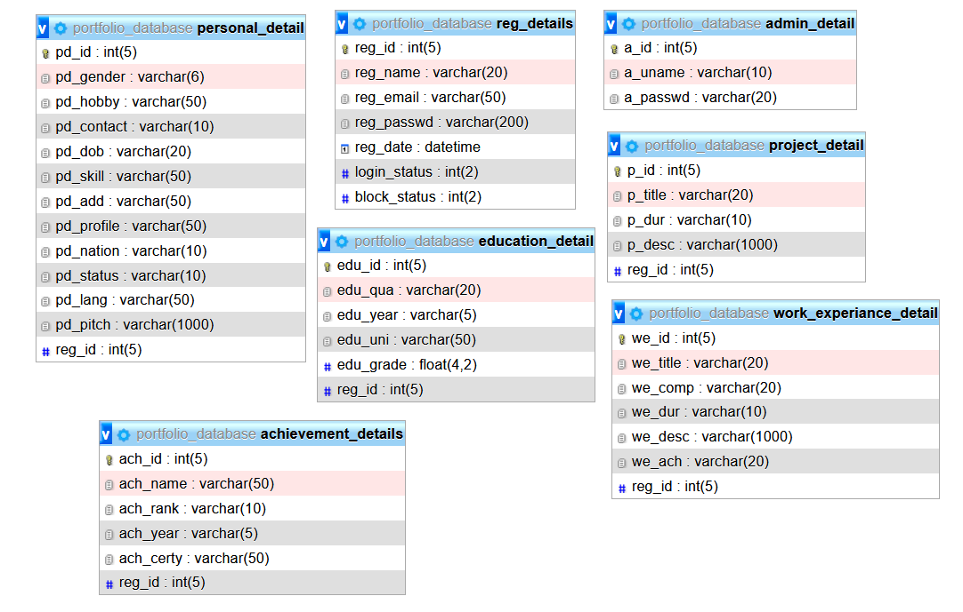

Database Design

Slide 12
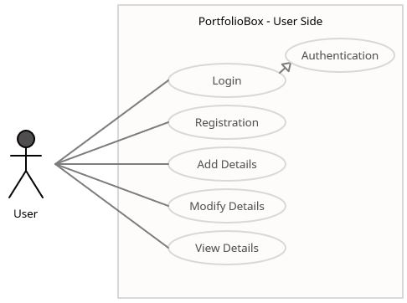

Use Case Diagram – User Side

Slide 13
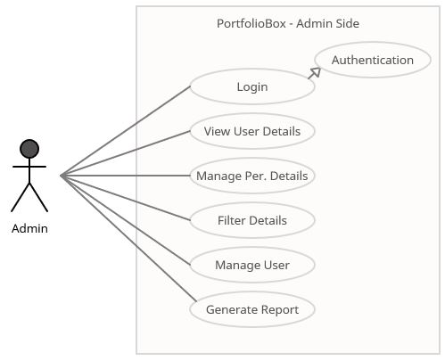

Use Case Diagram – Admin Side

Slide 14
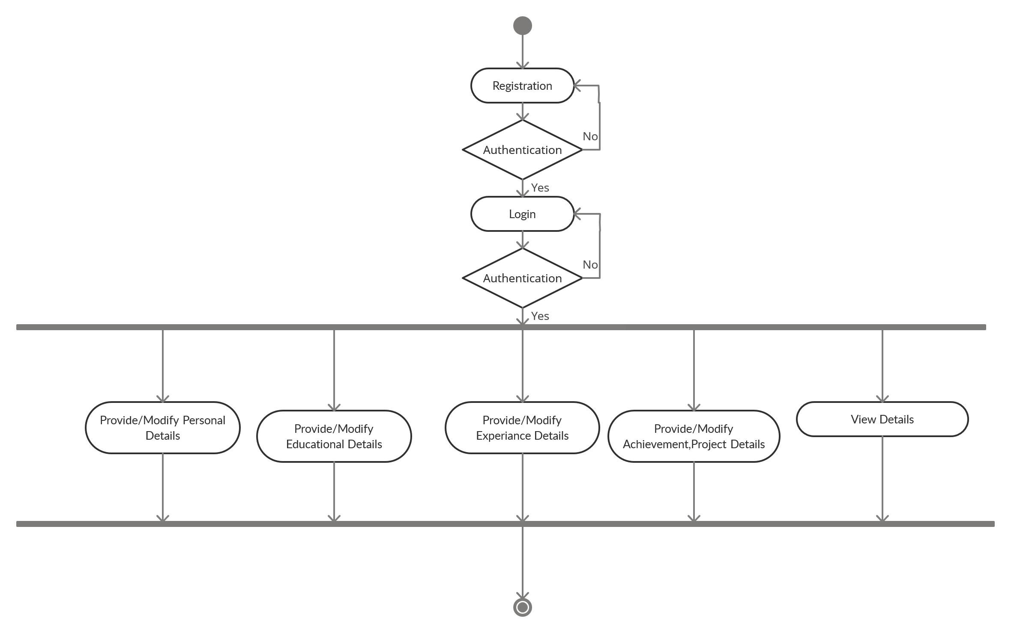
Activity Diagram – User Side

Slide 15
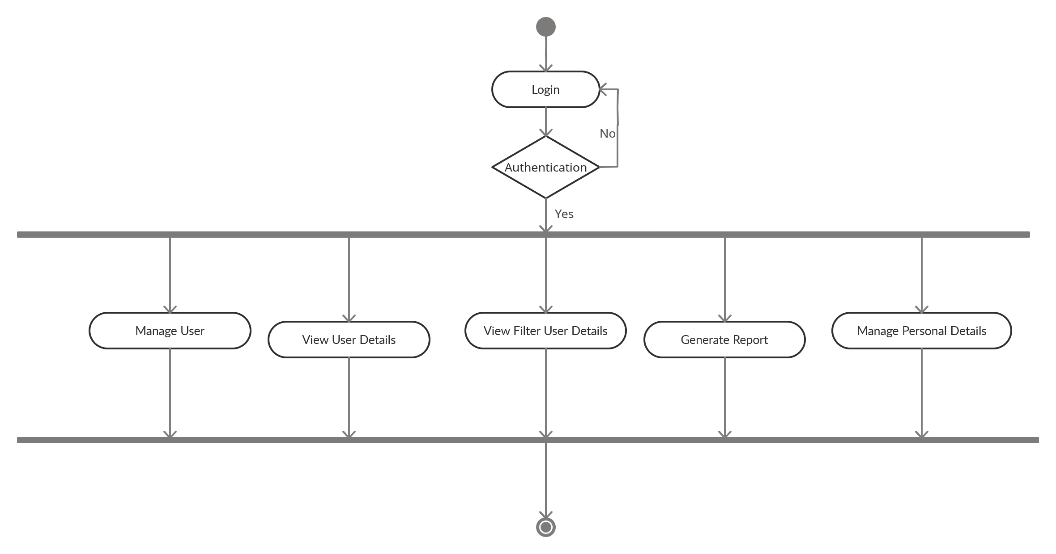
Activity Diagram – Admin Side

Slide 16
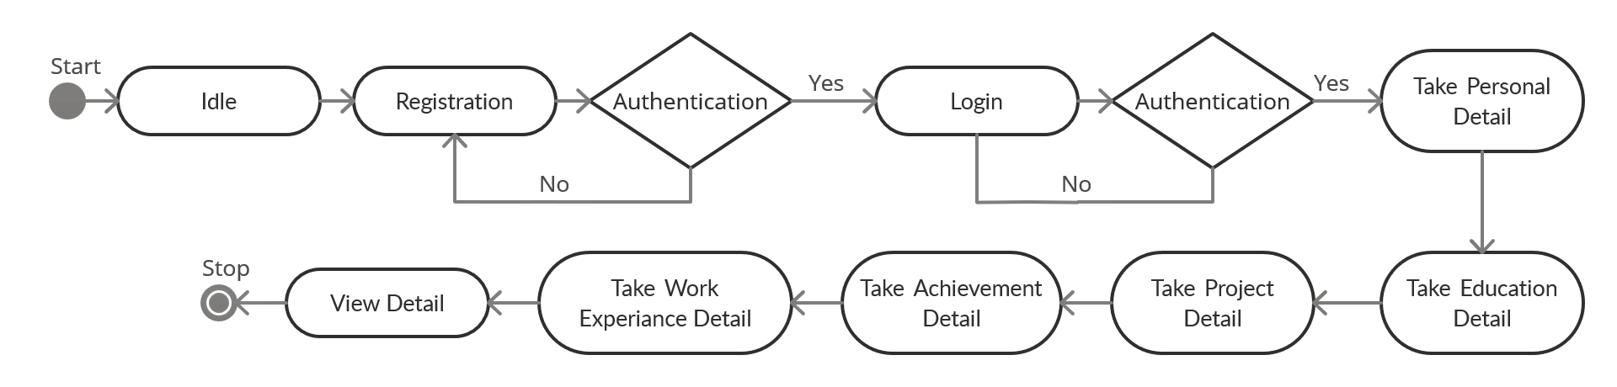
State Chart Diagram – User Side

Slide 17
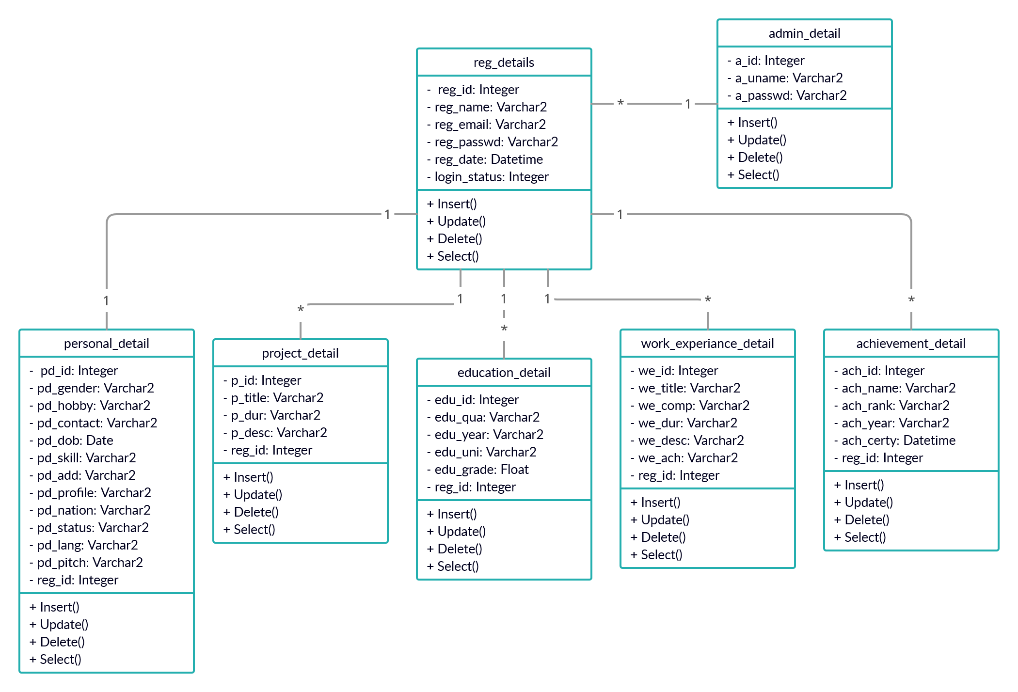
Class Diagram

Slide 18
Data Dictionary – reg_details
Sr No. | Columns | Data Type | Size | Null | Description
1. | reg_id | Integer | 5 | No | Primary key
2. | reg_name | Varchar2 | 20 | No | Name of user
3. | reg_email | Varchar2 | 20 | No | Email of user
4. | reg_passwd | Varchar2 | 20 | No | Password set by the user
5. | reg_date | Datetime |  | No | Registration Date of User
6. | login_status | Integer | 2 | No | Login Status
7. | block_status | Integer | 2 | No | User blocking status

Slide 19
Data Dictionary – personal_detail
Sr No. | Columns | Data Type | Size | Null | Description
1. | pd_id | Integer | 5 | No | Primary key
2. | pd_gender | Varchar2 | 2 | No | Gender of user
3. | pd_hobby | Varchar2 | 50 | Yes | Hobbies of user
4. | pd_contact | Varchar2 | 10 | No | Contact detail of a user
5. | pd_dob | Date | - | No | Birthdate of user
6. | pd_skill | Varchar2 | 50 | No | Technical skills of user
7. | pd_add | Varchar2 | 50 | No | Address of a user
8. | pd_profile | Varchar2 | 50 | No | Profile photo of user
9. | pd_nation | Varchar2 | 10 | No | Nationality of user
10. | pd_status | Varchar2 | 10 | No | Marital status of user
11. | pd_lang | Varchar2 | 50 | No | Languages known
12. | pd_pitch | Varchar2 | 50 | No | Short pitch about user
13. | reg_id | Integer | 5 | No | Reference from reg_detail

Slide 20
Data Dictionary – admin_detail
Sr No. | Columns | Data Type | Size | Null | Description
1. | a_id | Integer | 5 | No | Primary key
2. | a_uname | Varchar2 | 10 | No | Username of admin
3. | a_passwd | Varchar2 | 20 | No | Password of admin

Slide 21
Data Dictionary – education_detail
Sr No. | Columns | Data Type | Size | Null | Description
1. | edu_id | Integer | 5 | No | Primary key
2. | edu_qua | Varchar2 | 20 | No | Qualification details
3. | edu_year | Varchar2 | 5 | No | Passing year
4. | edu_uni | Varchar2 | 50 | No | Name of School/University
5. | edu_grade | Float | 4,2 | No | Grade of user
6. | reg_id | Integer | 5 | No | Reference from reg_detail

Slide 22
Data Dictionary – project_detail
Sr No. | Columns | Data Type | Size | Null | Description
1. | p_id | Integer | 5 | No | Primary key
2. | P_title | Varchar2 | 20 | No | Title of a project
3. | p_dur | Varchar2 | 10 | No | Project duration
4. | p_desc | Varchar2 | 50 | No | Project description
5. | reg_id | Integer | 5 | No | Reference from reg_detail

Slide 23
Data Dictionary – achievement_detail
Sr No. | Columns | Data Type | Size | Null | Description
1. | ach_id | Integer | 5 | No | Primary key
2. | ach_name | Varchar2 | 50 | No | Name of Achievement
3. | ach_rank | Varchar2 | 10 | No | Rank of user achievement
4. | ach_year | Varchar2 | 5 | No | Year of achievement
5. | ach_certy | Varchar2 | 50 | No | Certification of user
6. | reg_id | Integer | 5 | No | Reference from reg_detail

Slide 24
Data Dictionary – work_experiance_detail
Sr No. | Columns | Data Type | Size | Null | Description
1. | we_id | Integer | 5 | No | Primary key
2. | we_title | Varchar2 | 20 | No | Position of user
3. | we_comp | Varchar2 | 20 | No | Name of the company
4. | we_dur | Varchar2 | 10 | No | Working duration
5. | we_desc | Varchar2 | 50 | Yes | Company profile
6. | we_ach | Varchar2 | 20 | Yes | Achievement of a user
7. | reg_id | Integer | 5 | No | Reference from reg_detail

Slide 25
Test Plans
User Login Test Plans
No. | Testcase Title | Description | Expected Outcomes | Resul
T1. | Successful User Verification | The login to the system should be tried with the login assigned by the user and the correct password | Login should be successful and the user should enter in to the system | Passed
T2. | Unsuccessful User Verification due to wrong password | Login to the system with a wrong password | Login should fail with an error ‘Invalid Password’ | Faile
T3. | Unsuccessful User Verification due to invalid login id | Login to the system with an invalid login id | Login should fail with an error ‘Invalid user id’ | Failed
T4. | Successful to remember username | Using cookies verified username is remembered by the system for 3 days | Used to help faster login facility to the user | Passed
T5. | Unsuccessful to remember username | If email is not verified then cookie will not be created | Unable to remember the username | Failed

Slide 26
Test Plans
User Forgot Password Test Plans
No. | Testcase Title | Description | Expected Outcomes | Result
T1. | Successful User Verification | Forgot password will only works on the registered users with the system | Email verification should be successful | Passed
T2. | Unsuccessful User Verification due to invalid login id | If user is not registered with the system. Wrong email provided | Process should be failed with “Invalid email” error. | Failed
T3. | Successful for valid captcha code | Captcha code is for the security purpose | It will help to render to change password | Passed
T4. | Unsuccessful captcha code | Failed to provide valid captcha, not moving further | Process failed with “Invalid captcha” error | Failed
T5. | Successful confirm password verification | Confirm password should matched with new password | Changing password should be succeed | Passed
T6. | Unsuccessful confirm password verification | Confirm password is not matched with the new password | Process failed with “Password is not matching” error | Failed

Slide 27
Test Plans
User Registration Test Plans
No. | Testcase Title | Description | Expected Outcomes | Result
T1. | Successful User Verification with new email | When user is new to the system | User is registered successfully in the system | Passed
T2. | Unsuccessful User Verification due to Existing email | User is not allowed to provide the same email to register | Process should be failed with “Email already exists” error. | Failed
T3. | Successful for Filling required fields | User have to provide all the required fields in the form | Process successful if user fill all required fields | Passed
T4. | Unsuccessful for filling required fields | Failed to insert if required fields are empty, | Process failed with “This field is required” error | Failed

Slide 28
Test Plans
User Personal details Test Plans
No. | Testcase Title | Description | Expected Outcomes | Result
T1. | Successful User Verification with new email | User have to register their email with the system first | User is registered successfully in the system | Passed
T2. | Unsuccessful User Verification due to email is not registered | User is not allowed to access directly this page without registering | Process should be failed with “Registration error” error. | Failed
T3. | Successful for Filling required fields | User have to provide all the required fields in the form | Process successful if user fill all required fields | Passed
T4. | Unsuccessful for filling required fields | Failed to insert if required fields are empty, | Process failed with “This field is required” error | Failed

Slide 29
Test Plans
User Educational details Test Plans
No. | Testcase Title | Description | Expected Outcomes | Result
T1. | Successful User Verification with new email | User have to register their email with the system first | User is registered successfully in the system | Passed
T2. | Unsuccessful User Verification due to email is not registered | User is not allowed to access directly this page without registering | Process should be failed with “Registration error” error. | Failed
T3. | Successful for Filling required fields | User have to provide all the required fields in the form | Process successful if user fill all required fields | Passed
T4. | Unsuccessful for filling required fields | Failed to insert if required fields are empty, | Process failed with “This field is required” error | Failed

Slide 30
Test Plans
User Project details Test Plans
No. | Testcase Title | Description | Expected Outcomes | Result
T1. | Successful User Verification with new email | User have to register their email with the system first | User is registered successfully in the system | Passed
T2. | Unsuccessful User Verification due to email is not registered | User is not allowed to access directly this page without registering | Process should be failed with “Registration error” error. | Failed
T3. | Successful for Filling required fields | User have to provide all the required fields in the form | Process successful if user fill all required fields | Passed
T4. | Unsuccessful for filling required fields | Failed to insert if required fields are empty, | Process failed with “This field is required” error | Failed

Slide 31
Test Plans
User Experience details Test Plans
No. | Testcase Title | Description | Expected Outcomes | Result
T1. | Successful User Verification with new email | User have to register their email with the system first | User is registered successfully in the system | Passed
T2. | Unsuccessful User Verification due to email is not registered | User is not allowed to access directly this page without registering | Process should be failed with “Registration error” error. | Failed
T3. | Successful for Filling required fields | User have to provide all the required fields in the form | Process successful if user fill all required fields | Passed
T4. | Unsuccessful for filling required fields | Failed to insert if required fields are empty, | Process failed with “This field is required” error | Failed

Slide 32
Test Plans
User Achievement details Test Plans
No. | Testcase Title | Description | Expected Outcomes | Result
T1. | Successful User Verification with new email | User have to register their email with the system first | User is registered successfully in the system | Passed
T2. | Unsuccessful User Verification due to email is not registered | User is not allowed to access directly this page without registering | Process should be failed with “Registration error” error. | Failed
T3. | Successful for Filling required fields | User have to provide all the required fields in the form | Process successful if user fill all required fields | Passed
T4. | Unsuccessful for filling required fields | Failed to insert if required fields are empty, | Process failed with “This field is required” error | Failed

Slide 33
Test Plans
Admin Login Test Plans
No. | Testcase Title | Description | Expected Outcomes | Result
T1. | Successful Admin Verification | The login to the system should be tried with the login assigned by the system and the correct password | Login should be successful and the Admin should enter in to the system | Passed
T2. | Unsuccessful Admin Verification due to wrong password | Login to the system with a wrong password | Login should fail with an error ‘Invalid Password’ | Failed
T3. | Unsuccessful Admin Verification due to invalid login id | Login to the system with an invalid login id | Login should fail with an error ‘Invalid Admin id’ | Failed
T4. | Successful to remember username | Using cookies verified username is remembered by the system for 3 days | Used to help faster login facility to the user | Passed
T5. | Unsuccessful to remember username | If email is not verified then cookie will not be created | Unable to remember the username | Failed

Slide 34
Test Plans
Admin Forgot password Test Plans
No. | Testcase Title | Description | Expected Outcomes | Result
T1. | Successful Admin Verification | Forgot password will only works on the registered admins with the system | Email verification should be successful | Passed
T2. | Unsuccessful admin Verification due to invalid login id | If admin is not registered with the system. Wrong email provided | Process should be failed with “Invalid email” error. | Failed
T3. | Successful for valid captcha code | Captcha code is for the security purpose | It will help to render to change password | Passed
T4. | Unsuccessful captcha code | Failed to provide valid captcha, not moving further | Process failed with “Invalid captcha” error | Failed
T5. | Successful confirm password verification | Confirm password should matched with new password | Changing password should be succeed | Passed
T6. | Unsuccessful confirm password verification | Confirm password is not matched with the new password | Process failed with “Password is not matching” error | Failed

Slide 35


