Slide 1

Project Title - Seasonal Agriculture Performance Analysis
Student Name- PRANAV SAGAR
College Name- MAHARISHI MARKANDESHWAR ENGINEERING COLLEEGE
AICTE STU ID : STU6974f3f0b4dd11769272304

Slide 2

PROBLEM STATEMENT
Agricultural activities are influenced by seasonal variations in environmental conditions, farming practices, resource availability and market conditions. As a result, agricultural performance may differ from one season to another. However, raw agricultural data does not clearly explain how agricultural performance changes across seasons or what patterns can be observed in different seasonal conditions. The problem is to analyze the given agricultural dataset and investigate seasonal differences in agricultural performance by identifying meaningful patterns, trends, relationships and variations within the available data.

Slide 3
Project Description
Seasonal Agriculture Performance Analysis is a data analytics project that analyzes agricultural data across Kharif, Rabi and Zaid seasons. The project involves data cleaning, exploratory data analysis, statistical analysis and data visualization to identify seasonal differences in crop yield, production, resource utilization, environmental conditions, water efficiency and economic performance. The analysis aims to generate meaningful insights and evidence-based recommendations for better seasonal agricultural planning.

Slide 4

WHO ARE THE END USERS?
Farmers
Agricultural planners
Agricultural researchers
Government departments
Agricultural analysts
Irrigation/resource management authorities
Agribusiness stakeholders

Slide 5

Technology Used
Python
Google Colab
Pandas
NumPy
Matplotlib
Seaborn
CSV Dataset

Slide 6
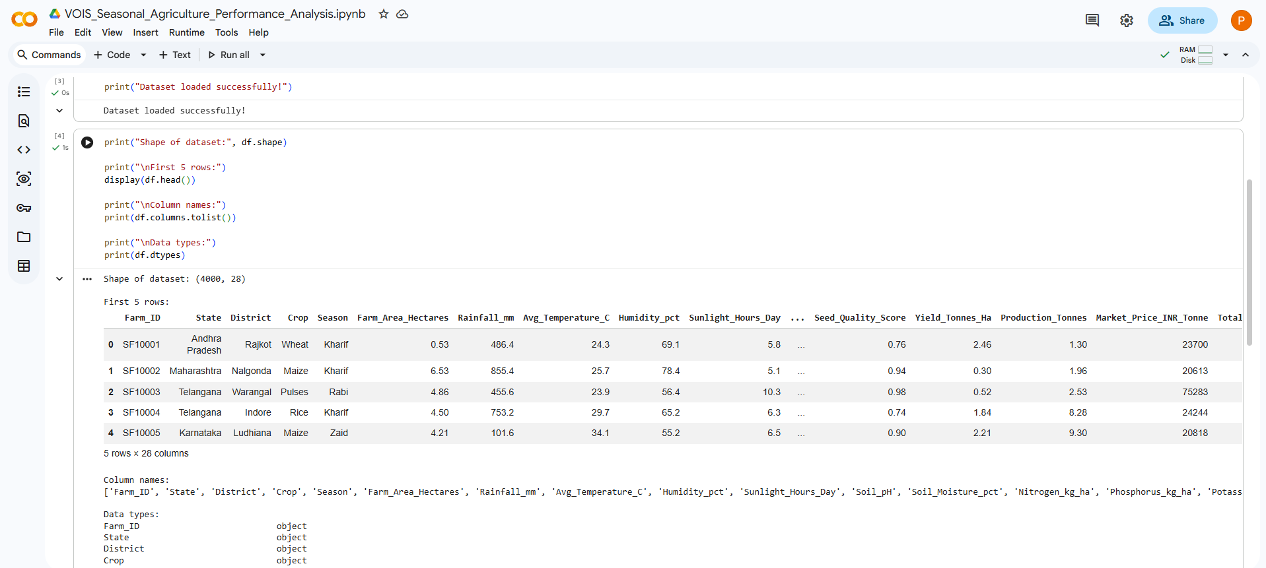
RESULTS
Dataset Exploration & Data Cleaning:-
The dataset contains 4,000 records and 28 variables. Missing values were identified in rainfall, soil moisture and yield and were handled using median imputation.

Slide 7
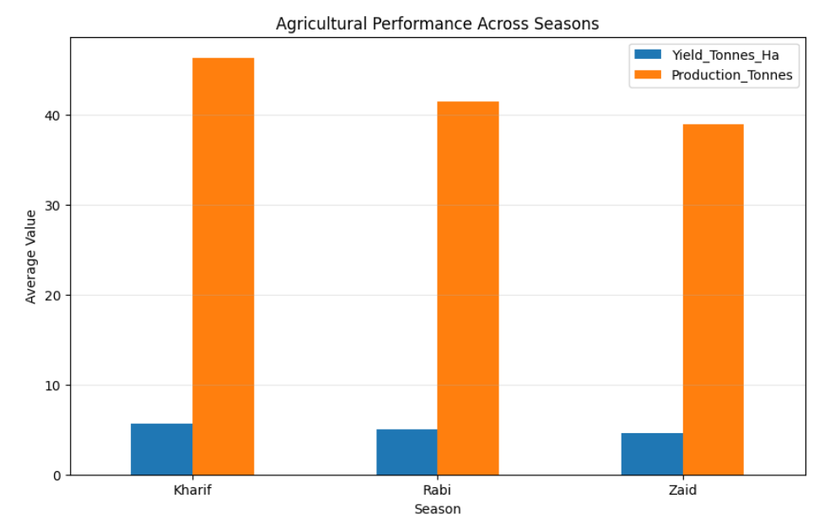
RESULTS
Seasonal Performance Analysis:
Kharif recorded the highest average yield, while Zaid recorded the lowest average yield among the three seasons.

Slide 8
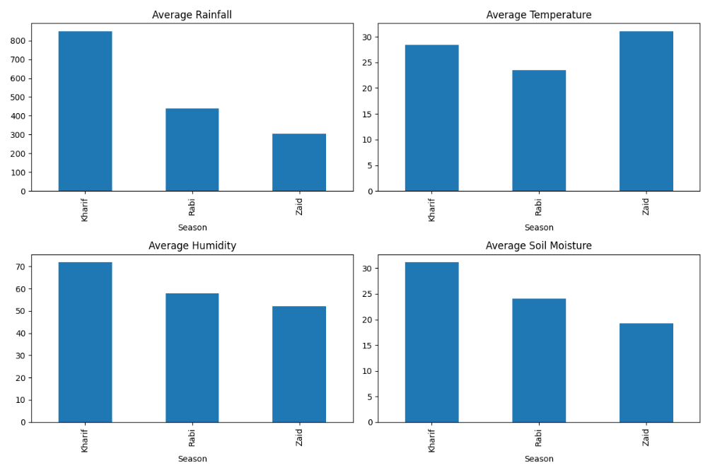
RESULTS
Environmental & Resource Analysis:
Seasonal differences were observed in rainfall, temperature, soil moisture and resource utilization. Kharif showed the highest average water efficiency.

Slide 9
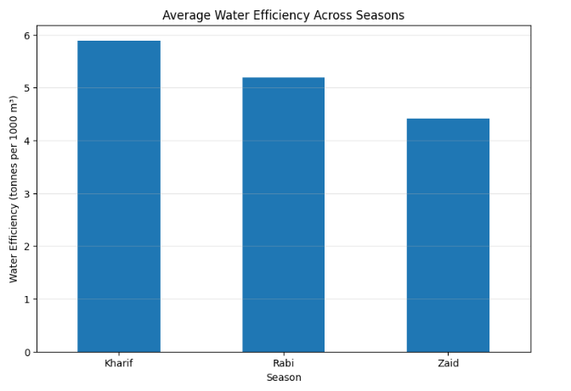
RESULTS

Slide 10
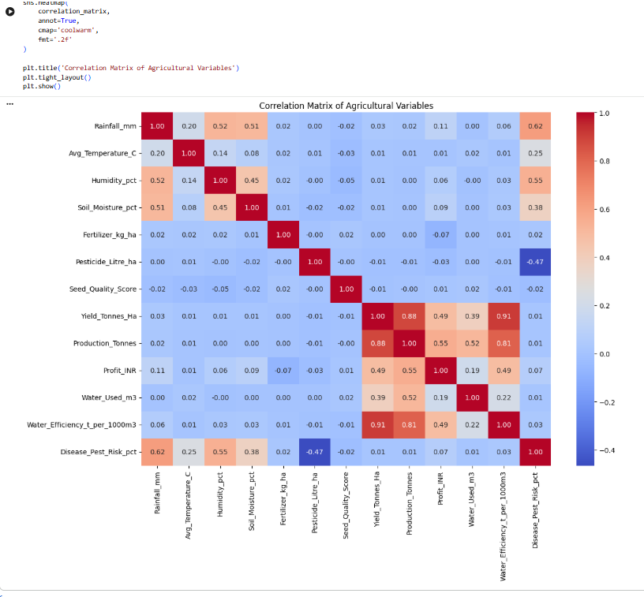
RESULTS
Correlation Analysis:
Yield showed a strong positive relationship with water efficiency and production in the dataset.

Slide 11
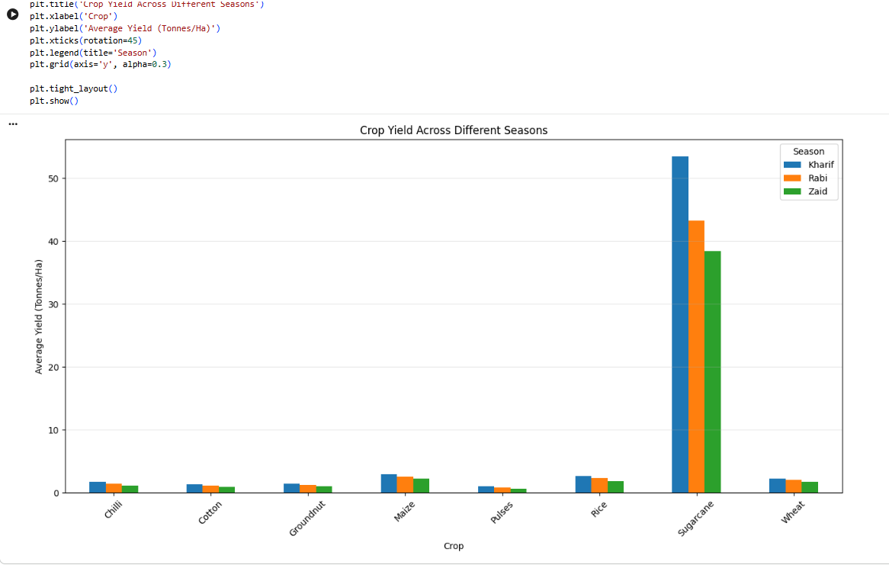
RESULTS
Crop-wise Seasonal Analysis:
Crop performance varied across seasons, indicating that seasonal conditions affect different crops differently.

Slide 12
Future scope
Integrate real-time weather data.
Incorporate soil and satellite-based information.
Develop predictive models for crop yield.
Forecast seasonal agricultural performance.
Develop dashboards for farmers and agricultural planners.
Include larger datasets from multiple years and regions.
Develop recommendation systems for crop and resource planning.

Slide 13
GitHub Link
https://github.com/sagarpranav118-prog/VOIS-Seasonal-Agriculture-Performance-Analysis

Slide 14

VOIS Course completion certificate -
Course name- Data Visualization

Slide 15
Thank You

