Slide 1

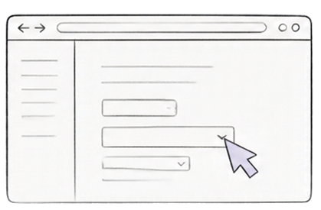
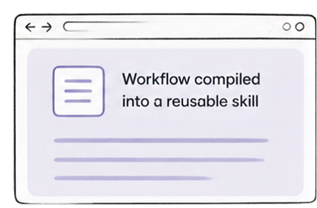
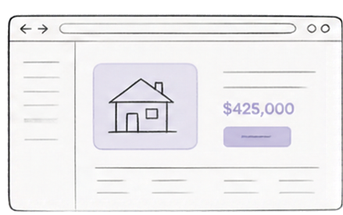


ShadowTwin
Teach once. Let the agent do the work again.
A browser apprentice that learns a workflow from your demonstration and corrections, then reuses the skill across new listings and sellers.
1. YOU DEMONSTRATE
2. SHADOWTWIN COMPILES
3. AGENT REUSES
You complete the workflow
in your browser
ShadowTwin learns the steps and constraints to build the skill
The agent runs the skill on a different seller or listing—reliably and at scale
Not another chatbot. A system that learns how to perform repeatable work inside browser applications.
Our hypothesis: completed workflows can make later runs
more reusable and reliable.
Powered by TinyFish | Demonstrated through DealMaker.

Slide 2




































AI can reason about a task. Repeating it reliably is harder.
People redo the same multi-step web work again and again. Scripts break when pages change. General agents need repeated guidance and supervision.
WHY IT MATTERS
WorkArena (PMLR, 2024)
studies 33 knowledge-work tasks and documents continuing challenges for web agents.
THE OLD WAY: REPEAT MANUALLY
THE BETTER WAY: REUSE A WORKFLOW
Open page
Find info
Copy details
Fill form
Submit
One adaptive workflow
built from the steps
World Economic Forum
Future of Jobs Report 2025
Open page
Find info
Copy details
Fill form
Submit
86%
Handles changes,
adapts as needed
Open page
Find info
Copy details
Fill form
Submit
of surveyed employers expect AI and information-processing technologies to transform their business by 2030.
Adoption context, not proof of demand for ShadowTwin.
Open page
Find info
Copy details
Fill form
Submit
Run reliably across tasks
and time
Repetitive, error-prone, breaks when the interface changes
Built once, reused many times
Conceptual illustration, not measured data.

Slide 3


















Teach once.
Apply the skill to a new situation.
DealMaker is ShadowTwin's demo app for negotiated offers.
Seller offer
₹9,500
1
2
3
Illustrative test data
TEACH
LEARN
REUSE
Seller
Hil I'm offering this camera for ₹9,500. Are you interested?
You demonstrate a negotiation and correct the agent.
ShadowTwin saves your confirmed constraints and workflow as a versioned skill.
For a different seller's ₹9,500 offer, ShadowTwin applies your rules — not your old messages.
10:21 AM
ShadowTwin captures what matters.
ShadowTwin (draft)
Thanks for sharing! I can do ₹8,000. I can pick it up at a time that works for you.
Please let me know if that works.
Illustrative rules
target: ₹8,000
absolute maximum: ₹9,000
tone: polite but firm
walk away above the limit
Skill saved
DealMaker Negotiation v1.0 v1.0
rules + workflow
versioned
Prepares a counter-offer for your approval.
Nothing sent.
Nothing committed.
10:22 AM
Your decision
convenient pickup may
be a trade-off
Review and approve before sending.
Approve & send
Edit draft
Illustrative test data for demo purposes only.

Slide 4





























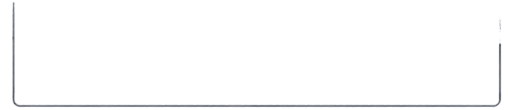





How the system works
TinyFish executes. ShadowTwin interprets, compiles, and routes. Deterministic checks ensure safety. Humans stay in control.
HUMAN INPUT
TINYFISH EXECUTION
SHADOWTWIN PROCESSING
EXECUTION ROUTER
VALIDATION & APPROVAL
OUTCOMES
& FEEDBACK
Deterministic actions
Versioned Skill Registry
Deterministic checks
TinyFish Agent
Stable, rule-based steps
Execute action
or respond
User / task input
Live interactive
browser exploration
Trace
Interpreter
Skill Compiler
Each skill stores: Applicability
Approved constraints
Output schema
Verification rules
Recovery notes
Version & test history
Validate seller, item, amount and user constraints
Create and update skills
from validated signals
Deliver result
to user
Process execution
brovery and corrections
Fetch route
Intent
Constraints
Preferences
Corrections
TinyFish Search/Fetch
Use TinyFish Search/Fetch
Targeted lookups and retrieval when appropriate
Human approval
gate
Store outcome
& corrections
Agent exploration
Required for outbound messages or commitments
Feed back into complier
Verified for the task
Use TinyFish Agent
Outcome & correction loop
TinyFish
ShadowTwin
Deterministic checks
Human

Slide 5


































The learning loop
ShadowTwin improves through each cycle. Every run strengthens skills and preferences.
FIRST RUN: TEACH
SECOND RUN: REUSE
build the skill
apply the skill
Explore
TinyFish executes
the task; ShadowTwin records evidence
you guide TinyFish through the task
ShadowTwin applies
the skill to new inputs
Learn and repair
Compile
corrections inform
a new version; failed versions are re-explored and tested
prices and website facts can change. retrieve volatile data again rather than memorizing stale values.
convert a successful, reviewed workflow and preferences into a candidate skill
reviews and confirms preferences
retrieves current website information as needed
ShadowTwin compiles the workflow into
a candidate skill
validates the result
against your rules
Validate
Reuse
deterministic checks decide if the result satisfies the rules
apply the skill to fresh inputs and current website information
validated result becomes the baseline skill
delivers the outcome
you asked for
Procedural learning
improve step sequences and branching logic
Preference learning
capture your constraints, formats, and choices
Anchor Browser and Autotab address demonstration-based automation. ShadowTwin's differentiation: Inspectable corrections, user-specific constraints, validation, and cross-listing reuse.
Outcome learning
learn from validated results and corrections

Slide 6








Current market, business model .
A growing adjacent market, clear early users, and a focused path to value.
ADJACENT RPA MARKET ESTIMATE
US$35.8B
by 2033
WHO USES IT FIRST
BUSINESS MODEL HYPOTHESES
US$4.7B
Teams running repeatable multi-step browser workflows
Individual and team subscriptions
in 2025
APIs or custom integrations are unavailable or too costly
Usage-based execution
29.0%
Enterprise governance and
audit features
CAGR
(2026-2033)
Operations, vendor onboarding, analysts and administrative teams
2025
2033
Core business question: can preference learning and reliable reuse make automation accessible enough to justify payment?
Source: Grand View Research
Third-party market estimate, adjacent category, not ShadowTwin TAM.

Slide 7















Meet the team. Prove one learning loop.
Expand from there.
Sagar Rathi
Kanav Sharma
Chiraj Kalra
Team Lead
Core Contributor
Core Contributor
Project Architecture & Lead
Engineering & Development
Engineering & Validation
Full-Stack & AI Systems
System Integration
Problem Solving
https://github.com/sagarrath16
Feature Development
Core Implementation
working
compiled skill
second-run proof on a different listing
controlled failure/recovery demonstration if time permits
Six-hour milestone
1
demonstrate
one workflow
2
validate reuse and recovery across more tasks
3
expand into a shared workspace for team skills
Seeking design partners
to validate repeatable browser workflows and measure the value of learning from demonstrations.
ShadowTwin doesn’t just complete a task. It learns how to do it again.

