Slide 1
Hands on session - 17CS353
Zookeeper and AMQP with Docker

Slide 2
Zookeeper
Apache ZooKeeper is a software project of the Apache Software Foundation, providing an open source distributed configuration service, synchronization service, and naming registry for large distributed systems. ZooKeeper was a sub-project of Hadoop but is now a top-level project in its own right.
https://hub.docker.com/_/zookeeper/

Slide 3
RabbitMQ
RabbitMQ is open source message broker software (sometimes called message-oriented middleware) that implements the Advanced Message Queuing Protocol (AMQP). The RabbitMQ server is written in the Erlang programming language and is built on the Open Telecom Platform framework for clustering and failover. Client libraries to interface with the broker are available for all major programming languages.
https://hub.docker.com/_/rabbitmq/

Slide 4
This hands-on is only a basic demo of how to get started with zookeeper and rabbitmq.
For this demo we will be using kazoo as the python client for interacting with zookeeper.
For amqp, we use pika, which is a python implementation of AMQP.
People using nodeJS can use amqp.node
For the purpose of demo, we’ll be using a single docker-compose file with containers for zookeeper, rabbitmq, producer, consumer and zookeeper_client.

Slide 5
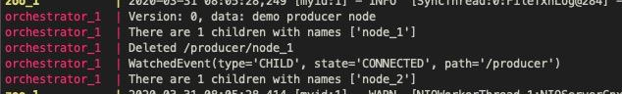
Zookeeper Demo
Run using `docker-compose up --build`
We create a znode called “node_1” and set a watch on it.
On deleting “node_1”, we see that the watch is triggered
And in the event handler of the watch, a new znode called “node_2” is created,
A similar approach has to be taken in the project to start new workers when a worker is killed.

Slide 6
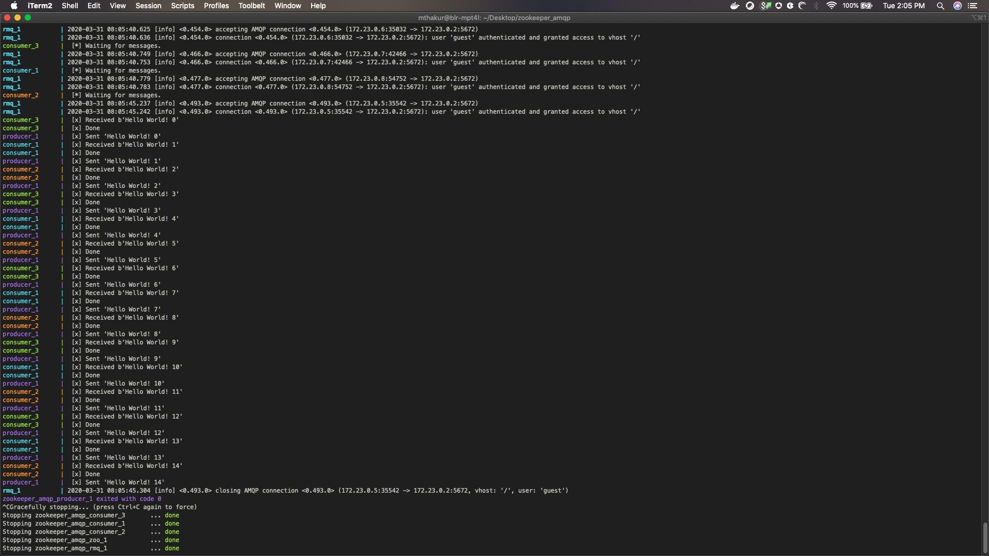
AMQP Demo
Run using `docker-compose up --build --scale consumer=3`
This is a simple demo where we show 1 producer and n consumers over a single queue.
The producer sends 15 messages, and there are 3 consumers.
The messages are load balanced in a round robin fashion among the three consumers.
Notice, in the code we connect to “rmq” host and not “localhost”.

