Slide 1

Books reviews
Books are a unique portable magic

Slide 2
DESCRIPTION
Our website is based on books platform where a user can go through a lot of books and can read a small description of a particular book . Our website gives the platform to new authors who wants to publish his/her new book . If a user is a new reader and doesn’t know about different genres then the user can learn about all the genres under the genres tab . Apart from this every user can comment on particular book about the like, dislike etc. but only if the user has created an account .

Slide 3
LINK
https://bookswebprojectvue.herokuapp.com

Slide 4
CONTRIBUTION
Pulleh Bhatia : I did most of the front-end, using Vue, Vuetify, Axios .
Sagar Ratan Garg : I did most of the back-end, using Django, rest-framework, serializer and permissions, corsheader.

Slide 5
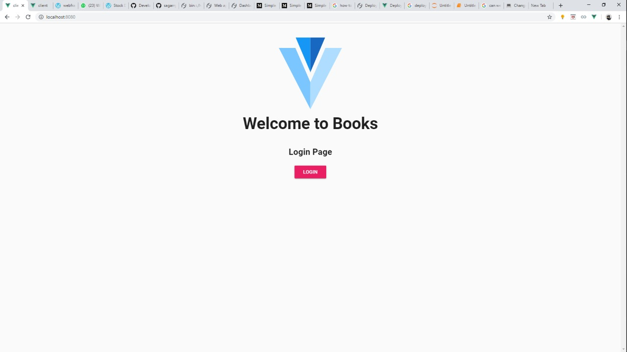
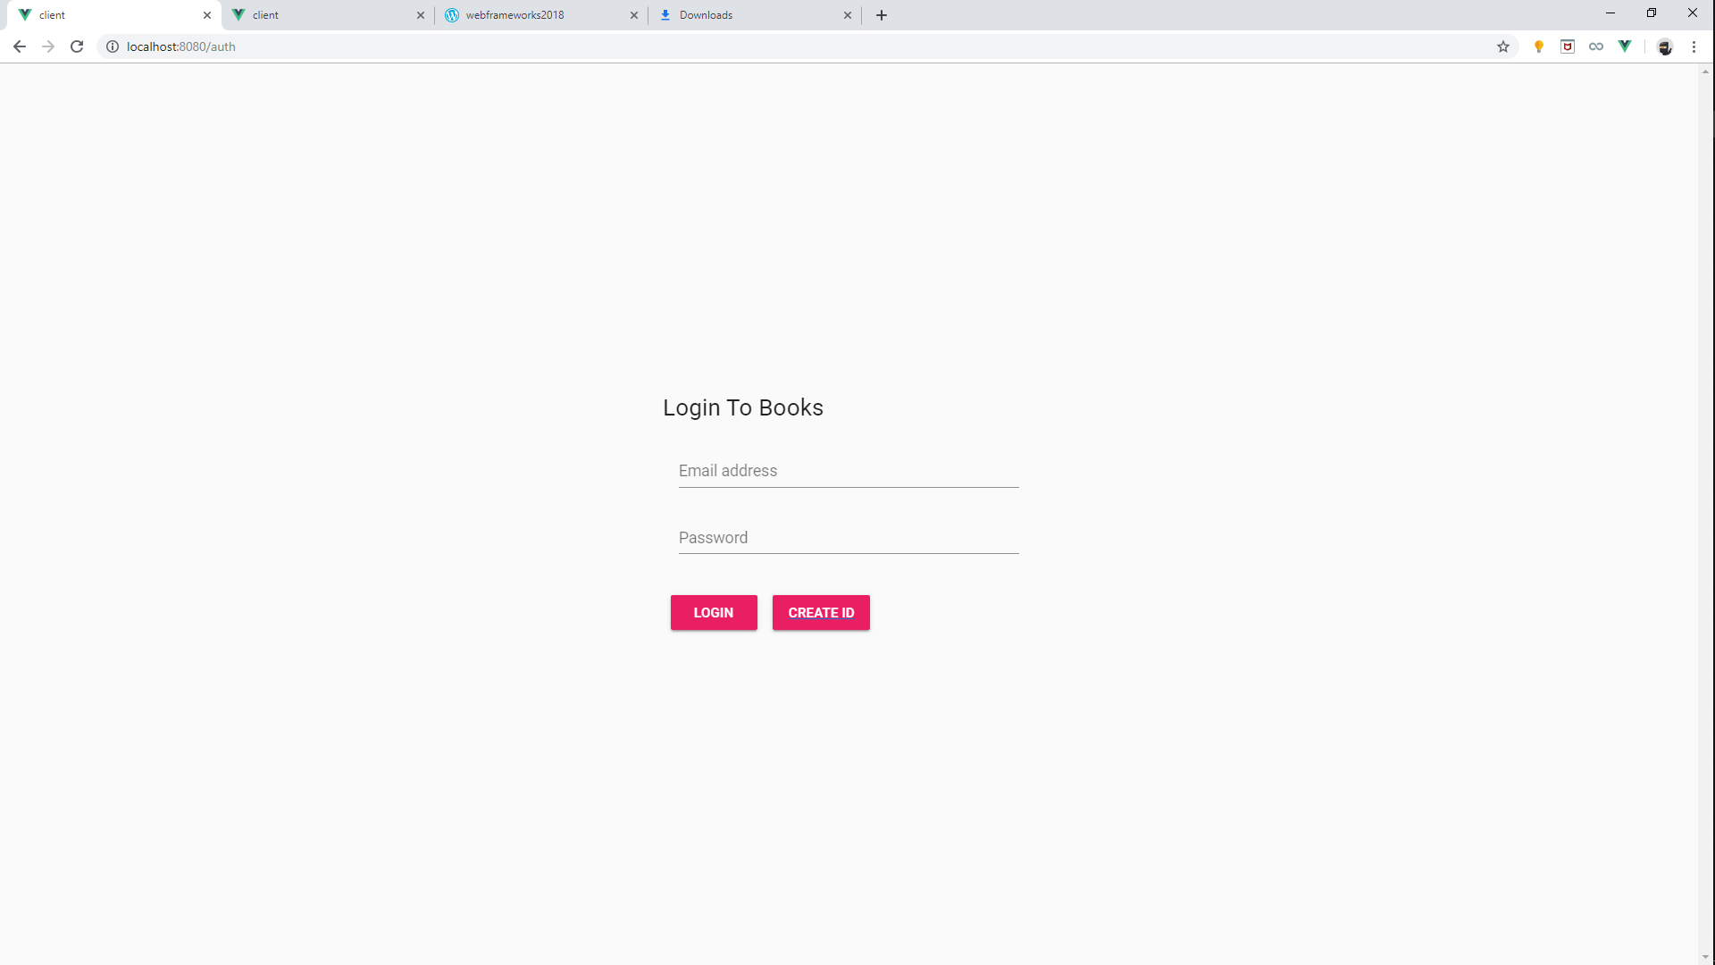
SCREENSHOTS

Slide 6
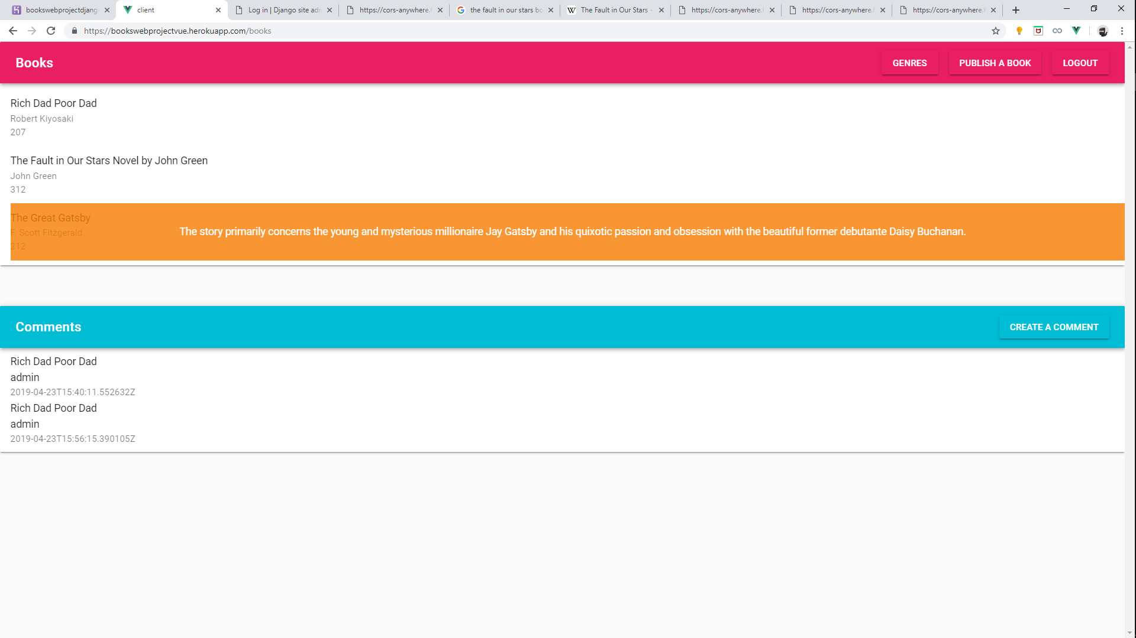

Slide 7
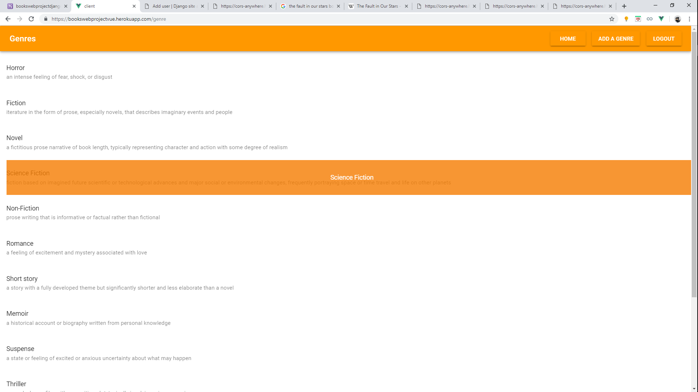

Slide 8
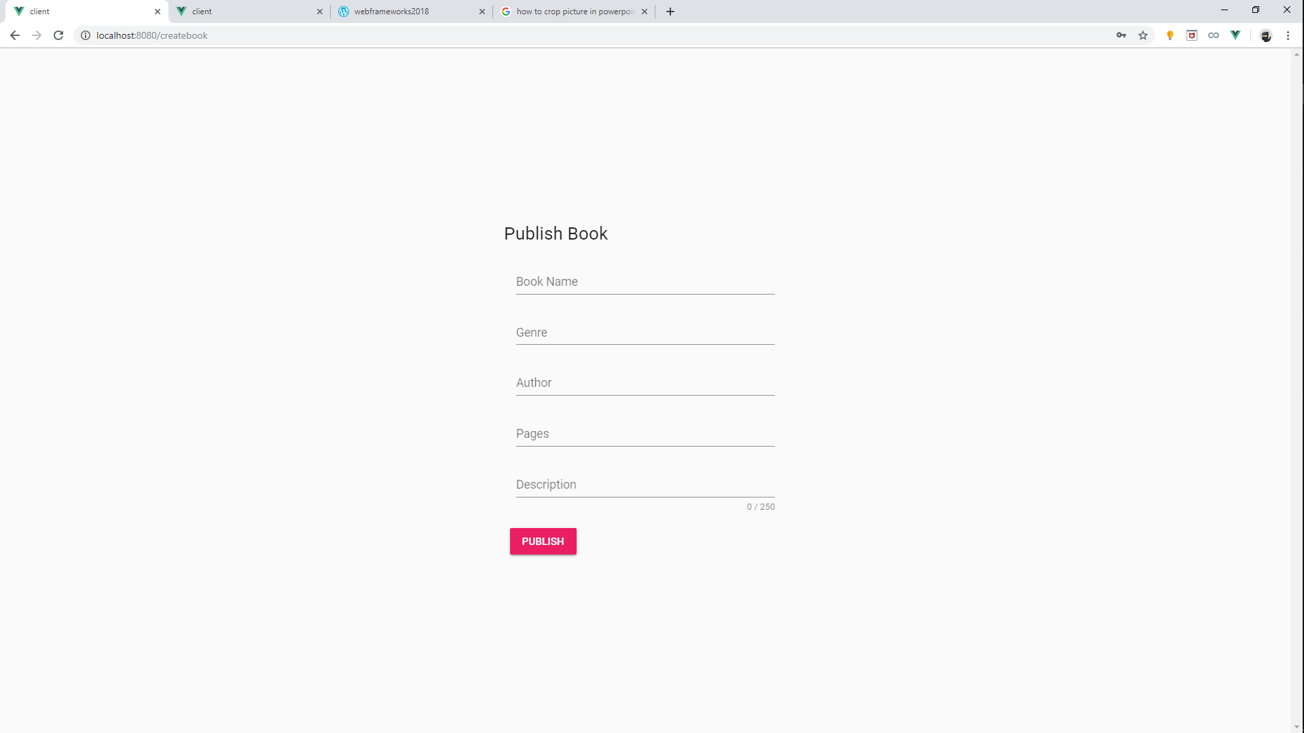
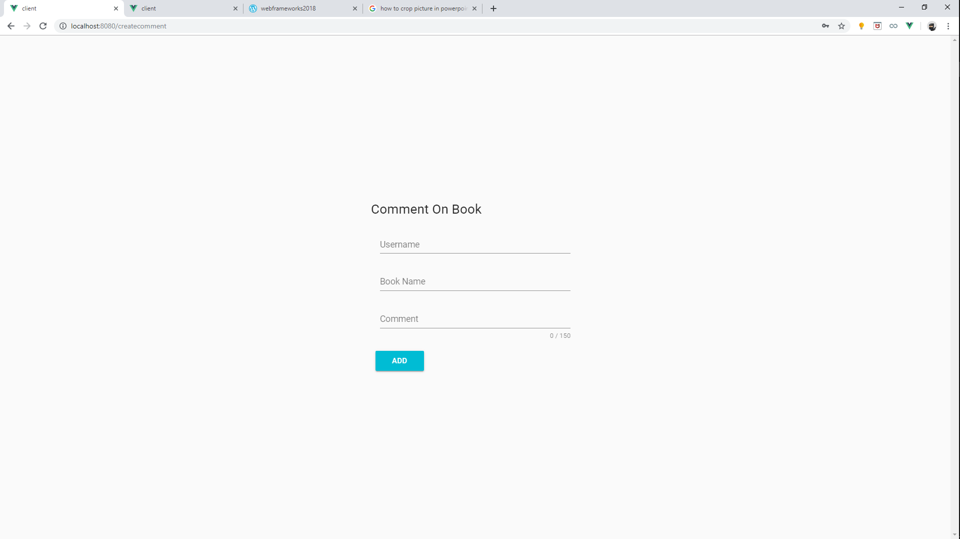

Slide 9
TAKEAWAY
We learnt about the following frameworks and parts of Django and Vue :
Django Rest Framework.
Axios (how to send and receive request using axios)
Rest Framework’s Serializer module, which helps in basically translating Django modules into other formats.
Vuetify which is a bootstrap like framework for Vue.
Rest Framework’s generics and permissions module.
Got a very good hands on the Vue and Django and specially using them together using corsheader(cross platform origin, helps in integrating multiple platform)

Slide 10
CHALLENGES
We came up with the following challenges:
First of all, making a login page and connecting it to django authorization was a difficult task(used restframework and jwt restframework)(resolved)
Signup form can’t be made as we were facing problems in saving it to Django database authorization.(unresolved)
V-loops, was a little bit difficult for the first time, but we got through this.(resolved).
Users have to manually enter their username in add a comment, section, (unresolved, due to not much knowledge of authorization process of Django.(unresolved)
At the starting, taking data from user , and sending it via axios without using serializers was giving us a bad request error.(resolved)

Slide 11
Contact
Name : Sagar Ratan Garg
SRN : PES1201700913
E-MAIL : sagarratangarg@gmail.com
Name : Pulleh Bhatia
SRN : PES1201700111
E-MAIL : pullehbhatia@gmail.com

