Slide 1
Data Engineering Final Assignment
Sagar Pandav – srp8070

Slide 2
Gist
Approached multiple analysis on latest data on currencies, to identify currencies to trade, like Simple Moving Average and derived data like Volatility and FD
Leveraged API thanks to libraries like Meta4API and softwares like Trading View to evaluate
Segregated logic into multiple functions to have production ready code
Programmable code to configure various currencies, trade type, trading windows, volumes and exit strategies

Slide 3
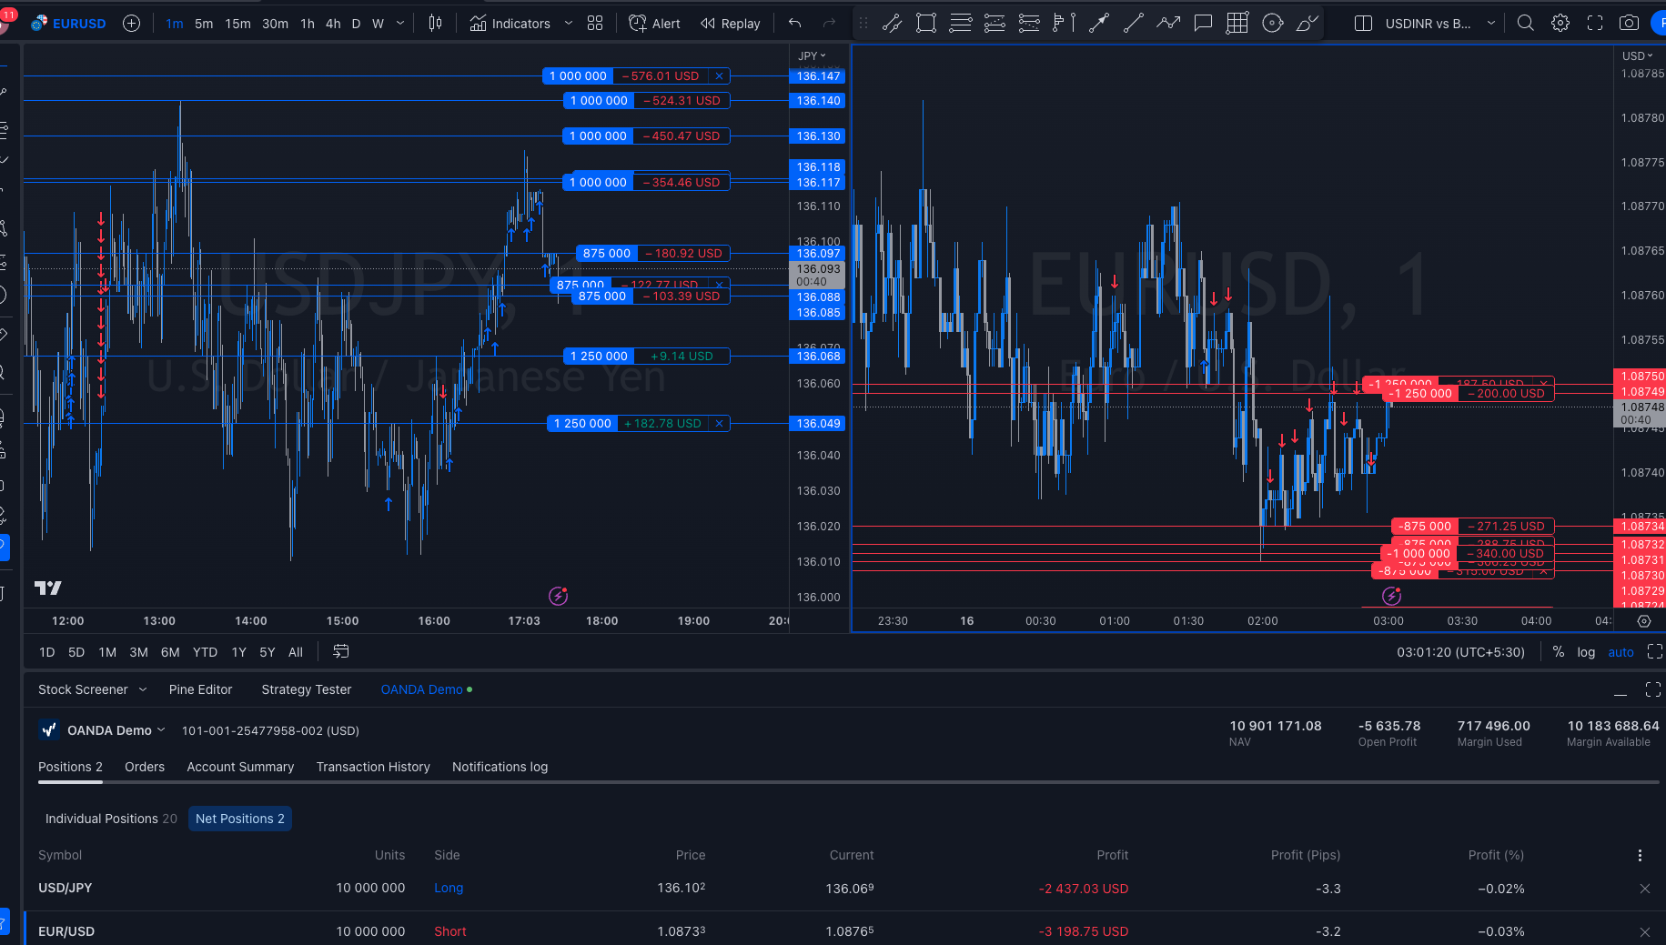

Slide 4
CODE TIME !
Tools : IDEA Pycharm, Google Colab
Interfaces : Polygon, Trading View, Meta4API, Oanda MT4
Libraries: sklearn, pycaret, pandas, numpy

Slide 5
Improvements
Classify structure start and end points in existing data as Uptrend, Downtrend, and Consolidation
Using Supervised Logistic Regression for 3 classes, train over last 5 years data without last 2 years, and test on last 2 years
Once we identify trend, write regression models specifically for uptrend and downtrend giving us probability of price reversing for less than 50 pips and going in favored direction for more than 100 pips, giving 1:2 trade signals
Induce concepts like retracement, retracement volume, Fibonacci levels into regression
Decision Tree would be suitable for this because we’ll be using them only once we have identified the trend by classification earlier

