Slide 1
Machine Learning and Feature Engineering for Art Classification
Aris Faria, Filip Nowicki, Shukan Parekh, Sagar Sachdev
Notes:
Main title: 40 pt. Arial
Presenter Name: 16 pt. Arial
Presenters Title: 16 pt. Arial Italic

Slide 2
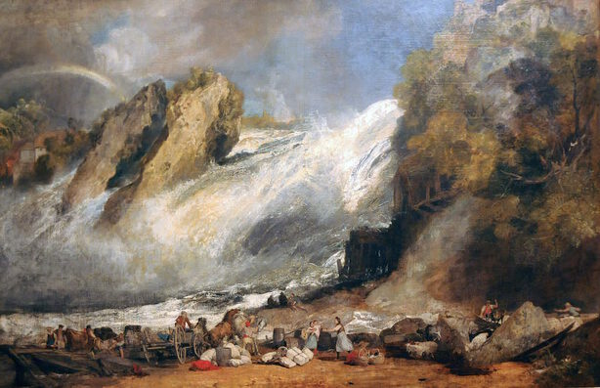
Project Overview
Motivation
Outline
Many great pieces of art by unknown artists
Developing expertise in art takes years
Explore feature engineering techniques as applied to art
Train ML models to classify paintings to their artists
Develop an easy-to-use script to let anyone effortlessly run classification models or classify 1 painting
Shallow Machine Learning techniques
Convolutional Neural Network
Dataset
Kaggle dataset of scanned paintings
50 most influential artists of all time
8446 paintings
Fall of the Rhine at Schaffhausen by William Turner

Slide 3

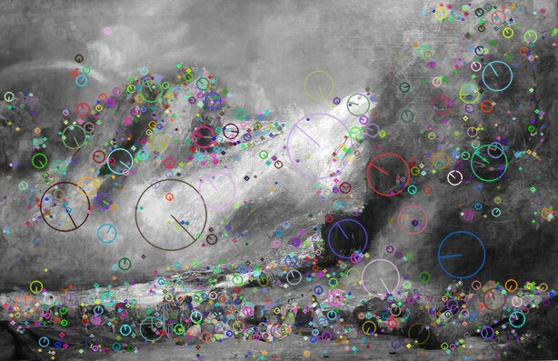
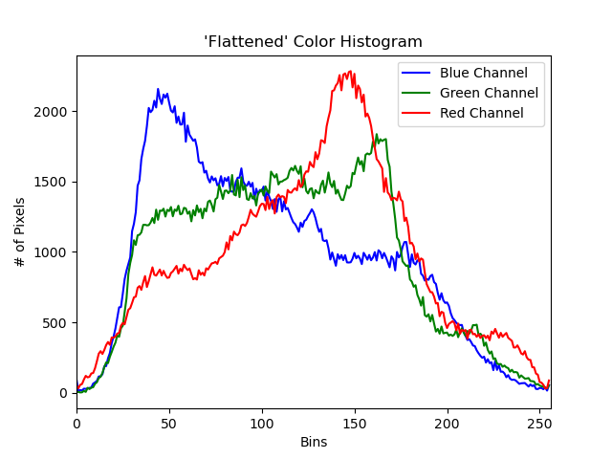
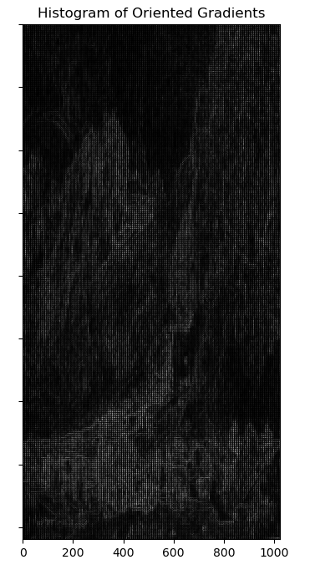
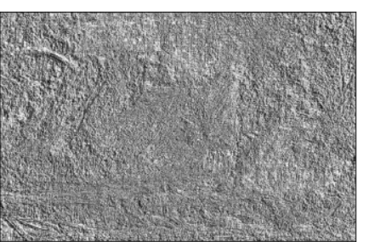
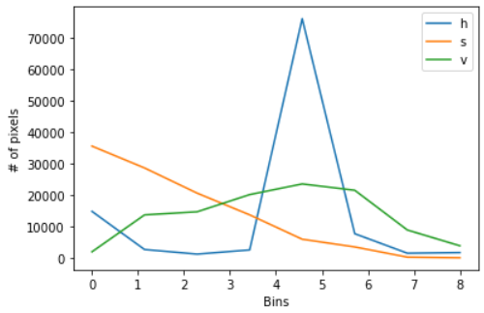
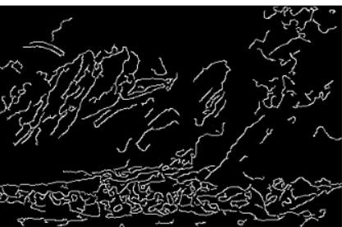
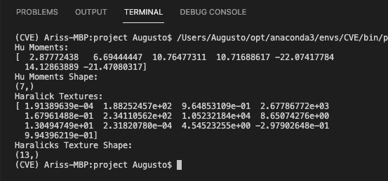
3
Gradient-based
Features
Color
Most representative colors with k-means
SIFT keypoints number
Original image
RGB Histogram
Sum of HOG Descriptors
Grayscale
Local Binary Patterns
HSV Histogram
Canny Edge Sum
Hu Moments
Haralick Textures

Slide 4
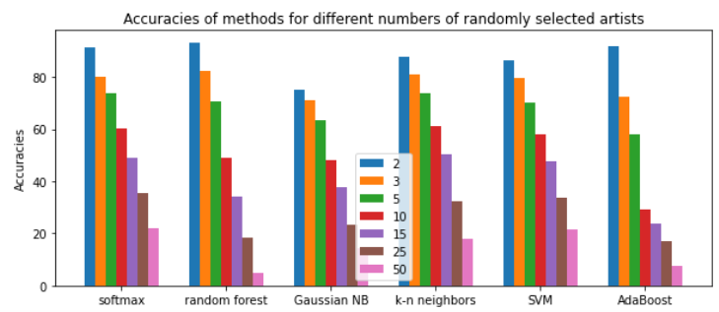
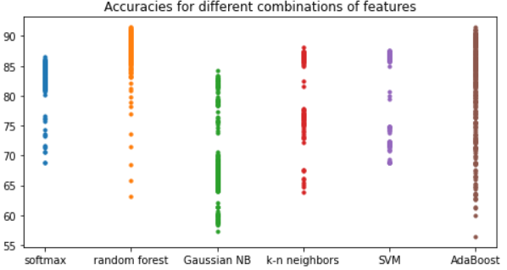
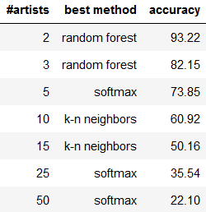
Shallow Machine Learning
90.44% accuracy in 5-fold learning:
RGB histogram + Hu moments + Haralick Textures + Canny edge sum
3 Artists – Paul Cezanne, Rembrandt, van Gogh – 1276 images

Slide 5
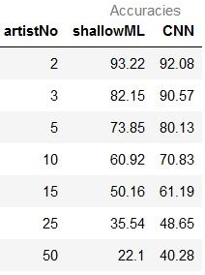
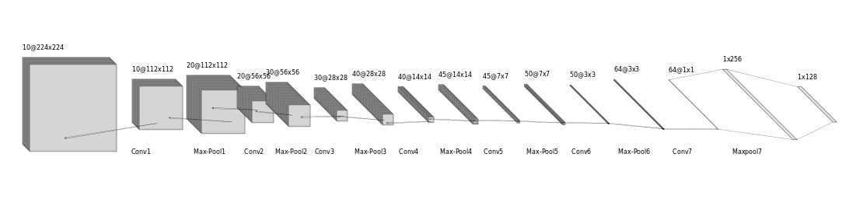
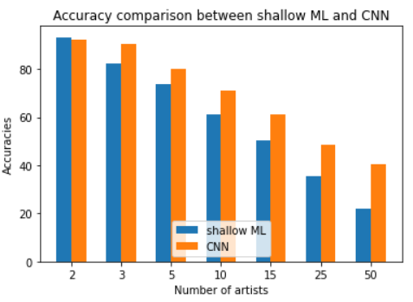
Convolutional Neural Networks
Conclusion
The more artists, the better CNN is compared to shallow ML
Performance for shallow Machine Learning drops gradually, but for CNN, it decreases more slowly with more artists
Only a subset of features, rather than all of them, gave the best accuracy in shallow Machine Learning

