Slide 1

NOETESAVIOUR
SAURABH SAGAR
168210550

Slide 2

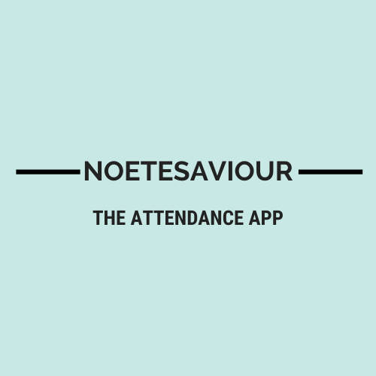



ATTENDANCE APP
Software Development
Link to Website

Slide 3

Product Details
Overview
A mobile application
Handles thousands of registers
Made for replacing normal registers
For adding attendance from anywhere
One step ahead towards Digital India

Slide 4
How did you build your product?
This product is made on React-Native.
React-Native is built over a JavaScript Framework (React) for creating native mobile apps.
I learnt JavaScript and React-Native from Official documentations to create this app .

Slide 5

Business Model
This product plans to generate revenue from ads integrated in it.
This will provide wider range of services for school and college emails.
Else needs subscription for premium usage.

Slide 6
Distribution & Marketing
-Marketting through Google and Facebook Ads.
- Reaching appropriate customers through mentoring YouTubers
- The customers can get this app from the Online store.

Slide 7

Future Objectives
6-months
Reaching to around 1k-10k users
Revenue of 50k – 100k
1-year
Enhancing database to support large crowd
Launching updates considering demand of market and feedbacks from customers

Slide 8
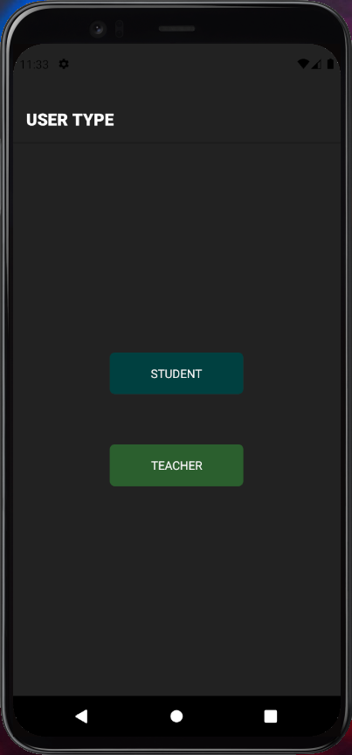
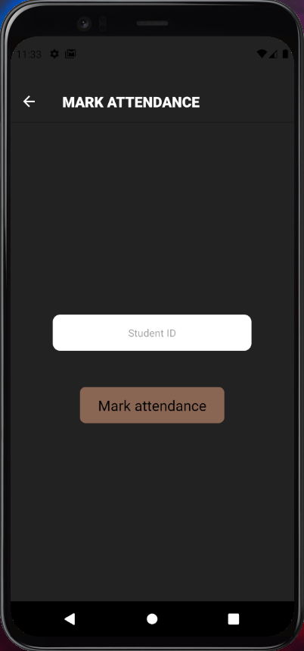
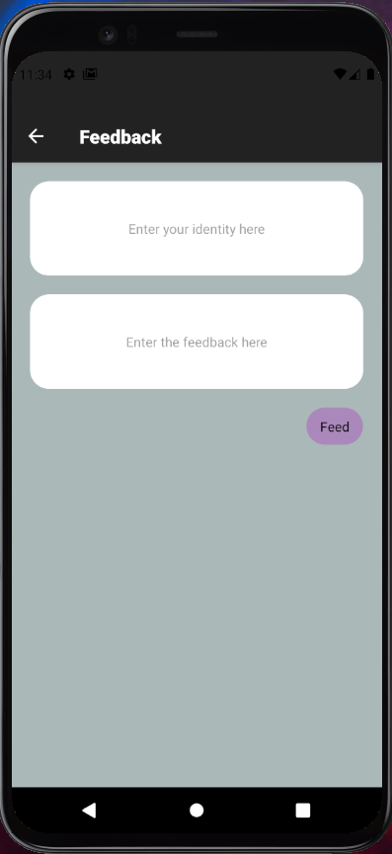
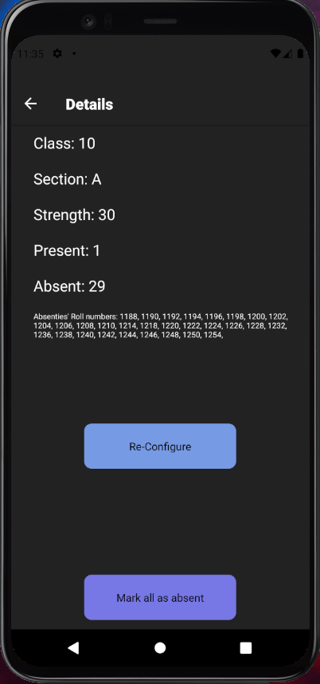
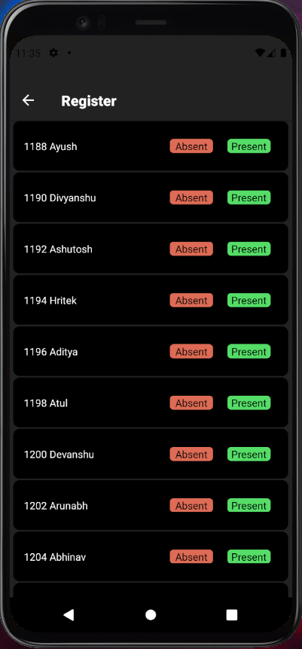
Pictures of Product

Slide 9
Product Links
Online Store here
Product Link here
Facebook Post here
Develpoment Reference here
Pitching Video here
PPT link here

Slide 10
Accomplishments
Tested by my colleagues being ideal customers for this product.
Feedbacks were great, several features were suggested for further versions.
40+ beta users

Slide 11

THANK YOU All
Keep Learning

