Slide 1

NOETESAVIOUR
Name of Individual or Team
Name of Individual: SAURABH SAGAR
ATP Code 168210550
Business Name:

Slide 2

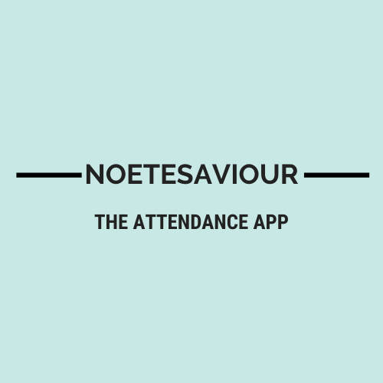



ATTENDANCE APP
NAME OF THE PRODUCT
Software Development
Link to Website

Slide 3

Product Details
Overview
A mobile application
Handles thousands of registers
Made for replacing normal registers
For adding attendance from anywhere
One step ahead towards Digital India

Slide 4
How did you build your product?
This product is made on React-Native.
React-Native is built over a JavaScript Framework (React) for creating native mobile apps.
I learnt JavaScript and React-Native from Official documentations to create this app .

Slide 5

What is your business model?
This product plans to generate revenue from ads integrated in it.
This will provide wider range of services for school and college emails.
Else needs subscription for premium usage.

Slide 6
Distribution & Marketing
-Marketting through Google and Facebook Ads.
- Reaching appropriate customers through mentoring YouTubers
- The customers can get this app from the Online store.

Slide 7

Future Plans for your Business
6-months
Reaching to around 1k-10k users
Revenue of 50k – 100k
1-year
Enhancing database to support large crowd
Launching updates considering demand of market and feedbacks from customers

Slide 8
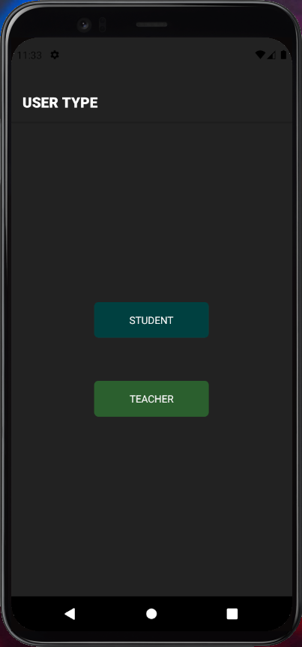
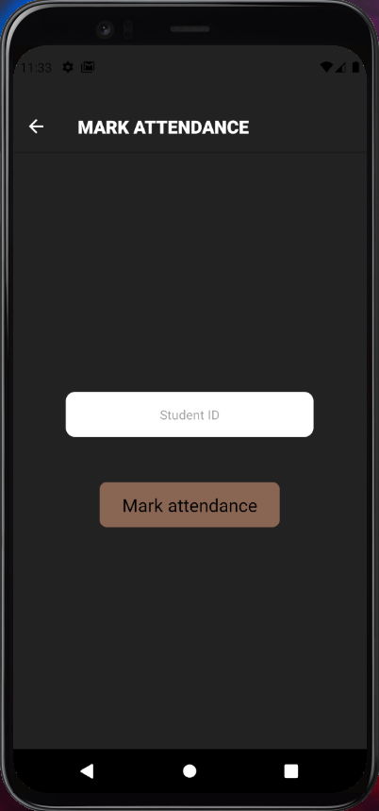
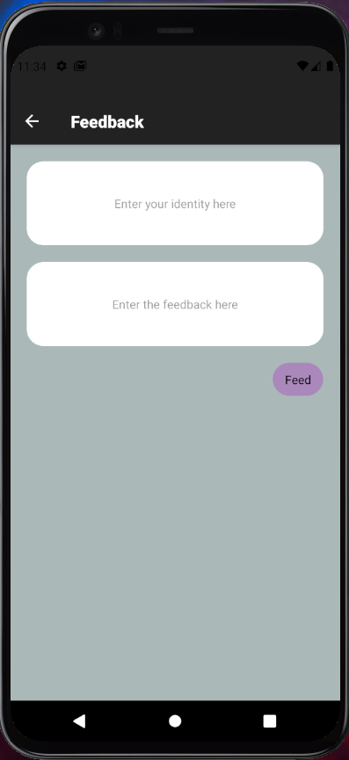
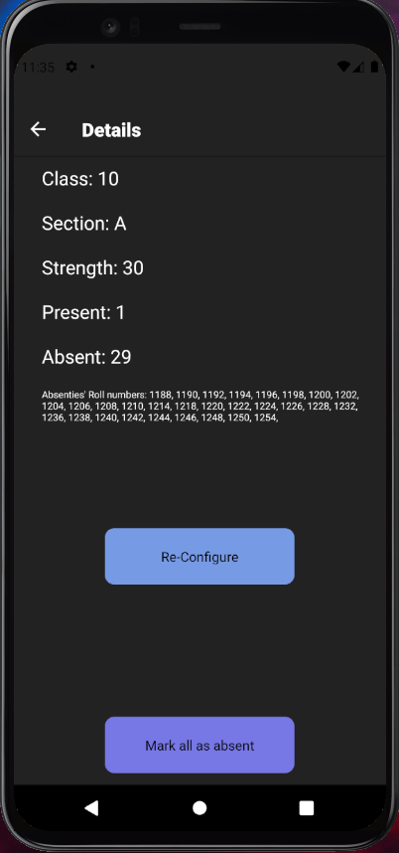
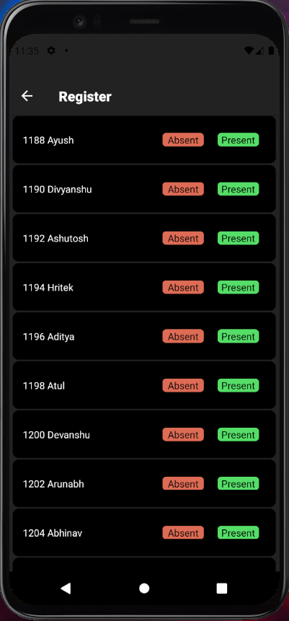
Pictures of your Product

Slide 9
Add names & pictures of your Team (Optional)
Student 1
Student 2
Student 3
Mentor
Teacher

Slide 10
Add all links of your product that will help the mentor evaluate your business venture
Online Store here
Product Link here
Facebook Post here
Develpoment Reference here
Pitching Video here
PPT link here

Slide 11
Add any accomplishments of your business venture (Optional)
Tested by my colleagues being ideal customers for this product.
Feedbacks were great, several features were suggested for further versions.
40+ beta users

Slide 12

THANK YOU
Keep Learning

