Slide 1
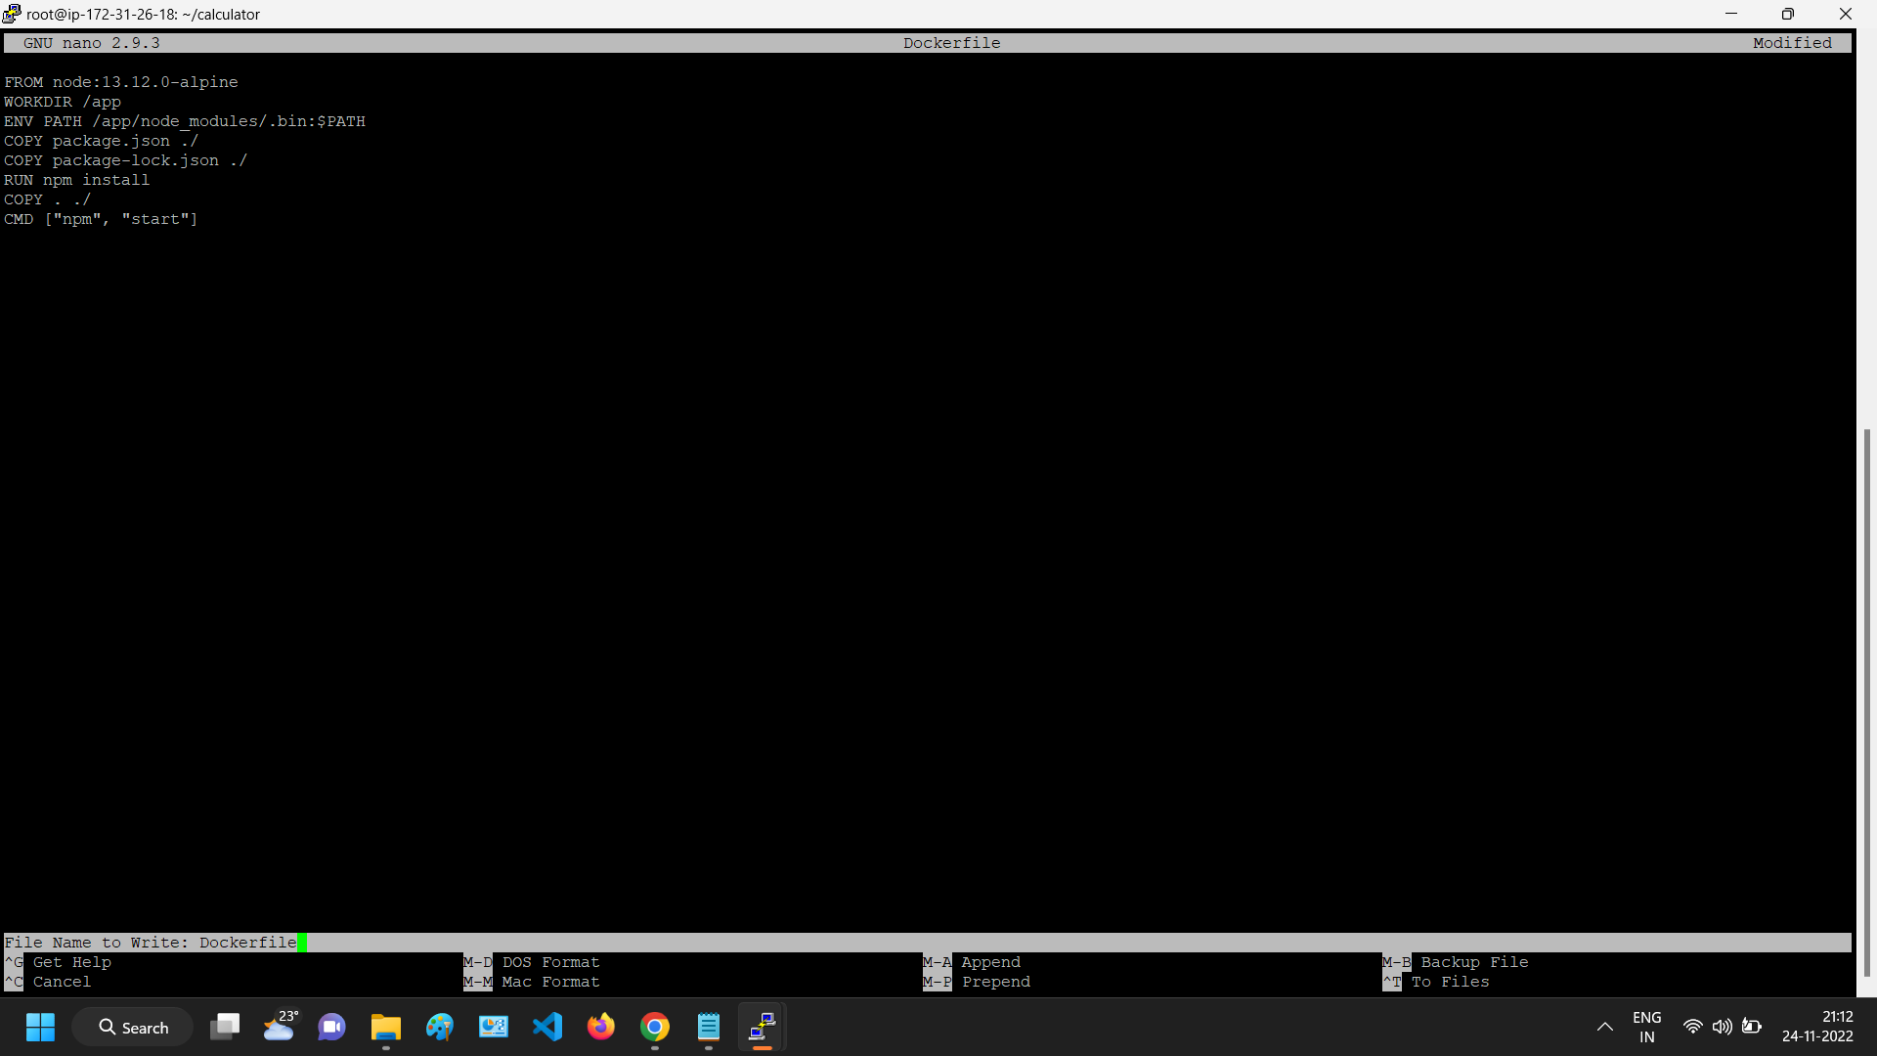
Created the Docker file

Slide 2
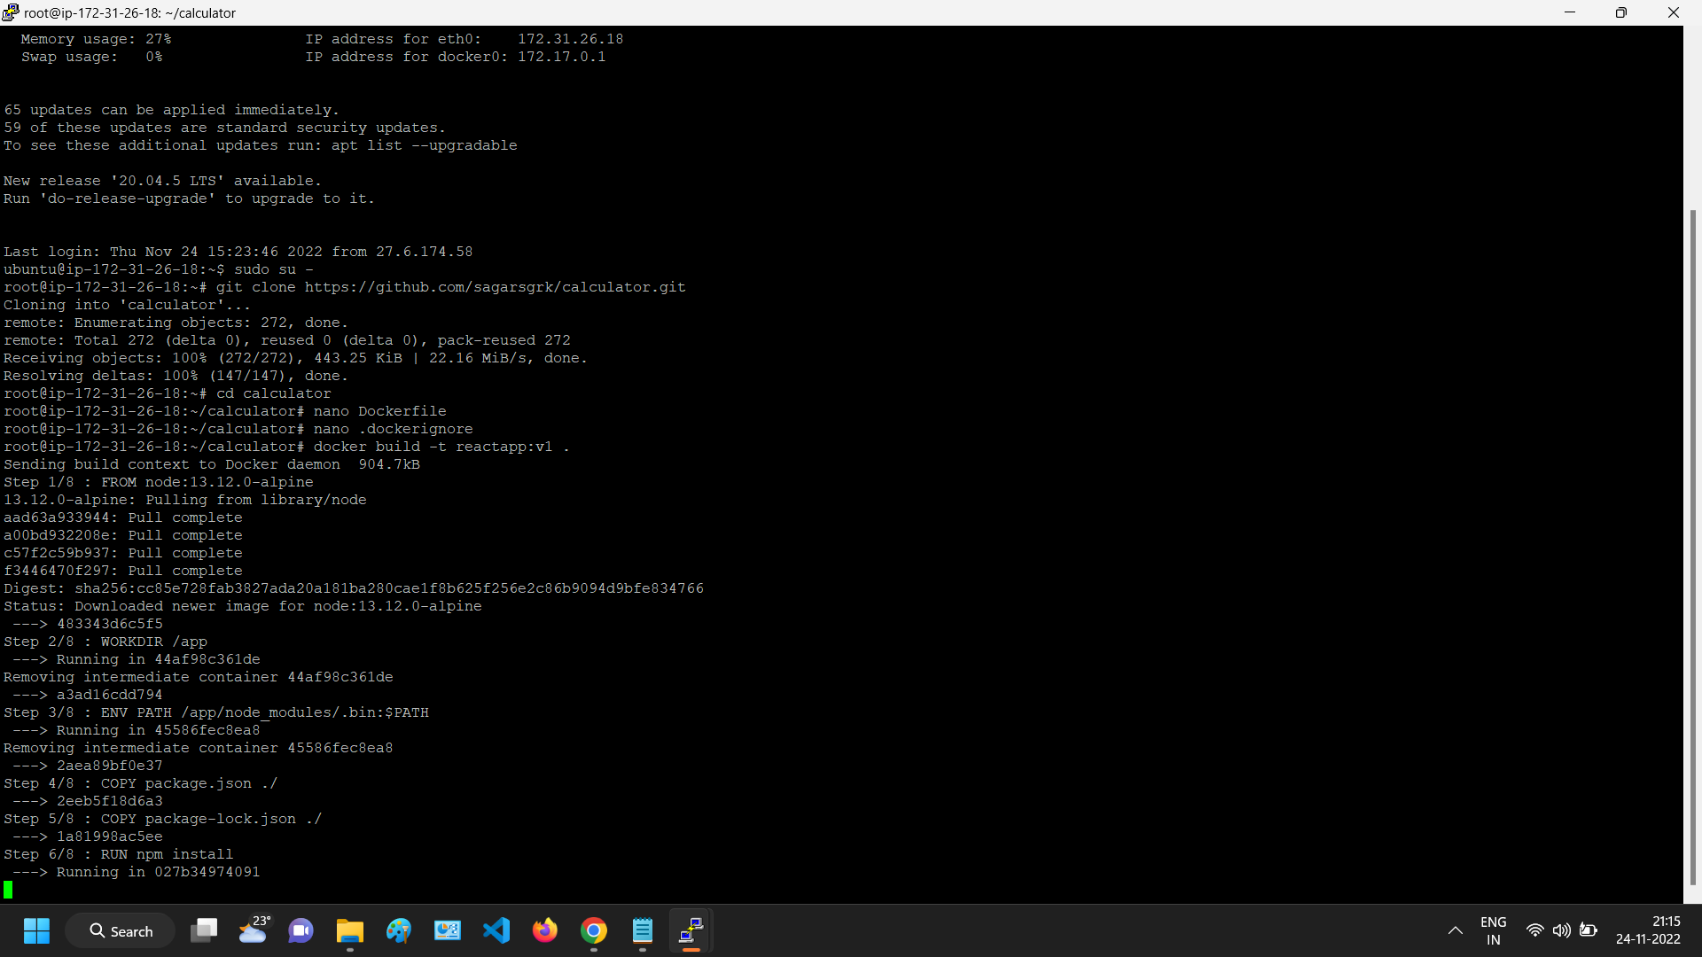
Git cloned and created docker file and Run the Dockerfile

Slide 3
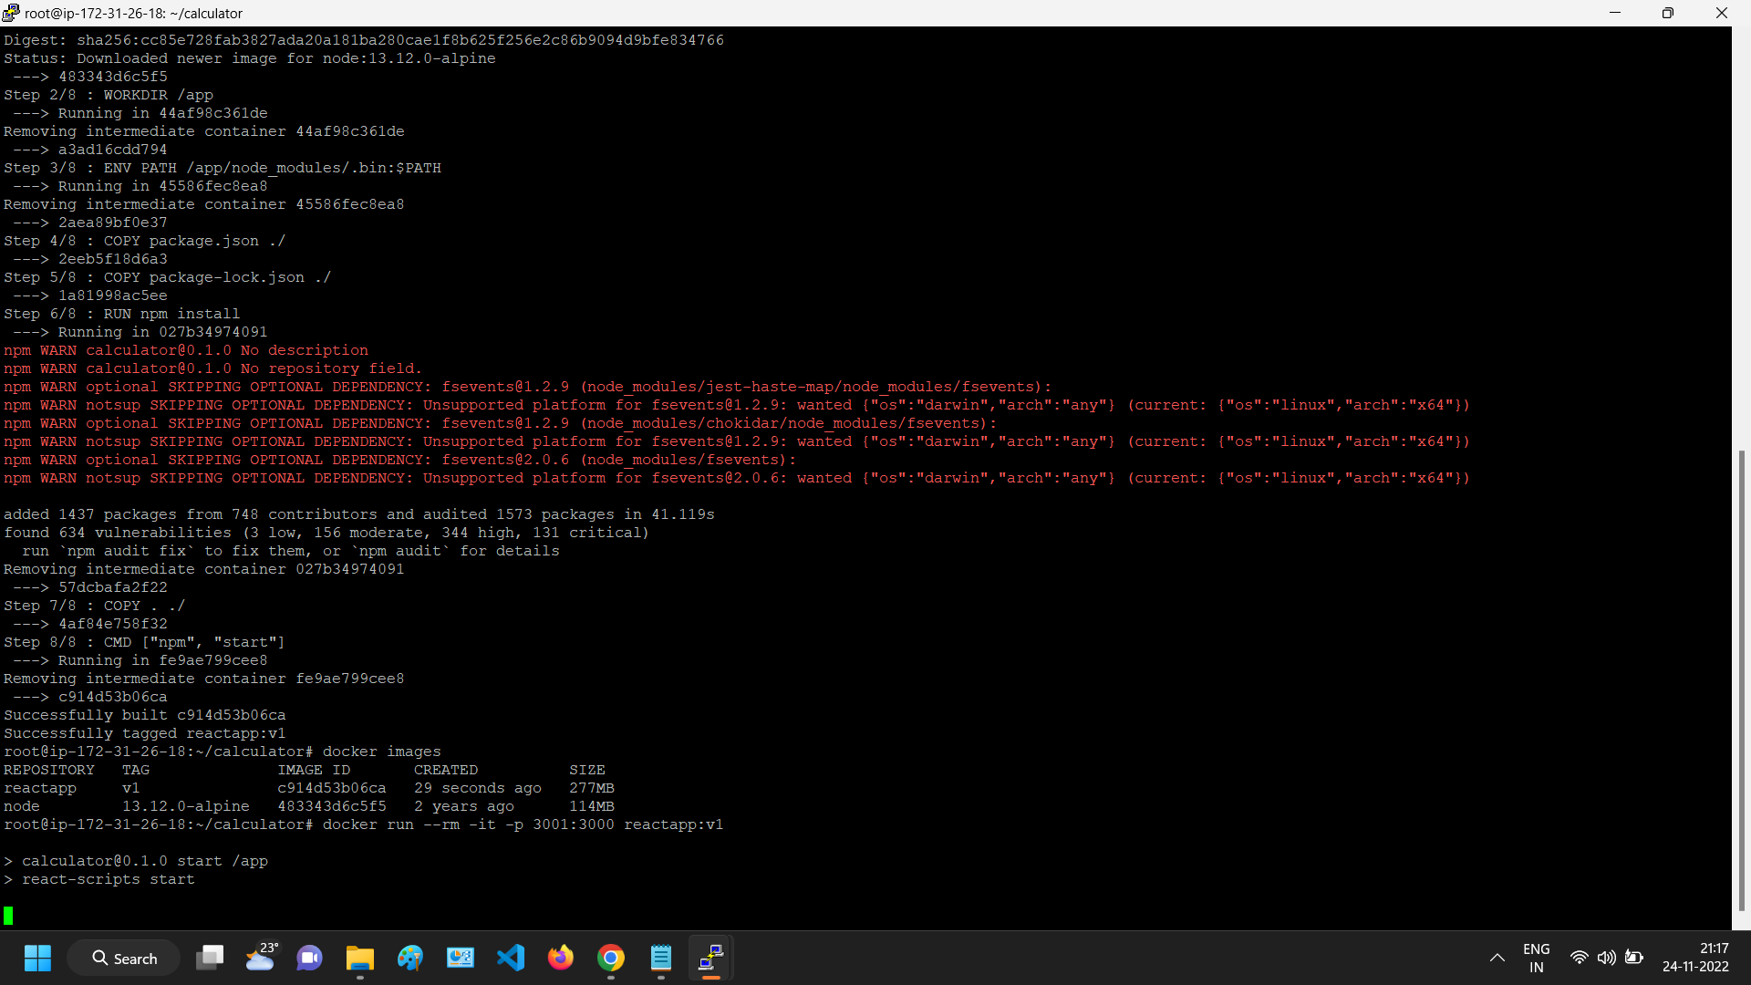
Run The Docker container from docker image with port 3000

Slide 4
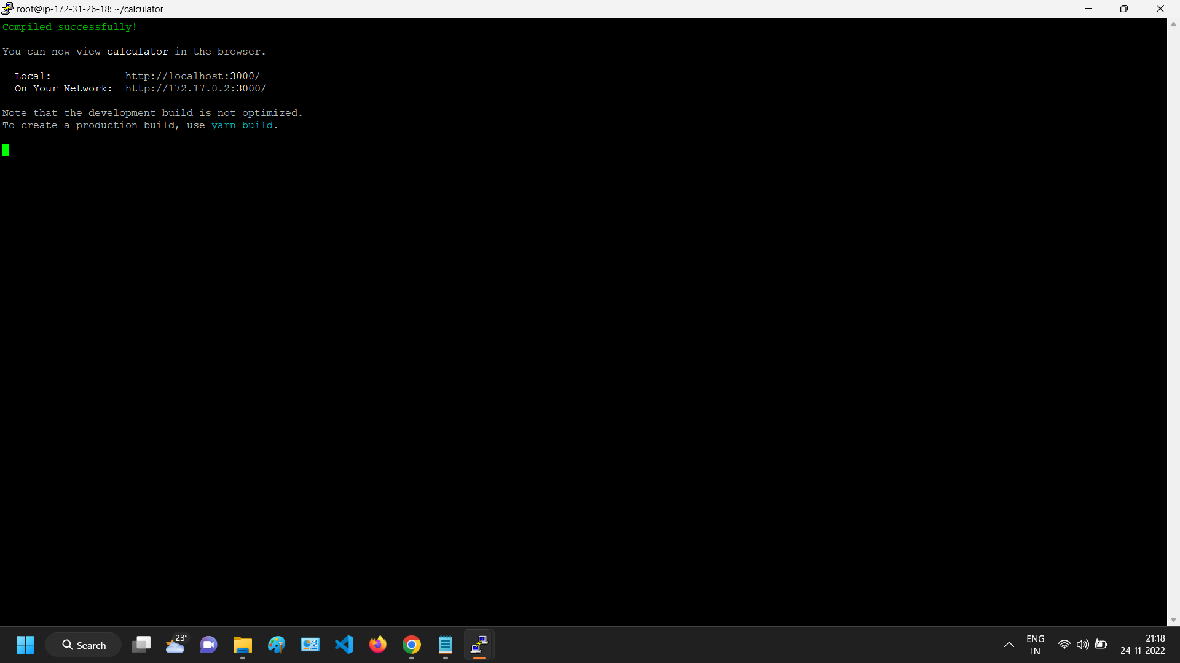

Slide 5
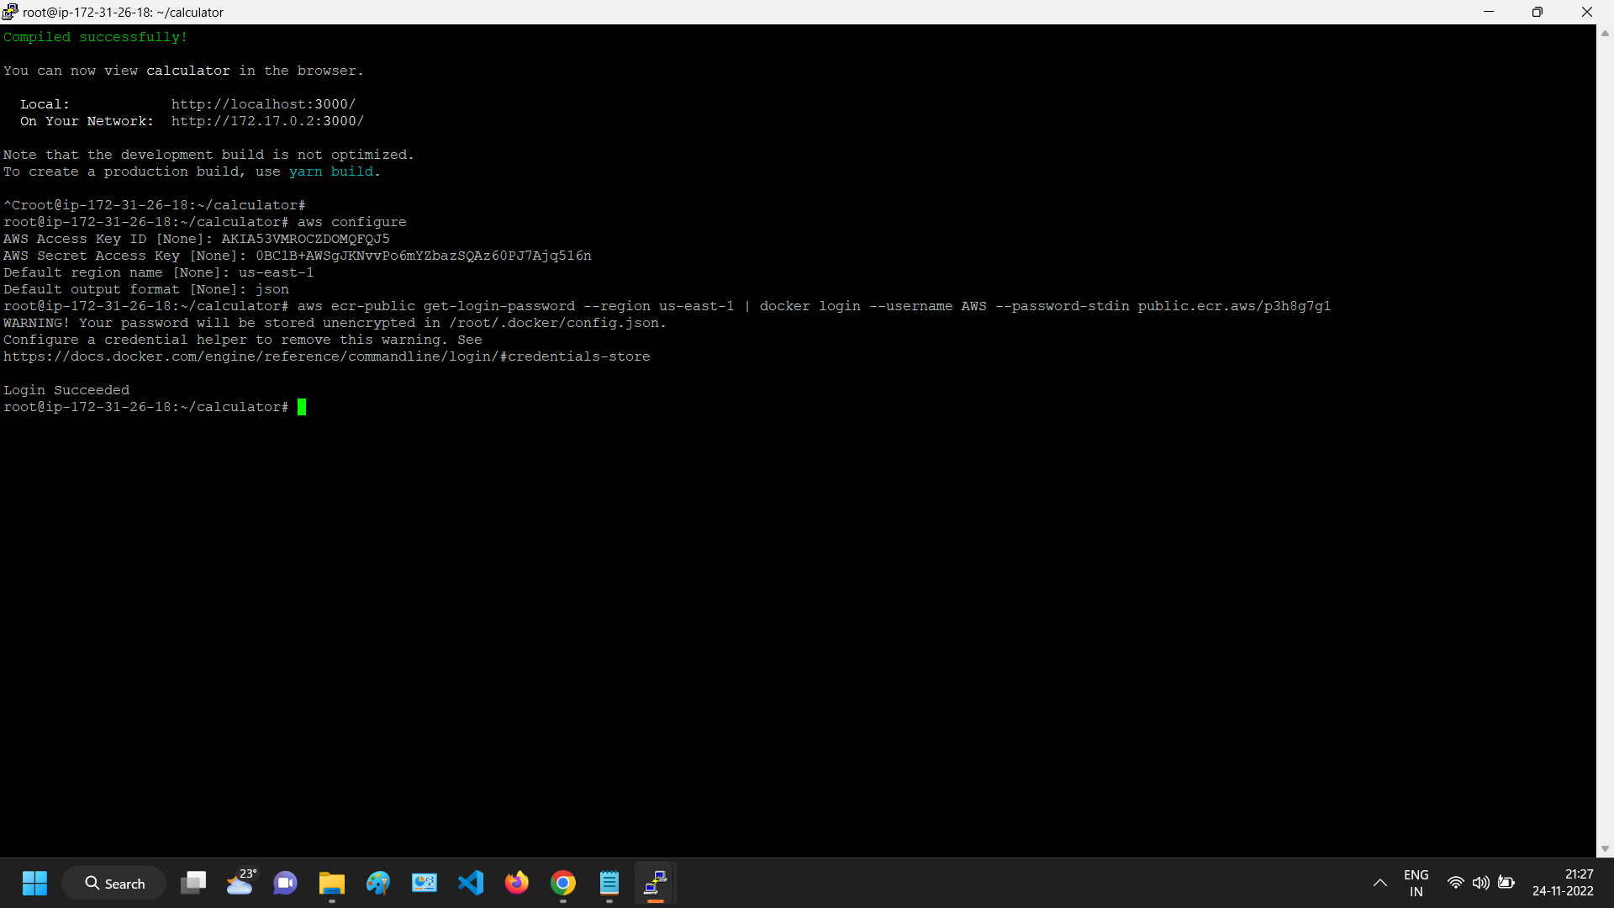
AWS Configure done using AWI CLI and provide Secret Key and Access key from IAM user

Slide 6
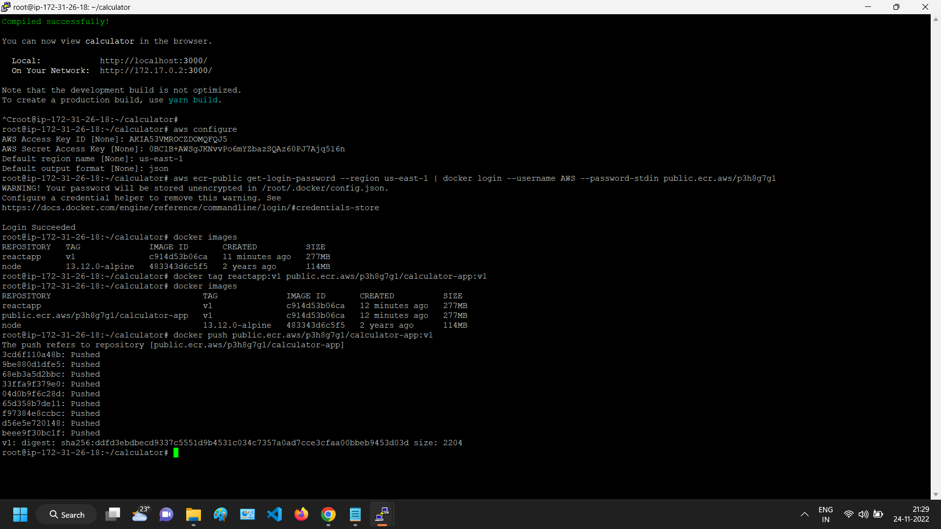
Pushed the docker image to Elastic Container Registry

Slide 7
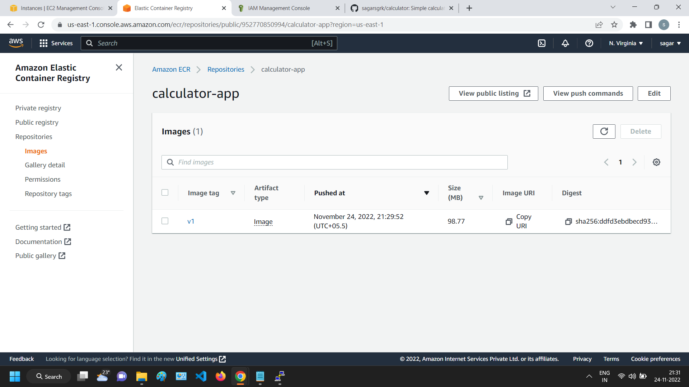

Slide 8
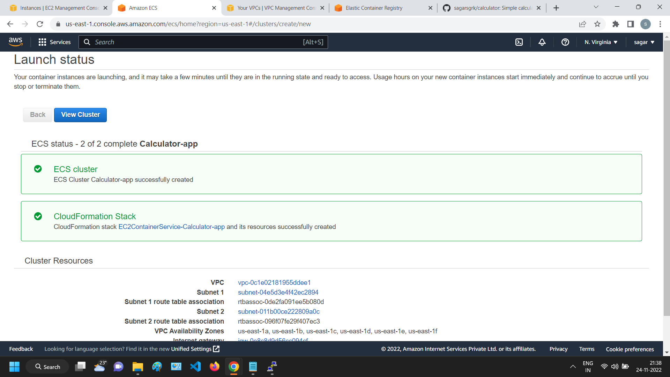
Cluster setup completed in Fargate mode in Elastic Container Service

Slide 9
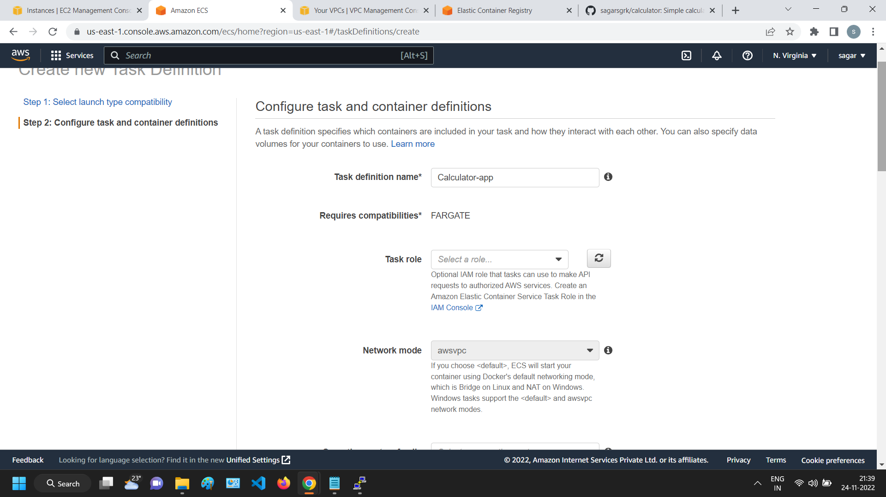
Created Task definition

Slide 10
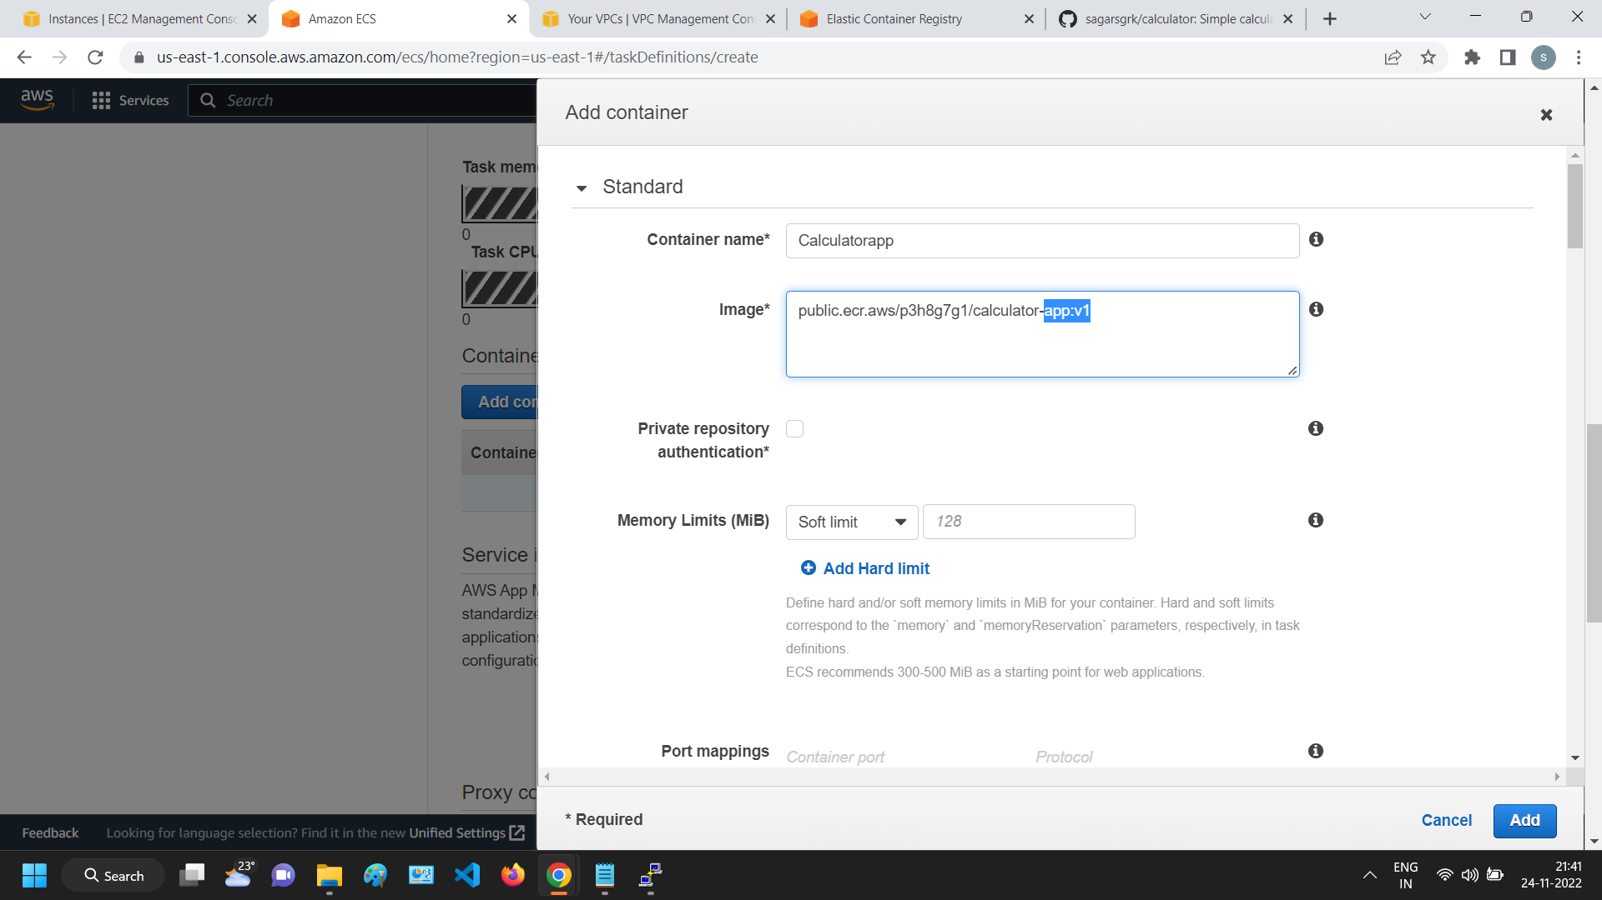
Enter the image from ECR which was pushed from Docker

Slide 11
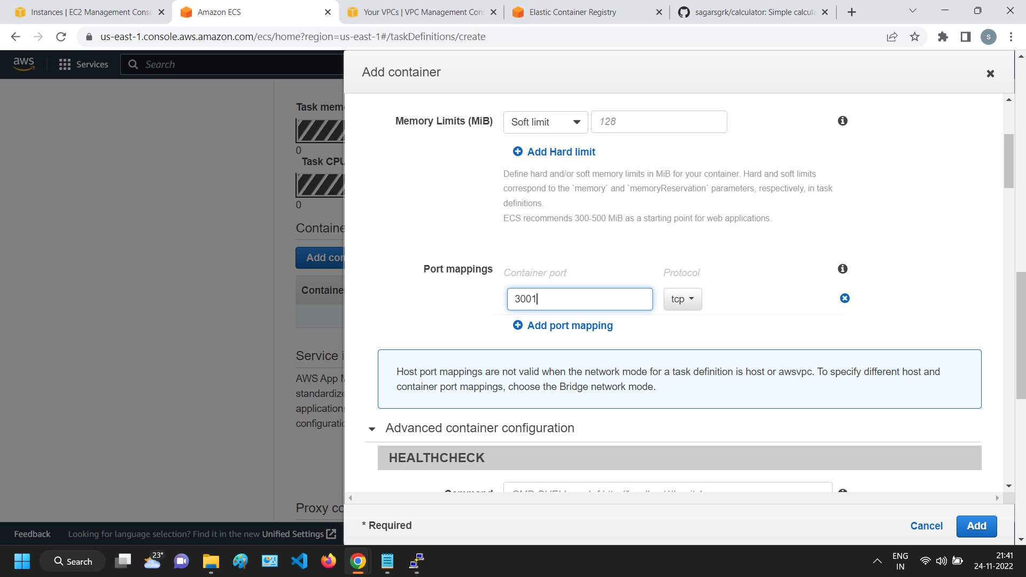

Slide 12
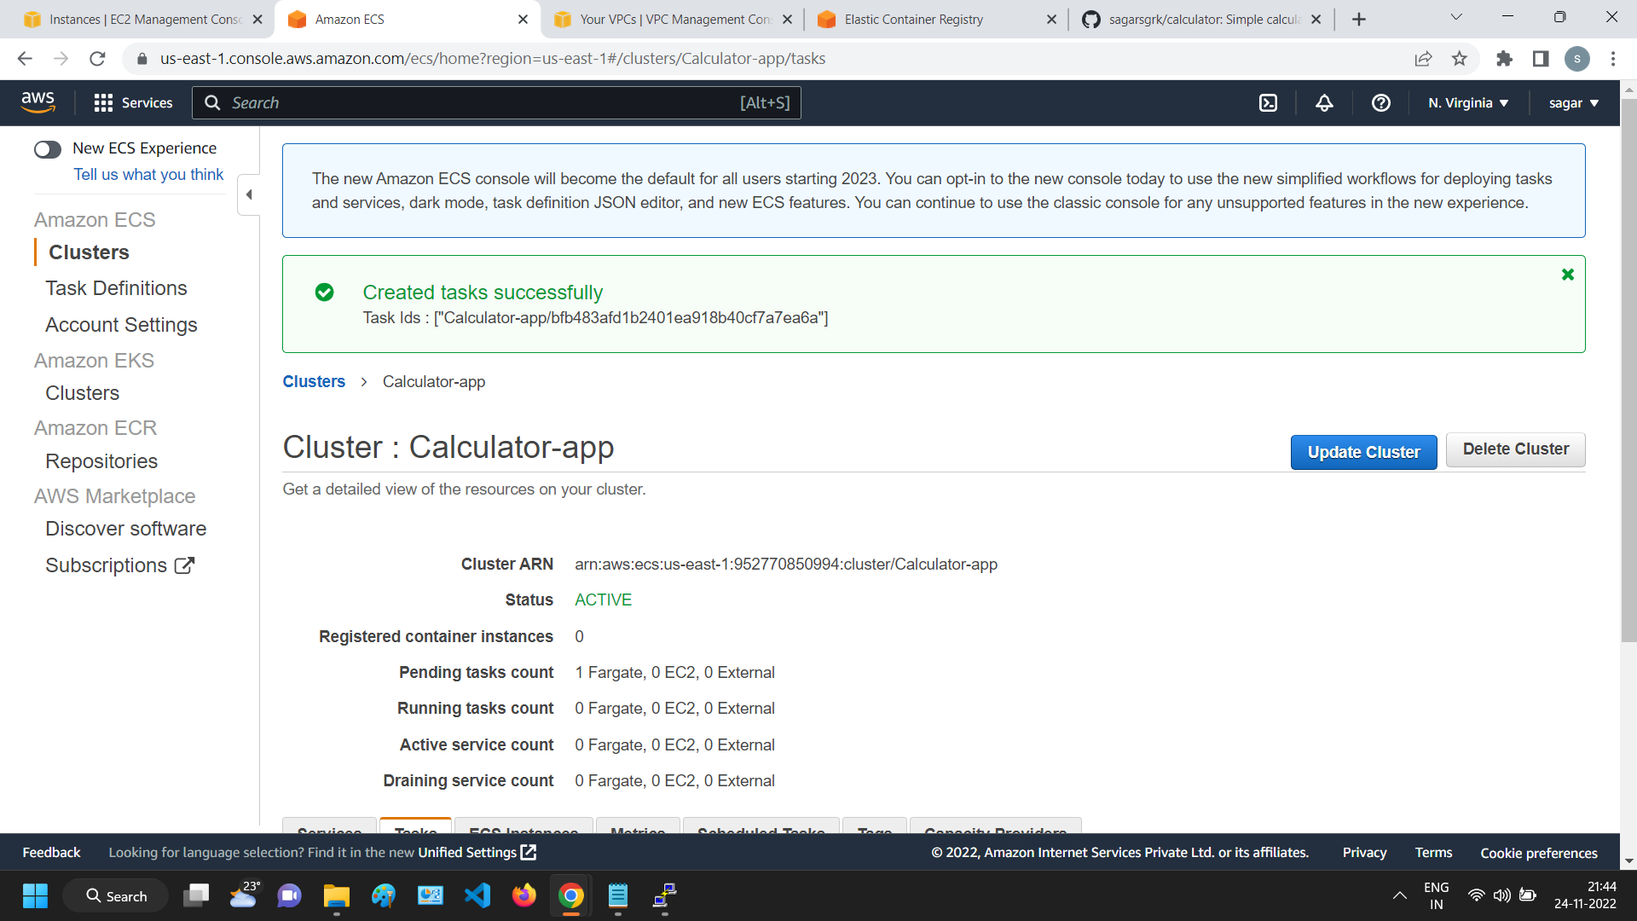
Created Task under the Task Definition from Cluster and Run the container

Slide 13
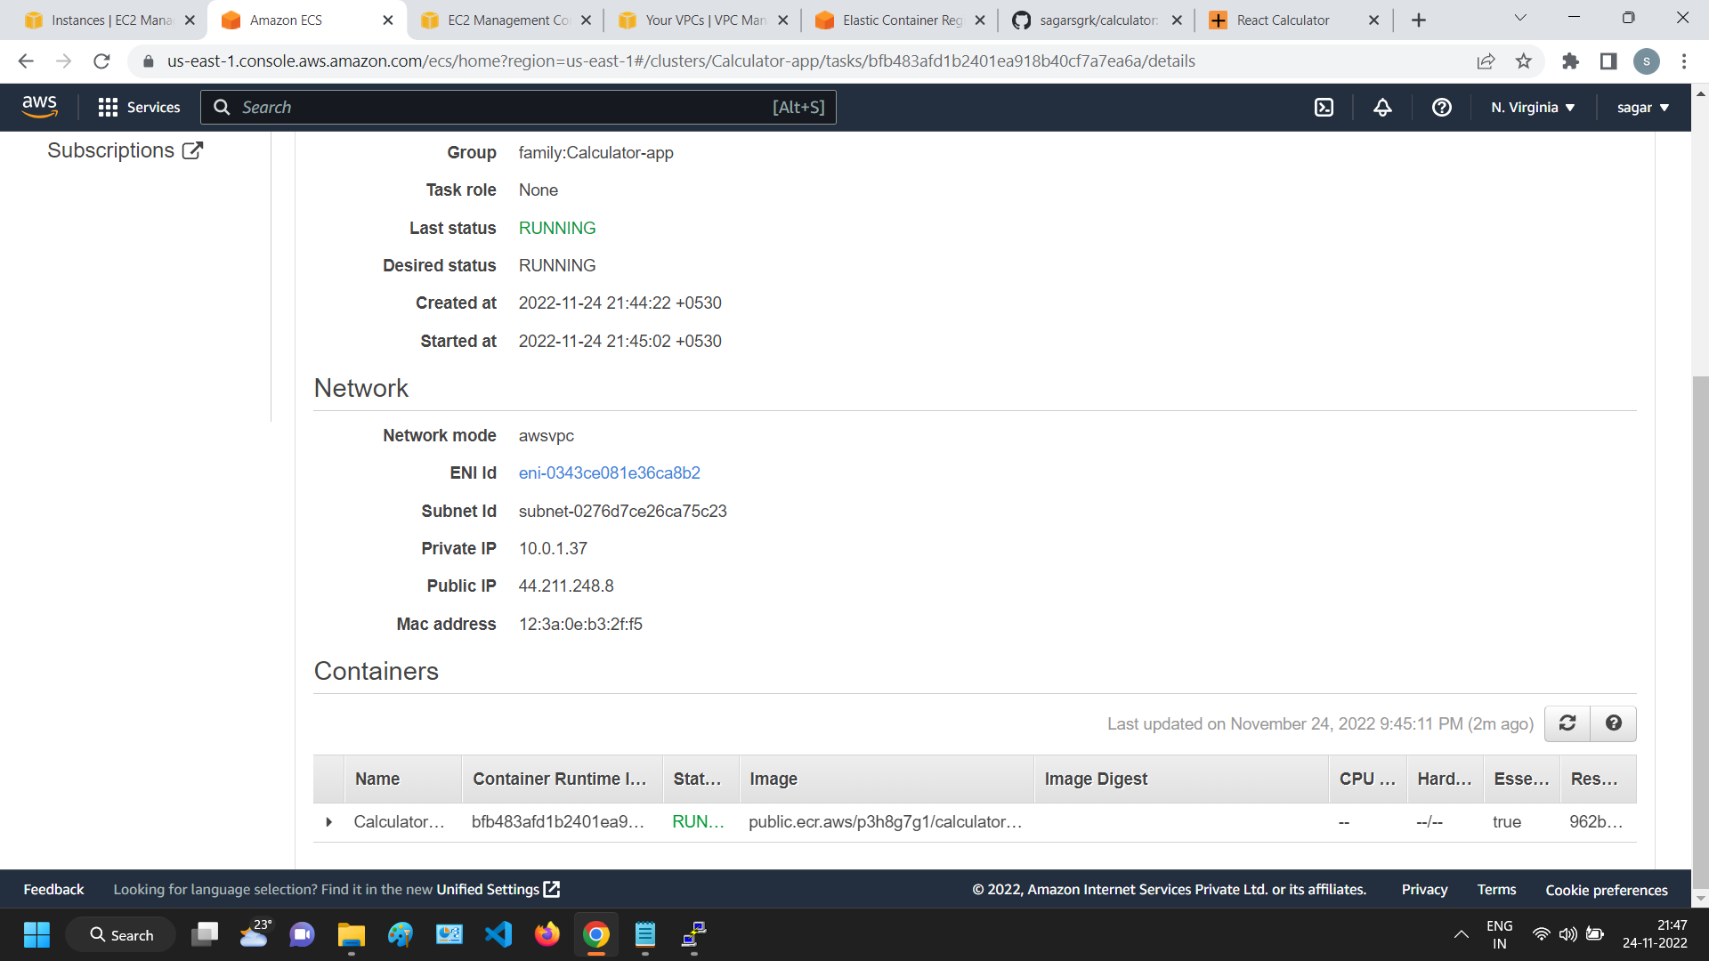

Slide 14
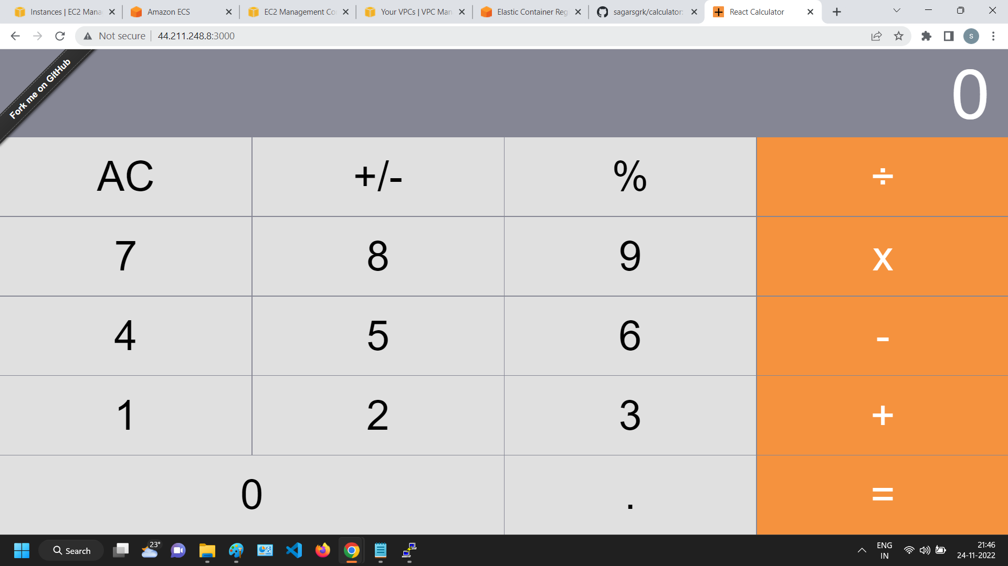
Final Deployment

Slide 15
Pubic URL
http://44.211.248.8:3000/

