Slide 1
PROBLEM STATEMENT
Developing Pregnancy Tracking Reinforcement system in order to prevent the infant mortality rate for people especially from rural areas where due to lack of knowledge or awareness either the child or parent and in some cases both die due to complications at the time of pregnancy.
This tracking system will help to analyze the critically of the patient and based on that required measures will be taken by the Hospitals.

Slide 2
SOLUTION
We have devised a system which will conduct the survey on the initial level of the newly married ladies.
Based on that the criticality of the patient is determined and based on that the necessary action is taken by the Hospitals.
Also Funding will be provided by external factors such as Banks and various other sponsors such as NGOs in order to start a new initiative towards reducing the infant mortality rate in under-priviledged areas.

Slide 3
Approach: Preventive step to reduce pregnancy Mortality rate by registering all women from rural areas who are not aware about medical treatment provided to them for free. Assigning Caretaker to a Particular Area that person will keep track of Pregnant Ladies. Medical Checkups and Medicines are provided by Hospitals for free . Banking and Sponsor organizations are involved to provide fund for treatment of patient .

Slide 4
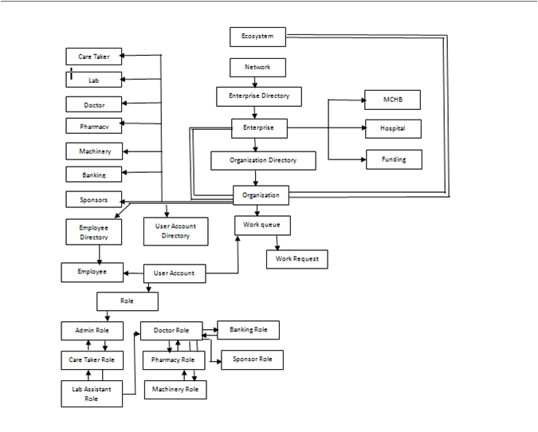
Object Model

Slide 5
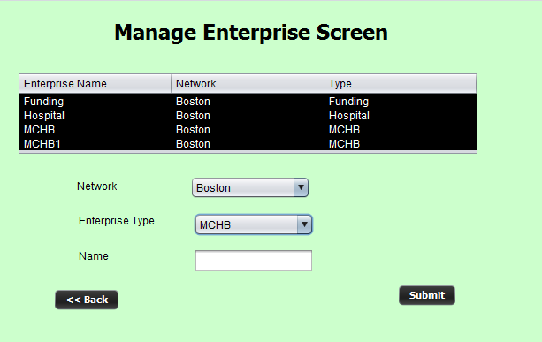
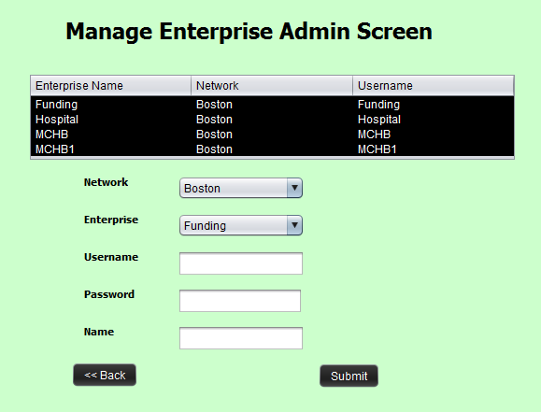
System Admin Enterprise screen to add enterprise of Organization and user name

Slide 6
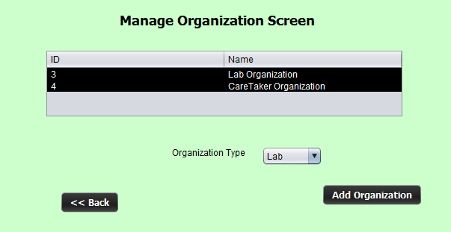
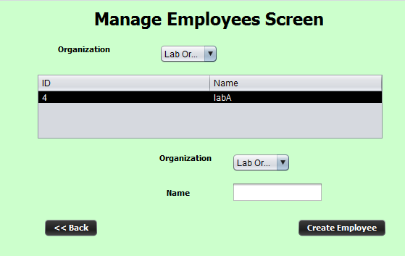
Enterprise Screen to add Organization and employees

Slide 7
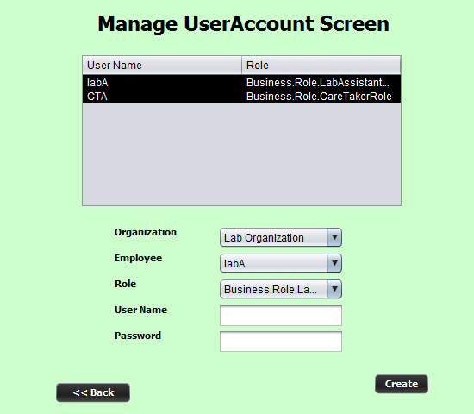
Enterprise Screen to add username and passwords for employees

Slide 8
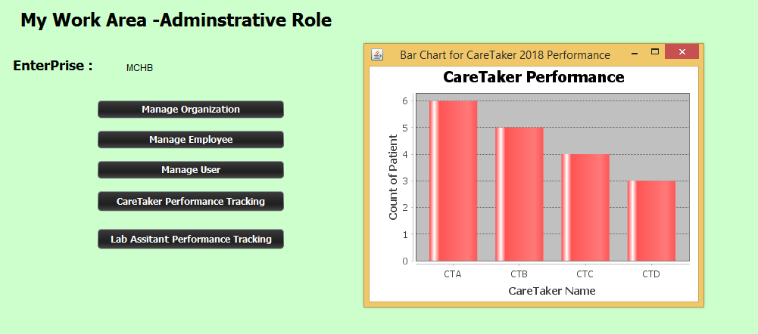
Care Takers 2018 performance based on MCHB data

Slide 9
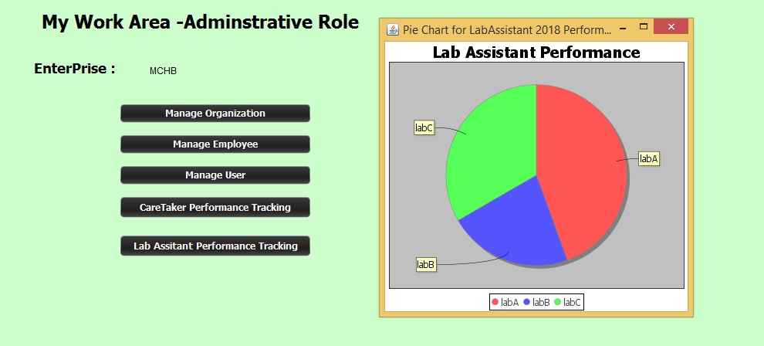
Lab Assistant 2018 Performance based on MCHB data

Slide 10
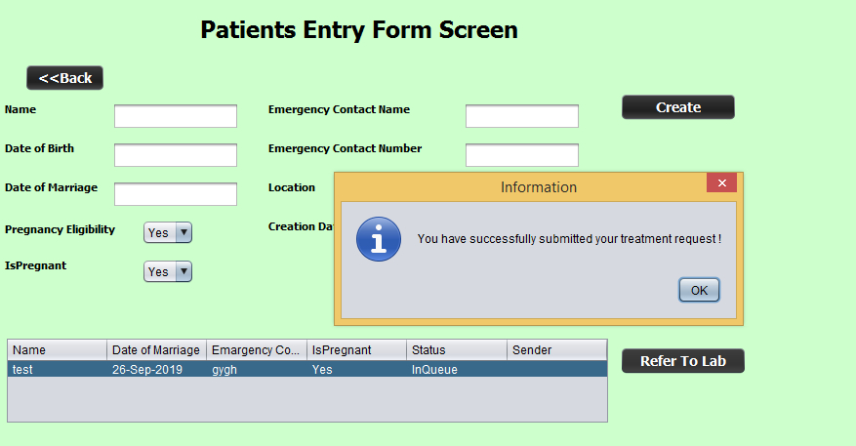
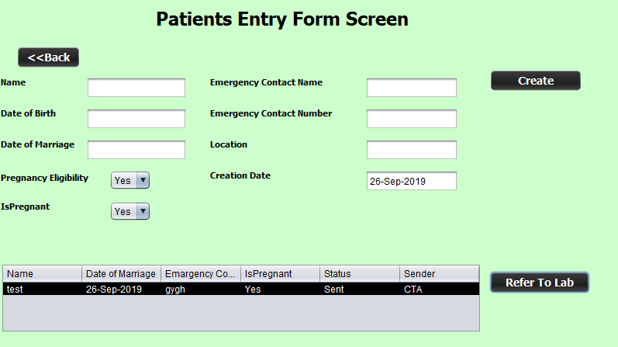
Care Taker fill the entry form for the patient and send the request to Lab for Vital Signs Checkup.

Slide 11
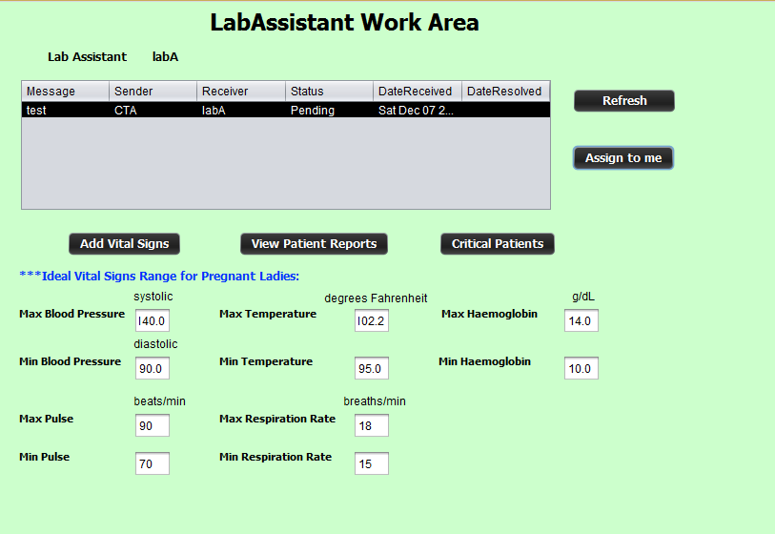
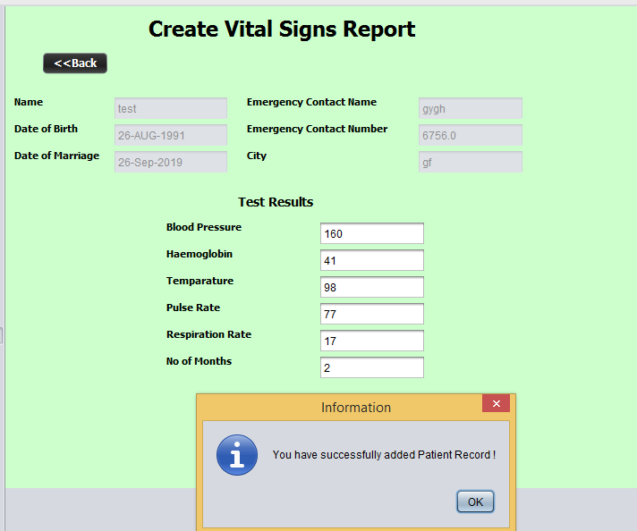
Lab assistant will assign and add the Report of Vital Signs.

Slide 12
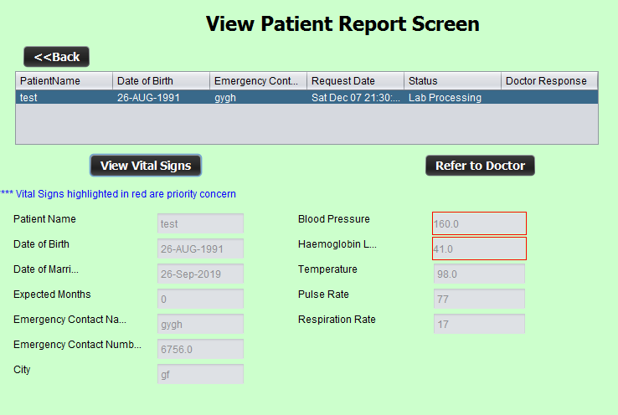
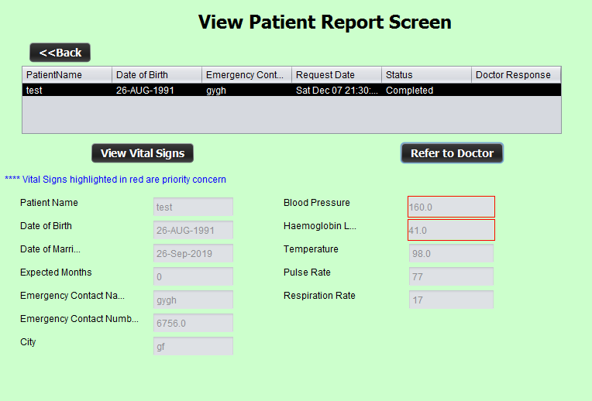
Lab Assistant will refer the patient to Doctor.

Slide 13
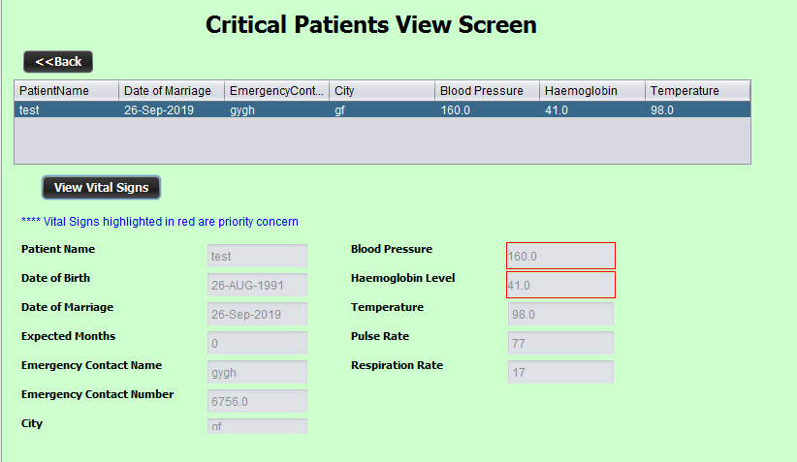
Critical Patient Screen will show patient when their Vital Signs is below or above the ideal range.

Slide 14
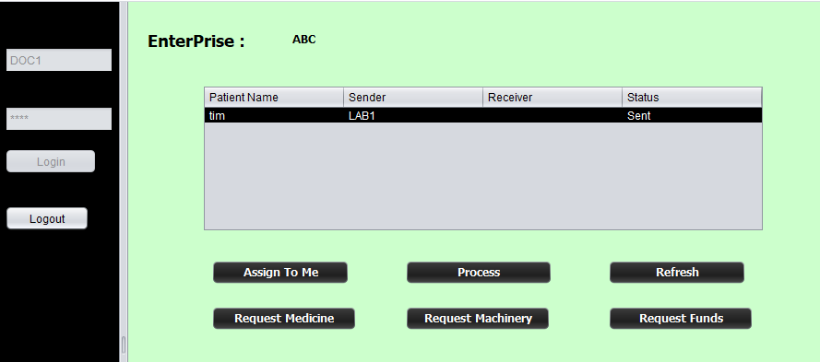
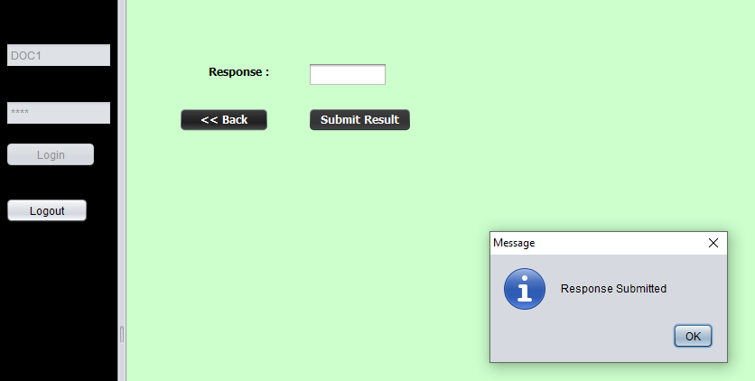
Doctor can approve or Decline request after assigning to self

Slide 15
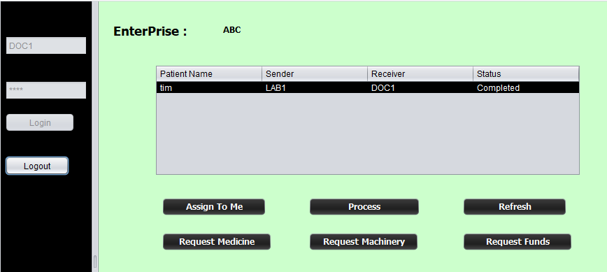
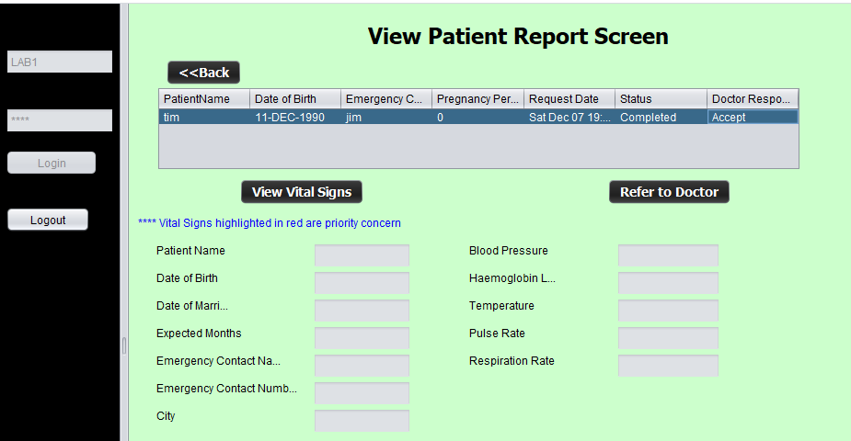
Doctor’s response can be seen on View Patient Report screen

Slide 16
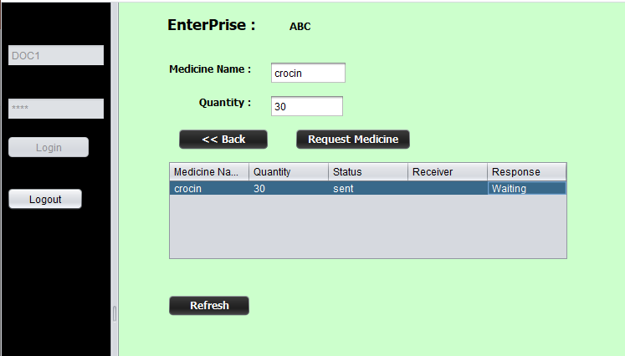
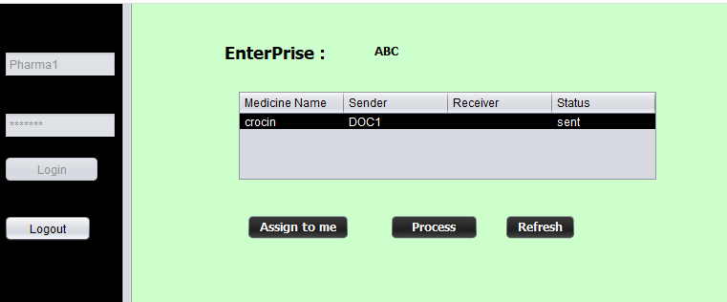
Doctor can request medicine and the same request can be seen from Pharamacy Work area

Slide 17
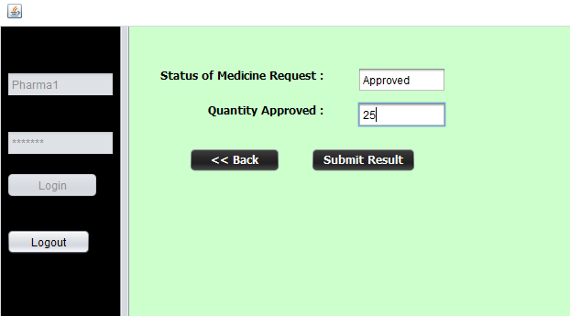
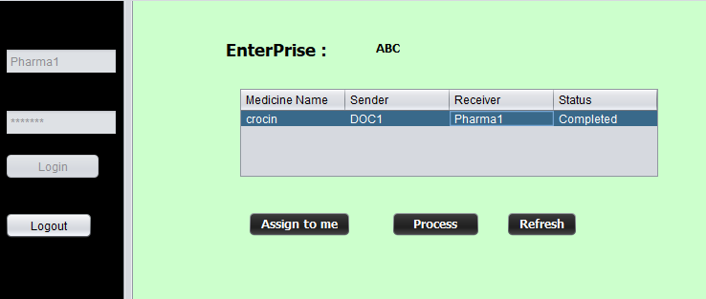
After submission of response the status will be changed to ”Completed”

Slide 18
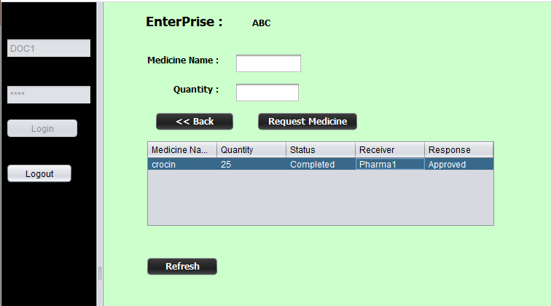
Response and approved quantity can be seen from Doctor’s work area

Slide 19
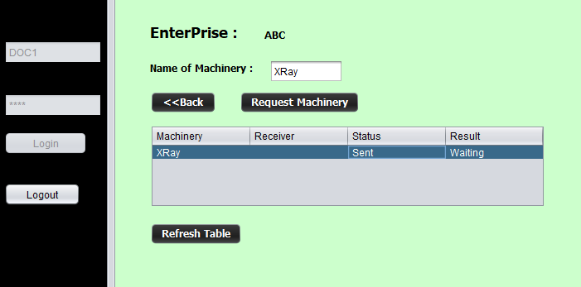
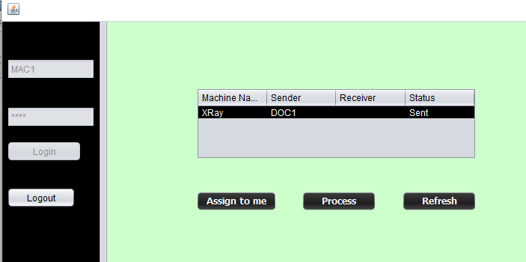
Doctor can request Machinery and Machinery department can view that request

Slide 20
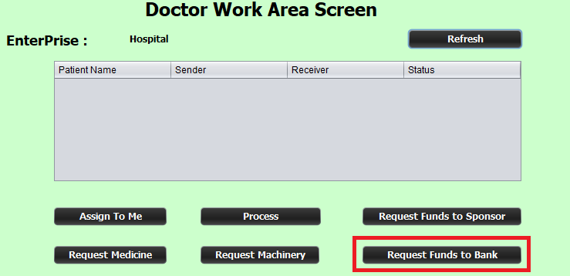
Requesting Bank for Funds

Slide 21
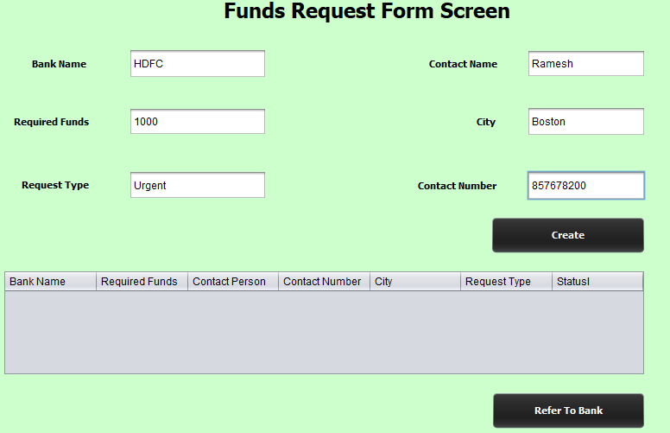

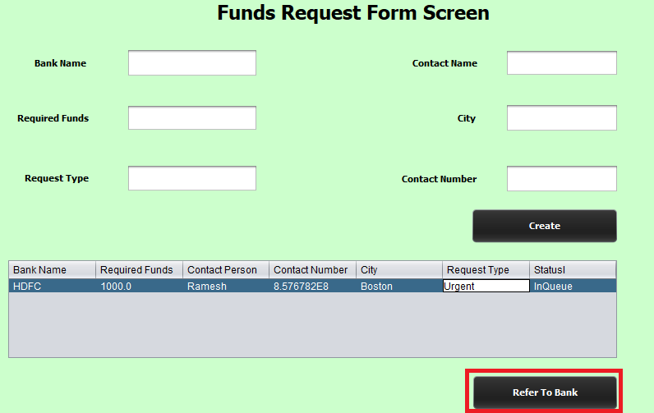


Slide 22
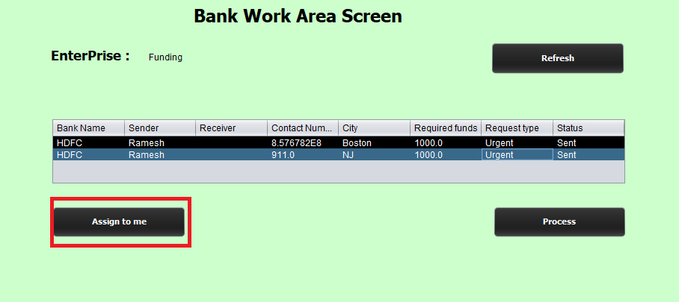
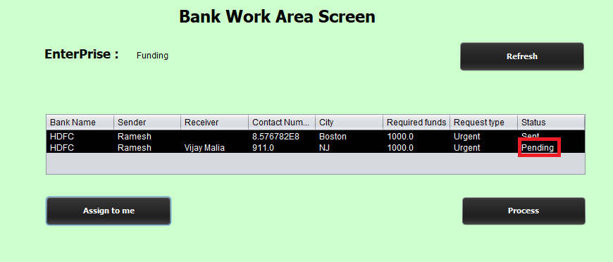
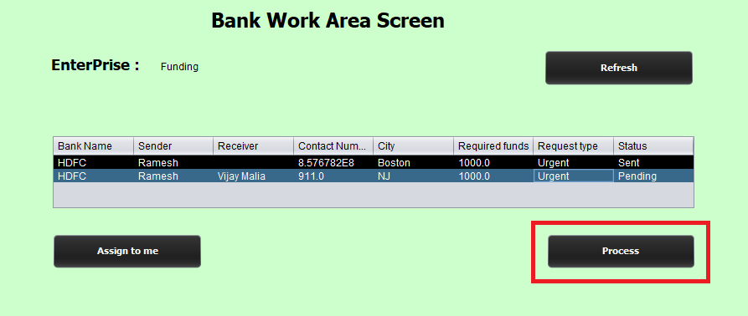

Slide 23
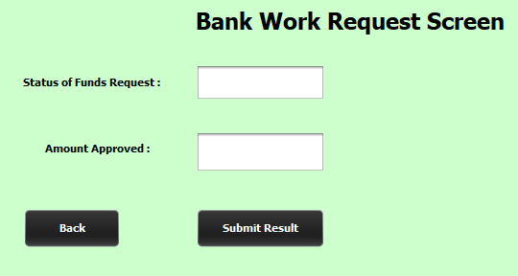
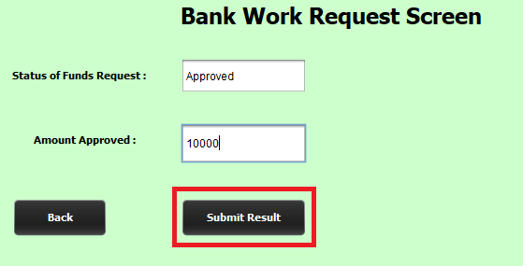

Slide 24
