Slide 1

IBM HACK CHALLENGE 2020
Title: Sentimental Analysis of COVID-19 Tweets –Visualization Dashboard
Team Name: Team Members:
RAKSHAK SAGAR SHARMA
ASHISH KUMAR BARAI
RUSHIKESH JARE
JERIN PJ

Slide 2
Problem Statement:
During this COVID-19 pandemic lockdown, people have taken social networks to express their feelings and find a way to calm themselves down. People used twitter to share there feeling by tweets and #hashtags. So the problem is aimed to check the sentiments of people by looking at there tweets and #hashtags and classify them into 3 categories NEGATIVE, POSITIVE and NEUTRAL. If the tweet is optimistic it is classified as POSITIVE or if the tweet is pessimistic it is classified as NEGATIVE or if it is neither of them it is classified as NEUTRAL. The tweets are classified into 3 categories according to the words in the tweet and by looking at there #hashtags.

Slide 3
Solution Approach:
We analyze the sentiments regarding coronavirus disease (COVID-19), so analyze the sentiments of different people’s opinion for this disease. For this purpose, we sued twitter API for collecting related tweets to the coronavirus, then positive, negative and neutral emotion analyzed by using machine learning approaches and tools. In addition, for pre-processing of fetched tweets NLTK library is used and Textblob dataset for analyzing tweets is used, after that show the interesting results in positive, negative, neutral sentiments through different visualizations.

Slide 4
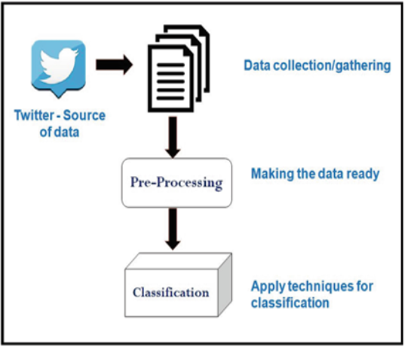
Block Diagram:

Slide 5






Requirements:
Project Requirements Software Requirements Technical Requirements

Slide 6
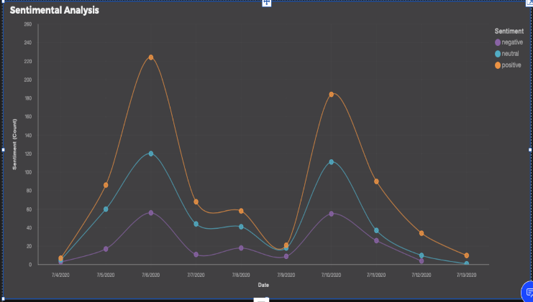
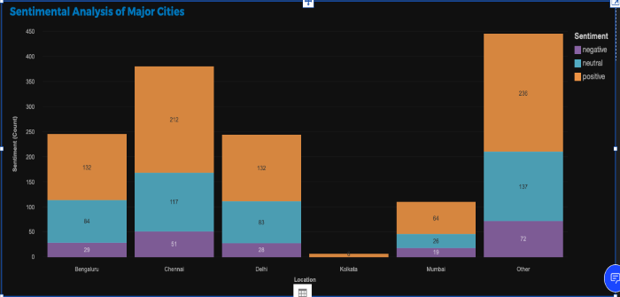
Dashboard visualization:

Slide 7
.
ADVANTAGES :
Helps to make awareness among the public Gives the sentiment values
Simple to handle
Simple to get any statistical data
Easy for Government to analysis the people view over their policies.
DISADVANTAGES:
Some times the dashboard lost s its connection due to the server problem.
We need to keep reviews current and up to date.

Slide 8
.
Thank You

