Slide 1
Javascript (JS)

Slide 2
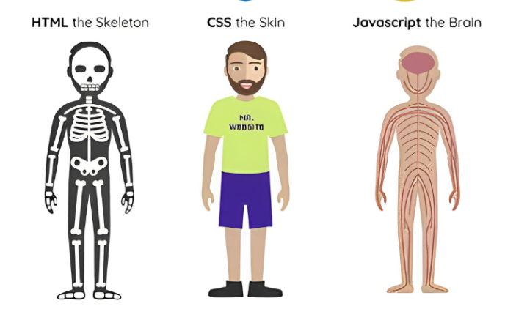
Introduction

Slide 3
Introduction
JavaScript is a high-level, interpreted programming language primarily used for web development.
It was created by Brendan Eich while he was working at Netscape and was first released in 1995.
JavaScript is a versatile language that allows developers to add interactivity and dynamic content to websites.
It is commonly used for client-side scripting, where code is executed on the user's web browser.
JavaScript can also be used on the server-side (with platforms like Node.js) for building server applications.
The language is supported by all major web browsers, making it a core component of web development.
Javascript is known as dynamically typed language.

Slide 4
Ecmascript
ECMAScript is a scripting language specification standardized by Ecma International.
It serves as the foundation for JavaScript and other scripting languages like ActionScript (used in Adobe Flash).
ECMAScript defines the syntax, semantics, and behavior of the scripting language.
JavaScript is the most widely used implementation of ECMAScript, but other implementations exist (e.g., JScript by Microsoft).
ECMAScript versions are released over time, each introducing new features and improvements.
Popular versions include ES5, ES6 (also known as ES2015), ES2016, ES2017, and so on.

Slide 5
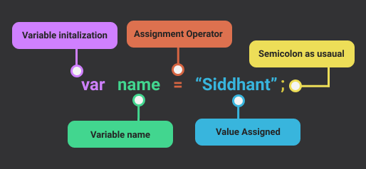
Variables

Slide 6
Variable initalization
Var - It is an outdated keyword in Javascript. We cannot declare a variable without var in older browsers. The variable declared using var can store variable values during the program's execution and can be redeclared anytime.
Const - It is a keyword used to declare constant variables whose value cannot be changed throughout the program.
Let - It is a newer keyword for declaring variables whose values can be changed. In this, a variable cannot be declared multiple times; however, they are declared once in a program.

Slide 7
Rules for Variables
Variable names should be short and easy to remember.
They should be descriptive enough to tell you what the variable represents.
They should not be too generic or too specific to avoid confusion.
They should not include any special characters like $, %, or @, except underscore.
They should not contain spaces.
They should not start with a number.

Slide 8
Rules for Variables
Start a variable name with a letter or underscore(_).
Javascript variables are case-sensitive, i.e., x is not equal to X.
They should be unique and not used by other variables in the code.
They could either be camel-cased or lowercase.
They should not start with a capital letter.

Slide 9
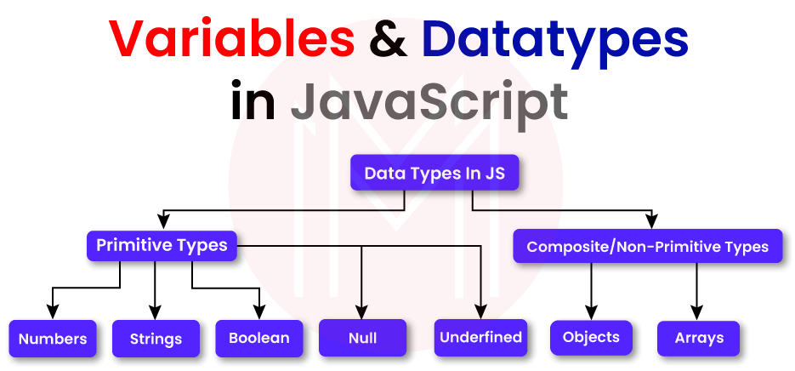
Datatypes

Slide 10
Primitive Datatypes
Data Type | Description
String | represents sequence of characters e.g. “hello”
Number | represents numeric values e.g. 100
Boolean | represents boolean value either false or true
Undefined | represents undefined value
Null | represents null i.e. no value at all
BigInt | represents big integer eg. BigInt(“543”)
Symbol | represents Symbol eg. Symbol(“myGlobalSymbol”)

Slide 11
Non-Primitive|Composite Data Types
Data Type | Description
Object | represents instance through which we can access members
Array | represents group of similar values

Slide 12
Non-Primitive|Composite Data Types
Data Type | Description
Object | represents instance through which we can access members
Array | represents group of similar values

Slide 13
Loosely|Weakly Typed
Javascript is known as untyped|loosely|weakly typed language. This means that we do not have to specify the data type in advance unlike other languages like C++, Java C# etc.
Example –
var x;
x = 5;
In the above example we can see that we did not have to specify any data type for the variable x in advance.

Slide 14
Dynamically Typed
This means, that once a variable is created in javascript using the keyword var, we can store any type of value in this variable supported by javascript.
Example –
var num = 5;
num = "Simple Snippets";
In this example above, you can see that the data type of the variable num changes from number to string as we pass string data. This it is flexible in nature.

Slide 15
Immutable Datatype
Immutable:
An object or data is considered immutable if its state cannot be modified after it is created.
Once an immutable object is created, any attempt to change its value or properties will result in the creation of a new object with the modified value, leaving the original object unchanged.
Immutable objects are often preferred in certain scenarios, as they can lead to more predictable and safer code.
Examples of immutable data types in JavaScript include numbers, strings, and boolean values. Once created, you cannot change their values directly.

Slide 16
Immutable Datatype
Immutable:
Numbers: const num = 42;
Strings: const message = "Hello";
Booleans: const isValid = true;

Slide 17
Mutable Datatype
Mutable:
A mutable object or data can be modified after its creation.
Any changes made to a mutable object will directly affect its state, without creating a new object.
Mutable objects can be modified in place, which means the same object can be changed with new values or properties.
Examples of mutable data types in JavaScript include objects and arrays. You can add, remove, or modify their properties or elements directly.

Slide 18
Mutable Datatype
Mutable:
Object: const person = {
name: "John",
age: 30,
};
person.name=”Ram”
document.write(a.toUpperCase())
Array : const numbers = [1, 2, 3, 4, 5];

Slide 19
Variable Scope
Global Scope – Scope outside the outermost function(we will discuss functions in detail in other article) attached to Window.
Local Scope – Inside the function being executed.

Slide 20
Variable Scope
var globalVar = "This is a global variable";
function fun() {
var localVar = "This is a local variable";
console.log(globalVar);
console.log(localVar);
}
fun();
console.log(localVar);

Slide 21
Variable Scope
Output:
This is a global variable
This is a local variable
Uncaught reference error: localVar is not defined

Slide 22
Arithmetic Operators
Operator | Description
+ | Addition
- | Subtraction
* | Multiplication
** | Exponentiation (ES2016)
/ | Division
% | Modulus (Division Remainder)
++ | Increment
-- | Decrement

Slide 23
Assignment Operators
Operator | Example | Same As
= | x = y | x = y
+= | x += y | x = x + y
-= | x -= y | x = x - y
*= | x *= y | x = x * y
/= | x /= y | x = x / y
%= | x %= y | x = x % y
**= | x **= y | x = x ** y

Slide 24
Functions
A JavaScript function is a block of code designed to perform a particular task.
A JavaScript function is executed when "something" invokes it (calls it).
function name(parameter1, parameter2, parameter3) {
// code to be executed
}
name(argument1,argument2,argument3)

