Slide 1
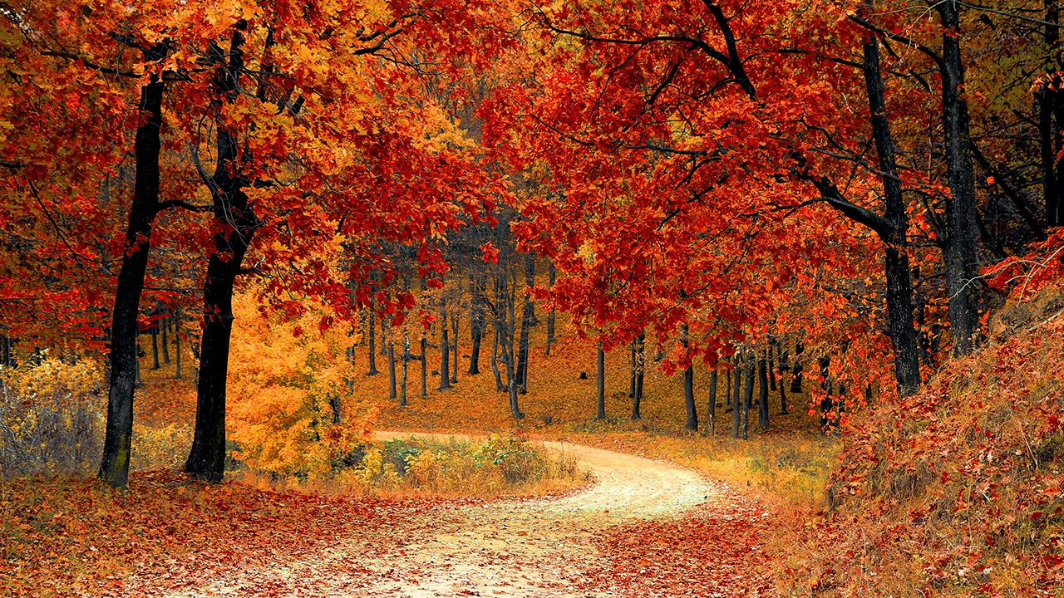
Forest Cover type dataset Machine Learning Analysis

Slide 2
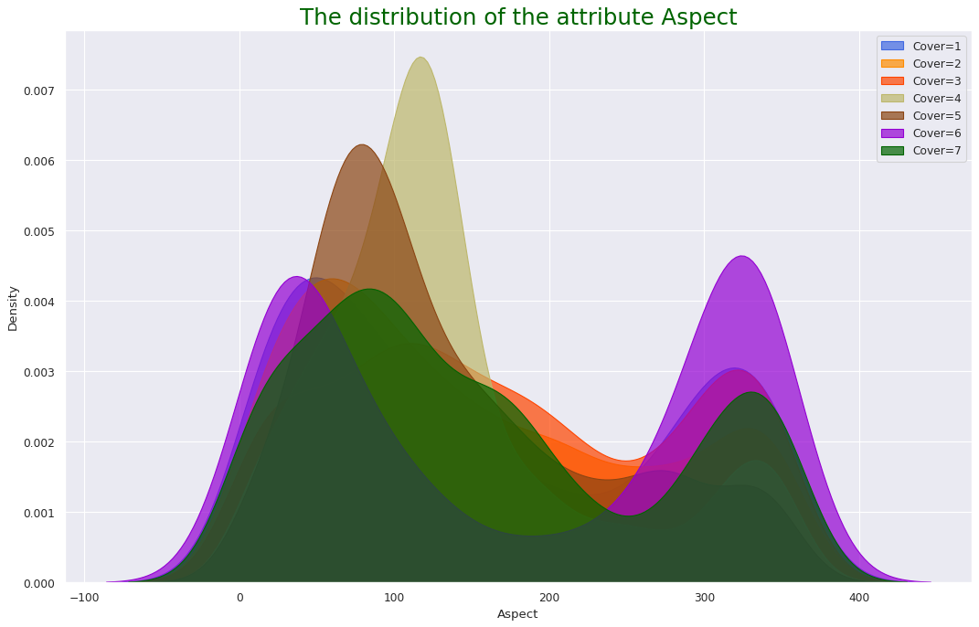
The Distribution of the attribute Aspect

Slide 3
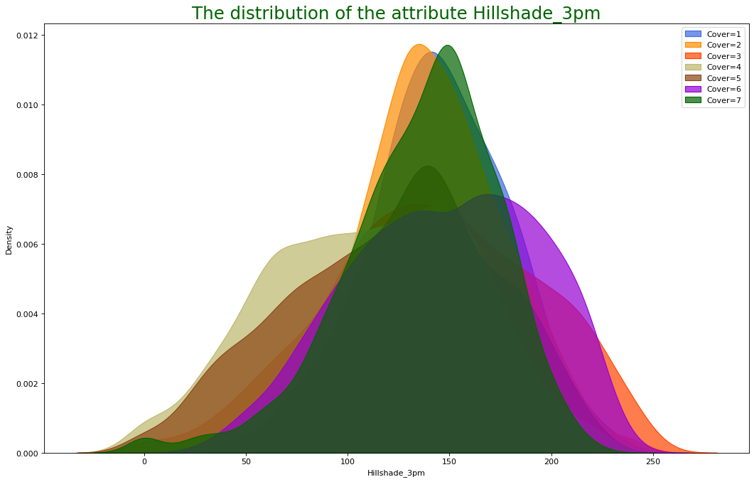
The distribution of the attribute Hillshade_3pm

Slide 4
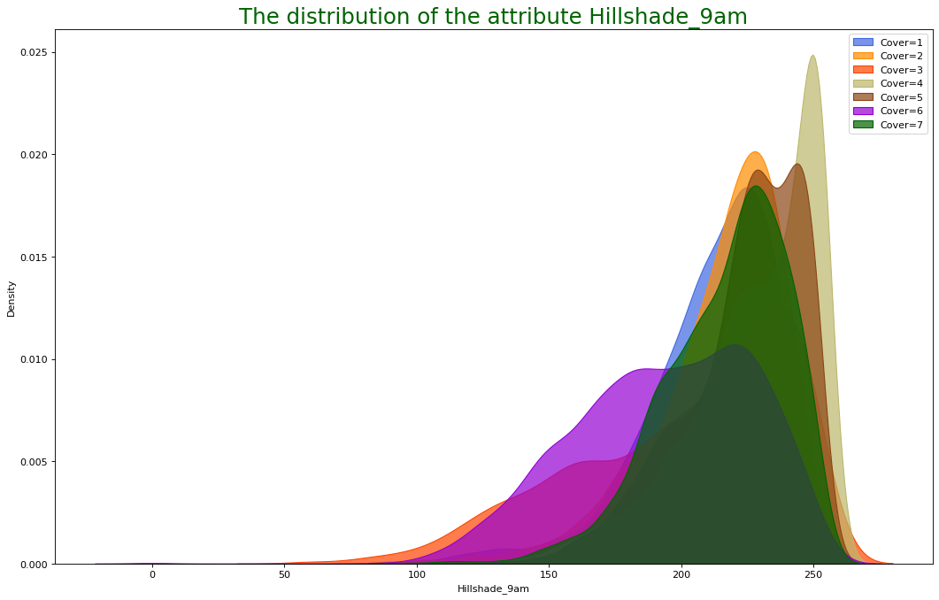
The distribution of the attribute Hillshade_9am

Slide 5
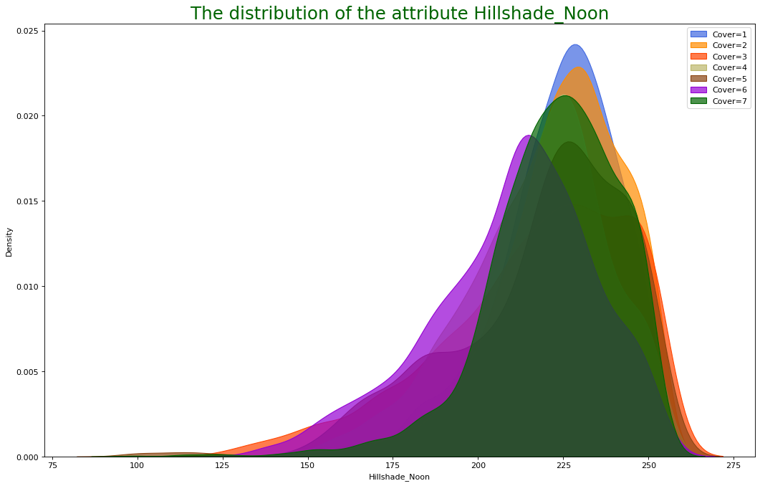
The distribution of the attribute Hillshade_noon

Slide 6
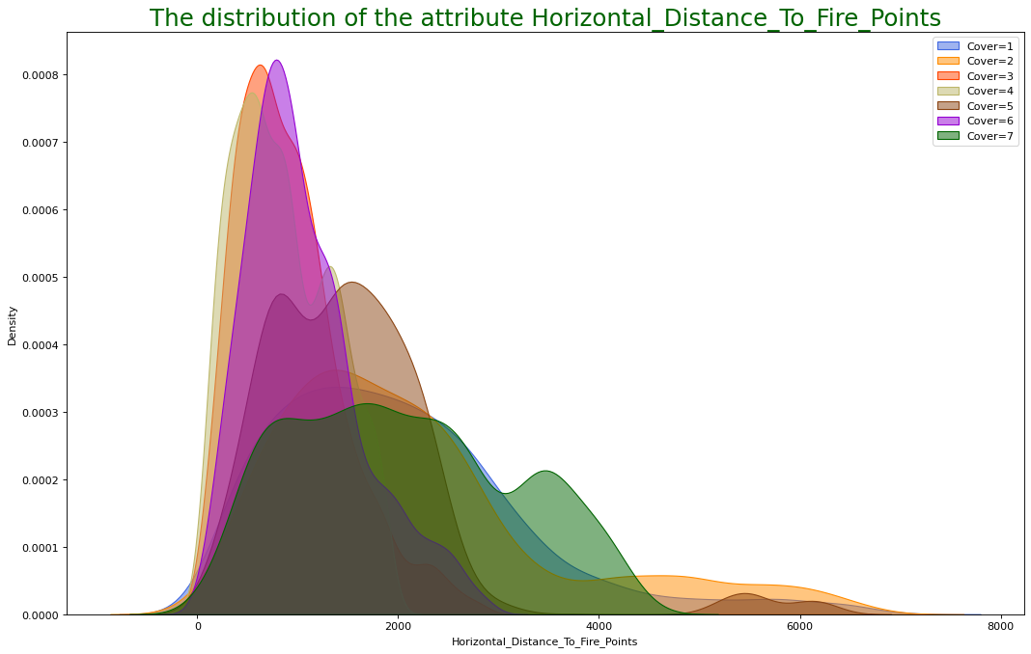
The distribution of the attribute Horizontal_distance_to_fire_points

Slide 7
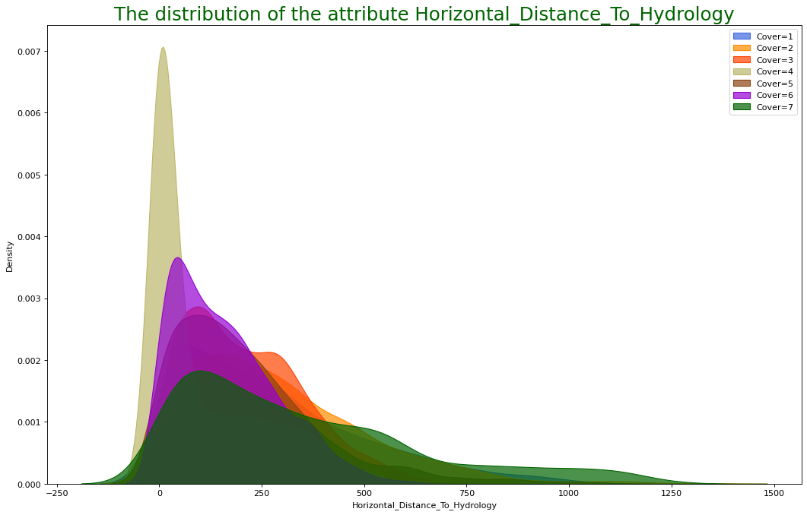
The distribution of the attribute Horizontal_distance_to_hydrology

Slide 8
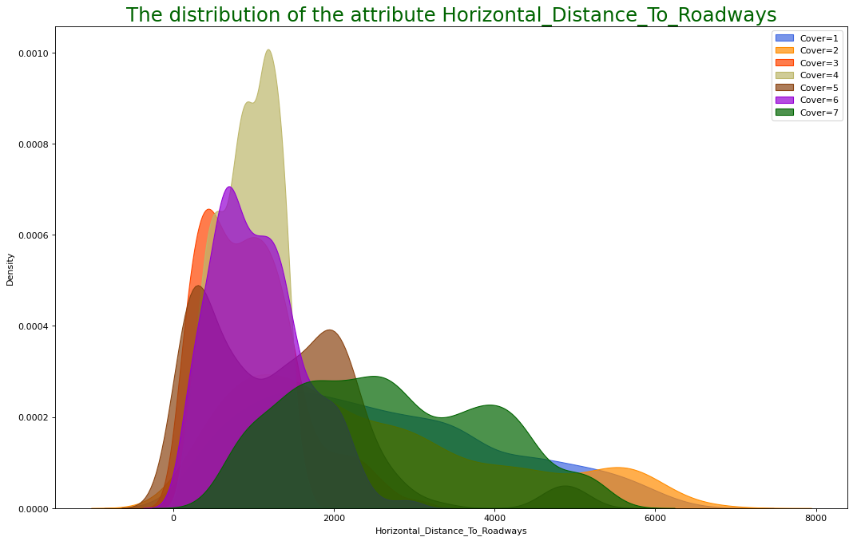
The distribution of the attribute Horizontal_distance_to_roadways

Slide 9
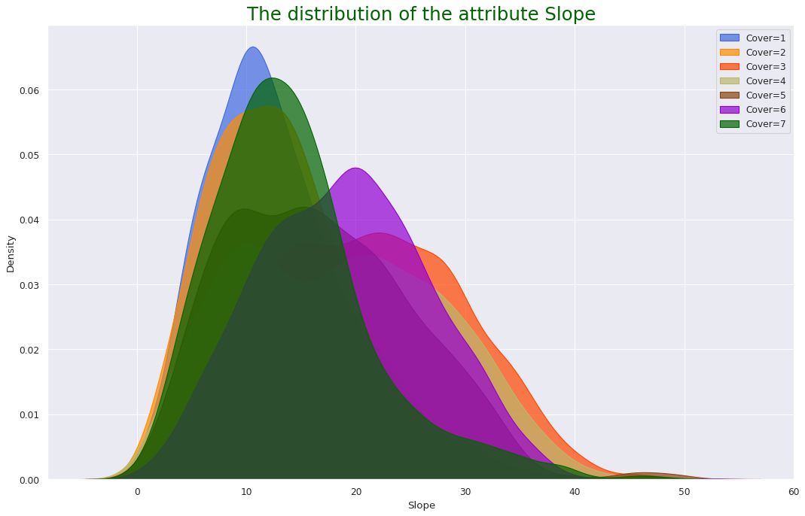
The distribution of the attribute Slope

Slide 10
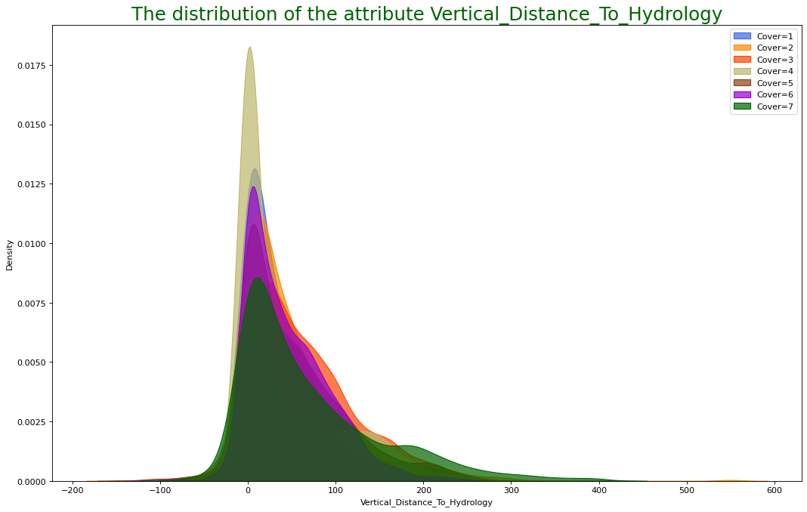
The distribution of the attribute vertical_distance_to_hydrology

Slide 11
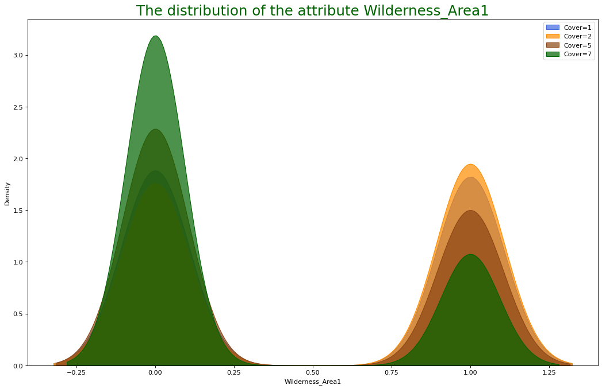
The distribution of the attribute Wilderness_area1

Slide 12
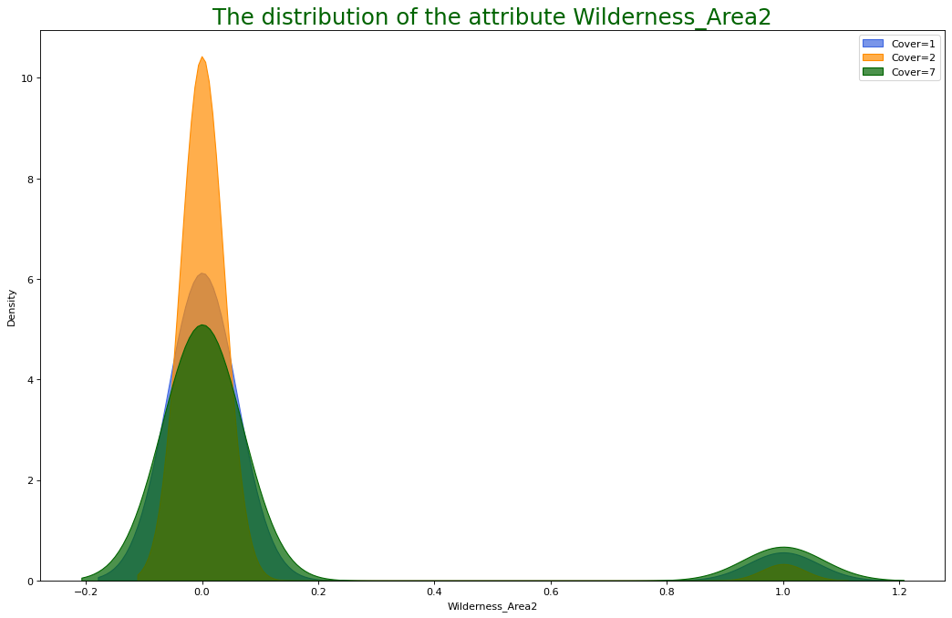
The distribution of the attribute Wilderness_area2

Slide 13
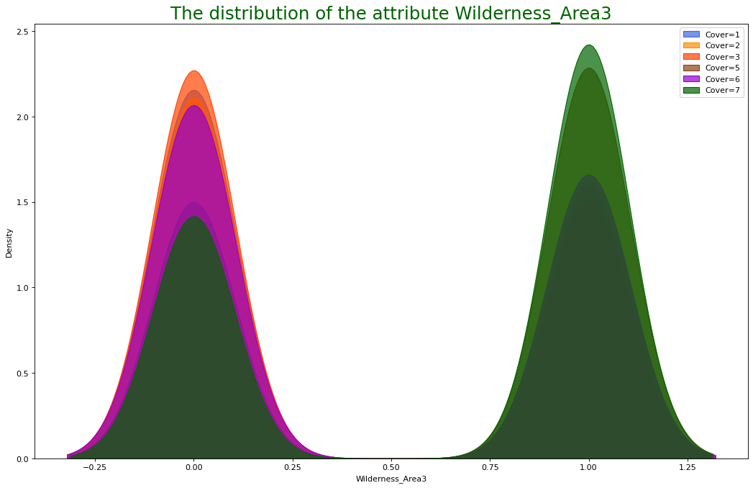
The distribution of the attribute Wilderness_area3

Slide 14
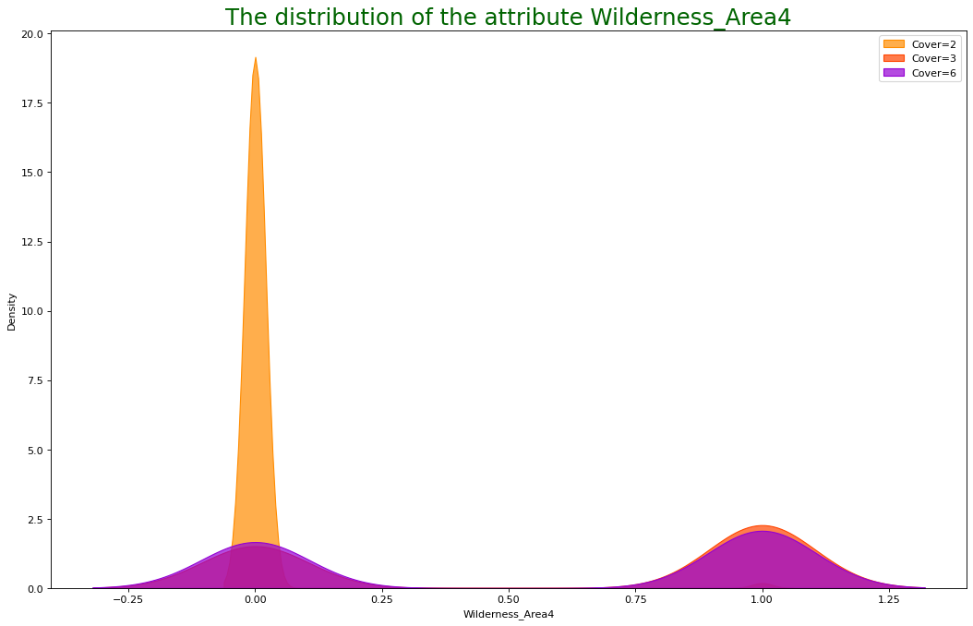
The distribution of the attribute Wilderness_area4

Slide 15
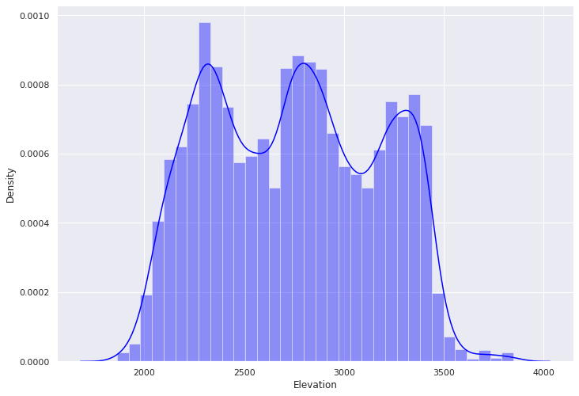
Elevation

Slide 16
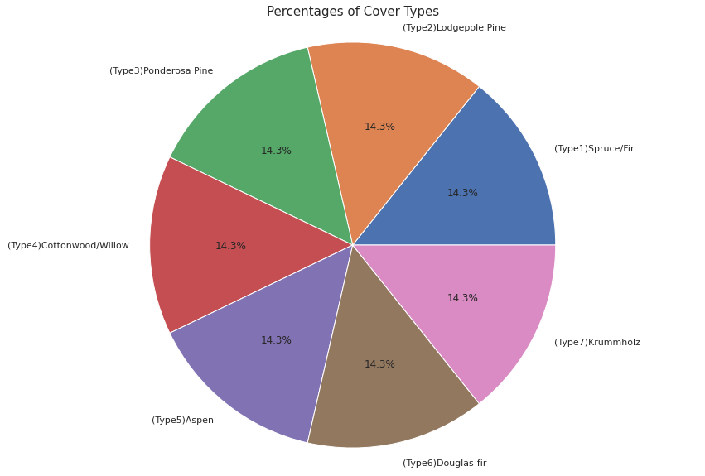
Percentage of Cover_type

Slide 17
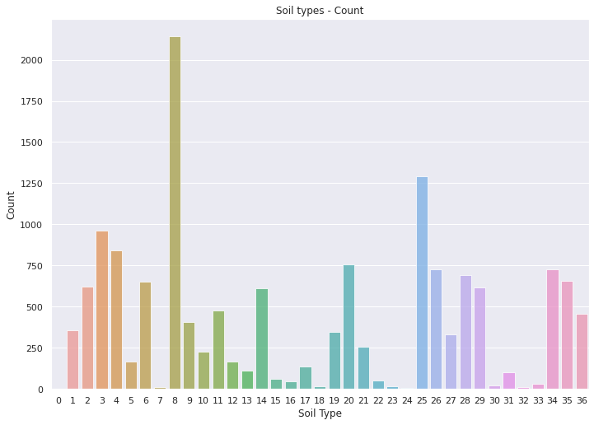
Soil type count

Slide 18
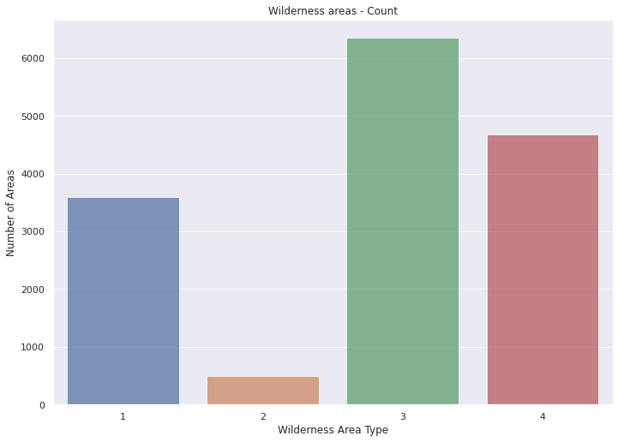
Wilderness_area count

Slide 19
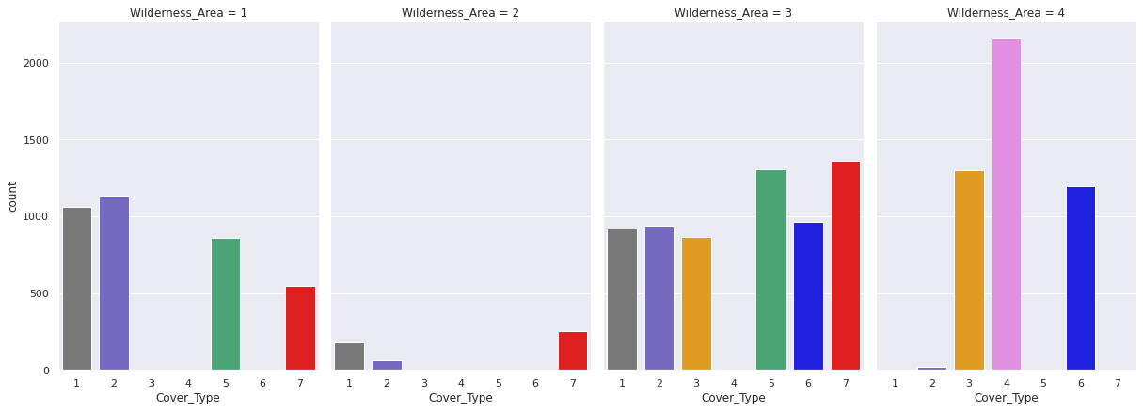
Wilderness Area over each cover type

Slide 20
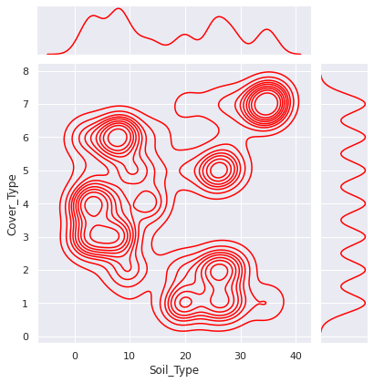
Soil type over Cover type

Slide 21
Conclusion
We can say that forest cover type 1,2,5 and 7 have Wilderness Area 1
Very less forest area in Wilderness Area 2
Wilderness Area 3 is more densely and have all types of Forest cover type except 4
Wilderness Area 3 Area 4 is more likely dense for 3,4 and 6 forest cover type
From the analysis, we can bring up like forest cover type 1 is on 1 and 3 Wilderness Area , forest cover type 2 is also same
1,2,5,7 forest cover type are closely related to one another and forest cover type 3 ,6 are also close to one another forest cover type is on 4 areas
We can say that to predict forest cover type 4 has Wilderness Areas 4 , for 1,2,5,7 forest cover type we need 1,3 Wilderness areas and for 3,6 forest cover type we need 3, 4 Wilderness Areas

Slide 22
Model Evaluation score
Logistic Reg - 0.49503968253968256
DecisionTree - 0.7906746031746031
RandomForest - 0.8634259259259259
KNN - 0.8270502645502645
Extra classifier - 0.8746693121693122
SVM - 0.6418650793650794

Slide 23
Thank You

