Slide 1

Can a hybrid of ANN-GARCH model provide a significant improvement in predicting the price volatility of the Ethereum?
Hybrid modeled Approach towards crypto currency market

Slide 2


Why is it important?
Market Share of US$18 Billion.
Very less amount of research is done on Ethereum.
Unique and different from other cryptocurrencies
Result of hybridisation on such volatile asset class.
Better insights for investors.
ANN (Nonlinearity) + GARCH (Volatility)
Notes:
loosely regulated thus making it more uncertain and volatile for prediction.

Slide 3
Proposed Question and objectives
Research Question
Objectives Set
Can a hybrid of ANN-GARCH model provide a significant improvement in predicting the price volatility of the Ethereum?
To statistically validate if the Ethereum time series is competent for the use of a proposed hybrid model.
To implement a rolling window approach in predicting the volatility by using GARCH and ANN.
To compare the hybrid results with the traditional systems and highlight its significance.

Slide 4

What have others done??
One paper uses 12 GARCH models on 7 major cryptocurrencies. Except Ethereum [1].
Use of LSTM on Bitcoin AR (2) [2].
Hybrid model used on Istanbul Stock Market (APGARCH-ANN) [3]
RNN with tree classifiers [4].
Prediction of Ethereum using sentiment analysis [5].
Notes:
71 days average 61 tweets
South Korean Markets

Slide 5
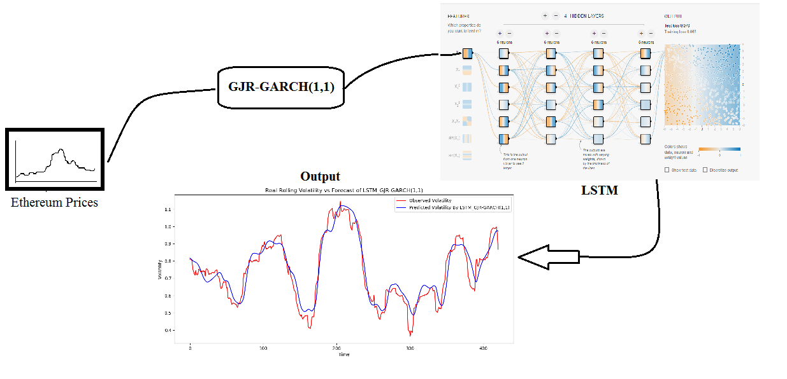
Architecture Diagram

Slide 6

Methodology Followed
Business Understanding
Predicting Volatility
Investors
Academicians – Use of Hybrid Models
Data Understanding
From: 07th August 2015 to 27th July 2019 (Frequency: Daily)
Number of Observations: 1451
Columns: Date, Open, High, Low, Close

Slide 7
Methodology Cont…
Data Preparation
Data Modelling:
Arrange data into ascending order by date.
Log Prices for feeding model.
Difference in Log Prices to find Standard Deviation (SD)
Rolling SD with window size = 30
Yang Zang Rolling Volatility with window size = 30 and period = 365
Tests Carried out on Data:
ADF test for stationarity
Alternate hypothesis accepted.
KPSS test for stationarity
Null Hypothesis accepted.
ARCH Test
ARCH effect of order 1 present.
Shortlisted GJR-GARCH(1,1) considering
Seasonal Volatility Pattern
Better prediction of conditional variance
Different impact of +ve and –ve shock
LSTM
Classification and non linear types of problems.
Time independent
Considers previous lagged training data to train model.
Mapping of input function to output function wrt time.
Helps in minimizing error between predicted and actual.

Slide 8
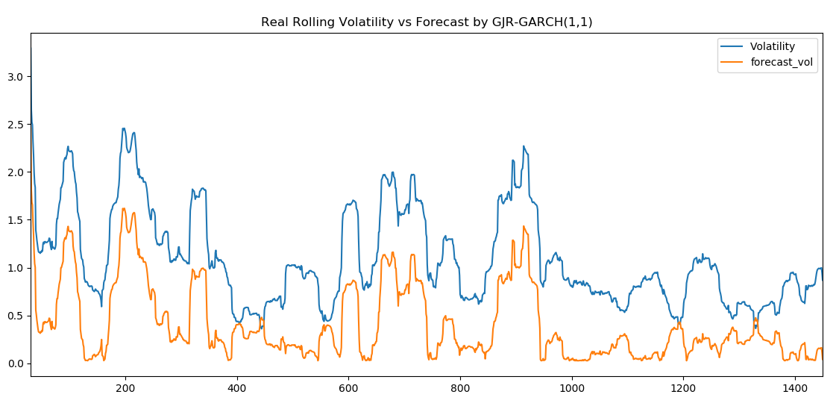
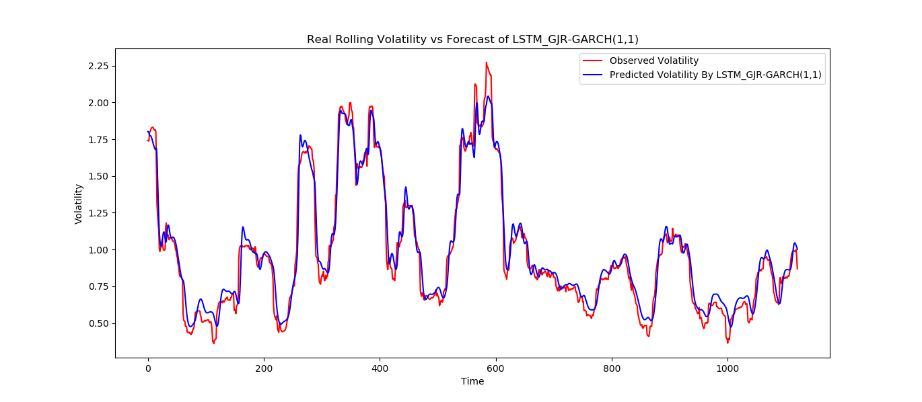
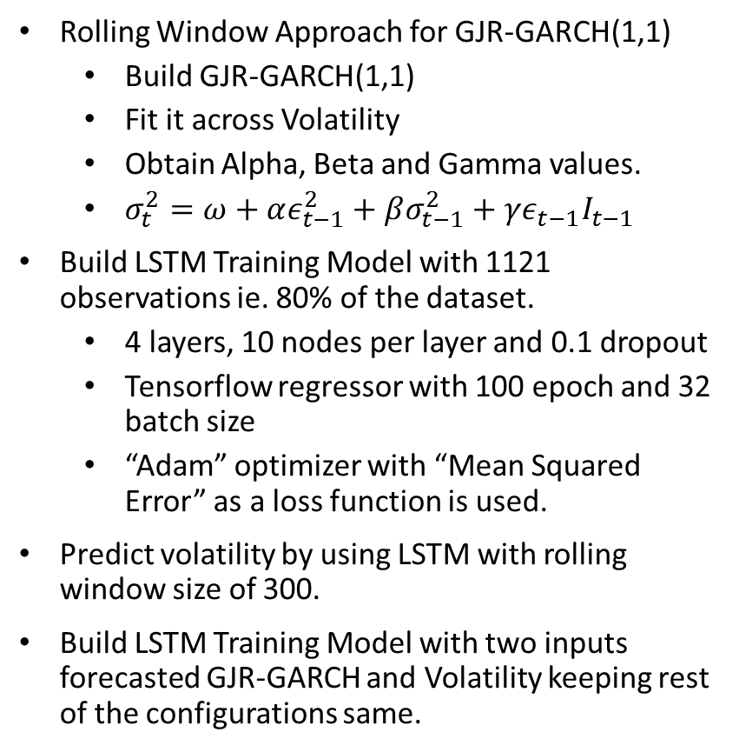
Implementation
Rolling Window Approach for GJR-GARCH(1,1)
Build GJR-GARCH(1,1)
Fit it across Volatility
Obtain Alpha, Beta and Gamma values.
$σ_{t}^{2}=ω+αε_{t−1}^{2}+βσ_{t−1}^{2}+γε_{t−1}I_{t−1}$
Build LSTM Training Model with 1121 observations ie. 80% of the dataset.
4 layers, 10 nodes per layer and 0.1 dropout
Tensorflow regressor with 100 epoch and 32 batch size
“Adam” optimizer with “Mean Squared Error” as a loss function is used.
Predict volatility by using LSTM with rolling window size of 300.
Build LSTM Training Model with two inputs forecasted GJR-GARCH and Volatility keeping rest of the configurations same.
Notes:
Dropout – 10% nodes switched off randomly to stop overfitting.
Adam Optimizer - Its features such as efficient use of computing power, handles
non stationary objects and minimum memory requirements makes it very likely to be used for this research. It is the most common and very effective optimizer.
Total Number of iteration = 100 epoch. 1 Epoch is traversing of throughout the LSTM Model
32 Batch size is 32 data points for each epoch

Slide 9

Evaluation
Model | RMSE | % Change
GJR-GARCH(1,1) | 0.6986146423 | NA
LSTM | 0.6070618624 | 13.09%
GARCH+LSTM | 0.5894160298 | 2.03%
$$\%Change=1−\frac{New RMSE}{Old RMSE} ×100$$

Slide 10

Conclusion and Limitations
Objectives | Achieved
To statistically validate if the Ethereum time series is competent for the use of a proposed hybrid model.
To implement a rolling window approach in predicting the volatility by using GARCH and ANN.
To compare the hybrid results with the traditional systems and highlight its significance.
Hybrid model 2.03% better than traditional LSTM.
Is it worth it?
Less Data points to train heavy model like LSTM
Only historical data, no sentiments, news, change in regulations, etc.
Base research for hybrid modelling and volatility estimation.

Slide 11

Thank you
x18109641@STUDENT.NCIRL.IE
Sagar Anil Tade, MSc. Fintech

Slide 12
References
[1] Chu, J., Chan, S., Nadarajah, S. and Osterrieder, J. (2017). GARCH Modelling of Cryptocurrencies. Journal of Risk and Financial Management, 10(4), p.17.
[2] Wu, C., Lu, C., Ma, Y. and Lu, R. (2018). A New Forecasting Framework for Bitcoin Price with LSTM. 2018 IEEE International Conference on Data Mining Workshops (ICDMW).
[3] Bildirici, M. and Ersin, Ö.Ö., 2009. Improving forecasts of GARCH family models with the artificial neural networks: An application to the daily returns in Istanbul Stock Exchange. Expert Systems with Applications, 36(4), pp.7355-7362.
[4] Mallqui, D. and Fernandes, R. (2019). Predicting the direction, maximum, minimum and closing prices of daily Bitcoin exchange rate using machine learning techniques. Applied Soft Computing, 75, pp.596-606.
[5] Steinert, L. and Herff, C. (2018). Predicting altcoin returns using social media. PLOS ONE, 13(12), p.e0208119.
Notes:
loosely regulated thus making it more uncertain and volatile for prediction.

