Slide 1

forecasting the price volatility of the Ethereum by using ANN-GARCH
Hybrid modeled Approach towards crypto currency market

Slide 2


Why is it important?
Market Share of US$18 Billion.
Very less amount of research is done on Ethereum.
Unique and different from other cryptocurrencies
Result of hybridisation on such volatile asset class.
Better insights for investors.
ANN (Nonlinearity) +
GARCH (Volatility)
Notes:
loosely regulated thus making it more uncertain and volatile for prediction.

Slide 3

What have others done??
One paper uses 12 GARCH models on 7 major cryptocurrencies. Except Ethereum.
Use of LSTM on Bitcoin AR (2).
Hybrid model used on Istanbul Stock Market (APAGARCH-ANN)
RNN with tree classifiers.
Prediction of Ethereum using sentiment analysis.
Notes:
71 days average 61 tweets
South Korean Markets

Slide 4
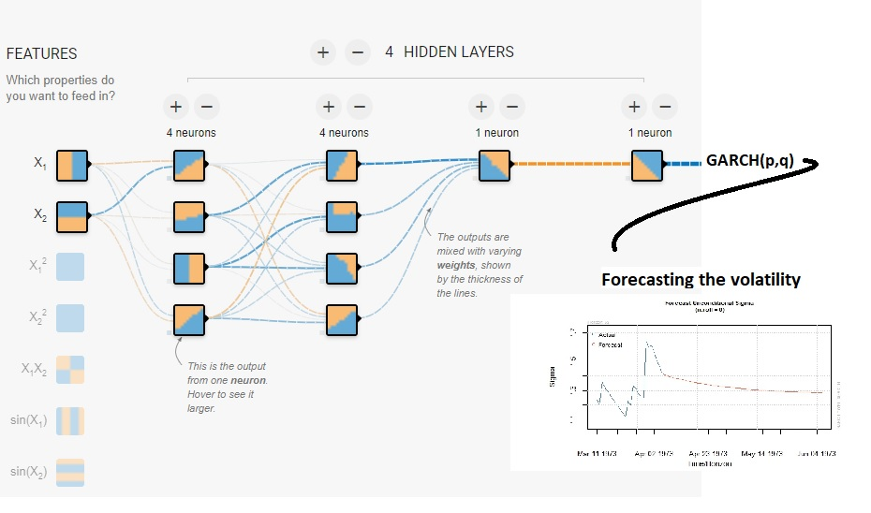
Methodology Followed
Business Understanding
  Less work in this space
  Forecasting Volatility
Data Understanding
  Decompose
  ADF – Stationarity
  ARCH Test
Data Preparation
  Scaling the data to feed MLP model
Modelling
  GARCH, APGARCH, EGARCH, IGARCH
    AIC, BIC, AICc,, Hannan Quinn to choose best fit models.
  MPL(2,3,4 Hidden Layers)
  (10,15,20 Neurons)
Evaluation
  Model Confidence Set Test
  Student’s t- test
  General Error Distribution test
Notes:
EGARCH log
APGARCH (Asymmetric Power)
IGARCH Integrated : Persistent parameter add up to 1

Slide 5

Thank you
x18109641@STUDENT.NCIRL.IE
Sagar Anil Tade,
MSc. Fintech

