Slide 1

forecasting the price volatility of the Ethereum by using ANN-GARCH
Hybrid modeled Approach towards crypto currency market

Slide 2


Why is it important?
Market Share of US$18 Billion.
Very less amount of research is done on Ethereum.
Unique and different from other cryptocurrencies
Result of hybridisation on such volatile asset class.
Better insights for investors.
ANN (Nonlinearity) + GARCH (Volatility)
Notes:
loosely regulated thus making it more uncertain and volatile for prediction.

Slide 3

What have others done??
One paper uses 12 GARCH models on 7 major cryptocurrencies. Except Ethereum [1].
Use of LSTM on Bitcoin AR (2) [2].
Hybrid model used on Istanbul Stock Market (APGARCH-ANN) [3]
RNN with tree classifiers [4].
Prediction of Ethereum using sentiment analysis [5].
Notes:
71 days average 61 tweets
South Korean Markets

Slide 4
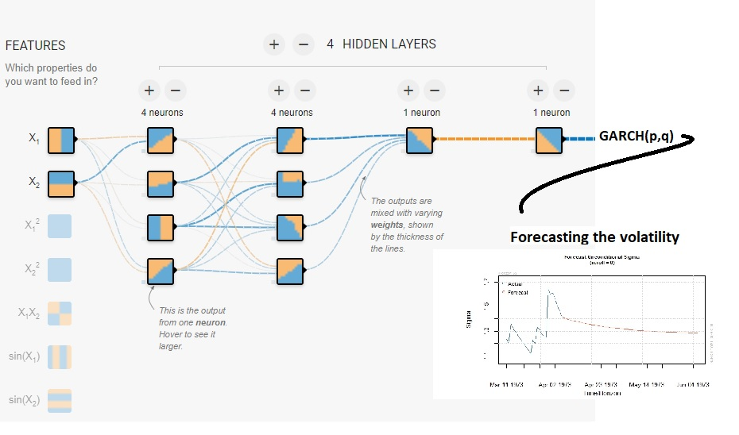
Methodology Followed
Business Understanding
Less work in this space
Forecasting Volatility
Data Understanding
Decompose
ADF – Stationarity
ARCH Test
Data Preparation
Scaling the data to feed MLP model
Modelling
GARCH, APGARCH, EGARCH, IGARCH
AIC, BIC, AICc,, Hannan Quinn to choose best fit models.
MPL(2,3,4 Hidden Layers) (10,15,20 Neurons)
Evaluation
Model Confidence Set Test
Student’s t- test
General Error Distribution test
Notes:
EGARCH log
APGARCH (Asymmetric Power)
IGARCH Integrated : Persistent parameter add up to 1

Slide 5

Thank you
x18109641@STUDENT.NCIRL.IE
Sagar Anil Tade, MSc. Fintech

Slide 6
References
[1] Chu, J., Chan, S., Nadarajah, S. and Osterrieder, J. (2017). GARCH Modelling of Cryptocurrencies. Journal of Risk and Financial Management, 10(4), p.17.
[2] Wu, C., Lu, C., Ma, Y. and Lu, R. (2018). A New Forecasting Framework for Bitcoin Price with LSTM. 2018 IEEE International Conference on Data Mining Workshops (ICDMW).
[3] Bildirici, M. and Ersin, Ö.Ö., 2009. Improving forecasts of GARCH family models with the artificial neural networks: An application to the daily returns in Istanbul Stock Exchange. Expert Systems with Applications, 36(4), pp.7355-7362.
[4] Mallqui, D. and Fernandes, R. (2019). Predicting the direction, maximum, minimum and closing prices of daily Bitcoin exchange rate using machine learning techniques. Applied Soft Computing, 75, pp.596-606.
[5] Steinert, L. and Herff, C. (2018). Predicting altcoin returns using social media. PLOS ONE, 13(12), p.e0208119.
Notes:
loosely regulated thus making it more uncertain and volatile for prediction.

