Slide 1

forecasting the price volatility of the Ethereum by Hybridization
Hybrid modeled Approach towards crypto currency market

Slide 2

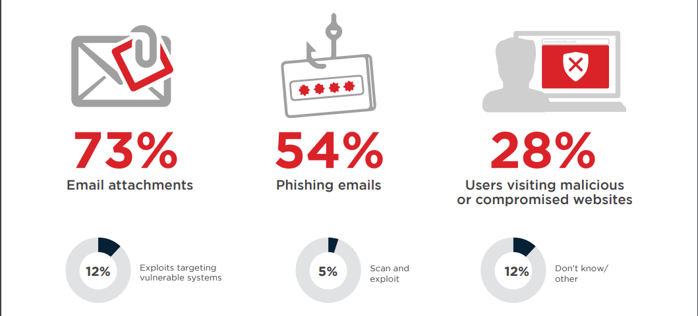
Why is it important?
“Ransom” + “Ware” = “Ransomware”
Locks down data by private key encryption
To be released only after payment of ransom
Types
Crypto
Locker

Slide 3

What have others done??
Primary target - Financial Data of Client.
62% chances of attack on FinTech Firms.
Secondary target – Personal Information.
Tertiary target – Employee Details.
Laptop, Personal Computers, Servers not patched.
Enormous Effects.

Slide 4


Steps for Implementing
Advance Antivirus Engines
Sapient machine learning and SONAR techniques
Full scan and Isolation of the system
In Case of popular WannaCry and NotPetya SMBv1 protocol must be disabled.
Employee Awareness
Documentation and Knowledgebase creation.
Consulting with expert
Reverse engineering and finding weakness.
Prevention is better than cure
Email Security
Intrusion prevention
Proactive Exploit Protection
Browser Protection
Best Practices and employee awareness
Containing the situation And Response

Slide 5

Thank you
x18109641@STUDENT.NCIRL.IE
Sagar Anil Tade, MSc. Fintech

