Slide 1

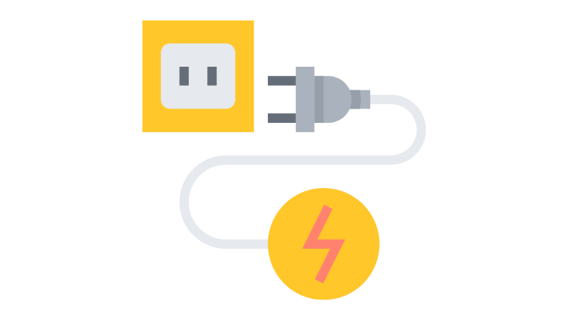
NGINX and WebSockets
husseinnasser.com
Enabling WebSockets with NGINX (Layer 4/Layer 7)

Slide 2
Agenda
Quick Introduction to WebSockets
Layer 4 vs Layer 7 WebSocket Proxying
Spin up a WebSocket Server without NGINX
Configure NGINX as a Layer 4 WebSocket Proxy/Load Balancer
Configure NGINX as a Layer 7 WebSocket Proxy/Load Balancer
Summary

Slide 3
Introduction to WebSockets

Slide 4
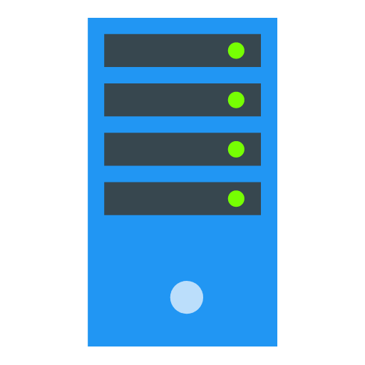

HTTP 1.0
open
close
80
GET /index.html
GET /img1.jpg
GET /img2.jpg
….

Slide 5
HTTP 1.1
open
close
80
GET /index.html
GET /img1.jpg
GET /img2.jpg
….

Slide 6
WebSockets
open
close
80
Websocket handshake
….

Slide 7
WebSockets Handshake ws:// or wss://
open
close
80
GET / HTTP/1.1 Connection:Upgrade
101 - Switching Protocols
….

Slide 8
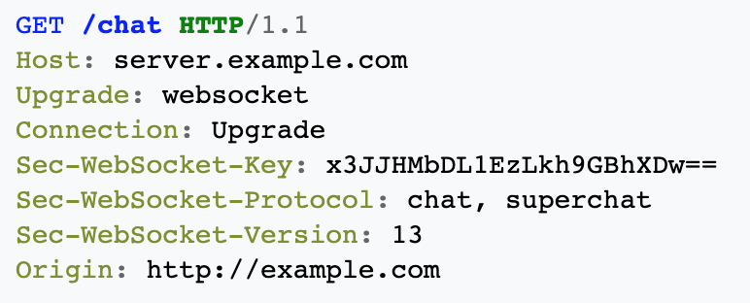
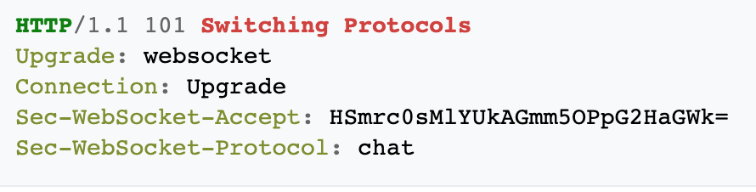
WebSocket Handshake
Client
Server

Slide 9




WebSockets use cases
Chatting
Live Feed
Multiplayer gaming
Showing client progress/logging

Slide 10

Layer 4 vs Layer 7
WebSockets
Proxying

Slide 11
Layer 4 vs Layer 7 WebSocket Proxying
In Layer 4 OSI model we see TCP/IP content
Connections, Ports, IP addresses.
Content remains encrypted (if unencrypted it is not inspected)
In Layer 7 OSI Model we see all what's below
Layer 4 + Application layer content
Content is decrypted (TLS termination)
We can read headers, paths, urls etc.

Slide 12
Layer 4 vs Layer 7 WebSocket Proxying
Layer 4 Proxying on WebSockets is done as a tunnel
NGINX intercepts the SYN for a connection and creates another connection on the backend
Any data sent on the frontend connection is tunneled to the backend connection
The backend connection remains private and dedicated to this client.

Slide 13

Layer 4 Proxying on WebSocket
open
open
close
close
TLS Handshake
TLS Handshake
TLS Handshake Fn.
TLS Handshake Fn.
443
UPGRADE
UPGRADE
101 - Switching Protocols
101 - Switching Protocols

Slide 14

Layer 7 Proxying on WebSocket
open
open
close
close
TLS Handshake
TLS Handshake
TLS Handshake Fn.
TLS Handshake Fn.
443
UPGRADE
UPGRADE
101 - Switching Protocols
101 - Switching Protocols

Slide 15
Layer 7 Load Balancing (Normal HTTP requests)
TLS Handshake
TLS Handshake
TLS Handshake

Slide 16
Layer 7 Load Balancing (WebSocket)
TLS Handshake
TLS Handshake

Slide 17
Spin up a
WebSockets Server

Slide 18
Configure NGINX
as Layer 4
WebSocket
Proxying

Slide 19
Layer 4 Proxying
Listening on port 80
Any TCP connection request is a tunnel and always goes to the websocket app
Paths don’t matter (layer 7)
ws://localhost/ -> websocket app
ws://localhost/blahblah -> websocket app
Layer 4 proxying blindly tunnels everything to the backend
Any connection request to port 80 will be tunneled to the websocket app backend

Slide 20
Configure NGINX
as Layer 7
WebSocket
Proxying

Slide 21
Layer 7 Proxying
Intercept the path and “route” appropriately
http://localhost/ -> open main html page
ws://localhost/wsapp -> websocket app
ws://localhost/chat -> another websocket app for chatting
Can’t do that in Layer 4 since port 80 is blindly tunnels

Slide 22
Summary
Quick Introduction to WebSockets
Layer 4 vs Layer 7 WebSocket Proxying
Spin up a WebSocket Server without NGINX
Deploy NGINX as a Layer 4 WebSocket Load Balancer
Deploy NGINX as a Layer 7 WebSocket Load Balancer

