Slide 1
CS542 Project: Link State Routing Simulation
Vivek Sagar Sahu A20375371

Slide 2
OverView
Overview
Introduction
Work Flow
Validations
Conclusions

Slide 3
Introduction
Link-state routing protocols are one of the two main classes of routing protocols used in packet switching networks for computer communications, the other being distance-vector routing protocols.
The basic concept of link state routing is that each node constructs a map of network topology in the form of graph. Thus after this construction , the node can calculate the best logical path from itself to all possible destination in the network.
Djikstra’s shortest path algorithm is used to find the shortest path from each node to all other nodes.

Slide 4
Work Flow
Welcome Screen
Connection Table
Shortest Path
Remove Router
Exit
Best Router
Create Topology

Slide 5
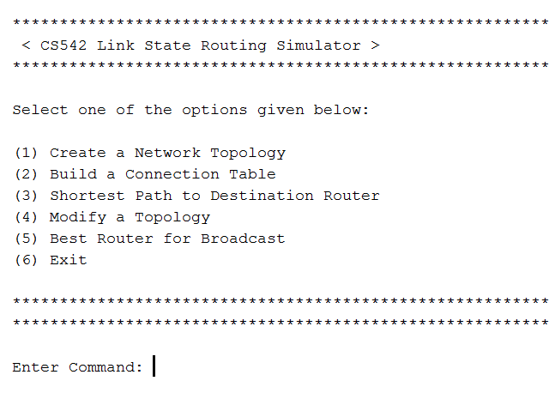
Welcome Screen
Run the program with command - python link_state.py
It will display all the options and prompt for command.

Slide 6
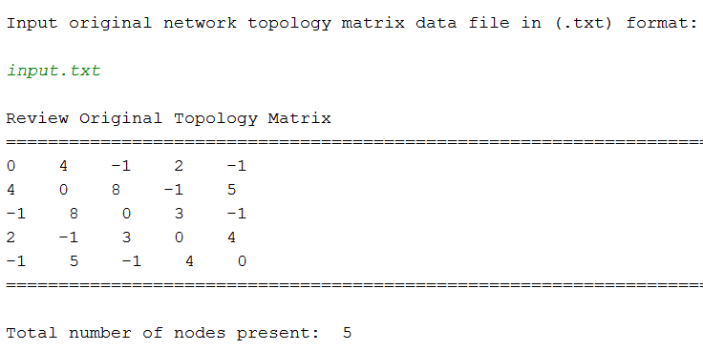
Create Topology
Enter command '1'. It will prompt you to enter the topology name.
If valid name is entered, it will display the data to review, and prompt for next command.

Slide 7
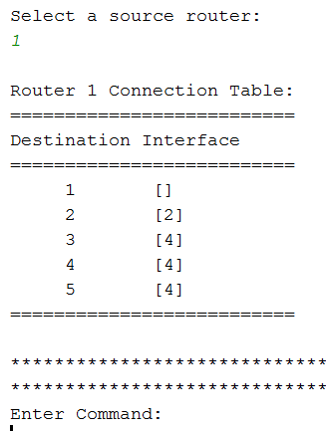
Connection Table
Enter command '2'. It will prompt you to enter the source router.
If valid source router is entered, it will display the connection table, and prompt for next command.

Slide 8
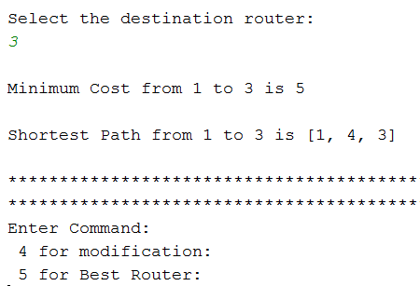
Shortest Path
Enter command '3'. It will prompt you to enter the destination router.
If valid destination router is entered, it will display the shortest path from source router to destination router with total cost, and prompt for next command.

Slide 9
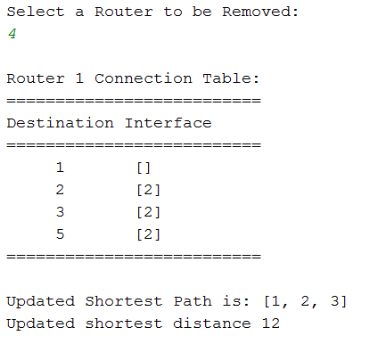
Remove Router
Enter command ‘4'. It will prompt you to enter the router which you want to delete.
If valid router is entered, it will display the updated connection table and new path.

Slide 10
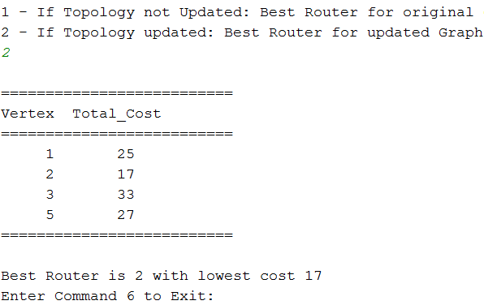
Best Router
Enter command ‘5'. It will prompt you to enter the options which you want to select.
If you have not updated the topology, choose 1 else choose 2.
If valid choice is enter, It will show you the best router with minimum cost to every other router.

Slide 11
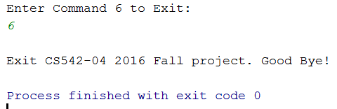
Exit
Enter command '4' to exit from the program.
It will exit the program, and control will be back to console.

Slide 12
Validations
Invalid Command
Invalid Topology File
Invalid Source router
Invalid Destination router
Invalid Router which is going to be deleted
Invalid selection for Best path.

Slide 13
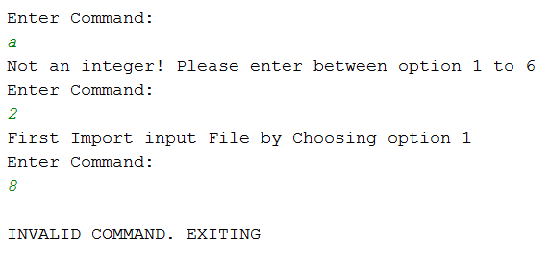
Invalid Command
If entered invalid command, it will display the error message, and prompt for it again.
If entered command other then 1 to 6, it will display the error message, and exit the command prompt.

Slide 14
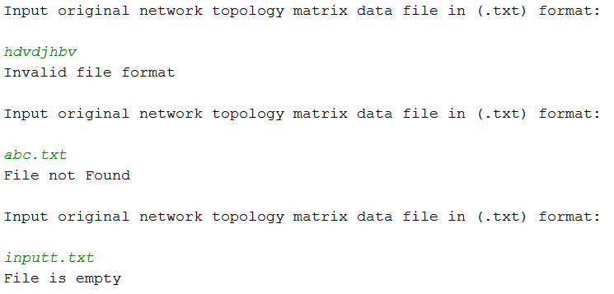
Invalid File
If invalid file format is entered, it will display the error message, and prompt for new file again.
If invalid topology is entered, it will display the error message, and prompt for new file again.
If empty topology file is entered, it will display the error message, and prompt for new file again.

Slide 15
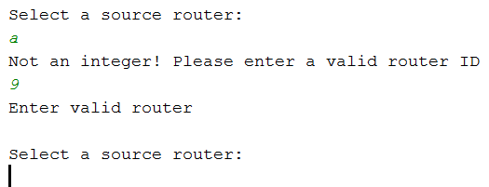
Invalid Source Router
If entered invalid source router, it will display the error message, and prompt for it again.

Slide 16
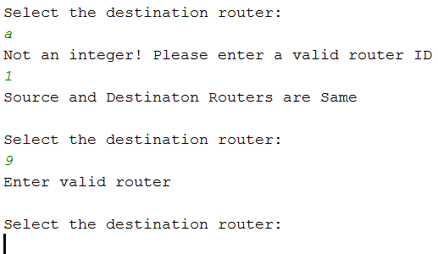
Invalid Destination Router
If entered invalid source router, it will display the error message, and prompt for it again.
If both source router and destination router are same, it will display the error message, and prompt for it again

Slide 17
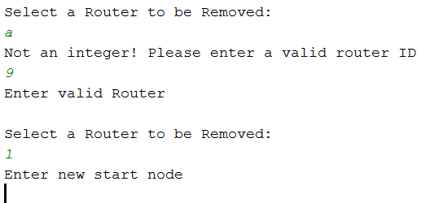
Invalid Router for modification
If entered invalid source router, it will display the error message, and prompt for it again.
If entered router same as source or destination router already being used, then it will prompt for new start or destination router.

Slide 18
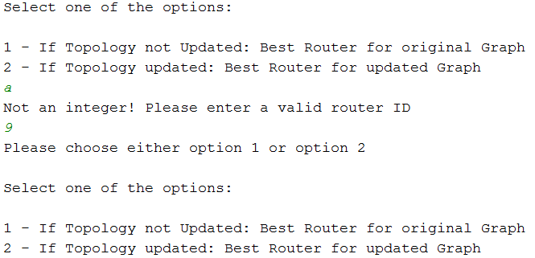
Invalid Selection for Best Path
If entered invalid option, it will display the error message, and prompt for it again.
If entered valid option but unrelative to updated topology, it will display the error message, and prompt for it again.

Slide 19
Conclusion
The implemented program for Link State Algorithm works for any network topology regardless of the size of network.
With every node having partial information about the network topology, it can create shortest path tree for the network.
Given valid topology data, it will provide you with the shortest path between source router and destination router.
You can also delete any node including source and destination router already being chosen in beginning by user.
It will give you the best router which has the lowest cost with every other routers in the given topology.

