Slide 1

Snakemake: Reproducible and Scalable Bioinformatic Workflows
Nathan Watson-Haigh
Acting Head of Bioinformatics
South Australian Genomics Centre (SAGC)
Wed 6th Jul 2020

Slide 2


Resources
Hands-on resources:
PowerPoint: https://bit.ly/sagc-snakemake-ppt
Handout: https://bit.ly/sagc-snakemake-pdf
Snakemake
Documentation: https://snakemake.readthedocs.io/
Citations:
https://doi.org/10.12688/f1000research.29032.2
http://bioinformatics.oxfordjournals.org/content/28/19/2520
$6.504/hr
48 vCPU, 384G RAM and 4 x 7500 NVMe SSD
i3en.12xlarge
4 vCPU, 32G RAM and 1 x 2500 NVMe SSD
Autoscaling: 0 – 6 nodes
12 Tbytes
i3en.xlarge
0.835/hr
$0.542/hr/ea
Total cost: $7.339 - 10.591/hr

Slide 3
Usual Pipeline Paradigm
Working on a Linux cluster with some sort of resource management system
Slurm
PBS
SGE
Others
Pipeline consists of a single (or small number of) script(s) submitted to the cluster
Commonly find that they each:
Do more than one task – read QC, read trimming, read alignment etc
Executes commands in serial
Use loops to iterate over files
Not easy to:
Ensure commands complete successfully before continuing with a dependant task
Get resource requirements right – end up over specifying CPU and memory
Rerun parts of a pipeline – end up commenting out lines of code

Slide 4
Usual Pipeline Paradigm
# CPUs
Consequences
Job waiting in queue for resources
Idle/unused resources
Delays in getting results
Mem
Time
Individual processes/commands
Idle/unused compute resources
Resources requested for script

Slide 5
Why Workflow Management?
Workflow management takes care of the following, so you don’t have to:
Parallelisation
Suspend/resume
Logging
Data provenance
Need to break pipelines down into individual tasks. Think UNIX philosophy which was summarized by Peter H. Salus in A Quarter-Century of Unix (1994) – emphasis is my own:
Write programs (tasks) that do one thing and do it well
Write programs (tasks) to work together

Slide 6
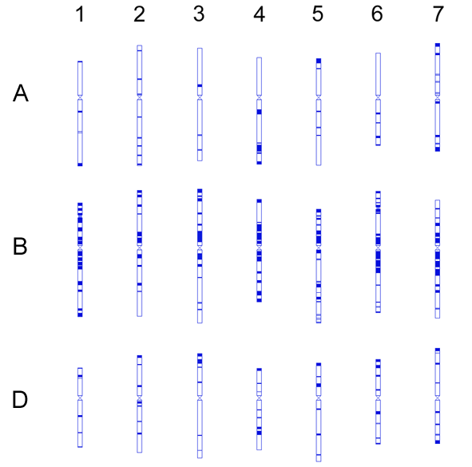
My Drivers for using Snakemake
Analyses in wheat (16Gbp and hexaploid) are time-consuming
Parallelisation - get the job done faster
Resume/continue - only redo what needs to be done
Efficient HPC resource utilisation/specification - avoid waiting in queues
Data provenance – a record of what was done
Reproducibility – others can check/reuse my workflows

Slide 7
Snakemake Paradigm
Decompose workflow into individual rules
Rules define how to create output files from input files
Snakemake infers a dependencies and execution order from the rules
Rule name
rule mytask:
input:
ref = "reference.fasta",
r1 = "reads/my_r1.fastq.gz",
r2 = "reads/my_r2.fastq.gz",
output:
"mapped/my.bam",
shell:
"""
bwa mem {input.ref} {input.r1} {input.r2} \
| samtools view -b > {output}
"""
Input file(s)
Output file(s)
How to create output from the input

Slide 8
Targets
You tell Snakemake what files (targets) to create. Snakemake figures out how to create them by using a dependency graph generated from the rules
By default Snakemake executes the first rule of the Snakefile
This gives rise to pseudo-rules at the beginning of the file that can be used to define build-targets (similar to GNU Make)
Convention to call first rule “all”
Always execute these rule(s) locally, don’t submit to cluster
localrules:
all
rule all:
input:
"mapped/Lancer.bam",
"mapped/Mace.bam",
An expand() here would be a great way to reduce repetition

Slide 9
Targets
You tell Snakemake what files (targets) to create. Snakemake figures out how to create them by using a dependency graph generated from the rules
By default Snakemake executes the first rule of the Snakefile
This gives rise to pseudo-rules at the beginning of the file that can be used to define build-targets (similar to GNU Make)
Convention to call first rule “all”
Expand the pattern using a list of values.
The list can be defined inline (as here) or in the body of the Snakefile.
localrules:
all
rule all:
input:
expand("mapped/{accession}.bam", accession=["Lancer", "Mace"]),

Slide 10
Generalise Rules Using Wildcards
rule mytask:
input:
ref = "reference.fasta",
r1 = "reads/my_r1.fastq.gz",
r2 = "reads/my_r2.fastq.gz",
output:
"mapped/my.bam",
shell:
"""
bwa mem {input.ref} {input.r1} {input.r2} \
| samtools view -b > {output}
"""

Slide 11
Generalise Rules Using Wildcards
rule mytask:
input:
ref = "reference.fasta",
r1 = "reads/{sample}_r1.fastq.gz",
r2 = "reads/{sample}_r2.fastq.gz",
output:
"mapped/{sample}.bam",
shell:
"""
bwa mem {input.ref} {input.r1} {input.r2} \
| samtools view -b > {output}
"""
This rule now knows how to make:
"mapped/my_sample.bam"
"mapped/another_sample.bam"
"mapped/any_sample.bam"

Slide 12
External Scripts
rule mytask:
input:
"path/to/input/file",
output:
"path/to/output/file",
script:
"path/to/script.py"
rule mytask:
input:
"path/to/input/file",
"path/to/other/inputfile"
output:
"path/to/output/file",
somename = "path/to/another/outputfile"
run:
for f in input:
...
with open(output[0], "w") as out:
out.write(...)
with open(output.somename, "w") as out:
out.write(...)
X
Supports:
Python
R/R Markdown
Julia
Rust
Jupyter notebooks
run is for Python code. Use script instead for Python code

Slide 13
Wrappers
rule mytask:
input:
bam = "mapped/{sample}.bam",
ref = "genome.fasta"
output:
gvcf = "calls/{sample}.g.vcf",
wrapper:
"0.31.1/bio/gatk/haplotypecaller"
Tool wrapper repository:
https://snakemake-wrappers.readthedocs.io/

Slide 14
Common-Workflow Language (CWL)
rule samtools_sort:
input:
input = "mapped/{sample}.bam"
output:
output_name = "mapped/{sample}.sorted.bam"
params:
threads = lambda wildcards, threads: threads,
memory = "4G"
threads:
8
cwl:
"https://github.com/common-workflow-language/workflows/blob/fb406c95/tools/samtools-sort.cwl"
For reproducibility, use a URL with a commit hash
Using CWL imposes additional restrictions on how input, output and params are specified

Slide 15
Installation
Recommended path is using conda
# Create a new conda environment for snakemake v5.4.0 (currently
# the latest version)
# https://anaconda.org/search?q=snakemake
conda create \
--name snakemake_v7.8.5 \
--channel bioconda --channel conda-forge \
--yes \
snakemake=7.8.5

Slide 16
Activate Snakemake Environment
# Activate the conda environment you created before
conda activate snakemake_v7.8.5

Slide 17
Example Workflow
# Generate DAG of job dependencies
snakemake \
--dag \
| dot -Tsvg \
> dag.svg

Slide 18
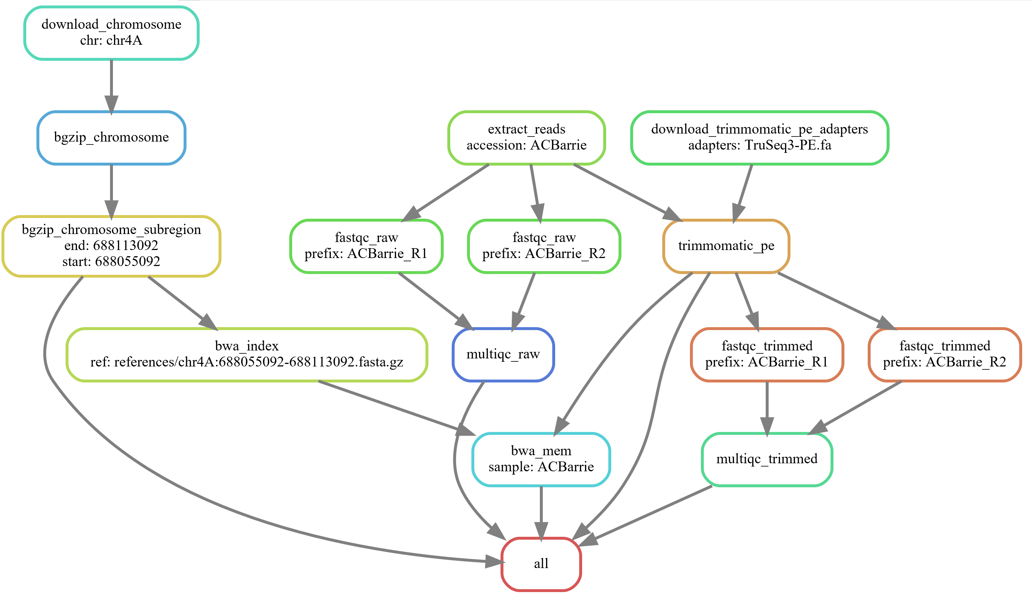
DAG of Jobs
A job
Rule name
A single accession
Wildcard name:value
Job dependency
Target

Slide 19
Example Workflow
# Generate DAG of job dependencies
snakemake \
--dag \
| dot -Tsvg \
> dag.svg
# See what rules and commands would be executed
snakemake \
--dry-run --printshellcmds
# Submit workflow to cluster and use conda software environment
module load \
Singularity
snakemake \
--profile profiles/slurm \
--use-conda

Slide 20
Add a New Accession
# Add "Alsen" to the ACCESSIONS array:
ACCESSIONS = [
"Lancer",
"Mace",
]
# Generate DAG of job dependencies
snakemake \
--dag \
| dot -Tsvg \
> dag2.svg

Slide 21
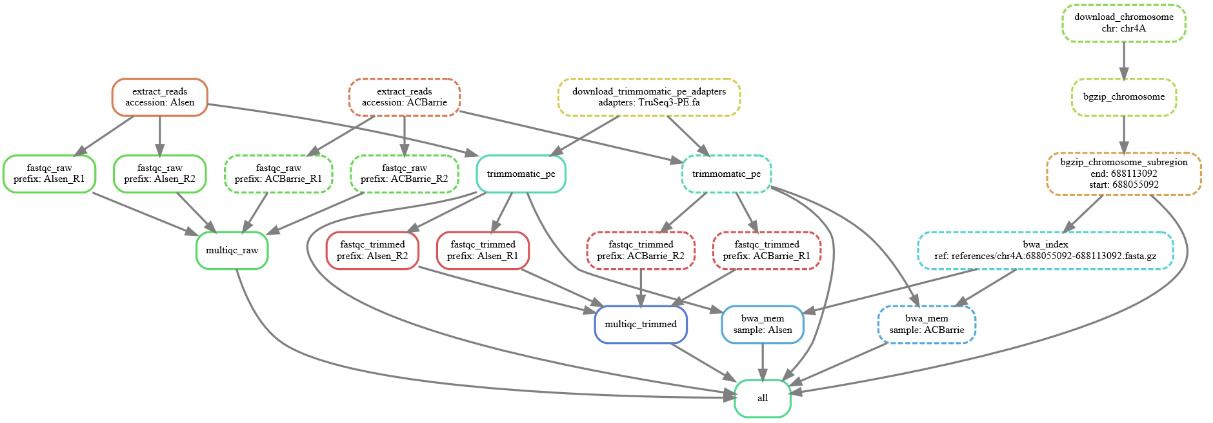
DAG of Jobs: Updated
New accession
Dashed = job completed
Solid = job needs running
Same node colour = same rule

Slide 22
Add a Bunch of Accessions
# Add more accessions to ACCESSIONS array:
ACCESSIONS = [
"Lancer",
"Mace",
"Baxter",
"Chara",
"Drysdale",
"Excalibur",
"Gladius",
"H45", "Kukri", "Pastor", "RAC875", "Volcanii", "Westonia", "Wyalkatchem", "Xiaoyan", "Yitpi",
]
# Generate DAG of job dependencies
snakemake \
--dag \
| dot -Tsvg \
> dag3.svg

Slide 23
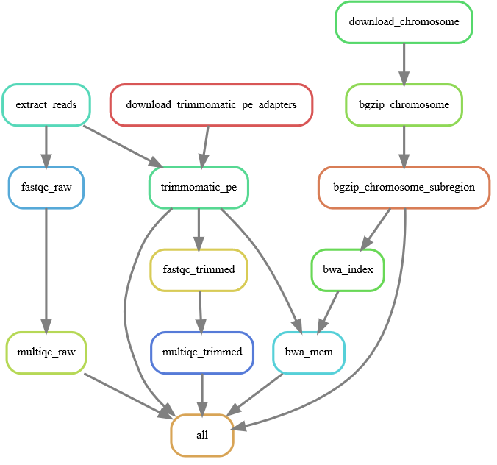
DAG of Rules
# Generate DAG of rules
snakemake \
--rulegraph \
| dot -Tsvg \
> rulegraph.svg
# Get a count of all jobs that would be run
snakemake \
--dry-run \
--quiet
Job counts:
count jobs
1 all
15 bwa_mem
15 extract_reads
30 fastqc_raw
30 fastqc_trimmed
1 multiqc_raw
1 multiqc_trimmed
15 trimmomatic_pe
108

Slide 24
Job Software Execution Environment
Jobs executed by Snakemake expect the software environment to “just work”
E.g. commands present in the shell section are expected to be on the PATH
Snakemake can make use of conda for a reproducible software environment
Use the conda keyword in rules to specify the location of a conda environment file
Use the --conda command line argument to instruct Snakemake to use them
channels:
- conda-forge
- bioconda
- defaults
dependencies:
- fastqc=0.11.8
- multiqc=1.7
- trimmomatic=0.36
- pigz=2.3.4
- bwa=0.7.17
- samtools=1.9
- htslib=1.9
- unzip=6.0
rule bwa_mem :
input: ...
output: ...
conda:
"envs/tutorial.yaml"
shell: ...
Can use rule-specific conda environments
Search Anaconda Cloud for available tools/versions

Slide 25
Summary
# CPUs
Mem
Time
Before
After

Slide 26
Advanced Features

Slide 27
Rule Resources
Jobs submitted to the cluster are all getting the same default resources
The slurm profile (profiles/slurm) together with cluster-config files determine what resources each job gets
# Reminder on how we’re submitting workflow jobs to a cluster
snakemake \
--profile profiles/slurm \
--use-conda
cluster-configs/default.yaml file sets some default cluster configuration values
cluster-configs/phoenix.yaml file overrides some of those values for my specific Slurm cluster

Slide 28
Rule Resources: default.yaml
__default__ :
job-name : "{rule}"
output : "logs/{rule}/{wildcards}.out"
ntasks : 1
cpus-per-task : 1
mem : "200M"
time : "00-00:05:00"
account : "my_account"
partition : "my_partition"
# Override the above defaults, with job specific values
bwa_mem :
cpus-per-task : 16
mem : "10000M"
time : "00-01:00:00"

Slide 29
Rule Resources: resources keyword
# Job specific resource requirements can be passed from the rule, in
# the Snakefile, itself via the "resources" keyword
bwa_mem :
cpus-per-task : 4
mem : "{resources.mem_mb}M"
time : "00-00:{resources.time_mins}:00"
rule bwa_mem :
input: ...
output: ...
resources:
mem_mb = 10000,
time_mins = 60,
shell: ...
Resources must be integers

Slide 30
Rule Resources: Dynamic Scaling
Lambda (anonymous) functions
Signature: callable(wildcards [, input] [, threads] [, attempt])
Restricted to a single expression – can easily get ugly (see next slide)
Simple way to scale up resources on each job retry attempt
Can get more complex by access information about input files (e.g. their size), number of threads being used
rule bwa_mem :
input: ...
output: ...
resources:
mem_mb = lambda wildcards, attempt: 10000 * attempt,
time_mins = lambda wildcards, attempt: 60 * attempt,
shell: ...
attempt | mem_mb | time_mins
1 | 10000 | 60
2 | 20000 | 120
Scales memory and time linearly with attempt number

Slide 31
Rule Resources: Dynamic Scaling
For each job restart (attempt) add an additional 10%
Round up to nearest integer
rule bwa_mem :
input: ...
output: ...
resources:
mem_mb = lambda wildcards, attempt: math.ceil(10000 * (1+(attempt-1)/10)),
time_mins = lambda wildcards, attempt: math.ceil(60 * (1+(attempt-1)/10)),
shell: ...
attempt | mem_mb | time_mins
1 | 10000 | 60
2 | 11000 | 66

Slide 32
Rule Resources: Dynamic Scaling with Input Size
import os
rule myrule :
input: index = ...,
...
output: ...
resources:
mem_mb = lambda wildcards, input, attempt: math.ceil( sum(os.path.getsize(f) for f in input['index'] if os.path.isfile(f)) / 1024**2*(1+(attempt-1)/10)),
shell: ...
Sum of input.index file size(s) in Mbytes
For each job restart (attempt) add an additional 10%
Round up to nearest integer

Slide 33
Benchmarking
Snakemake can generate benchmark info for executed jobs using the benchmark keyword
The repeat() function allows one to specify the number of replicate benchmarks to run
Benchmark repeats are run from within the same cluster job, therefore, don’t forget to scale the job times accordingly
N_BENCHMARKS = 3
rule bwa_mem :
input: ...
output: ...
benchmark:
repeat("benchmarks/bwa_mem/{prefix}.txt", N_BENCHMARKS),
shell: ...

Slide 34
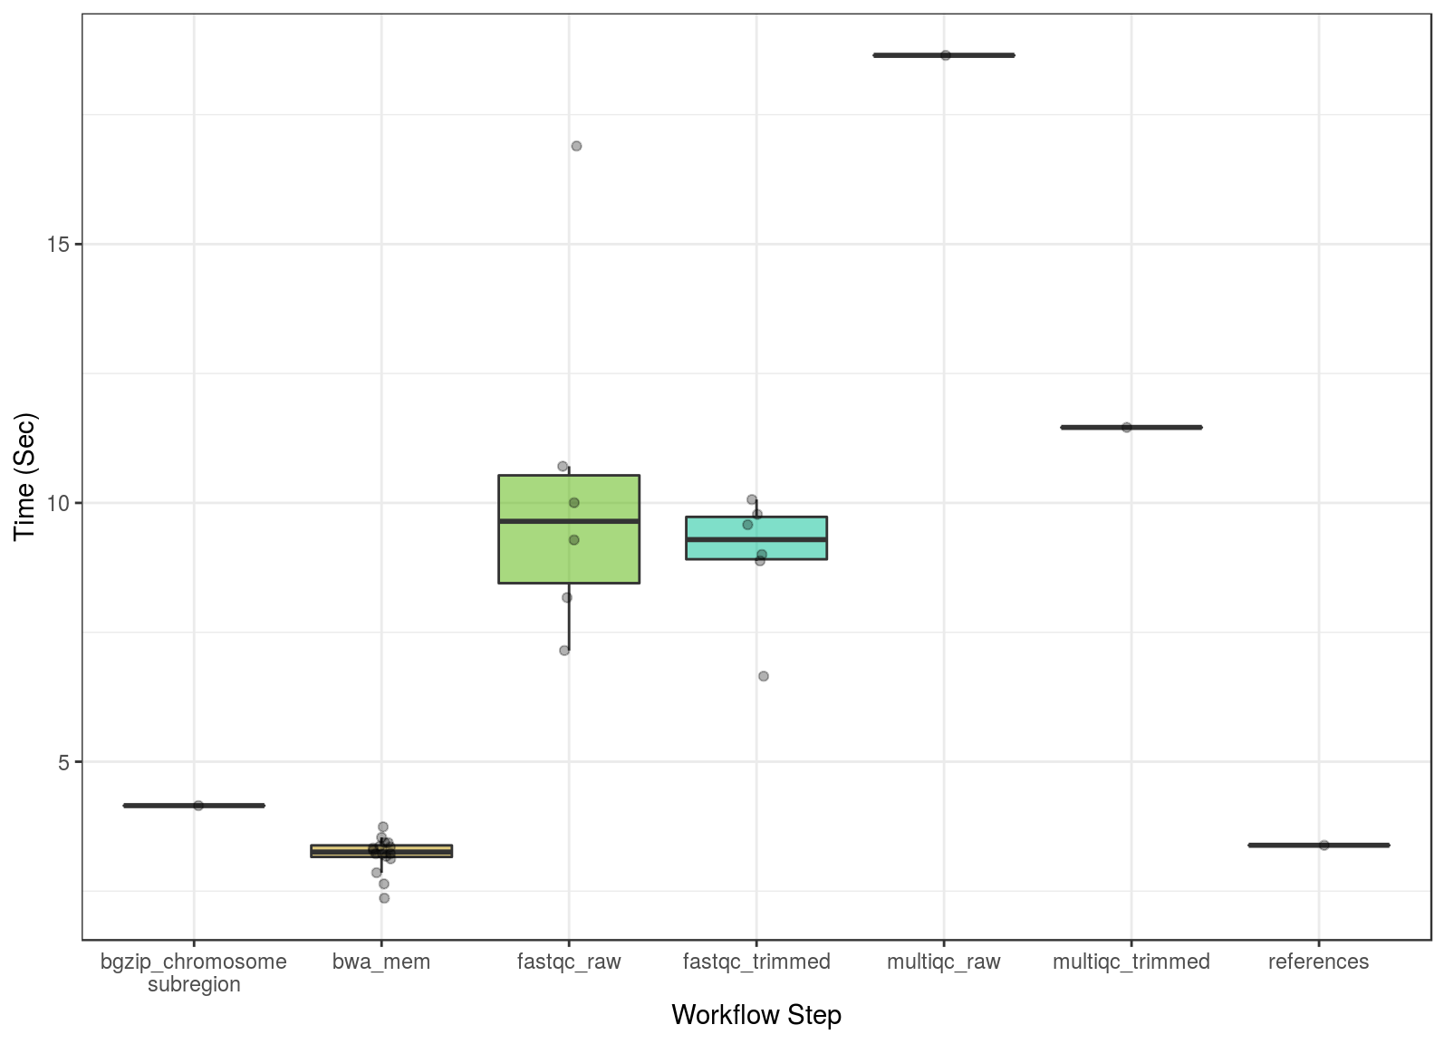
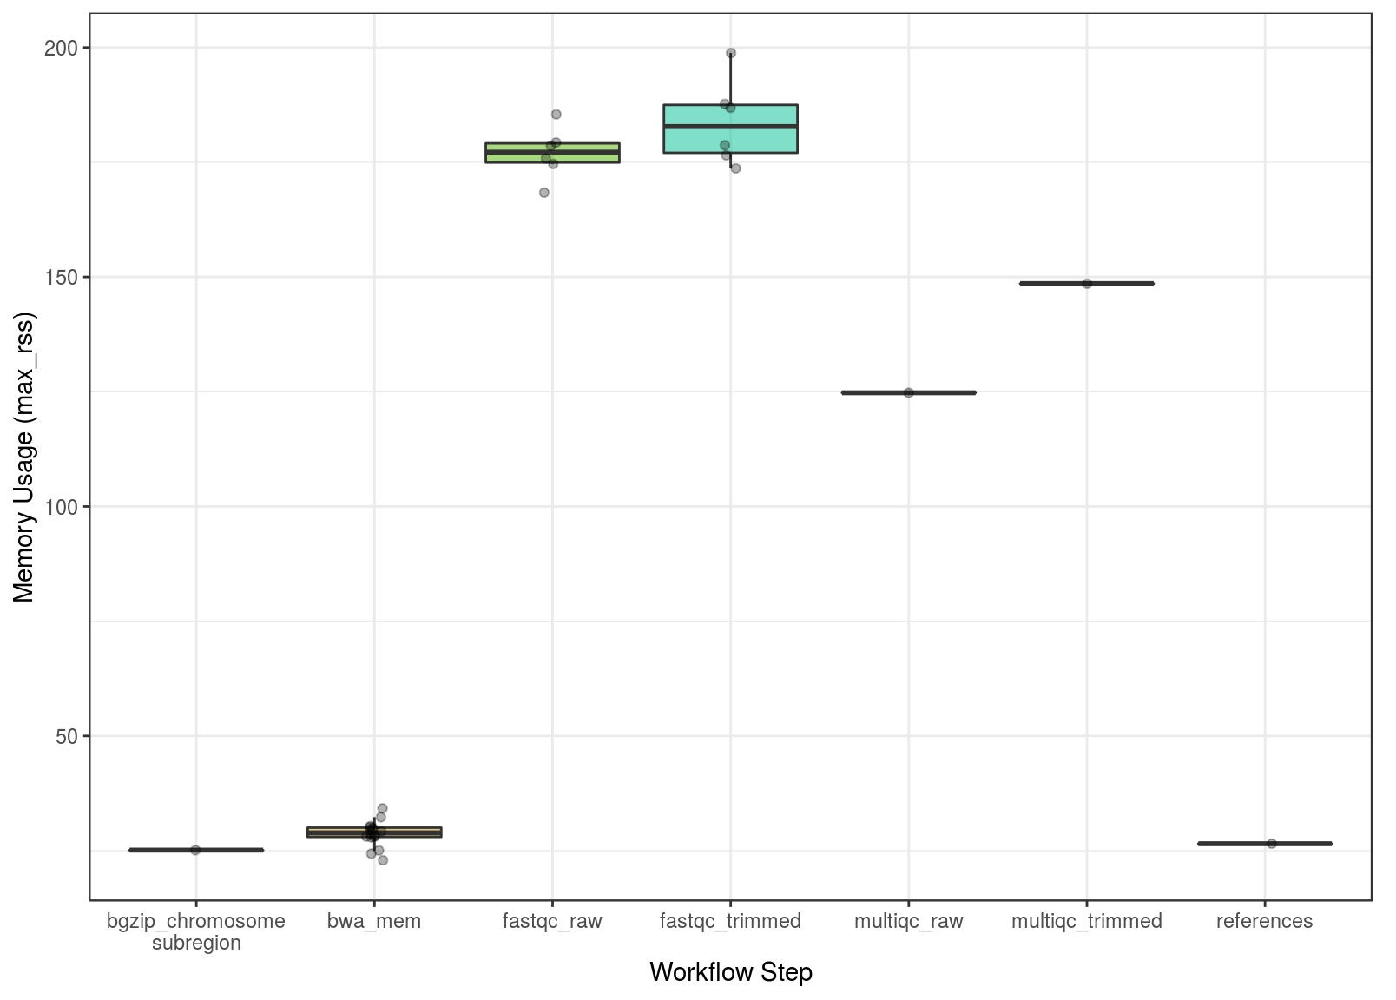
Benchmarking
Thanks to Steve Pederson for R Markdown to plot the benchmark stats

Slide 35
Containers for Reproducibility
Snakemake can use docker or singularity containers. Just specify --use-singularity
These can be specified for each rule, using the singularity keyword
rule NAME:
input:
"table.txt"
output:
"plots/myplot.pdf"
singularity:
"docker://joseespinosa/docker-r-ggplot2"
script:
"scripts/plot-stuff.R"
docker:// → https://hub.docker.com/
shub:// → https://singularity-hub.org/

Slide 36
Containers for Reproducibility
Snakemake can use docker or singularity containers. Just specify --use-singularity
These can be specified for each rule, using the singularity keyword
Or globally for every rule to use
singularity:
"docker://joseespinosa/docker-r-ggplot2"
rule NAME:
input:
"table.txt"
output:
"plots/myplot.pdf"
script:
"scripts/plot-stuff.R"

Slide 37
Containers for Reproducibility
Snakemake can use docker or singularity containers. Just specify --use-singularity
These can be specified for each rule, using the singularity keyword
Or globally for every rule to use
Conda usage inside a singularity container can be achieved with --use-singularity and --use-conda
singularity:
"docker://continuumio/miniconda3:4.5.12"
rule NAME:
input:
"table.txt"
output:
"plots/myplot.pdf"
conda:
"envs/tutorial.yml"
script:
"scripts/plot-stuff.R"
Minimal software environment e.g. no unzip
Must explicitly set in conda environment

