Slide 1
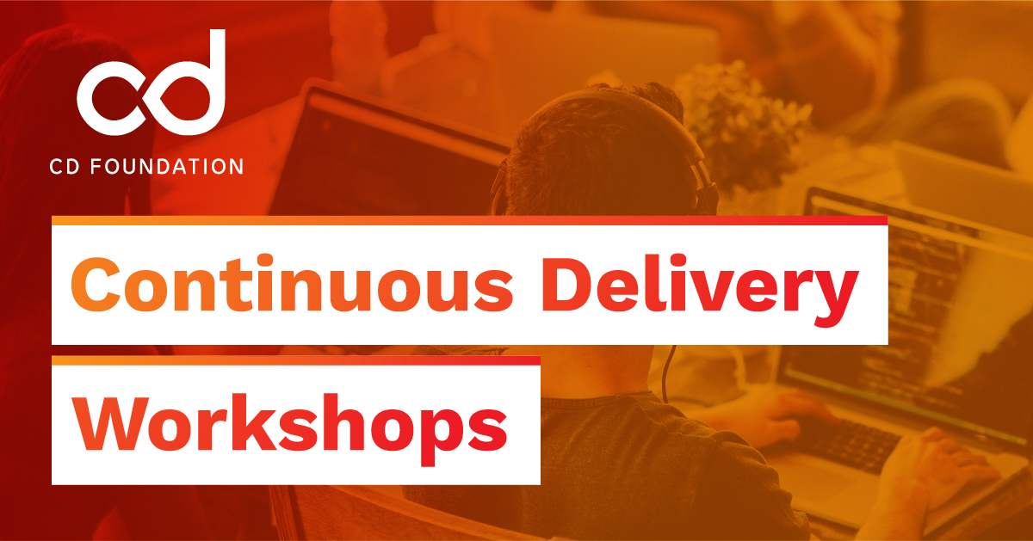
Notes:
“Hi everyone, I’m Sage. In the next 30 minutes we’ll turn Spark jobs into versioned, testable releases you can ship with the same confidence as application code. First half is the ‘why’ and the blueprint; second half is a live, local-only demo on my laptop using kind. You’ll walk away with a starter repo, a repeatable delivery pattern, and a production checklist you can apply at your company.”

Slide 2
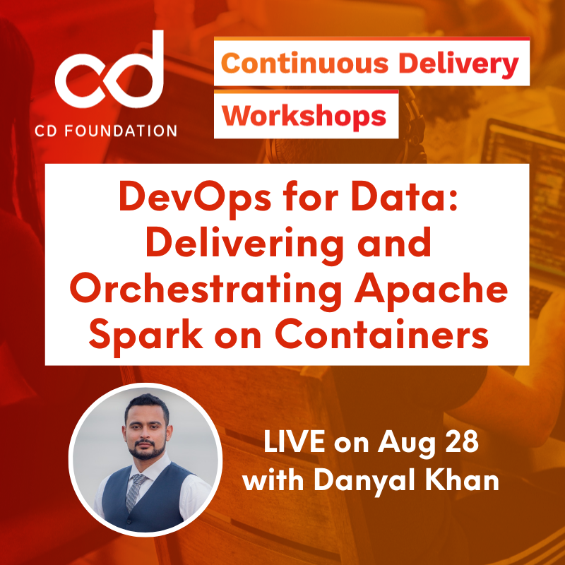


Slide 3
Apache Spark
Apache Spark is a distributed compute engine built to process large datasets fast, especially iterative workloads that were slow on Hadoop MapReduce
It offers unified APIs for SQL, batch ETL, streaming, and ML across clusters, with in-memory execution to keep stages snappy
From a DataOps perspective, Spark is the “execution muscle” behind data products
Notes:
Apache Spark (what, why, what it does, why it matters to DataOps)
Apache Spark is a distributed compute engine built to process large datasets fast, especially iterative workloads that were slow on Hadoop MapReduce. It offers unified APIs for SQL, batch ETL, streaming, and ML across clusters, with in-memory execution to keep stages snappy. Practically, Spark reads from lakes (S3, ADLS, HDFS), transforms/joins data at scale, powers feature pipelines and model scoring, and serves analytics use cases. From a DataOps perspective, Spark is the “execution muscle” behind data products—so treating Spark jobs as versioned, testable, promotable releases (with CI/CD, quality gates, and rollbacks) is what turns ad-hoc scripts into reliable production systems.
Monoliths vs. Containerization
A monolith bundles app code, system packages, and configs onto long-lived servers (“snowflakes”). It’s simple at first but drifts over time—updates are risky, dependencies conflict, and scaling often means bigger VMs. Containerization packages an app with its exact dependencies into a small, immutable image that starts fast and runs the same everywhere. You get isolation (no library collisions), portability (laptop → CI → prod), and density (many workloads per host). In short: monoliths optimize for stability of machines; containers optimize for stability of artifacts.
Why containerize; why Docker/LXC; why Kubernetes (and how it fixes DevOps pain)
Linux containers (LXC) use kernel namespaces and cgroups to isolate processes and resources. Docker popularized an easy developer workflow: Dockerfile → layered image → run anywhere. That solves “works on my machine,” but at scale you need a traffic cop—Kubernetes. K8s schedules containers on a cluster, restarts them on failure, rolls out updates gradually, injects configs/secrets, load-balances, and autoscal es based on demand—all from declarative YAML. For DevOps, this means reproducible environments, zero-downtime rollouts, policy guardrails (RBAC, quotas), and a clean path to GitOps and CDEvents. It reduces toil (no more one-off servers), improves resource utilization (bin-packing), and standardizes release operations across teams.
Why run Spark on Kubernetes instead of “simple monoliths”
Spark is a fleet workload by nature: a driver coordinates many executors. On a monolithic host or static VM cluster, you battle dependency conflicts, idle capacity, and slow, bespoke operations. On Kubernetes, each Spark app becomes a set of pods: the driver requests executors on demand, gets isolation per job (different Spark/Python versions coexist), and returns resources when done. Platform teams enforce namespaces, quotas, and RBAC; autoscalers add/remove nodes; ops gets unified logging/metrics and reliable rollouts/rollbacks. Net effect: higher utilization, faster delivery, easier multi-tenancy, and a consistent DevOps model shared with the rest of your apps—exactly what big organizations need to scale DataOps safely and cost-effectively.

Slide 4
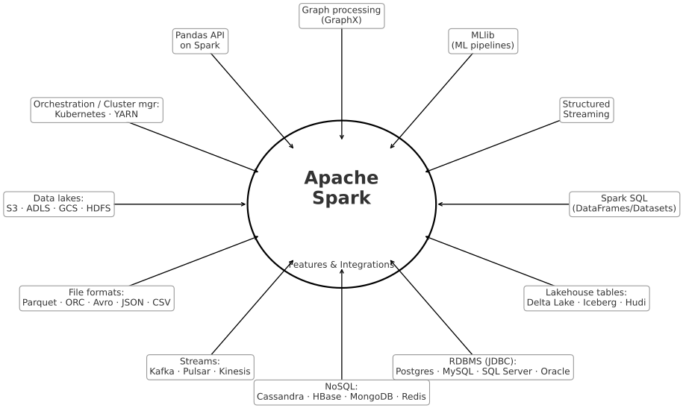
Apache Spark
Processes large datasets quickly, analyze data (batch + real-time), Machine Learning & AI pipelines, Search, recommendations, fraud detection
Handles huge data (GB → PB), Scales well (1 computer → 1000s), Faster insights (real-time fraud alerts, analytics), Flexible → one engine, many jobs, Backed by community & industry (Netflix, Uber, eBay, etc.)
Notes:
Created at UC Berkeley AMPLab (2009) becoming open source under Apache Software Foundation (2010)
Apache Spark is an open-source big data processing engine. Think of it like a super-fast calculator that can handle huge amounts of data spread across many computers. It’s mainly used for: Processing large datasets quickly, Analyzing data (batch or real-time), Powering machine learning and AI pipelines, Handling tasks like search, recommendations, fraud detection, and more. So, Apache Spark makes it easy, fast, and scalable to process and analyze massive amounts of data in real-time or in batches.
Key Features of Spark includes its speed – Processes data much faster than older systems like Hadoop (because it keeps data in memory instead of always writing to disk). Versatility – Works for batch jobs, streaming data, machine learning, and graph processing. Easy to Use – Provides simple APIs in Python, Java, Scala, R, and SQL. Runs Anywhere – Can run on your laptop, a cluster of servers, or in the cloud (with Kubernetes, Hadoop, or standalone). Ecosystem – Has built-in libraries for SQL, ML, streaming, and graph workloads.
Why is it so widely used? Handles big data easily (from gigabytes to petabytes). Scales well → can run on just one computer or thousands. Faster insights → helps companies act quickly on data (e.g., real-time fraud alerts). Flexible → one platform for many types of data processing. Community & industry support → used by Netflix, Uber, eBay, and many others. Old tools (Hadoop MapReduce) were slow & complex while Spark is fast, unified, simple → one engine for batch, streaming & ML
What problem does Spark solve? Before Spark, companies used older big data tools (like Hadoop MapReduce), which were Slow (because they kept writing to disk) and Complex (needed multiple tools for different tasks).
Spark solved this by: Making big data processing fast (in-memory computation), allowing different data tasks (batch, streaming, ML) on one platform and Reducing complexity → one engine, many jobs.

Slide 5
Why DevOps/CD for Spark (not 'just Kubernetes')
Spark powers business‑critical data products; many jobs bypass CI/CD guardrails.
We need immutable artifacts, environment promotion, rollbacks, and SLOs—just like app teams.
Containers → reproducible runtime • CD → trusted, auditable delivery • CDEvents → traceability.
Notes:
“Quick show of hands—or drop it in chat—who has a Spark job that ‘only works on one machine’? That’s our starting pain. Data teams often ship notebooks or scripts outside the governance that app teams enjoy. The result: drift, unknown dependencies, and fragile releases. DevOps for data means we treat Spark jobs as products: versioned images, tests, promotion rules, rollbacks, and SLOs. Kubernetes will be our example runtime, but the star of the show is continuous delivery—a repeatable, auditable way to get from commit to a safe production run.”
Quick pulse check: who has a Spark job that ‘only works on one machine’? That’s the pain. Data teams often ship notebooks or scripts outside CI/CD. DevOps for data = treat Spark jobs as products: immutable images, tests, promotion rules, rollbacks, and SLOs. Kubernetes is the runtime example; the star is Continuous Delivery.

Slide 6
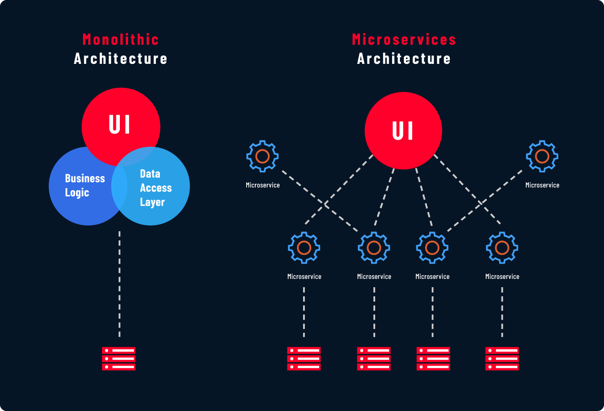
Monolithic, Containerization & Microservices
Monoliths optimize for stability of machines;
Containers optimize for stability of artifacts.
Notes:
Monoliths vs. Containerization
A monolith bundles app code, system packages, and configs onto long-lived servers (“snowflakes”). It’s simple at first but drifts over time—updates are risky, dependencies conflict, and scaling often means bigger VMs. Containerization packages an app with its exact dependencies into a small, immutable image that starts fast and runs the same everywhere. You get isolation (no library collisions), portability (laptop → CI → prod), and density (many workloads per host). In short: monoliths optimize for stability of machines; containers optimize for stability of artifacts.

Slide 7
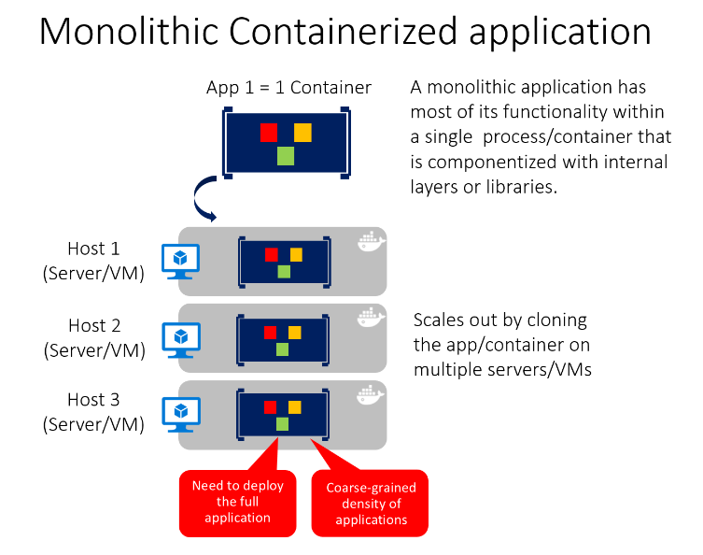
Monolithic, Containerization & Microservices
You can include multiple components, libraries, or internal layers in each container
A monolithic containerized application has most of its functionality within a single container, with internal layers or libraries, and scales out by cloning the container on multiple servers/VMs
This monolithic pattern might conflict with the container principle "a container does one thing, and does it in one process", but might be ok for some cases.
Notes:
You can include multiple components, libraries, or internal layers in each container, as illustrated in Figure 4-1. A monolithic containerized application has most of its functionality within a single container, with internal layers or libraries, and scales out by cloning the container on multiple servers/VMs. However, this monolithic pattern might conflict with the container principle "a container does one thing, and does it in one process", but might be ok for some cases.
The downside of this approach becomes evident if the application grows, requiring it to scale. If the entire application can scale, it isn't really a problem. However, in most cases, just a few parts of the application are the choke points that require scaling, while other components are used less.
For example, in a typical e-commerce application, you likely need to scale the product information subsystem, because many more customers browse products than purchase them. More customers use their basket than use the payment pipeline. Fewer customers add comments or view their purchase history. And you might have only a handful of employees that need to manage the content and marketing campaigns. If you scale the monolithic design, all the code for these different tasks is deployed multiple times and scaled at the same grade.

Slide 8
How Containers Fix DevOps Aches
Linux containers (LXC) use kernel namespaces and cgroups to isolate processes and resources
Docker popularized an easy developer workflow: Dockerfile → layered image → run anywhere. That solves “works on my machine,” but at scale Kubernetes
K8s schedules containers on a cluster, restarts them on failure, rolls out updates gradually, injects configs/secrets, load-balances, and autoscal es based on demand—all from declarative YAML
Notes:
Why containerize; why Docker/LXC; why Kubernetes (and how it fixes DevOps pain)
Linux containers (LXC) use kernel namespaces and cgroups to isolate processes and resources. Docker popularized an easy developer workflow: Dockerfile → layered image → run anywhere. That solves “works on my machine,” but at scale you need a traffic cop—Kubernetes. K8s schedules containers on a cluster, restarts them on failure, rolls out updates gradually, injects configs/secrets, load-balances, and autoscal es based on demand—all from declarative YAML. For DevOps, this means reproducible environments, zero-downtime rollouts, policy guardrails (RBAC, quotas), and a clean path to GitOps and CDEvents. It reduces toil (no more one-off servers), improves resource utilization (bin-packing), and standardizes release operations across teams.

Slide 9
Running Spark on Kubernetes vs “Simple Monoliths”
Spark is a fleet workload by nature: a driver coordinates many executors
On a monolithic host or static VM cluster, you battle dependency conflicts, idle capacity, and slow, bespoke operations
On Kubernetes, each Spark app becomes a set of pods: the driver requests executors on demand, gets isolation per job (different Spark/Python versions coexist), and returns resources when done
Notes:
Why run Spark on Kubernetes instead of “simple monoliths”
Spark is a fleet workload by nature: a driver coordinates many executors. On a monolithic host or static VM cluster, you battle dependency conflicts, idle capacity, and slow, bespoke operations. On Kubernetes, each Spark app becomes a set of pods: the driver requests executors on demand, gets isolation per job (different Spark/Python versions coexist), and returns resources when done. Platform teams enforce namespaces, quotas, and RBAC; autoscalers add/remove nodes; ops gets unified logging/metrics and reliable rollouts/rollbacks. Net effect: higher utilization, faster delivery, easier multi-tenancy, and a consistent DevOps model shared with the rest of your apps—exactly what big organizations need to scale DataOps safely and cost-effectively.

Slide 10
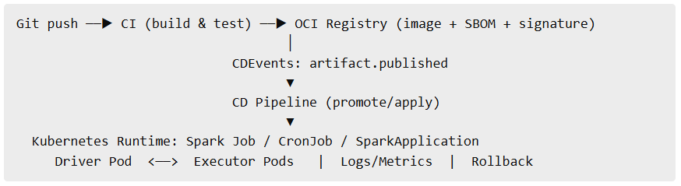
CD Blueprint for Spark
Flow: commit → CI build (image/jar) → tests (code+data+deps) → SBOM & sign → CD apply → observe & rollback
CDF fit: Tekton/Jenkins pipelines • CDEvents • SBOM/provenance inventory
Notes:
“Here’s the movie in one frame. A commit triggers CI to build a single immutable artifact—usually a Docker image with Spark + your code. CI runs code tests and data checks. We produce an SBOM and optionally sign the image. A CD pipeline promotes that image to an environment by applying a Job/CronJob/SparkApplication. Everything emits CDEvents so we can answer: who ran what, where, and with which bits? If anything looks off—bad data, performance regression—we roll back by redeploying the previous, known-good image. That’s the backbone you can scale across teams.”
An SBOM is a machine-readable inventory of everything inside a software artifact—libraries, versions, licenses, checksums, and where they came from. Think of it as a nutrition label for code. Teams generate SBOMs during CI builds (formats like SPDX or CycloneDX) so security and compliance tools can: (1) quickly spot vulnerable dependencies, (2) prove what was shipped and when, and (3) trace supply-chain risk. For DataOps, bundling an SBOM with each Spark image/jar/wheel turns pipelines into auditable, trustworthy releases.

Slide 11
CD Blueprint for Spark
Git push → CI (build & test) → OCI Registry (image + SBOM + signature) │ CDEvents: artifact.published ▼ CD Pipeline (promote/apply) ▼ Kubernetes Runtime: Spark Job / CronJob / SparkApplication Driver Pod ↔ Executor Pods | Logs/Metrics | Rollback
Notes:
A commit becomes one image that’s tested and labeled (SBOM/signature). CI announces ‘new artifact ready’; CD hears it and applies the same image to Kubernetes. K8s runs a driver and executors, we watch logs/metrics, and if needed we roll back by switching to the last good image. That’s our reliable loop from commit to cluster
We see One continuous path from a code change to a Spark job running on Kubernetes, with the same artifact moving through each step and events tying it all together.
The story in simple steps
Git push → CI (build & test) A developer pushes code. CI pulls the repo and builds one immutable artifact (usually a Docker image that contains Spark + your code + your Python/Scala deps). CI then runs:
Code tests (unit/integration)
Data checks (schema/freshness/quality with pandera or Great Expectations) If it all passes, we stamp the build with metadata:
SBOM (the “ingredients list” of libraries/versions)
Signature (optional, for provenance/trust)
Publish to an OCI registry (image + SBOM + signature) CI pushes the image (tagged with the Git SHA) to a container registry (Docker Hub/GHCR/ECR/GCR). That makes it addressable by tag or digest from any environment. (In the local demo, we skip the registry and load the image into kind—same idea, no internet.)
CDEvents: artifact.published (and CI status) CI emits small JSON events that say what just happened:
artifact.published → “a new Spark image is ready at X”
pipelinerun.finished → “build/tests: success/failure” These events let other tools trigger the next action and give you an audit trail.
CD pipeline (promote/apply) Your CD tool (Tekton/Jenkins/GitOps) listens for those events, fetches the exact image (by digest), renders the Kubernetes manifest with that version, and applies it to the target environment (dev → stage → prod). Only config changes between environments (secrets/CPU/memory); the artifact stays identical.
Runtime: Kubernetes schedules Spark Kubernetes creates a driver pod from your image; the driver requests executor pods using the same image.
K8s handles placement, restarts, scaling, quotas, RBAC, etc.
If a pod dies, K8s brings it back; when the job finishes, resources are freed.
Observe & record You watch logs and metrics (e.g., with Prometheus/Grafana). CD emits deployment.started/deployment.finished events so you can see status in chat/dashboards. If anything looks wrong, you rollback by re-applying the previous image tag/digest—no guesswork, no server drift.
How does this link together?
One artifact, many environments: the image built in CI is the same thing that runs in dev, stage, and prod—reproducible and portable.
Events glue the stages: CDEvents are the handshakes between CI, registry, CD, and runtime—automation + traceability.
Kubernetes provides the runway: it gives Spark per-job isolation, scheduling, and guardrails (namespaces/quotas/secrets) that monoliths can’t.
Rollback is trivial: you just deploy the previous digest; no rebuilding machines or fixing “snowflake” servers.
Compliance ready: SBOM + signatures make supply-chain and audit conversations easy.
Quick “terms → meaning” cheat sheet
OCI registry = a container image store (Docker Hub/GHCR/etc.).
SBOM = machine-readable “ingredients list” of your image.
Signature = cryptographic proof the image is the one CI built.
Driver = Spark’s coordinator; Executors = workers that do the tasks.
Job/CronJob/SparkApplication = three ways to run Spark on K8s:
Job: one-off run (what the demo uses)
CronJob: scheduled runs (e.g., nightly)
SparkApplication: CRD from the Spark Operator with richer lifecycle features
Mappin it to demo commands
Build artifact: make build
(Optional) data gates: pip install -r requirements-dev.txt && make test
Publish (local equivalent): make load (preloads image into kind)
Apply to runtime: make deploy-local (creates Job → driver → executors)
Observe: kubectl get pods -n spark -w and kubectl logs job/spark-pi -n spark -f
Rollback (concept): re-deploy the previous image tag/digest
So we have Git push → CI (build/test) → image + SBOM/signature → CDEvents kick CD → CD applies manifest to the runtime. Kubernetes schedules driver+executors. We watch logs/metrics; if needed, roll back to the last good image. That’s the backbone of repeatable Spark delivery.

Slide 12
Packaging & Quality Gates (Code + Data + Supply Chain)
Package one job = one artifact (Docker image / jar / wheel) with pinned Spark & libs.
Code tests: unit & integration (pytest/ScalaTest).
Data tests: schema/contract checks, null/freshness thresholds (pandera / Great Expectations).
Security: dependency scan (Trivy), SBOM (Syft), signatures (Cosign), attestations (in‑toto/SLSA).
Policy-as-code gates: build must pass all to promote.
Notes:
“Treat each Spark job like a microservice: one image per job with pinned versions. Before it’s eligible to run anywhere, we gate it. First, unit/integration tests. Second, data contracts: schemas, nulls, ranges, and freshness using pandera or Great Expectations. Third, supply chain checks—Trivy for CVEs, Syft for SBOM, Cosign for signatures. Your pipeline becomes a set of gates that must go green; if any fails, it never reaches an environment. This is how we keep data quality and security from becoming afterthoughts.”
One job = one artifact. Pin Spark and Python deps. Gate with unit/integration tests plus data contracts (schemas, nulls, ranges, freshness) via pandera or Great Expectations. Add supply-chain checks: Trivy for CVEs, Syft for SBOM, Cosign for signatures. Use policy-as-code: no green gates, no deploy.

Slide 13
Orchestration Targets (Containers First)
Kubernetes (demo): Driver/Executors as pods; Job/CronJob; Spark Operator (CRD).
Other runtimes: OpenShift, Nomad, managed Spark—same CD pattern, different apply method.
Portability: the CD blueprint stays the same across runtimes.
Notes:
“Kubernetes is our concrete runtime because it’s widely available and open source. Spark runs the driver and executors as pods. For batch, a simple Job does the trick; for schedules, use CronJob; at scale, you might adopt the Spark Operator. If your company uses OpenShift or Nomad, great—the CD pattern doesn’t change. The only difference is how we apply manifests. This separation—artifact is constant, apply is pluggable—is what keeps you portable.”
Kubernetes is our concrete runtime: driver and executors as pods. Batch = Job; schedules = CronJob; at scale consider the Spark Operator CRD. If you’re on OpenShift/Nomad, same CD pattern—only the apply step changes. Artifact is constant; apply is pluggable, which preserves portability.

Slide 14
Observability & SLOs (Production)
Metrics: Spark → Prometheus/Grafana (job duration, stage time, shuffle I/O, executor CPU/mem).
Logs: Centralize (ELK/Cloud logging) with correlation IDs.
SLOs: job latency, success rate, cost/run; alert on error budget burn.
Notes:
“In production, two questions matter: Did it work? and Was it healthy? Expose Spark metrics to Prometheus/Grafana—duration, stage times, shuffle I/O, executor CPU/memory. Centralize logs so on-call can jump from an alert to driver/executor logs quickly. Define SLOs like ‘99% of runs finish < 20 minutes’ and track error budgets. This turns ad‑hoc jobs into managed, reliable services.”
In prod: expose Spark metrics to Prometheus/Grafana—duration, stage times, shuffle I/O, CPU/mem. Centralize logs (ELK/Cloud) with correlation IDs. Define SLOs (e.g., 99% of runs < 20 minutes) and track error budgets. Turn ad-hoc jobs into managed services.

Slide 15
Platform Guardrails
Multi‑tenancy: Namespaces, ResourceQuota, LimitRange, admission policies.
Secrets: Vault/ESO; KMS‑backed keys; least‑privilege service accounts.
Cost: requests/limits, VPA (drivers), autoscaler, spot/priority, TTL for finished jobs.
Release mgmt: environments; immutable images; rollback via previous tag.
Notes:
“Platform teams, this one’s for you. Carve the cluster with namespaces and apply quotas/limits so a single runaway job can’t starve others. Route secrets through Vault or ESO and apply least-privilege service accounts. For cost, set requests/limits, enable autoscaling, TTL finished jobs, and consider spot pools. Enforce immutable images and keep a prior tag handy for instant rollback. These guardrails let many teams share one platform safely.”
Platform perspective: carve namespaces; enforce ResourceQuota/LimitRange and admission policies. Route secrets through Vault/ESO with least-privilege ServiceAccounts. Control cost: set requests/limits, autoscale, TTL finished jobs, and consider spot/priority. Keep releases immutable and rollback to prior tag when needed.

Slide 16
Risks and Fixes
Symptom | Root cause | Quick fix
Pods Pending | Requests + overhead > allocatable | Right‑size mem/cores; autoscale; bigger nodes
Executor OOMKilled | Overhead too low; Py/shuffle heavy | Raise memoryOverhead; ≤5 cores/executor
Slow start | Cold images | Pre‑pull; slimmer base image
Stragglers / GC | Too many cores or huge heap | ≤5 cores; ≤32 GiB; G1GC
Notes:
These are the four failure modes you’ll hit first when running Spark on Kubernetes. The table maps each symptom → why it happens → the fastest, safest fix.
Pending pods usually mean requests plus overhead don’t fit—shrink executors or scale nodes. OOMKilled on executors? Python and heavy shuffle need more memoryOverhead and fewer cores per executor. Cold starts are image pulls—pre‑pull or slim the image. Config drift—solve with GitOps and a single source of truth. And data regressions—fail the pipeline early with schema and freshness checks so bad data never ships.”
1) Pods Pending
What’s happening: Kubernetes can’t place your driver/executor pods because the requested CPU/RAM + pod overhead won’t fit on any node (and nodes keep some memory for the OS/kube daemons).
How to see it:
kubectl describe pod <pod> -n spark # look for "0/1 nodes are available: X Insufficient memory/cpu" kubectl describe node <node> # see "Allocatable" vs "Capacity"
Quick fix: lower per-executor size or add capacity.
Reduce: spark.executor.memory=1g → 768m, spark.executor.cores=2 → 1
Or scale out (more, smaller executors) instead of scaling up (big executors).
For local demos, allocate enough to the cluster (e.g., kind/minikube ≥ 3 vCPU, 4 GiB).
2) Executor OOMKilled
What’s happening: the container hits its memory limit. Most often memoryOverhead is too low, especially for Python or shuffle-heavy stages.
How to see it:
kubectl get pods -n spark kubectl describe pod <executor-pod> | grep -i oom
Quick fix:
Increase overhead: --conf spark.executor.memoryOverhead=1024m (or 2048–4096m for Py/shuffle).
Keep ≤ 5 cores per executor; fewer cores = less heap pressure per container.
If still tight, bump spark.executor.memory a bit and re-run.
3) Slow start
What’s happening: big images take time to pull and unpack (“cold start”).
How to see it: long delay before pod reaches Running; events show Pulling → Pulled.
Quick fix:
Pre-load images on nodes (we do this locally with kind load docker-image).
Use slimmer bases; avoid installing large toolchains you don’t need.
4) Stragglers / heavy GC
What’s happening: executors are oversized (too many cores) or heaps are huge, causing long GC pauses; or some tasks are skewed and run way longer.
Quick fix:
Keep executors ≤ 5 cores and ≤ 32 GiB memory.
Prefer G1GC via: --conf spark.executor.extraJavaOptions=-XX:+UseG1GC
(If advanced) enable Adaptive Query Execution and skew handling in Spark.
Most of these issues disappear when you start with sane sizes (next slide), then adjust using a few “golden knobs” (cores, memory, memoryOverhead, #executors).
“Here are the four gremlins you’ll actually see. Pending pods? Your requested size doesn’t fit—shrink executors or add capacity. OOMKilled? Raise memoryOverhead and keep ≤5 cores/executor. Slow starts? Pre-pull or slim the image. Stragglers and GC? Avoid giant heaps and use G1GC. We’ll set initial sizes next so you avoid most of these from the start.”
Common issues: Pending pods mean requests + overhead don’t fit—shrink executors or scale nodes. OOMKilled often needs higher memoryOverhead and <=5 cores per executor. Cold starts? Pre-pull or slim images. Stragglers/GC? Keep heaps <=32 GiB and use G1GC. Block deploys on data test failures to avoid bad data shipping.

Slide 17
Resource Sizing
Tier | Driver (vCPU/RAM) | Executor (vCPU/RAM) | Count | Notes
Dev/Small (<100 GB) | 1 / 2 GiB | 1 / 2 GiB | 2–3 | kind/minikube ≥3 vCPU, 4 GiB; pod overhead
Medium (0.1–1 TB) | 2–4 / 4–8 GiB | 3–4 / 8–16 GiB | 10–20 | ≤5 cores/executor; overhead ≥10–25%
Large (1–10 TB) | 4–8 / 8–16 GiB | 4–5 / 24–32 GiB | 50–100 | SSD local dirs; autoscaler + dynamic alloc
Notes:
This table is your on-ramp. For demos and small jobs: driver 1/2, executors 1/2 with two or three workers. For medium jobs: executors around 3–4 cores with 8–16 GiB; launch 10–20. For big jobs: keep each executor under 5 cores and ~32 GiB, and scale out to dozens. The golden rule: favor many small executors, add memoryOverhead, and leave headroom for Kubernetes’ reserves. If you see Pending pods or OOMs, adjust using the knobs we just covered.”
Sizing cheat-sheet: Dev—driver 1 core/2 GiB, executors 1 core/2 GiB x2–3; Medium—driver 2–4 cores/4–8 GiB, executors 3–4 cores/8–16 GiB x10–20; Large—driver 4–8 cores/8–16 GiB, executors 4–5 cores/24–32 GiB x50–100. Rules of thumb: <=5 cores/executor, <=32 GiB heap, account for K8s node reserve and pod overhead.
Purpose of the slide: this is a starting grid, not a law. It gets you running quickly without over-allocating, and it aligns with the fixes above.
How to read the table
Driver size: small brain coordinating the job—keep modest (1–8 vCPU, 2–16 GiB).
Executor size: the workers—better to have more small executors than a few giant ones.
Count: how many executors to start with (or enable dynamic allocation in prod).
Notes: practical caveats (K8s overhead, demo constraints, SSD for big shuffles).
Baselines
Dev/Small (<100 GB)
Driver 1 vCPU / 2 GiB
Executors 1 vCPU / 2 GiB, count 2–3
Works on kind/minikube if the cluster has ≥3 vCPU / 4 GiB total.
Medium (0.1–1 TB)
Driver 2–4 vCPU / 4–8 GiB
Executors 3–4 vCPU / 8–16 GiB, count 10–20
Keep ≤5 cores/executor; set memoryOverhead 10–25% at least (more for Py/shuffle).
Large (1–10 TB)
Driver 4–8 vCPU / 8–16 GiB
Executors 4–5 vCPU / 24–32 GiB, count 50–100
Use SSD for spark.local.dir; pair with autoscaler + dynamic allocation.
Rules of thumb
Start small and wide: many small executors keep failures cheap and reduce GC pain.
≤ 5 cores / executor and ≤ 32 GiB heap are safe defaults.
Always budget memoryOverhead (25–40% for Python/shuffle-heavy jobs).
Remember K8s node reserve + pod overhead: don’t allocate to 100% on paper.
If pods Pending → size down; if OOMKilled → raise overhead or split cores; if slow → pre-pull/slim image.
Map to your demo
We’ll use the Dev/Small row:
--conf spark.executor.instances=2
--conf spark.executor.cores=1
--conf spark.executor.memory=1g
(If needed) --conf spark.executor.memoryOverhead=512m
On a laptop with kind: min 3 vCPU / 4 GiB to keep it smooth.
Map the demo straight to prod: swap kind for EKS/GKE/AKS, swap Job for SparkApplication via the Spark Operator, and put GitOps in front so all changes go through pull requests. Add Vault/ESO for secrets, SSO/RBAC for access, and autoscaling for elasticity. Your action items: clone the starter repo, run the demo, and pilot one pipeline with your platform team in the next sprint.”
Handy copy-paste snippets
Check why pods are pending / killed
kubectl describe pod -n spark <pod-name> | egrep -i "Insufficient|evicted|oom"
kubectl describe node <node> | egrep -i "Allocatable|Capacity"
Spark submit knobs that matter
--conf spark.executor.instances=2 --conf spark.executor.cores=1 --conf spark.executor.memory=1g --conf spark.executor.memoryOverhead=512m --conf spark.executor.extraJavaOptions=-XX:+UseG1GC

Slide 18
Quick Sizing by Company Tier
Tier | Daily Data Volume | DAU (people + schedulers) | Concurrent jobs (peak) | Typical SLA | Good first target
Small | 10–100 GB/day | 5–15 | 2–5 | Best-effort / hour | 1 shared K8s node pool, 3–5 workers
Medium | 0.1–1 TB/day | 15–40 | 10–20 | < 30–60 min | 2 pools (drivers small, executors large), 8–12 workers
Large | 1–10 TB/day | 40–120 | 40–80 | < 5–20 min | 3 pools, 24–40 workers, autoscaling
Notes:
DAU = Data-platform active users (data/ML engineers + scheduled jobs that run daily).
Batch-heavy, a few streaming jobs (Kafka) possible.
Parquet/Delta/Iceberg in an object store; shuffle uses local NVMe.
Spark 3.4/3.5; Python jobs common; Kubernetes as the orchestrator.
TL;DR by size
Small: 3–5 modest workers (4/16), 1 TB NVMe each, 1–10 GbE; simple Prom/Grafana; Postgres metastore; MinIO or cloud bucket.
Medium: 8–12 solid workers (16/64), 2 TB NVMe, 10–25 GbE; HA everything; 20–100 TB lake; Harbor + Vault + Tekton/Jenkins.
Large: 24–40 big workers (32/128), 4 TB NVMe, 25–40 GbE; 100–1,000 TB lake; multi-pool K8s with autoscaling, Kafka, GitOps, strict policy.

Slide 19
Kubernetes Cluster & Compute
Tier | Worker node spec (vCPU/RAM) | # Workers | Effective vCPU/RAM for Spark | Notes
Small | 4 vCPU / 16 GiB | 3–5 | ~10–18 vCPU / 36–60 GiB | Fits demo/dev + a few prod jobs
Medium | 16 vCPU / 64 GiB | 8–12 | ~110–180 vCPU / 450–900 GiB | Separate driver (small) and executor (large) pools
Large | 32 vCPU / 128 GiB | 24–40 | ~700–1,200 vCPU / 2.6–5 TiB | Add high-IO pool (NVMe heavy) for shuffle
Notes:
Reserve ~8–15% of each node for Kubernetes/system overhead
Executor sizing rule of thumb: ≤ 5 cores / executor, ≤ 32 GiB heap, memoryOverhead 25–40% for PySpark or shuffle-heavy jobs.

Slide 20
Storage (Capacity & IO)
Tier | Object store (data lake)* | Metastore | Local NVMe (per worker) | Why
Small | 2–5 TB | Postgres 2 vCPU/4 GiB | 0.5–1 TB | Lake holds Parquet/Delta; NVMe speeds shuffle
Medium | 20–100 TB | Postgres 4 vCPU/8 GiB HA | 1–2 TB | Consider Delta/Iceberg + compaction jobs
Large | 100–1,000 TB | Postgres 8 vCPU/16 GiB HA | 2–4 TB | Tiered/object lifecycle policies to control cost
Notes:
* On-prem: MinIO or Ceph; cloud: S3/ADLS/GCS. Keep throughput quotas in mind for compaction & large scans.

Slide 21
Network Throughput Planning
Tier | NIC per worker | East-west agg. throughput | Notes
Small | 1× 1–10 GbE | 3–50 Gb/s | Fine for dev/smaller shuffles
Medium | 1× 10–25 GbE | 80–300 Gb/s | Prefer 25 GbE if shuffles > 0.5 TB
Large | 1× 25–40 GbE | 600 Gb/s–1.6 Tb/s | Spine/leaf fabric, avoid oversubscription on shuffle-heavy pools
Notes:
Back-of-napkin: shuffle IO can be 1–3× input size. Make sure NIC + NVMe can keep up for your SLA.

Slide 22
Typical Spark App Defaults (per tier)
Tier | Driver | Executors (instances × cores × mem) | Notes
Small | 1 core / 2–4 GiB | 2–3 × 1 core × 1–2 GiB | memoryOverhead=512m, G1GC
Medium | 2–4 cores / 4–8 GiB | 10–20 × 3–4 cores × 8–16 GiB | Overhead 1–4 GiB; enable AQE
Large | 4–8 cores / 8–16 GiB | 50–100 × 4–5 cores × 24–32 GiB | NVMe for spark.local.dir, dynamic allocation
Notes:
Back-of-napkin: shuffle IO can be 1–3× input size. Make sure NIC + NVMe can keep up for your SLA.

Slide 23
Platform Services Requirement
Component | Small | Medium | Large | Notes
Kubernetes control-plane | 1× single-node | HA (3 control) | HA (3–5 control) | Managed or kubeadm
Image registry | Local (kind/minikube cache) or self-hosted (Harbor) | Harbor/Artifactory HA | HA + retention & signing | Attach Cosign & SBOM
Secrets | K8s secrets | External Secrets + Vault (small) | Vault HA | GitOps-friendly
Observability | Prometheus + Grafana (small) | Prom + Grafana (HA) + EFK/Opensearch | Same + tracing (OTel) | 1–3% of cluster CPU/RAM
CI/CD | GitHub Actions / Jenkins single | Jenkins HA / Tekton | Tekton/Jenkins + Argo CD | Emit CDEvents
Catalog/Metastore | Hive/Glue/Unity-like (Postgres) | HA Postgres | HA + backups | One source of truth
Streaming (opt.) | Single Kafka broker | 3-broker Kafka | 5–9 brokers | Only if you stream
Notes:
Security & Governance (must-haves)
RBAC & Namespaces per team; ResourceQuota/LimitRange to prevent noisy neighbors.
NetworkPolicies between namespaces; private endpoints for object store.
Image policy: only signed, SBOM-present images run.
Audit trail: CDEvents + CI logs + Git history = who/what/when/where.
Example Cluster Topologies
Small (dev + light prod)
1 control-plane, 3×(4 vCPU/16 GiB/1 TB NVMe) workers
One node pool; Prom/Grafana on the same cluster
MinIO (single) or connect to cloud bucket
Medium
HA control-plane (3), 10×(16 vCPU/64 GiB/2 TB NVMe) workers
2 pools: drivers (8×32) and executors (16×64)
Harbor registry, Vault + ESO, Prom/Grafana HA, Postgres HA Metastore
Large
HA control-plane (3–5), 30×(32 vCPU/128 GiB/4 TB NVMe) workers
3 pools: drivers (small), executors (large), high-IO (shuffle-heavy)
Cluster autoscaler + VPA for drivers; Kafka 5–9 brokers; Argo CD + Tekton
Capacity “sanity check” formulas
Effective cores ≈ (Σ node cores × 0.9) – system daemons – observability (1–3%).
Max executors ≈ effective cores ÷ (cores per executor).
Memory per executor = executorMemory + memoryOverhead. Keep heap ≤ 32 GiB.
Network budget ≈ (concurrent jobs × shuffle multiplier × read/write rate). Start with 2× input as a safe bound.

Slide 24
Monolithic Fallback
3–10 VMs with Spark Standalone/YARN; same NVMe, object store, Prometheus/Grafana.
Expect lower utilization, more drift, and weaker isolation; still keep one image per job if possible (podman/nerdctl) and wire CI/CD for artifacts.

Slide 25
CDEvents Mapping (examples)
{ "type":"dev.cdevents.artifact.published.v1", "subject":{"id":"spark-app:${GIT_SHA}","type":"artifact"} } { "type":"dev.cdevents.pipelinerun.finished.v1", "subject":{"id":"build-123"}, "data":{"outcome":"success"} } { "type":"dev.cdevents.deployment.started.v1", "subject":{"id":"job/spark-pi"} }
Notes:
CDEvents give end-to-end traceability: artifact.published from CI/registry, pipelinerun.finished from CI, deployment.started/finished from CD/runtime. Use them for notifications, audit, and automated rollbacks or approvals. CDEvents are postcards our pipeline sends when something important happens. First postcard: artifact.published—that tells us a new Spark image exists. Second: pipelinerun.finished—CI is done and whether tests passed. Third: deployment.started/finished—CD applied the manifest. Because all tools speak the same event format, we get easy automation and an auditable chain from commit to cluster.”
CDEvents is a shared “language” for CI/CD tools to talk to each other.
Each event is a tiny JSON message that says what happened, to what, and when.
In our pipeline, three simple events tell the whole story:
artifact.published → “a new Spark image was built and pushed.”
pipelinerun.finished → “the CI build/tests completed (success/failure).”
deployment.started (and usually deployment.finished) → “we’re deploying (and we’re done).”
It provides us
Traceability: you can answer “who ran what, where, and with which artifact” in seconds.
Automation: events can trigger the next step (e.g., publish → deploy → notify).
Tool-agnostic: works across Jenkins/Tekton/GitHub Actions, any registry, any runtime.

Slide 26
Spark → Prometheus (JMX exporter)
metrics.properties: jmxReporter.enabled=true metrics.namespace=spark Driver/Executor opts: --conf spark.metrics.conf=/opt/spark/conf/metrics.properties --conf spark.driver.extraJavaOptions=-javaagent:/opt/jmx/jmx_prometheus_javaagent.jar=9404:/opt/jmx/config.yaml --conf spark.executor.extraJavaOptions=-javaagent:/opt/jmx/jmx_prometheus_javaagent.jar=9504:/opt/jmx/config.yaml
Notes:
How to get metrics: enable JMX reporter; bundle metrics.properties; attach jmx_prometheus_javaagent to driver and executors; add scrape annotations or ServiceMonitor so Prometheus scrapes 9404/9504. Use dashboards for job duration, stage breakdown, shuffle, executor health.
Spark already knows a lot about itself. We turn those internal metrics into a simple HTTP endpoint with the JMX Prometheus agent. Prometheus scrapes it, Grafana shows dashboards. Now ops can see job duration, stage breakdown, and executor health—so we can set SLOs and alert before a batch misses its window.”
Spark already exposes internal metrics (task counts, stage times, memory, shuffle I/O) via JMX.
The JMX Prometheus Java Agent sits inside the JVM and converts those JMX metrics to plain HTTP.
Prometheus scrapes that HTTP endpoint; Grafana visualizes the metrics.
It provides
Operational visibility: “Did the job run long? Are executors memory-starved?”
SLOs and alerts: track job duration, failure rate, and cost per run.
Same stack as the rest of your platform: one monitoring story for microservices and Spark.

Slide 27
Live Demo Plan (15 min)
1) make kind-up — local cluster
2) make build — build Spark app image
3) (Optional) pip install -r requirements-dev.txt && make test
4) make load — preload image (no registry)
5) make deploy-local — run job;
- kubectl logs jobs/spark-pi -n spark -f
6) make kind-down — cleanup
Notes:
“Alright, let’s ship a Spark job locally with no paid services. Step 1, I spin up a kind cluster and apply the namespace/RBAC. Step 2, I build the image—this bakes Spark + app code into one artifact. Optional: I run pandera/GE tests to gate data. Step 3, I load that image into kind so Kubernetes doesn’t need a registry. Step 4, I deploy a Kubernetes Job; the driver pod will create executors. I’ll watch pods come up, then tail logs until we see ‘Pi is roughly…’. If we have time, I’ll bump executors from 2→3 and rerun to show elasticity. Finally, we tidy up. This is the exact loop your CI/CD will automate.”
# 1) Cluster up
make kind-up
# 2) Build + test
make build
make test
# 3) Generate SBOM + sign (optional)
make sbom
make sign # requires COSIGN_EXPERIMENTAL=1 and a keypair
# 4) Deploy and watch
make deploy
kubectl get pods -w
kubectl logs job/spark-pi -f
# 5) Schedule nightly (optional)
make cron-deploy
# 6) Tear down
make kind-down

Slide 28
Quick Demo Commands (Copy/ Paste)
make kind-up make build && make load && make deploy-local kubectl get pods -n spark -w kubectl logs job/spark-pi -n spark -f make kind-down
Notes:
I’ll run these commands live. If anything fails, we read the driver pod logs, adjust executor settings (instances, memoryOverhead), and rerun. Keep the flow fast and repeatable.

Slide 29
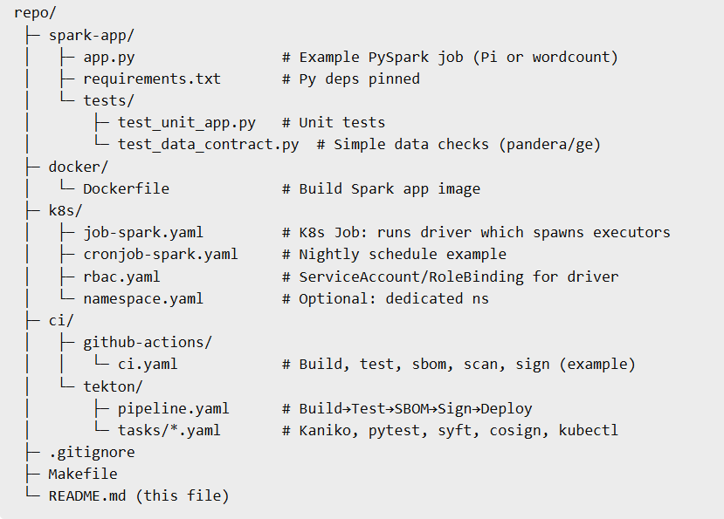
Repository Layout
https://github.com/sage-khan/cdf-workshop-spark-containers/
Notes:
repo/
├─ spark-app/
│ ├─ app.py # Example PySpark job (Pi or wordcount)
│ ├─ requirements.txt # Py deps pinned
│ └─ tests/
│ ├─ test_unit_app.py # Unit tests
│ └─ test_data_contract.py # Simple data checks (pandera/ge)
├─ docker/
│ └─ Dockerfile # Build Spark app image
├─ k8s/
│ ├─ job-spark.yaml # K8s Job: runs driver which spawns executors
│ ├─ cronjob-spark.yaml # Nightly schedule example
│ ├─ rbac.yaml # ServiceAccount/RoleBinding for driver
│ └─ namespace.yaml # Optional: dedicated ns
├─ ci/
│ ├─ github-actions/
│ │ └─ ci.yaml # Build, test, sbom, scan, sign (example)
│ └─ tekton/
│ ├─ pipeline.yaml # Build→Test→SBOM→Sign→Deploy
│ └─ tasks/*.yaml # Kaniko, pytest, syft, cosign, kubectl
├─ .gitignore
├─ Makefile
└─ README.md (this file)
Prerequisites
Docker, kubectl, kind (or Minikube), Make
Python 3.11, Java 11+
Optional: syft (SBOM), cosign (signing), trivy (scan)

Slide 30
Key Takeaways
CD blueprint: commit → artifact → checks → promotion → safe rollouts (Job/Cron/SparkApplication).
Quality gates for code and data: unit/integration + schema/freshness; dep scan; SBOM; signatures.
CDEvents everywhere: event‑driven orchestration & traceability across CI, registry, runtime.
Platform guardrails: namespaces/quotas, secrets, cost controls, multi‑tenancy, SLOs.
From laptop to prod: kind/Minikube → managed K8s with Tekton/Jenkins/GitOps.
Notes:
Takeaways: a CD blueprint you can reuse; quality gates for code and data; CDEvents for orchestration and traceability; platform guardrails for safety and cost; and a path from laptop (kind/Minikube) to managed K8s with Tekton/Jenkins and GitOps.

Slide 31
Q & A
Share your org’s top blocker; we’ll map it to the blueprint.
Share your problems and we will help solve it it
Questions, Concerns?

Slide 32
Thanks, Gracias, Спасибо, Shukrya
Contact:
sagekhanofficial@gmail.com
www.linkedin.com/in/sagekhan

