Slide 1
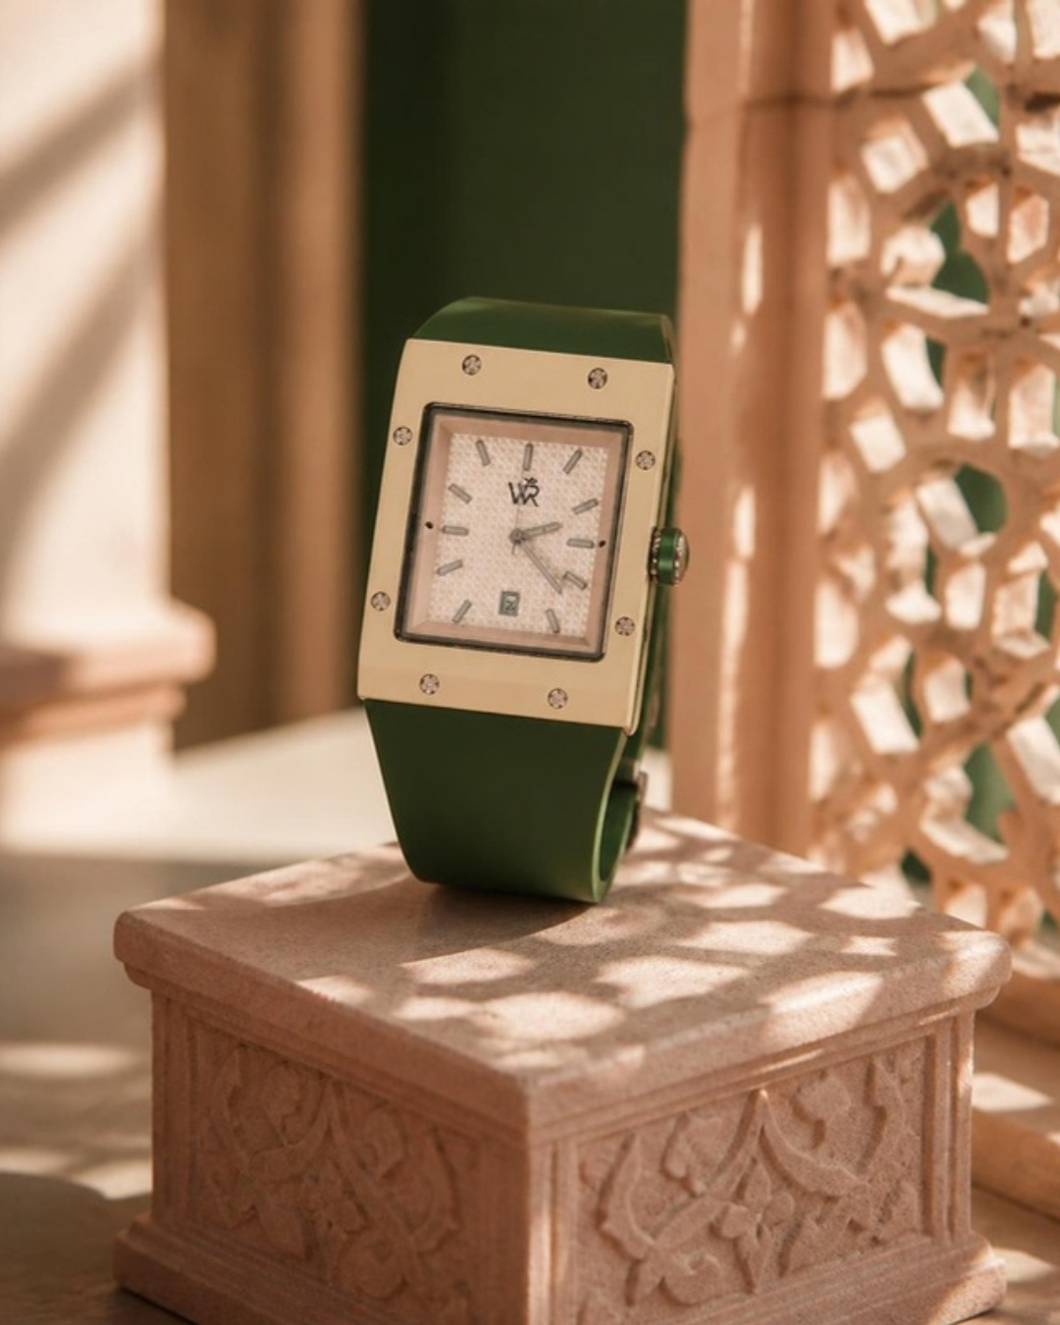
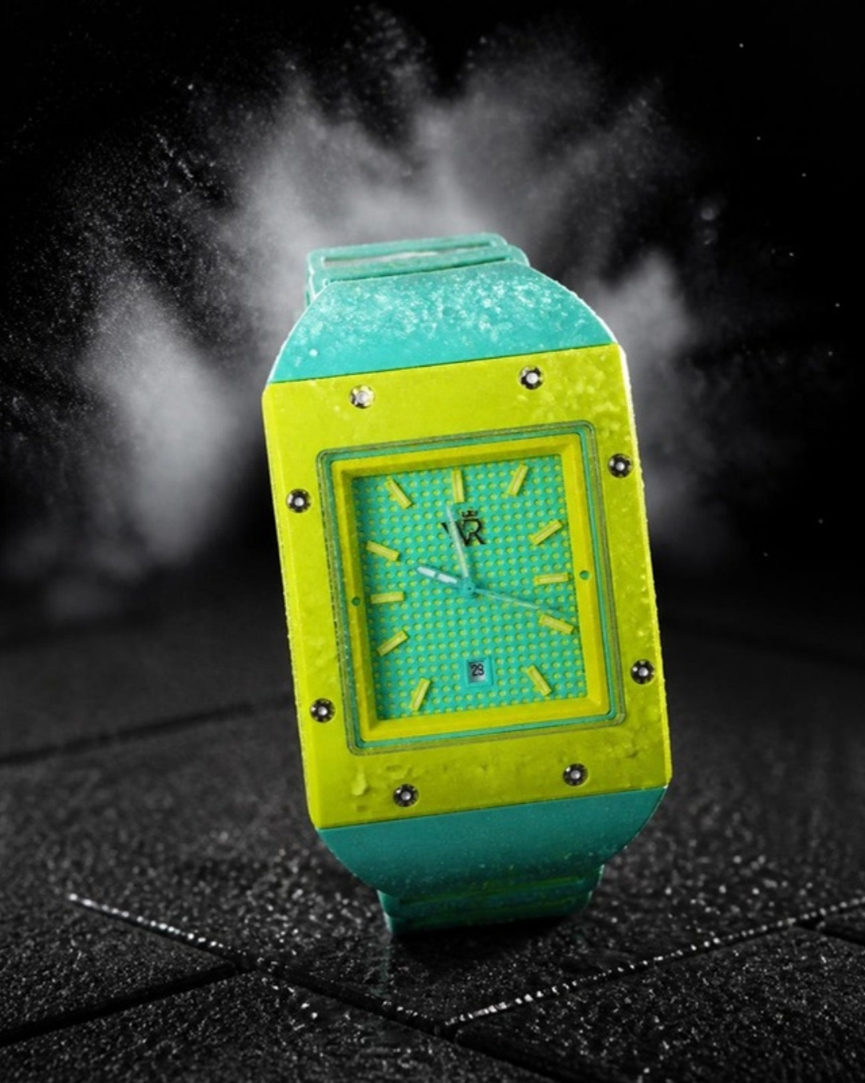
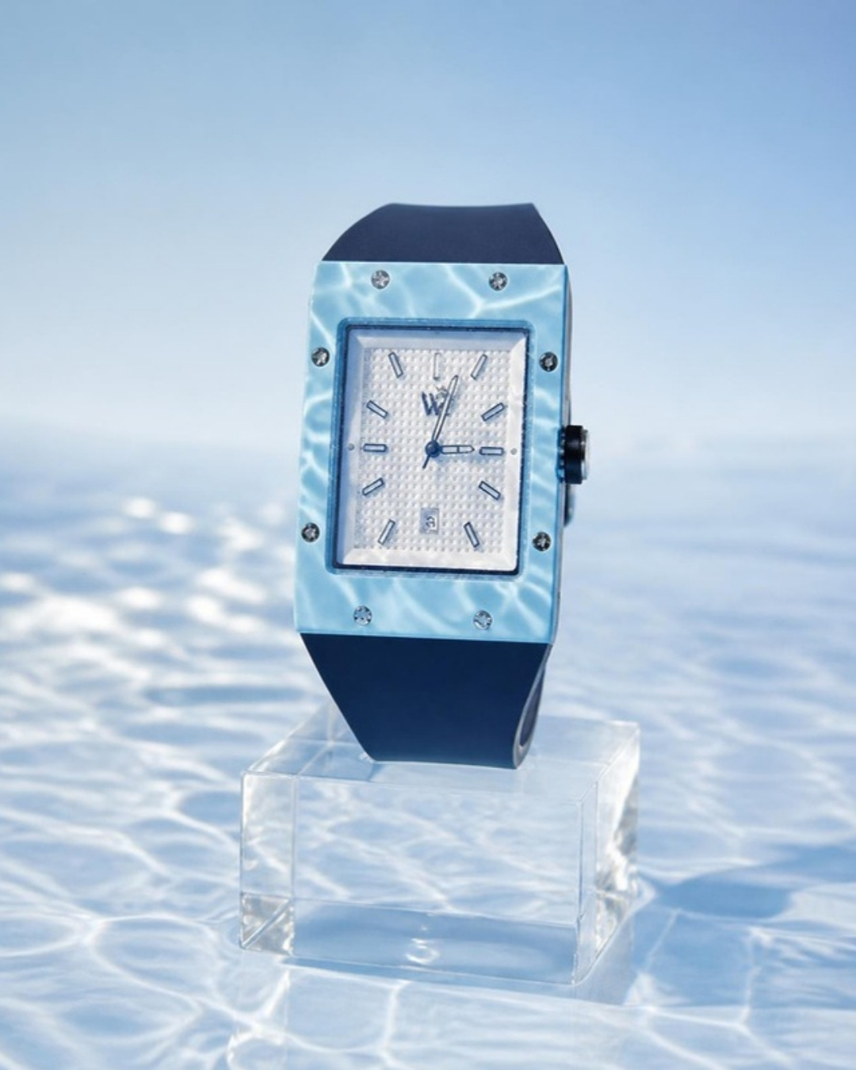
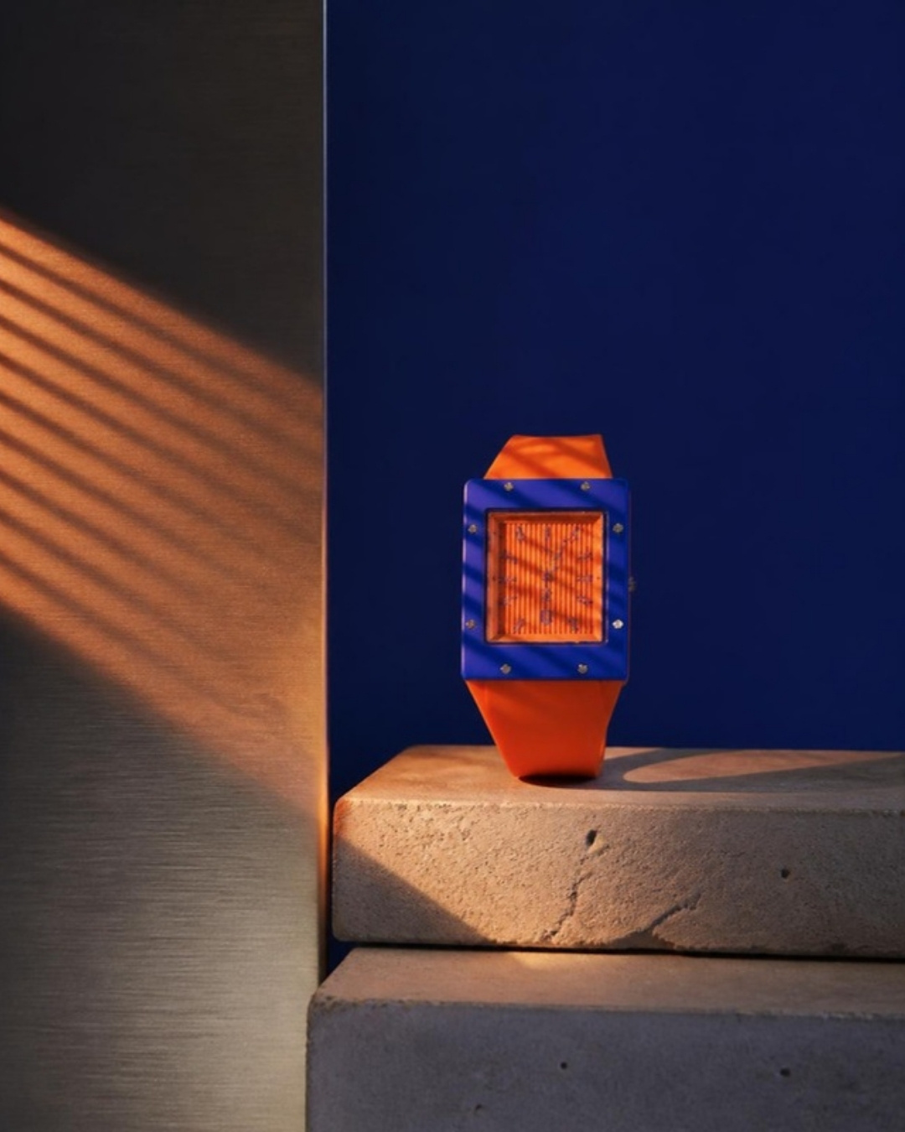
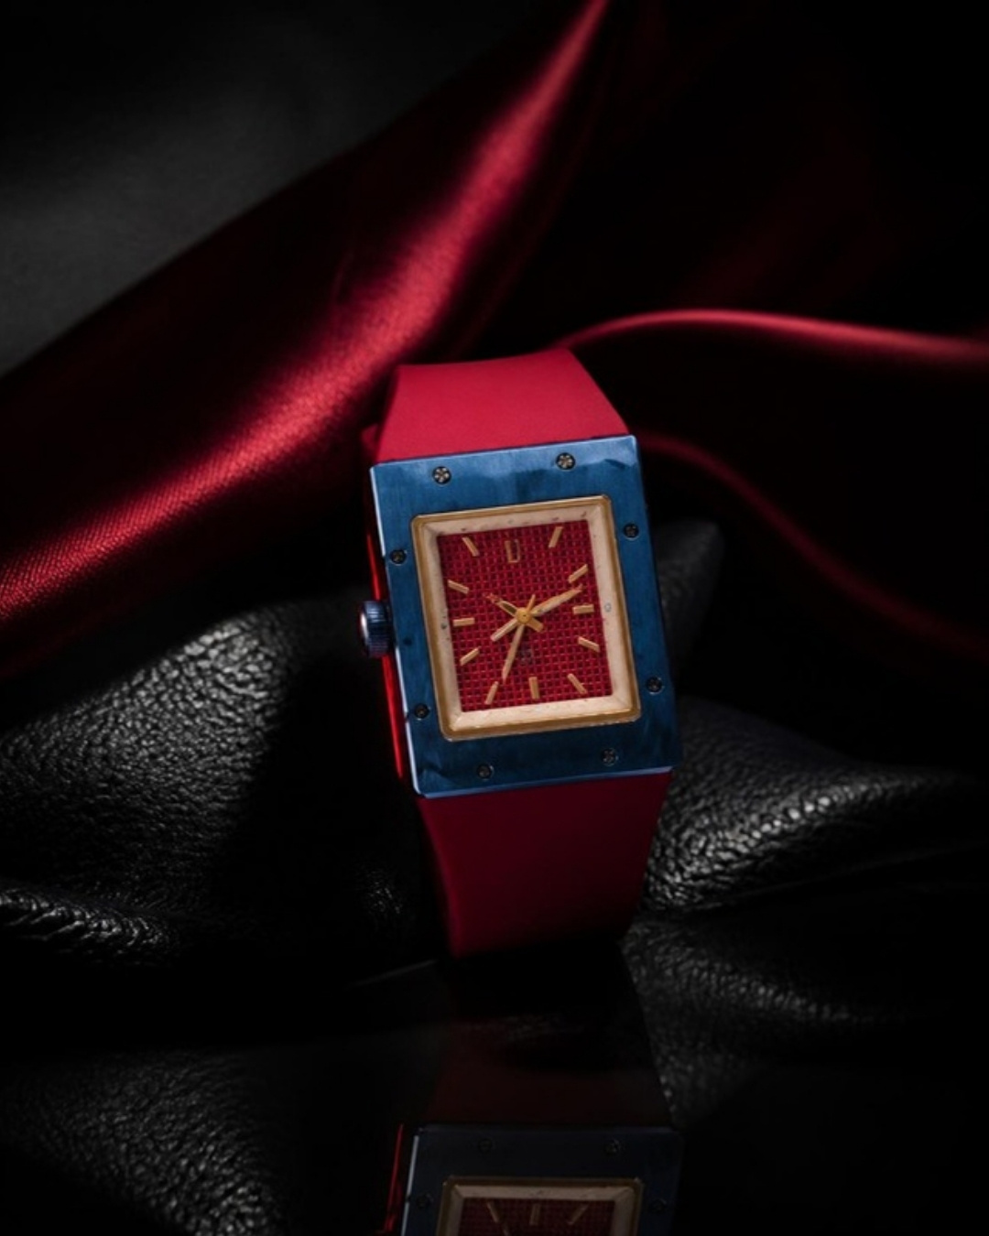
WEALTH ROOTS · DAY 2
THE WATCH.
AND THE
WOMAN
BEHIND IT.
Morning: a half-day product shoot, five watches, six sets.
Afternoon: Neetu's founder film and five "in her words" reels.
Product mood board · founder scripts · schedule · kit
Prepared by Sage Media
WEALTH ROOTS · DAY 2
01

Slide 2
DAY 2 · ONE DAY, TWO HALVES
PRODUCT BY LUNCH. FOUNDER BY SUNSET.
TIME | SET | WHAT WE CAPTURE | FOR
07:30 | Call | Crew call · five sets pre-lit the night before · watches checked out, cleaned, film peeled | —
08:00–09:00 | 1 · Colour heroes | Each watch upright on an acrylic stand on its own colour seamless · front / 3/4 / crown side | Launch, ads, website
09:00–10:45 | 2 · Material worlds | One world per watch (next five pages) · 3 hero frames each | Hero posts, ads
10:45–11:30 | 3 · Macro | Focus-stacked details: 8 screws · WR monogram · waffle dial · crown · caseback crest · strap · clasp | Detail carousels
11:30–12:00 | 4 · Glow | UV-charged lume in total black · one frame per watch + 10 s glow-up video | Glow posts, reels
12:00–12:45 | 5 · Motion | 360° turntable loop · Cerulean water splash · light sweep across dials · strap flex | Reels, website
12:45–13:15 | 6 · Packaging | Box, magnetic lid opening (record the sound), 001/500 card, unboxing hands | Unboxing reel
13:15–14:15 | Lunch | Founder set dressed (studio/office) · Neetu hair & make-up | —
14:15–15:30 | Founder · film | Brand film to camera, two cameras (A 50 mm, B 85 mm side) | Founder film
15:30–16:45 | Founder · reels | Five segments, the watch in her hands, one per watch | 5 reels
16:45–17:30 | Founder · B-roll | Sketching, loupe on a dial, strap check, team at the table, numbering cards | All founder edits
WEALTH ROOTS · DAY 2 · SCHEDULE
02

Slide 3
PRODUCT LOOK · RULES FOR EVERY FRAME
QUIET LUXURY. LOUD COLOUR.
THE WATCH STANDS
ONE COLOUR WORLD EACH
REAL MATERIALS
Always upright on a stand, plinth or acrylic block, never lying flat. Same rule as the campaign.
Each watch only sits in its own palette and materials. No mixing on one set.
Stone, rubber, water, steel, leather, silk, all physical and in camera. No CGI backdrops.
HARD KEY, DEEP SHADOW
DETAIL IS THE HERO
TIME ON EVERY DIAL
One hard light shapes the case; shadows stay rich. The dial is always readable.
Every set ends on a macro: the screws, the waffle, the monogram. That's where six years show.
Set all five to 10:08:37 for stills (classic), and 12:00 for the founder film.
PALETTES
FOREST IVORY
CITRUS MINT
CERULEAN
ROYAL TANGERINE
CRIMSON NAVY
#E8DFC8 · #2F5D46
#D7F25A · #8FE3C3
#8EC9EE · #1E3A6B
#F28C28 · #2547A8
#D2283A · #1C2A55
WEALTH ROOTS · DAY 2 · MOOD BOARD
03

Slide 4
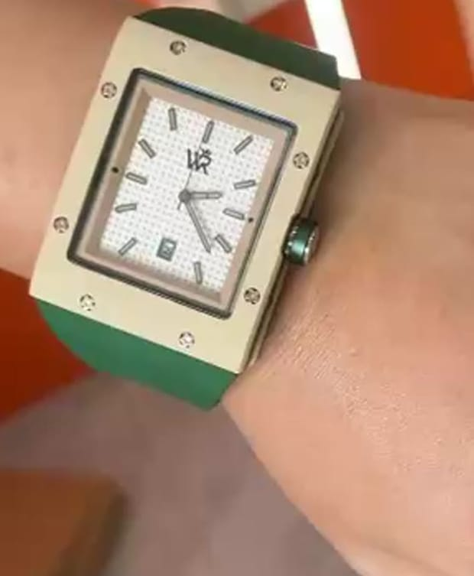
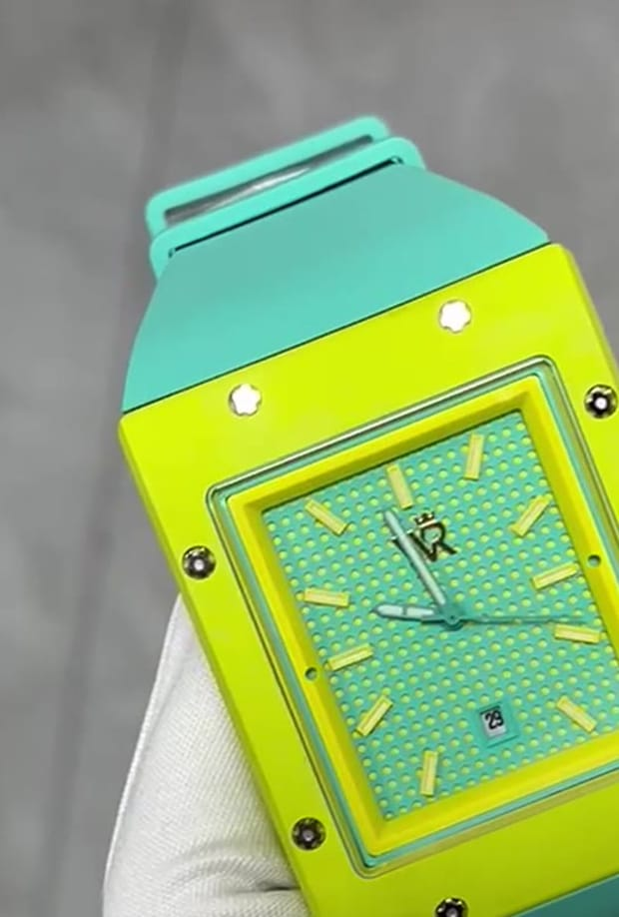
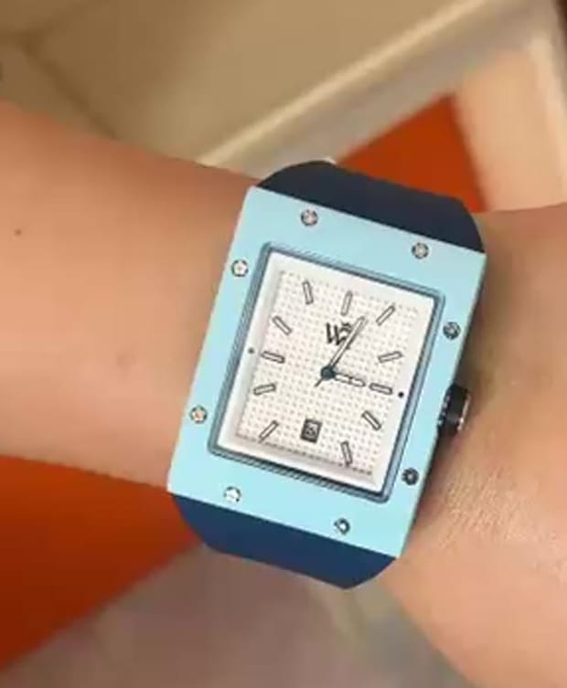
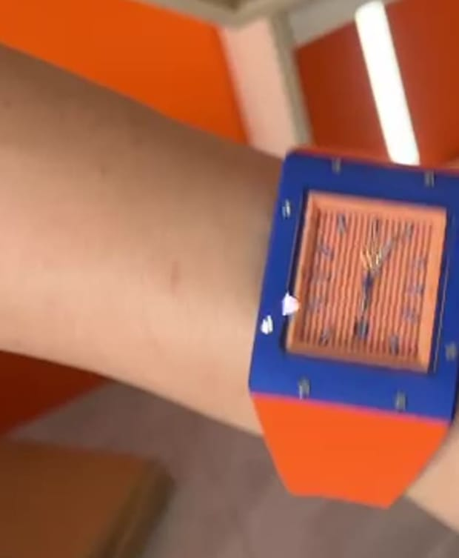
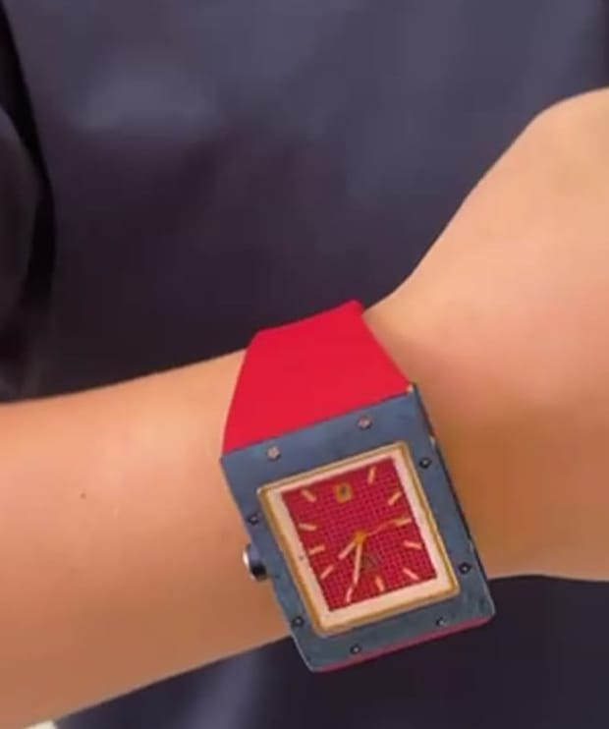
SET 1 · 08:00–09:00 · COLOUR HEROES
FIVE WATCHES. FIVE COLOURS. NOTHING ELSE.
FOREST IVORY
CITRUS MINT
CERULEAN
ROYAL TANGERINE
CRIMSON NAVY
Ivory seamless, bottle-green gel shadow
Lime seamless, mint gel rim
Sky-blue seamless, white cloud gradient
Royal-blue seamless, orange gel slash
Navy seamless, red rim light
Shot list per watch: front · 3/4 left · crown side · caseback · strap & clasp · one hero with a soft gradient. Light: big soft key overhead + strip rim each side; a black flag under the stand for a clean edge. Lens: 100 mm macro, f/11, tethered. (Frames above are your real watch photos, used here for colour and pose only.)
WEALTH ROOTS · DAY 2 · SET 1 · COLOUR HEROES
04

Slide 5
SET 2 · MATERIAL WORLD · 01
FOREST IVORY
Ivory case · white waffle dial · bottle-green strap
WORLD
Carved pink sandstone plinth · Rajasthani jaali screen throwing patterned sunlight
LIGHT
Hard warm sun through the jaali (2 m behind) + soft bounce front. 3200–3800 K.
PROPS
Sandstone block (antique market), jaali panel or laser-cut MDF jaali, a brass bowl out of focus
ENDS ON
Here's to your roots. The frame should feel like the line.
HERO FRAMES
1. Hero 3/4 upright on the plinth, jaali shadow across dial
2. Front, shadow pattern crossing the strap
AI MOOD FRAME · FOR LIGHT, MATERIAL AND COMPOSITION
3. Low angle, plinth edge in the foreground, palace-warm bokeh
WEALTH ROOTS · DAY 2 · SET 2 · FOREST IVORY
05

Slide 6
SET 2 · MATERIAL WORLD · 02
CITRUS MINT
Lime case · mint waffle dial · mint strap
WORLD
Matte black rubber gym flooring · water droplets on the case · a pinch of chalk dust in the air
LIGHT
Hard top-light strip + crisp rim; droplets lit from behind so they sparkle. 5600 K.
PROPS
Rubber gym tile, spray bottle (glycerine + water), climbing chalk, a dumbbell handle edge out of focus
ENDS ON
Here's to your sweat. The frame should feel like the line.
HERO FRAMES
1. Hero upright on the rubber tile, droplets on the crystal
2. Chalk puff behind, 1/2000 s freeze
AI MOOD FRAME · FOR LIGHT, MATERIAL AND COMPOSITION
3. Macro: droplet sliding down the mint strap
WEALTH ROOTS · DAY 2 · SET 2 · CITRUS MINT
06

Slide 7
SET 2 · MATERIAL WORLD · 03
CERULEAN
Sky-blue case · white waffle dial · navy strap
WORLD
Clear acrylic stand standing in shallow water · rippling caustic light · a white sky behind
LIGHT
Hard light through a water tray above = moving caustics; soft white backlight for the sky. 6000 K.
PROPS
Glass tray with 2 cm water, clear acrylic block, small pump or hand ripple, white sweep
ENDS ON
Here's to your freedom. The frame should feel like the line.
HERO FRAMES
1. Hero upright in the water, caustics across the dial
2. Splash crown frozen at 1/4000 s (watch rated?)
AI MOOD FRAME · FOR LIGHT, MATERIAL AND COMPOSITION
3. Top-down: watch above ripples, sky reflected
WEALTH ROOTS · DAY 2 · SET 2 · CERULEAN
07

Slide 8
SET 2 · MATERIAL WORLD · 04
ROYAL TANGERINE
Royal-blue case · orange striped dial · orange strap
WORLD
Brushed steel and concrete steps · a hard orange light slash · architectural lines
LIGHT
One hard orange-gelled slash (snoot/blind) across a royal-blue scene; cool steel fill. Mixed 3200 K / 5600 K.
PROPS
Brushed-steel sheet, 2 concrete blocks as steps, venetian-blind gobo, orange CTO gel
ENDS ON
Here's to your journey. The frame should feel like the line.
HERO FRAMES
1. Hero upright on the top step, orange slash across the dial
2. Low angle "climbing" composition up the steps
AI MOOD FRAME · FOR LIGHT, MATERIAL AND COMPOSITION
3. Macro: stripes of the dial echoing the blind shadows
WEALTH ROOTS · DAY 2 · SET 2 · ROYAL TANGERINE
08

Slide 9
SET 2 · MATERIAL WORLD · 05
CRIMSON NAVY
Navy case · red textured dial · red strap · rose-gold hands
WORLD
Black leather + a fold of red silk · night · a single hard spot
LIGHT
Single hard spot (fresnel) from high side, deep shadow, red edge light. Low key.
PROPS
Black leather swatch (car-seat grain), red silk, black acrylic for reflections, smoke (optional)
ENDS ON
Here's to your power. The frame should feel like the line.
HERO FRAMES
1. Hero upright on black leather, red silk falling behind
2. Reflection on black acrylic, spot only
AI MOOD FRAME · FOR LIGHT, MATERIAL AND COMPOSITION
3. Glow transition: lights off, case lume takes over
WEALTH ROOTS · DAY 2 · SET 2 · CRIMSON NAVY
09

Slide 10
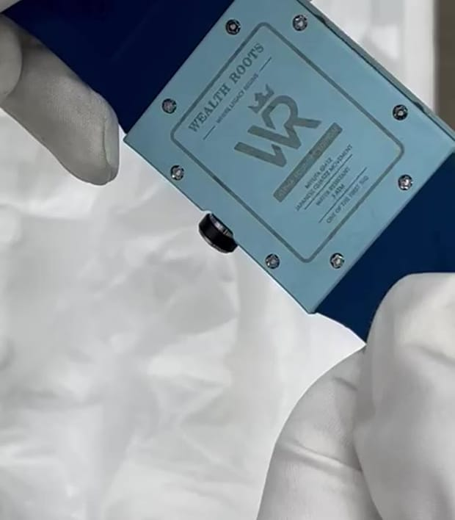
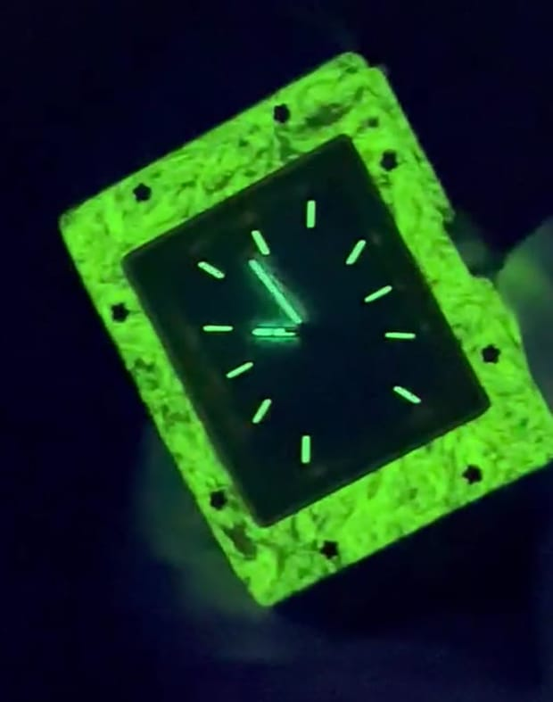
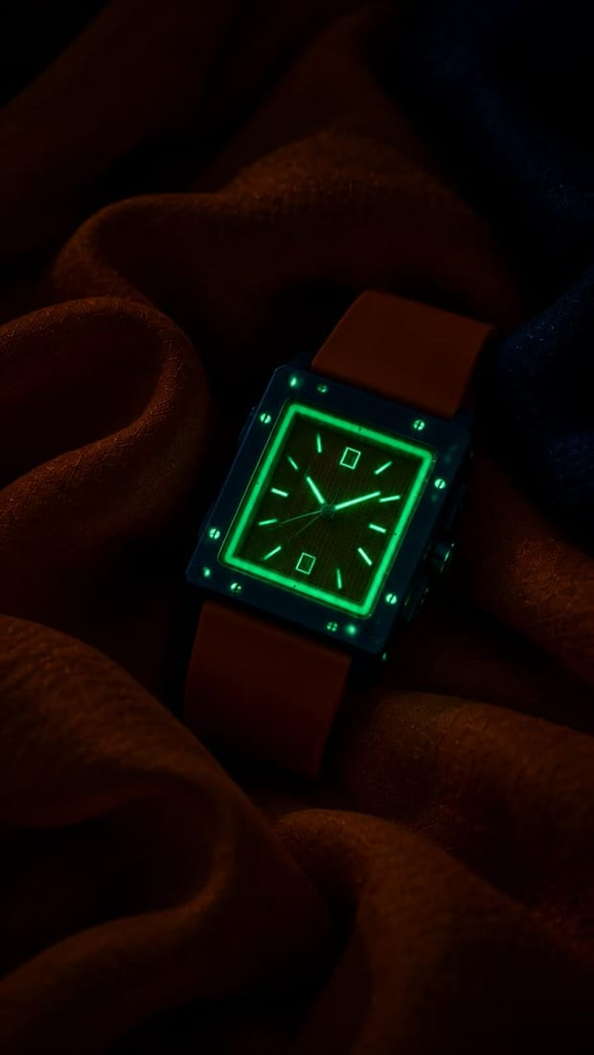
SET 3 · 10:45–11:30 · MACRO
SET 4 · 11:30–12:00 · GLOW
WHERE SIX YEARS SHOW.
LIGHTS OFF. IT TAKES OVER.
1. Eight screws, one by one, same light
2. WR monogram on the dial
3. Waffle texture raking light at 10°
4. Crown with its knurling
5. Caseback crest + 001/500 engraving
6. Strap grain and stitching, clasp closing
Charge each watch 60 s with a UV torch, kill every light, shoot at 2–4 s exposures on a tripod. Then one video: lights on → lights off, the case glows up. One frame per watch + the glow-up reel.
Check which of the five glow full-case (we know one does) and match the plan to that.
WEALTH ROOTS · DAY 2 · SETS 3 & 4 · MACRO AND GLOW
10

Slide 11
SET 5 · MOTION · SET 6 · PACKAGING
MAKE IT MOVE. MAKE IT ARRIVE.
SHOT | HOW | USE
360° turntable | Watch upright on a motorised turntable, 10 s loop, each colour seamless | Website, reel openers
Light sweep | A strip light passes across the dial on a slider; the waffle lights up line by line | Reel transitions
Cerulean splash | Water splash crown frozen at 1/4000 s; only if the rating is confirmed | Cerulean hero
Strap flex | Hands bend the strap slowly, macro on the grain | Quality story
Unboxing | Magnetic lid opening (record the "thock"), watch lifted, the 001/500 card turned | Unboxing reel, launch
KIT FOR THE HALF DAY
· Camera + 100 mm macro + 50 mm, tethered laptop
· 2 strobes, 1 fresnel spot, 2 strip softboxes, snoot, gels (CTO, green, blue, red)
· Focus-stacking rail
· Motorised turntable
· Acrylic stands ×5, sandstone, rubber tile, steel sheet, leather, silk, water tray
· Seamless paper: ivory, lime, sky, royal blue, navy
· UV torch, glycerine spray, chalk, blower, gloves, lint-free cloths
· Hand model (glow + unboxing)
WEALTH ROOTS · DAY 2 · SETS 5 & 6 · MOTION, PACKAGING, KIT
11

Slide 12
FOUNDER FILM · NEETU TO CAMERA · ~80 S
SIX YEARS FOR FIVE WATCHES.
TIME | NEETU SAYS (TO CAMERA) | WE SEE (B-ROLL)
0:00 | "People ask me why a watch takes so long to make. Ours took six years." | Her face, then the caseback crest in macro
0:08 | "It started in 2020. The world had stopped, and suddenly all of us were looking at time differently. That's when I started drawing this." | Old sketchbook pages, the first rectangle case drawn in pencil
0:20 | "Since then, my team and I have argued over things most people will never notice. The depth of a screw. The weight of the crown. How a strap feels at eleven at night, after a sixteen-hour day." | The team at a table, loupe on a dial, a screw turned under a lamp
0:36 | "Our straps are made to the same standard as the world's most expensive watch houses." [If confirmed and cleared: "the same standard as Jacob & Co."] | Strap flex macro, stitching, clasp closing
0:46 | "Every case, every dial, every number on the back is checked by hand. If it wasn't right, we started again. We once rejected an entire packaging run because the lid closed too fast." | Hands checking each watch, a box lid closing slowly, the 001/500 card
1:02 | "Because the people who wear this built everything they have themselves. They deserve something made with the same obsession." | The five watches upright in a row on their colours
1:14 | "Six years. Five watches. Five hundred pieces. This is Wealth Roots." (beat) "Wear what's yours." | Her smile; end card: WEALTH ROOTS · WHERE LEGACY BEGINS
WEALTH ROOTS · DAY 2 · FOUNDER FILM
12

Slide 13
FOUNDER REEL 01 · "IN HER WORDS" · ~30 S · 9:16
FOREST IVORY
The first one had to be about where we come from.
# | NEETU SAYS | WE SEE
1 | "The first one had to be about where we come from." | Neetu holds Forest Ivory up to the light
2 | "Ivory, like the stone of Jaipur's palaces. And a deep bottle green, the colour of things that last." | Macro: ivory case edge, then the green strap
3 | "I wanted a dial you only notice when the light moves, so we gave it this waffle texture." | Light sweep across the waffle dial
4 | "And eight screws, all visible. I didn't want to hide how it's built." | Focus pull across the screws
5 | "This one is for the person who has gone very far and never forgot where they started. Here's to your roots." | Her to camera; the watch on its sandstone plinth
On screen at the end: the watch on its colour · "FOREST IVORY" · WEAR WHAT'S YOURS.
WEALTH ROOTS · DAY 2 · FOUNDER REEL · FOREST IVORY
13

Slide 14
FOUNDER REEL 02 · "IN HER WORDS" · ~30 S · 9:16
CITRUS MINT
I designed this one for the five a.m. people.
# | NEETU SAYS | WE SEE
1 | "I designed this one for the five a.m. people." | Neetu turns the watch in her hands, morning light
2 | "Lime and mint, colours that look like energy, even before your coffee." | Lime case macro, mint dial
3 | "The strap had to survive sweat, rain and a hundred bad days. We tested it more than any other." | Strap flex, water droplets on the case
4 | "Light enough to forget, until you look down and remember why you're doing this." | Watch upright on the rubber tile, chalk in the air
5 | "For everyone who shows up when nobody's watching. Here's to your sweat." | Her to camera
On screen at the end: the watch on its colour · "CITRUS MINT" · WEAR WHAT'S YOURS.
WEALTH ROOTS · DAY 2 · FOUNDER REEL · CITRUS MINT
14

Slide 15
FOUNDER REEL 03 · "IN HER WORDS" · ~30 S · 9:16
CERULEAN
I drew this one on a day I badly needed a holiday.
# | NEETU SAYS | WE SEE
1 | "I drew this one on a day I badly needed a holiday." | Neetu smiles, the watch in her palm
2 | "Sky on the case. Clouds on the dial. Deep water on the strap." | Three macros: case, dial, strap
3 | "Every watch you own tells you where you're supposed to be. I wanted one that reminds you where you could be." | Caustic light rippling over the dial
4 | "Made to go wherever you go, even into the water." [only if the rating is confirmed] | The splash crown frozen mid-air
5 | "For the ones who've earned the right to disappear for a while. Here's to your freedom." | Her to camera
On screen at the end: the watch on its colour · "CERULEAN" · WEAR WHAT'S YOURS.
WEALTH ROOTS · DAY 2 · FOUNDER REEL · CERULEAN
15

Slide 16
FOUNDER REEL 04 · "IN HER WORDS" · ~30 S · 9:16
ROYAL TANGERINE
Orange is the hunger. Royal blue is the arrival.
# | NEETU SAYS | WE SEE
1 | "Orange is the hunger. Royal blue is the arrival." | Neetu holds it against a royal-blue background
2 | "Nobody hands you either. You build the climb yourself." | The orange light slash crossing the case
3 | "The stripes on the dial are the steps. Every line is a day you didn't quit." | Macro along the striped dial
4 | "It's the boldest one we made, because the people who wear it never asked for permission." | Watch on the top concrete step
5 | "For the self-made. Here's to your journey." | Her to camera
On screen at the end: the watch on its colour · "ROYAL TANGERINE" · WEAR WHAT'S YOURS.
WEALTH ROOTS · DAY 2 · FOUNDER REEL · ROYAL TANGERINE
16

Slide 17
FOUNDER REEL 05 · "IN HER WORDS" · ~30 S · 9:16
CRIMSON NAVY
Red isn't a colour you wear by accident.
# | NEETU SAYS | WE SEE
1 | "Red isn't a colour you wear by accident. It's a decision." | Neetu, low-key light, the red dial in her fingers
2 | "Navy case, red textured dial, rose-gold hands. Nothing loud, and still it's the first thing anyone sees." | Macro: rose-gold hands over the red texture
3 | "And when the lights go out, the whole case glows. Power doesn't need daylight." | Lights off: the case glows up
4 | "I made this one for the man the room adjusts to." | Watch upright on black leather, red silk behind
5 | "Here's to your power." | Her to camera, half in shadow
On screen at the end: the watch on its colour · "CRIMSON NAVY" · WEAR WHAT'S YOURS.
WEALTH ROOTS · DAY 2 · FOUNDER REEL · CRIMSON NAVY
17

Slide 18
FOUNDER SHOOT · HOW WE GET IT NATURAL
INTERVIEW FIRST. LINES SECOND.
· Ask questions, don't make her recite. The lines above are the target; she can say them in her own words, English or Hinglish.
· Two cameras: A at 50 mm straight on, B at 85 mm side. Eyeline just off lens for the film, into lens for the reels.
· For each watch, hand her the watch and ask: "What were you thinking the day you drew this one?" Roll until she smiles.
· Record 30 s of room tone and every product sound: the lid, the clasp, the crown clicking.
TO CONFIRM BEFORE THE SHOOT
1. Jacob & Co strap claim. Don't say the name on camera unless the supplier link is confirmed in writing and cleared. The safe line is in the script.
2. Timeline. Started in 2020 = six years in 2026. If work began earlier, give us the year and we'll change "six years".
3. Water resistance rating for Cerulean (splash shot + "into the water" line).
4. Which watches have full-case lume.
5. Founder name on screen: Neetu ___ (surname, title).
6. "500 pieces": confirm it applies to all five watches.
WEALTH ROOTS · DAY 2 · FOUNDER · NOTES
18

