Slide 1
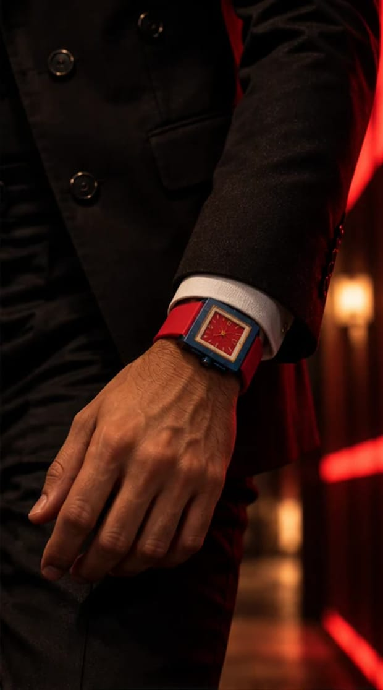
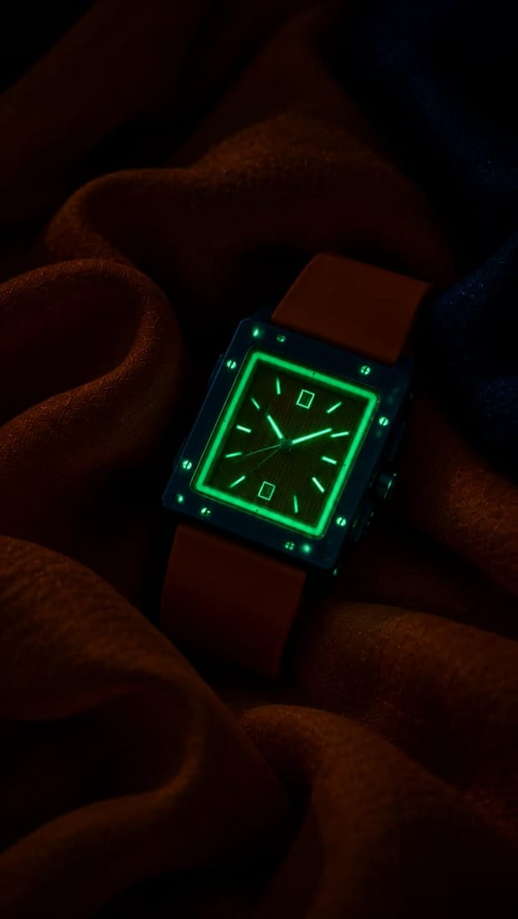
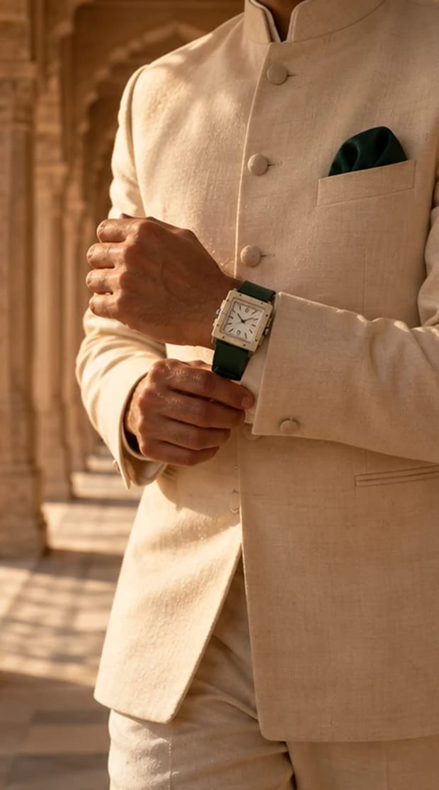
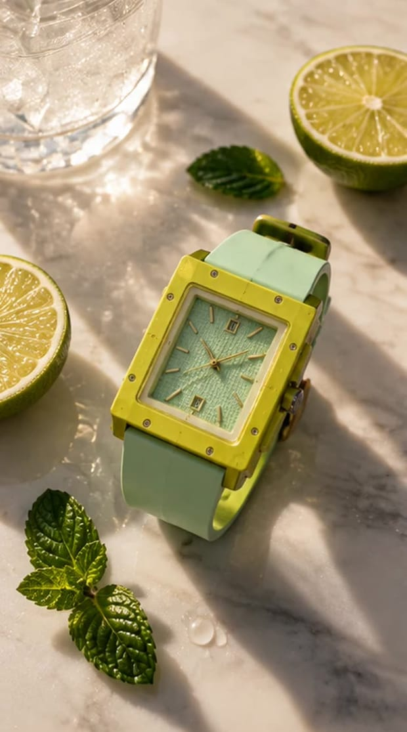
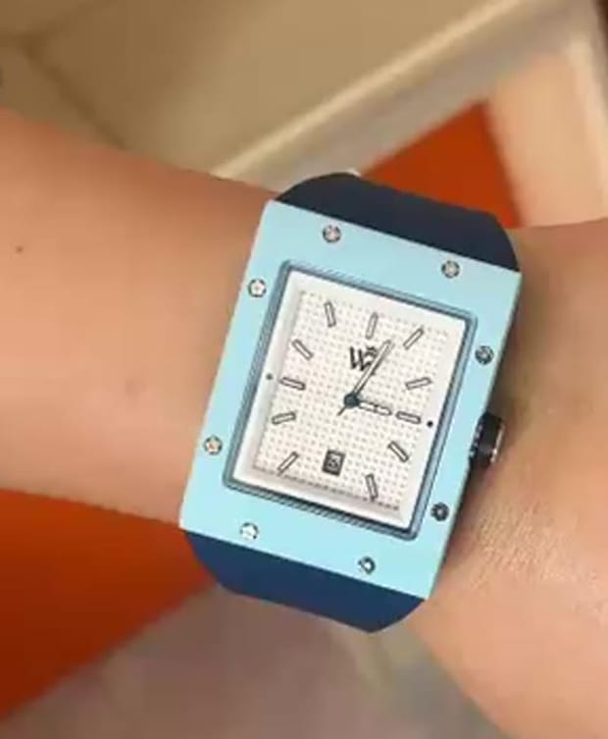
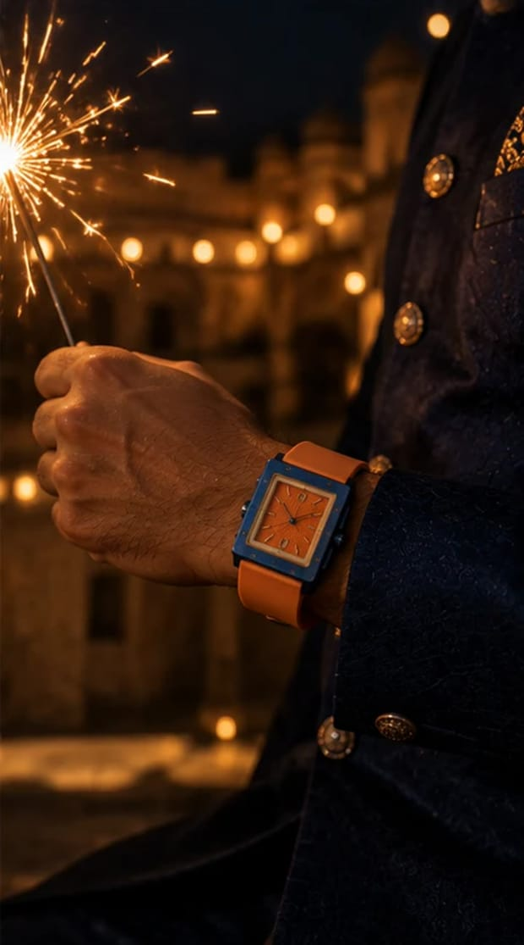
WEALTH ROOTS · JAIPUR SHOOT PLAN
BOLD.
ALPHA.
TIME.
One man, one Jaipur day, five watches. Mukesh ji carries every reel on Day 1; Day 2 is the product shoot and Neetu's founder film.
Shoot week of 26 Oct 2026 · Dhanteras 6 Nov · Diwali 8 Nov
Prepared by Sage Media
WEALTH ROOTS × MUKESH GUPTA · JAIPUR SHOOT PLAN
01

Slide 2
WHAT WE'RE MAKING
TWO DAYS. ONE FACE. FIVE WATCHES.
15
5 + 1
7
REELS ON DAY 1
GLOW LOOPS + HERO FILM
JAIPUR CITY CLIPS
3 per watch, all Mukesh ji
Shot as inserts, cut free
B-unit, dawn to night
80+
1 + 4
2
PRODUCT STILLS
FOUNDER FILM + REELS
FESTIVE DROPS
+ turntables and unboxing
Neetu, in Hinglish
Dhanteras · Diwali
WEALTH ROOTS × MUKESH GUPTA · JAIPUR SHOOT PLAN · OVERVIEW
02

Slide 3
THE IDEA
ONE MAN. ONE DAY. FIVE WATCHES.
Day 1 follows Mukesh ji through a single Jaipur day, dawn to after midnight. Each watch owns an hour — its own light, wardrobe, corner of the haveli and colour story. Fifteen reels that work alone, and read as one man's day when you scroll the grid.
DAWN
MORNING
MIDDAY
GOLDEN HOUR → DUSK
NIGHT
ROOTS
DISCIPLINE
BUILD
UTSAV · DIWALI
AFTER DARK
Forest Ivory
Citrus Mint
Cerulean
Royal Tangerine
Crimson Navy
A1 Pehli Ghadi
A2 Jaali
A3 Kitne Ki Hai?
B1 4:59
B2 Cold. Sharp. On Time.
B3 300 Saal
C1 Neev
C2 6 Feet. 6 Inches.
C3 60 Seconds
D1 Ek Diya
D2 Dhanteras
D3 Jaipur Se
E1 Unfinished
E2 Red / Blue
E3 Shor Nahi. Signal.
Every reel ends on the same promise: WEAR YOUR TIME. COMMAND YOUR PRESENCE. BUILD YOUR LEGACY.
WEALTH ROOTS × MUKESH GUPTA · JAIPUR SHOOT PLAN · THE IDEA
03

Slide 4
BOLD. ALPHA. TIME. — THE RULES ON SET
POWER IS FELT, NOT ANNOUNCED.
01
RESTRAINT OVER NOISE
02
THE CASE IS ALWAYS SHARP
Neetu: "The loudest man in the room is usually the most insecure." No shouting, no flexing, no money-gun energy. Stillness reads as power.
Every reel has at least one macro where the eight bezel screws and the WR monogram are in focus.
03
ONE COLOUR STORY PER WATCH
04
HINGLISH, LOW AND SLOW
Wardrobe, props and light take their colours from the dial. Nothing in frame fights the watch.
Mukesh ji speaks like he isn't trying to convince anyone. Short lines, pauses, no smile on the last word.
05
SIGNATURE SOUNDS
06
TYPE: ENGLISH, CAPS, FEW WORDS
The deployant clasp click and one dry tick are our audio logo — every reel uses one of them.
Hinglish lives in the voice; the screen carries one English line. Never more than 8 words on screen.
WEALTH ROOTS × MUKESH GUPTA · JAIPUR SHOOT PLAN · TONE
04

Slide 5
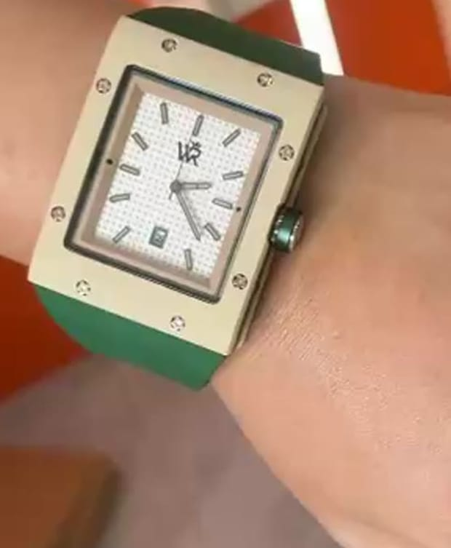
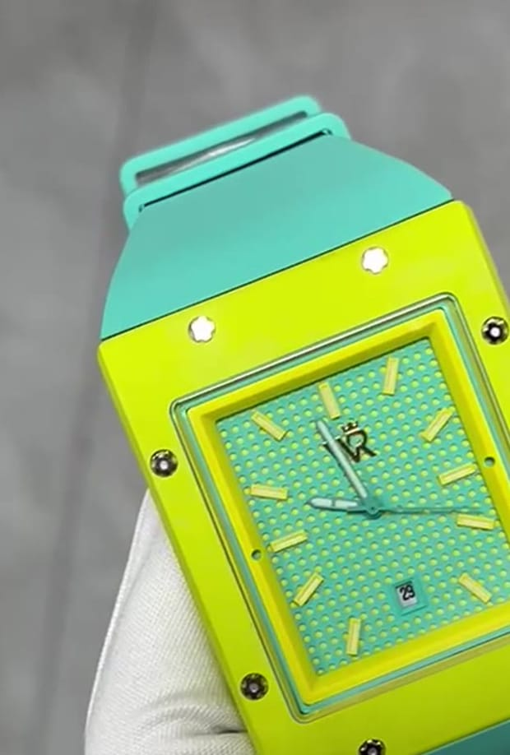
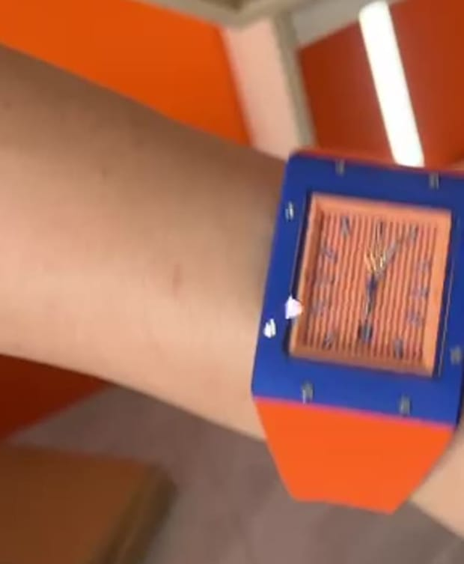
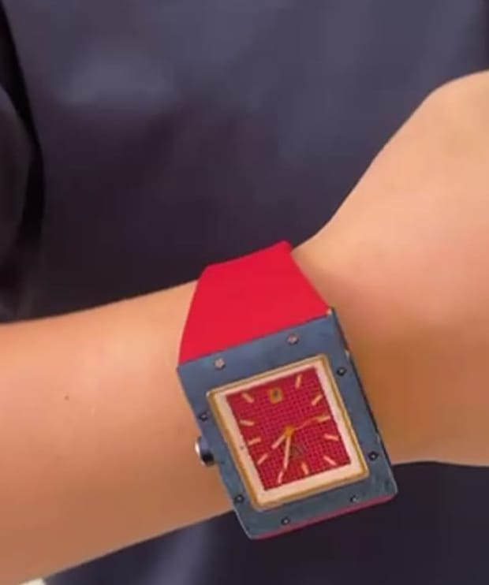
THE FIVE WATCHES
EACH ONE OWNS AN HOUR.
FOREST IVORY
CITRUS MINT
CERULEAN
ROYAL TANGERINE
CRIMSON NAVY
Ivory case · white waffle dial · bottle-green strap
Lime case · mint waffle dial · mint strap
Sky-blue case · white waffle dial · navy strap
Royal-blue case · orange striped dial · orange strap
Navy case · red textured dial · red strap · rose-gold hands
ROOTS · Dawn
DISCIPLINE · Morning
BUILD · Midday
UTSAV · DIWALI · Golden hour → dusk
AFTER DARK · Night
All five carry the full-case night glow — charge the lume with a UV torch for 30 s before every glow shot.
WEALTH ROOTS × MUKESH GUPTA · JAIPUR SHOOT PLAN · THE WATCHES
05

Slide 6
LOCATION · RENT ONE HAVELI THAT HOLDS ALL FIVE WORLDS
ONE ROOF. FIVE HOURS OF LIGHT.
SAMODE HAVELI
Gangapole, old city
THE LOCATION MUST HAVE
Painted rooms, courtyards, rooftop over the old city, pool terrace — every zone under one roof.
East-facing rooftop over the old city (dawn + Diwali night)
A jaali corridor with low morning sun
Open chowk (courtyard) for 200 diyas
Study / library with a big table
Pool or sandstone terrace
One room we can black out (After Dark + glows)
A jharokha with afternoon light
Power for 2 × 600 W + tubes · parking for the car
NARAIN NIWAS PALACE
Kanota Bagh, Narain Singh Rd
1928 palace: long corridors, gardens, darbar halls, a pool. Easier access, more space for kit.
ALSISAR HAVELI
Sansar Chandra Rd
Classic courtyard + jaali work + pool; central location for city clips.
SHAHPURA HOUSE
Devi Marg, Bani Park
Strong rooftop and darbar-style rooms; good for the After Dark set.
Shortlist to scout this week — confirm shoot fee, hours (05:00–23:30), diya/flame and hazer permission, and a room we can black out completely.
WEALTH ROOTS × MUKESH GUPTA · JAIPUR SHOOT PLAN · LOCATION
06

Slide 7
ZONE MAP
WHICH CORNER SHOOTS WHICH REEL.
ZONE | REELS | WHEN | LIGHT
Rooftop (east) | B1 4:59 · C1 Neev · C2 6 ft → 6 in · D1 Ek Diya (end) | 06:15 · 11:00 · 17:45 | Sunrise · hard noon sky · blue hour
Darwaza + jaali corridor | A1 Pehli Ghadi · A2 Jaali | 07:30–09:30 | Low east sun through stone
Chowk (courtyard) | A3 Kitne Ki Hai · D1 diya walk | 08:30 · 17:00 | Soft bounce · 200 diyas at dusk
Pool / sandstone terrace | B3 300 Saal · B2 tabletop | 09:30–11:00 | Hard sun, long shadows
Study / library | A1 empty box · C1 drafting · C3 drawer · E1 desk | 08:00 · 11:30 · 19:30 | Window → practical lamp
Jharokha | D3 Jaipur Se | 15:30–16:30 | Golden hour
Blacked-out room | E2 Red / Blue · all glow inserts | 14:15 · 20:00 | Red + blue tubes · total black
Car + city | E3 Shor Nahi. Signal. | 21:15–22:45 | City bokeh · dashboard off
WEALTH ROOTS × MUKESH GUPTA · JAIPUR SHOOT PLAN · LOCATION
07

Slide 8
JAIPUR CITY CLIPS · B-UNIT (NO MUKESH JI NEEDED)
THE PINK CITY, DAWN TO NIGHT.
WHEN | WHERE | SHOT | PERMIT / NOTE
05:45–07:00 | Nahargarh viewpoint | Dawn over the old city (A1 open) | State archaeology ticket; tripod ok at the viewpoint
07:00–07:30 | Jal Mahal (roadside) | Morning mist, still water (spare) | Public road
08:00–09:00 | Jantar Mantar — Samrat Yantra | Sundial shadow (B3) | Video-camera ticket; ask before using a tripod
09:30–10:30 | Hawa Mahal from the cafés opposite | Facade, pink city (D3 whip) | Shoot from a rooftop café with permission
10:30–11:00 | Patrika Gate, Jawahar Circle | Colour-blocked arches (D3 alt) | Public; early hours avoid crowds
18:30–19:30 | Johari / Bapu Bazaar | Festival lights (D1) | Handheld only; crowds after 7 pm
21:00–22:00 | Albert Hall + MI Road | Night traffic, lit facade (E3) | Public; no drone
No drone: Jaipur sits under airport and heritage no-fly zones. A drone shot needs Digital Sky clearance + local police — not worth it for this shoot.
WEALTH ROOTS × MUKESH GUPTA · JAIPUR SHOOT PLAN · JAIPUR
08

Slide 9
MUKESH JI · FIVE LOOKS, ONE PER WATCH
DRESSED BY THE DIAL.
FOREST IVORY
CITRUS MINT
CERULEAN
ROYAL TANGERINE
CRIMSON NAVY
ROOTS
DISCIPLINE
BUILD
UTSAV · DIWALI
AFTER DARK
Look 1: ivory bandhgala, no pocket square, brown loafers. Look 2: cream kurta + bottle-green shawl.
Look 1: black training tee + black track pants. Look 2: open white linen shirt, white trousers.
Look 1: white shirt, sleeves rolled twice, navy trousers. Look 2: + navy blazer for C3.
Royal-blue bandhgala · orange leheriya safa (D3 only) · tan juttis.
Black suit, open collar · black knit for E2.
Grooming: short beard trimmed the night before · no rings on the watch hand · nails clean and buffed — the wrist is in macro in every reel.
WEALTH ROOTS × MUKESH GUPTA · JAIPUR SHOOT PLAN · MUKESH JI
09

Slide 10
DAY 1 · RUN OF SHOW
FIFTEEN REELS, SUN TO MIDNIGHT.
TIME | SETUP | UNIT
05:00 | Crew call at the haveli · B-unit leaves for Nahargarh | All
05:45 | Mukesh ready (Look: black training) · lume UV torch charged | Main
06:15–07:00 | B1 · 4:59 — rooftop at first light | Main
07:00–07:30 | Change → ivory bandhgala | —
07:30–09:30 | A1 Pehli Ghadi · A3 Kitne Ki Hai · A2 hand insert | Main
06:30–09:30 | A2 Jaali time-lapse + macros · city dawn clips | B-unit
09:30–11:00 | B3 pool deck · B2 hand inserts (white linen) | Main
09:30–11:00 | B2 tabletop · Jantar Mantar (B3) | B-unit
11:00–13:30 | C1 Neev · C2 6 ft → 6 in · C3 60 Seconds | Main
13:30–14:15 | Lunch · change → royal-blue bandhgala | —
14:15–15:30 | Glow inserts for A, B, C in blacked-out room · D2 hand inserts | Main
14:15–15:30 | D2 Dhanteras thali · diya set dressing (200) | B-unit / art
15:30–17:45 | D3 Jaipur Se (jharokha, golden hour) · D1 walk through diya chowk | Main
17:45–18:30 | D1 rooftop: lights off → one diya → glow | Main
18:30–19:15 | Dinner · change → black suit · gels + hazer set | —
18:30–19:30 | Bazaar lights (D1) · Albert Hall (E3) | B-unit
19:15–21:15 | E1 Unfinished · E2 Red / Blue · glow inserts D, E | Main
21:15–22:45 | E3 night drive (car + driver) | Main
23:00 | Wrap · card backup ×2 · watches checked back in | All
WEALTH ROOTS × MUKESH GUPTA · JAIPUR SHOOT PLAN · DAY 1
10

Slide 11
WORLD 01
DAWN · 07:00–09:30
ROOTS
Where it all starts. A haveli at first light — jaali shadows, old frames, an empty watch box. The man who will become the family's first heirloom-maker.
FOREST IVORY
WHERE
Darwaza + jaali corridor · chowk (courtyard) · old study
WARDROBE
Look 1: ivory bandhgala, no pocket square, brown loafers. Look 2: cream kurta + bottle-green shawl.
MUSIC
Tanpura drone, one sarangi phrase. No beat drop.
A1
A2
A3
PEHLI GHADI
JAALI
KITNE KI HAI?
Story reel · 30 s
Detail · ASMR · 15 s
Dialogue punch · 10–12 s
The first heirloom
It waits for you to step closer
Price vs position
Ivory
Sandstone
Bottle green
Brass
WEALTH ROOTS × MUKESH GUPTA · JAIPUR SHOOT PLAN · ROOTS
11

Slide 12
A1 · STORY REEL · 30 S · 9:16
PEHLI GHADI
The first heirloom
CONCEPT
Every Indian family has one watch everyone calls "Dadaji ki ghadi". Somebody had to buy the first one. Mukesh is that man — the first-generation builder whose watch becomes the heirloom. Roots are not inherited; they are planted.
HOOK · FIRST 2 SECONDS
Extreme close-up of a sepia family photo in a brass frame. His hand enters and sets the Forest Ivory in front of it. VO starts on frame one.
SCRIPT · HINGLISH
ON SCREEN
"Har ghar mein ek ghadi hoti hai… jise sab 'Dadaji ki ghadi' kehte hain."
"Par kabhi socha hai — pehli kisne khareedi thi?"
"Virasat milti nahi. Banaayi jaati hai."
"Is ghar ki pehli ghadi… main pehen raha hoon."
EVERY HEIRLOOM WAS NEW ONCE. → end card: WEALTH ROOTS · Build your legacy.
SOUND
Tanpura bed · pigeons · darwaza creak · clasp click lifted in the mix.
AI mood frame · watch exact, face is a stand-in
WEALTH ROOTS × MUKESH GUPTA · JAIPUR SHOOT PLAN · ROOTS · A1
12

Slide 13
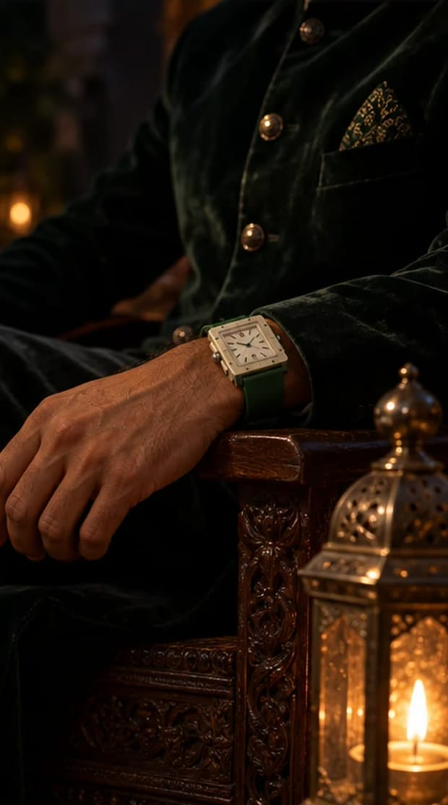
A1 · SHOT LIST
PEHLI GHADI
TIME | SHOT | CAMERA · LENS · MOVE
0–2s | Sepia photo, his hand places the watch | 100mm macro, top light, locked
2–6s | Jaipur at dawn from Nahargarh, mist over the old city | B-unit city clip · 35mm, slow pan
6–10s | Haveli darwaza swings open; he walks in, back to camera | 24mm gimbal follow, waist height
10–14s | Jaali corridor — sun patterns slide over his wrist as he walks | 85mm side track, 50 fps
14–20s | Old study: he opens the watch box — every slot empty | Top shot, 35mm, slow push
20–25s | He fastens the watch; clasp click | 100mm macro, sound up
25–30s | He looks up into lens. End card. | 50mm, static, eye level
Second mood frame · the real watch
REFERENCES — TAP TO OPEN
Pinterest · haveli jaali light portrait
Pinterest · vintage watch box heirloom
Instagram · @sabyasachiofficial — heritage pacing
Instagram · @rolex — slow craft reveals
PROPS & SET
Sepia family portrait in brass frame · wooden watch box with empty velvet slots · old ledger · brass desk lamp.
WEALTH ROOTS × MUKESH GUPTA · JAIPUR SHOOT PLAN · ROOTS · A1
13

Slide 14
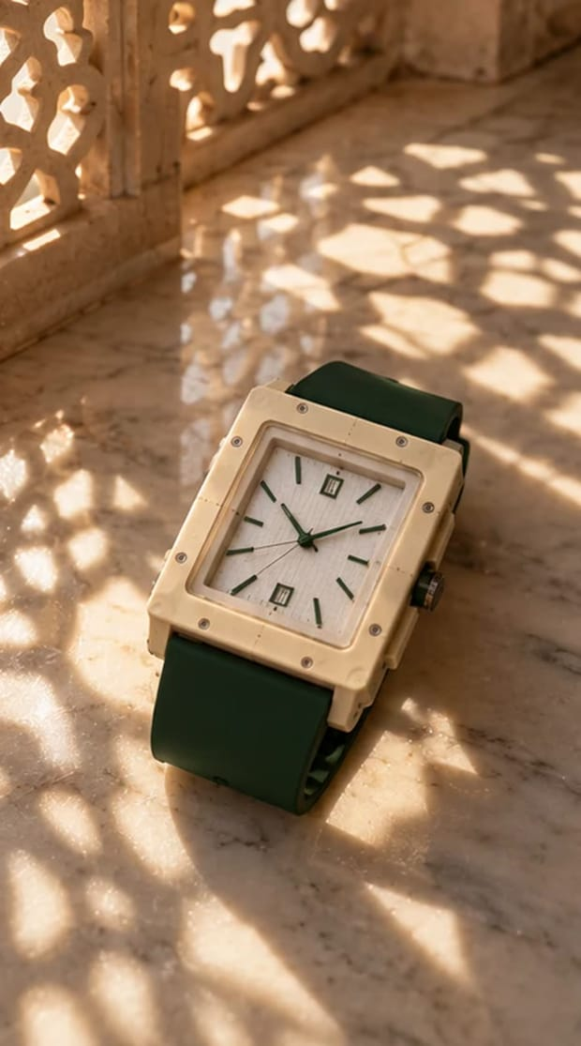
A2 · DETAIL · ASMR · 15 S · 9:16
JAALI
It waits for you to step closer
CONCEPT
Neetu's rule for the design: luxury doesn't scream across the room — it waits for you to step closer. The watch lies on the haveli's marble floor while the morning sun moves through a carved jaali; each pattern lands on a different detail — the eight screws, the WR monogram, the waffle dial, the green strap.
HOOK · FIRST 2 SECONDS
Time-lapse: a star-shaped patch of jaali light slides across the floor and stops exactly on the dial.
VOICE
ON SCREEN
No voice-over.
IT WAITS FOR YOU TO STEP CLOSER.
SOUND
Broom on stone · distant temple bell · pigeons · one soft tick at the end.
AI mood frame · watch exact, face is a stand-in
WEALTH ROOTS × MUKESH GUPTA · JAIPUR SHOOT PLAN · ROOTS · A2
14

Slide 15
A2 · SHOT LIST
JAALI
TIME | SHOT | CAMERA · LENS · MOVE
0–3s | Watch on floor, jaali light travels onto the dial | Time-lapse 1 frame/2s for 20 min, 35mm locked
3–6s | The eight bezel screws in a patch of light | 100mm macro / probe lens
6–9s | Waffle dial + WR monogram | Probe lens slide
9–12s | Green strap texture, crown | 100mm macro rack focus
12–15s | Mukesh's hand enters and picks it up | 35mm locked (only shot that needs him)
The real watch — match colours exactly
PROPS & SET
REFERENCES — TAP TO OPEN
Clean white marble or sandstone floor under a jaali window · microfibre · blower.
Pinterest · jaali shadow product photography
Pinterest · watch macro light pattern
Instagram · @cartier — light-play macro
PRODUCTION NOTE
B-unit shoots shots 1–4 without Mukesh while the main unit shoots A1.
WEALTH ROOTS × MUKESH GUPTA · JAIPUR SHOOT PLAN · ROOTS · A2
15

Slide 16
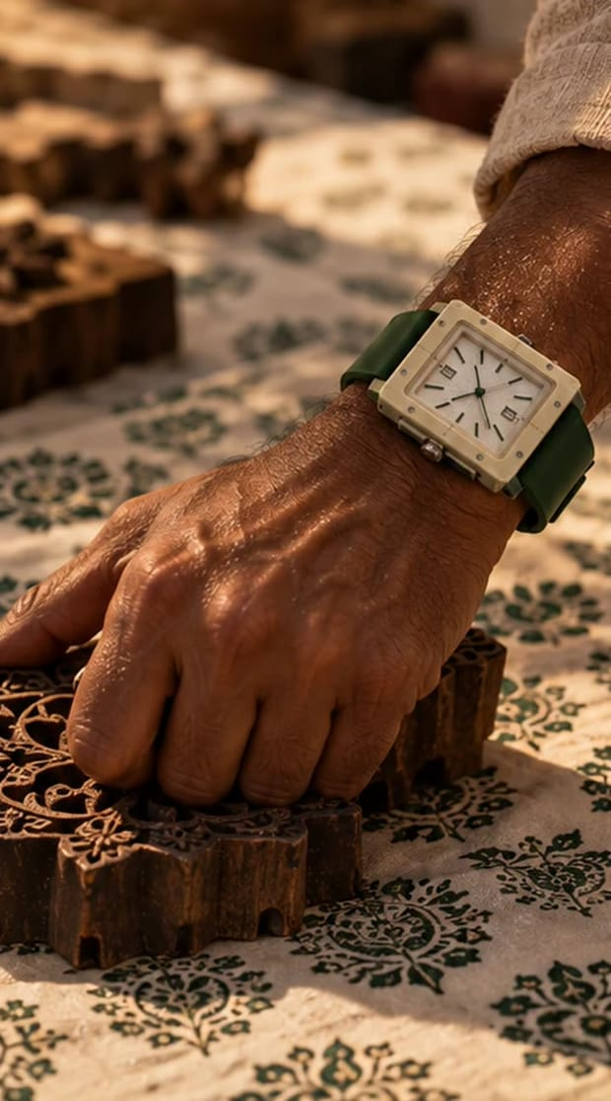
A3 · DIALOGUE PUNCH · 10–12 S · 9:16
KITNE KI HAI?
Price vs position
CONCEPT
The most Indian question there is — "Kitne ki hai?" Mukesh doesn't answer with a number. Straight from Neetu: an expensive watch has a price; a Wealth Roots watch has a position.
HOOK · FIRST 2 SECONDS
Off-camera elder's voice in the courtyard: "Beta, ye ghadi kitne ki hai?"
SCRIPT · HINGLISH
ON SCREEN
Elder: "Beta, ye ghadi kitne ki hai?"
Mukesh (calm, no smile): "Mehngi ghadi ki keemat hoti hai, chacha. Iski position hai."
Elder (beat): "…Achha." — cut.
AN EXPENSIVE WATCH HAS A PRICE. THIS ONE HAS A POSITION.
SOUND
Diegetic only — chai sip, courtyard birds. Music hits on the last 2 s.
AI mood frame · watch exact, face is a stand-in
WEALTH ROOTS × MUKESH GUPTA · JAIPUR SHOOT PLAN · ROOTS · A3
16

Slide 17
A3 · SHOT LIST
KITNE KI HAI?
TIME | SHOT | CAMERA · LENS · MOVE
0–3s | Over the elder's shoulder: Mukesh on the takht with chai | 35mm OTS
3–5s | He sets the glass down, shirt cuff slides back | 85mm insert on wrist
5–9s | His answer, straight to the elder | 50mm single, eye level
9–12s | Elder nods slowly. Cut to black. | 35mm reverse
PROPS & SET
The real watch — match colours exactly
Takht or charpai · brass chai glasses · one elder extra (60+; face can stay out of frame).
REFERENCES — TAP TO OPEN
Pinterest · indian courtyard chai cinematic
Instagram · @mukesh_gupta14 — his own dialogue pacing
WEALTH ROOTS × MUKESH GUPTA · JAIPUR SHOOT PLAN · ROOTS · A3
17

Slide 18
WORLD 02
MORNING · 06:15–07:00 + 09:30–11:00
DISCIPLINE
The routine nobody sees. Neetu's definition of dominance — absolute command over your own calendar. Not a gym flex: a quiet 5 a.m. that belongs to him.
CITRUS MINT
WHERE
Rooftop at first light · pool terrace · white-marble tabletop
WARDROBE
Look 1: black training tee + black track pants. Look 2: open white linen shirt, white trousers.
MUSIC
Breath, rope whip, one kick drum on the end card.
B1
B2
B3
4:59
COLD. SHARP. ON TIME.
300 SAAL
Story reel · 25 s
Detail · tabletop · 12 s
Match-cut punch · 10 s
Sovereign time
Fresh cut
Jaipur has told time for 300 years
White
Lime
Mint
Sun on sandstone
WEALTH ROOTS × MUKESH GUPTA · JAIPUR SHOOT PLAN · DISCIPLINE
18

Slide 19
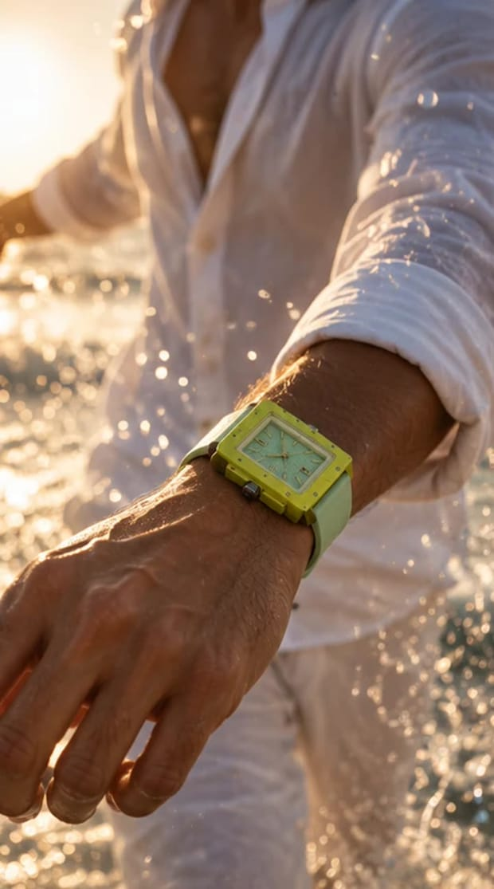
B1 · STORY REEL · 25 S · 9:16
4:59
Sovereign time
CONCEPT
The city is asleep; he is already up. The alarm reads 4:59 and he switches it off before it rings. Dominance isn't noise — it's control over your own time.
HOOK · FIRST 2 SECONDS
Phone alarm at 4:59 — his hand stops it before it rings. The watch is already on.
SCRIPT · HINGLISH
ON SCREEN
"Duniya ka alarm abhi baja nahi."
"Mera din shuru ho chuka hai."
"Dominance shor se nahi aata… control se aata hai."
"Apne time pe."
SOVEREIGN TIME.
SOUND
Room tone · breath · rope whip · birds at sunrise · single kick on the end card.
AI mood frame · watch exact, face is a stand-in
WEALTH ROOTS × MUKESH GUPTA · JAIPUR SHOOT PLAN · DISCIPLINE · B1
19

Slide 20
B1 · SHOT LIST
4:59
TIME | SHOT | CAMERA · LENS · MOVE
0–3s | Dark room, phone shows 4:59, his hand stops it | 100mm macro, practical light from phone
3–6s | Water from a brass lota splashed on his face (wrist in frame) | 85mm, 120 fps — splash only, no submersion
6–10s | He climbs the haveli stairs to the roof | 24mm gimbal from below
10–17s | Skipping / push-ups at first light; macro at the bottom of a push-up | 35mm wide + 100mm insert
17–22s | He stops, checks the watch; sunrise over Jaipur behind | 85mm backlit, flare
22–25s | End card | —
The real watch — match colours exactly
REFERENCES — TAP TO OPEN
Pinterest · 5am routine cinematic rooftop
Instagram · @tagheuer — sport discipline edits
PROPS & SET
Phone with 4:59 alarm screen · brass lota with water · skipping rope.
PRODUCTION NOTE
Sunrise ≈ 06:35 in late October. This is the first setup of the day (06:15–07:00).
WEALTH ROOTS × MUKESH GUPTA · JAIPUR SHOOT PLAN · DISCIPLINE · B1
20

Slide 21
B2 · DETAIL · TABLETOP · 12 S · 9:16
COLD. SHARP. ON TIME.
Fresh cut
CONCEPT
Freshness as discipline. White marble, halved limes, mint, ice, a sweating glass — the Citrus Mint looks like it was made for the table.
HOOK · FIRST 2 SECONDS
One hard knife cut through a lime — ASMR crunch — the watch is revealed behind it.
VOICE
ON SCREEN
No voice-over.
COLD. SHARP. ON TIME.
SOUND
Knife, ice clink, fizz, one tick.
AI mood frame · watch exact, face is a stand-in
WEALTH ROOTS × MUKESH GUPTA · JAIPUR SHOOT PLAN · DISCIPLINE · B2
21

Slide 22
B2 · SHOT LIST
COLD. SHARP. ON TIME.
TIME | SHOT | CAMERA · LENS · MOVE
0–2s | Knife slices a lime, watch behind | 100mm macro, 120 fps
2–5s | Ice drops into the glass; droplets on the case | 85mm, spray bottle — no water on the dial
5–8s | Top-down flat lay | 35mm overhead
8–10s | Slow turn on the lazy susan | 100mm locked
10–12s | His hand takes the glass, wrist to camera | 50mm
The real watch — match colours exactly
PROPS & SET
REFERENCES — TAP TO OPEN
White marble slab · limes · mint · clear ice · glass · spray bottle (droplets only) · lazy susan.
Pinterest · lime mint marble product photography
Instagram · @omega — clean tabletop motion
PRODUCTION NOTE
B-unit tabletop; Mukesh needed only for the last 2 s.
WEALTH ROOTS × MUKESH GUPTA · JAIPUR SHOOT PLAN · DISCIPLINE · B2
22

Slide 23
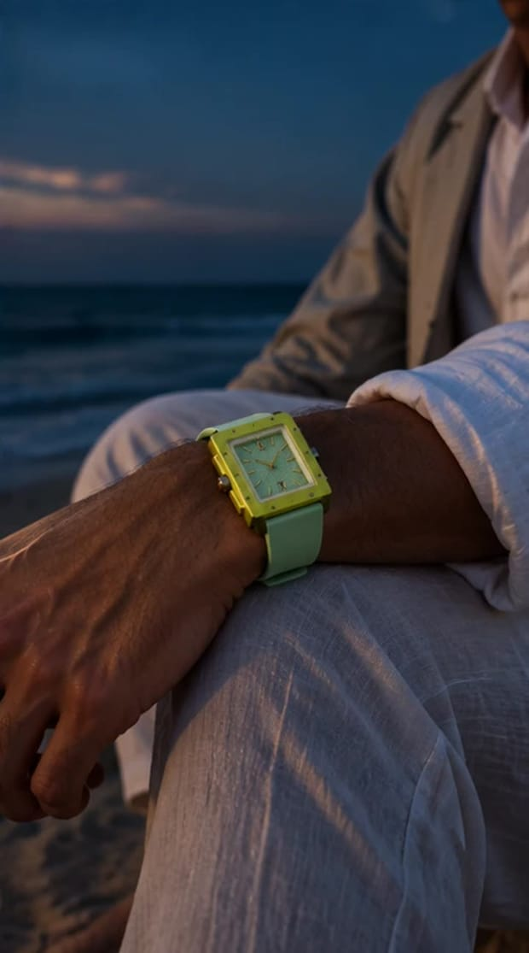
B3 · MATCH-CUT PUNCH · 10 S · 9:16
300 SAAL
Jaipur has told time for 300 years
CONCEPT
Jaipur owns the world's largest sundial — Jantar Mantar's Samrat Yantra (1730s). The giant shadow on the sundial match-cuts to Mukesh's shadow on the pool deck, then to the watch. The city has told time for 300 years; now it wears it.
HOOK · FIRST 2 SECONDS
The Samrat Yantra's shadow crawling across the stone scale.
VOICE
ON SCREEN
No voice-over — or one line: "Jaipur ne waqt bataaya hai. Ab pehenta hai."
JAIPUR HAS TOLD TIME FOR 300 YEARS. NOW IT WEARS IT.
SOUND
Wind · one deep bell · tick.
AI mood frame · watch exact, face is a stand-in
WEALTH ROOTS × MUKESH GUPTA · JAIPUR SHOOT PLAN · DISCIPLINE · B3
23

Slide 24
B3 · SHOT LIST
300 SAAL
TIME | SHOT | CAMERA · LENS · MOVE
0–3s | Jantar Mantar — shadow on the Samrat Yantra scale | B-unit city clip, 35mm locked
3–6s | Match cut: Mukesh's shadow falls across the pool deck | 24mm high angle
6–10s | Tilt up to his wrist, sun flare on the lime case | 85mm, 50 fps
PROPS & SET
—
The real watch — match colours exactly
PRODUCTION NOTE
REFERENCES — TAP TO OPEN
Jantar Mantar: buy the video-camera ticket; tripods usually need prior permission — shoot handheld if refused.
Pinterest · sundial shadow cinematic
Pinterest · match cut shadow transition
WEALTH ROOTS × MUKESH GUPTA · JAIPUR SHOOT PLAN · DISCIPLINE · B3
24

Slide 25
WORLD 03
MIDDAY · 11:00–13:30
BUILD
Builders, not inheritors. Midday: a drafting table, a blueprint, an open blue sky over the roof. The watch for people laying foundations for their own name.
CERULEAN
WHERE
Study / library (drafting table) · rooftop under open sky
WARDROBE
Look 1: white shirt, sleeves rolled twice, navy trousers. Look 2: + navy blazer for C3.
MUSIC
Tick-led percussion, short piano stabs.
C1
C2
C3
NEEV
6 FEET. 6 INCHES.
60 SECONDS
Story reel · 30 s
Detail · one-take · 15 s
POV · 10 s
Foundation
Seen from six feet, felt at six inches
The meeting ritual
Sky blue
White
Navy
Drafting paper
WEALTH ROOTS × MUKESH GUPTA · JAIPUR SHOOT PLAN · BUILD
25

Slide 26
C1 · STORY REEL · 30 S · 9:16
NEEV
Foundation
CONCEPT
Some people are born with a name; some build one. Mukesh at a drafting table with the blueprint of something not built yet. He takes it up to the roof and holds it against the open Jaipur sky where it will stand.
HOOK · FIRST 2 SECONDS
A pencil snaps on the blueprint — loud. He doesn't flinch; he picks up another.
SCRIPT · HINGLISH
ON SCREEN
AI FRAME PENDING
"Kuch log naam ke saath paida hote hain."
"Kuch log naam banaate hain."
"Log kehte hain — bas, ho gaya."
"Main kehta hoon… abhi toh sirf neev daali hai."
BUILT FOR THE BUILDERS.
Product still shown. The prompt for this frame is in the appendix — run it once and drop the frame here.
SOUND
Pencil snap · paper roll · wind on the roof · piano stab on the end card.
WEALTH ROOTS × MUKESH GUPTA · JAIPUR SHOOT PLAN · BUILD · C1
26

Slide 27
C1 · SHOT LIST
NEEV
TIME | SHOT | CAMERA · LENS · MOVE
0–3s | Pencil snaps on the blueprint | 100mm macro
3–8s | Overhead drafting table, his wrist sweeps the scale ruler | 35mm overhead, slider
8–11s | Phone lights up "Party tonight?" — he turns it face down | 85mm insert
11–16s | He rolls the blueprint, takes the stairs | 24mm gimbal
16–25s | Rooftop: unrolls the plan against open sky, wrist in frame | 35mm low angle, sky fills frame
25–30s | End card | —
The real watch — match colours exactly
REFERENCES — TAP TO OPEN
Pinterest · architect blueprint cinematic
Instagram · @iwcwatches — engineering storytelling
PROPS & SET
Large blueprint (a real architectural plan) · drafting scale · pencils · coffee.
WEALTH ROOTS × MUKESH GUPTA · JAIPUR SHOOT PLAN · BUILD · C1
27

Slide 28
C2 · DETAIL · ONE-TAKE · 15 S · 9:16
6 FEET. 6 INCHES.
Seen from six feet, felt at six inches
CONCEPT
Lifted straight from Neetu's design rule: a watch should be spotted from six feet away, but its finishing only shows up close. One continuous push-in from six feet (full figure, the sky-blue case popping against the white shirt) to six inches (the waffle dial and the screws).
HOOK · FIRST 2 SECONDS
On-screen counter: "6 FEET" on a full-body wide — it counts down as the camera moves in.
VOICE
ON SCREEN
AI FRAME PENDING
No voice-over.
6 FT → 3 FT → 1 FT → 6 IN · SEEN FROM 6 FEET. FELT AT 6 INCHES.
Product still shown. The prompt for this frame is in the appendix — run it once and drop the frame here.
SOUND
Rising whoosh · single tick when the macro lands.
WEALTH ROOTS × MUKESH GUPTA · JAIPUR SHOOT PLAN · BUILD · C2
28

Slide 29
C2 · SHOT LIST
6 FEET. 6 INCHES.
TIME | SHOT | CAMERA · LENS · MOVE
0–10s | Gimbal push-in from full figure to wrist | 24mm on gimbal, one take
10–15s | Cut on motion to the macro: dial texture + screws | 100mm macro / probe lens
PROPS & SET
Clean white wall or open sky background.
The real watch — match colours exactly
REFERENCES — TAP TO OPEN
Pinterest · dolly zoom push in watch
Instagram · @panerai — scale and detail
WEALTH ROOTS × MUKESH GUPTA · JAIPUR SHOOT PLAN · BUILD · C2
29

Slide 30
C3 · POV · 10 S · 9:16
60 SECONDS
The meeting ritual
CONCEPT
From Neetu's own story — her husband reaching for one particular watch before a decisive meeting, like a ritual. POV of the 60 seconds before the meeting that decides the year. Bonus: the drawer shows all five watches — a range shot.
HOOK · FIRST 2 SECONDS
On-screen: "POV: 60 seconds before the meeting that decides your year."
SCRIPT · HINGLISH
ON SCREEN
AI FRAME PENDING
Optional whisper as the door opens: "Chalo."
POV: 60 SECONDS BEFORE THE MEETING THAT DECIDES YOUR YEAR.
Product still shown. The prompt for this frame is in the appendix — run it once and drop the frame here.
SOUND
Clock tick speeding up · drawer slide · clasp click · door.
WEALTH ROOTS × MUKESH GUPTA · JAIPUR SHOOT PLAN · BUILD · C3
30

Slide 31
C3 · SHOT LIST
60 SECONDS
TIME | SHOT | CAMERA · LENS · MOVE
0–2s | Mirror: top collar button | 50mm
2–5s | Drawer opens — five watches; his hand hovers, takes Cerulean | Top shot 35mm
5–7s | Clasp click | 100mm macro
7–9s | Blazer on, shoulder roll | 35mm
9–10s | Door opens into bright light — cut | 24mm, overexposed
The real watch — match colours exactly
PROPS & SET
REFERENCES — TAP TO OPEN
Dark wood drawer with all five watches · mirror · navy blazer.
Pinterest · getting ready ritual cinematic watch
Instagram · @audemarspiguet — ritual & detail
WEALTH ROOTS × MUKESH GUPTA · JAIPUR SHOOT PLAN · BUILD · C3
31

Slide 32
WORLD 04
GOLDEN HOUR → DUSK · 15:30–18:30
UTSAV · DIWALI
Jaipur in festival light — and the watch that doesn't need to shout. Shot the week before Diwali; goes live on Dhanteras (6 Nov) and Diwali (8 Nov).
ROYAL TANGERINE
WHERE
Rooftop with diyas · chowk lined with diyas · jharokha · Jaipur bazaar lights
WARDROBE
Royal-blue bandhgala · orange leheriya safa (D3 only) · tan juttis.
MUSIC
Shehnai motif, dhol tuned low.
D1
D2
D3
EK DIYA
DHANTERAS
JAIPUR SE
Diwali story reel · 30 s
Detail · festive · 15 s
Speed-ramp punch · 10 s
Some are the light
Buy something you've earned
From Jaipur, for the world
Royal blue
Marigold
Gold
Diya flame
WEALTH ROOTS × MUKESH GUPTA · JAIPUR SHOOT PLAN · UTSAV · DIWALI
32

Slide 33
D1 · DIWALI STORY REEL · 30 S · 9:16
EK DIYA
Some are the light
CONCEPT
Diwali night: the city is pure noise — crackers, speakers, lights on everything. He climbs to the roof, switches the fairy lights off and lights one diya. In the dark, the watch's whole case glows beside the flame. Neetu's belief: wealth doesn't have to be loud.
HOOK · FIRST 2 SECONDS
Total black. A matchstick strikes; the flame lights his face.
SCRIPT · HINGLISH
ON SCREEN
"Is Diwali, sab roshni dikhaayenge."
"Kuch log roshni dikhaate hain…"
"…kuch log khud roshni hote hain."
"Shubh Deepavali."
SOME SHOW THEIR LIGHT. SOME ARE THE LIGHT. → Shubh Deepavali · WEALTH ROOTS
SOUND
Match strike · distant crackers (low) · silence when the lights go off · one shehnai note.
AI mood frame · watch exact, face is a stand-in
WEALTH ROOTS × MUKESH GUPTA · JAIPUR SHOOT PLAN · UTSAV · DIWALI · D1
33

Slide 34
D1 · SHOT LIST
EK DIYA
TIME | SHOT | CAMERA · LENS · MOVE
0–2s | Match strike, flame | 100mm macro, black
2–6s | Jaipur lit for the festival, crackers in the distance | B-unit: bazaar lights / skyline from the roof
6–12s | He walks through the chowk lined with diyas | 35mm gimbal, 50 fps
12–18s | Rooftop: he switches the fairy lights off; one diya left | 35mm wide
18–25s | He sets the diya on the parapet — the watch case glows beside it | 85mm, lume charged 30 s with UV torch
25–30s | Silhouette against the city. End card. | 24mm wide
Second mood frame · the real watch
REFERENCES — TAP TO OPEN
Pinterest · diwali cinematic diya man
Instagram · @tanishqjewellery — festive storytelling
PROPS & SET
150–200 clay diyas · marigold strings · fairy lights on a switch · matchbox · UV torch to charge the lume.
PRODUCTION NOTE
Jaipur's bazaars (Johari, Bapu, Nehru) usually light up 1–2 weeks before Diwali — grab them on Day 1 evening. Backup: our own diya courtyard.
WEALTH ROOTS × MUKESH GUPTA · JAIPUR SHOOT PLAN · UTSAV · DIWALI · D1
34

Slide 35
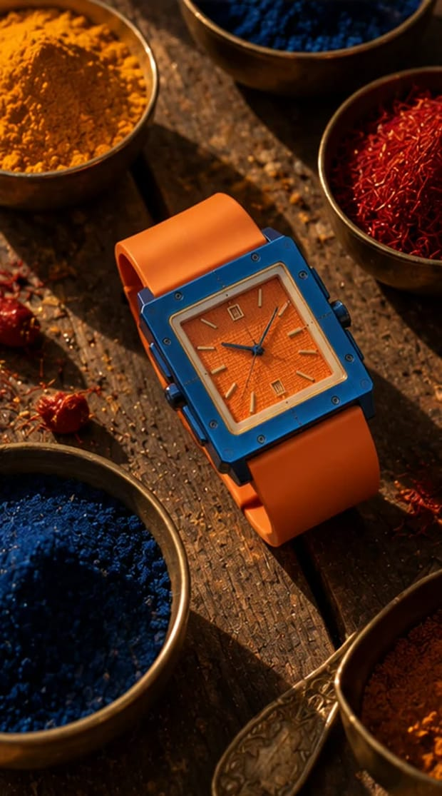
D2 · DETAIL · FESTIVE · 15 S · 9:16
DHANTERAS
Buy something you've earned
CONCEPT
On Dhanteras India buys something precious for the year ahead. A brass thali with a silver coin, haldi, kumkum, rice and marigold — and the Royal Tangerine at its centre. Tied to the 500 Alpha Founder pieces.
HOOK · FIRST 2 SECONDS
Rice grains and kumkum fall onto the brass thali in slow motion.
SCRIPT · HINGLISH
ON SCREEN
"Dhanteras pe kuch keemti lete hain."
"Is baar… kuch aisa lo jo kamaaya ho. Sirf khareeda nahi."
ONLY 500 ALPHA FOUNDER PIECES. → card: 001 / 500
SOUND
Rice on brass · bell · one dhol hit.
AI mood frame · watch exact, face is a stand-in
WEALTH ROOTS × MUKESH GUPTA · JAIPUR SHOOT PLAN · UTSAV · DIWALI · D2
35

Slide 36
D2 · SHOT LIST
DHANTERAS
TIME | SHOT | CAMERA · LENS · MOVE
0–3s | Rice + kumkum fall on the thali | 100mm, 240 fps
3–7s | Top-down thali composition, watch at centre | 35mm overhead
7–10s | Diya flame reflection sweeps across the orange dial | 100mm macro
10–13s | His hand lifts the watch from the thali | 50mm
13–15s | Card: 001 / 500 | Insert
The real watch — match colours exactly
PROPS & SET
REFERENCES — TAP TO OPEN
Brass thali · silver coin · haldi + kumkum bowls · rice · marigold · numbered card "001/500" · diya.
Pinterest · dhanteras thali product shoot
Pinterest · marigold brass top view
PRODUCTION NOTE
Post on Dhanteras, 6 Nov. Keep it respectful: thali only, no deity on screen.
WEALTH ROOTS × MUKESH GUPTA · JAIPUR SHOOT PLAN · UTSAV · DIWALI · D2
36

Slide 37
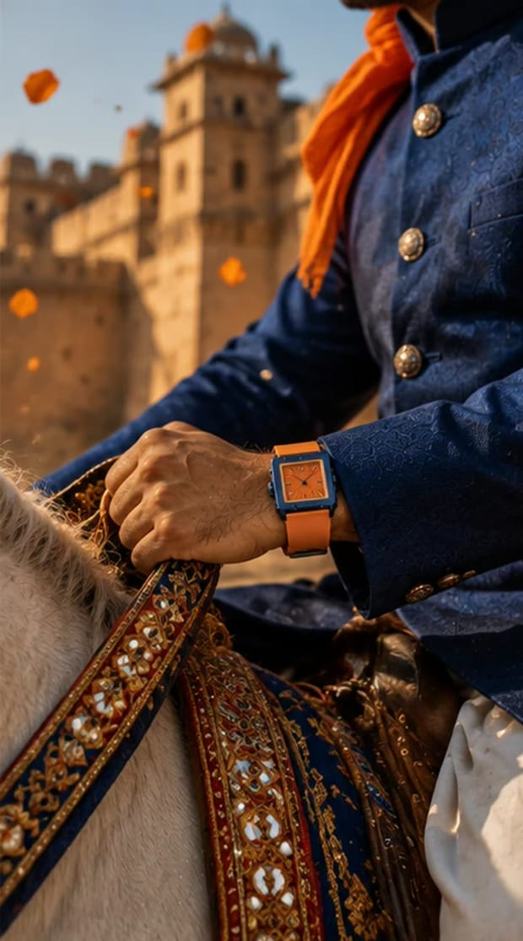
D3 · SPEED-RAMP PUNCH · 10 S · 9:16
JAIPUR SE
From Jaipur, for the world
CONCEPT
The brand's own line: born in Jaipur, made for the world. At a haveli jharokha he ties the last fold of an orange leheriya safa → the camera drops to his wrist → whip-pan to the pink city — blue and orange colour-matched.
HOOK · FIRST 2 SECONDS
The orange safa cloth whips into frame against the royal-blue bandhgala.
VOICE
ON SCREEN
No voice-over.
JAIPUR SE. DUNIYA KE LIYE.
SOUND
Shehnai sting · dhol hit on the whip.
AI mood frame · watch exact, face is a stand-in
WEALTH ROOTS × MUKESH GUPTA · JAIPUR SHOOT PLAN · UTSAV · DIWALI · D3
37

Slide 38
D3 · SHOT LIST
JAIPUR SE
TIME | SHOT | CAMERA · LENS · MOVE
0–3s | Safa cloth whips through frame; he ties the last fold | 50mm, 120 fps → speed ramp
3–6s | Drop to wrist as he lowers his hands | 85mm tilt
6–10s | Whip-pan to Patrika Gate / Hawa Mahal | B-unit city clip, matched whip
PROPS & SET
Orange leheriya safa (pre-tied backup) · jharokha with afternoon sun.
The real watch — match colours exactly
REFERENCES — TAP TO OPEN
Pinterest · rajasthani safa portrait jharokha
Pinterest · whip pan transition city
WEALTH ROOTS × MUKESH GUPTA · JAIPUR SHOOT PLAN · UTSAV · DIWALI · D3
38

Slide 39
WORLD 05
NIGHT · 19:15–23:00
AFTER DARK
The hours nobody sees. Building anything meaningful is lonely — the watch is the only witness. Ends with the glow: quiet power in the dark.
CRIMSON NAVY
WHERE
Dark lounge / darbar room with red + blue gels · study desk · Jaipur night drive
WARDROBE
Black suit, open collar · black knit for E2.
MUSIC
Low synth, sub heartbeat.
E1
E2
E3
UNFINISHED
RED / BLUE
SHOR NAHI. SIGNAL.
Story reel · 30 s
Detail · lighting · 15 s
Night drive · 12 s
Nobody sees the nights
Two lights, one watch
Signal, not noise
Black
Red light
Blue light
Glow green
WEALTH ROOTS × MUKESH GUPTA · JAIPUR SHOOT PLAN · AFTER DARK
39

Slide 40
E1 · STORY REEL · 30 S · 9:16
UNFINISHED
Nobody sees the nights
CONCEPT
The night everyone else is out, he is still finishing the work that pays for it. His phone floods with invites; he turns it over. At 1:47 a.m. he switches the lamp off — and the watch glows in the dark.
HOOK · FIRST 2 SECONDS
Phone screen floods: "Bro kahan hai?? 🎉" — he turns it face down.
SCRIPT · HINGLISH
ON SCREEN
"Raat sabki hoti hai."
"Kaam sirf kuch logon ka."
"Jo kisi ko nahi dikhta… wahi sab kuch banata hai."
NOBODY SEES THE NIGHTS. THE WATCH DOES.
SOUND
Notification buzzes · pen scratch · lamp switch · sub drop · silence on the glow.
AI mood frame · watch exact, face is a stand-in
WEALTH ROOTS × MUKESH GUPTA · JAIPUR SHOOT PLAN · AFTER DARK · E1
40

Slide 41
E1 · SHOT LIST
UNFINISHED
TIME | SHOT | CAMERA · LENS · MOVE
0–3s | Phone notifications, his hand turns it over | 100mm macro
3–9s | Desk, lamp pool, red neon through the window | 35mm, hazer low
9–14s | Wrist working over papers | 85mm
14–18s | Watch macro: 1:47 | 100mm
18–24s | He switches the lamp off — darkness — the case glows | 50mm, lume charged
24–30s | He exhales, leans back. End card. | 35mm
The real watch — match colours exactly
REFERENCES — TAP TO OPEN
Pinterest · late night work cinematic neon
Instagram · @hublot — bold night edits
PROPS & SET
Phone with group-chat screens · desk lamp · papers/laptop · red neon or red LED outside the window.
WEALTH ROOTS × MUKESH GUPTA · JAIPUR SHOOT PLAN · AFTER DARK · E1
41

Slide 42
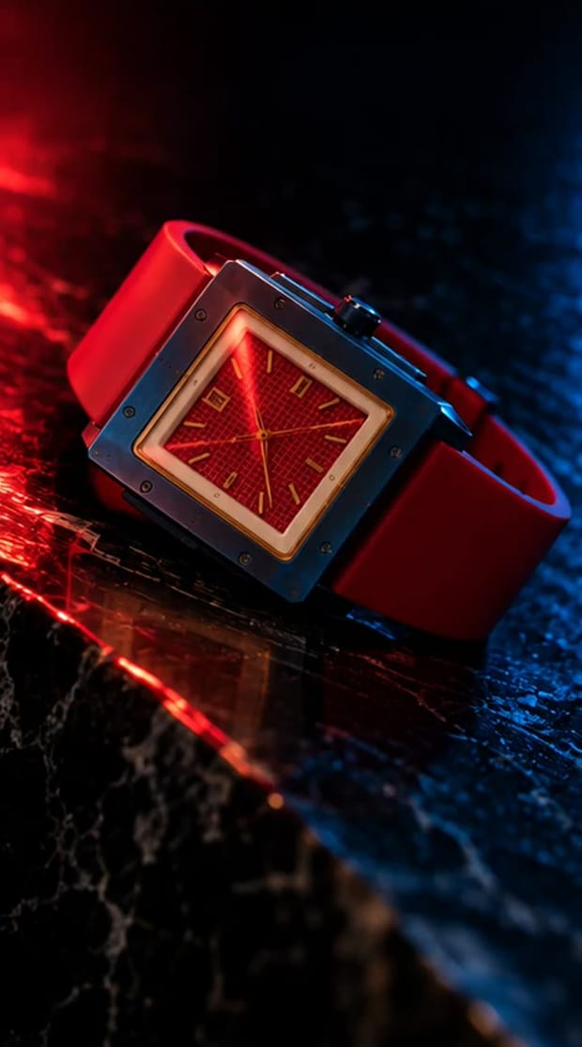
E2 · DETAIL · LIGHTING · 15 S · 9:16
RED / BLUE
Two lights, one watch
CONCEPT
Red from one side, blue from the other — the navy case and red dial split perfectly between them. On the beat both lights cut; only the glow remains.
HOOK · FIRST 2 SECONDS
Hard cuts red ↔ blue on the beat.
VOICE
ON SCREEN
No voice-over.
AFTER DARK.
SOUND
Synth pulse; total silence on the glow.
AI mood frame · watch exact, face is a stand-in
WEALTH ROOTS × MUKESH GUPTA · JAIPUR SHOOT PLAN · AFTER DARK · E2
42

Slide 43
E2 · SHOT LIST
RED / BLUE
TIME | SHOT | CAMERA · LENS · MOVE
0–5s | Wrist turns in red / blue light, cut on beat | 85mm, black background
5–10s | Macro of the red dial in split light | 100mm
10–15s | Both lights off → the case glows alone | 50mm locked
PROPS & SET
Two RGB tubes (red + blue) · black velvet · whisky glass (out of focus).
The real watch — match colours exactly
REFERENCES — TAP TO OPEN
Pinterest · red blue split lighting watch
Instagram · @jacobandco — dramatic light play
WEALTH ROOTS × MUKESH GUPTA · JAIPUR SHOOT PLAN · AFTER DARK · E2
43

Slide 44
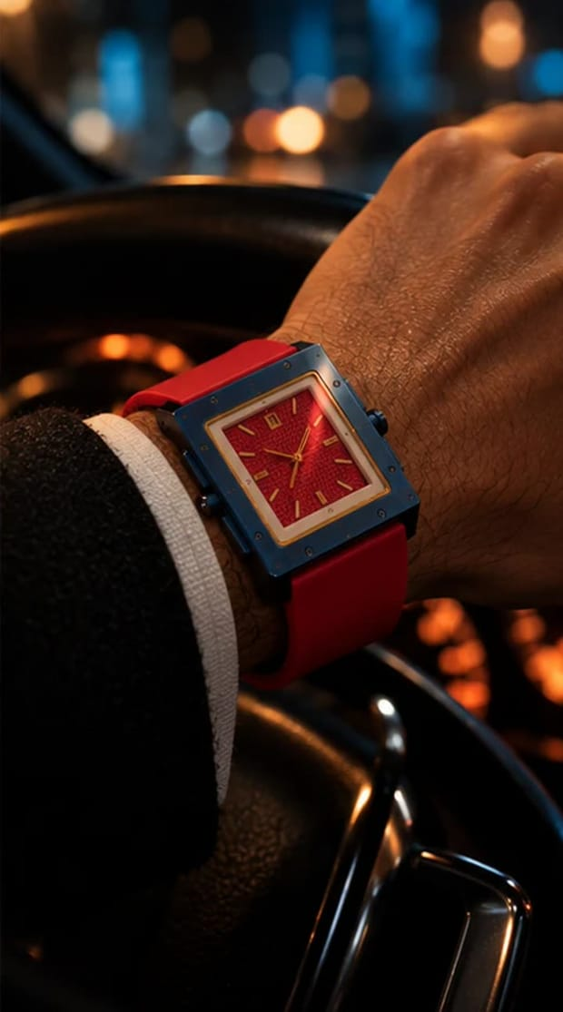
E3 · NIGHT DRIVE · 12 S · 9:16
SHOR NAHI. SIGNAL.
Signal, not noise
CONCEPT
Jaipur at night — horns, lights, noise. The car door shuts: silence. At a red light the dashboard goes dark and the case glows on the steering wheel.
HOOK · FIRST 2 SECONDS
Loud traffic → door shuts → total silence.
VOICE
ON SCREEN
No voice-over.
SHOR NAHI. SIGNAL.
SOUND
City noise → hard silence → one low tone.
AI mood frame · watch exact, face is a stand-in
WEALTH ROOTS × MUKESH GUPTA · JAIPUR SHOOT PLAN · AFTER DARK · E3
44

Slide 45
E3 · SHOT LIST
SHOR NAHI. SIGNAL.
TIME | SHOT | CAMERA · LENS · MOVE
0–3s | Albert Hall lit / MI Road traffic at night | B-unit city clip
3–5s | Door shuts — silence | 35mm inside the car
5–9s | Hand on the wheel, city bokeh through the windscreen | 85mm
9–12s | Dashboard off, the glow lights his jaw; signal turns green | 50mm
PROPS & SET
The real watch — match colours exactly
Premium sedan/SUV with dark interior · driver for moving shots.
REFERENCES — TAP TO OPEN
Pinterest · night drive cinematic watch steering
Instagram · @tagheuer — car & speed
PRODUCTION NOTE
Safety: moving shots with a driver at the wheel, or parked with light passes. Mukesh never drives while we film.
WEALTH ROOTS × MUKESH GUPTA · JAIPUR SHOOT PLAN · AFTER DARK · E3
45

Slide 46
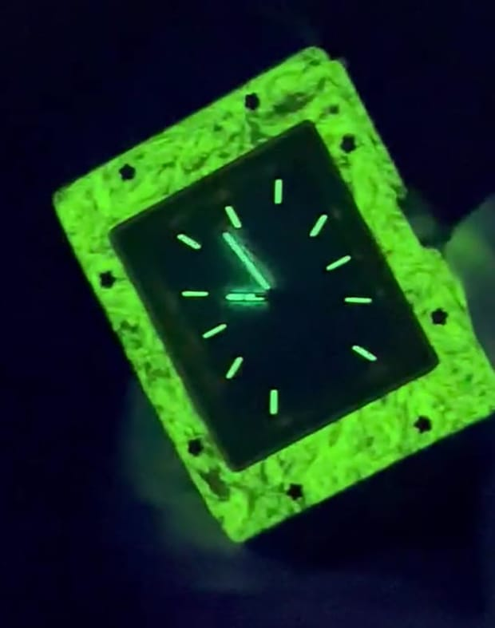
THE SIGNATURE · GLOW INSERTS
FIVE GLOWS, SHOT AS YOU GO.
In the dark the whole case lights up — bezel, case edges, hands, indices. It's the most ownable thing these watches do, so every world gets a 5-minute glow insert in the blacked-out room.
01 CHARGE
02 THREE FRAMES
03 HOLD
UV torch on the case for 30 s, lights already off.
Wrist turn · flat on black velvet · macro on the bezel.
Locked camera, 10 s each — the glow is the only light in frame.
WHAT IT GIVES US
A 4th reel per watch for free — a 6-second glow loop (5 total).
"Five Glows" — a 20-second hero film cutting all five in the dark, for launch day.
The end card for E1, D1 and E2.
WEALTH ROOTS × MUKESH GUPTA · JAIPUR SHOOT PLAN · GLOW
46

Slide 47
DAY 2 · HALF PRODUCT, HALF FOUNDER
THE WATCH ALONE. THEN THE WOMAN WHO MADE IT.
TIME | SETUP | UNIT
07:30 | Crew call · product sets lit (white sweep + colour sweep + macro rig) | Product
08:00–09:00 | Set A · white sweep e-com — all five watches, locked camera | Product
09:00–10:30 | Set B · colour-matched seamless heroes (navy, lime, sky, ivory/green, royal blue) | Product
10:30–11:30 | Set C · macros with focus stacking (screws, WR monogram, dial, crown, caseback, clasp) | Product
11:30–12:15 | Set D · glow long exposures + 360° turntable videos | Product
12:15–13:00 | Set E · packaging + unboxing (magnetic lid, 001/500 card) | Product
13:00–14:00 | Lunch · founder set dressed (library / darbar room) · Neetu HMU | —
14:00–15:15 | Founder interview — two cameras, Hinglish | Founder
15:15–16:15 | Founder B-roll (sketching, loupe, packaging test, numbering) | Founder
16:15–17:15 | Portraits — window light, corridor walk, with the box | Founder
17:15–17:45 | Golden-hour portrait on the roof | Founder
17:45–18:30 | Optional: the ritual (husband choosing the watch, no face) · wrap | Founder
WEALTH ROOTS × MUKESH GUPTA · JAIPUR SHOOT PLAN · DAY 2
47

Slide 48

DAY 2 · PRODUCT SHOOT (07:30–13:00)
SIX SETS, ASSEMBLY-LINE.
SET | SHOTS | USED FOR | PER WATCH
A · White sweep | Front · 3/4 · crown side · caseback · clasp open/closed · strap flat | E-com + website | 6 stills × 5 watches
B · Colour seamless | Each watch on its own colour: navy, lime, sky, ivory+green, royal blue | Hero / ads / launch | 2 stills × 5
C · Macro rig | Eight screws · WR monogram · waffle dial · crown · caseback crest · deployant clasp | Detail carousels | 6 stills × 5
D · Glow | Lume charged with UV torch, long exposure in black | Glow posts | 1 still × 5
E · 360° turntable | Lazy susan 10 s loop, white + black | Website + reels | 2 videos × 5
F · Packaging | Box closed · magnetic lid opening (sound) · 001/500 card · full flat lay | Unboxing reel + launch | 1 set + 1 video
Kit: 100 mm macro + focus stacking · probe lens · lazy susan · cotton gloves · blower · microfibre · UV torch · coloured seamless rolls (5). A hand model or crew hand for the e-com wrist shots — Mukesh ji isn't on Day 2.
WEALTH ROOTS × MUKESH GUPTA · JAIPUR SHOOT PLAN · DAY 2 · PRODUCT
48

Slide 49
DAY 2 · FOUNDER SHOOT (14:00–18:30)
OUTPUTS
THE
OUTSIDER
FOUNDER FILM — 60–90 s, the whole story in her own Hinglish
4 FOUNDER REELS — 30–45 s each — scripts on the next slides
12 PORTRAITS — Editorial, for press, website and LinkedIn
LINKEDIN CUT — 2 min, subtitled
HOW WE FILM HER
"Because no one expected me to."
Seated in the library / darbar room, warm practical lamps, dark background — the same world as the watches.
Two cameras: A wide on 35 mm, B tight on 85 mm. Eyeline just off lens to the interviewer.
She answers in Hinglish, the way she talks — we cut the reels from her real answers, not a teleprompter.
Wardrobe her call: structured blazer / pantsuit or a saree with a structured blouse. Solid colours, no logos.
One shot we must get: her hands strapping a Wealth Roots watch onto a man's wrist (her husband or a hand model, no face).
Neetu — from a government school in Dalelpura and a ₹5,000 first salary in Jaipur, to an Indian luxury house built for the builders.
B-ROLL + PORTRAITS
Sketching the square case · jeweller's loupe on a dial · testing a box lid and rejecting it · numbering cards 001–500 · flipping a caseback · corridor power walk · window-light portrait · golden hour on the roof with the box.
WEALTH ROOTS × MUKESH GUPTA · JAIPUR SHOOT PLAN · DAY 2 · FOUNDER
49

Slide 50
FOUNDER INTERVIEW · 12 QUESTIONS IN HINGLISH
ASK LIKE A CONVERSATION. LISTEN FOR THESE.
# | QUESTION (HINGLISH) | WHAT WE'RE LISTENING FOR (FROM HER BRIEF)
01 | Dalelpura se Jaipur — woh pehla din yaad hai? | Studied in a village government school; moved to Jaipur.
02 | Pehli salary ₹5,000 thi. Tab time ki value kaise samjhi? | "When you have no safety net, time is your only real currency."
03 | Ek ladki, men's luxury watch brand — logon ne kya kaha? | Polite smiles, "vanity hobby" — she answered with drawings, tolerances, sourcing.
04 | Aapke liye "dominance" ka matlab kya hai? | "Restraint. The loudest man in the room is usually the most insecure."
05 | Ghadi bolne se pehle insaan ke baare mein kya batati hai? | "It tells you their relationship with time."
06 | Pehli ghadi jo aap chahti thi — jo mili hi nahi? | "It didn't exist, which is why Wealth Roots exists."
07 | Aapke husband ka meeting se pehle wala ritual? | A private ledger of risk, promotions, close calls and victories.
08 | Sirf 500 Alpha Founder pieces kyun? Advisors ne kya kaha? | "500 lifetime advocates over early vanity sales."
09 | Woh packaging wala kissa — poori run kyun reject ki? | "Luxury is obsessive, unglamorous friction."
10 | Wealth Roots kaun pehnega? | The founder in a seed round, the architect, the surgeon — people with grit.
11 | Paanch saal baad London ya Dubai mein koi caseback palte — kya dikhe? | "Roots in Jaipur" — Indian horology on the world stage.
12 | Pehle din wali Neetu ko aaj kya kahengi? | "Stop questioning whether you belong in the room."
WEALTH ROOTS × MUKESH GUPTA · JAIPUR SHOOT PLAN · DAY 2 · FOUNDER
50

Slide 51
FOUNDER REELS · CUT FROM HER REAL ANSWERS
FOUR REELS, IN HER VOICE.
F1
₹5,000 SE
ORIGIN
F2
DOMINANCE = RESTRAINT
BELIEF
"Dalelpura ke sarkari school se padhi. Jaipur mein pehli naukri — ₹5,000 mahina. Tab samjha: jab koi safety net nahi hota, toh time hi asli currency hai. Wealth Roots wahin se aaya."
"Mere liye dominance ka matlab hai restraint. Room ka sabse loud aadmi aksar sabse insecure hota hai. Asli power — apne calendar, emotions aur standards pe control."
F3
SIRF 500
DECISION
F4
LUXURY IS FRICTION
CRAFT
"Advisors ne kaha production badhao, cost giraao. Maine mana kar diya. Pehle 500 log invoice ki line item nahi hain — woh is brand ki neev hain."
"Luxury gold plating nahi hai. Ek poori packaging run phenk di, kyunki magnet sahi resistance se band nahi ho raha tha. Jo detail kisi ko nahi dikhti — wahi asli quality hai."
These are the lines to steer toward — she says them her way on the day. Each reel ends on: Wear your time. Command your presence. Build your legacy.
WEALTH ROOTS × MUKESH GUPTA · JAIPUR SHOOT PLAN · DAY 2 · FOUNDER
51

Slide 52
CREW & KIT
TWO UNITS, ONE DAY.
MAIN UNIT
B-UNIT
KIT
DOP + 1st AC (A cam)
Gaffer + 2 light assistants
Sound: lav + boom (A3, interviews)
Stylist (5 looks) + HMU
Watch handler — gloves, cloths, log sheet
Director / creative lead (Sage Media)
Camera op + assistant
City clips (7 spots), time-lapses
Tabletop details: A2, B2, D2
Art / props: 200 diyas, marigold, thali, blueprint, limes
Runner + driver
Cine camera ×2 (4K 10-bit, 120 fps)
24 · 35 · 50 · 85 mm + 100 mm macro + probe lens
Gimbal · slider · lazy susan
2 × 600 W + RGB tubes (red/blue gels) + hazer
Blackout cloth · black velvet · UV torch
Spray bottle · blower · microfibre
WEALTH ROOTS × MUKESH GUPTA · JAIPUR SHOOT PLAN · PRODUCTION
52

Slide 53
BEFORE WE LOCK · TO CONFIRM
EIGHT ANSWERS WE NEED THIS WEEK.
# | QUESTION | WHY IT MATTERS
01 | Water-resistance rating of the watches | Decides whether B1/B2 can show splashes — we never submerge without it.
02 | Final watch names + which five are launching | Locks on-screen names and the drawer shot in C3.
03 | Haveli choice + shoot fee | Scout this week; book 05:00–23:30 with flame, diya and hazer permission.
04 | One elder extra for A3 | Local, 60+; face can stay out of frame.
05 | Neetu's husband for the ritual shot (hands only) | Optional — otherwise a hand model.
06 | Premium car + driver for E3 | Dark interior, Mukesh ji never drives on camera.
07 | Two pieces of each watch on set | Backup if one scratches; one stays charged for glows.
08 | Music: original score or licensed library | Festive reels go live 6 and 8 Nov — no time for copyright strikes.
WEALTH ROOTS × MUKESH GUPTA · JAIPUR SHOOT PLAN · PRODUCTION
53

Slide 54
RELEASE ORDER
STORY FIRST, DETAIL BETWEEN, FESTIVE ON THE DAY.
WHEN | REEL | WHY HERE
Launch day | Five Glows (hero film) + A1 Pehli Ghadi | Signature + origin story together
+1 | C2 6 ft → 6 in | Shows the watch at every distance
+2 | B1 4:59 | Discipline, early in the week
+3 | A3 Kitne Ki Hai? | The most shareable line we have
Fri 6 Nov · Dhanteras | D2 Dhanteras + 500 Alpha Founder push | The day India buys something precious
Sun 8 Nov · Diwali | D1 Ek Diya | Goes live at dusk
After Diwali | E1 Unfinished → C1 Neev → founder film | Back to work, back to building
Then, every 1–2 days | Details + punches: A2, B2, B3, C3, D3, E2, E3 · founder reels F1–F4 | Keeps the grid colour-balanced
WEALTH ROOTS × MUKESH GUPTA · JAIPUR SHOOT PLAN · RELEASE
54

Slide 55
APPENDIX · AI FRAMES
TWELVE REELS FRAMED. THREE TO MAKE.
The mood frames in this deck were made image-to-image from the real watch stills, so the case, screws, colours and strap are exact — the man in them is a stand-in for Mukesh ji. Cerulean's frames are still to make; paste these into Claude Design with crop_skyblue.jpg attached.
C1 · NEEV
Portrait 9:16 photoreal. Overhead shot of an architect's drafting table: a large blueprint, a pencil, a scale ruler; a man's forearm in a white shirt with rolled sleeves sweeps the ruler; on his wrist the sky-blue square watch with eight bezel screws, white waffle dial and navy rubber strap (exactly as in crop_skyblue.jpg). Soft window light, shallow depth of field, no text.
C2 · 6 FT → 6 IN
Portrait 9:16 photoreal. Extreme macro of the sky-blue square watch on a man's wrist: the eight bezel screws, the WR monogram at 12 and the white waffle dial in razor focus; white shirt cuff and bright blue sky behind, out of focus. Hard midday sun, crisp shadows, no text.
C3 · 60 SECONDS
Portrait 9:16 photoreal. Top-down view into an open dark-wood drawer lined in black velvet holding five square watches (navy/red, lime/mint, sky-blue/navy, ivory/green, royal-blue/orange — match the attached stills); a man's hand in a navy blazer sleeve lifts the sky-blue one. Moody side light, no text.
WEALTH ROOTS × MUKESH GUPTA · JAIPUR SHOOT PLAN · APPENDIX
55

Slide 56
WEALTH ROOTS
WEAR YOUR TIME.
COMMAND YOUR PRESENCE.
BUILD YOUR LEGACY.
Shoot plan by Sage Media · Jaipur · business@sagemedia.in
WEALTH ROOTS × MUKESH GUPTA · JAIPUR SHOOT PLAN
56

