Slide 1
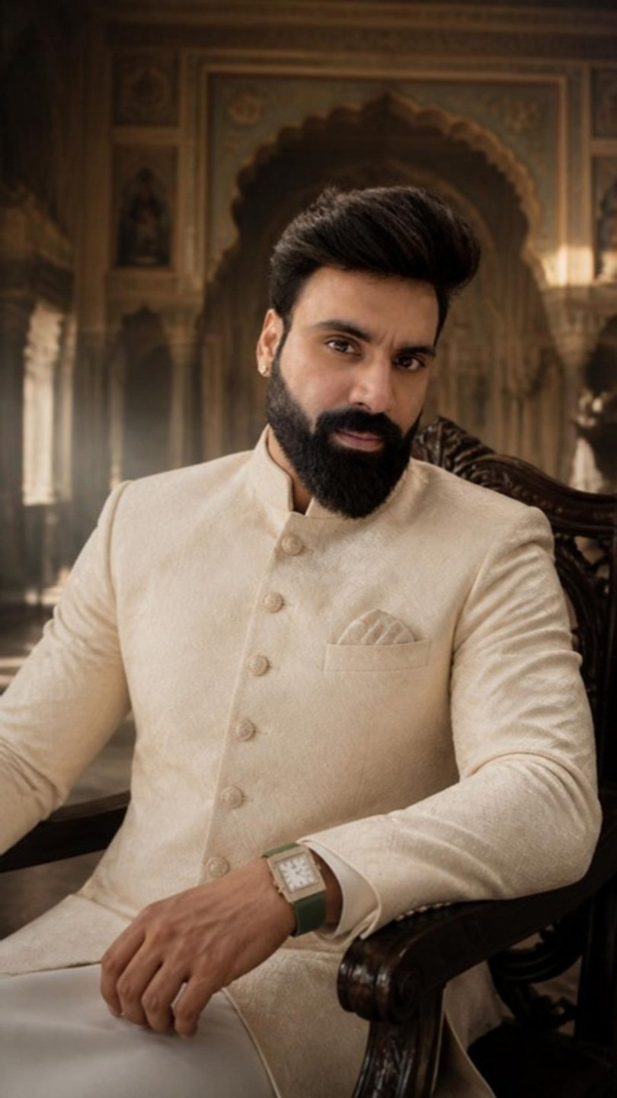
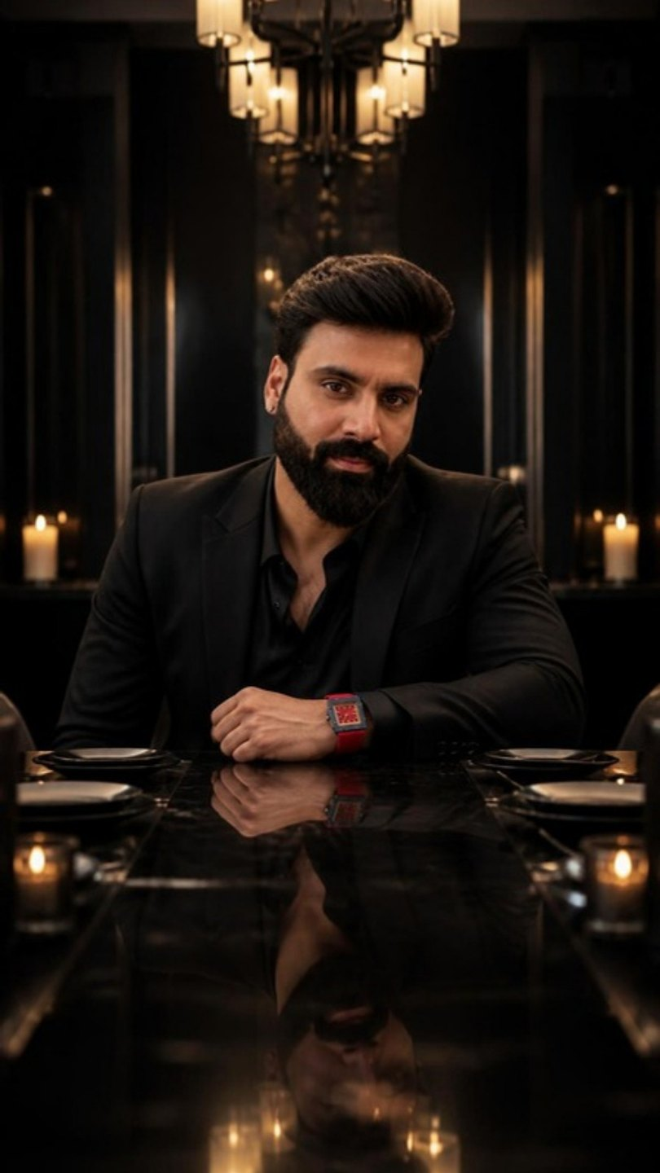
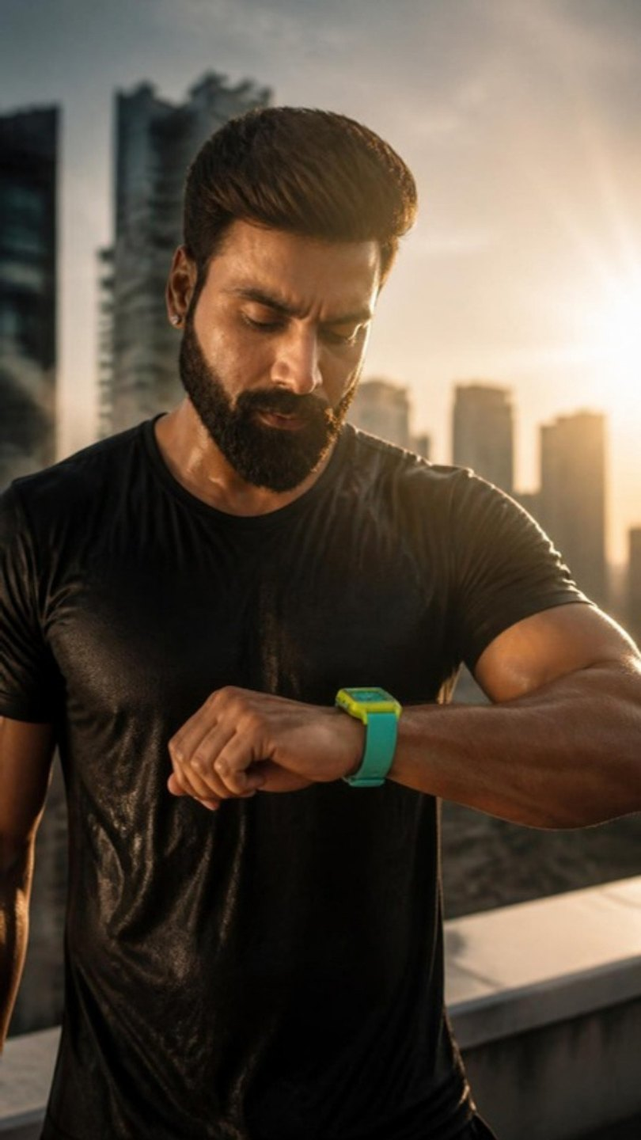
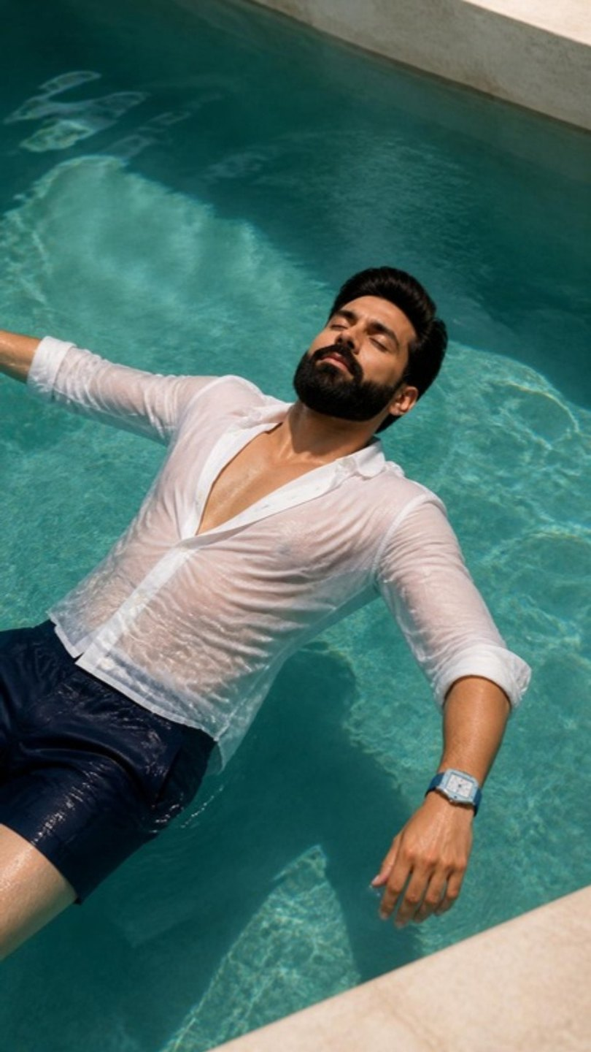
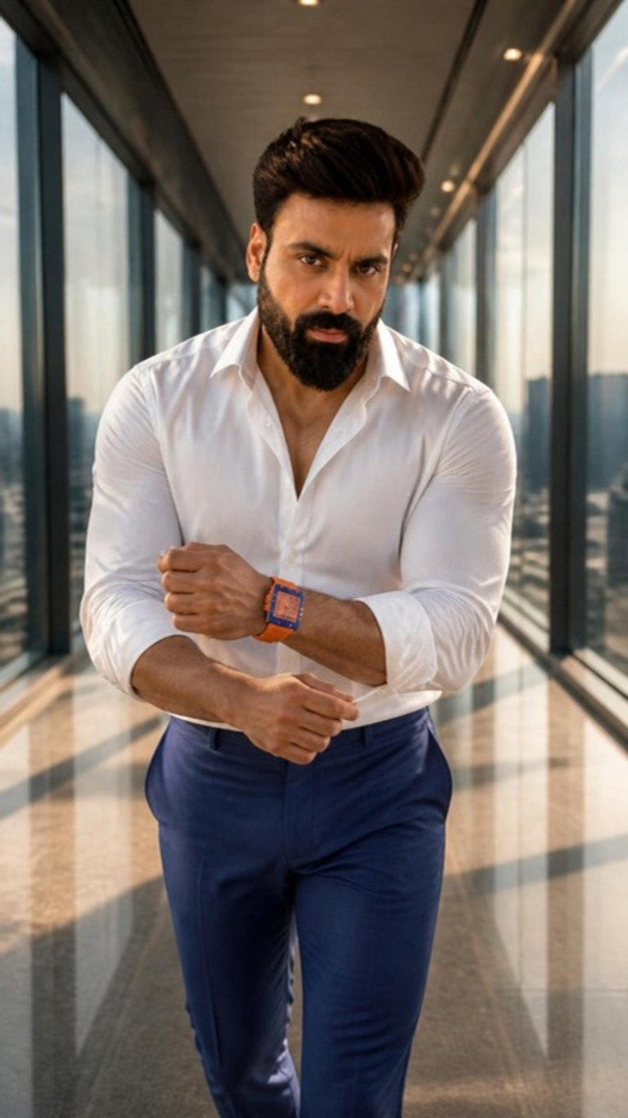
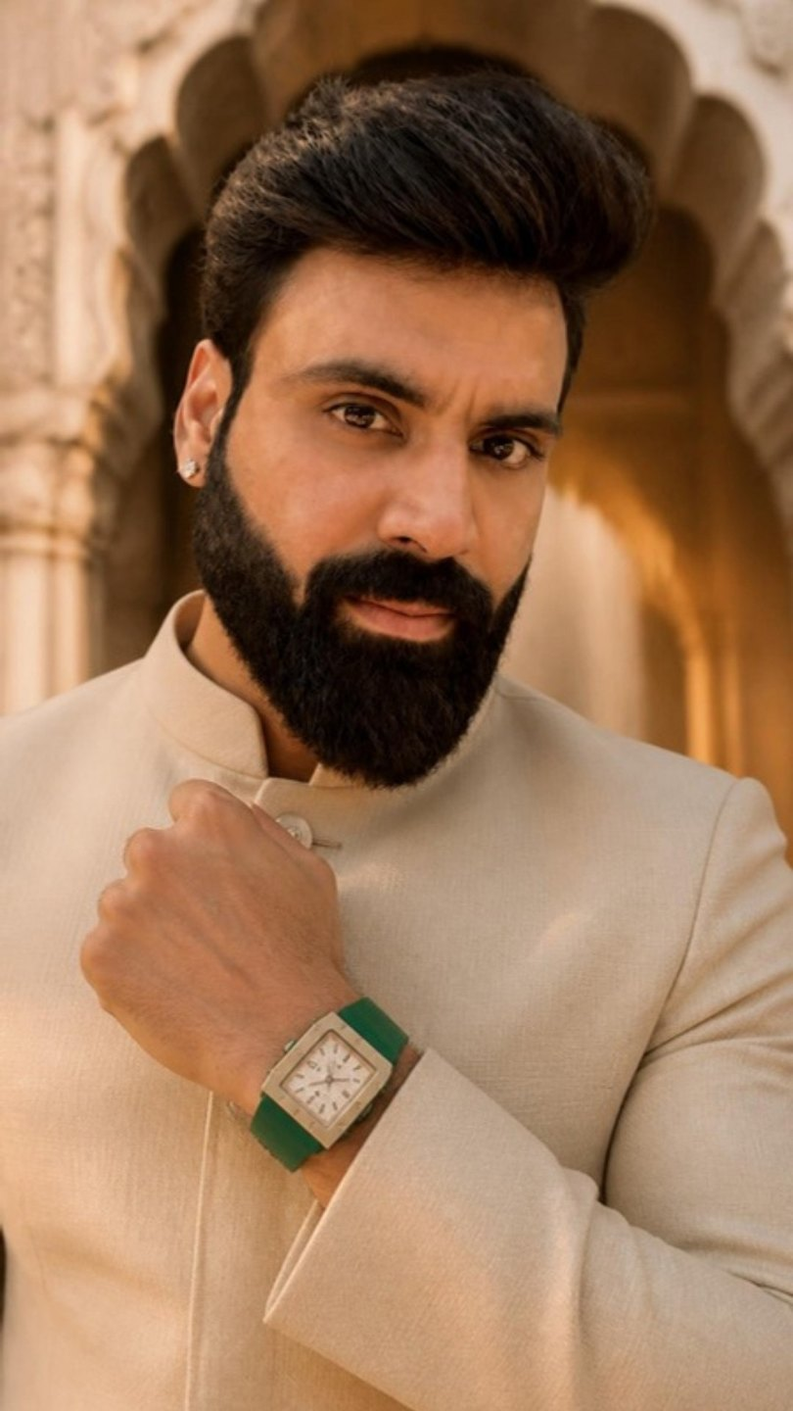
WEALTH ROOTS × MUKESH GUPTA · SHOOT PLAN
WEAR
WHAT'S
YOURS.
Five watches. Five worlds. Fifteen reels — all Mukesh ji, all in one day. Day 2 is the product shoot and Neetu's founder film.
Shoot week of 26 Oct 2026 · Dhanteras 6 Nov · Diwali 8 Nov
Prepared by Sage Media
WEALTH ROOTS × MUKESH GUPTA · WEAR WHAT'S YOURS
01

Slide 2
THE CAMPAIGN LINE
WEAR WHAT'S YOURS.
You only wear what you've earned. Five watches, five sides of one man — and every reel ends on a toast to the side he's wearing that day.
FOREST IVORY
CITRUS MINT
CERULEAN
ROYAL TANGERINE
CRIMSON NAVY
THE ONE THAT STAYS
THE ONE THAT TRAINS WITH YOU
THE ONE THAT GOES ANYWHERE
THE SELF-MADE
THE DOMINANT
Heritage · royal palace · ethnic wear
Workout · athletic
Travel · sky · water · freedom
Energy · fast · the climb
Power · alpha · black suit · red convertible
Here's to your roots.
Here's to your sweat.
Here's to your freedom.
Here's to your journey.
Here's to your power.
Wear what's yours.
Wear what's yours.
Wear what's yours.
Wear what's yours.
Wear what's yours.
EVERY REEL ENDS ON
[toast] → WEAR WHAT'S YOURS. · WEALTH ROOTS #WearWhatsYours
Neetu closes the founder film with the same line, in her words: "Jo tumhara hai — wahi pehno."
WEALTH ROOTS × MUKESH GUPTA · WEAR WHAT'S YOURS · THE CAMPAIGN
02

Slide 3
THE RULES ON SET
ONE MAN. NO WORDS ON CAMERA. ONE WORLD PER WATCH.
01
MUKESH JI IS THE ONLY PERSON ON SCREEN
02
HE NEVER SPEAKS ON CAMERA
No family, no extras, no second actor. Every other voice (an uncle, an announcer) is off-screen only.
Every word is an English voice-over, recorded separately. He acts with stillness, looks and the watch.
03
THE WATCH IS ALWAYS WORN
04
ONE WORLD PER WATCH — NEVER MIXED
Never on a floor, table, thali or cloth. In the product shoot it sits on a stand, a pillow, in its box or on a hand model.
Palace is Forest Ivory only. Gym and track for Citrus Mint. Modern pool villa for Cerulean. Glass office tower for Royal Tangerine. Night city and the red car for Crimson Navy.
05
THE CASE IS ALWAYS SHARP
06
RESTRAINT OVER NOISE
Every reel has one macro where the eight screws and the WR monogram are in focus.
Neetu: "The loudest man in the room is usually the most insecure." No flexing, no shouting. Stillness reads as power.
WEALTH ROOTS × MUKESH GUPTA · WEAR WHAT'S YOURS · RULES
03

Slide 4
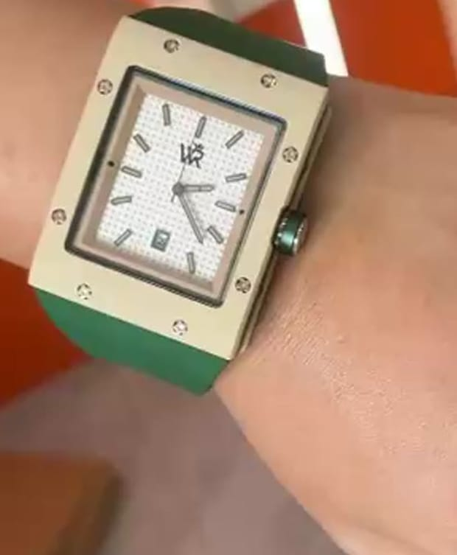
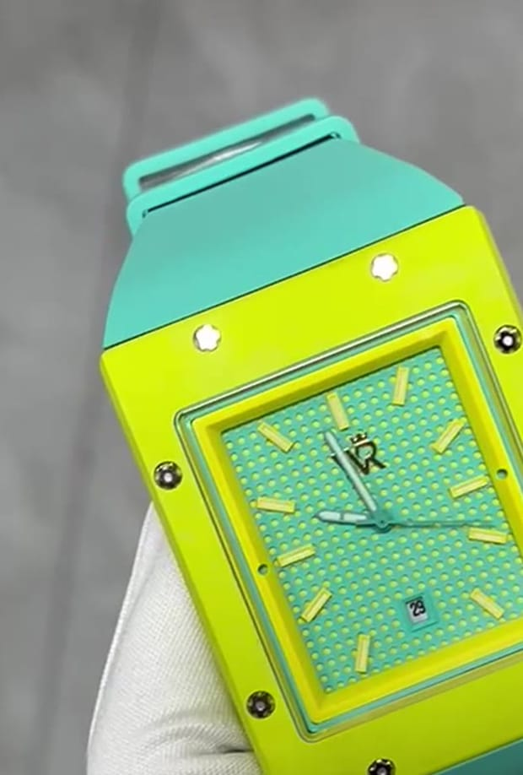
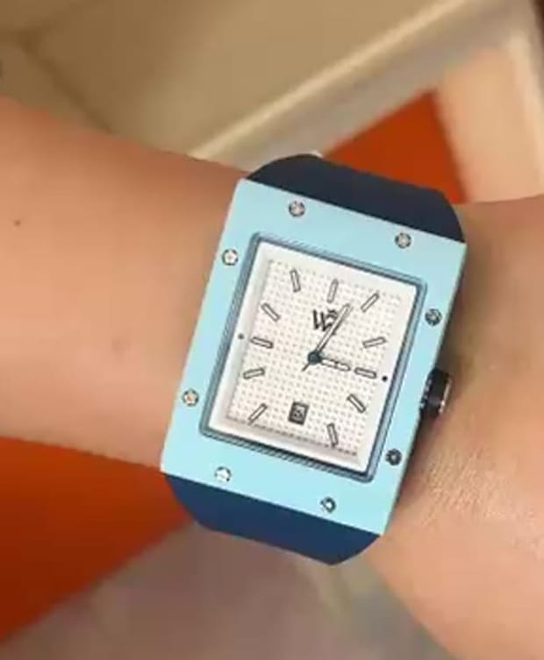
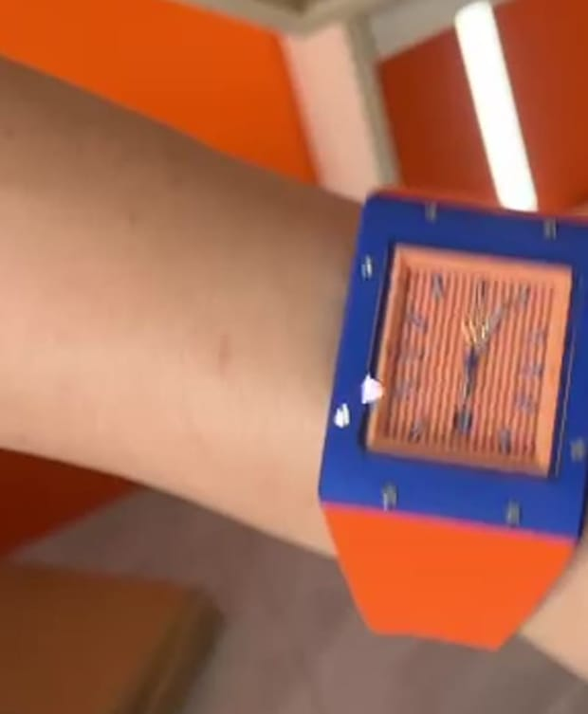
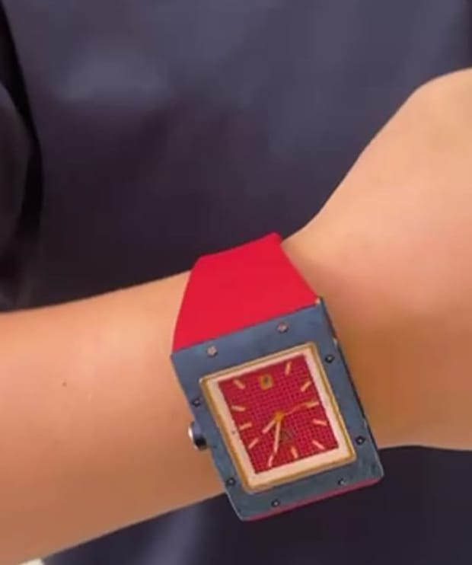
THE FIVE WATCHES · FIVE CHARACTERS
EACH ONE IS A SIDE OF HIM.
FOREST IVORY
CITRUS MINT
CERULEAN
ROYAL TANGERINE
CRIMSON NAVY
Ivory case · white waffle dial · bottle-green strap
Lime case · mint waffle dial · mint strap
Sky-blue case · white waffle dial · navy strap
Royal-blue case · orange striped dial · orange strap
Navy case · red textured dial · red strap · rose-gold hands
THE ONE THAT STAYS
THE ONE THAT TRAINS WITH YOU
THE ONE THAT GOES ANYWHERE
THE SELF-MADE
THE DOMINANT
Heritage here means one thing: what survives time. The palace is the proof it exists. The Forest Ivory is the man who builds the same way — quiet, right, made to last.
Loud in colour, quiet in effort. The one luxury watch that doesn't come off for the workout — it was built for it.
Sky on the case, clouds on the dial, deep water on the strap. The watch that reminds you that you can be anywhere — even under water.
Orange is the hunger. Royal blue is the arrival. Nothing about it was handed over. Fast cuts, momentum, no pause.
Red is a decision, not a colour. Built for the black suit, the red car and the night. Power that never raises its voice.
WEALTH ROOTS × MUKESH GUPTA · WEAR WHAT'S YOURS · THE WATCHES
04

Slide 5
LOCATIONS · A PALACE, A MODERN HOTEL, TWO FREE SPOTS
THREE PLACES. FIVE WORLDS.
USE | WHERE | WHAT WE NEED FROM IT | ASK FOR
Heritage palace (Forest Ivory only) | Narain Niwas Palace or Samode Haveli | Carved corridor, brass-studded door, darbar hall, tall windows. 2 hours, morning light. | Shoot fee for 2 hours · no diyas, no haze · quiet corridor access
Modern luxury hotel (Mint, Cerulean, Tangerine, Crimson) | A modern 5-star — e.g. Hyatt Regency / JW Marriott / Fairmont Jaipur | Gym (black floor, steel racks) · infinity pool with clean edges · glass lobby, stairwell, a corner office or boardroom with a city view · porte-cochère for the car at night · a private dining room. | Full-day access · gym before 07:00 · pool 10:30–13:00 · business floor 14:00–16:30 · porch + dining room after 18:30 · parking for the convertible
Free public spots | Central Park jogging track · JLN Marg · Albert Hall exterior | B3 sunrise run · E3 night drive past the lit facade. | Handheld, crew of three, no tripod on the pavement, no drone
Why a modern hotel: one building gives us the gym, the pool, the glass lobby and stairwell, a corner office with a city view, a private dining room and a lit porch for the car — four worlds, no company moves. Confirm pool and gym hours in writing.
WEALTH ROOTS × MUKESH GUPTA · WEAR WHAT'S YOURS · LOCATIONS
05

Slide 6
DAY 1 · RUN OF SHOW · MUKESH JI ONLY
FIFTEEN REELS, DAWN TO MIDNIGHT.
TIME | SETUP | UNIT
05:30 | Crew call at the hotel · lume UV torch charged · convertible delivered and parked | All
06:00–06:45 | B1 Nobody Claps — gym (laces) + rooftop (push-ups, sunrise) | Main
06:45–07:15 | B2 Twenty-One — gym battle ropes | Main
07:15–07:45 | B3 Proof — Central Park track (10 min away) | Main
07:45–08:00 | Move to the palace · change → ivory bandhgala | —
08:00–10:00 | A1 What Survives · A2 Everything Moves (time-lapse plate first) · A3 Thirty Years | Main
10:00–10:30 | Back to the hotel · change → white linen + navy shorts | —
10:30–13:00 | C1 Supposed To Be · C2 Quiet (underwater housing) · C3 Monday | Main
13:00–14:00 | Lunch · change → white shirt + royal-blue trousers · glass office dressed | —
14:00–16:30 | D1 Nobody Was Coming (stairwell, glass door, corridor) · D2 Two Colours (desk + lobby) · D3 Only One (window) | Main
16:30–18:30 | Break · change → black suit · car detailed · porch lights set | —
18:30–20:30 | E1 Red Is A Decision (porch, dining room) · E2 Noticed (wheel, roof, cuff) | Main
20:30–22:00 | E3 It Glows — JLN Marg / Albert Hall exterior (follow car) | Main
22:15 | Wrap · cards backed up ×2 · watches checked back in | All
WEALTH ROOTS × MUKESH GUPTA · WEAR WHAT'S YOURS · DAY 1
06

Slide 7
WORLD 01
HERITAGE · ROYAL PALACE · ETHNIC WEAR · 08:00–10:00
FOREST IVORY
Heritage here means one thing: what survives time. The palace is the proof it exists. The Forest Ivory is the man who builds the same way — quiet, right, made to last.
THE ONE THAT STAYS
Here's to your roots. Wear what's yours.
WHERE
Heritage palace interiors only — carved corridor, brass-studded door, darbar hall, tall windows.
WARDROBE
Ivory bandhgala, tan juttis. One look for all three reels.
SOUND
Strings and silence. No beat.
A1
A2
A3
WHAT SURVIVES
EVERYTHING MOVES
THIRTY YEARS
Hero · 30 s
Time-lapse · 20 s
Punch · 10 s
Belonging to something bigger
Stillness as strength
One line you remember
Ivory
Sandstone
Bottle green
Brass
WEALTH ROOTS × MUKESH GUPTA · WEAR WHAT'S YOURS · FOREST IVORY
07

Slide 8
A1 · HERO · 30 S · 9:16 · ENGLISH VO
WHAT SURVIVES
Belonging to something bigger
VOICE-OVER · THE PICK
WHY THIS ONE
Everything here was built to outlast the men who built it.
The arches. The doors. Even the silence.
A hundred years on, they're still standing.
Not because they were loud.
Because they were made right.
Heritage isn't what you inherit.
It's what survives you.
Here's to your roots. Wear what's yours.
Built to outlast → still standing → made right → heritage is what survives you. The watch is never named and every line is about it.
MUSIC REFERENCE · TAP TO LISTEN
Max Richter — "On the Nature of Daylight"
Footsteps on marble · a door's brass studs · wind through the arches · one clasp click.
OTHER OPTIONS WRITTEN FOR THIS REEL
QUIET THINGS
NOBODY RUSHED THIS
The loudest things in history are gone. The parades. The speeches. The men who needed to be seen. What's left is the quiet work — the stone, the carving, the things made by people who never asked for applause. Heritage is quiet. That's how you know it's real.
Nobody rushed this palace. Nobody could. Stone doesn't care about deadlines. Neither does anything built to be remembered. You can make something fast, or you can make something last. The men who built this chose.
AI frame · Mukesh ji likeness, watch exact
WEALTH ROOTS × MUKESH GUPTA · WEAR WHAT'S YOURS · FOREST IVORY · A1
08

Slide 9
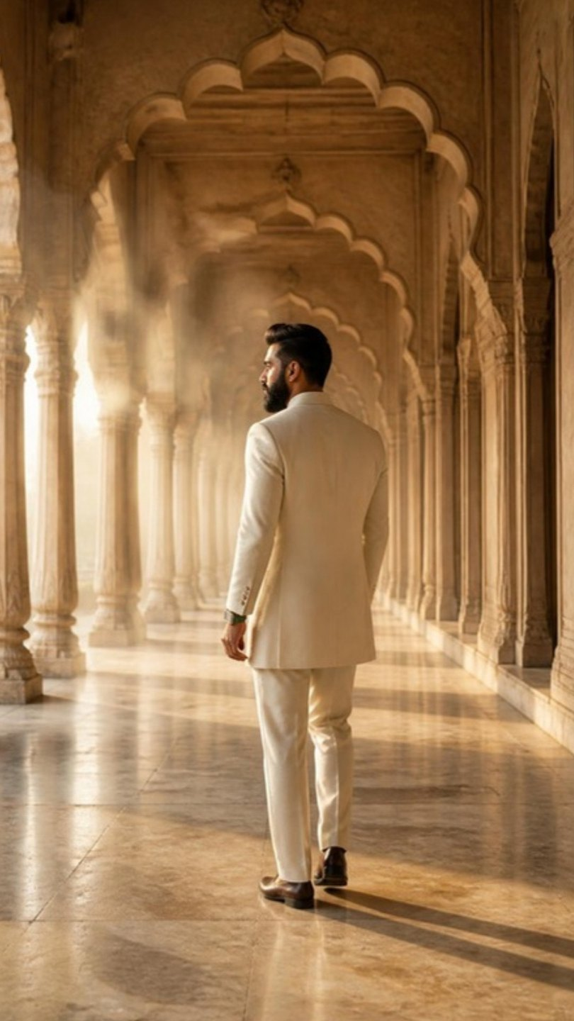
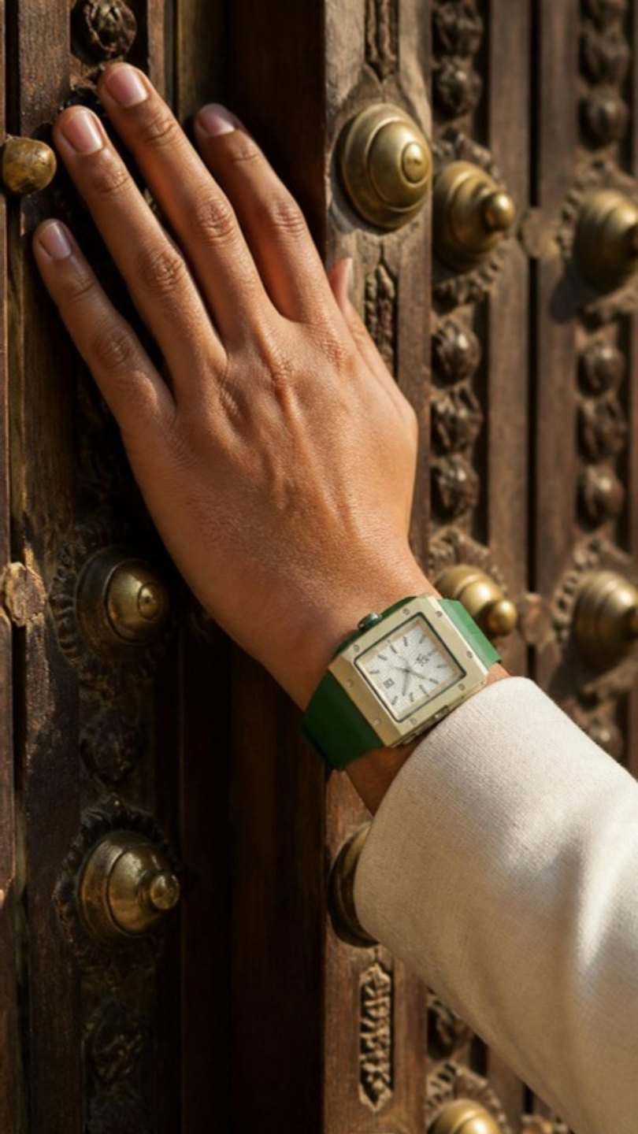
A1 · STORYBOARD · 3 CLIPS × 8 S
WHAT SURVIVES
The real watch — match colours exactly
MOTION · FOR THE VIDEO PASS
A1-1: Slow push forward down the corridor as he walks away from camera, dust drifting in the light.
A1-2: Very slow slide along the door; his hand lifts slightly so the watch catches a strip of sun.
A1-3: Locked camera, slow push-in; the light shifts across the floor, he does not move.
A1-1 · OPEN
A1-2 · MIDDLE
A1-3 · CLOSE
VISUAL REFERENCES — TAP TO OPEN
Frame: Early morning in a long palace corridor of carved sandstone arches, low sun raking across the marble. He stands far down the corridor, small in frame, facing away.
Frame: Close on his left hand resting flat on a massive carved wooden door studded with old brass; the ivory case beside the aged brass, both in the same warm light.
Frame: The darbar hall, tall arches, soft haze. He sits perfectly still in a carved wooden chair at the centre, wrist on the armrest, looking straight at the lens.
Pinterest · palace corridor cinematic portrait
Instagram · @sabyasachiofficial — heritage pacing
WEALTH ROOTS × MUKESH GUPTA · WEAR WHAT'S YOURS · FOREST IVORY · A1
09

Slide 10
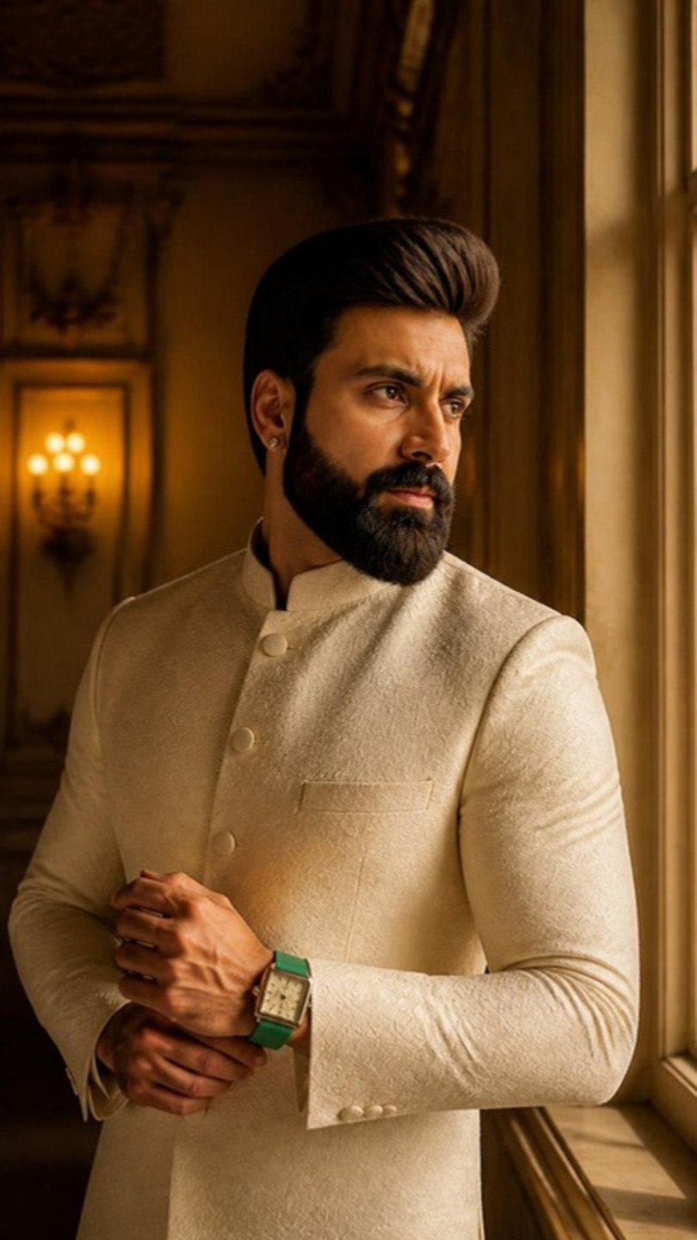
A2 · TIME-LAPSE · 20 S · 9:16 · ENGLISH VO
EVERYTHING MOVES
Stillness as strength
VOICE-OVER · THE PICK
WHY THIS ONE
Everything moves.
Trends. Cities. What people call success this year.
The light in this hall alone has moved a hundred thousand times.
And the hall hasn't.
That's the difference between a trend and a root.
One moves with time.
The other, time moves around.
Here's to your roots. Wear what's yours.
Everything moves → the light here moved a hundred thousand times, the hall didn't → trend vs root → the turn.
MUSIC REFERENCE · TAP TO LISTEN
Ólafur Arnalds — "Saman"
A ticking second hand at real speed under the sped-up light · curtains · birds.
OTHER OPTIONS WRITTEN FOR THIS REEL
BELONGS
STILL HERE
Some things look borrowed wherever they go. The wrong watch with a bandhgala. The wrong man in an old room. And some things look like they were always there. That's the whole secret of heritage. It never has to try.
This hall has watched a hundred years of people trying to look important. None of them are here anymore. The hall is. Roots aren't about standing out. They're about standing.
AI frame · Mukesh ji likeness, watch exact
WEALTH ROOTS × MUKESH GUPTA · WEAR WHAT'S YOURS · FOREST IVORY · A2
10

Slide 11
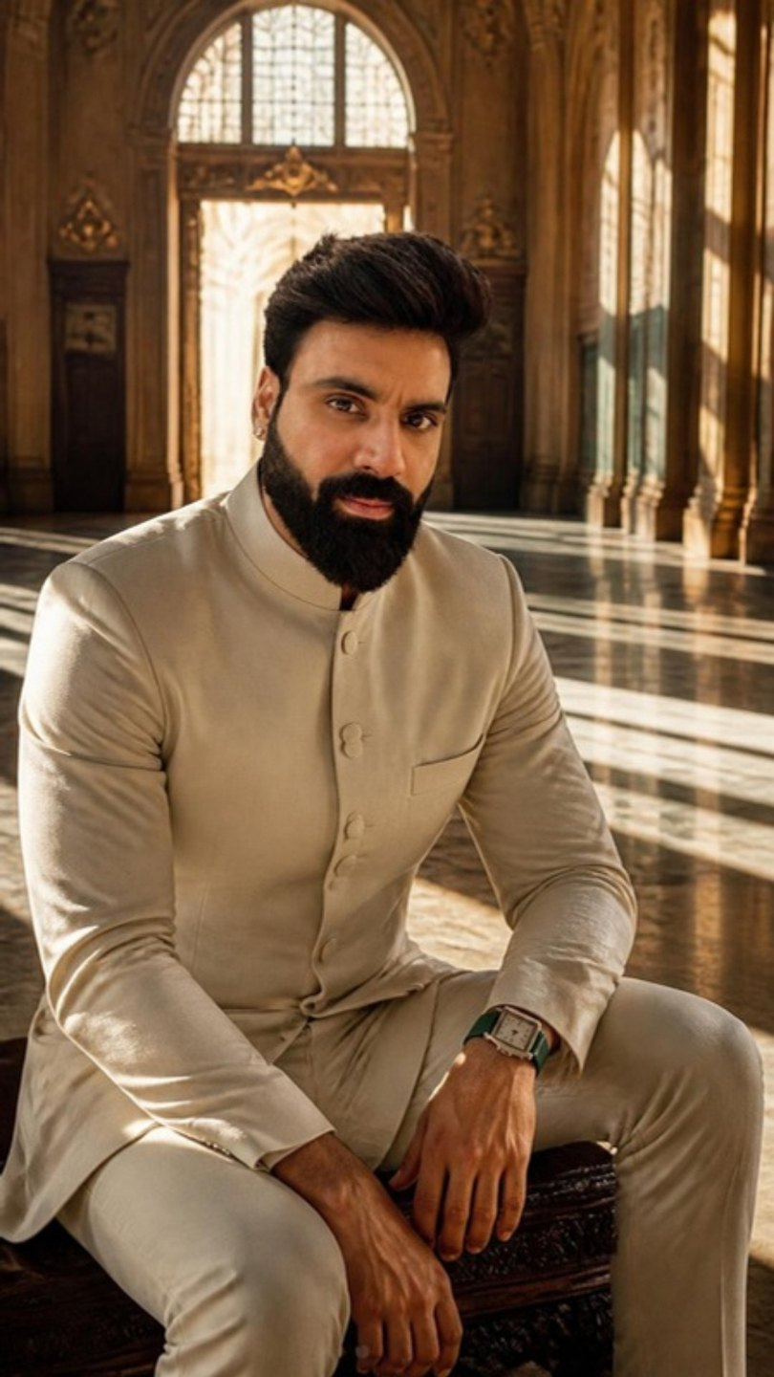
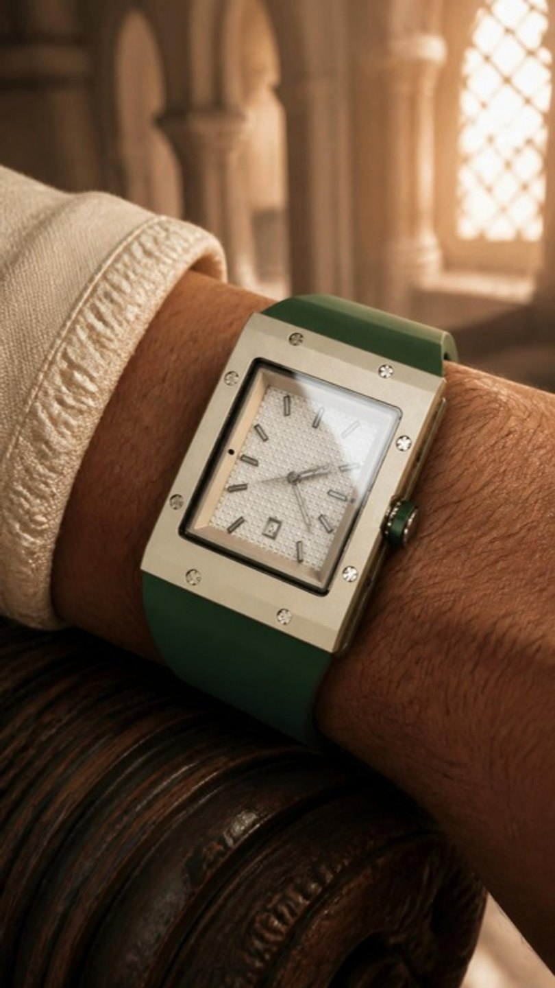
A2 · STORYBOARD · 3 CLIPS × 8 S
EVERYTHING MOVES
The real watch — match colours exactly
MOTION · FOR THE VIDEO PASS
A2-1: Time-lapse: the bars of light sweep fast across the floor and walls, curtains flutter, while he stays absolutely still.
A2-2: Locked macro; only the second hand sweeps at real speed, a reflection drifting across the crystal.
A2-3: Slow push-in from behind as the light fades; he turns his head slightly toward the window.
A2-1 · OPEN
A2-2 · MIDDLE
A2-3 · CLOSE
VISUAL REFERENCES — TAP TO OPEN
Frame: Wide symmetrical hall with tall windows; sunlight falls in long diagonal bars across the floor. He sits motionless on a carved bench at the centre.
Frame: Macro of the watch on his wrist on the carved bench: white waffle dial, eight screws, bottle-green strap.
Frame: Same hall at dusk, deep amber light; he stands and faces the tall window, back half-turned, watch visible.
Pinterest · time-lapse light interior man still
Instagram · @cartier — slow light play
WEALTH ROOTS × MUKESH GUPTA · WEAR WHAT'S YOURS · FOREST IVORY · A2
11

Slide 12
A3 · PUNCH · 10 S · 9:16 · ENGLISH VO
THIRTY YEARS
One line you remember
VOICE-OVER · THE PICK
WHY THIS ONE
Fashion is what you wear this year.
Heritage is what you're still wearing in thirty.
Here's to your roots. Wear what's yours.
Two lines, one turn. It defines the watch as timeless without describing it.
MUSIC REFERENCE · TAP TO LISTEN
Nicholas Britell — "Succession (Main Title Theme)"
Footsteps · one clasp click on the last word.
OTHER OPTIONS WRITTEN FOR THIS REEL
OLD-FASHIONED
NO ANNOUNCEMENT
They'll call it old-fashioned. Right up until it outlasts everything they're wearing.
Heritage doesn't announce itself. It was here before the announcement. It'll be here after.
AI frame · Mukesh ji likeness, watch exact
WEALTH ROOTS × MUKESH GUPTA · WEAR WHAT'S YOURS · FOREST IVORY · A3
12

Slide 13
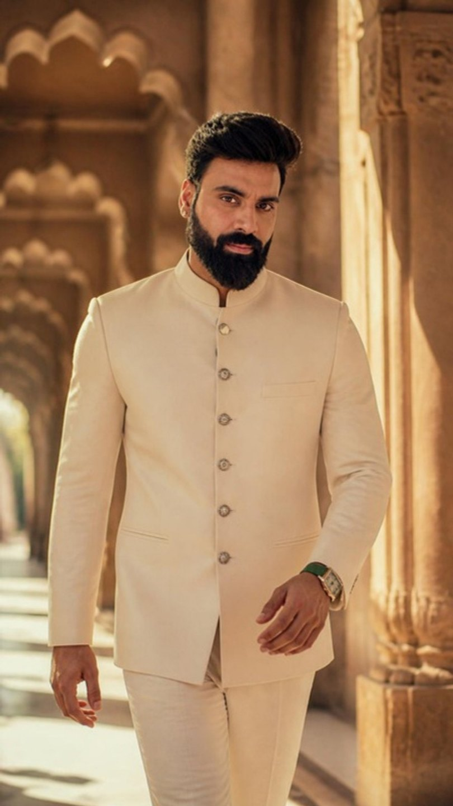
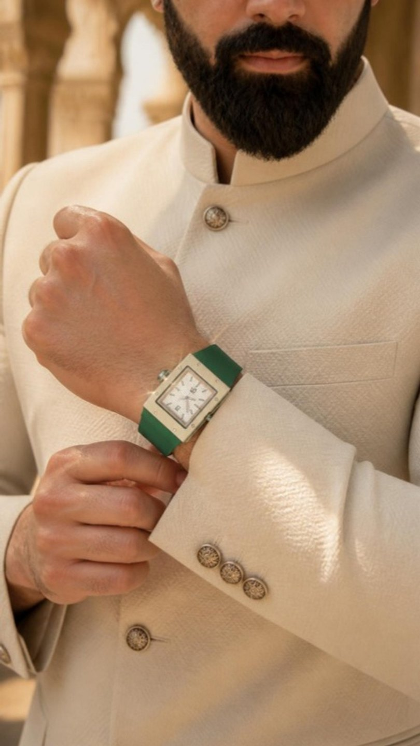
A3 · STORYBOARD · 3 CLIPS × 8 S
THIRTY YEARS
The real watch — match colours exactly
MOTION · FOR THE VIDEO PASS
A3-1: Slow backward track at waist height as he walks toward camera, light pulsing through each arch.
A3-2: 85mm slow motion; the cuff slides back and sunlight flares across the case.
A3-3: Locked, slow push-in; he holds the look, barely breathing.
A3-1 · OPEN
A3-2 · MIDDLE
A3-3 · CLOSE
VISUAL REFERENCES — TAP TO OPEN
Frame: A sunlit palace corridor of arches. He walks toward camera in the ivory bandhgala, mid-stride, calm.
Frame: Close on his hands adjusting the cuff at chest height, the watch coming into view against the ivory fabric.
Frame: Medium close: he stops under an arch and looks straight into the lens, steady, unsmiling, warm light on one side of his face.
Pinterest · bandhgala portrait palace arch
WEALTH ROOTS × MUKESH GUPTA · WEAR WHAT'S YOURS · FOREST IVORY · A3
13

Slide 14
WORLD 02
WORKOUT · ATHLETIC · 06:00–07:45
CITRUS MINT
Loud in colour, quiet in effort. The one luxury watch that doesn't come off for the workout — it was built for it.
THE ONE THAT TRAINS WITH YOU
Here's to your sweat. Wear what's yours.
WHERE
Modern gym (black rubber floor, steel racks), a concrete rooftop at sunrise, a public park running track. No heritage anywhere.
WARDROBE
Black training tee, black shorts, white trainers — so the lime pops.
SOUND
Breath, rope, one kick drum.
B1
B2
B3
NOBODY CLAPS
TWENTY-ONE
PROOF
Hero · 30 s
Counter · 15 s
Punch · 10 s
Respect for what nobody sees
Adrenaline
A nod
Black
Lime
Mint
Sunrise
WEALTH ROOTS × MUKESH GUPTA · WEAR WHAT'S YOURS · CITRUS MINT
14

Slide 15
B1 · HERO · 30 S · 9:16 · ENGLISH VO
NOBODY CLAPS
Respect for what nobody sees
VOICE-OVER · THE PICK
WHY THIS ONE
Nobody claps at five in the morning.
No crowd. No camera. Nobody to impress.
Just you, and the version of you that wanted to stay in bed.
Every morning, one of them wins.
The world only ever sees the result.
The watch sees the mornings.
Here's to your sweat. Wear what's yours.
The watch becomes the only witness to the work. "The watch sees the mornings" is the line that makes it the athlete's watch.
MUSIC REFERENCE · TAP TO LISTEN
Hans Zimmer — "Mountains" (Interstellar)
Laces · breath · a push-up on concrete · wind on the roof · one kick on the end card.
OTHER OPTIONS WRITTEN FOR THIS REEL
YOU CAN'T BUY THIS
IT COMES OFF
You can buy the shoes. The gym. The coach. The playlist. You can buy everything that makes it look easy. You can't buy one drop of this. This, you earn. One morning at a time.
Most luxury watches come off before the workout. Too precious. Too delicate. Too scared of a little sweat. This one was made for it. It doesn't watch you train. It trains with you.
AI frame · Mukesh ji likeness, watch exact
WEALTH ROOTS × MUKESH GUPTA · WEAR WHAT'S YOURS · CITRUS MINT · B1
15

Slide 16
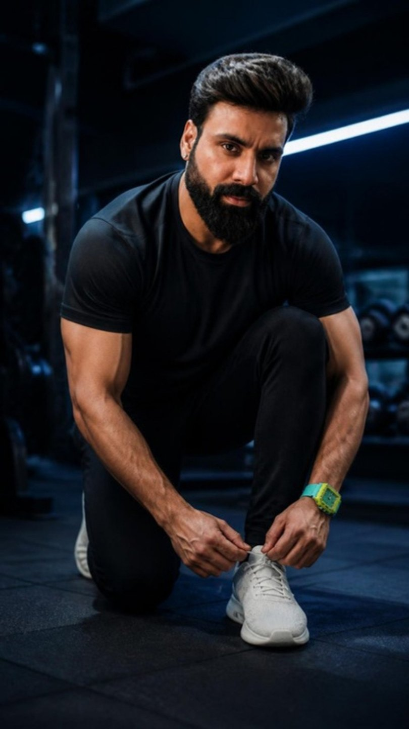
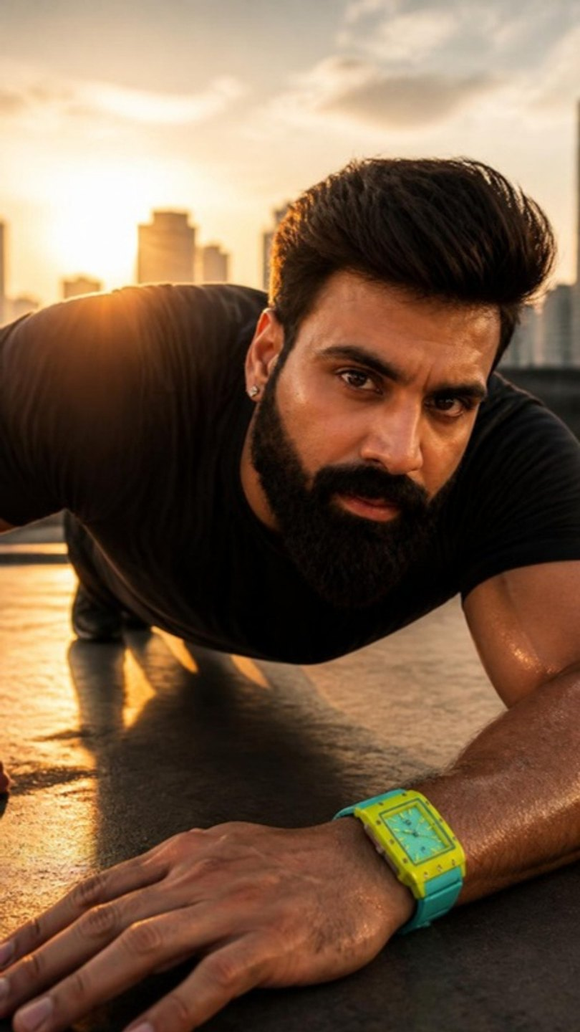
B1 · STORYBOARD · 3 CLIPS × 8 S
NOBODY CLAPS
The real watch — match colours exactly
MOTION · FOR THE VIDEO PASS
B1-1: Handheld, quiet; he finishes lacing, exhales, looks up.
B1-2: Slow motion; he presses up, a drop of sweat falls past the watch, the sun flares.
B1-3: Slow push-in from behind into silhouette; he lowers his wrist and stays facing the sun.
B1-1 · OPEN
B1-2 · MIDDLE
B1-3 · CLOSE
VISUAL REFERENCES — TAP TO OPEN
Frame: Blue hour in a dark modern gym, one strip of LED light. He kneels and laces white trainers; the lime watch is the only bright thing in frame.
Frame: Sunrise on a concrete rooftop, city towers behind: he is at the bottom of a push-up, backlit, sweat on his arms; macro on the lime watch flexing on his wrist.
Frame: He stands tall at the rooftop edge, chest heaving, steam off his shoulders, the sun over the skyline, wrist raised to check the watch.
Pinterest · 5am rooftop workout sunrise cinematic
Instagram · @tagheuer — sport edits
WEALTH ROOTS × MUKESH GUPTA · WEAR WHAT'S YOURS · CITRUS MINT · B1
16

Slide 17
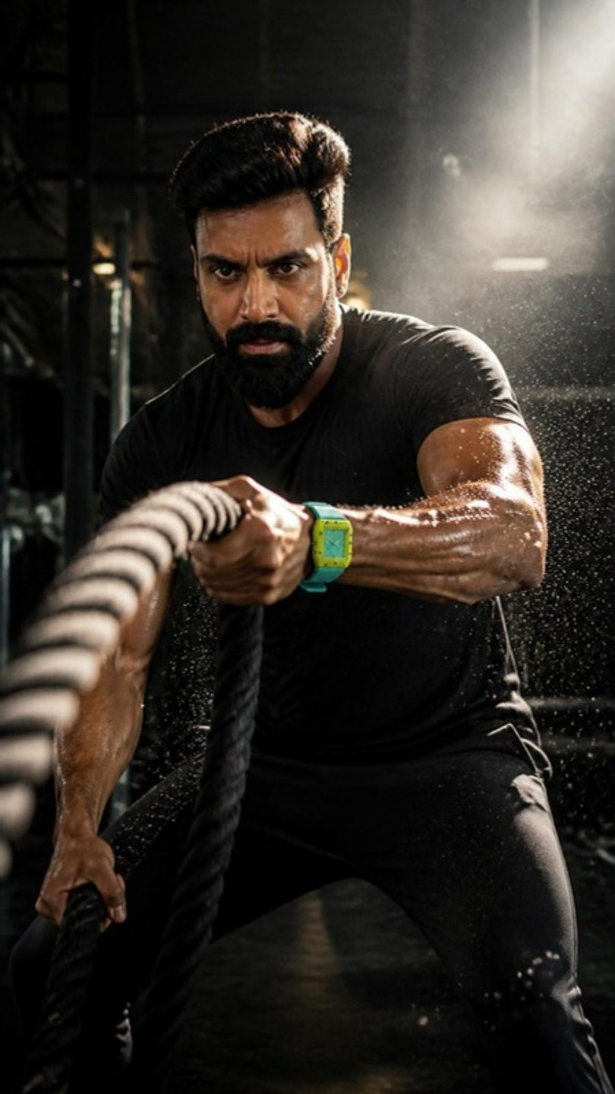
B2 · COUNTER · 15 S · 9:16 · ENGLISH VO
TWENTY-ONE
Adrenaline
VOICE-OVER · THE PICK
WHY THIS ONE
The body quits at ten.
The mind quits at twenty.
Everything you want lives in twenty-one.
Here's to your sweat. Wear what's yours.
A counting rhythm with real tension. An on-screen rep counter (1 → 21) is added in the edit.
MUSIC REFERENCE · TAP TO LISTEN
Kendrick Lamar — "HUMBLE." (instrumental)
Rope slams on the beat · breath · silence before rep 21 · one slam.
OTHER OPTIONS WRITTEN FOR THIS REEL
REST DAY
FROM TOMORROW
Rest days are for the body. Not for the standard.
Every fitness plan starts with the same two words. From tomorrow. From Monday. From the first. From after the wedding. Mine started the day I stopped saying them.
AI frame · Mukesh ji likeness, watch exact
WEALTH ROOTS × MUKESH GUPTA · WEAR WHAT'S YOURS · CITRUS MINT · B2
17

Slide 18
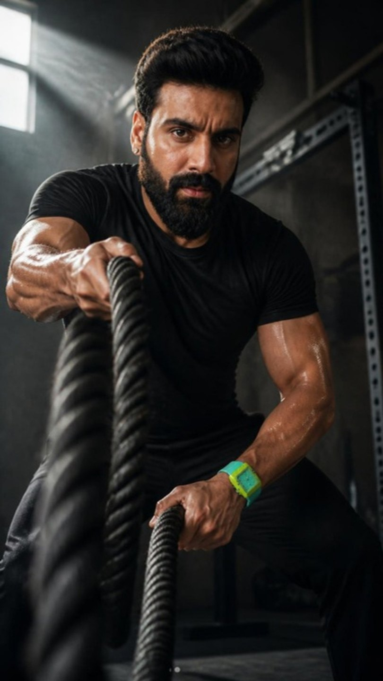
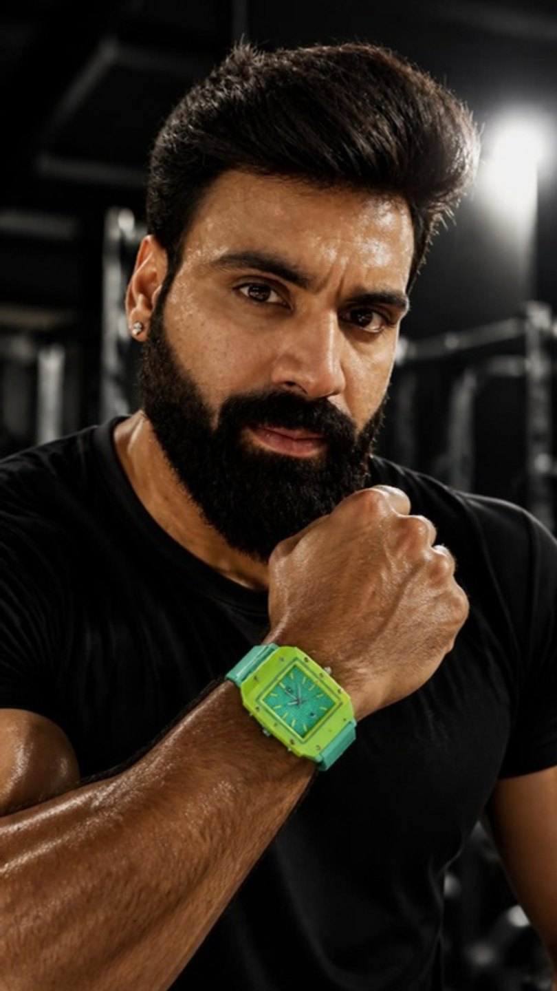
B2 · STORYBOARD · 3 CLIPS × 8 S
TWENTY-ONE
The real watch — match colours exactly
MOTION · FOR THE VIDEO PASS
B2-1: Fast rhythmic slams, rope waves crashing toward lens, sweat flicking in the light.
B2-2: 85mm, slight handheld shake with each slam; his breathing is visible.
B2-3: He straightens, grabs the ropes and delivers one final massive slam in extreme slow motion, sweat exploding off his arms.
B2-1 · OPEN
B2-2 · MIDDLE
B2-3 · CLOSE
VISUAL REFERENCES — TAP TO OPEN
Frame: Modern industrial gym, one hard shaft of window light: tight low-angle of him slamming battle ropes, rope waves rushing toward camera, lime watch on his gripping hand.
Frame: Close on his face mid-effort: jaw clenched, sweat, eyes locked forward.
Frame: He stands bent over, hands on knees, gasping, then glances at the watch; ropes at his feet.
Pinterest · battle ropes cinematic gym
WEALTH ROOTS × MUKESH GUPTA · WEAR WHAT'S YOURS · CITRUS MINT · B2
18

Slide 19
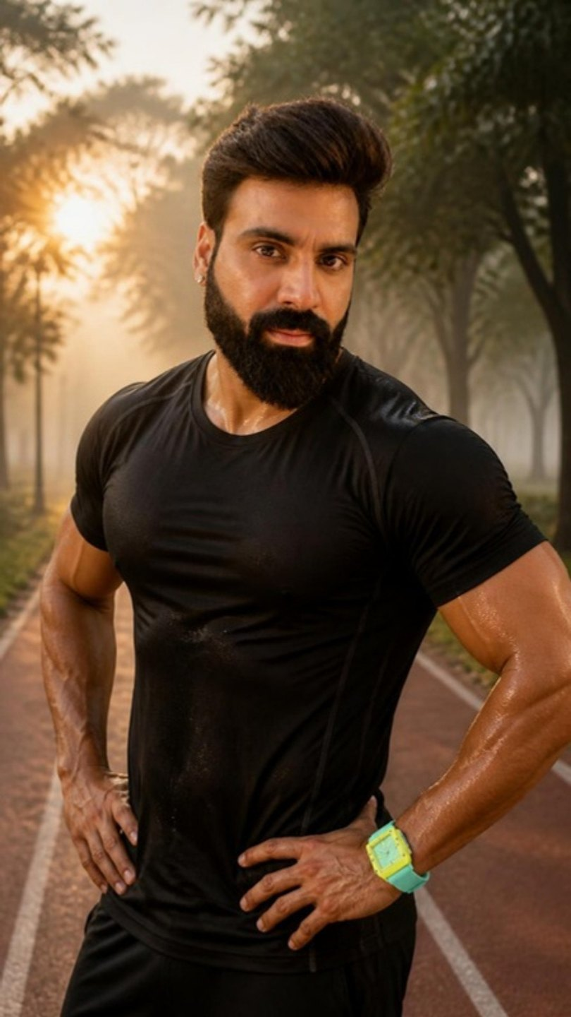
B3 · PUNCH · 10 S · 9:16 · ENGLISH VO
PROOF
A nod
VOICE-OVER · THE PICK
WHY THIS ONE
Talent is a rumour.
Sweat is proof.
Here's to your sweat. Wear what's yours.
Five words. It ties "sweat" to the ending line and needs no explanation.
MUSIC REFERENCE · TAP TO LISTEN
Gesaffelstein — "Opr"
Footfalls · breath · a hard stop · one tick.
OTHER OPTIONS WRITTEN FOR THIS REEL
WHY SO BRIGHT?
SNOOZE
(Uncle on the morning walk, off-screen): "Beta, why such a bright watch?" — So you can see me coming. And going.
The snooze button has never built anything.
AI frame · Mukesh ji likeness, watch exact
WEALTH ROOTS × MUKESH GUPTA · WEAR WHAT'S YOURS · CITRUS MINT · B3
19

Slide 20
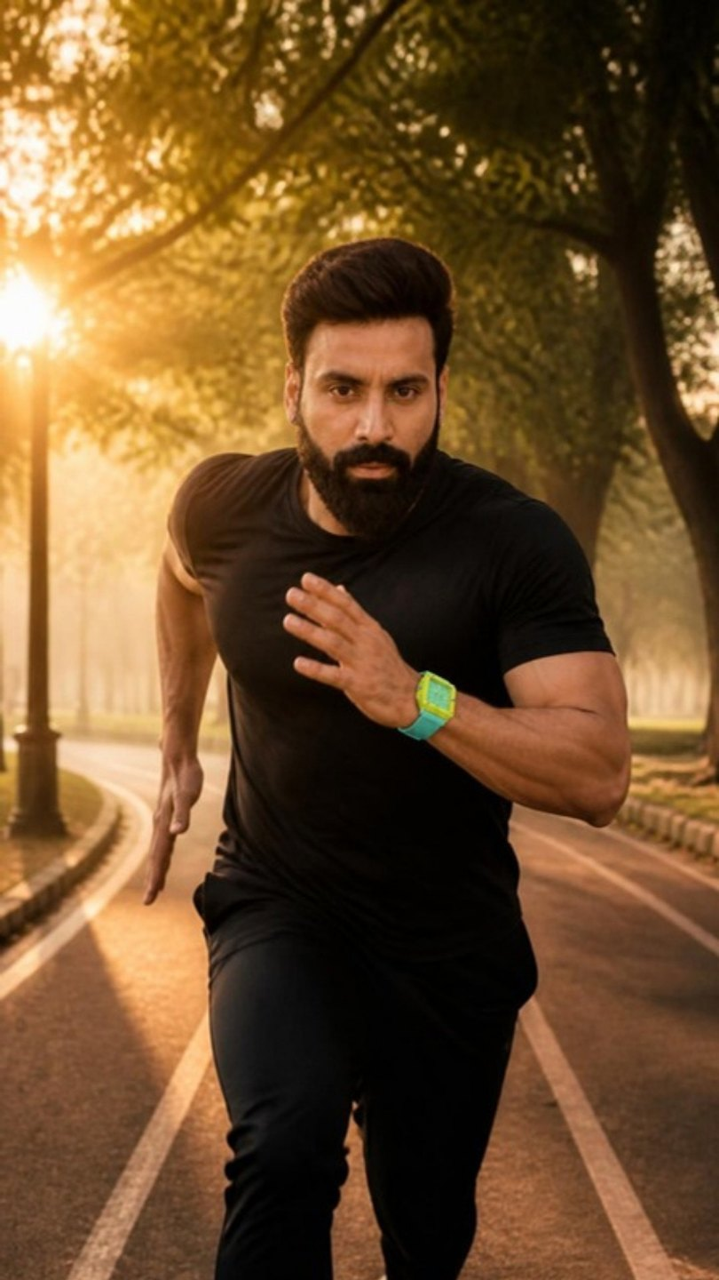
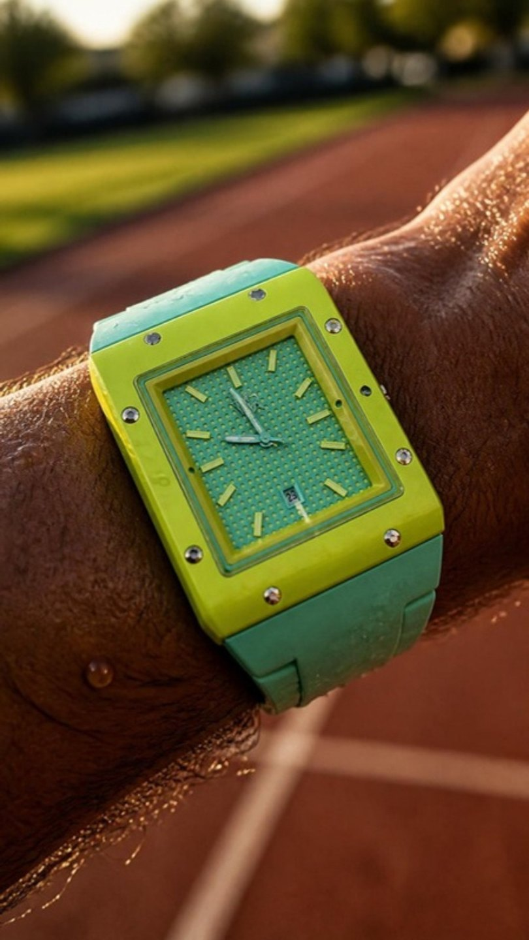
B3 · STORYBOARD · 3 CLIPS × 8 S
PROOF
The real watch — match colours exactly
MOTION · FOR THE VIDEO PASS
B3-1: Backward tracking, 35mm, sun flare pulsing through the trees as he closes the distance.
B3-2: Slow motion, the arm swings through frame once.
B3-3: Locked; he holds the look and takes one slow breath.
B3-1 · OPEN
B3-2 · MIDDLE
B3-3 · CLOSE
VISUAL REFERENCES — TAP TO OPEN
Frame: Sunrise on a tree-lined park running track, golden mist, empty path. He sprints straight toward camera, arms driving, the lime watch flashing.
Frame: Macro of the watch on his wrist mid-stride, sweat on the skin, the mint strap damp, low sun on the lime case.
Frame: He stops, drenched, hands on hips, and looks dead into the lens with a slight nod, mist and sun behind him.
Pinterest · sunrise run park track cinematic
WEALTH ROOTS × MUKESH GUPTA · WEAR WHAT'S YOURS · CITRUS MINT · B3
20

Slide 21
WORLD 03
TRAVEL · SKY · WATER · FREEDOM · 10:30–13:00
CERULEAN
Sky on the case, clouds on the dial, deep water on the strap. The watch that reminds you that you can be anywhere — even under water.
THE ONE THAT GOES ANYWHERE
Here's to your freedom. Wear what's yours.
WHERE
A modern minimalist villa pool — clean white stone edges, turquoise water, open sky. No heritage.
WARDROBE
Open white linen shirt, navy swim shorts / navy linen trousers.
SOUND
Piano, water, breath.
C1
C2
C3
SUPPOSED TO BE
QUIET
MONDAY
Hero · 30 s
Underwater · 15 s
Punch · 10 s
Letting go
Total calm
A smile
Sky blue
White
Navy
Pool
WEALTH ROOTS × MUKESH GUPTA · WEAR WHAT'S YOURS · CERULEAN
21

Slide 22
C1 · HERO · 30 S · 9:16 · ENGLISH VO
SUPPOSED TO BE
Letting go
VOICE-OVER · THE PICK
WHY THIS ONE
Every watch you've ever owned told you where you were supposed to be.
The meeting. The deadline. The flight you couldn't miss.
This one tells you something else.
The sky doesn't keep a schedule.
The water doesn't check the time.
And today, neither do you.
Here's to your freedom. Wear what's yours.
Watches tell you where to be → this one says the sky and the water don't keep time → and today neither do you.
MUSIC REFERENCE · TAP TO LISTEN
Ludovico Einaudi — "Experience"
Water lapping · a distant plane · wind · nothing else.
OTHER OPTIONS WRITTEN FOR THIS REEL
NOTHING, FINALLY
THE WINDOW SEAT
People think freedom is doing nothing. It isn't. It's years of doing everything… so that one afternoon, nothing is finally allowed.
Sky blue, for every horizon you haven't reached yet. White, like the clouds outside a window seat. Navy, like the deep end you finally jumped into. Most watches remind you where you're supposed to be. This one reminds you that you can be anywhere.
AI frame · Mukesh ji likeness, watch exact
WEALTH ROOTS × MUKESH GUPTA · WEAR WHAT'S YOURS · CERULEAN · C1
22

Slide 23
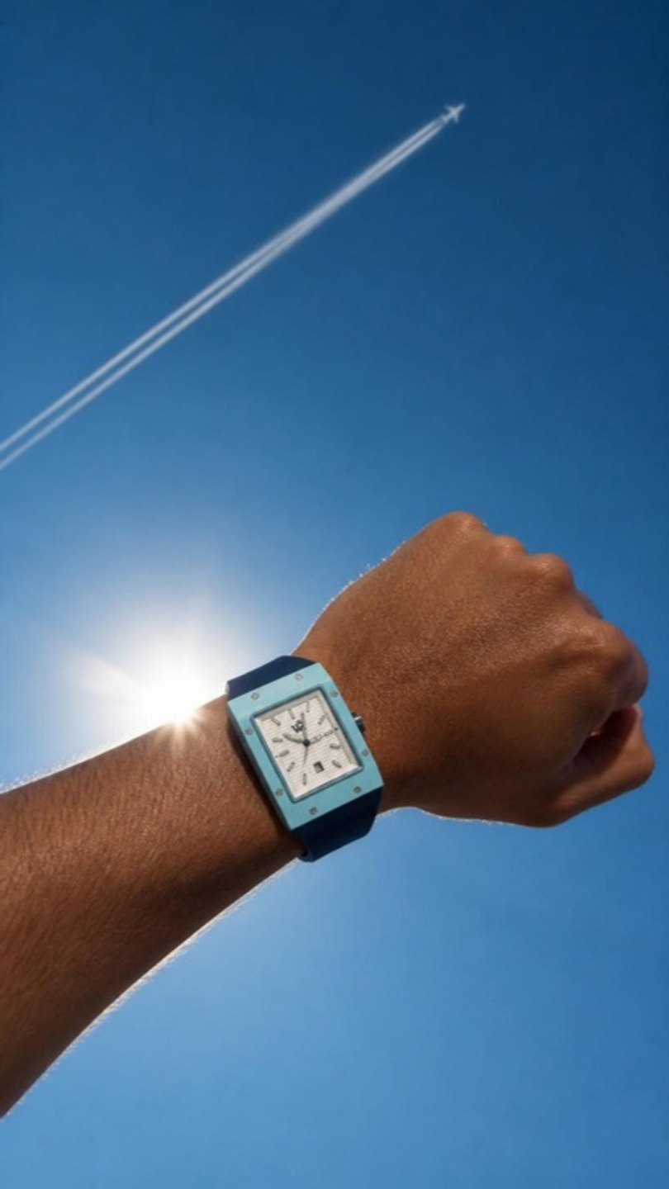
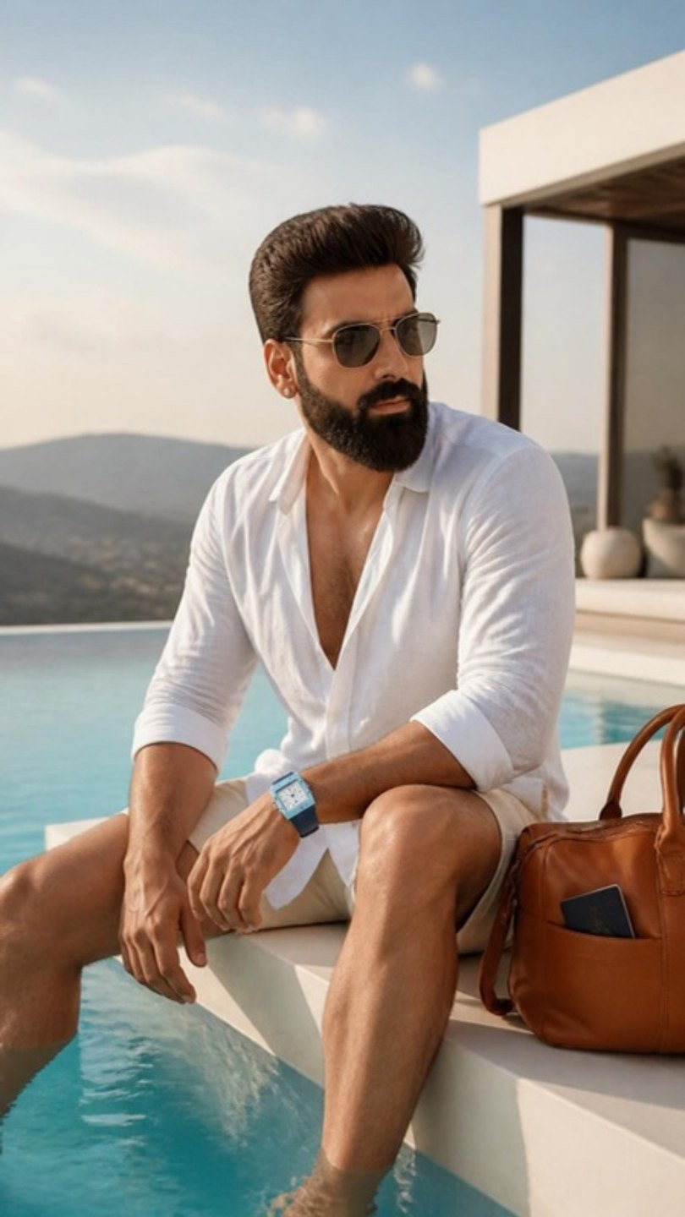
C1 · STORYBOARD · 3 CLIPS × 8 S
SUPPOSED TO BE
The real watch — match colours exactly
MOTION · FOR THE VIDEO PASS
C1-1: Very slow overhead rotation; ripples spread gently from his hands.
C1-2: Slow drift; the sun flares behind the wrist, the contrail lengthens.
C1-3: Slow push-in from the side; water laps at his legs, he leans back on his hands.
C1-1 · OPEN
C1-2 · MIDDLE
C1-3 · CLOSE
VISUAL REFERENCES — TAP TO OPEN
Frame: Top-down: he floats on his back in a still turquoise infinity pool at a modern villa, arms out, eyes on the sky, the sky-blue watch above the water.
Frame: Low angle: his left wrist raised against a vast clear blue sky, the sky-blue case almost melting into it, one plane contrail high above.
Frame: He sits on the white stone pool edge in the open linen shirt, legs in the water, a leather weekender beside him with a passport tucked in, looking at the open sky.
Pinterest · infinity pool villa man floating sky
Instagram · @omega — water and sky
WEALTH ROOTS × MUKESH GUPTA · WEAR WHAT'S YOURS · CERULEAN · C1
23

Slide 24
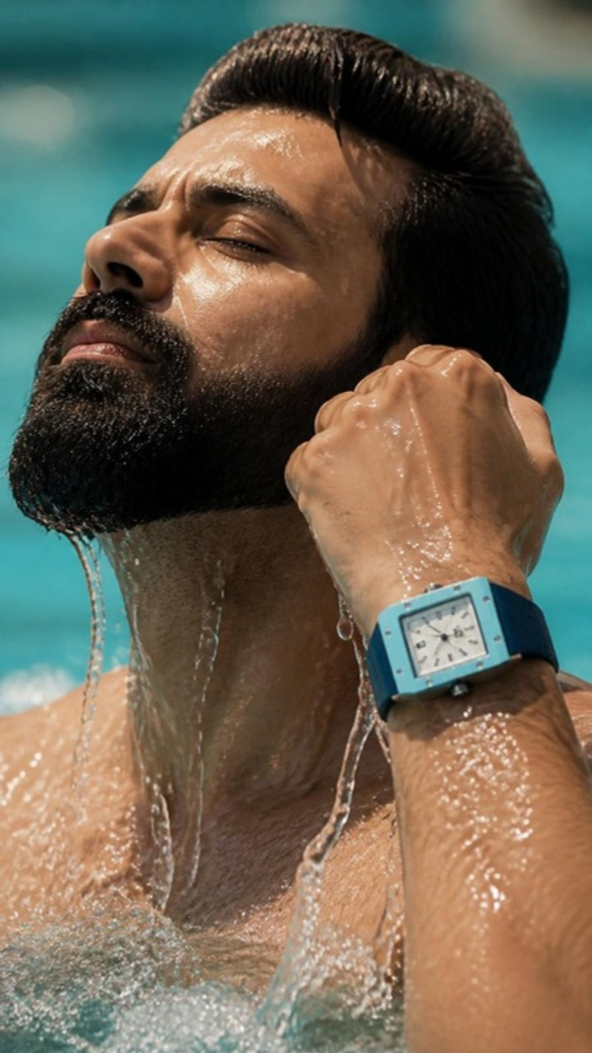
C2 · UNDERWATER · 15 S · 9:16 · ENGLISH VO
QUIET
Total calm
VOICE-OVER · THE PICK
WHY THIS ONE
Underwater, the world goes quiet.
No calls. No meetings. No one who needs "just five minutes."
Just your breath. Your heartbeat.
And the one thing that never needs to come off.
Here's to your freedom. Wear what's yours.
Water resistance sold as peace, not specs. The sound drops out underwater and returns when he surfaces.
MUSIC REFERENCE · TAP TO LISTEN
Ólafur Arnalds — "Saman"
Surface splash → muffled underwater hush → heartbeat → air on the surface.
OTHER OPTIONS WRITTEN FOR THIS REEL
PERMISSION
TWO SKIES
Freedom isn't a holiday. It's the first time you don't have to ask anyone for one.
Some days, you get the sky twice. Once above you. Once all around you.
AI frame · Mukesh ji likeness, watch exact
WEALTH ROOTS × MUKESH GUPTA · WEAR WHAT'S YOURS · CERULEAN · C2
24

Slide 25
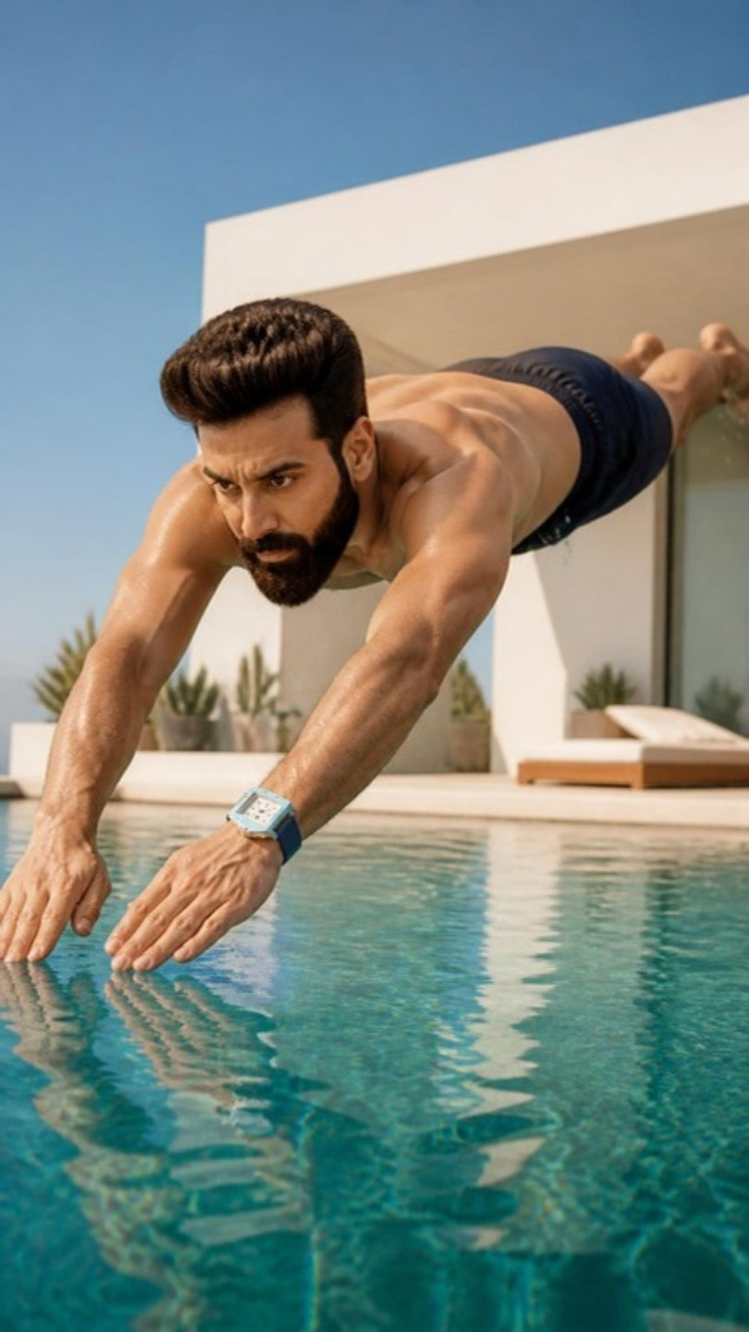
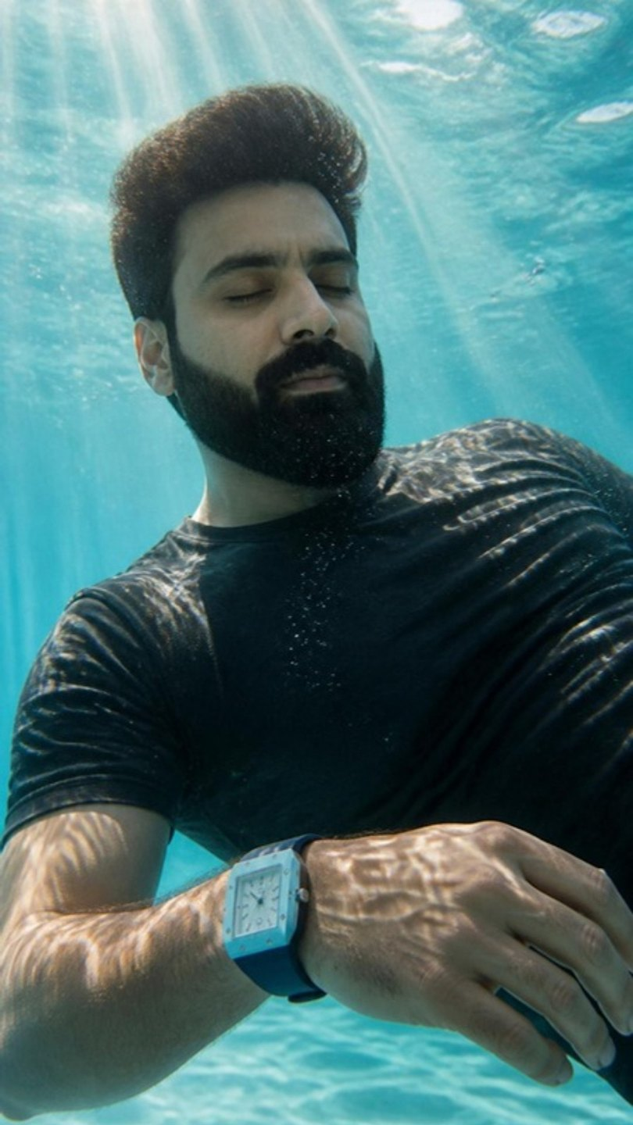
C2 · STORYBOARD · 3 CLIPS × 8 S
QUIET
The real watch — match colours exactly
MOTION · FOR THE VIDEO PASS
C2-1: Slow motion; he enters cleanly, the surface swallows him, bubbles bloom.
C2-2: Locked underwater camera; bubbles rise slowly, light caustics ripple over him and the watch.
C2-3: Slow motion; one slow breath, the water settles to glass.
C2-1 · OPEN
C2-2 · MIDDLE
C2-3 · CLOSE
VISUAL REFERENCES — TAP TO OPEN
Frame: Side angle: he is mid-dive into the turquoise pool, body straight, inches from the surface, sunlight on the water.
Frame: Underwater: he hangs completely still beneath the surface, eyes closed, arms loose, sun rays through the water, bubbles rising across the white dial.
Frame: He breaks the surface, head back, eyes to the sky, water streaming off his face and the watch.
Pinterest · underwater portrait man still sun rays
Needs the official water-resistance rating and an underwater housing. If the rating is under 50 m, shoot C2 at the surface only.
WEALTH ROOTS × MUKESH GUPTA · WEAR WHAT'S YOURS · CERULEAN · C2
25

Slide 26
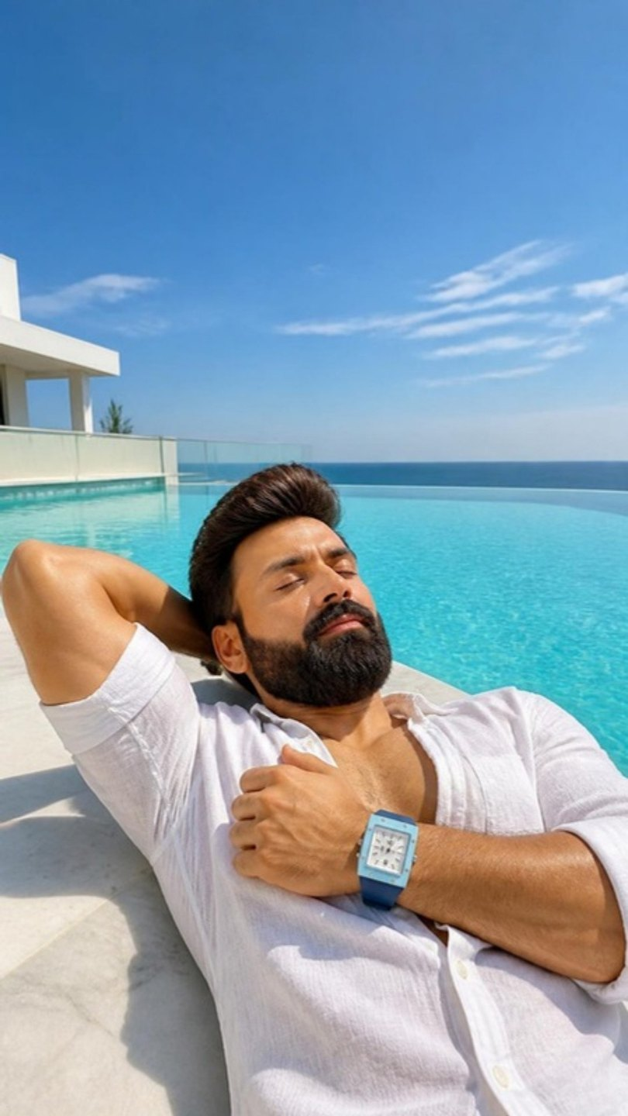
C3 · PUNCH · 10 S · 9:16 · ENGLISH VO
MONDAY
A smile
VOICE-OVER · THE PICK
WHY THIS ONE
It's Monday. Eleven a.m.
And I'm exactly where I want to be.
Here's to your freedom. Wear what's yours.
Everyone knows where they usually are on a Monday at 11. The dial reads 11:00 in the macro.
MUSIC REFERENCE · TAP TO LISTEN
Khruangbin — "Time (You and I)"
A phone buzz left unanswered · water · wind.
OTHER OPTIONS WRITTEN FOR THIS REEL
PACKED
OUT OF OFFICE
Passport. Sunglasses. One linen shirt. The watch? Already on.
(on-screen auto-reply) Out of office. Back when I feel like it.
AI frame · Mukesh ji likeness, watch exact
WEALTH ROOTS × MUKESH GUPTA · WEAR WHAT'S YOURS · CERULEAN · C3
26

Slide 27
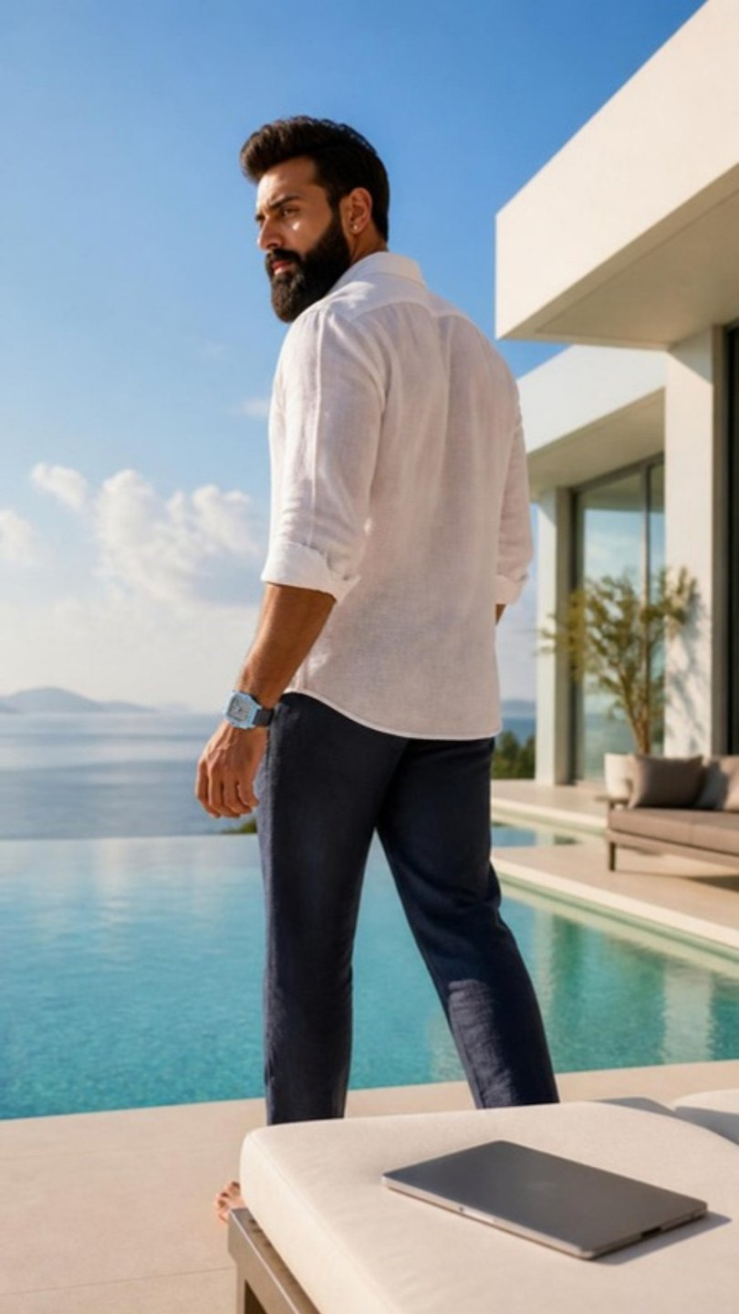
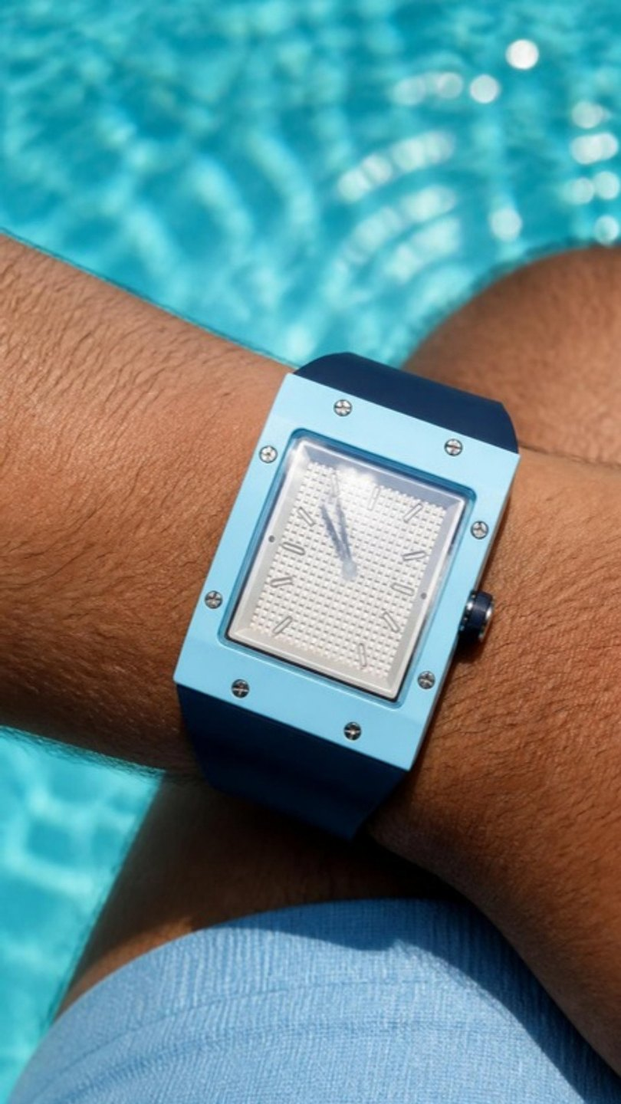
C3 · STORYBOARD · 3 CLIPS × 8 S
MONDAY
The real watch — match colours exactly
MOTION · FOR THE VIDEO PASS
C3-1: Slow lateral track; he doesn't look at the laptop.
C3-2: Locked macro; a cloud drifts across the reflection.
C3-3: Slow push-in from above; the water glitters, he closes his eyes.
C3-1 · OPEN
C3-2 · MIDDLE
C3-3 · CLOSE
VISUAL REFERENCES — TAP TO OPEN
Frame: Bright late morning: a white sun lounger by the pool with a closed laptop on it; he walks past it toward the water in the open linen shirt.
Frame: Macro of the watch on his wrist at the pool edge, white dial reading eleven o'clock, sky reflected in the crystal.
Frame: Wide from above: he lies back on the pool edge, one arm behind his head, the other wrist on his chest, pool and open sky filling the frame.
Pinterest · pool edge lying back linen shirt
WEALTH ROOTS × MUKESH GUPTA · WEAR WHAT'S YOURS · CERULEAN · C3
27

Slide 28
WORLD 04
ENERGY · FAST · THE CLIMB · 14:00–16:30
ROYAL TANGERINE
Orange is the hunger. Royal blue is the arrival. Nothing about it was handed over. Fast cuts, momentum, no pause.
THE SELF-MADE
Here's to your journey. Wear what's yours.
WHERE
A modern glass office tower — concrete-and-steel stairwell, frosted-glass doors, glass corridors, a night desk, floor-to-ceiling windows over the city. No heritage.
WARDROBE
White shirt, sleeves rolled, royal-blue trousers (D1) · royal-blue suit (D2, D3).
SOUND
Driving percussion, strings that never resolve.
D1
D2
D3
NOBODY WAS COMING
TWO COLOURS
ONLY ONE
Hero · 30 s
Night → day · 15 s
Punch · 10 s
Momentum
Hunger, then arrival
Hunger
Royal blue
Orange
White
Steel
WEALTH ROOTS × MUKESH GUPTA · WEAR WHAT'S YOURS · ROYAL TANGERINE
28

Slide 29
D1 · HERO · 30 S · 9:16 · ENGLISH VO
NOBODY WAS COMING
Momentum
VOICE-OVER · THE PICK
WHY THIS ONE
Nobody was coming to save me.
No contacts. No surname that opened doors. No plan B.
So I became the plan.
Every door they didn't open, I built my own.
Every room I wasn't invited to, I built a bigger one.
Self-made isn't a story.
It's a pace.
And I've never slowed down.
Here's to your journey. Wear what's yours.
Nobody coming → became the plan → built his own doors and rooms → self-made is a pace. The edit never stops moving.
MUSIC REFERENCE · TAP TO LISTEN
Ludwig Göransson — "Can You Hear the Music" (Oppenheimer)
Footsteps hammering stairs · a door hit flat · a corridor whoosh · heartbeat.
OTHER OPTIONS WRITTEN FOR THIS REEL
THE LIST
RECEIPTS
At twenty-two, I wrote a list. Take Maa on a flight. A house with my name on the door. Start something of my own. Order without looking at the prices. The last line, I almost didn't write. It felt too big. A watch, bought with my own money. Thirteen years. Every line, ticked.
Too young. Too small-town. Too ambitious. Too late. I heard them all. I kept every one. Like receipts. Because one day I'd come back to show them exactly what they'd paid for.
AI frame · Mukesh ji likeness, watch exact
WEALTH ROOTS × MUKESH GUPTA · WEAR WHAT'S YOURS · ROYAL TANGERINE · D1
29

Slide 30
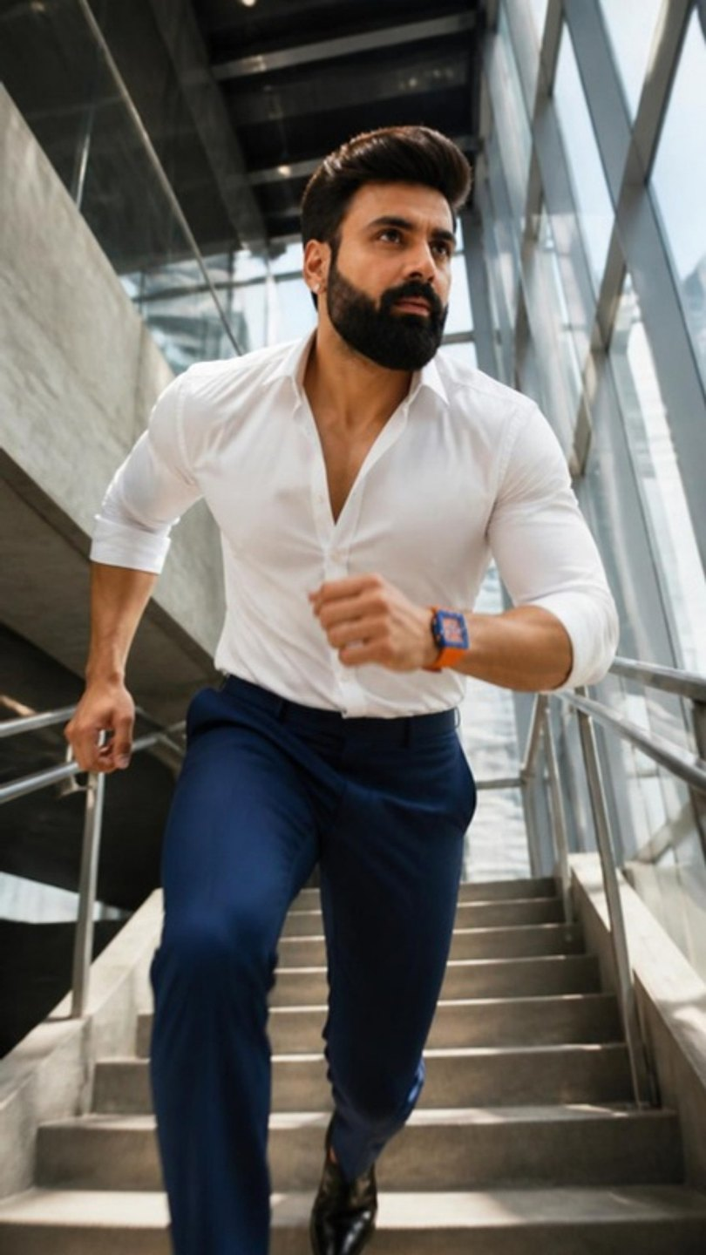
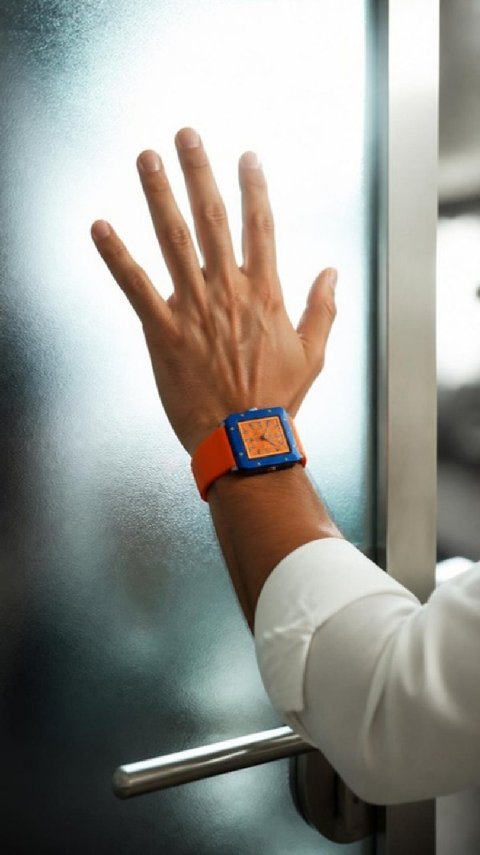
D1 · STORYBOARD · 3 CLIPS × 8 S
NOBODY WAS COMING
The real watch — match colours exactly
MOTION · FOR THE VIDEO PASS
D1-1: Fast handheld follow from below, slight whip, footsteps hard.
D1-2: Snap zoom; the door swings open to a blast of white light.
D1-3: Fast backward track, speed ramp into slow motion on the last two steps as he looks into the lens.
D1-1 · OPEN
D1-2 · MIDDLE
D1-3 · CLOSE
VISUAL REFERENCES — TAP TO OPEN
Frame: A steep concrete-and-steel stairwell inside a glass office tower, hard daylight. He takes the steps two at a time, mid-motion, blurred edges, the orange strap on his swinging wrist.
Frame: A heavy frosted-glass office door with a steel handle; his left hand hits it flat, the orange dial sharp against the glass, white light glowing through.
Frame: He strides down a long glass-walled corridor straight at camera, city visible through the glass, unbuttoning his cuff, the royal-blue and orange watch flashing.
Pinterest · office stairwell running cinematic
Instagram · @hublot — bold pace
WEALTH ROOTS × MUKESH GUPTA · WEAR WHAT'S YOURS · ROYAL TANGERINE · D1
30

Slide 31
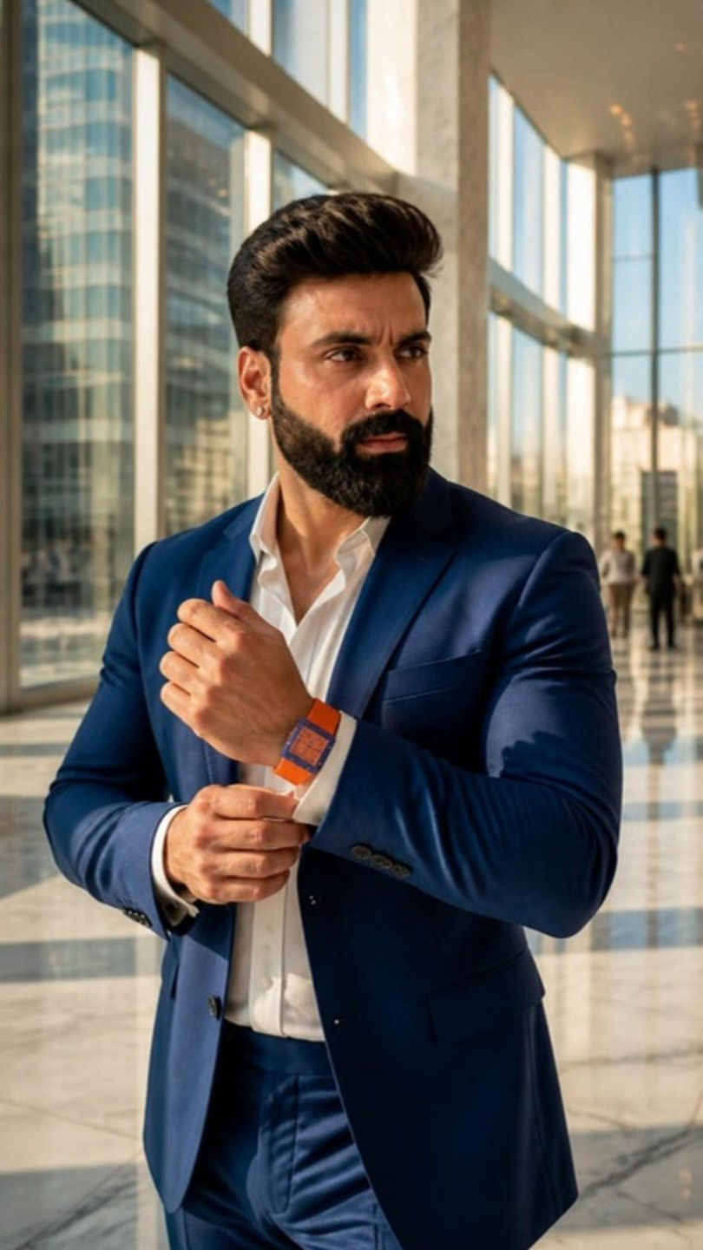
D2 · NIGHT → DAY · 15 S · 9:16 · ENGLISH VO
TWO COLOURS
Hunger, then arrival
VOICE-OVER · THE PICK
WHY THIS ONE
Orange is the colour of hunger.
The fire that kept you up at 2 a.m.
Every "not yet" you turned into "watch me."
Royal blue is the colour of arrival.
This watch wears both.
Because you never get one without the other.
Here's to your journey. Wear what's yours.
The watch's two colours tell the whole self-made story. Night desk → daylight lobby.
MUSIC REFERENCE · TAP TO LISTEN
Hans Zimmer — "Time" (Inception)
Pen on paper · a lamp hum · hard cut to daylight and footsteps on marble.
OTHER OPTIONS WRITTEN FOR THIS REEL
LUCK
THIS SPEED
People call it luck. Luck doesn't show up at five in the morning. Luck doesn't take the last train home. Luck doesn't eat the same lunch for three years. I know. I was there. Luck wasn't.
They keep telling me to slow down. Enjoy it. I am enjoying it. At this speed.
AI frame · Mukesh ji likeness, watch exact
WEALTH ROOTS × MUKESH GUPTA · WEAR WHAT'S YOURS · ROYAL TANGERINE · D2
31

Slide 32
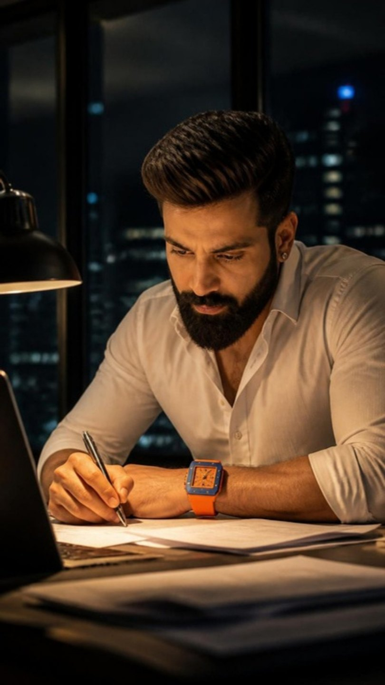
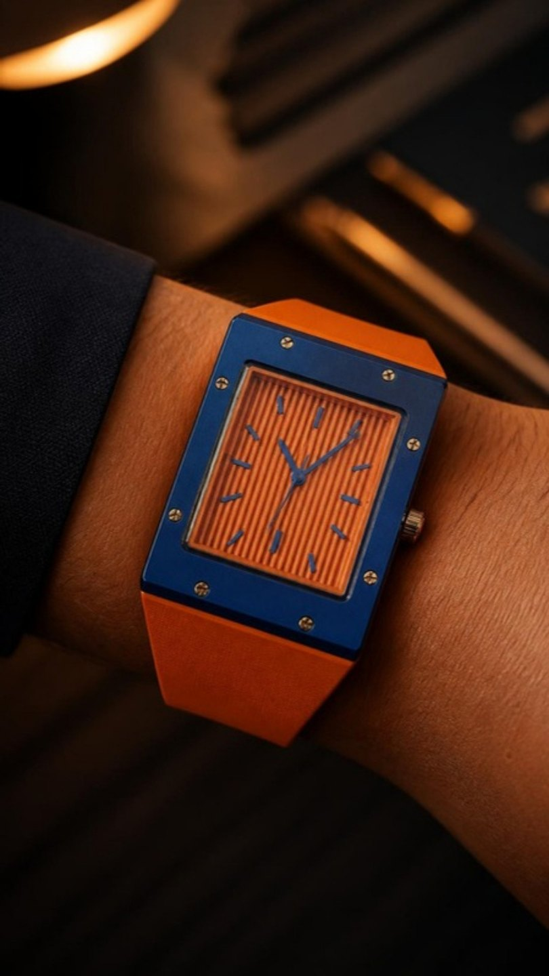
D2 · STORYBOARD · 3 CLIPS × 8 S
TWO COLOURS
The real watch — match colours exactly
MOTION · FOR THE VIDEO PASS
D2-1: Slow push-in; he writes fast, the lamp flickers once.
D2-2: Locked; the light slowly cools from orange to clean daylight across the dial.
D2-3: Gimbal at waist height moving with him, speed ramp to slow motion as the cuff settles.
D2-1 · OPEN
D2-2 · MIDDLE
D2-3 · CLOSE
VISUAL REFERENCES — TAP TO OPEN
Frame: Night in a modern glass office, one desk lamp, city lights blurred through the window. He is bent over papers and a laptop at 2 a.m., the orange dial glowing warm in the lamplight.
Frame: Macro of the orange striped dial and orange strap in hot tungsten light, every stripe sharp.
Frame: Bright day: he walks through the vast glass-and-marble lobby of the tower in a sharp royal-blue suit, sunlight pouring in, adjusting his cuff so both colours of the watch show.
Pinterest · late night desk lamp city window
WEALTH ROOTS × MUKESH GUPTA · WEAR WHAT'S YOURS · ROYAL TANGERINE · D2
32

Slide 33
D3 · PUNCH · 10 S · 9:16 · ENGLISH VO
ONLY ONE
Hunger
VOICE-OVER · THE PICK
WHY THIS ONE
Given and earned look the same on the wrist.
Only one of them keeps you hungry.
Here's to your journey. Wear what's yours.
A luxury watch admitting that the object alone proves nothing — only the way it was earned does.
MUSIC REFERENCE · TAP TO LISTEN
Trent Reznor & Atticus Ross — "In Motion"
A city hum through glass · one exhale · footsteps leaving.
FRAME D3-3
SEE FRAME NOTE
OTHER OPTIONS WRITTEN FOR THIS REEL
BUILT
THE LONG WAY
You can buy a watch. You build the man who wears it.
No shortcut. No contacts. No uncle in the business. The long way. The only way that's actually yours.
The real watch — frame described below
WEALTH ROOTS × MUKESH GUPTA · WEAR WHAT'S YOURS · ROYAL TANGERINE · D3
33

Slide 34
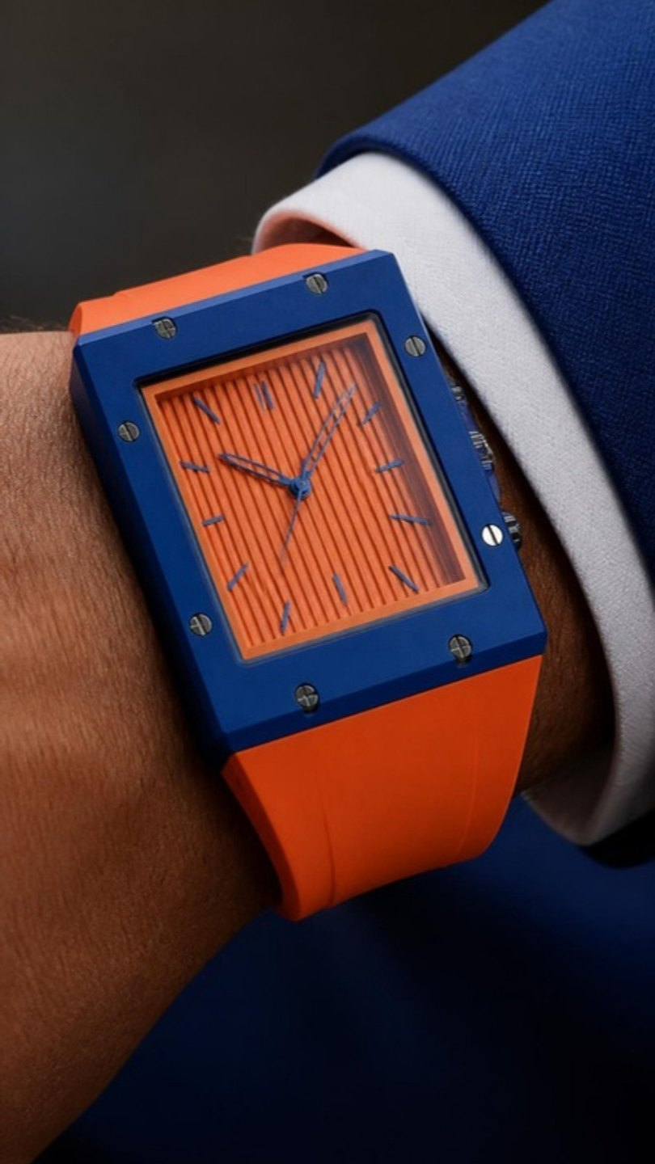
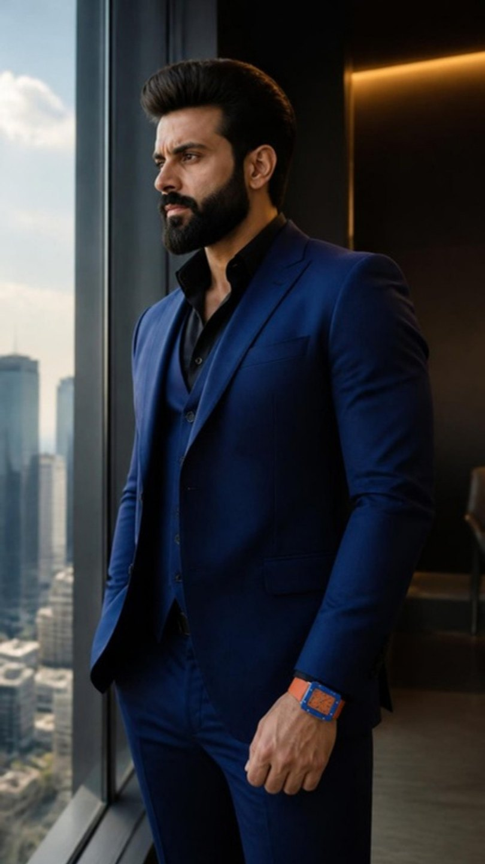
D3 · STORYBOARD · 3 CLIPS × 8 S
ONLY ONE
The real watch — match colours exactly
FRAME D3-3
SEE FRAME NOTE
MOTION · FOR THE VIDEO PASS
D3-1: Slow 360-degree orbit around the wrist.
D3-2: Slow push-in; his hand tightens slightly into a fist, the watch flexes.
D3-3: Whip pan following him out, the frame left on the empty window light.
D3-1 · OPEN
D3-2 · MIDDLE
D3-3 · CLOSE
VISUAL REFERENCES — TAP TO OPEN
Frame: Extreme close-up of the watch on his wrist against a royal-blue suit sleeve, orange striped dial, clean hard light.
Frame: He stands at a floor-to-ceiling window high in the tower, the city below, jaw set, looking out, hungry rather than satisfied.
Frame: He turns from the window and walks straight past the camera, fast, out of frame.
Pinterest · man at skyscraper window city below suit
WEALTH ROOTS × MUKESH GUPTA · WEAR WHAT'S YOURS · ROYAL TANGERINE · D3
34

Slide 35
WORLD 05
POWER · ALPHA · BLACK SUIT · RED CONVERTIBLE · 18:30–22:00
CRIMSON NAVY
Red is a decision, not a colour. Built for the black suit, the red car and the night. Power that never raises its voice.
THE DOMINANT
Here's to your power. Wear what's yours.
WHERE
Night only — a modern luxury-hotel porte-cochère, a private dining room, a wide city boulevard (JLN Marg / Albert Hall exterior, free). Red convertible on rental.
WARDROBE
Black suit, black shirt open at the collar. No tie.
SOUND
Low synth, sub heartbeat.
E1
E2
E3
RED IS A DECISION
NOTICED
IT GLOWS
Hero · 30 s
Beat cut · 15 s
Signature · 12 s
The room adjusts
Swagger
The signature
Black
Red
Navy
Glow
WEALTH ROOTS × MUKESH GUPTA · WEAR WHAT'S YOURS · CRIMSON NAVY
35

Slide 36
E1 · HERO · 30 S · 9:16 · ENGLISH VO
RED IS A DECISION
The room adjusts
VOICE-OVER · THE PICK
WHY THIS ONE
Red isn't a colour you wear by accident.
It's a decision.
A black suit. A red car. A red dial.
None of it asks for attention.
It takes it.
Crimson Navy.
For the man the room adjusts to.
Here's to your power. Wear what's yours.
The watch's colour becomes the attitude. "The man the room adjusts to" is power without shouting.
MUSIC REFERENCE · TAP TO LISTEN
Nicholas Britell — "Succession (Main Title Theme)"
Engine idle · a car door shut once, firmly · footsteps on stone · silence in the hall.
OTHER OPTIONS WRITTEN FOR THIS REEL
THE QUIET ONES
MAKING SPACE
Every room has a loud man. He talks first. Laughs hardest. Needs everyone to know. I used to think that was power. Then I watched the quiet ones. They never raised their voice. They never had to.
Power isn't taking up space. It's the room making space… before you've said a word.
AI frame · Mukesh ji likeness, watch exact
WEALTH ROOTS × MUKESH GUPTA · WEAR WHAT'S YOURS · CRIMSON NAVY · E1
36

Slide 37
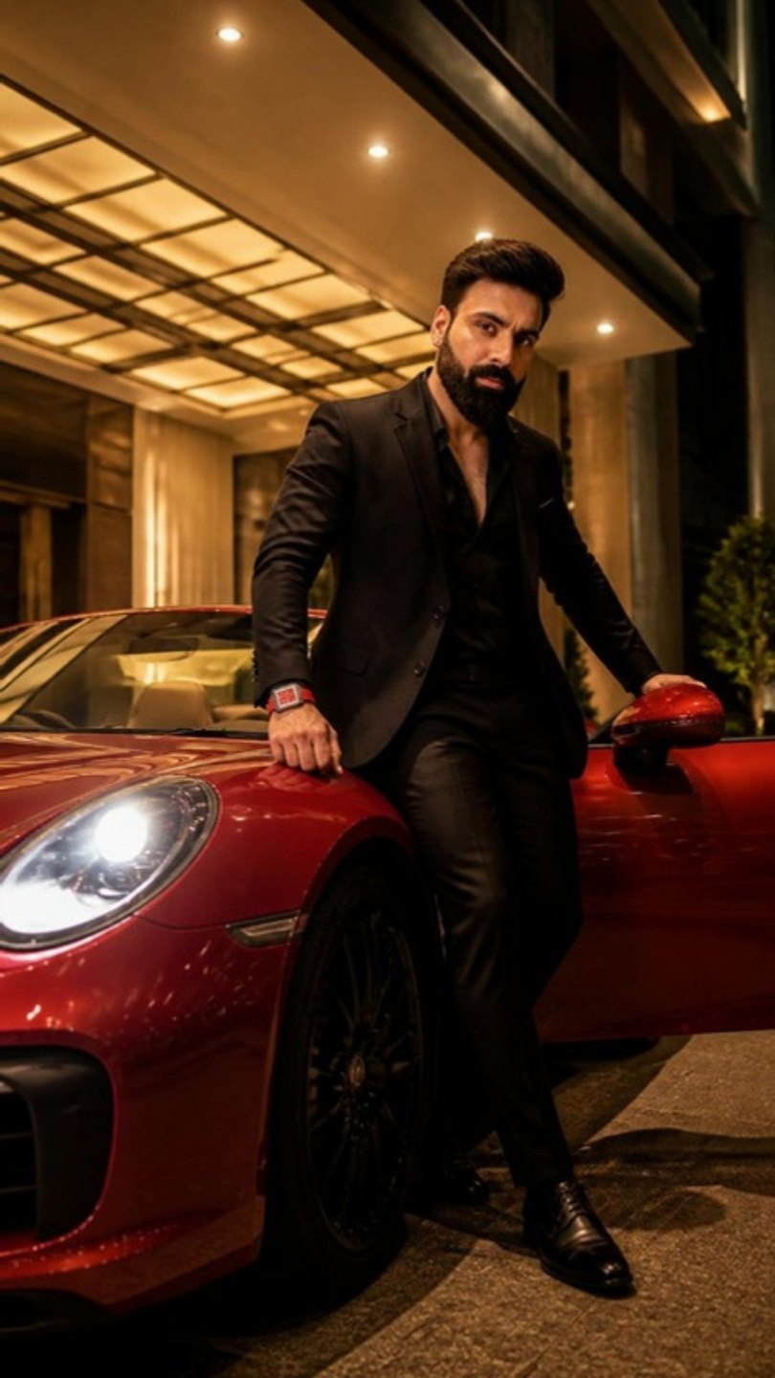
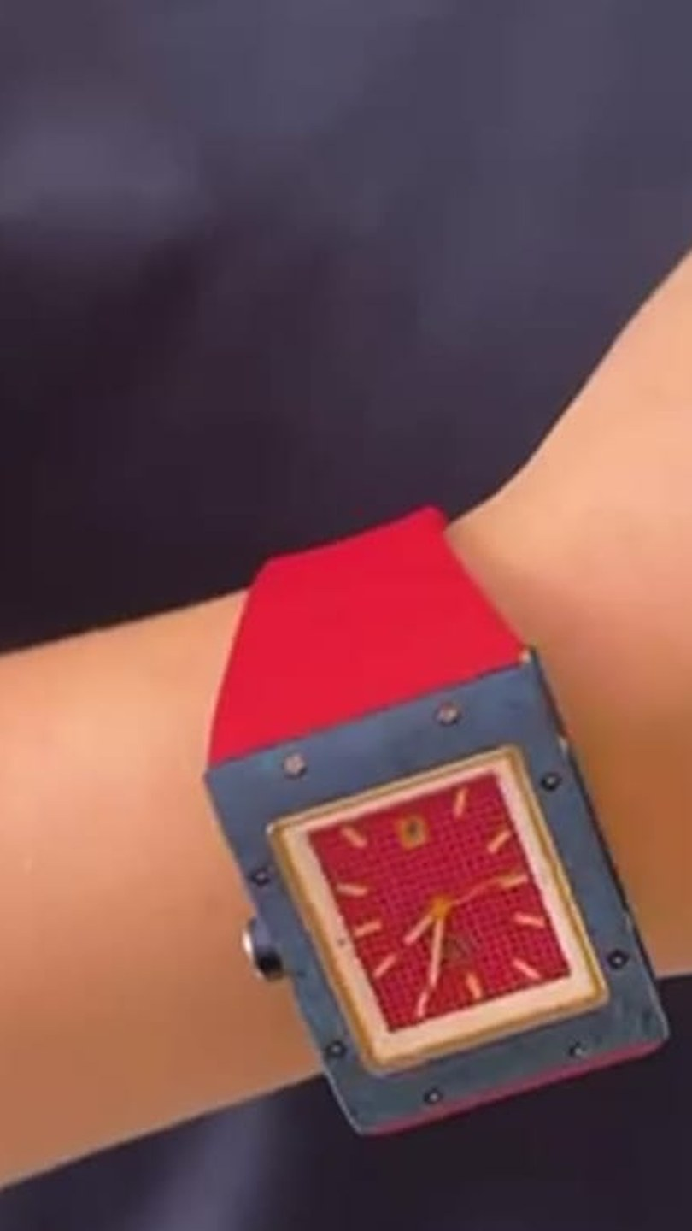
E1 · STORYBOARD · 3 CLIPS × 8 S
RED IS A DECISION
The real watch — match colours exactly
MOTION · FOR THE VIDEO PASS
E1-1: Low wide; he steps out and shuts the door with one firm push, headlights sweep the columns.
E1-2: Slow slide; a red reflection glides across the crystal.
E1-3: Wide symmetrical, slow push-in; he leans back one inch and holds the gaze.
E1-1 · OPEN
E1-2 · MIDDLE
E1-3 · CLOSE
VISUAL REFERENCES — TAP TO OPEN
Frame: Night: a glossy red convertible, roof down, under the lit porte-cochère of a modern luxury hotel, headlights on; he steps out in a black suit, hand on the door, the red-dialled watch leading the motion.
Frame: Macro: the red dial and rose-gold hands, the navy case gleaming under warm porch light, the car's red paint blurred behind.
Frame: A private dining room: a long polished black table, a low chandelier, candles. He sits alone at the head of the empty table, jacket unbuttoned, left forearm on the table, looking straight into the lens.
Pinterest · black suit red convertible night hotel
Instagram · @jacobandco — dramatic night
WEALTH ROOTS × MUKESH GUPTA · WEAR WHAT'S YOURS · CRIMSON NAVY · E1
37

Slide 38
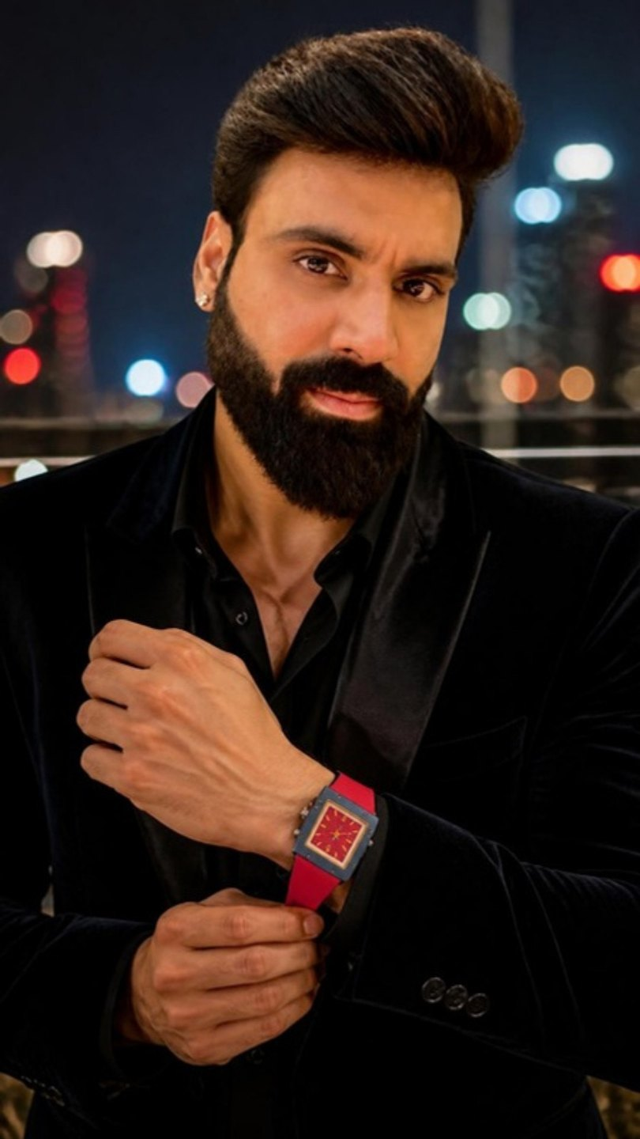
E2 · BEAT CUT · 15 S · 9:16 · ENGLISH VO
NOTICED
Swagger
VOICE-OVER · THE PICK
WHY THIS ONE
Some people dress to be noticed.
Some people are noticed…
…and dress accordingly.
Here's to your power. Wear what's yours.
One flipped sentence. Red car, red dial, black suit, cut to the beat.
MUSIC REFERENCE · TAP TO LISTEN
Kavinsky — "Nightcall"
Engine start · the roof motor · a cuff · every cut on the beat.
OTHER OPTIONS WRITTEN FOR THIS REEL
SAME RED
ANNOUNCED
Same red. Same attitude. One waits in the driveway. One never leaves my wrist.
Power that has to be announced… isn't power.
AI frame · Mukesh ji likeness, watch exact
WEALTH ROOTS × MUKESH GUPTA · WEAR WHAT'S YOURS · CRIMSON NAVY · E2
38

Slide 39
E2 · STORYBOARD · 3 CLIPS × 8 S
NOTICED
The real watch — match colours exactly
FRAME E2-1
SEE FRAME NOTE
FRAME E2-2
SEE FRAME NOTE
MOTION · FOR THE VIDEO PASS
E2-1: Slow slide along the wheel; his thumb taps once.
E2-2: Low angle; the roof folds fully back, porch light spills onto his face.
E2-3: 85mm slow motion; the cuff settles, he turns his head to the lens for the last second.
E2-1 · OPEN
E2-2 · MIDDLE
E2-3 · CLOSE
VISUAL REFERENCES — TAP TO OPEN
Frame: Night macro: his hand on a red-and-black leather steering wheel, the red dial matching the red stitching, city lights beyond the windscreen.
Frame: The convertible's roof mid-fold under the hotel porch lights, him in the driver's seat in a black suit, looking ahead.
Frame: Close-up: he adjusts his cuff with one hand, red dial showing, black suit, city bokeh, no smile, eyes straight ahead.
Pinterest · red steering wheel hand watch night
WEALTH ROOTS × MUKESH GUPTA · WEAR WHAT'S YOURS · CRIMSON NAVY · E2
39

Slide 40
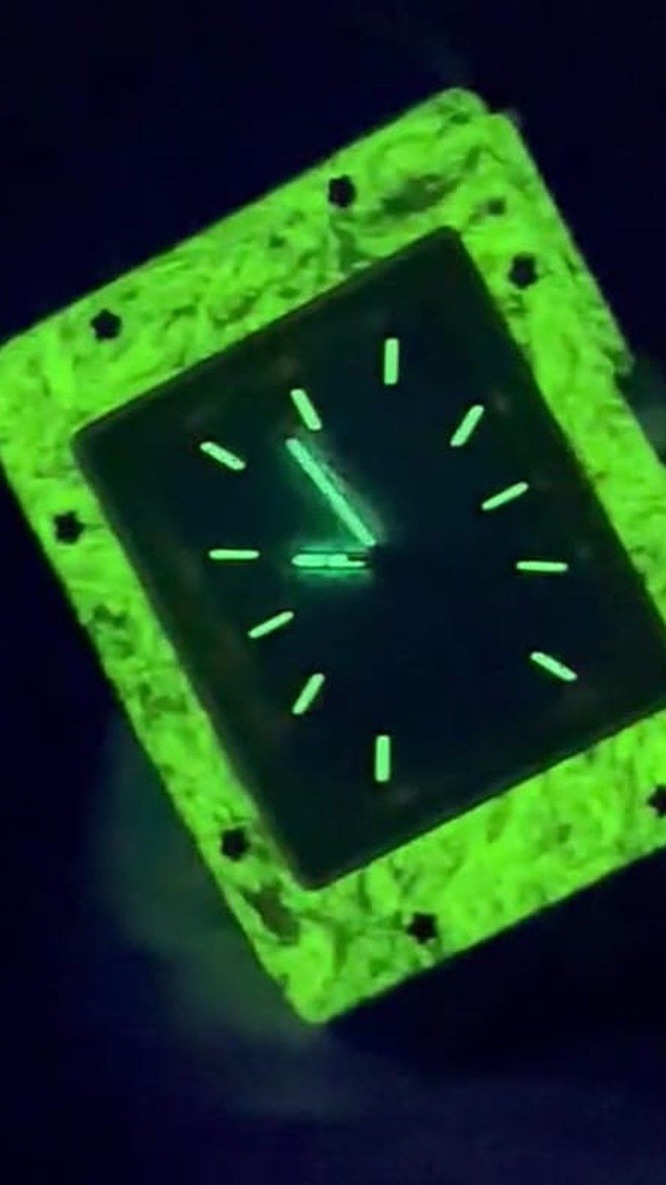
E3 · SIGNATURE · 12 S · 9:16 · ENGLISH VO
IT GLOWS
The signature
VOICE-OVER · THE PICK
WHY THIS ONE
When the lights go out, most things disappear.
The car. The suit. The city.
Power doesn't.
It glows.
Here's to your power. Wear what's yours.
The whole campaign ends on the watch's signature — the full-case night glow.
MUSIC REFERENCE · TAP TO LISTEN
Gesaffelstein — "Pursuit"
City noise → dashboard click → total silence on the glow → the signal's tick → engine.
OTHER OPTIONS WRITTEN FOR THIS REEL
WALK IN
THE NIGHT
Some men need an introduction. Some just need to walk in.
The day belongs to everyone. The night belongs to the ones who still have somewhere to be.
AI frame · Mukesh ji likeness, watch exact
WEALTH ROOTS × MUKESH GUPTA · WEAR WHAT'S YOURS · CRIMSON NAVY · E3
40

Slide 41
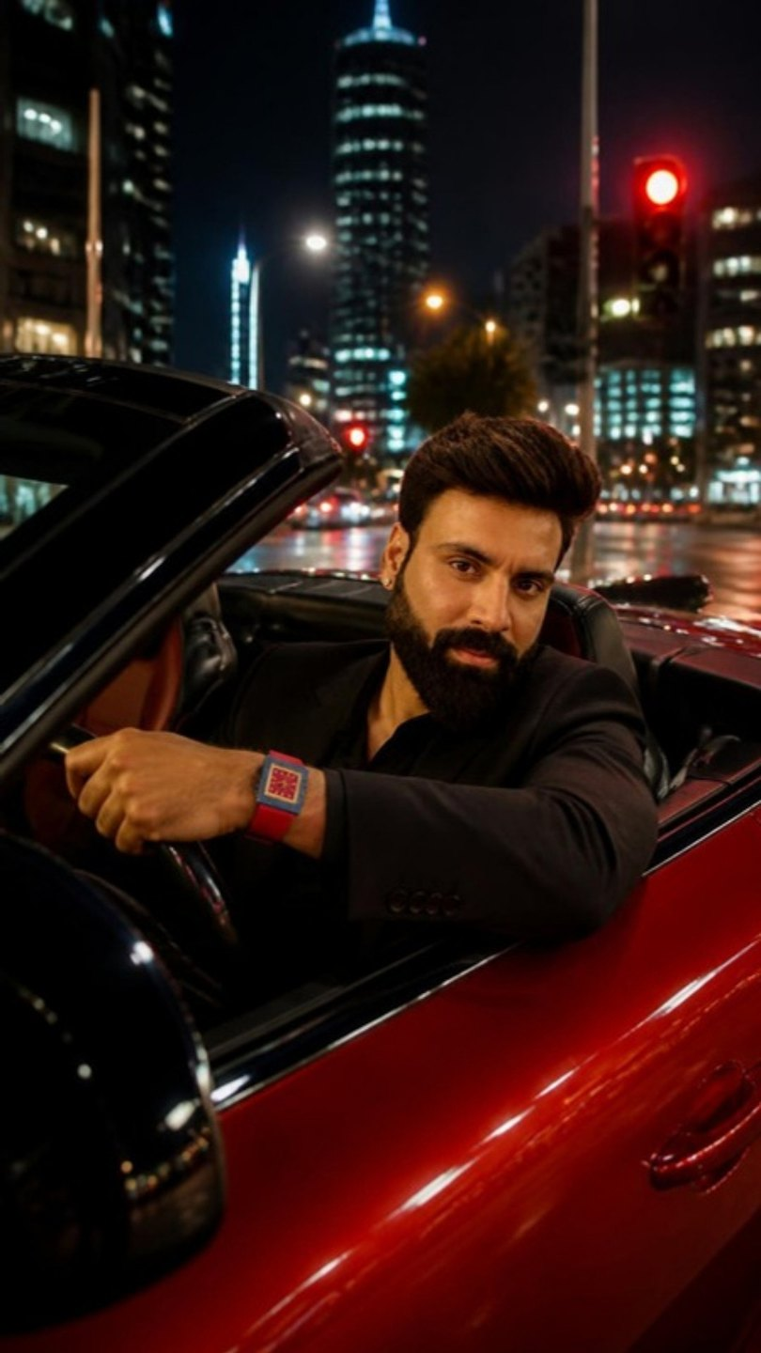
E3 · STORYBOARD · 3 CLIPS × 8 S
IT GLOWS
The real watch — match colours exactly
FRAME E3-2
SEE FRAME NOTE
MOTION · FOR THE VIDEO PASS
E3-1: Low wide; traffic light streaks pass, he waits, still.
E3-2: The red signal light fades out too, leaving near-total darkness.
E3-3: Locked; the glow is the only light; after a beat the signal turns green on the bonnet and the car pulls away.
E3-1 · OPEN
E3-2 · MIDDLE
E3-3 · CLOSE
VISUAL REFERENCES — TAP TO OPEN
Frame: Night on a wide city boulevard: the red convertible, roof down, stopped at a red signal, city lights all around, him at the wheel in a black suit.
Frame: Inside the car: his hand flicks off the dashboard lights; the cabin goes almost black, only the red signal on his jaw and wrist.
Frame: Total darkness: the whole watch case, bezel, hands and indices glow bright green on his wrist on the steering wheel, lighting his jaw; nothing else visible.
Pinterest · lume watch glow dark car
Safety: moving shots from a follow car at normal speed, or parked with light passes. Nothing rigged outside the car. Charge the lume with a UV torch for 30 s before every glow take.
WEALTH ROOTS × MUKESH GUPTA · WEAR WHAT'S YOURS · CRIMSON NAVY · E3
41

Slide 42
TURNING THE FRAMES INTO CLIPS · GEMINI
45 FRAMES. 45 CLIPS. TWO STEPS EACH.
01
02
03
04
ATTACH TWO PHOTOS
MAKE THE STILL
ANIMATE IT
SEND THEM BACK
Mukesh ji's face reference + the watch photo for that reel (crop_green / lime / skyblue / orange / redblue; add crop_glow for E3-3).
Paste the header below, then the clip's Frame line. If the watch or the face is off, regenerate before moving on.
On that image choose Create video and paste the clip's Motion line plus the motion note.
Name clips A1-1, A1-2 … E3-3. We cut them to the VO and drop them into this deck.
HEADER — PASTE BEFORE EVERY FRAME LINE
Photoreal cinematic still, vertical 9:16, luxury watch commercial: ARRI Alexa look, soft film grain, shallow depth of field, real lens behaviour. The man is the one in the attached photo — thick full dark beard, swept-back pompadour hair, strong eyebrows, small ear stud, Indian, mid-30s, muscular — calm, never speaking. On his left wrist is the watch in the attached watch photo: copy it exactly — square case, eight exposed bezel screws, layered case, WR monogram at 12, textured dial, colour-blocked rubber strap, crown on the right. Never change its shape or colours. The watch is always worn, never lying on any surface. He is the only person in frame. No text, captions, logos or watermarks.
MOTION NOTE — ADD TO EVERY MOTION LINE
Natural cinematic motion, no dialogue, no speech, ambient sound only. Keep the man and the watch exactly as in the image.
The two clips already made (A1-1 corridor, A1-2 door) are the proof the pipeline works — the watch came out exact.
WEALTH ROOTS × MUKESH GUPTA · WEAR WHAT'S YOURS · AI CLIPS
42

Slide 43
DAY 2 · HALF PRODUCT, HALF NEETU
THE WATCH ALONE. THEN THE WOMAN WHO MADE IT.
TIME | SETUP | UNIT
07:30 | Crew call · product sets lit (white sweep, colour sweep, macro rig) · stands ready | Product
08:00–09:00 | Set A · white sweep e-com — all five watches on acrylic stands | Product
09:00–10:30 | Set B · colour-matched heroes on stands (ivory/green, lime, sky, royal blue, navy/red) | Product
10:30–11:30 | Set C · macros with focus stacking (screws, monogram, dial, crown, caseback, clasp) | Product
11:30–12:15 | Set D · glow on a hand model's wrist + 360° turntable on a watch pillow | Product
12:15–13:00 | Set E · packaging + unboxing (magnetic lid, 001/500 card) | Product
13:00–14:00 | Lunch · founder set dressed · Neetu HMU | —
14:00–15:15 | Neetu · her story — 12 questions, two cameras, Hinglish | Founder
15:15–16:30 | Neetu · each watch in her words — five segments, the watch in her hands | Founder
16:30–17:30 | B-roll: sketching, loupe on a dial, numbering cards · portraits | Founder
17:30–18:00 | Golden-hour portrait · wrap | Founder
WEALTH ROOTS × MUKESH GUPTA · WEAR WHAT'S YOURS · DAY 2
43

Slide 44
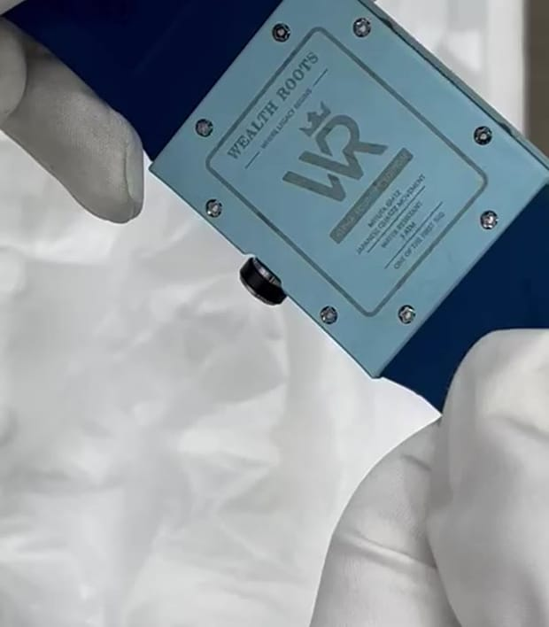
DAY 2 · PRODUCT SHOOT (07:30–13:00)
SIX SETS. NEVER FLAT ON A TABLE.
SET | SHOTS | USED FOR | PER WATCH
A · White sweep | Front · 3/4 · crown side · caseback · clasp · strap — on a clear acrylic stand | E-com + website | 6 stills × 5 watches
B · Colour seamless | Each watch on its own colour, on a stand | Hero / ads / launch | 2 stills × 5
C · Macro rig | Eight screws · WR monogram · waffle dial · crown · caseback crest · deployant clasp | Detail carousels | 6 stills × 5
D · Glow | Lume charged with UV torch, on a hand model's wrist in black | Glow posts | 1 still × 5
E · 360° turntable | On a leather watch pillow on a lazy susan, 10 s loop | Website + reels | 1 video × 5
F · Packaging | Watch seated in its box · magnetic lid opening (sound) · 001/500 card | Unboxing reel + launch | 1 set + 1 video
Rule: the watch sits on a clear acrylic stand, a leather pillow, in its box, or on a hand model's wrist — never flat on a surface. Kit: 100 mm macro + focus stacking · probe lens · lazy susan · cotton gloves · blower · UV torch · 5 coloured seamless rolls.
WEALTH ROOTS × MUKESH GUPTA · WEAR WHAT'S YOURS · DAY 2 · PRODUCT
44

Slide 45
DAY 2 · NEETU (14:00–18:00)
ONLY TALK — NO CONCEPTS, NO ACTING
THE
FOUNDER
Neetu is on camera only on Day 2, seated, talking: first her own story, then each of the five watches in her words. Hinglish, the way she speaks. No scripted scenes.
OUTPUTS
FOUNDER FILM — 60–90 s, her whole story, closing on "Wear what's yours"
4 STORY REELS — cut from her answers
5 WATCH REELS — Neetu on each character, 30–40 s each
12 PORTRAITS — press, website, LinkedIn
"Jo tumhara hai — wahi pehno."
HOW WE FILM HER
Neetu — from a government school in Dalelpura and a ₹5,000 first salary in Jaipur, to an Indian luxury house for people who built everything themselves.
Seated, warm practical lamps, dark background — a quiet corner of the hotel, dressed.
Two cameras: A wide on 35 mm, B tight on 85 mm. A third locked macro on the watch in her hands for the watch segments.
She answers in Hinglish — we cut from her real answers, no teleprompter.
Wardrobe her call: a structured blazer or pantsuit, or a saree with a structured blouse. Solid colours, no logos.
B-ROLL + PORTRAITS
Sketching the square case · a jeweller's loupe on a dial · numbering cards 001–500 · window-light portrait · golden hour.
WEALTH ROOTS × MUKESH GUPTA · WEAR WHAT'S YOURS · DAY 2 · NEETU
45

Slide 46
PART 1 · HER STORY · 12 QUESTIONS IN HINGLISH
ASK LIKE A CONVERSATION. LISTEN FOR THESE.
# | QUESTION (HINGLISH) | WHAT WE'RE LISTENING FOR
01 | Dalelpura se Jaipur — woh pehla din yaad hai? | Studied in a village government school; moved to Jaipur.
02 | Pehli salary ₹5,000 thi. Tab time ki value kaise samjhi? | "When you have no safety net, time is your only real currency."
03 | Ek ladki, men's luxury watch brand — logon ne kya kaha? | Polite smiles, "vanity hobby" — she answered with drawings, tolerances, sourcing.
04 | Aapke liye "dominance" ka matlab kya hai? | "Restraint. The loudest man in the room is usually the most insecure."
05 | Ghadi bolne se pehle insaan ke baare mein kya batati hai? | "It tells you their relationship with time."
06 | Pehli ghadi jo aap chahti thi — jo mili hi nahi? | "It didn't exist, which is why Wealth Roots exists."
07 | Aapne ghadi ki taaqat pehli baar kab samjhi? | Her husband reaching for one watch before a decisive meeting, like a ritual.
08 | Sirf 500 Alpha Founder pieces kyun? Advisors ne kya kaha? | "500 lifetime advocates over early vanity sales."
09 | Woh packaging wala kissa — poori run kyun reject ki? | "Luxury is obsessive, unglamorous friction."
10 | Wealth Roots kaun pehnega? | The founder in a seed round, the architect, the surgeon — people with grit.
11 | Paanch saal baad London ya Dubai mein koi caseback palte — kya dikhe? | "Roots in Jaipur" — Indian horology on the world stage.
12 | "Wear what's yours" — aapke liye iska matlab? | Her own line to close the founder film.
WEALTH ROOTS × MUKESH GUPTA · WEAR WHAT'S YOURS · DAY 2 · NEETU
46

Slide 47
PART 1 · STORY REELS · CUT FROM HER REAL ANSWERS
FOUR REELS, IN HER VOICE.
F1
₹5,000 SE
HER STORY
F2
DOMINANCE = RESTRAINT
HER BELIEF
"Dalelpura ke sarkari school se padhi. Jaipur mein pehli naukri — ₹5,000 mahina. Tab samjha: jab koi safety net nahi hota, toh time hi asli currency hai. Wealth Roots wahin se aaya."
"Mere liye dominance ka matlab hai restraint. Room ka sabse loud aadmi aksar sabse insecure hota hai. Asli power — apne calendar, emotions aur standards pe control."
F3
SIRF 500
HER DECISION
F4
JO TUMHARA HAI
HER LINE
"Advisors ne kaha production badhao, cost giraao. Maine mana kar diya. Pehle 500 log invoice ki line item nahi hain — woh is brand ki neev hain."
"Ye ghadi kisi ko impress karne ke liye nahi hai. Ye un logon ke liye hai jinhone apna sab kuch khud banaya. Jo tumhara hai — wahi pehno."
Lines to steer toward — she says them her way on the day. Music for all founder cuts: Ludovico Einaudi — "Nuvole Bianche" (reference).
WEALTH ROOTS × MUKESH GUPTA · WEAR WHAT'S YOURS · DAY 2 · NEETU
47

Slide 48
PART 2 · EACH WATCH, IN HER WORDS
FIVE CHARACTERS. FIVE SHORT TALKS.
FOREST IVORY
CITRUS MINT
CERULEAN
ROYAL TANGERINE
CRIMSON NAVY
ROOTS
SWEAT
FREEDOM
JOURNEY
POWER
"Ivory aur bottle green hi kyun? Ye ghadi kis aadmi ke liye hai jo apni jadein nahi bhoolta?"
"Ek luxury watch jo gym mein utarni nahi padti — ye idea kahan se aaya?"
"Aasmaan, paani, safar — Cerulean un logon se kya kehti hai jo apne time pe jeete hain?"
"Orange aur royal blue — bhookh aur manzil. Self-made logon ke liye ye ghadi kyun?"
"Red ek decision hai. Ye ghadi kis aadmi ki hai — aur "dominance = restraint" isme kaise dikhta hai?"
The one that stays. Made to be passed down.
The one that trains with you.
The one that goes anywhere.
The self-made.
The dominant.
Format: she holds the watch while she talks; camera C stays on the watch in her hands. One question per watch, 3–4 minutes each, cut to 30–40 s.
WEALTH ROOTS × MUKESH GUPTA · WEAR WHAT'S YOURS · DAY 2 · NEETU
48

Slide 49
CREW & KIT
ONE UNIT, ONE DAY, FIVE MOVES.
CREW
KIT
TO HIRE
DOP + 1st AC (A cam)
Gaffer + 1 light assistant
Stylist (5 looks) + HMU
Watch handler — gloves, cloths, log sheet
Runner + driver for the follow car
Director / creative lead (Sage Media)
Cine camera ×2 (4K 10-bit, 120 fps)
24 · 35 · 50 · 85 mm + 100 mm macro
Underwater housing (C2) · gimbal · slider
2 × 600 W + 2 RGB tubes · small hazer (office, dining room)
UV torch for the lume · blackout cloth
Time-lapse intervalometer (A2)
Red convertible + delivery to the hotel by 17:00
Battle ropes + kettlebell (B1, B2)
Leather weekender + passport prop (C1)
Watch stands + leather pillow (Day 2)
5 coloured seamless rolls (Day 2)
Lav + boom for Neetu (Day 2)
WEALTH ROOTS × MUKESH GUPTA · WEAR WHAT'S YOURS · PRODUCTION
49

Slide 50
BEFORE WE LOCK · TO CONFIRM
EIGHT ANSWERS WE NEED THIS WEEK.
# | QUESTION | WHY IT MATTERS
01 | Water-resistance rating of the Cerulean | Decides whether C2 is shot under water or at the surface.
02 | Palace: 2-hour morning slot + fee | Forest Ivory only. Corridor, door, hall. No haze, no diyas.
03 | Modern hotel: gym / pool / office floor / porch / dining room access | Four worlds under one roof. Confirm hours in writing.
04 | Red convertible rental + delivery time | E1–E3. Must be at the porch by 17:00, detailed.
05 | Mukesh ji's five looks approved | Ivory bandhgala · black training · white linen + navy · white shirt + royal-blue trousers / royal-blue suit · black suit.
06 | Two pieces of each watch on set | Backup if one scratches; one stays charged for the glow.
07 | VO artist: Mukesh ji himself or a narrator | All 15 reels are English VO, recorded after the shoot.
08 | Music: licensed library or original score | The tracks in this deck are mood references only (see music slide).
WEALTH ROOTS × MUKESH GUPTA · WEAR WHAT'S YOURS · PRODUCTION
50

Slide 51
RELEASE ORDER
HERO FIRST. PUNCHES BETWEEN. FESTIVE ON THE DAY.
WHEN | REEL | WHY HERE
Launch day | E1 Red Is A Decision + A1 What Survives | The two strongest heroes — power and roots
+1 | B3 Proof | Shortest, sharpest, most shareable
+2 | C1 Supposed To Be | The breath after the power
+3 | D1 Nobody Was Coming | The self-made story, mid-week energy
Fri 6 Nov · Dhanteras | D2 Two Colours + 500 Alpha Founder push | Hunger → arrival on the day India buys something precious
Sun 8 Nov · Diwali | E3 It Glows | The glow at dusk, on the night of lights
After Diwali | A2 · B1 · C2 · founder film | Back to the slow, thoughtful ones
Then, every 1–2 days | A3 · B2 · C3 · D3 · E2 · Neetu: F1–F4 + five watch talks | Keeps the grid colour-balanced
WEALTH ROOTS × MUKESH GUPTA · WEAR WHAT'S YOURS · RELEASE
51

Slide 52
MUSIC · EVERY REEL HAS A REFERENCE TRACK
REFERENCE TO EDIT TO. LICENSED TO POST.
REEL | TITLE | REFERENCE TRACK — TAP TO LISTEN
A1 | What Survives | Max Richter — "On the Nature of Daylight"
A2 | Everything Moves | Ólafur Arnalds — "Saman"
A3 | Thirty Years | Nicholas Britell — "Succession (Main Title Theme)"
B1 | Nobody Claps | Hans Zimmer — "Mountains" (Interstellar)
B2 | Twenty-One | Kendrick Lamar — "HUMBLE." (instrumental)
B3 | Proof | Gesaffelstein — "Opr"
C1 | Supposed To Be | Ludovico Einaudi — "Experience"
C2 | Quiet | Ólafur Arnalds — "Saman"
C3 | Monday | Khruangbin — "Time (You and I)"
D1 | Nobody Was Coming | Ludwig Göransson — "Can You Hear the Music" (Oppenheimer)
D2 | Two Colours | Hans Zimmer — "Time" (Inception)
D3 | Only One | Trent Reznor & Atticus Ross — "In Motion"
E1 | Red Is A Decision | Nicholas Britell — "Succession (Main Title Theme)"
E2 | Noticed | Kavinsky — "Nightcall"
E3 | It Glows | Gesaffelstein — "Pursuit"
BEFORE ANYTHING GOES LIVE
These tracks are for the editor — they set the mood, pace and cut points.
Wealth Roots posts from a business account: Instagram only allows its own licensed library there, and copyrighted film scores get muted or blocked.
So each final reel uses a licensed sound-alike (Artlist / Epidemic / Meta Sound Collection) or a short original score.
For the Dhanteras and Diwali drops, lock the licensed track before the edit — those dates can't slip.
WEALTH ROOTS × MUKESH GUPTA · WEAR WHAT'S YOURS · MUSIC
52

Slide 53
WEALTH ROOTS
WEAR
WHAT'S
YOURS.
Here's to your roots. Your sweat. Your freedom. Your journey. Your power.
Shoot plan by Sage Media · Jaipur · business@sagemedia.in
WEALTH ROOTS × MUKESH GUPTA · WEAR WHAT'S YOURS
53

