Slide 1
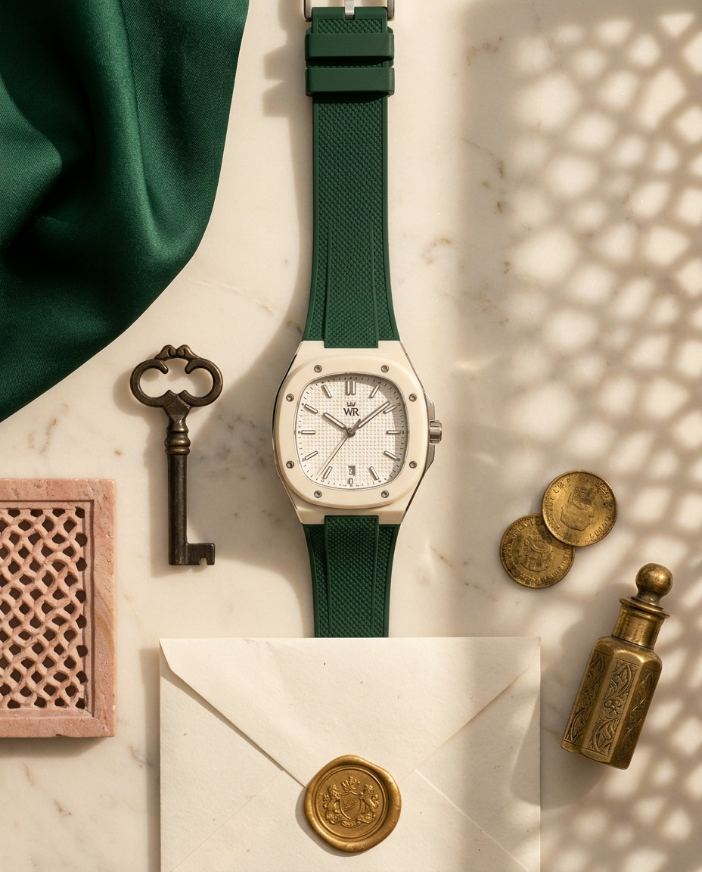
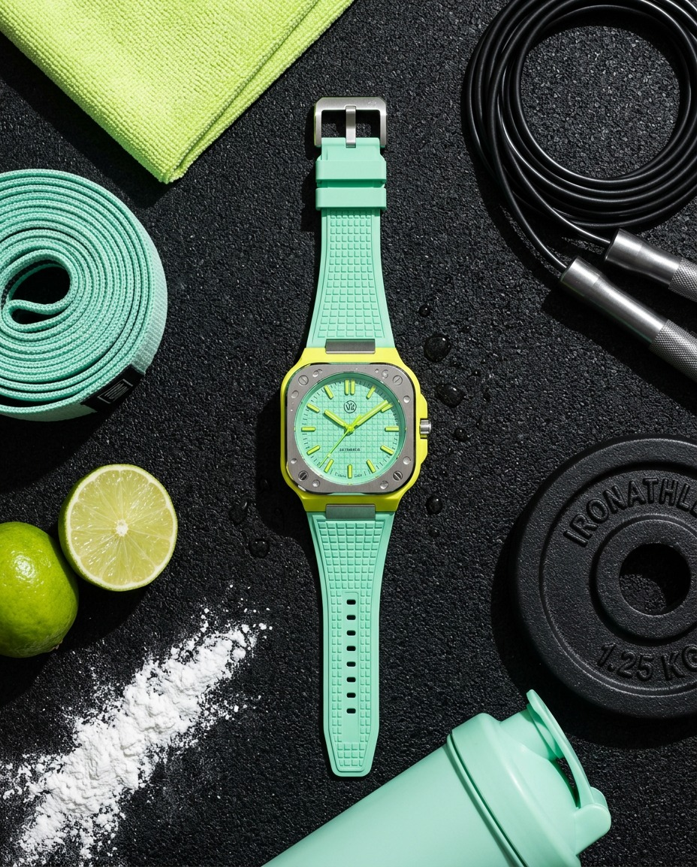
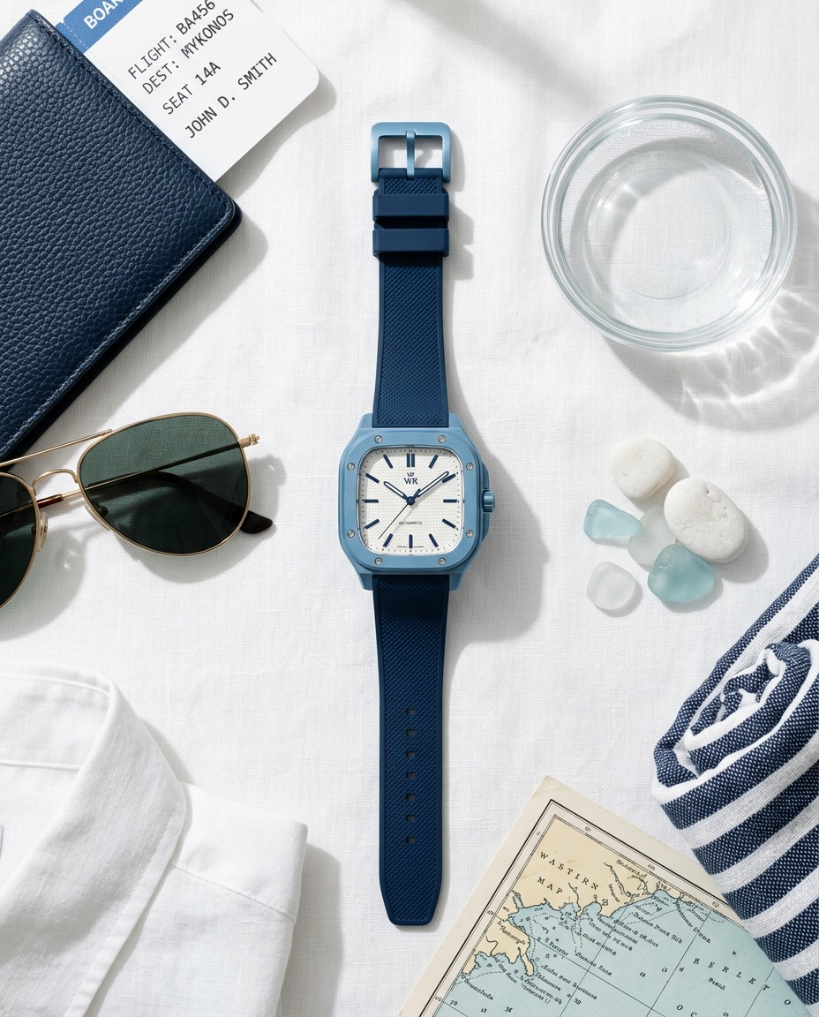
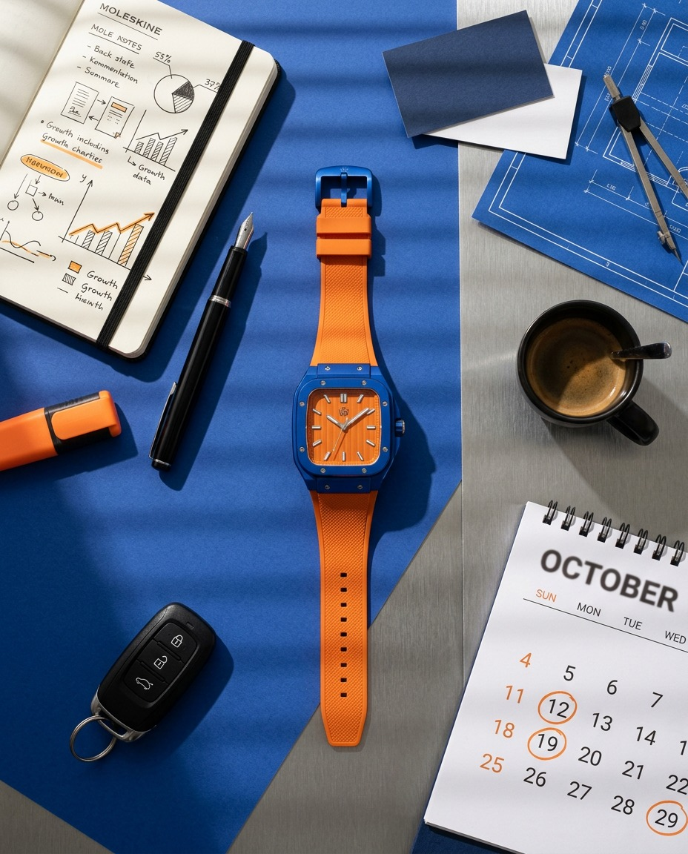
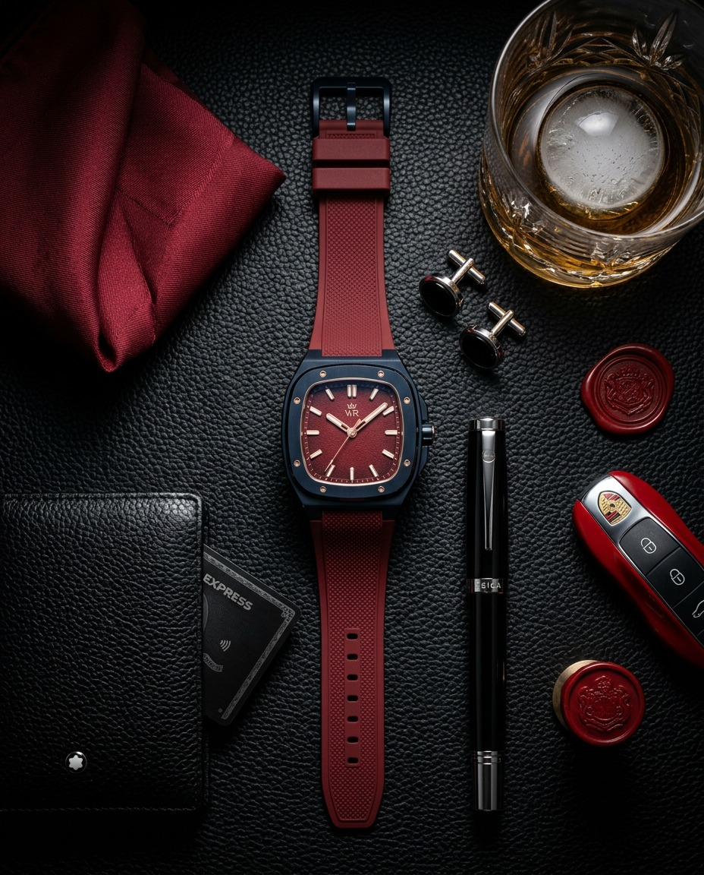
WEALTH ROOTS · PRODUCT SHOOT
FIVE WATCHES.
FIVE WORLDS.
SHOT FROM
ABOVE.
A themed flat-lay set for every watch: the visual reference, the surface, the light, the layout, the shot list and the full props checklist.
Wear what’s yours.
Prepared by Sage Media
WEALTH ROOTS · FLAT LAY SHOOT
01

Slide 2
THE SYSTEM
ONE RIG. FIVE SETS. EACH WATCH GETS ITS WORLD.
# | WATCH | THEME | THE WORLD ON THE TABLE | SURFACE | LIGHT
01 | Forest Ivory | Heritage | A Rajput heirloom drawer: key, sealed letter, coins, ittar | Ivory marble | Warm hard key through a jaali
02 | Citrus Mint | Workout | The 6 a.m. gym floor: chalk, sweat, band, rope, lime | Black rubber gym tile | Hard top light, backlit droplets
03 | Cerulean | Travel · Sky · Freedom | Packed for a trip with no return date: passport, linen, sea map | White linen + water dish | Cool daylight + water caustics
04 | Royal Tangerine | Self-made · Energy | The founder's desk at 1 a.m.: plans, circled dates, espresso | Royal-blue board + steel | Orange-gelled blind stripes
05 | Crimson Navy | Power · Alpha | The night the deal closes: leather, red silk, card, key, glass | Black pebbled leather | Low-key spot + red edge
Everything is shot straight down (90°), same camera height and same lens, so the five sets read as one series on the grid.
WEALTH ROOTS · FLAT LAY SHOOT · OVERVIEW
02

Slide 3
01 · HERITAGE
FOREST IVORY
Here’s to your roots.
Ivory case · white waffle dial · bottle-green strap
A Rajput heirloom drawer, opened for the first time in decades. Old keys, a sealed letter, coins, ittar. The watch sits among them as if it was always meant to be passed down.
PALETTE
Ivory
Bottle green
Antique gold
Sandstone
SURFACE
White / ivory Makrana marble slab, 60 × 90 cm. Backup: marble-print matte vinyl on a foam board.
LIGHT
One warm key (3200–4000 K) from the left, hard, through a jaali panel so the pattern falls across the set. White bounce on the right. No fill from above.
LAYOUT
Watch slightly diagonal, centre-right, strap open. Green silk folds along the top-left corner. Key lower-left pointing at the dial. Envelope tucked behind the strap.
Hero, full set, jaali shadow crossing the dial
Tight crop: dial + 8 screws, shadow pattern
Strap laid over the green silk (texture shot)
Clean negative-space version for text (9:16 + 4:5)
SHOT LIST
WEALTH ROOTS · FLAT LAY SHOOT · FOREST IVORY
03

Slide 4
01 · FOREST IVORY · PROPS CHECKLIST
WHAT WE NEED ON SET
☐ | PROP | WHAT EXACTLY | WHERE TO GET IT
☐ | Marble slab | White/ivory, matte, 60 × 90 cm (or marble vinyl) | Marble showroom, Kishangarh / Sitapura
☐ | Bottle-green silk | 1 m raw silk or a safa, soft folds | Johari Bazaar / Bapu Bazaar
☐ | Antique brass key | 1 large, aged, ornate bow | Chandpole antique shops
☐ | Jaali piece | Small carved sandstone/marble tile | Stone carvers, Jaipur
☐ | Jaali gobo panel | Laser-cut MDF jaali, ~60 × 60 cm, for shadow | Laser-cutting shop (1 day)
☐ | Handmade envelope | Ivory Sanganeri paper, deckled edge | Sanganer paper units
☐ | Gold wax seal | Gold wax + WR crest stamp (or generic crest) | Amazon / custom stamp maker
☐ | Gold coins | 3–5 replica mohur coins, aged gold | Johari Bazaar
☐ | Brass ittar bottle | 1 small, ornate, with dauber | Ittar shops, Johari Bazaar
☐ | Optional | Kundan cufflinks, dried jasmine buds (few) | Bazaar / florist
Brief for the stylist: keep every prop logo-free or logo-down. The watch is the only brand in frame.
WEALTH ROOTS · FLAT LAY SHOOT · FOREST IVORY · PROPS
04

Slide 5
02 · WORKOUT
CITRUS MINT
Here’s to your sweat.
Lime case · mint waffle dial · mint strap
The 6 a.m. gym floor, mid-session. Chalk on the mat, sweat on the crystal, a lime cut for after. Energy, discipline, freshness.
PALETTE
Rubber black
Lime
Mint
Chalk white
SURFACE
Matte black rubber gym tile with a fine grain, 60 × 90 cm (2 tiles side by side, seam hidden under a prop).
LIGHT
Hard top light (strip box or bare head with grid), 5600 K. A small backlight from the top edge so water droplets sparkle. Crisp, high contrast.
LAYOUT
Watch upright through the centre, strap straight. Band coiled left, rope curling top-right, plate bottom-right, lime halves bottom-left, chalk streak cutting across the lower-left corner.
Hero, full set, droplets on crystal
Macro: droplet on the mint waffle dial
Chalk streak motion: blow chalk across the mat, shoot burst
Watch on the towel only, minimal
SHOT LIST
WEALTH ROOTS · FLAT LAY SHOOT · CITRUS MINT
05

Slide 6
02 · CITRUS MINT · PROPS CHECKLIST
WHAT WE NEED ON SET
☐ | PROP | WHAT EXACTLY | WHERE TO GET IT
☐ | Rubber gym tile | Matte black, fine grain, 2 pieces | Decathlon / gym-flooring dealer
☐ | Resistance loop band | Mint green, flat | Decathlon / Amazon
☐ | Microfibre towel | Lime / neon green, small | Decathlon
☐ | Skipping rope | Black speed rope, metal handles | Decathlon
☐ | Weight plate | Small black 1.25–2.5 kg, clean logo-free side up | Decathlon / sports shop
☐ | Shaker bottle | Mint or translucent, no brand print | Amazon / Decathlon
☐ | Fresh limes | 4–5 (cut fresh every 30 min) | Local market
☐ | Climbing chalk | Block or powder (talc works too) | Decathlon
☐ | Spray mix | Water + glycerine 3:1, fine-mist bottle | Chemist + any spray bottle
☐ | Optional | White earbuds case, mint shoelaces | At hand
Brief for the stylist: keep every prop logo-free or logo-down. The watch is the only brand in frame.
WEALTH ROOTS · FLAT LAY SHOOT · CITRUS MINT · PROPS
06

Slide 7
03 · TRAVEL · SKY · FREEDOM
CERULEAN
Here’s to your freedom.
Sky-blue case · white waffle dial · navy strap
The night before a trip with no return date. White linen, passport, sunglasses, a sea map, and light rippling like water. Calm, airy, free.
PALETTE
Linen white
Sky blue
Navy
Sea glass
SURFACE
Crisp white linen sheet, lightly crumpled, taped over a board. Alternative: white board + shallow glass dish of water for caustic light.
LIGHT
Big soft cool key (5600–6000 K) like window daylight. A hard spot through a glass dish of water from above-side for rippling caustics across the watch.
LAYOUT
Watch centre, strap running top to bottom. Passport top-left, sunglasses mid-left, shirt corner bottom-left, map bottom-right, sea glass + water dish right, striped towel top-right.
Hero, full set, caustics across dial
Watch on the open map (journey crop)
Watch half-in a water dish (only if water rating confirmed)
Minimal: watch + sunglasses on linen
SHOT LIST
WEALTH ROOTS · FLAT LAY SHOOT · CERULEAN
07

Slide 8
03 · CERULEAN · PROPS CHECKLIST
WHAT WE NEED ON SET
☐ | PROP | WHAT EXACTLY | WHERE TO GET IT
☐ | White linen | 1.5 m sheet, crisp, light crumple | Fabric market / home linen
☐ | Passport + cover | Navy leather cover; dummy pages only, no real ID | Amazon (cover)
☐ | Boarding pass | Printed mock-up, “JAI → anywhere” | We design + print
☐ | Aviator sunglasses | Gold or silver frame, logo-free | Any optician / Amazon
☐ | Linen shirt | White, folded collar visible | Wardrobe
☐ | Vintage sea map | Printed on matte or kraft paper, A3 | We print
☐ | Sea glass + pebbles | Pale blue glass, smooth white pebbles | Amazon / aquarium shop
☐ | Glass dish | Shallow clear dish of water (caustics) | Kitchen
☐ | Striped towel | Navy + white, rolled | Home store
☐ | Optional | Model plane, film camera, sky polaroid | Toy / at hand
Brief for the stylist: keep every prop logo-free or logo-down. The watch is the only brand in frame.
WEALTH ROOTS · FLAT LAY SHOOT · CERULEAN · PROPS
08

Slide 9
04 · SELF-MADE · ENERGY
ROYAL TANGERINE
Here’s to your journey.
Royal-blue case · orange striped dial · orange strap
The founder’s desk at 1 a.m. Plans in the notebook, dates circled, espresso half done. Late-afternoon sun slicing through the blinds. Built, not given.
PALETTE
Royal blue
Tangerine
Brushed steel
Ink black
SURFACE
Matte royal-blue paper or painted board (60 × 90 cm), with a strip of brushed-steel sheet along one side.
LIGHT
One hard light through a venetian-blind gobo so stripes fall diagonally, warmed with an orange (CTO) gel. Cool fill to keep the blue rich.
LAYOUT
Watch centre on a diagonal, echoing the blind shadows. Notebook top-left, pen + highlighter left, calendar bottom-right, espresso top-right, key bottom-left, blueprint corner top-right.
Hero, blind stripes across the set
Macro: dial stripes vs. shadow stripes
Watch on the open notebook page
Clean version: watch + espresso only
SHOT LIST
WEALTH ROOTS · FLAT LAY SHOOT · ROYAL TANGERINE
09

Slide 10
04 · ROYAL TANGERINE · PROPS CHECKLIST
WHAT WE NEED ON SET
☐ | PROP | WHAT EXACTLY | WHERE TO GET IT
☐ | Royal-blue base | Matte paper roll or painted MDF, 60 × 90 cm | Art supply store
☐ | Brushed steel sheet | Small strip, ~20 × 90 cm | Hardware / sheet-metal shop
☐ | Notebook | Black hardcover, pages with handwritten plans + growth sketch | Stationery store
☐ | Fountain pen | Black, logo-free | Stationery store
☐ | Highlighter | Orange | Stationery store
☐ | Desk calendar | Page with dates circled in orange | We print
☐ | Blueprint | A3 print, blue, cropped into corner | We print
☐ | Espresso cup | Small black cup + saucer, real espresso | Café / kitchen
☐ | Business cards | WR cards or blank cards, small stack | Client
☐ | Car key | Generic black fob (tape over any logo) | At hand
☐ | Blind gobo | Venetian blind or slatted card + orange CTO gel | Hardware / lighting rental
Brief for the stylist: keep every prop logo-free or logo-down. The watch is the only brand in frame.
WEALTH ROOTS · FLAT LAY SHOOT · ROYAL TANGERINE · PROPS
10

Slide 11
05 · POWER · ALPHA
CRIMSON NAVY
Here’s to your power.
Navy case · red textured dial · red strap · rose-gold hands
The night after the deal closes. Black leather, red silk, the card, the key, a glass on ice. One light, deep shadows. Quiet dominance.
PALETTE
Black
Navy
Crimson
Rose gold
SURFACE
Black pebbled leather sheet (car-seat / upholstery grain), 60 × 90 cm. Backup: black suede.
LIGHT
Low key. One hard snooted spot from high side on the watch. A thin red-gelled edge light from the opposite side. Black flags everywhere else.
LAYOUT
Watch centre, strap vertical. Silk top-left, glass top-right, cufflinks under the glass, wallet bottom-left, pen right of the strap, key + wax seal bottom-right.
Hero, single spot, deep shadows
Macro: rose-gold hands on the red dial
Watch + glass only, ice catching the spot
Lights-off glow frame (if lume is confirmed)
SHOT LIST
WEALTH ROOTS · FLAT LAY SHOOT · CRIMSON NAVY
11

Slide 12
05 · CRIMSON NAVY · PROPS CHECKLIST
WHAT WE NEED ON SET
☐ | PROP | WHAT EXACTLY | WHERE TO GET IT
☐ | Black leather | Pebbled upholstery leather, 60 × 90 cm | Leather/upholstery market
☐ | Red silk pocket square | Deep crimson, soft folds | Menswear store
☐ | Cufflinks | Silver or gunmetal, simple | Menswear store
☐ | Leather wallet | Black, logo-free (or logo hidden) | At hand
☐ | Metal card | Black matte blank card (no bank name) | Online custom print
☐ | Car key fob | Red or black, logo taped / turned | At hand
☐ | Fountain pen | Black lacquer, logo-free | Stationery store
☐ | Crystal tumbler | Heavy cut-glass + acrylic ice (doesn’t melt) | Home store / Amazon
☐ | Liquid | Whisky or cold brew/tea (client call) | At hand
☐ | Red wax seal | Red wax + stamp, 2–3 pressed discs | Amazon
Brief for the stylist: keep every prop logo-free or logo-down. The watch is the only brand in frame.
WEALTH ROOTS · FLAT LAY SHOOT · CRIMSON NAVY · PROPS
12

Slide 13
FOR EVERY SET
THE BASE KIT (ONE LIST, ALL FIVE SHOOTS)
CAMERA + RIG
LIGHT
STYLING
OUTPUT PER WATCH
Full-frame body, tethered to laptop
100 mm macro + 50 mm
Overhead boom arm / copy stand, spirit level
f/8–f/11, ISO 100, 1/160 s (flash)
2 strobes or LEDs + 1 small spot (snoot/fresnel)
Softbox + strip box, grids
Gels: CTO orange, red, ½ CTB
Black flags, white bounce boards
Museum putty / blu-tack, tweezers
Cotton gloves, microfibre, air blower
Glycerine spray, steamer for fabric
Gaffer tape, clamps, extra watch cleaning kit
Hero 4:5 (feed) + 9:16 (story)
2 detail macros
1 clean negative-space plate for text
1 lifestyle crop for website
Order of the day: Forest Ivory → Cerulean → Royal Tangerine → Citrus Mint (water + chalk) → Crimson Navy (low-key, last). About 45–60 min per set.
WEALTH ROOTS · FLAT LAY SHOOT · COMMON KIT
13

Slide 14
BEFORE WE SHOOT
THREE THINGS TO CONFIRM
01
The visuals are AI references.
The watch in each frame is drawn from a description, not the real product. Case shape, screws and dial texture will differ. Use them for set, props, colour and light only.
02
Water and lume.
Cerulean’s water shot and the Crimson Navy glow frame only go ahead once the client confirms the water rating and lume.
03
Alcohol and logos.
Crimson Navy uses a whisky glass; swap to cold brew if the client prefers. Every third-party logo (wallet, car key, pen, weights) stays hidden.
WEALTH ROOTS · FLAT LAY SHOOT · NOTES
14

