Slide 1
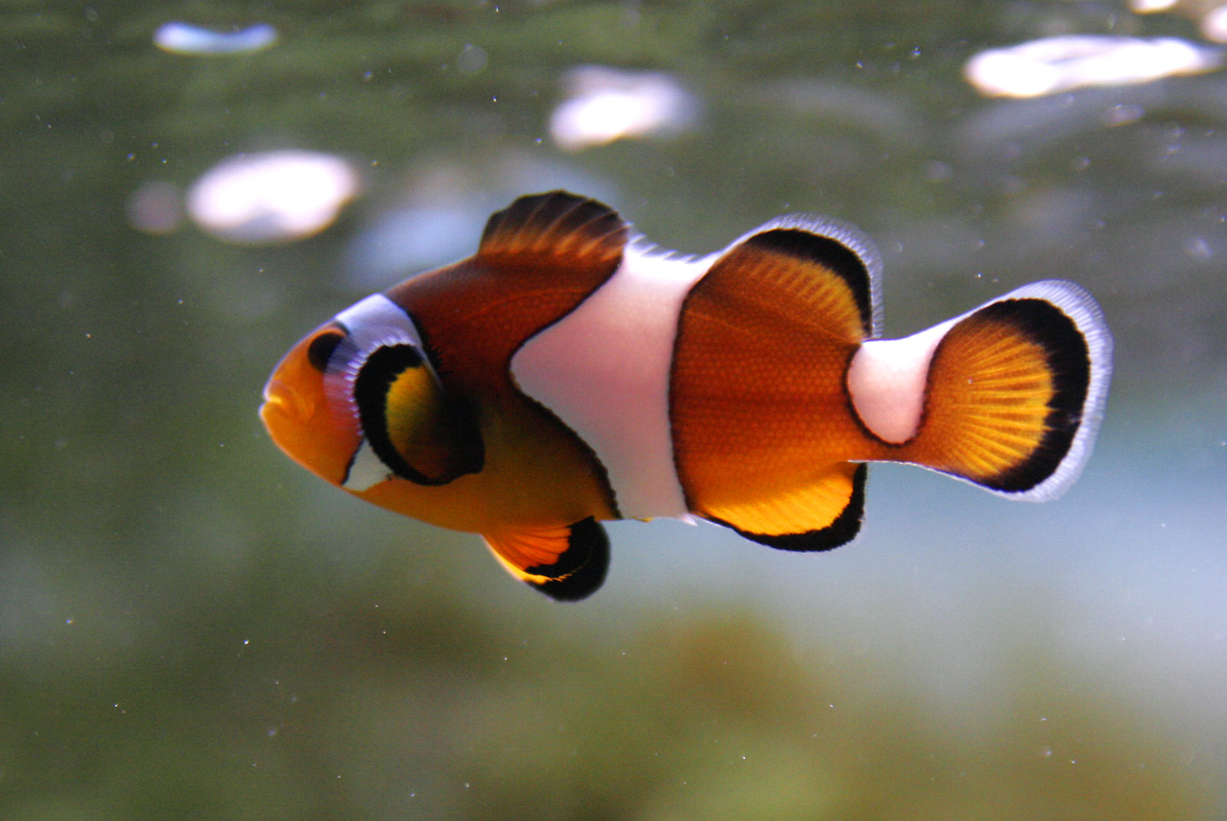
Test Slide 1
There’s something fishy about this…

Slide 2

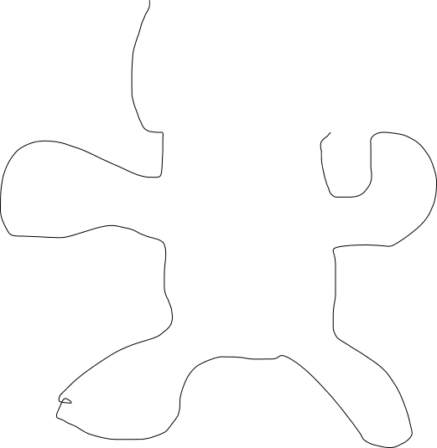








Unbearable

