Slide 1
Fleet Maintenance & Transport Operations Management System (DB)
Student: ASDODJI Le Sage (27232)
Course: PL/SQL Oracle Database Development
Lecturer: Eric Maniraguha
Institution: AUCA
Date: November 2025

Slide 2
Problem Statement
The Challenge
Transport companies struggle with manual, error-prone fleet operations.
No automated monitoring of vehicle maintenance or driver assignments.
Difficulty tracking overdue services, risks, and operational efficiency.
Affected Users
Fleet managers
Drivers
Mechanics
Administrators

Slide 3
Proposed Solution
Objectives
Build a secure, automated Fleet Management System using Oracle PL/SQL.
Track vehicles, maintenance, drivers, parts, alerts, and trips in real time.
Enforce business rules with triggers and auditing.
Ensure clean data + reliable analytics foundation.
Scope Includes
Vehicle & Driver registry
Trips & routing
Spare parts & maintenance
Alerts & activity auditing

Slide 4
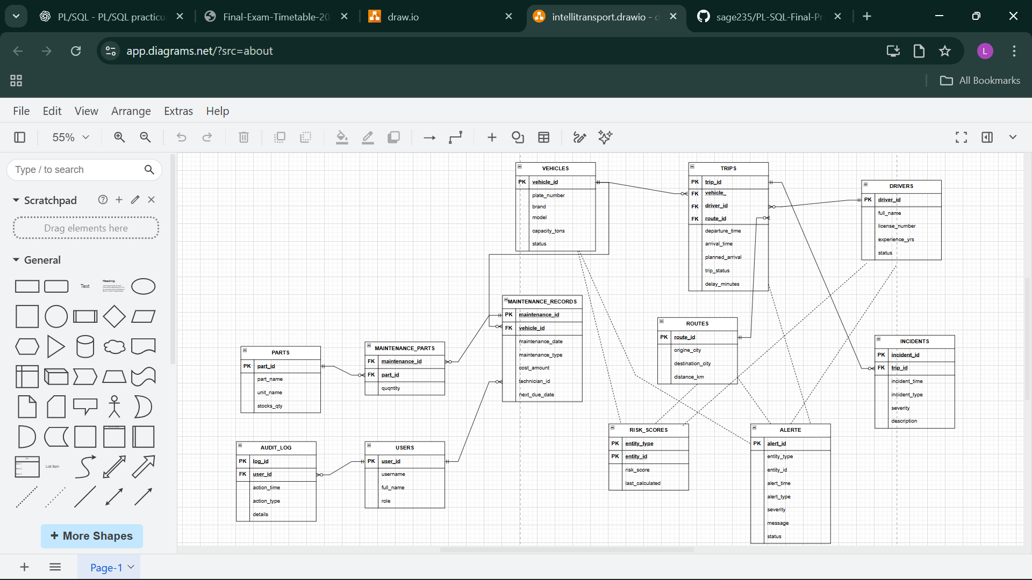
Database (ER diagram, entities)

Slide 5
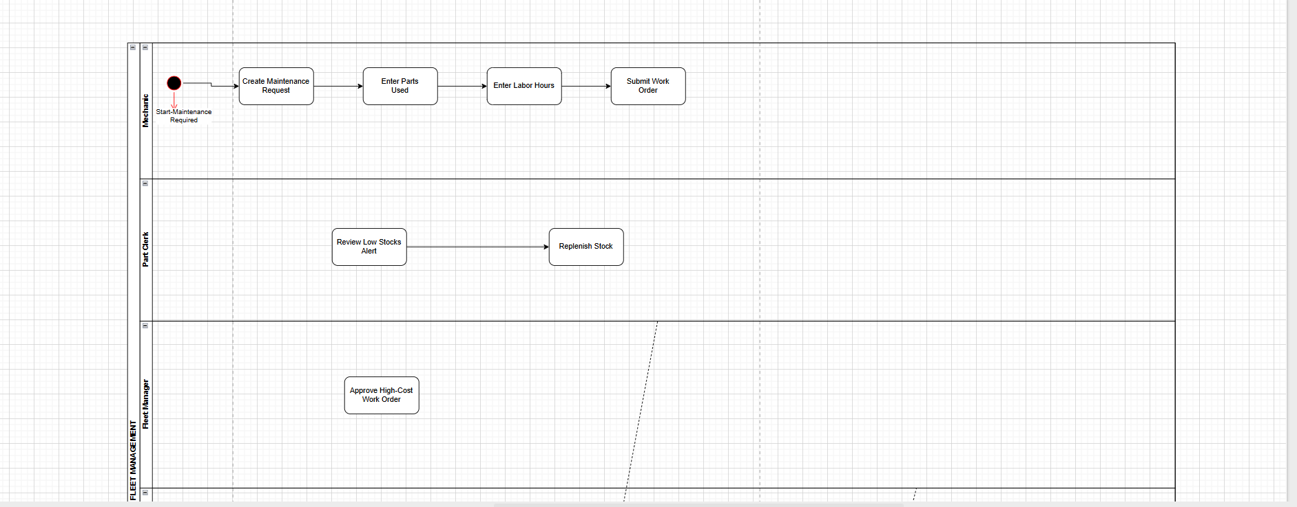
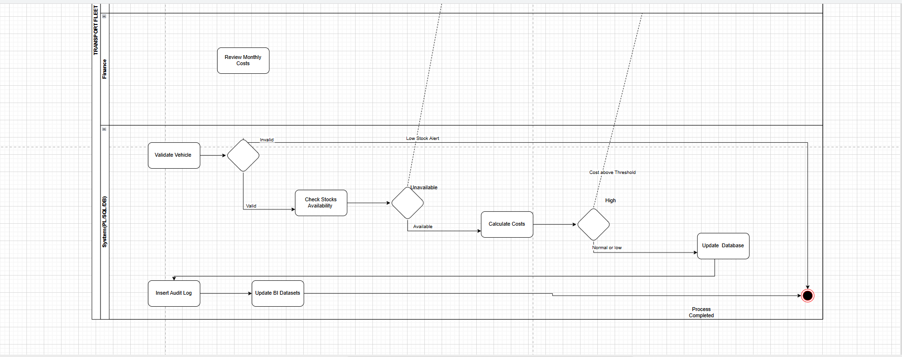

Slide 6
Technical Implementation
Tools Used
Oracle 21c / SQL Developer
PL/SQL (Procedures, Functions, Packages)
Key Features
Bulk data processing
Explicit cursors
Window functions: ROW_NUMBER, RANK, LAG, LEAD
Custom exceptions + error logging

Slide 7
Advanced Features
Auditing
Full DML log of who did what, when, allowed/blocked, why
Security Rules
EMPLOYEES cannot insert, update, or delete:
  On weekdays (Mon–Fri)
  On public holidays (next 30 days)
Triggers
Before DML triggers for validation
Compound triggers for audit consistency
Autonomous transactions for logging

Slide 8
Results & Testing
Data Volume
200+ vehicles
300+ drivers
500+ maintenance records
Thousands of parts & trip entries
Tests Performed
Weekday DML BLOCKED ✔
Weekend DML ALLOWED ✔
Holiday DML BLOCKED ✔
Audit log correctness verified ✔

Slide 9
Conclusion
Achievements
Fully functional PL/SQL fleet management system
Strong auditing, validation, and security logic
Clean architecture ready for BI dashboards
Reliable and scalable schema
Lessons Learned
Complex trigger design
Error handling & autonomous transactions
Enterprise-style PL/SQL programming

