Slide 1
SHARKS
This is a presentation about sharks
Notes:
Note about SHARKS

Slide 2
First slide about sharks
Point form shark
Shark #1
Shark #2
Shark #3
Paragraph about a shark, a bold shark, a shark in italics, and then an underlined shark. Text should be replaced while keeping formatting.
Shark in text box
Notes:
Shark in the notes

Slide 3
Shark in a square
Shark in a star!
Shark Word Art

Slide 5
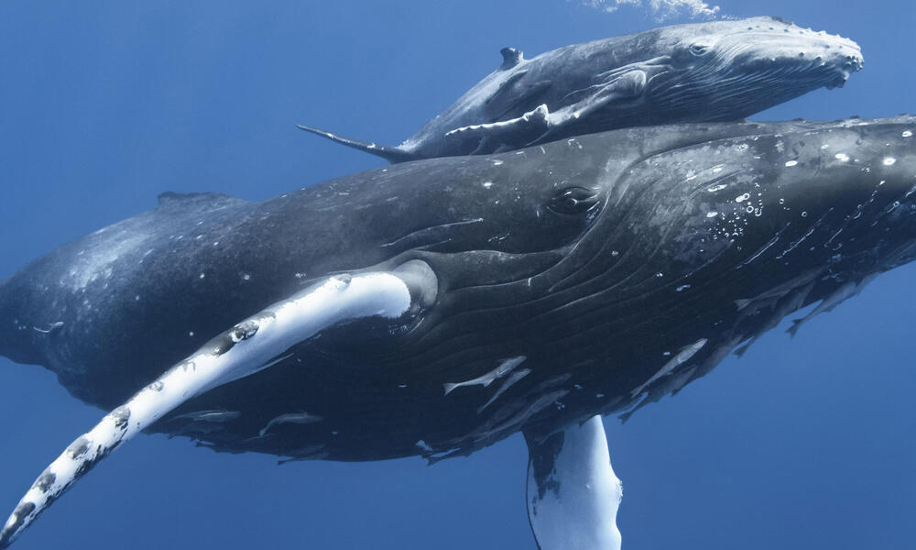
Shark table | Shark shark shark
Here’s some info about sharks | More info about sharks

